Slide 1
Introducing Graphics
There are generally two types of graphics facilities in Java
Drawing
GUIs
We concentrate on drawing here
We will draw on a Graphics object by passing the object various drawing messages
a Graphics object can only be created within certain contexts including GUI components and Applets, we will use GUI components
there is some overhead needed to do this, for now we will find the simplest approach and just use it rather than worry about why or how it is done

Slide 2
The Basic Idea…
Create a JPanel which is one of the GUI components that includes a Graphics context
Insert the JPanel into a JFrame
Show the JFrame
Draw on the JPanel as desired using messages like
drawLine
drawRect
fillRect
setColor
drawString
Unfortunately, to do this requires at least two separate class definitions and at least 2 methods
a skeleton is given next, we will use this for our graphics programs, at least for now, where all you have to do is fill in the paintComponent method with your Graphics messages

Slide 3
Graphics Skeleton
import javax.swing.*;
import java.awt.*;
public class GraphicsSkeleton {
private static final int X_SIZE = 300, Y_SIZE = 300;
public static void main(String[ ] args) {
JFrame frame = new JFrame(“Graphics Skeleton");
frame.setDefaultCloseOperation(JFrame.EXIT_ON_CLOSE);
frame.setSize(X_SIZE, Y_SIZE);
GraphicsPanel panel = new GraphicsPanel( );
frame.add(panel);
frame.setVisible(true);
}
private static class GraphicsPanel extends JPanel {
public void paintComponent(Graphics g) {
super.paintComponent(g);
// Add drawing code here.
}
}
}
Alter the size of the
Graphics window here
Here’s where your
Graphics code will go

Slide 4
Message Passing
Recall that we use message passing when we want to command an object to perform some action
For a String, we did things like name.toUpperCase( ) and the random number generator was generator.nextInt( ), and so forth
Graphics is a class, and we will use a Graphics object, so we will have to send it messages
The Graphics object is automatically created for us by the JPanel, so all we have to do is get ahold of it (in a method called paintComponent) and pass it messages
Example: (assume the Graphics object is called g)
g.drawLine(5,10,25,30); // draws a line from <5,10> to <25,30>
There are numerous Graphics messages, we look at the important ones next

Slide 5
Graphics Messages
drawLine(x1, y1, x2, y2)
<x1, y1> is the source point, <x2, y2> is the destination point
drawRect(x, y, width, height) and fillRect(x, y, width, height)
Draw/fill rectangle starting at <x, y> with width and height as specified
draw3DRect/fill3DRect(x, y, width, height, bool)
Bool is true or false denoting whether the rectangle is raised (true) or indented (false)
drawRoundRect/fillRoundRect(x, y, width, height, awd, aht)
The corners of the rectangle are rounded using awd and aht as the height and width of the arc for the corners
drawOval/fillOval(x, y, width, height)
draws or fills an oval that fills a “bounded box” starting at point <x, y> with height and width as specified
drawString(str, x, y)
prints the String str at point <x, y>
NOTE: x1, y1, x2, y2, x, y, width, height, awd and aht are all int values

Slide 6
Additional Graphics Messages
setColor(col)
changes the current drawing color, col must be of type Color and is usually denoted as Color.name such as Color.blue or Color.red
or create a color using RGB values as in new Color(128, 255, 0);
setFont(ft)
changes the font for drawString commands to a different font, ft must be of type Font
drawPolygon/fillPolygon(x[ ], y[ ], num)
draws/fills a polygon of <x, y> points where each point is stored as one element in each of arrays x and y, and where there are num points
drawArc/fillArc(x, y, width, height, sAngle, aAngle)
like draw/fillOval but only draws a portion based on the two angles provided
drawImage(src, x, y, width, height, col, obsv)
used to display an image src (gif, jpg) – col is the background color for any transparent pixels, and obsv is an ImageObserver, use “this”
Note: col is a Color, ft is a Font, x[ ] and y[ ] are arrays of ints, num, x, y, width, height, sAngle, aAngle, are all ints, and obsv should be this

Slide 7
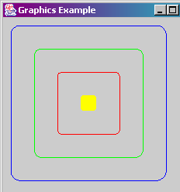
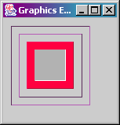
Some Graphics Examples
public void paintComponent(Graphics g)
{
g.setColor(Color.blue);
g.drawRoundRect(10, 10, 200, 200, 25, 25);
g.setColor(Color.green);
g.drawRoundRect(40, 40, 140, 140, 15, 15);
g.setColor(Color.red);
g.drawRoundRect(70, 70, 80, 80, 10, 10);
g.setColor(Color.yellow);
g.fillRoundRect(100, 100, 20, 20, 5, 5);
}
public void paintComponent(Graphics g)
{
g.setColor(new Color(128, 64, 128));
g.draw3DRect(10, 10, 100, 100, false);
g.draw3DRect(20, 20, 80, 80, true);
g.setColor(new Color(255, 0, 64));
g.fill3DRect(30, 30, 60, 60, true);
g.setColor(Color.white);
g.fill3DRect(40, 40, 40, 40, false);
}

Slide 8
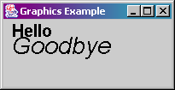
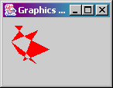
More Examples
public void paintComponent(Graphics g)
{
g.setFont(new Font("Ariel", Font.BOLD, 20));
g.drawString("Hello", 10, 20);
g.setFont(new Font("Chicago", Font.ITALIC, 28));
g.drawString("Goodbye", 10, 40);
}
public void paintComponent(Graphics g)
{
g.setColor(Color.red);
int[ ] x = {15, 30, 60, 25, 35, 45, 10, 30, 45, 20, 10, 25};
int[ ] y = {10, 25, 40, 55, 30, 15, 30, 45, 60, 45, 30, 10};
g.fillPolygon(x, y, 12);
}

Slide 9
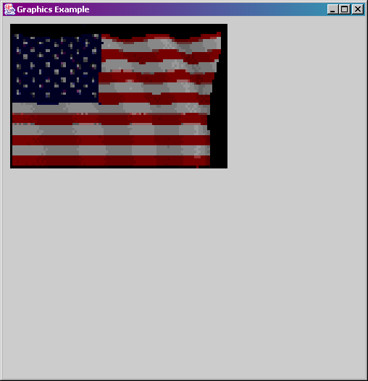
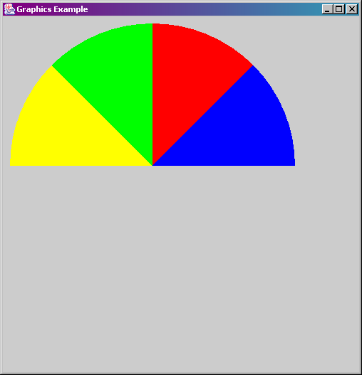
And More Examples
public void paintComponent(Graphics g)
{
ImageIcon icon = new ImageIcon("flag.gif");
Image image = icon.getImage( );
g.drawImage(image, 10, 10, 300, 200, Color.white, this);
}
public void paintComponent(Graphics g)
{
g.setColor(Color.blue);
g.fillArc(10, 10, 100, 100, 0, 45);
g.setColor(Color.red);
g.fillArc(10, 10, 100, 100, 45, 45);
g.setColor(Color.green);
g.fillArc(10, 10, 100, 100, 90, 45);
g.setColor(Color.yellow);
g.fillArc(10, 10, 100, 100, 135, 45);
}

Slide 10
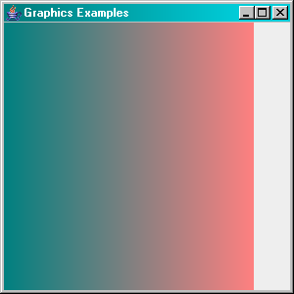
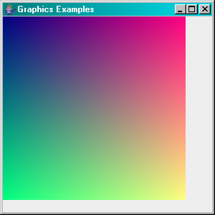
Using Loops
public void paintComponent(Graphics g)
{
super.repaint();
int i;
for(i=0;i<255;i++)
{
g.setColor(new Color(i, 128, 128));
g.drawLine(i,0,i,300);
}
}
public void paintComponent(Graphics g)
{
super.repaint();
int i, j;
for(i=0;i<255;i++)
for(j=0;j<255;j++)
if(j%2= =0) {
g.setColor(new Color(i, j, 128));
g.drawLine(i,j,i,j+1);
}
}

Slide 11
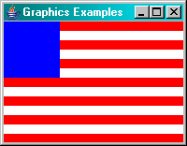
Drawing a Flag
public void paintComponent(Graphics g)
{
super.repaint();
int i;
g.setColor(Color.blue);
g.fillRect(0,0,60,60);
for(i=0;i<6;i++)
{
if(i%2==0) g.setColor(Color.red);
else g.setColor(Color.white);
g.fillRect(60,i*10,140,10);
}
for(i=6;i<13;i++)
{
if(i%2==0) g.setColor(Color.red);
else g.setColor(Color.white);
g.fillRect(0,i*10,200,10);
}
}
How would you add
the 50 stars?

Slide 12
Some Comments
The paintComponent method is automatically called whenever
your code calls repaint( )
the JFrame first appears on the screen
so you don’t need to call repaint( ), but it’s a good habit to get into
the JFrame is resized or altered on the screen
You cannot automatically generate a Graphics object, so you must rely on the JPanel doing it for you
this is inconvenient and causes you to include all the JFrame and JPanel code that we don’t normally want
or we would have to generate the drawing in an Applet, which is just as much work
It is helpful to work out the size of your drawing components before starting
you need to know the size for the JFrame, JPanel and the values used in your messages
Sizes, dimensions, end points, etc are all in terms of pixels, starting at <0,0> in the upper left hand corner of the JPanel

Slide 13
Animating a Program
Animation requires displaying images very quickly
We will want to slightly alter the image in between each display
We call super.paintComponent(g) in paintComponent which “clears the Graphics object screen
We then draw a new (slightly different) image
The instruction panel.repaint(); will cause paintComponent to execute
We will continually call panel.repaint(); but place a delay in between each call:
while(true) { for(long i=0;i<2500000000l;i++);
panel.repaint(); }
notice the ; here

Slide 14
Example
import javax.swing.*;
import java.awt.*;
import java.util.*;
public class GraphicsSkeleton {
private static final int X_SIZE = 300, Y_SIZE = 300;
private static int x=150,y=150; // the item being animated
public static void main(String[ ] args) {
JFrame frame = new JFrame(“Graphics Skeleton");
frame.setDefaultCloseOperation(JFrame.EXIT_ON_CLOSE);
frame.setSize(X_SIZE, Y_SIZE);
GraphicsPanel panel = new GraphicsPanel( );
frame.add(panel);
frame.setVisible(true);
Random g=new Random();
long i;
while(true) {
x+=g.nextInt(3)-1; y+=g.nextInt(3)-1;
panel.repaint();
for(i=0;i<2500000000l;i++); }
}

Slide 15
Continued
private static class GraphicsPanel extends JPanel {
public void paintComponent(Graphics g) {
super.paintComponent(g);
g.setColor(Color.black);
g.fillRect(0,0,X_SIZE,Y_SIZE);
g.setColor(Color.red);
if(x<25) x=25;
else if(x>275) x=275;
if(y<25) y=25;
else if(y>275) y=275;
g.drawOval(x-2,y-2,5,5);
}
}
}

Slide 16
Another Approach: Input to Pause
Instead of using a for loop to pause the program, we can force the program to pause by asking for input
This requires that the user control when the next “turn” takes place
for(i=0;i<2500000000l;i++);
Instead of the above for loop we use
in.nextLine();
in is a Scanner, nextLine inputs the next line including just an empty line by pressing <enter>
With this command, the user pressed <enter> to move on to the next turn

