Slide 1
Machine Learning Introduction
Why is machine learning important?
AI systems are brittle, learning can improve a system’s capabilities
AI systems require knowledge acquisition, learning can reduce this effort
producing AI systems can be extremely time consuming – dozens of man-years per system is the norm
there is often too much knowledge for humans to enter (e.g., common sense reasoning, natural language processing)
Some problems are not well understood but can be learned (e.g., speech recognition, visual recognition)
AI systems are often placed into real-world problem solving situations
the flexibility to learn how to solve new problem instances can be invaluable
A system can improve its problem solving accuracy (and possibly efficiency) by learning how to do something better

Slide 2
How Does Machine Learning Work?
Learning in general breaks down into one of a few forms
Learning something new
no prior knowledge of the domain/concept
no previous representation
we need to add new information to the knowledge base
Learning something new about something you already know
add to the existing knowledge base or refine the knowledge base
modification of the previous representations
Learning how to do something better, either more efficiently or with more accuracy
previous problem solving instance (case, chain of logic) can be “chunked” into a new rule (also called memoizing)
previous knowledge can be modified – typically this is a parameter adjustment like a weight or probability in a network that indicates that this was more or less important than previously thought

Slide 3
Types of Machine Learning
There are many ways to implement ML
Supervised vs. Unsupervised (discovery) vs. Reinforced
is there a “teacher” that rewards/punishes right/wrong answers?
Symbolic vs. Subsymbolic vs. Evolutionary
at what level is the representation?
subsymbolic is the fancy name for neural networks
evolutionary learning is actually a subtype of symbolic learning
Knowledge acquisition vs. Learning through problem solving vs. Explanation-based learning vs. Analogy
We can also focus on what is being learned
Learning functions
Learning rules
Parameter adjustment
Learning classifications
these are not mutually exclusive, for instance learning classification is often done by parameter adjustment or by learning a function

Slide 4
Supervised Learning
The idea behind supervised learning is that the learning system is offered examples
The system uses what it already knows to respond to an input
if correct, system strengthens components that led to the right answer
if incorrect, system weakens components that led to the wrong answer
This is performed for each item in the training set
Repeat some number of iterations or until the system “converges” to an answer
Once “trained”, we test the system with the testing set data
Note that supervised learning can result in an “overtrained” structure so that it learns the training set but does not translate well to the testing set

Slide 5
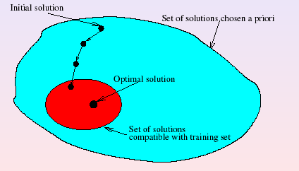
Continued
Supervised learning is actually a search problem
Search for the representation that will allow it to respond correctly to every (or most) instance in the training set
there could be many “correct” solutions
some of these will also allow the system to respond correctly to most instances in the testing set

Slide 6
Unsupervised Learning
Here, we present unlabeled data to the system
It attempts to find hidden patterns within the data
This is an attempt at knowledge discovery
Data mining is a form of unsupervised learning (e.g., clustering, rule induction)
Statistical methods are commonly used to find similarities and differences among the data to segregate the data into meaningful classes or groupings
For a hidden Markov model, the E-M (or Baum Welch) algorithm to learn or improve its probabilities is a form of unsupervised learning
In neural networks, the self-organizing map is a form of unsupervised learning

Slide 7
Reinforcement Learning
A form of learning through trial and error where feedback is not a correct answer (as with supervised learning) but a utility or feedback function
This function does not tell us if we have a right answer but instead evaluates the answer in terms of how useful it is
We would like to maximize utility
One example is to minimize the effort needed to achieve the output, so our reinforcement utility function determines effort and attempts to modify the process so that the next time we reach this output state, we have done so with less effort
Implementations include
Genetic algorithms where the utility function is our fitness function
Statistical search approaches using dynamic programming along with a utility function to evaluate each path
Neural networks

Slide 8
Types of Learning
We will explore several different forms of learning in this and the next lecture
We can view learning as one of
classification – training data mapped to a class
regression – training data mapped to continuous values/function
Or, we can view learning based on the specific algorithmic approach
Inductive learning (supervised)
Support vector machines* (supervised)
Discovery/similarity learning (unsupervised)
Reinforcement learning (utility function)**
Probabilistic (unsupervised or reinforcement)
Explanation-based learning***
* - covered next week, ** - covered minimally next week,
*** - not covered

Slide 9
Learning Within a Concept Space
A concept space consists of the features used to represent a particular class
our task is to learn the proper values for the features that describe legal entities in the class
By introducing positive and negative examples, we learn the class – this is called inductive learning
instances are hits and misses
working one example at a time, we represent the class by legal values for each feature
generalizing the representation for positive instances
specializing the representation for negative instances

Slide 10
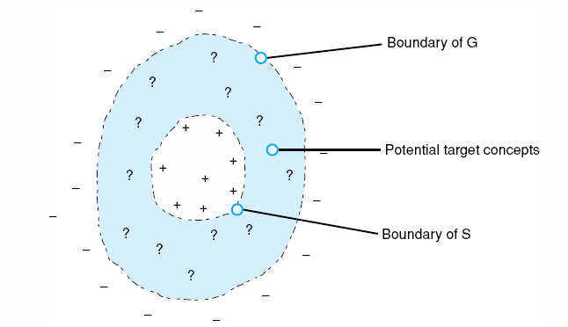
Candidate Elimination
One approach is through candidate elimination
G is the set of values that represent our current general description
S is the set of values that represent our most specific description
process iterates over + and - examples
specialize G with - ex
generalize S with + ex
until the two representations are equal
or until they become empty, in which case the examples do not lead to a single representation for the given class

Slide 11
Discovery
We have data and want to learn something from it
Unsupervised – we do not know what the data might tell us
Primarily use statistical methods to explore data
Data might not be set up for data mining so we have to modify the data first
change values in a continuous range into discrete values (e.g., converting age to a class such as “child”, “teen”, “adult”, “senior”
we might need to anonymize the data for privacy concerns
we might have to remove certain fields that may not be useful – for instance, address may not be relevant for medical data discovery
We explore three data mining approaches here

Slide 12
Decision Trees
The basic idea behind the decision tree dates back to the 1960s as a form of automated induction (updated in the 1970s by Quinlan and the ID3 algorithm)
Use training data to generate a tree that divides the training data into decision classes where branches of the tree are based on values of a selected feature (e.g., one branch for age < 20, one for age >= 20)
Given a set of data, create a tree that will predict what a new datum will be categorized as
Decision trees are sometimes referred to as classification trees, regression trees (when the output is not a class but instead a real value) or CART, based on a newer algorithm that produces multiple trees in order to find the best decision tree

Slide 13
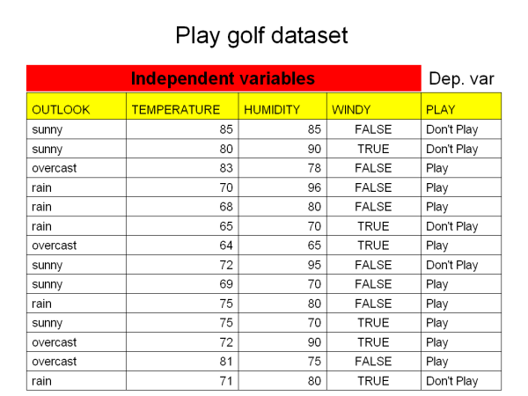
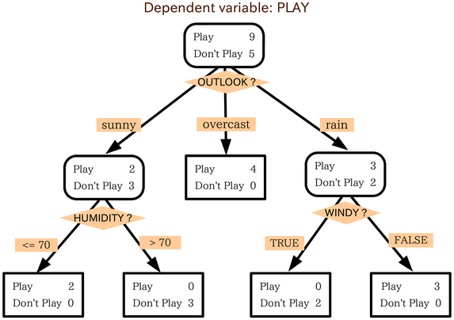
Example

Slide 14
Decision Tree Algorithms
The basic algorithm works as follows:
Given all data, find the attribute that divides the data set most cleanly into categories/classes/decisions (e.g., the “play golf” and the “do not play golf” categories)
what does it mean to most cleanly divide into categories?
this measure of dividing data into sets is known as information gain and is based on the statistical principle of entropy
Create a node in the tree that represents this attribute and create one edge leaving this node for each possible attribute value
Recursively do the same at each successive branch
Stop recursing when
all data fall into one category, or
there are no more attributes to apply, or
you have reached a threshold value such as a maximum tree depth or a minimum number of elements left in the data set for this given node

Slide 15
Information Gain and Entropy
Entropy tells you how likely the given feature will lead to a proper classification
by computing the entropy of the entire group, you can maximize information gain by selecting the feature which leads to a minimum entropy
Information gain itself is a distance from an estimated probability to an actual probability
information gain can be interpreted as the expected extra message-length per datum that must be communicated if a code that is optimal for a given (wrong) distribution Q is used, compared to using a code based on the true distribution P
where n_{b} = number of instances in branch b, n_{bc} = number of instances of class c in branch b, n_{t} = total number of all instances in all branches

Slide 16
Clustering
Given data with n features, map these in n-dimensional space
Identify groups that are “near” to each other
we usually compute the distance between data using a Euclidian distance-like formula
D = ((x₁₁ – x₂₁)² + (x₁₂ – x₂₂)² + … + (x_{1n} – x_{2n})²)^{1/2}
this approach might tell us what data cluster together but not why the cluster exists or what the cluster represents
it is usually up to humans to then explore each cluster and perhaps identify its significance or name
In k-means clustering, we select k data to represent the centers of clusters and then for each new datum, determine which cluster center it is closest to and thus build clusters in this way
Once generated, we repeatedly perform this task using the cluster centers so that we do not bias our clusters by the first k data selected

Slide 17
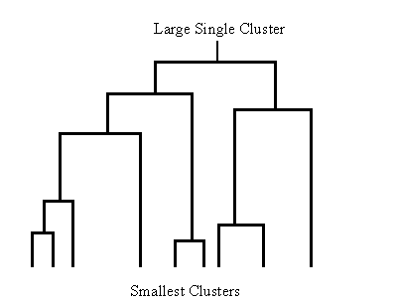
Hierarchical Clustering
Some clusters will reflect classes of interest, others may be artifacts of data or algorithm
One way to attempt to ensure useful clusters is to create the clusters hierarchically
create small clusters
add data to clusters
combine similar clusters
until either all data belong to a cluster or some threshold has been passed
Two techniques:
divisive (top down) – start with one big set and begin to divide into 2 or more classes by using some distinguishing feature
agglomerative (bottom up) – group data together into a class, and then group classes together, …

Slide 18
Fuzzy Clustering
Recall in fuzzy set theory, an element exists in every set to some extent
In fuzzy clustering, a datum belongs to every cluster to some extent, that extent is determined through fuzzy calculations
this allows data that are on the edge of several clusters to be in multiple clusters
we define the membership value as u_{k}(x) which provides a real number [0, 1] of how well x fits into cluster k and where the sum of all u_{i}(x) for all i will be 1.0
we define the center of a cluster to be:
and then
A learning algorithm, much like that of k-means, is used to create initial clusters and then identify fuzzy clustering for test data

Slide 19
Ensemble of Classifiers
Clustering algorithms and decision trees produce/represent classifiers
A classifier will only be as good as the training data
and even then, classifiers may be over or under trained
We can instead generate multiple classifiers from the same training data
each classifier might be trained on different data, different subsets of data or different features of the data, or by different algorithms
this may help prevent training bias from impacting the performance of our classifiers
Now we use the ensemble for classification by using some voting scheme
simple majority rule vote
a weighted vote
a vote using scoring from each classifier (add up the strengths of their beliefs)

Slide 20
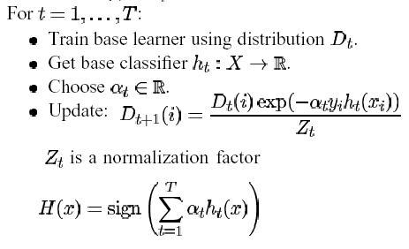
Boosting
A generic form of ensemble learning is called Boosting
produce an ensemble classifier which might include poorly trained classifiers and then learn under which conditions which classifiers are more trustworthy
the AdaBoost algorithm is shown to the below
here, we are training a set of classifiers H consisting of individual classifiers D_{t}(i) (classifier i at time t) and using α_{t} as a training factor specialized to that classifier and that input
We train our classifiers
And then we iteratively determine when each classifier is inaccurate and reduce its relative weighting in the overall decision making for the given class

Slide 21
Rule Induction
An easily obtained set of information is association rules which are derived by finding patterns in the data through counting appearances
In n of m records, features Y and Z both occur
If n / m > threshold, we might consider Y and Z to be related through association
The common usage is to identify common trends
Of 1000 store receipts, 700 customers bought bread and of those 700, 500 bought milk
Therefore we consider bread and milk to be related
We might then move the bread and milk closer together or offer a deal that if you buy bread you get milk ¼ off
Unfortunately, rule induction may provide rules without any kind of meaning since it merely finds associations

Slide 22
Measuring Rules
3 measurables are:
Accuracy – how often is the rule correct? Count(A & B) / Count(A)
Coverage – how often does the rule apply? Count(A) / All records examined
Interestingness – how interesting is this rule? A relative term computed by combining accuracy and coverage
Example: store statistics show for 100 shopping baskets
number with eggs = 30, number with milk 40, number with cheese = 10, number with both eggs and milk 20, number with both eggs and cheese = 5
Rule1: People who buy milk will buy eggs, accuracy = 20 / 40 = 50%, coverage = 20 / 100 = 20%,
Rule2: People who buy eggs will buy cheese, accuracy = 5 / 30 = 17%, coverage = 5 / 100 = 5%
Rule 1 is more interesting, having both greater accuracy and coverage

Slide 23
Probabilistic Learning
Naïve Bayes classifiers, Bayesian nets and hidden Markov models all require probabilities
We can “learn” probabilities through counting
p(a) = number of occurrences of a out of all data
p(a | b) = number of occurrences of a when b is true
we can obtain these directly from a data set
we need to make sure the data set is not biased or our probabilities may not be very accurate
Two forms of learning for Bayesian nets and HMMs are
Learning the structure of the network from data (this is more commonly applied to Bayesian nets)
Learning parameters (probabilities) by applying data to the network/HMM and then modifying these parameters to improve the accuracy – we will use the E-M (Emission, Modification) algorithm

Slide 24
Naïve Bayesian Learning
We want to learn, given some conditions, whether to play tennis or not
see the table on the next page
The data available generated tells us from previous occurrences what the conditions were and whether we played tennis or not during those conditions
there are 14 previous days’ worth of data
To compute our prior probabilities, we just do
P(tennis) = days we played tennis / totals days = 9 / 14
P(!tennis) = days we didn’t play tennis = 5 / 14
The evidential probabilities are computed by adding up the number of Tennis = yes and Tennis = no for that evidence, for instance
P(wind = strong | tennis) = 3 / 9 = .33 and P(wind = strong | !tennis) = 3 / 5 = .60

Slide 25
Continued
We do not have enough data for some combinations of conditions leading to probabilities of 0
we do not want to use 0% probabilities so we will add an absolute minimum probability to apply in such cases
We must rely on the Naïve Bayesian assumption of conditional independence to get around this problem
P(Sunny & Hot & Weak | Yes) =
P(Sunny | Yes) * P(Hot | Yes) * P(Weak | Yes)

Slide 26
Learning Structure
For a Bayesian network, how do we know what states should exist in our structure? How do we know what links should exist between states?
There are two forms of learning here
to learn the states that should exist
to learn which transitions should exist between states
States are the variables found in the data (unless we build junction trees) so is not particularly interesting to learn
Two algorithms to learn transitions are
Score and search – generate a BN from the data, generate “neighbor” BNs (those that you can obtain by adding or removing edges) and evaluate them, retain the best BN and repeat
Constraint-based – edges represent dependencies, learn these by evaluating the data

Slide 27
Example
Given a collection of research articles, learn the structure of a paper’s header
that is, the fields that go into a paper
Data came in three forms: labeled (by human), unlabeled, distantly labeled (data came from bibtex entries, which contains all of the relevant data but had extra fields that were to be discarded) from approximately 5700 papers
the transition probabilities were learned by simple counting

Slide 28
HMMs
Recall the Markov model combined a network of nodes in which we had prior probabilities and transition probabilities
Most interesting AI problems cannot be solved by a Markov model because there are unknown states in our real world problems
we see the effects of some cause but want to know what the cause is
A hidden Markov model (HMM) is a Markov model which includes hidden nodes and an additional form of probability – emission probability
that is, the probability that the effect of the node would arise given that the cause is true
now, to compute a cause, we find the most probable path through the Markov model where the probability of the path is the product of the prior probability of each node, the transition probability between each node, and the emission probability that the node would occur given a hidden node

Slide 29
More
HMMs often consist of just a few states repeated to represent a change in time to represent a likely sequence
There are 3 problems that HMMs can be used to solve
Given an HMM, compute the probability of a given output sequence – this is not AI but might be used for prediction
Given an HMM and an output sequence, compute the most likely state transitions – here, we are trying to determine the most likely cause of the events witnessed (diagnosis, speech recognition, etc)
Given an HMM and an output sequence, learn (or tune) the probabilities that make up the HMM

Slide 30
HMM Problem 1
Problem 1: given an HMM and an output sequence, compute the probability of generating that particular output sequence (e.g., what is the likelihood of seeing this particular sequence of observations?)
We have an observation sequence O: O1 O2 O3 … Ok and states
Recall that we have 3 types of probabilities, prior probabilities, transition probabilities and output probabilities
We generate every possible sequence of hidden states through the HMM from 1 to k and compute
p_{s1} * b_{s1}(O₁) * a_{s1s2} * b_{s2}(O₂) * a_{s2s3} * b_{s3}(O₃) * … * a_{sk-1sk} * b_{sk}(O_{k})
Where p is the prior probability, a is the transition probability and b is the output probability
Since there are a number of sequences through the HMM, we compute the above probability for each sequence and sum them up

Slide 31
Brief Example
We have 3 time units, t1, t2, t3 and each has 2 states, s1, s2
p(s1 at t1) = .8, p(s2 at t1) = .2 and there are 3 possible outputs , A, B, C
Our transition probabilities a are p(s1, s1) = .7, p(s1, s2) = .3 and
p(s2, s2) = .6, p(s2, s1) = .4
Our output probabilities are p(A, s1) = .5, p(B, s1) = .4, p(C, s1) = .1
p(A, s2) = .7, p(B, s2) = .3, p(B, s2) = 0
What is the probability of generating A, B, C?
Possible sequences are
s1 – s1 – s1: .8 * .5 * .7 * .4 * .3 * .1 = 0.00336
s1 – s1 – s2: .8 * .5 * .7 * .4 * .3 * 0 = 0.0
s1 – s2 – s1: .8 * .5 * .3 * .3 * .4 * .1 = 0.00144
s1 – s2 – s2: .8 * .5 * .3 * .3 * .6 * 0 = 0.0
s2 – s1 – s1: .2 * .7 * .4 * .4 * .7 * .1 = 0.001568
s2 – s1 – s2: .2 * .7 * .4 * .4 * .3 * 0 = 0.0
s2 – s2 – s1: .2 * .7 * .6 * .3 * .4 * .1 = 0.001008
s2 – s2 – s2: .2 * .7 * .6 * .3 * .6 * 0 = 0.0
Likelihood of the
sequence A, B, C
is 0.00336 +
0.00144 +
0.001568 +
0.001008
= 0.007376

Slide 32
More Efficient Solution
You might notice that there is a lot of repetition in our computation from the last slide
In fact, the number of sequences is O(k * n^{k})
When we compute s2 – s2 – s2, we had already computed s1 – s2 – s2, so the last half of the computation was already done
By using dynamic programming, we can reduce the number of computations
this is particularly relevant when the sequence is far longer than 3 states and has far more states per time unit than 2
We use a dynamic programming algorithm called the Forward algorithm (see the next slide)

Slide 33
The Forward Algorithm
We solve the problem in three steps
The initialization step sets the probabilities of starting at each initial state at time 1 as
α₁(i) = π_{i}*b_{i}(O₁) for all states i
That is, the probability of starting at some state i is the prior probability for i * the output probability of seeing observation O1 from state i
The main step is recursive for all times after 1
α_{t+1}(j) = [Σ α_{t}(i)*a_{ij}]*b_{j}(O_{t+1}) for all states j at time t+1
That is, at time t+1, the probability of being at state j is the sum of all of the previous states at time t leading to state j (α_{t}(i)*a_{ij}) times the output probability of seeing O_{t+1} at time t+1
The final step is to sum up the probabilities of ending in each of the states at time n (sum up α_{n}(j) for all states j)

Slide 34
HMM Problem 2
Given a sequence of observations, compute the optimal sequence of hidden state transitions that would cause those observations
Alternatively, we could say that the optimal sequence best explains the observations
This sequence will be the one that is computed as the most likely (probable) given the observations
To solve this problem, we need to combine the prior probabilities for the start state with the transition probability to reach a new state from the start state and the emission probability of reaching the new state given the observations
For instance, if we are currently at state i and want to transition to state j and see output k, then the probability of transitioning from i to j is p(i)*w_{ij}*p(k | j) where wij is the transition probability (weight) from i to j and p(k | j) is the probability of seeing observation k from hidden state j

Slide 35
Example: Rainy and Sunny Days
Your colleague in another city either walks to work or drives every day and his decision is usually based on the weather
Given daily emails that include whether he has walked or driven to work, you want to guess the most likely sequence of whether the days were rainy or sunny
Two hidden states: rainy and sunny
Two observables: walking and driving
Assume equal likelihood of the first day being rainy or sunny
Transitional probabilities
rainy given yesterday was (rainy = .7, sunny = .3)
sunny given yesterday was (rainy = .4, sunny = .6)
Output (emission) probabilities
rainy given walking = .1, driving = .9
sunny given walking = .8, driving = .2
Given that your colleague walked, drove, walked, what is the most likely sequence of days?

Slide 36
Solving Problem 2
The description given on the slide 33 earlier is only the forward portion of the problem (we saw a similar solution to problem 1)
We also need to take into account the probability of ending at a particular state
just as we include the probability of starting from a particular state using its prior probability
thus, we need a backward pass which is similar to the forward pass algorithm but working from the end of the HMM backward to the current state
Given the forward and backward passes, we then must combine the two probabilities using a smoothing operation (we could for instance just multiply the two results together)

Slide 37
Forward-Backward
We compute the forward probabilities as before
computing α_{t}(i) for each time unit t and each state i
The backward portion is similar but reversed
computing β_{t}(i) for each time unit t and each state i
Initialization step
β_{t}(i) = 1 – unlike the forward algorithm which used the prior probabilities, here we start at 1 (notice that we also start at time t, not time 1)
Recursive step
β_{t}(i) = Σa_{ij} * b_{j}(O_{t+1})*β_{t+1}(j) – the probability of reaching state i at time t backwards, is the sum of transitions from all states at time t+1 * the probability of reaching state j at time t+1 * the probability of being at state j given output O_{t+1}
this recursive step is almost the same as the step in the forward algorithm except that we use β instead of α

Slide 38
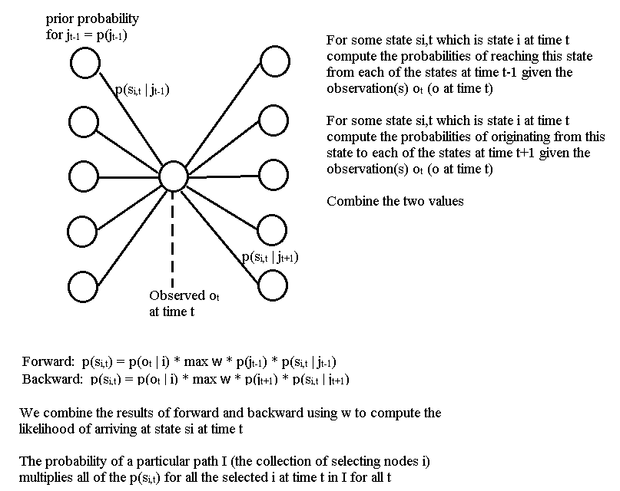

Slide 39
The Viterbi Algorithm
The forward backward algorithm requires recomputing transitions between many pairs of nodes
for instance, the transition from node 1 to node 3 between time 4 and 5 would be recomputed for every node at time 6
similarly, we would recompute many partial paths such as from node 1 to 2 to 3 to 4 between time units 1 and 4
we will use dynamic programming to remember every computation we have already made so that we do not have to repeat computations
we will also apply recursion to implement the forward backward algorithm
lets assume at some time t, we know the best paths to all states
at time t+1, we extend each of the best paths to time t by finding the best transition from time t to a state at t+1
The dynamic programming recursive implementation of forward-backward is known as the Viterbi Algorithm

Slide 40
Viterbi Formally Described
Initialization step
δ₁(i) = π_{i}*b_{i}(O₁) – same as in the forward algorithm
ψ₁(i) = 0 – this array will represent the state that maximized our path leading to the prior state
The recursive step
δ_{t+1}(j) = max [δ_{t}(i)*a_{ij}]*b_{j}(O_{t+1}) – here, we look at all of the previous states i at time t, and compute the state transition from t to t+1 that gives us the maximum value of δ_{t}(i)*a_{ij} –multiply that by the likelihood of this state being true given this time unit’s observation (see the next slide for a visual representation)
ψ_{t+1}(j) = argmax [δ_{t}(i)*a_{ij} ] –which i from the possible preceding states led to the maximum value? Store that

Slide 41
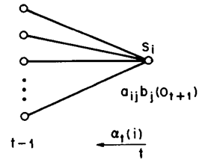
Continued
Termination step
p* = max[δ_{n}(i)] – the probability that the path selected is correct is the path that has the largest probability as found in the final time step from the last recursive call
q* = argmax [δ_{n}(i)] – this is the last state reached
Path backtracking
Now that we have found the best path, we backtrack using the array ψ starting at ψ[q*] until we reach time unit 1
At time t-1, we know the best paths to reach each of the states
Now at time t, we look at each state si, and try to extend the path from t-1 to t

Slide 42
How Do We Obtain our Probabilities?
We saw one of the issues involved Bayesian probabilities was gathering accurate probabilities
Like Bayesian probabilities, we need both prior probabilities and transition probabilities (the probability of moving from one state to another)
But here we also need output (or emission) probabilities
We can accumulate probabilities through counting
Given N cases, how many started at state s1? s2? s3?
although do we have enough cases to give us a good representative mix of probabilities?
Given N cases, out of all state transitions, how often do we move from s1 to s2? From s2 to s3? Etc
again, are there enough cases to give us a good distribution for transition probabilities?
How do we obtain the output probabilities? That is, how do we determine the likelihood of seeing output O_{i} in state S_{j}?

Slide 43
HMM Problem 3
The final problem for HMMs is the most interesting and also the most challenging
It is also the problem where we need to implement a learning algorithm
It turns out that there is an algorithm for modifying probabilities given a set of correct test cases
The algorithm is called the Baum-Welch algorithm (also known as the Estimation-Modification or EM algorithm) which uses as a component, the forward-backward algorithm
After we have completed one full forward-backward computation for the given input, which is the estimation phase, we take the results and feed them back into the HMM to modify the probabilities (the modification phase)

Slide 44
Baum-Welch (EM)
We add a new value, the probability of being in state i at time t and transitioning to state j, which we will call ξ_{t}(i, j)
Once we have run the forward-backward algorithm, this is easy to compute as
ξ_{t}(i, j) = α_{t}(i)*a_{ij}*b_{j}(O_{t+1})*β_{t+1}(j) / denominator
Before describing the denominator, lets understand the numerator
this is the product of the probability of being at state i at time t multiplied by the transition probability of going from i to j multiplied by the output probability of seeing O_{t+1} at time t+1 multiplied by the probability of being at state j at time t+1
that is, it is the value derived by the forward algorithm for state i at time t * the value derived by the backward algorithm for state j at time t+1 * transition * output probabilities

Slide 45
Continued
The denominator is a normalizing value so that all of our probabilities ξ_{t}(i, j) for all states i and j add up to 1 for time t
So this is merely the sum for all i and all j of α_{t}(i)*a_{ij}*b_{j}(O_{t+1})*β_{t+1}(j)
Now we have some additional work
We add γ_{t}(i) = Σ ξ_{t}(i, j) for all j at time t
This represents the expected number of times we are at state i at time t
If we sum up γ_{t}(i) for all times t, we have the number of expected times we are in state I
Now recall that we may have started with improper probabilities (prior, transition and output)

Slide 46
Re-estimation
By running the system on some test cases, we can accumulate probabilities of how likely a transition is (transition probability), how likely we start in a given state (prior probability), how likely a state is for a given observation (emission probability)
At this point of the Baum Welch algorithm, we have accumulated a summation (from the previous slide) of various states we have visited
p(observation i | state j) = (expected number of times we saw observation i in the test case / number of times we achieved state j) (our observation probabilities)
p(state i | state j) = (expected number of transitions from i to j / number of times we were in state j) (our transition probabilities)
π(state i) = α₁(i)*β₁(i) / Σ[α₁(i)*β₁(i)] for all states i (this is the prior probability)

Slide 47
Continued
The math may be elusive, and the amount of computations required is intensive but now we have the ability to
Start with estimated probabilities (they don’t even have to be very good)
Use training examples to adjust the probabilities
And continue until the probabilities stabilize
that is, between iterations of Baum-Welch, they do not change (or their change is less than a given error rate)
So HMMs can be said to learn the proper probabilities through training examples
Each training example is merely the observations and the expected output (hidden states)
The better the initial probabilities, the more likely it will be that the algorithm will converge to a stable state quickly, the worse the initial probabilities, the longer it will take

Slide 48
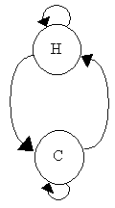
Example: Determining the Weather
Here, we have an HMM that attempts to determine for each day, whether it was hot or cold
observations are the number of ice cream cones a person ate (1-3)
the following probabilities are estimates that we will correct through learning
 | p(…|C) | p(…|H) | p(…|START)
p(1|…) | 0.7 | 0.1 |  | If today is cold (C) or hot (H), how many cones did I prob. eat?
p(2|…) | 0.2 | 0.2
p(3|…) | 0.1 | 0.7
p(C|…) | 0.8 | 0.1 | 0.5 | If today is cold or hot, what will tomorrow probably be?
p(H|…) | 0.1 | 0.8 | 0.5
p(STOP|…) | 0.1 | 0.1 | 0

Slide 49
Computing a Path Through the HMM
Assume we know that the person ate in order, the following cones: 2, 3, 3, 2, 3, 2, 3, 2, 2, 3, 1, …
What days were hot and what days were cold?
P(day i is hot | j cones) = α_{i}(H) * β_{i}(H) / (α_{i}(C) * β_{i}(C) + α_{i}(H) * β_{i}(H) )
α(H), β(H), α(C) and β(C) were all computed using the forward-backward algorithm
We started with guesses for our initial probabilities
Now that we have run one iteration of forward-backward, we can apply re-estimation
Sum up the values of our computations P(C | 1)s and P(C)
Recompute P(1 | C) = sum P(C | 1) / P(C)
we also do the same for P(C | 2), and P(C | 3) to compute P(2 | C) and P(3 | C) as well as the hot days for P(1 | H), P(2 | H), P(3 | H)
And we recompute P(C | C), P(C | H), etc
Now our probabilities are more accurate (although not necessarily correct)

Slide 50
Continued
We update the probabilities (see below)
since our original probabilities will impact how good these estimates are, we repeat the entire process with another iteration of forward-backward followed by re-estimation
we continue to do this until our probabilities converge into a stable state
So, our initial probabilities will be important only in that they will impact the number of iterations required to reach these stable probabilities
 | p(…|C) | p(…|H) | p(…|START)
p(1|…) | 0.6765 | 0.0584
p(2|…) | 0.2188 | 0.4251
p(3|…) | 0.1047 | 0.5165
p(C|…) | 0.8757 | 0.0925 | 0.1291
p(H|…) | 0.109 | 0.8652 | 0.8709
p(STOP|…) | 0.0153 | 0.0423 | 0

Slide 51
Convergence and Perplexity
This system converged in 10 iterations to the probabilities shown in the table below
Our original transition probabilities were part of our “model” of weather
updating them is fine, but what would happen if we had started with different probabilities? say p(H|C) = .25 instead of .1?
the perplexity of a model is essentially the degree to which we will be surprised by the results of our model because of the “guesses” we made when assigning a random probability like p(H|C)
We want our model to have a minimal perplexity so that it is most realistic
 | p(…|C) | p(…|H) | p(…|START)
p(1|…) | 0.6406 | 7.1E-05
p(2|…) | 0.1481 | 0.5343
p(3|…) | 0.2113 | 0.4657
p(C|…) | 0.9338 | 0.0719 | 5.1E-15
p(H|…) | 0.0662 | 0.865 | 1.0
p(STOP|…) | 1.0E-15 | 0.0632 | 0

Slide 52
Other HMM Learning
We can also learn the structure of the HMM itself similar to how we might learn the structure of a Bayesian net
There are several possible approaches
Start with a fully connected graph and use the E-M algorithm to modify the transition probabilities, removing links when transition probabilities drop to 0 (or some low value)
not a practical solution
Start with each observation of each test case representing its own node and as each new test case is introduced, merge nodes that have the same observation at time t and the HMMs begin to collapse
Collapse states that are the same as well as states that share the same transitions
Notice there is nothing probabilistic about learning the structure

Slide 53
Two Problems With HMMs
There are two primary problems with using HMMs
The first is minor – what if a probability (whether output or transition) is 0?
since we are dealing with products, a 0 will cause the entire product to be 0 so that the path that contains this probability will never be selected
we will replace any 0 probabilities with some minimum probability (say .001)
The complexity of the search
imagine we are using an HMM for speech recognition where the hidden states are the possible phonemes (say there are 35 of them) and the utterance consists of some 100 phonemes (perhaps 20 words)
the complexity for the forward algorithm is O(T*N^{T}), in this case N is 35 and T is 100! Ouch
use a beam search to reduce the number of possible paths searched

Slide 54
Beam Search
A beam search is a combination of the heuristic search idea along with a breadth-first search
The beam search algorithm examines all of the next states accessible from the current node and evaluates each of them
for an HMM, the evaluation is the probability α or β depending on whether we are doing a forward or backward pass
To reduce the complexity of the search, we retain only the top rated transitions at this time interval
we might either keep the top k where k is a constant (known as the beam width) or we can use a threshold value and prune away states that do not exceed the threshold value
if we discard a state, we are actually discarding the entire path that led us to that state

