Slide 1
Evolution of the Intel Architecture
8086 released in 1978, ranged between 4-10 MHz
16 bit architecture which grew out of the earlier 8008 and 8080 architectures
mostly backward compatible with 8008, 8080 and 8085
20-bit address space by
left shifting segment register 4 bits to be a 20-bit base and adding index register as an offset
integer only, signed and unsigned
microcoded multiply and divide operations
CPU had 40 pins whose uses overlapped based on clock cycle
see next slide
pins and address/data bus are multiplexed (address during first cycle, data during second – fourth cycles)
floating point available by adding 8087 coprocessor

Slide 2
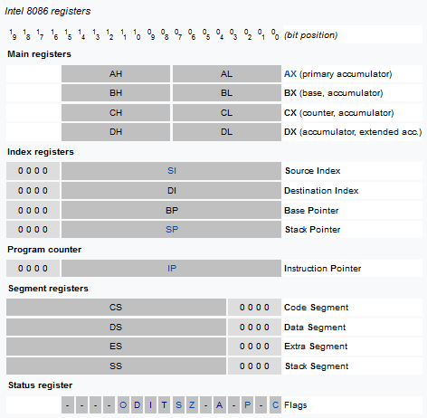
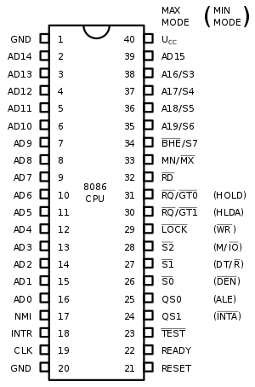

Slide 3
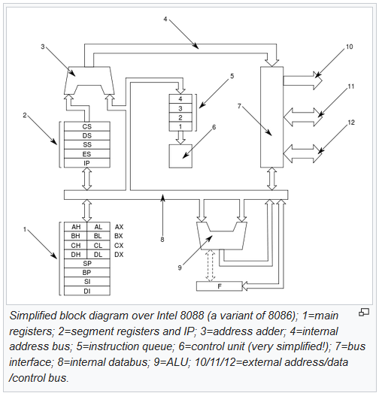
Notes:
3: add base address
and offset
5: 4-item instruction
buffer (not for
prefetching but
because instruction
lengths vary)
10: address bus
11 & 12: data and
control buses

Slide 4
Addressing Modes and Execution Time
Each mode is listed as two numbers
1st for mov instruction, 2nd for ALU
Register-register: 2, 3
Register-immediate: 4, 4
Register-memory: 8+EA, 9+EA
Memory-register: 9+EA, 16+EA
Memory-immediate: 10+EA, 17+EA
EA = time to compute effective address which ranges from 5 to 12 cycles
multiply ranged from 70-160, divide from 80-190
For jump instructions: 11 (unconditional, no label), 15 (unconditional, labeled), 16 (conditional, labeled)

Slide 5
80286
Introduced in 1982
address and data bus and pins separated (no longer multiplexed)
protection capabilities to detect memory violations
two modes: real mode and protected mode (used to permit access to larger memory spaces, up to 4GB)
this is because the 286 was designed for multiuser and multitasking systems (even though MS DOS and early versions of Windows were not)
ranged from 4-25 MHz
performance averaged CPI of about 5
still required a math coprocessor for FP (80287)

Slide 6
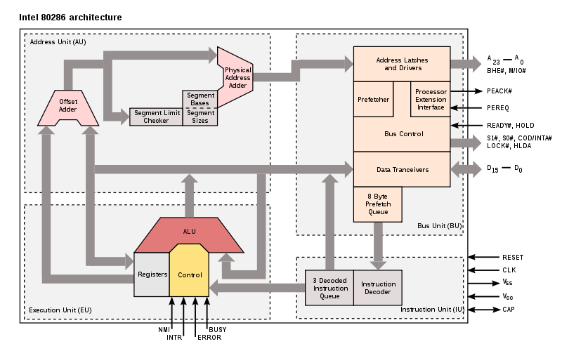

Slide 7
80386
Released in 1985
Extended the 286 architecture to 32 bits
all registers retained but “E” versions added to add the extra 16 bits
Third mode added (virtual mode multitasking)
added paging translation unit for virtual memory address translation
Added several new built-in data types: char, string, long int, boolean, pointer
still required math coprocessor for FP
Clock rates ranged from 12 MHz to 40 MHz

Slide 8
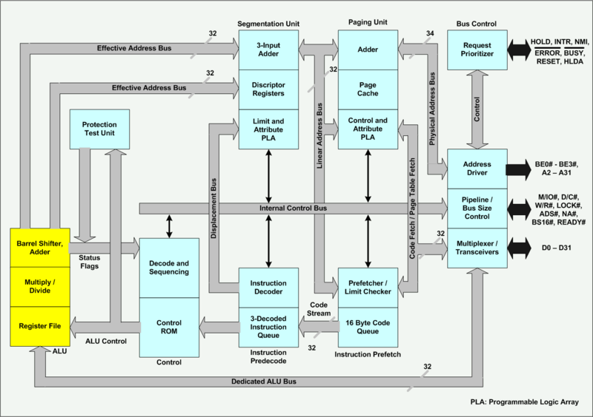

Slide 9
486 Processor
Added a pipeline (see next 2 slides)
Added floating point functional unit
no longer needed the math coprocessor
FP unit has its own bus to connect to FP registers
functional unit provided a degree of parallel processing in that while FP operations were executed, the pipeline would continue to fetch and execute integer operations
Added an atomic operation to better implement synchronization
Contained 8KB combined instruction/data cache
later expanded to 16KB
Clock rates range from 33 MHz to 100 MHz

Slide 10
The 486 Pipeline
5 stages
Fetch 16 bytes worth of instruction
may be 1 instruction, part of 1 instruction, multiple instructions
Decode stage 1 – examine 16 bytes to identify whole instruction
if buffer does not contain entire instruction, stall pipeline and continue fetching instruction
divide 16 bytes into instruction(s) (find the end of each instruction)
Decode stage 2 – decode the next instruction
includes fetching operands from registers
Execution – ALU operations, branch operations, cache (mov) instructions
may take multiple cycles if ALU operation requires multiple cycles (*, /, FP) or requires 1 (or more) memory accesses
further stalls needed if memory access is a cache miss
Write result of load or ALU operation to register

Slide 11
486 Difficulties
Stalls arise for numerous reasons
17 byte long instructions require 2 instruction fetch stages
ALU memory-register/memory-immediate takes at least 1 additional cycle
possibly two if memory item is both source and destination
such a situation stalls instructions in the decode 2 stage
or if there is a cache miss
Complex addressing modes can cause stalls
pointer accessing (indirect addressing) takes 2 memory accesses
scaled addressing mode involves both a shift and an add
again, stalls occur in the decode 2 stage
Branch instructions have a 3 cycle penalty
branches are computed in the EX stage (4th stage)
some loop operations take more than 1 cycle to compute adding a further stall

Slide 12
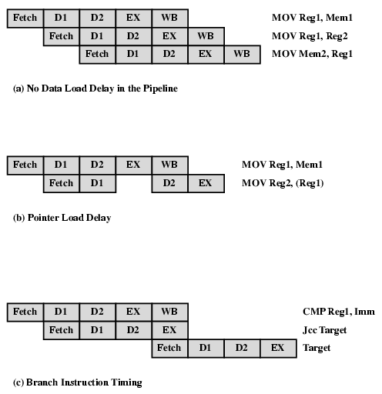
486 Examples
Example 1:
three data movements, no stalls
Example 2:
data hazard, 1 cycle of stall
Example 3:
branch penalty

Slide 13
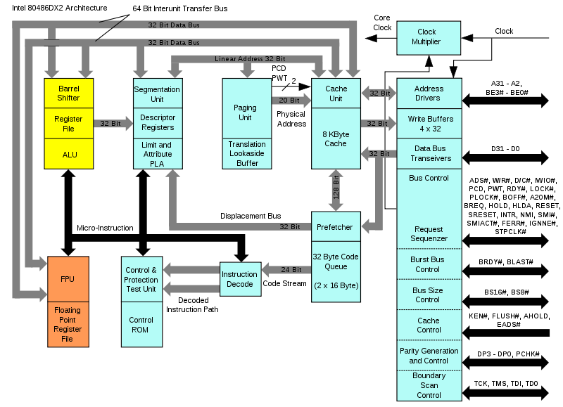
486 Overall Architecture

Slide 14
Pentium Architecture
Summarizing problems with the 486 pipeline
variable length instructions, variable complexity of operations, memory-register ALU operations, indirect addressing
to improve performance using RISC features, Pentium (586) architects needed to rethink things while still implementing backward compatibility
CISC architectures handle the fetch-execute cycle through a microprogrammed control unit
a microprogram consists of a sequence of microinstructions, each being of equal length and taking 1 clock cycle (usually) to execute
Re-implement the pipeline as follows
continue to use an instruction fetch unit to fill a buffer with instructions
use a separate decode unit to identify each instruction and decode it into microcode
issue microinstructions to a pipeline

Slide 15
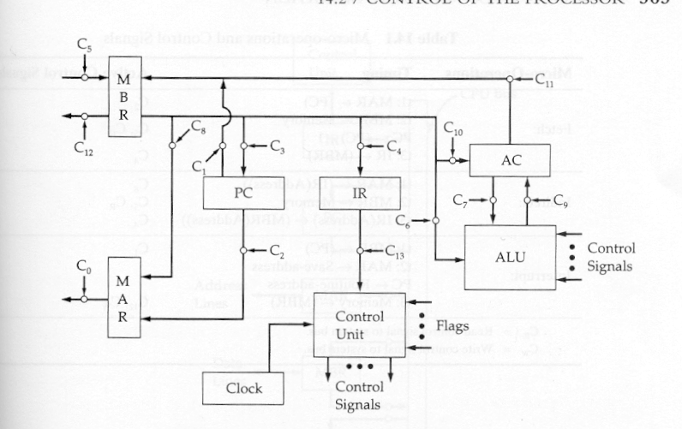
Control and Micro-Operations
An example architecture is shown to the right
Each of the various connections is controlled by a particular control signal
MBR to the AC controlled with signal C11
PC to MAR by C2
AC to ALU C7
note that this figure is incomplete
A microprogram is a sequence of micro-operations
this is not an x86 architecture!

Slide 16
Example
Consider a CISC instruction such as Add R1, X
X copied into MAR and a memory read signaled
datum returned across data bus to MBR
adder sent values in R1 and MBR, adding the two, storing result back into R1
This sequence can be written in terms of micro-operations as:
t1: MAR ← (IR (address) )
t2: MBR ← Memory
t3: R1 ← (R1) + (MBR)
t3: Acc ← (R1) + (MBR)
t4: R1 ← (Acc)
Each micro-operation is handled by one or more control signals
For instance, MBR ← Memory is C5
t1 – t5 are clock cycles, each
microinstruction executes in
separate clock cycles

Slide 17
Control Memory
Each micro-program consists of one or more micro-instructions, each stored in a separate entry of the control memory
The control memory itself is firmware, a program stored in ROM, that is placed inside of the control unit
...
Jump to Indirect or Execute
Fetch cycle routine
...
Jump to Execute
Indirect Cycle routine
...
Jump to Fetch
Interrupt cycle routine
Jump to Op code routine
Execute cycle begin
...
Jump to Fetch or Interrupt
AND routine
...
Jump to Fetch or Interrupt
ADD routine
Note: each micro-program ends with a branch to the
Fetch, Interrupt, Indirect or Execute micro-program

Slide 18
Example of Three Micro-Programs
Fetch: t1: MAR ← (PC) C2 t2: MBR ← Memory C0, C5, CR PC ← (PC) + 1 C* t3: IR ← (MBR) C4
Indirect: t1: MAR ← (IR (address) ) C8 t2: MBR ← Memory C0, C5, CR t3: IR(address) ← (MBR (address) ) C4
Interrupt: t1: MBR ← (PC) C1 t2: MAR ← save address C* PC ← routine address C* t3: Memory ← (MBR) C12, CW
CR – Read control to system bus
CW – write control to system bus
C0 – C12 refers to the previous figure
C* are signals not shown in the figure

Slide 19
Horizontal vs. Vertical Micro-Instructions
Micro-instruction address points to a branch in the control memory and is taken if the condition bit is true
Micro-instruction Address
Function Codes
Jump
Condition
Horizontal micro-instructions contain 1 bit for every control signal controlled by the control unit
Vertical micro-instructions
use function codes that
need additional decoding
Internal CPU Control Signals
Micro-instruction Address
This micro-instruction requires 1 bit for every control line, it is longer than the vertical micro-instruction and therefore takes more space to store, but does not require additional time to decode by the control unit
Jump Condition
System Bus
Control Signals

Slide 20
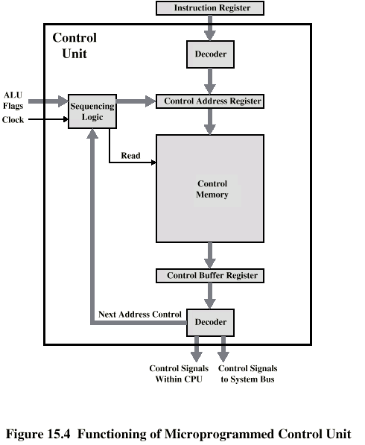
Micro-programmed Control Unit

Slide 21
Continued
Decoder analyzes IR
delivers starting address of op code’s micro-program in control store
address placed in the to a micro-program counter (here, called a Control Address Register)
Loop on the following
sequencer signals read of control memory using address in microPC
item in control memory moved to control buffer register
contents of control buffer register generate control signals and next address information
if the micro-instructions are vertical, decoding is required here
sequencer moves next address to control address register
next instruction (add 1 to current)
jump to new part of this microprogram
jump to new machine routine

Slide 22
Pentium Architectures
Pentium I released 1993
upgraded to 64-bit data bus
superscalar 5-stage pipeline (2 parallel pipelines)
branch speculation added
separate instruction and data catches
FP portion of the processor had an infamous bug requiring the entire CPU be replaced!
Pentium II released 1995
added L2 cache
Pentium III released 1999
both PII and PIII used 14-stage pipelines
Pentium IV released 2000
superscalar expanded to 3 parallel pipelines
21-31 stage pipeline

Slide 23
Pentium IV: RISC features
RISC features implemented on microinstructions
instead of machine instructions
Microinstruction-level pipeline
Dynamically scheduled micro-operations
Reservation stations (128)
Multiple functional units (7)
Branch speculation via branch target buffer
speculation at micro-instruction level
instead of an ROB, decisions made at the reservation stations
miss-speculation causes reservation stations to flush their contents
correct speculation causes reservation stations to forward results to registers/store units
trace cache used (discussed shortly)

Slide 24
Pentium II-III Pipeline
IF unit: 3 stages
ID unit: 2 stages
Issue unit: 2 stages
up to 3 microinstructions issued per cycle
register renaming occurs here
instructions sent to reservation station
Execution units: 1-32 stages
1 for int, up to 32 for FP
Write back: 3 stages
Commit: 3 stages
up to 3 microinstructions can commit in any cycle

Slide 25
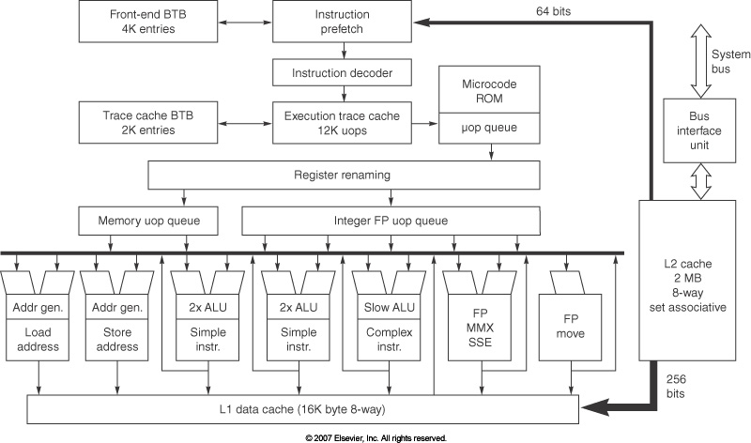
Pentium IV Overall Architecture

Slide 26
Specifications
7 functional units:
2 simple ALUs (add, compare, shift) – ½ cycle execution to accommodate up to 2 micro-operations per cycle
1 complex ALU (integer multiplication and division) – multicycle, pipelined
1 load unit and 1 store unit – including address computation
1 FP move (register to register move and convert)
1 FP arithmetic unit (+, -, *, /) – multicycle, pipelined, some SIMD execution permitted on these units
128 registers for renaming
reservation stations are used rather than a re-order buffer
instructions must wait in reservation stations longer than in Tomasulo’s version, waiting for speculation results

Slide 27
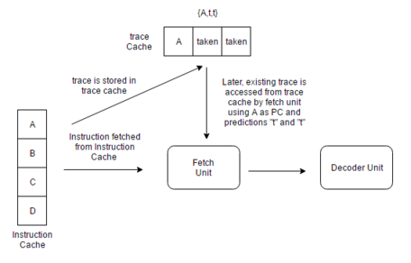
Trace Cache
Instruction cache
caches blocks of instructions recently executed together
Trace cache encodes branch behavior implicitly
Miss-speculated instructions would be discarded from the cache
stores microinstructions (not machine instructions)
Combining a trace cache and branch target buffer minimizes microinstruction fetch and decoding
as long as the microinstructions remain in the trace cache
Miss-predictions at the
microinstruction level are
far rarer than miss-predictions
at the machine level

Slide 28
Source of Stalls
Process breaks down as follows
in the issue stage
branch miss-predictions
cache misses, particularly trace cache miss
reservation stations full
limited number of entries in the commit buffer
less than 3 instructions fetched in 1 cycle
less than 3 microinstructions can be issued at the time
at the commit stage
branch miss-predictions
instructions not ready to commit yet
branch computation not yet available

Slide 29
Continued
Miss-prediction of microinstruction are very infrequent (about .8% for int, .1% for FP)
FP are often more predictable because they involve a lot of for loops
machine language level miss-speculation between .1% and 1.5%
Trace cache has nearly a 0% miss rate
L1 and L2 data caches have miss rates of around 6% and .5% respectively
machine’s effective CPI ranges from around 1.2 to 5.85 with an average of around 2.2
machine instructions, not micro-operations

Slide 30
Intel Core (iCore)
Multi-core processors (started with 2 cores)
originally released with two cores where one was disabled
Same basic architecture as Pentium III but with lower clock rates, this was offset by several new innovations
issue up to 4 microinstructions at a time
more efficient decode stages
using macro-ops which attempts to combine two micro-instructions into a single one such as a compare and conditional branch
more efficient execution units
one cycle throughput due to pipelined ALU units (previously had a 2-cycle throughput)
larger caches and buses
no SMT processing (developed for Pentium IV)
lower power consumption (needed when there are multiple cores)
iCore has released processors of 1, 2, 4 and 6 cores

Slide 31
Intel Core i7
Aggressive out of order speculation
pipeline reduced from 31 to 14 stages
Instruction fetch unit
retrieves 16 bytes to decode
feeds a queue that can store up to 18 instructions at a time
multilevel branch target buffer, return address stack for speculation
miss-predictions cause a penalty of about 15 cycles
32 KB instruction cache
if a loop is detected that contains fewer than 28 instructions or 256 bytes
these instructions will remain in a buffer to repeatedly be issued (rather than repeated instruction fetches)

Slide 32
Continued
Decoding converts machine instructions into microcode using any of four decoders
simple micro-operation instructions (2 each)
complex micro-operation instructions (2 each)
Instruction issue can issue up to 6 micro-operations per cycle to
36 centralized reservation stations
6 functional units including 1 load and 2 store units that share a memory buffer connected to 3 different data caches

Slide 33
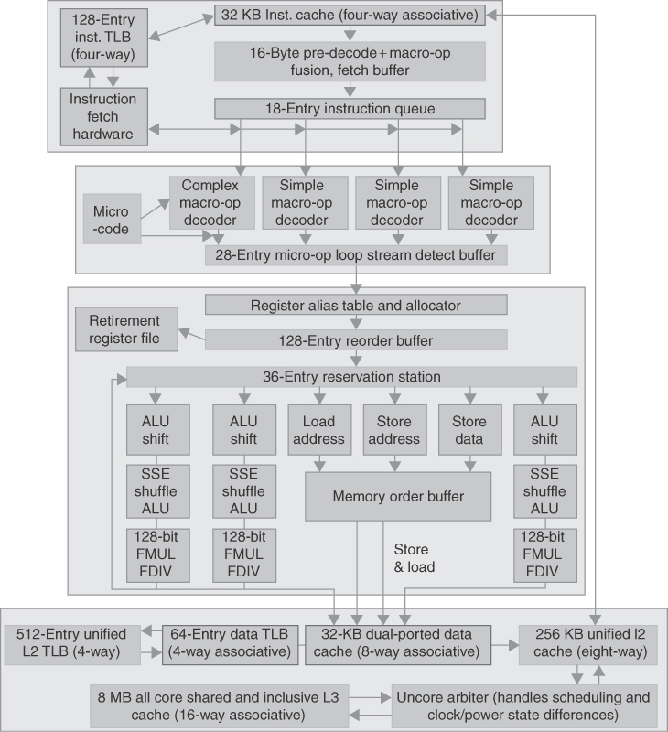
i7 Architecture

Slide 34
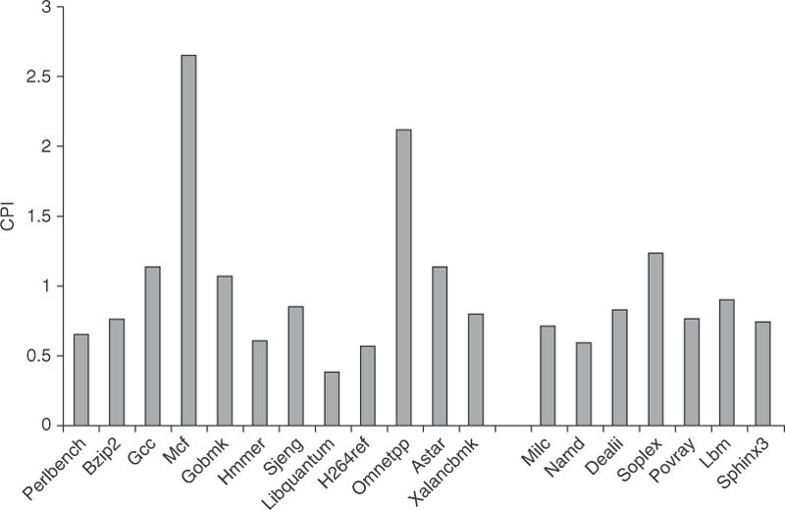
i7 Performance
CPI for various SPEC06
benchmarks
Average CPI is 1.06 for
integer programs
and .89 for FP (machine
instructions, not
micro-instructions)
i7 susceptible to miss-speculation resulting in “wasted” work
Up to 40% of the total work that goes into Spec 06 benchmarks is wasted
Waste also arises from cache misses (10 cycles or more lost with an L1 miss, 30-40
for L2 misses and as much as 135 for L3 misses)

Slide 35
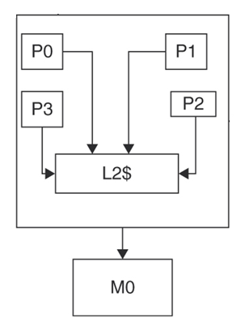
Multicore Processors
Each core is a separate processor with its own registers, ALU, control unit, local bus, and L1 cache
L2 cache is shared among all cores
L3 off chip may be added
performance of multicore processors shown below
speedup is close to but not always linear to the number of cores

Slide 36
A Balancing Act
Improving one aspect of our processor does not necessarily improve performance
it might actually harm performance
lengthening pipeline depth, increasing clock speed in the P4 without adding reservation stations or using a trace cache degrades performance
stalls arise at issue stage due to needing more instructions to issue
cache misses have greater impact when the clock speed is increased
without accurate branch prediction and speculation hardware, stalls from miss-predicted branches can have a tremendous impact on performance
we saw this in both the ARM and i7 processors

Slide 37
Continued
As clock speeds increase
stalls from cache misses create a bigger impact on CPI
larger caches and cache optimization techniques are needed
To support multiple issue of instructions
need larger cache-to-processor bandwidth
Increasing instruction issue rate
requires a proportional increase in the number of reservation stations and reorder buffer size

