Slide 1
TLP: Multiprocessor Architectures
In chapter 3, we looked at ways to directly support threads in a processor
  here we expand our view to multiple processors
We differentiate among multiple processors as follows
  multiple cores
  multiple processors each with one core
  multiple processors each with multiple cores
  Whether processors/cores share memory
When processors share memory, they are known as tightly coupled
  they can promote two types of parallelism
    parallel processing of multiple threads (or processes) collaborating on a single task
    request-level parallelism in which independent (or relatively independent) processes run on separate processors (sometimes called multiprogramming)
  we do not consider loosely coupled (distributed memory) processors because there are fewer issues and computer networks can be viewed as loosely coupled multiprocessors

Slide 2
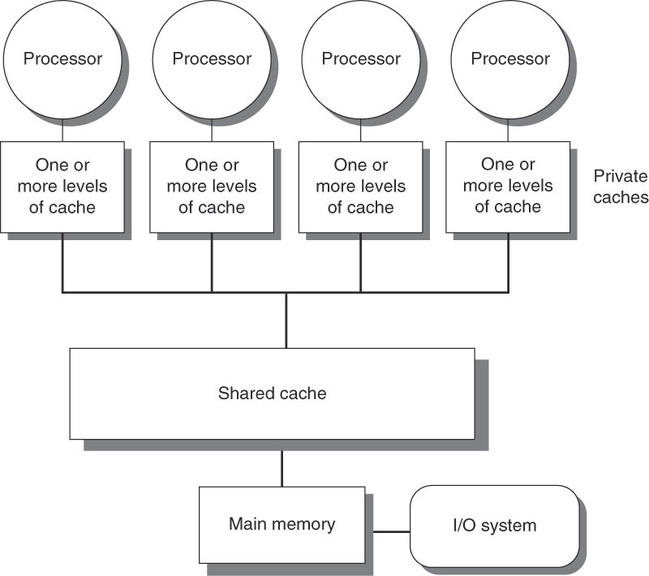
Shared Memory Architecture
Commonly referred to as symmetric multiprocessors (SMP)
  tightly coupled/shared memory
    also known as uniform memory access multiprocessor
  usually no more than 8 processors in such an architecture because memory becomes a bottleneck as processor count increases
SMPs used to be specialized computers, often built for research purposes
  but with multicore processors, most of us have SMPs today

Slide 3
SMP Cache Access
Every processor or core will have its own cache memory
  access to this memory is fast but a cache miss requires going to another layer of the hierarchy
  if the next level is shared, it will be a slower access not only because of its remoteness to the processor but also because other processors may be accessing it causing it to wait
  remote memory access is also more complex because of cache coherence (covered shortly)
Two ways or views for remote cache access
  NUCA – nonuniform cache access – access times will differ based on the location of the remote cache
  UMA – uniform memory access – all processors have the same (or similar) access times to all remote caches
    referring back to the figure on the previous slide, we see UMA because there is a single, shared cache backed up by a single, shared memory, offering uniform access to all

Slide 4
Challenges
We want to minimize communication between processors/cores
  while processors/cores are communicating, they are idle
    example: we want to achieve 80 times speedup with 100 processors
    what fraction of the processors need to be in use (on average) to achieve this?
      use Amdahl’s Law assuming processors are idle while they communicate
    80 = 1 / (1 – f + f / 100), solving for f gives us 99.75%
    communication between processors should occur only .25% of the time!
How much parallelism exists within a program to distribute to processors/cores?
  given 100 processors and an application that can use 1, 50 or 100 processors assuming we can use all 100 processors 95% of the time, how much of the remaining 5% needs to employ 50 for a speedup of 80?
    S = 1 / (1 – F100 – F50 + F100 / 100 + F50 / 50), F100 = .95, solving for F50 gives us 4.8%, so we should only use the 1 processor .2% of the time for a speedup of 80!

Slide 5
Continued
Another challenge is the large latency of contacting other processor(s)/core(s) during communication
  latency might be 35-50 clock cycles for cores on a shared chip but 100-300 clock cycles for processors that use an interconnection network to communicate (see slide 15)
Example: 32 processors, 100 ns latency to shared (remote) memory
  assume all memory references to a processor’s local memory are hits, processor stalls when needing to access shared memory
    4 GHz clock rate (miss penalty = 100ns / .25ns = 400 cycles)
    base CPI of .5
  how much faster does a program execute that never accesses shared memory as opposed to one with .2% of all instructions accessing shared memory?
  CPI = .5 + remote request rate * miss penalty = .5 + .2% * 400 = 1.3
  program with no shared memory access is 1.3/.5 = 2.6 times faster!

Slide 6
Cache Coherence
The most challenging aspect of a shared memory architecture is ensuring data coherence across processors
  what happens if two processors both read the same datum from shared memory into a local cache?
  if one processor changes the datum, the other processor has a stale value
  how do we alert the other processor to update the value?
Consider the following time line of events (assume write-through cache)
Time | Event | A’s Cache storing X | B’s Cache storing X | Memory item X
0 |  | ---- | ---- | 1
1 | A reads X | 1 | ---- | 1
2 | B reads X | 1 | 1 | 1
3 | A writes 0 into X | 0 | 1 | 0
Note: in a write-back cache, X
is written back to memory later, so
X in memory would remain 1
for some amount of time meaning
two values are stale, at least for
a time

Slide 7
Cache Coherence Problem
We need our memory system to be both coherent and consistent
  a memory system is coherent if
    a write by processor P to X followed by a read by P from X with no writes of X by any other processor always returns the value written previously by P
    a write by a processor to X followed by a read of a different processor of X always returns the written value as long as the write and read are separated by a sufficient amount of time and no other write to X occurs in that time
    writes to the same location are serialized so that the writes are seen by all processors in the same order
  consistency determines when a written value will be returned by a later read
    assume a write is only complete once that write becomes available to all processors
      a write to a local cache does not mean a write has completed
      the write must also be made to shared memory
    if two writes take place, to X and Y, then all processors must see the two writes in the same order (X first and then Y for instance)

Slide 8
Snooping Coherence Protocol
In an SMP, all processors have their own local caches
These caches connect to the next level of the memory hierarchy by a single common bus
  the caches listen to this bus for write updates
  we refer to these caches as “snoopy” caches
Data fall into one of three categories
  Shared – datum that can be read by anyone and is valid to all
  Modified – datum has been modified by this processor which must update all other processors
  Invalid – datum has been modified by another processor but this processor has not yet received the update so its version is invalid
    note this refers to “datum” but really means the datum’s entire refill line

Slide 9
Snooping Cache Write Protocols
The snooping cache has two alternative protocols
  Write-invalidate – upon a write, other caches must mark their own copy as invalid
    before using the datum, a fresh copy must be retrieved
    if two processors attempt to write at the same time, only one wins, the other must invalidate its write, and obtain the new value before repeating the write
    this is also sometimes called a write broadcast protocol
  Write-update – upon a write, update all other caches at the same time by broadcasting the new datum
    this approach yields a more coherent cache with less future work but also consumes far more bandwidth
    most recent multiprocessors use write-invalidate instead

Slide 10
More on Write Invalidate
Because this is the more common approach, we concentrate on it
  if the local caches connect to the next layer by system bus, the modified cache must first obtain access to the bus
    as this bus is shared, access may be postponed while other processors are using it
  it is preferred to connect these local caches to a shared cache via a local bus within the CPU rather than the system bus
    local bus shared among all cores
    each core has an L1 cache, the shared cache is L2, and backed up off the chip by shared DRAM (or shared L3 and shared DRAM)
  for a write-through cache, updated refill line is placed on bus and sent to all lower levels, snooping caches can identify the updated address and its content as needed
  for a write-back cache, snooping cache intercepts only the address
    if the address is of a currently cached line, snooping cache must contact the updated cache to receive the modified line

Slide 11
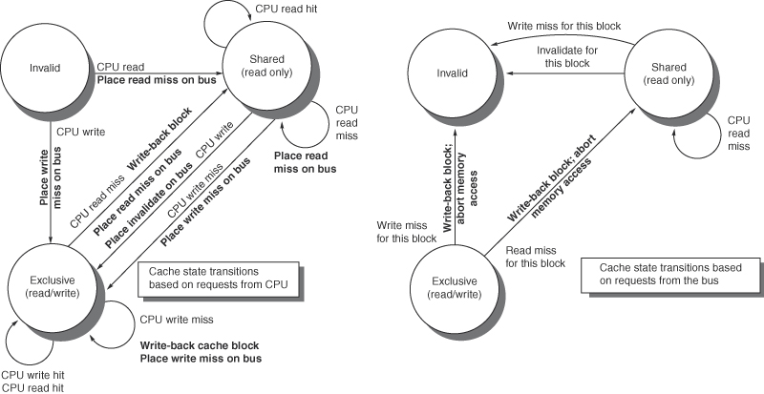
Implementation
Processor | Bus | A’s cache | B’s cache | Memory
 |  | ---- | ---- | 0
A reads X | Cache miss | 0 | ---- | 0
B reads X | Cache miss | 0 | 0 (from A, not memory) | 0
A writes X | Invalidate X | 1 | ---- | 1 (or ----)*
B reads X | Cache miss | 1 | 1 | 1
* - depends on whether
A is a write-through
cache (in which case
memory is now storing 1)
or a write-back (in which
case the datum in memory
is invalidated)
NOTE: all operations
assumed to be atomic

Slide 12
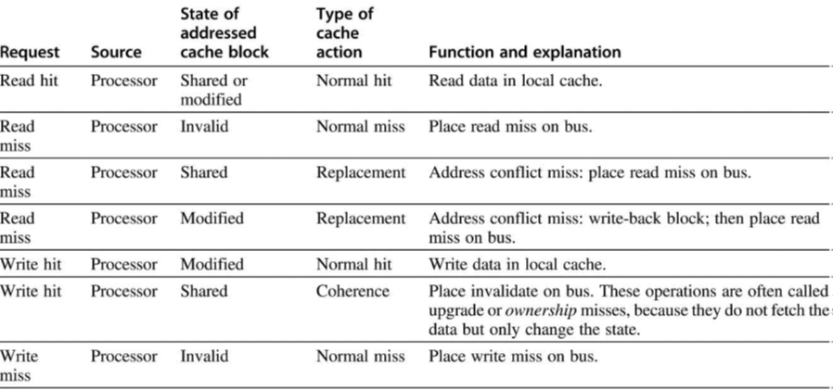
The Complete Protocol (part 1)

Slide 13
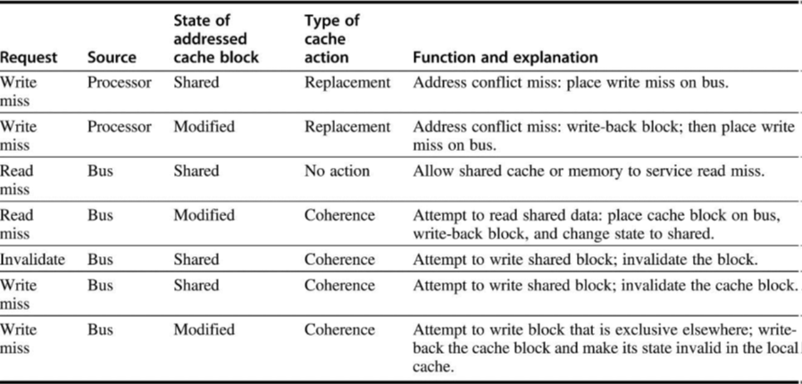
The Complete Protocol (part 2)

Slide 14
Extensions to Protocol
MESI – adds a state called Exclusive
  if datum is exclusive to the cache, it can be written without generating an invalidate message to the bus
  if a read miss occurs to a datum that is exclusive to a cache, then the cache must intercept the miss, send the datum to the requesting cache and modify the state to shared
MOESI – adds a state called Owned
  if owned, the cache owns the datum AND the datum is out of date in memory (hasn’t been written back yet)
  this cache MUST respond to any requests for the datum since memory is out of date
  the advantage is if a modified block is known to be exclusive, it can be changed to Owned to avoid writing back to memory at this time

Slide 15
Example
Single bus and shared L3/DRAM become a bottleneck
How does the shared communication medium impact performance?
  assume 8 cores each with their own L1 and L2 caches
  L2 caches perform snooping on shared bus which connects them to the shared level. access to L2 averages 15 cycles
  clock rate is 3.0 GHz, CPI is 0.7
  load/store frequency is 40%
  our goal: no more than 50% of L2 bandwidth occurs because of the snooping protocol
  what is the maximum coherence miss rate per processor?

Slide 16
Solution
Solve for cache cycles available computed in two ways
  cache cycles available = clock rate / (cycles per request * 2) = 3 GHz / 30 = .1 ns
  cache cycles available = memory references * clock rate * processor count * coherence miss rate = .4 / .7 * 3 GHz * 8 * cache coherence miss rate
Assign the result of one equation to the other
  .1 ns = .4 / .7 * 3 GHz * 8 * cache coherence miss rate
Solve for cache coherence miss rate
  gives us .73% (or less)
Many applications have a coherence miss rate of about 1%
  since 8 cores require a lower coherence miss rate, we might need to restrict our processor to 6 or fewer cores

Slide 17
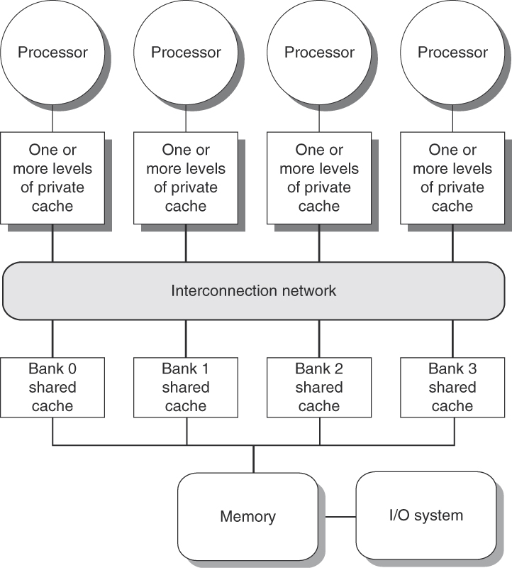
A Variation of the SMP
As before, each processor has its own L1 and L2 caches
  snooping occurs by the L2 cache over an interconnection network
A shared L3 cache is banked to improve performance
  DRAM backs up L3 and is also shared among all processors
    it is probably also banked

Slide 18
Performance for Shared Memory
Many factors impact the performance of an SMP
  we concentrate only on cache performance impacted by coherence protocol
Coherence misses are broken into two separate sources
  true sharing misses
    occurs when a shared datum has been modified by one processor causing others to be invalidated
    later accesses by other processors result in a sharing miss requiring communication between the processor that has a miss and the processor owning the true datum
  false sharing
    occurs because invalidation usually occurs at the refill line level, not the datum level
    if X has been modified and X and Y are in the same line and this processor wants to access Y, it is considered an invalidation miss even though Y is still valid
    we can avoid this problem by using 1 valid bit per entry in a line

Slide 19
Example
Assume z1 and z2 are in the same cache line and are shared by P1 and P2
  both variables are currently in both processors’ caches and listed as valid
Indicate the true and false misses and hits from below:
  P1 P2
  1 Write z1
  2 Read z2
  3 Write z1
  4 Write z2
  5 Read z2
1. true sharing miss – P2 needs to invalidate z1 (and z2)
2. false sharing miss – z2 is still valid but P2 has marked it as invalid
3. false sharing miss – this would not have been a miss if P2 hadn’t read z2 and thus received a modified version of the line
4. false sharing miss – this is the same situation as #3, just reversed because z1 has been modified making it seem like z2 needs to be read first
5. true sharing miss – because P1’s z2 is invalid

Slide 20
Commercial Workloads
A study was done in 1998 on the DEC ALPHA 21164, we compare it to the Intel iCore 7 layout
  4 processor SMP, issuing up to 4 instr/clock cycle per core, 3 levels of cache
    L1: 8 KB/8 KB instr/data cache, direct-mapped, 32 byte blocks, 7 cycle miss penalty
    L2: 96 KB, 3 way set assoc, 32 byte block, 21 cycles
    L3: 2 MB, direct mapped, 64 byte block, 80 cycle miss (these are separate, unshared caches, one per processor) – these are the snoopy caches
  As a point of comparison, the Intel i7 has these three caches
    L1: 32 KB/32 KB instr/data cache, 8 way/8 way, 64 byte blocks, 10 cycle miss penalty
    L2: 256 KB, 8 way set assoc, 64 byte block, 35 cycles – these are the snoopy caches
    L3: 8 MB (4 2-MB shared caches), 16 way, 64 byte block, ~100 cycle miss

Slide 21
These charts indicate performance
on an on-line transaction-processing
system using an Oracle back-end
Server processes consume 85% of the
user time, 15% is for the clients
(placing requests, receiving responses
from the server)
71% of execution time spent in user
mode, 18% by the OS, 11% idle
because of I/O wait time
Of particular note is that true sharing
miss rate decreases more than a factor
of 2 as refill line increases from 32
to 256 bytes but false sharing miss
rate nearly doubles (even though
it remains small)

Slide 22
Another Study
This example was of a benchmark that simulates a compiler
  Unix make commands to: compile code, install object files into a library, and remove object files created during the compilation phase that aren’t permanent
  compilation is compute intensive while the other tasks are OS intensive
  run in parallel on 8 processors
Memory and I/O organization (each processor has L1 and L2 caches)
  L1 instruction cache – 32KB 2-way set associative, 64-byte block, 1 cycle hit time
  L1 data cache – 32 KB, 2-way set associative, 32-byte block, 1 cycle hit time
  L2 unified cache – 1 MB, 2-way set associative, 128-byte block, 10 cycle hit time – the snoopy caches
  DRAM – shared among all 8 processors, 100 cycle access time
  Disk – 3 ms access time

Slide 23
Results
Instructions executed:
  User execution: 27%
  Kernel execution: 3%
  Synch execution/wait time: 1%
  Processor idle (waiting for disk): 69%
Execution time:
  User execution: 27%
  Kernel execution: 7%
  Synch execution/wait time: 2%
  Processor idle (waiting for disk): 64%
Meaning of the four types of execution time
  Idle – kernel mode waiting on I/O to complete (disk I/O in this case)
  User – executing user code
  Synchronization – executing or waiting for synch variables (i.e., wait function, release function)
  Kernel – executing the OS (outside of synch time)

Slide 24
Compiler Miss Rates
Notice how much worse the kernel miss rates are indicating that kernel code is far less
predictable/consistent in its execution than user code (for this compiler)

Slide 25
Continued: Kernel Misses
The large percentage of compulsory misses indicates that there is less
repetition among the code and more subroutines being called

Slide 26
Distributed Shared Memory
The tightly coupled (shared memory) multiprocessor is useful for promoting parallelism within tasks
  whether 1 process, a group of threads, or related processes
When processes generally will not communicate with each other, there is little need to force the architect to build a shared memory system
  loosely coupled, or distributed memory system, is generally easier to construct and possibly cheaper
    any network of computers can be thought of as a loosely coupled multiprocessor
  while a multicore single CPU is usually an SMP, a multicore multiprocessor will usually be a DSM

Slide 27
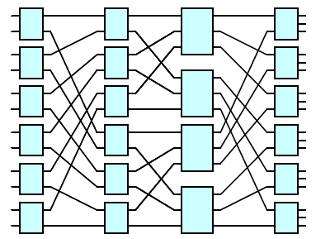
DSM Architecture
Here, each multicore MP is a SMP as per our previous slides
Connecting each processor together is an interconnection network
  an example ICN is shown above to the right (there are many topologies, this is just one example)
  a new item, a directory, is provided for each MP

Slide 28
Directory-based Protocol
Snoopy protocol requires that caches broadcast invalidates, each of which consumes shared bandwidth, presenting a bottleneck
For a DSM, broadcasting is not practical because the ICN lengthens the latency for any such communication
  additionally, the ICN is not a single bus but instead perhaps numerous pathways
DSM requires a different coherence protocol
We use a directory-based protocol
  every cached line is recorded in a central repository called a directory
  directory maintains information for each line
    which caches are currently storing it
    whether any cache has modified it
    who currently “owns” the line

Slide 29
The Basics of the Protocol
Refill lines will be in one of three states
  Shared – one or more nodes currently have the line and the value is up to date in all caches and main memory
  Uncached – no node currently has the line, only memory
  Modified – the line has been modified by one node, called the owner, and all other caches that may have had the line have removed it (or invalidated it)
    because the owner is the only node to now store the value, it can be modified without worry of having stale values – this creates exclusivity
    if a node intends to modify a line that is being shared, it must first seek to own the line from the other caches
      now the node can modify the line without concern that the line is being or has been modified by another node in the time it takes to share the communication
    once modified, the line in memory (and any other cache) is invalid, or dirty

Slide 30
The Directory(ies)
Having a single directory responsible for keeping track of every line is not practical because it is not scalable
  the directory must be distributed
Refer back to the figure 3 slides ago
  each multiprocessor has its own set of cores where each core has its own L1 and L2 caches and the MP as a whole has a shared L3 cache and possibly its own I/O
  but in addition, each MP has its own directory
  this is a local directory consisting of 1 entry per line in its combined caches
We differentiate between
  local node (the one making a request)
  home node (the node storing or owning the line)
  remote node (a node that has requested an item from the owner or a node that requires invalidation once the owner has modified the datum)

Slide 31
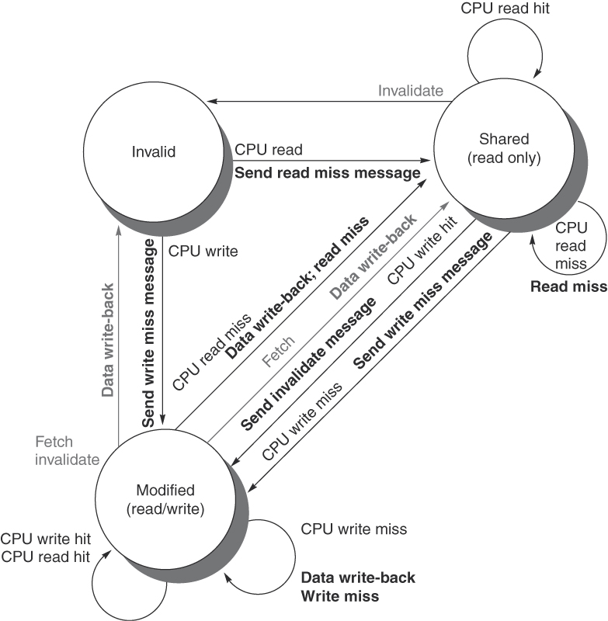
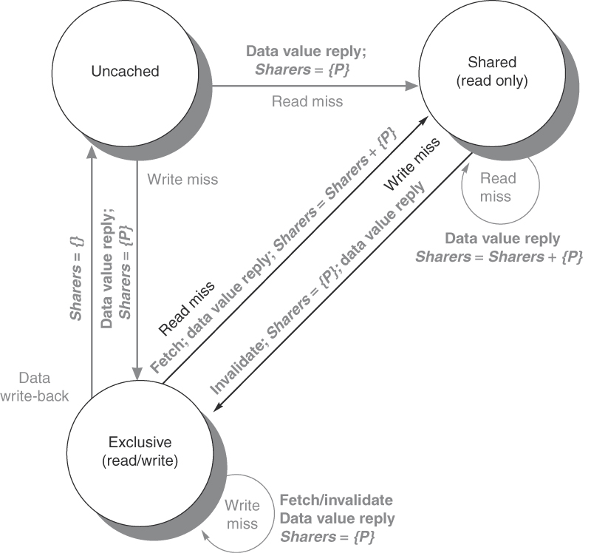
Example Protocol

Slide 32
Explanation
In each case, a processor’s local cache does not have the item of interest
Item currently only in memory
  If a read – read miss, item sent to cache from memory, noted as shared
  If a write – write miss, item sent to cache from memory to be updated (in cache), noted as exclusive for that cache
Item shared among other caches
  If a read – read miss, item sent to cache from memory, this processor is added to the list of sharing caches
  If a write – write miss, item sent to cache from memory, line indicated as exclusive to this processor, all other processors in the shared list are sent an invalidate message

Slide 33
Continued
Item exclusive to another cache (any other cache has an invalid value)
  If a read – read miss, owner of item is sent request, owner returns item and also writes it to memory, updates from exclusive to shared, request processor added to list of sharing caches
  If a write – write miss, line now has a new owner, message sent to old owner to invalidate its value, directory updates to indicate the new owner
This processor is exclusive owner
  If a read – hit, no other action taken
  If a write – hit, no other action taken
  If the line needs to be removed (being replaced) – write-back, line sent to memory, memory becomes the owner and the only place it is currently stored

Slide 34
Protocol Messages
P = processor node #, A = requested address, D = data
Type | Source | Destination | Content | Function
Read miss | Local cache | Home directory | P, A | P has a read miss at A, requests data to make P a sharer
Write miss | Local cache | Home directory | P, A | P has a write miss at A, requests data and makes P owner
Invalidate | Local cache | Home directory | A | Invalidate all remote caches for A
Invalidate | Home directory | Remote cache | A | Invalidate a shared copy of A
Fetch | Home directory | Remote cache | A | Fetch line A from remote cache, send to home directory and change A to shared
Fetch/Invalidate | Home directory | Remote cache | A | Fetch line A from remote cache, send to home directory and change remote cache’s A to invalid
Data value reply | Home directory | Local cache | D | Return D from home
Data write-back | Remote cache | Home directory | A, D | Write D back at A

Slide 35
Multicore Processor Performance
We look at 3 examples, IBM Power8, Xeon E7, Spark64 X+
  these processors are targeted for servers rather than desktop/laptop units
  the E7 is based on the i7 but has more cores and a slower clock
  notable is that all three implement SMT
The three processors have different approaches to connecting the core and its local cache(s) to the rest of the memory hierarchy
  they all, by necessity, implement some form of cache coherence, in this case they are all based on snoopy caches rather than directory-based approaches
  the power8 is a NUCA, the other two are UMA

Slide 36
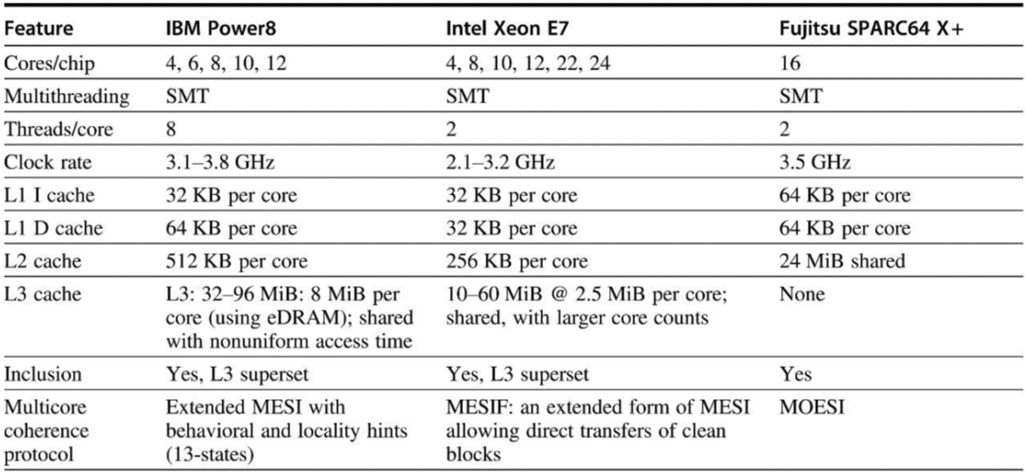

Slide 37
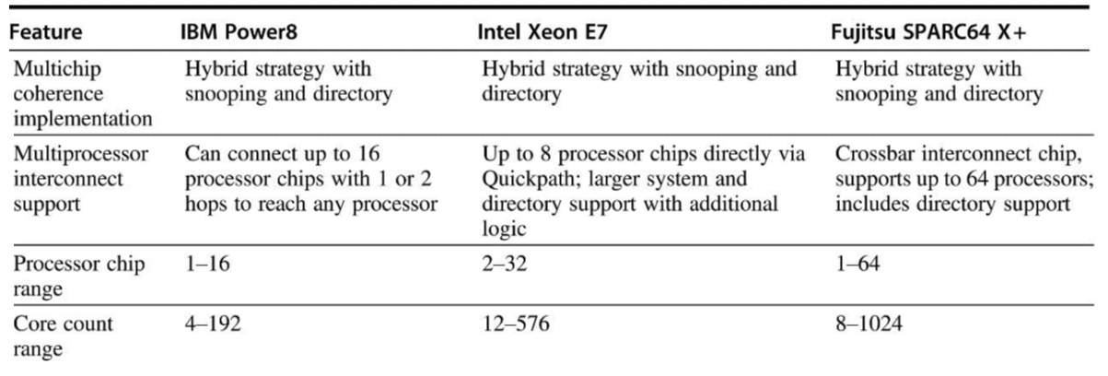

Slide 38
Memory Layouts
SPARC 64 X+
  each of 16 cores has its own L1 instruction and data caches
  all cores share a single L2 cache (24-way set associative)
  no L3, 4 separate channels to DRAM utilizing a 16x4 switch between the cores and DRAM
Power8
  each core has its own L1 instruction & data caches and L2 cache
  L3 caches are off-chip and shared with each core directly connecting to one L2 and connecting to all other L3s through an ICN
    this creates a NUCA
  the ICN connects to an L4 and then DRAM
Xeon E7
  similar to the Power8 in configuration but the L3s are structured in rings instead of a true ICN creating a different form of NUCA

Slide 41
Performance Comparisons
The graph to the left shows how performance improves as cores are added
  note that each processor’s plot is independent of the others, for instance, they are not comparing the speed of the Power8 to the Xeon E7, these are relative performance improvements as they expand the cores
  the Power8 is 1.5 times faster than the SPARC for 4 cores
Notice how the Xeon E7
performs after 40 cores
This data is from integer benchmarks only

Slide 42
Future Multicore Scaling
Prior to around 2005, single processors (single core) were improving well enough that multiprocessors/multicores were not relevant
  it was only once miniaturization started leveling off that multi-core became important
  for economic reasons, multi-core is more popular than true multiple processors
    only 1 slot needed on a motherboard, less power consumption, easier to implement
Trying to find more ILP to exploit through a Tomasulo-style superscalar is not paying off, so instead we might turn to TLP
But, there is a limitation to how many cores we can employ
  first, there is a space restriction because of the lack of progress in miniaturization
  second, for mobile devices, there is a power consumption problem
  third, there are problems in configuring the cores to communicate with each other and shared memory
  fourth, there is a limitation on how we can parallelize a process’ code into parallel threads

Slide 43
Speculating the Future
Its expected that the next doubling of transistor count for a 2016 processor will arrive around 2022-2024 (6-8 years instead of 2)
Such a processor will compare to the 2016 as follows

Slide 44
Example
Assume we can build a 96-core processor
On average, 54 cores are busy
  90% of the time, we can employ all cores
  9% of the time, we can employ 50 cores
  1% of the time, we can employ 1 core
What is the speedup?
  Average core usage = 54 = max cores * .9 + 50 * .09 + 1 * .01, solving for max cores gives us (54 – 4.51) / .9 = max cores = 54.99 (55)
  Speedup = 1 / (.90 / 55 + .09 / 50 + .01 / 1) = 35.5
What is the speedup if we have 24 processors?
  We can employ at least 24 processors 99% of the time and 1 processor 1%
  Speedup = 1 / (.99 / 24 + .01 / 1) = 19.5
Notice that our speedup is closer to linear with only 24 cores

