Slide 1
SIMD
Single instruction on multiple data
  has existed since the 1960s
  execute array operations parallel on different processing elements (ALUs) (rather than looping)
    convert for(i=0;i<n;i++) a[i]++;
    into a single operation, say A=A+1
  we get a speedup from the parallelism but also from removing the loop mechanisms
    incrementing i, comparison and conditional branch
3 approaches to SIMD
  vector architectures (including matrix architectures)
  multimedia SIMD instruction set extensions
  graphics processor units

Slide 2
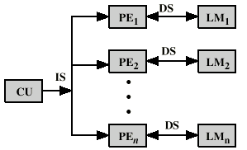
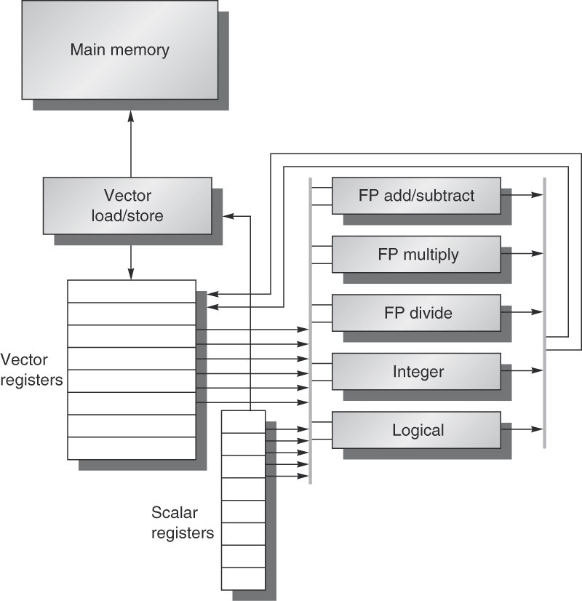
Two Views
CPU divided into control unit and n processing elements
  each PE handles 1 datum from the array on the given operation
  data are cached in local caches (one per PE)
Pipelined functional units
  issue instruction on different array values sequentially to the same functional unit
  FU is pipelined, each array element is processed in an overlapped fashion in the pipelined FU
  requires accessing vector element every clock cycle (from register or cache)

Slide 3
The Pipelined Approach
The first approach is much more efficient but not realistic
  an array of 1000 values requires 1000 PEs and 1000 local caches
Using pipelined functional units costs almost nothing
  with vector operations, we can still eliminate the looping mechanism as long as the size of the registers storing our vectors can store the entire vector at one time (otherwise, we still need a loop)
  using multi-banked caches improves performance so that multiple loads/stores can take place per cycle
  requires less power utilization

Slide 4
RV64V
A vector-based version of RISC-V
  based loosely on the Cray-1 supercomputer (1970s)
Operations are
  scalar – operate on scalar registers but still use pipelined functional unit
  vector – operate on vector register and scalar register
  matrix – operate on two vector registers
    the latter two have operations appended with .vs and .vv to indicate vector-scalar or vector-vector operation, like vadd.vs and vmul.vv
      for our examples, we will omit the .vs/.vv
    table 4.2 on page 286 lists all vector operations added to RISC-V
    data sizes determined by the vector register name specified in the code, using a scheme like Intel where a data register could store 32, 16 or 8 bits

Slide 5
Example
Y = a * X + Y (known as a DAXPY loop)
  X and Y are vectors of length n
  both vectors are resident in memory whose addresses are preloaded into x5 and x6 respectively
    vsetdcf 4*FP64 // specify register size
    fld f0, a // load scalar value a into f0
    vld v0, x5 // load vector X
    vmul v1, v0, f0
    vld v2, x6 // load vector Y
    vadd v3, v1, v2
    vst v3, x6
    vdisable // ends the vector register usage
  no loop! number of “iterations” handled by size of X/Y
    as long as this size can fit within v0, v1, v2, v3 – we’ll address this later
    non-vectorized RISC-V code on page 288
8 instructions versus
258 for RISC-V

Slide 6
Vector Execution Time
We typically compute execution time in seconds (ns) or clock cycles
  for vector operations, architects are more interested in the number of distinct issues required to execute some code
Vector processor performance is impacted by the
  number of array values stored in the array
  structural hazards (caused by limitations to the number and type of functional units)
  data dependencies (which we ignore for now)
Vector processor’s performance is primarily based on the length of the vector
  in RV64V, the max vector length is 64 doubles (128 single precision floats) – if our vector stores more than 64 doubles, we have to use a loop

Slide 7
Convoys and Chimes
Convoy
  set of sequential vector operations that can be issued together without a structural hazard
  by operating on vectors in a pipeline, execution of these operations is overlapped
Chime
  the amount of time to execute a convoy (assuming no stalls)
  chime takes n + x – 1 cycles where
    x is the length of the convoy
    n is the number of data in the vector
  a program of m convoys takes m chimes
    approx m * (n + x – 1) cycles (assuming no stalls)
    we simplify this to m * n
  the chime time ignores pipeline overhead, and so architects prefer to discuss performance in chimes

Slide 8
Convoy Example
Assume 1 pipelined functional unit for each operation type
  load/store, add, multiply, divide
The following RV64V code is used for a vector of 64 doubles
    vld v0, x5 // load vector X
    vmul v1, v0, f0 // * each vector element by scalar
    vld v2, x6 // load vector Y
    vadd v3, v1, v2 // vector-vector add (X[i] * c + Y[i])
    vst v3, x6 // store result back into Y
  first load and multiply paired in a convoy
  second load cannot be paired with them because there is only 1 load unit so the second load and add are paired in a convoy
  store cannot be paired for the same reason (one load/store unit) so it goes into a convoy by itself
  the code above consists of 3 convoys:
    vld, vmul
    vld, vadd
    vst

Slide 9
Start-Up Time
One source of overhead that is usually ignored is the limitation on initializing multiple vector instructions in a single cycle
  with a superscalar, we generally assume we can issue all instructions across the superscalar in 1 cycle, but this may not be realistic with vector processing
Another form of overhead is start-up time
  time needed to fill the pipeline – in this case, the functional unit pipeline
    not the instruction pipeline as with after a branch
  all functional units are pipelined so we have two forms of start-up time and we obtain full efficiency only once a given functional unit’s pipeline is full

Slide 10
Questions
Can we issue multiple vector operations at once
  possible if we have multiple functional unit pipelines like four pipelined adders
What happens when the vector’s length > maximum vector length
How do we cope with if statements within the vector code
How much bandwidth is needed between the vector processor and memory
How do we handle multi-dimensional arrays
Are there ways to deal with sparse matrices
How do high-level programming languages support vector operations

Slide 11
Multiple Lanes
The original idea for SIMD was to have n PEs to execute n vector elements at the same time
  in practice, we pipeline the functional units instead
  we can combine both ideas: multiple pipelined FUs
  we refer to these multiple FUs as lanes
Without lanes, we launch 1 FP operation per cycle
  with lanes, we launch one FP operation per lane per cycle
    assume 4 lanes, lane j gets all elements with index i % 4 == j
To best support lanes we prefer lengthy vectors
  if a vector has 64 doubles and we have 16 lanes and multiply takes 7 cycles to compute, we can issue 16 instructions per cycle over 4 cycles
    we run out of data before we can finish the first multiplies!

Slide 12
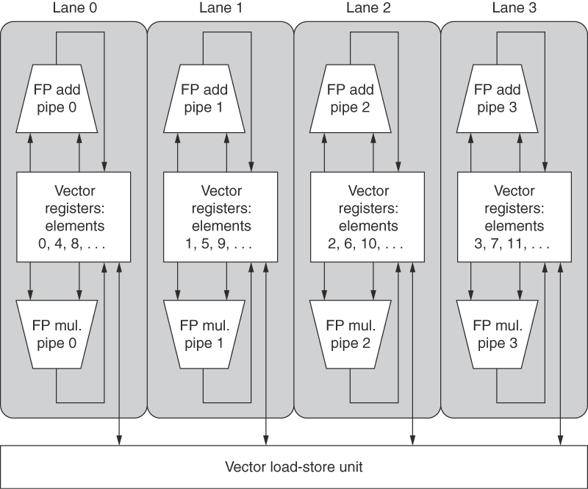
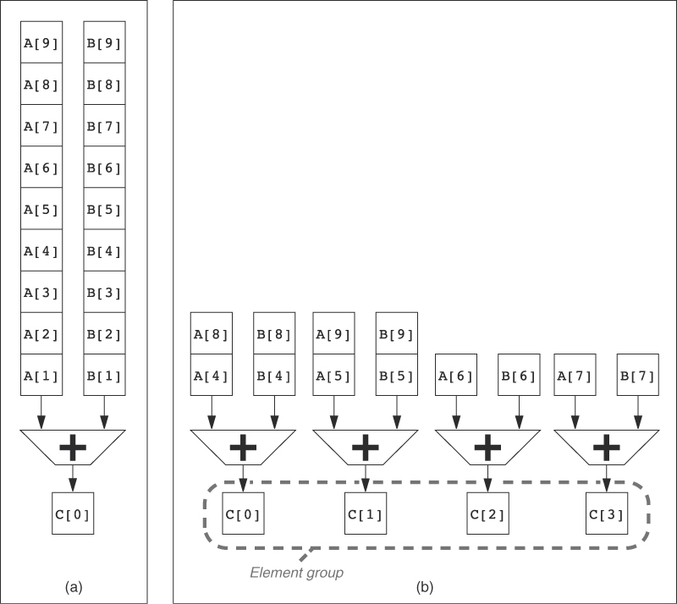
A single pipelined adder
PE versus four lanes
Structure of a 4-lane
vector processor

Slide 13
Vector Lengths != MVL
MVL = maximum vector length
  determined by the number of registers in our vector register(s)
If vector length > MVL then we need a loop
  vector length probably won’t be known at compile time
  compiler generates code with a loop assuming vector length > MVL
What if the vector length is not an exact multiple of MVL?
  an approach called strip mining uses two loops
    one executes an MVL’s worth of data
    other operates on remainder of the data (vector length % MVL)
    often the latter loop executes first (see figure 4.6, page 297)

Slide 14
Handling If Statements
Consider
  for(i=0;i<n;i++)
  if(x[i] != 0)
  x[i]=x[i] – y[i];
  the if clause (the subtraction) is not launched until we know the result of the condition
In order to accomplish this, use a vector mask register
  condition applied in a pipelined unit creating a list of 1s and 0s stored in a vector mask register
  vector mask operations apply given operation (subtraction above) to all vector units where the resulting boolean in the vector mask register is 1
  in this case the adder only subtracts if mask[i] is true

Slide 15
Example Code
vsetdcfg 2*FP64 // enable vector registers (2 sets of 64)
vsetpcfgi 1 // enable 1 predicate register (vector mask)
vld v0, x5 // load X into v0
vld v1, x6 // load Y into v1
fmv.d.x f0, x0 // set f0 to 0.0
vpne p0, v0, f0 // set p0[i] if v0[i] != 0
vsub v0, v0, v1 // apply subtract on all corresponding
// elements of v0/v1 where p0[i] == 1
vst v0, x5 // store v0 back into X
vdisable // disable both vector registers and mask
vpdisable

Slide 16
Memory Bank Support
Need non-blocking caches with critical word first/early restart
  this does not necessarily guarantee 1 vector element per cycle to keep up with the pipelined functional unit
    because cache access start-up time may be more than 1 cycle (as much as 100 cycles for some processors)
    for RV64V, assume a start-up of 12 cycles (same as Cray-1)
We want to interleave vector data across banks
  this does not guarantee parallel access because data may not be accessed strictly sequentially
    consider loading x[i] and y[i], these are not stored sequentially in memory (instead, x[i] is followed by x[i+1])
    may result in multiple load/store units trying to access the same bank at the same time

Slide 17
Example: Cray T90
32 processors – each capable of generating up to 4 loads and 2 stores per clock cycle
Processor’s clock cycle is 2.167 ns
Cache has a response time of 15 ns
  calculate minimum number of memory banks to allow all processors to run at full memory bandwidth
Solution
  max memory references per cycle = 32 * (4 + 2) = 192
  each cache requires 15 / 2.167 = 6.92 cycles to complete (round up to 7)
  with 192 references per cycle, we need 192 * 7 = 1344 separate cache banks! (the Cray T932 has 1024 banks of pipelined caches)

Slide 18
Strides
Memory access may not be sequential
  this can happen when accessing two or more vectors but also multi-dimensional arrays (assume the arrays below are doubles)
    for(i=0;i<100;i++)
    for(j=0;j<100;j++)
    for(k=0;k<100;k++)
    a[i][j]=a[i][j] + b[i][k] * d[k][j]
A stride is the distance separating elements in a given operation – the optimal stride is 1
  d has a stride of 800 bytes because the inner loop references the column, not the row, b has a stride of 8 bytes
The larger the stride, the less effective vector operations become due to the number of memory accesses needed cycle-after-cycle

Slide 19
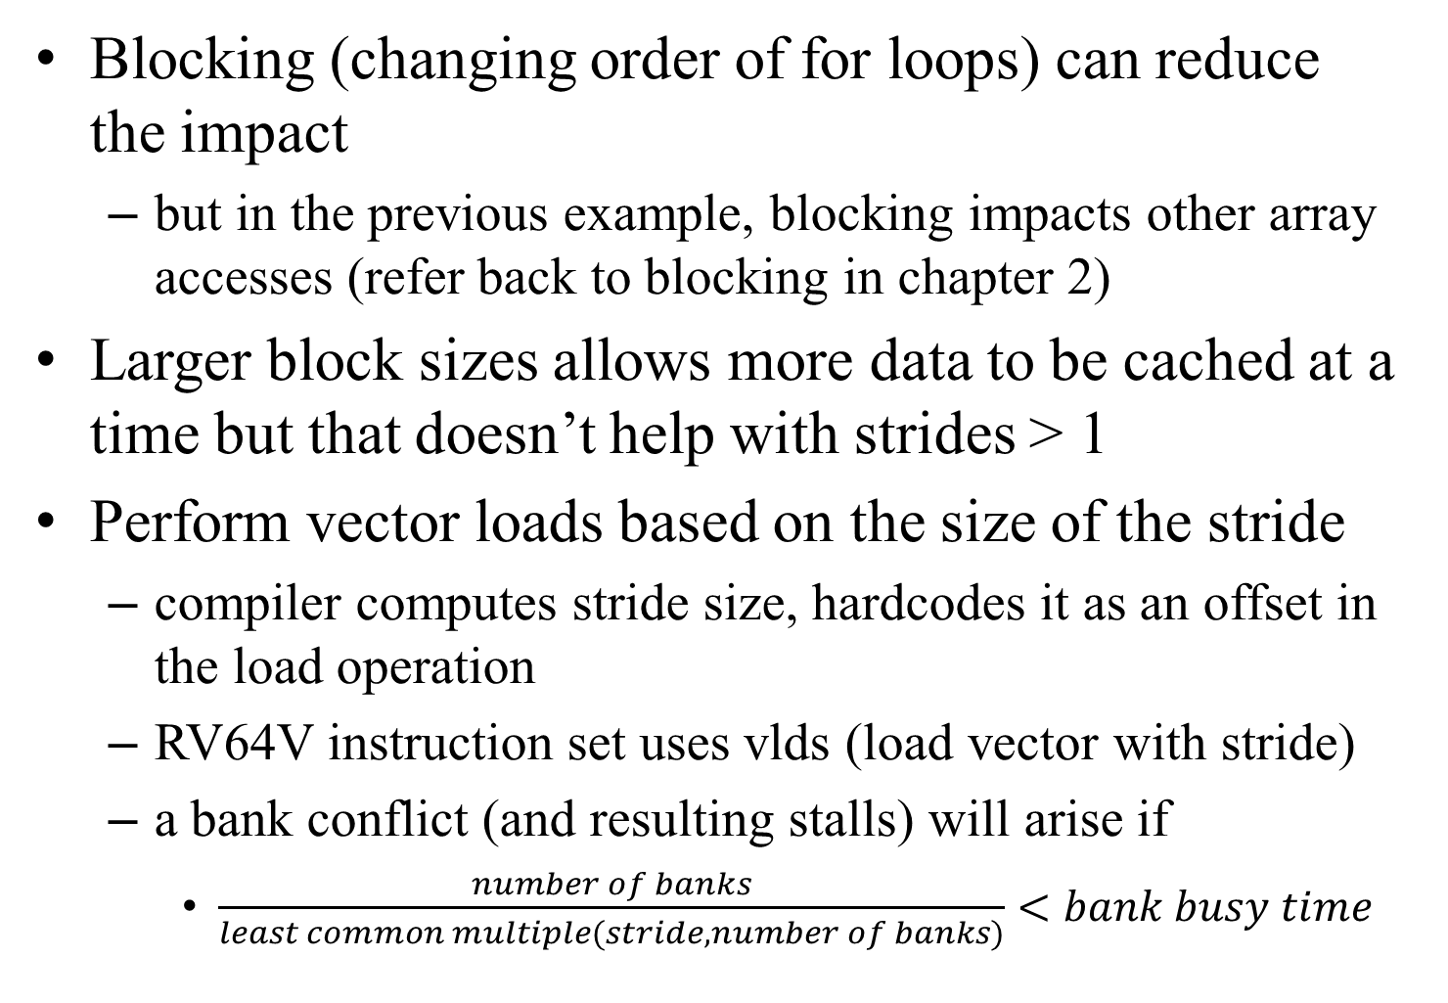
Solutions
Blocking (changing order of for loops) can reduce the impact
  but in the previous example, blocking impacts other array accesses (refer back to blocking in chapter 2)
Larger block sizes allows more data to be cached at a time but that doesn’t help with strides > 1
Perform vector loads based on the size of the stride
  compiler computes stride size, hardcodes it as an offset in the load operation
  RV64V instruction set uses vlds (load vector with stride)
  a bank conflict (and resulting stalls) will arise if
    $\frac{number of banks}{least common multiple(stride, number of banks)}<bank busy time$

Slide 20
Example
8 memory banks, busy time = 6 clock cycles, memory latency = 12 cycles
  how many cycles will it take to complete a 64-element vector load with a stride of 1? of 32?
Solution
  with a stride of 1, we have 8 / 1, which is not less than bank busy time (6) so there are no stalls
    therefore all 64 loads can be handled in just 12 + 64 = 76 cycles
  with a stride of 32, the least common multiple is 8 giving us 8 / 8 < 6, so there will be stalls
    in fact, any multiple of 8 causes collisions with banks and so the 6 cycle busy time comes into play for each group of loads
    12 + 1 + 6 * 63 = 391 clock cycles

Slide 21
Handling Sparse Matrices
Sparse matrix contains many 0s
  the remainder of the matrix is sparsely populated
Consider an operation like
  A = A + B
If A and/or B are sparse, we are doing a lot of needless additions
  if a[i] == 0, all we need to do is a[i] = b[i] and if both are 0, we don’t need to do anything
    a[i] = b[i] takes less time than an FP addition
The solution is to use a gather-scatter operation
  gather non-zero elements into a smaller, more dense array
  perform the operation
  scatter the results back to the original array
    code example shown on page 302

Slide 22
GPUs
GPUs contain (up to) thousands of parallel FP units
  GPUs did not originate as parallel processors but instead as graphics accelerators (see section 4.10 if interested)
Question: should we use CPUs or GPUs for scientific and multimedia computing?
  how can we use GPUs for general computing?
  complications are
    how to coordinate GPU with CPU and memory
    how to support multi-threading
  one current use of GPUs is for deep neural network computation
    each computation is independent of every other computation and requires no if-else statement, so the GPU is ideal for this purpose

Slide 23
CUDA
Compute Unified Device Architecture
  a C-like programming language + programming environment to support the generation of parallel processing code for GPUs
Basic unit of parallelism called a CUDA Thread
  thousands of CUDA threads can be supported at a time
  can support higher level forms of parallelism including multithreading, MIMD, as well as SIMD and ILP
  threads are blocked together to be executed as a block, known as a Thread Block
Programming notation
  functions, variables
    __device__ (GPU), __host__ (CPU), __global__
  functions running on a GPU are invoked as
    name <<<dimGrid, dimBlock>>> (param list)
    block identifiers: blockIdx.name, thread identifiers: threadIdx.name

Slide 24
Example: DAXPY
// Invoke DAXPY
daxpy(n, 2.0, x, y);
// daxpy code in C:
void daxpy(int n, double a, double *x, double *y) {
for(int i=0;i<n;i++)
y[i] = a * x[i] + y[i];
}
// Invoke DAXPY with 256 threads per ThreadBlock
__host__
int nblocks = (n + 255) / 256;
daxpy<<<nblocks, 256>>>(n, 2.0, x, y);
// DAXPY in CUDA
__global__
void daxpy(int n, double a, double *x, double *y) {
int i = blockIdx.x*blockDim.x + threadIdx.x;
if(i < n) y[i] = a * x[i] + y[i];
}
The CUDA
code contains
no loop
where i (the
array index)
is computed
by each unit

Slide 25
Comments
Each GPU functional unit handles its own block
  thread management is handled by the hardware directly, not by the OS as we saw previously with thread-level parallelism
To support this, each block must be independent of all other blocks
  blocks are permitted to run in any order
  blocks cannot directly communicate with other blocks but instead can only communicate through global memory
    with selection statements and variables in global memory, we can force blocks to operate in some dependent-based order
    the CUDA programmer must think not in terms of GPU hardware but how to arrange the code in a logical way to run on the GPU
    similarly, any MIMD programmer needs to work out such logic

Slide 26
CUDA Terminology
Name | CUDA term | Explanation
Vectorizable loop | Grid | Loop broken into thread blocks
Body of loop | Thread Block | Parallelizable code, communicate only via local mem
Sequence of lane ops | CUDA Thread | Vertical cut of a thread corresponding to one element executed by one SIMD lane
Thread of instr | Warp | Traditional thread
SIMD instr | PTX instr | Single SIMD instruction executed across lanes
Thread block scheduler | Giga thread engine | Assigns thread blocks to SIMD processors
SIMD thread scheduler | Warp scheduler | Schedules and issues threads within the SIMD processor, uses a scoreboard
SIMD lane | Thread processor | Executes operations of a thread on a single element
GPU mem | Global mem | DRAM accessible to all SIMD lanes
Private mem | Local mem | DRAM accessible to a single SIMD lane
Local mem | Shared mem | SRAM accessible to a single SIMD lane
SIMD lane registers | Thread processor regs | Registers for a single SIMD lane

Slide 27
Thread Blocks and Grids
A thread block is code assigned to a single SIMD processor to be executed in lanes
  each lane executes the thread block instruction(s) in parallel
    e.g., a[i] = b[i] * c[i] – this will be referenced as A = B * C
  sets of lane code are grouped into threads
  groups of threads make up a thread block
A grid is the collection of all code of the loop that is broken into thread blocks
  which are each broken into threads of instructions issued across lanes (see the figure on the next slide)
The thread block scheduler assigns a thread block to a GPU processor

Slide 28
16 thread blocks
Each block consists of 16 threads
Each thread consists of 32 chunks
of code, issued as a single vector
instruction
Each vector instruction issued in
a lane
8192 elements executed in total

Slide 29
Hardware
to run the
previous
example
16 lanes
Each lane
contains
pipelined
FP unit(s)
to overlap
execution
of a thread

Slide 30
GPUs
The GPU consists of
  one to many multithreaded SIMD processors
    each SIMD processor consists of lanes of pipelined FP units coupled with load/store units to local memory
    an instruction register to issue across the lanes
  two levels of hardware schedulers
    thread block scheduler assigns thread block to SIMD processors
    warp scheduler connects to instruction cache to schedule a thread within the SIMD processor
  interconnection network to both local and global memories
Pascal P100 GPU has 56 SIMD processors each with 16 lanes
  the previous example was of 1 SIMD processor of 16 lanes

Slide 31
NDIVIA GPU Instruction Set
Called PTX is not the actual hardware instruction but instead a target for compiler writers and assembly programmers
  conversion of PTX to actual hardware instructions occurs by software at program load time
All PTX instructions have the format
  opcode.type d, a, b, c
  type is the type of datum (untyped, unsigned, signed, FP, in sizes of 8, 16, 32 and 64 bits)
  d is a destination register (except for store instructions)
  a, b and c are source operands (registers or immediate data)
  all instructions can include a condition based on a 1-bit predicate register
One PTX instruction may equate to one hardware instruction or may unfold into multiple instructions

Slide 32
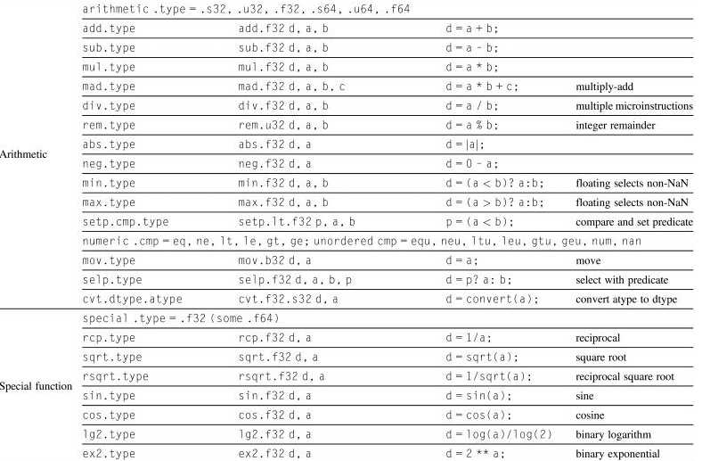

Slide 33
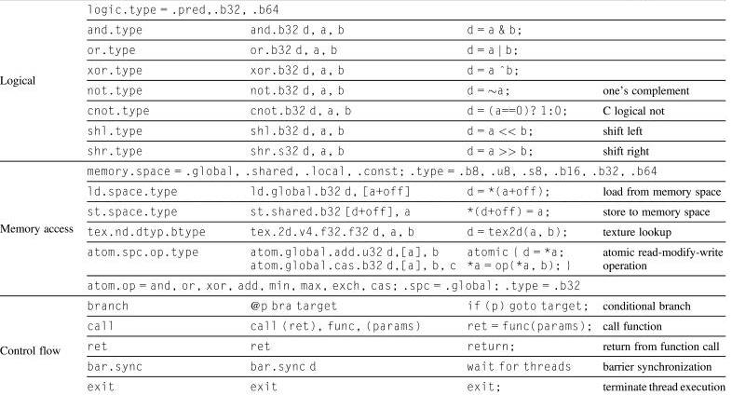

Slide 34
Conditional Branching
Branching from loops is often removed because of the SIMD-level parallelism available
  there will still be some loop branching when logic requires it
Selection statement branching needs to be handled
  GPUs use several techniques to handle selection statement branches, especially when there is nested logic
PTX assembler creates a branch graph from the branching instructions
  the assembler analyzes this graph to select which approach(es) to use to optimize branch performance
Branches are handled through
  predicate registers (1-bit register per lane)
  internal masks
  branch synchronization stack
  instruction markers

Slide 35
Continued
Let’s first consider this by an example
  if(X[i]!=0) X[i]=X[i]-Y[i]; else X[i]=Z[i];
    each lane of the SIMD processor needs to compare its element of X and then perform either the if or else clause
  to avoid branching: test condition on each vector element and set or clear corresponding bit in predicate register
    P[i] ← 1 if X[i] !=0, P[i] ← 0 otherwise
  two different instructions are issued across two sets of lanes – the if clause and the else clause
    each lane tests its P[i] to see if it should execute or not
    lane with if clause tests P[i]==1, lane with else clause tests P[i]==0
    no branching takes place
    if all P[i]==0, if clause not issued, if all P[i]==1, else clause not issued

Slide 36
CUDA Code for if-else
ld.global.f64 RD0, [X+R8] // load registers (RD0) with X[i]
setp.neq.s32 P1, RD0, 0 // set pred. register, P1, to X[i]!=0
@!P1.bra ELSE1, *Push // push old mask (see next slides),
// if P1[i] is false, go to ELSE1,
// and set new mask
ld.global.F64 RD2, [Y+R8] // load all RD2 registers with Y[i]
sub.f64 RD0, RD0, RD2 // RD0 = X[i] – Y[i]
st.global.f64 [X+R8], RD0 // X[i] = RD0
@P1, bra ENDIF1, *Comp // complement mask bits, go to ENDIF1
// if P1[i] is true
ELSE1: // else clause here
ld.global.f64 RD0, [Z+R8] // load all RD0 registers with Z[i]
st.global.f64 [X+R8], RD0 // X[i] = RD0 (Z[i])
ENDIF1:<next instr>, *Pop // branch here after if clause ends
// popping off any pushed mask

Slide 37
Synchronization Stack
What if we have nested logic?
  we need to push these predicate register values onto a stack
  we use a synchronization stack
  each thread is given its own stack
The stack will contain entries consisting of
  identifier token – a name for this particular selection
  target instruction address – location of where to branch to when this inner selection statement is complete
  target thread-active mask – this is a copy of the current (old) predicate register values, set aside on the stack until the inner selection statement is completed
Specialized GPU instructions push entries on the stack or pop entries off the stack

Slide 38
Other Uses of Branches
Loops are mostly handled by distributing each loop iteration to a thread and distributing the thread across lanes
  what about loops that operate on single vector elements?
    while(a[i]<n) {…}
    this loop does not iterate over i but is controlled by a[i]’s value
  the thread uses its stack to store masks that indicate which lanes are still looping and which have exited their loop
    convergence occurs when all vector elements have exited the loop meaning the loop itself can terminate
Branches are also needed for function calls and returns
  these use the thread-level stack and encode which vector elements have not yet completed their function call by using another mask

Slide 39
GPU Memory Structures
Each SIMD lane has its own DRAM
  used as a run-time stack and for storing local variables that cannot reside currently in registers
  as much of this DRAM is cached in L1 and L2 caches as possible
Each SIMD has its own on-chip local memory
  shared among lanes
  high-bandwidth used to store data that is reused within or across threads of the same thread block
  dynamically allocated per thread block
The GPU has an off-chip DRAM shared among all SIMD processors

Slide 41
Comparing Vector and GPU Architectures
Both promote data-level parallelism
  GPUs contain multiple SIMD processors
    because each SIMD processor can execute its own thread, the GPU may act like an MIMD architecture instead of a massive SIMD
    SIMD processor intended simply as a vector processing machine, so not an MIMD
Memory layouts differ
  SIMD contain vector registers
  a vector is distributed across SIMD processors within the GPU
  GPUs have additional registers to support multithreading

Slide 42
Continued
GPUs generally have many more lanes than SIMD processors
  GPU chimes are shorter, memory latency is hidden due to issuing multiple threads while in SIMD, it is reduced due to lengthy FP pipelines
GPUs use gather/scatter for load/store operations and an address coalescing unit to handle stride distances

Slide 43
SIMD vs GPU Architectures

Slide 44
Comparing MultiCore with GPU
GPU’s are more useful when there is a high degree of DLP
GPU memory layout is less supportive of handling non-vector data

