Slide 1
Computer Architecture
We will use a
  quantitative approach to analyze architectures and potential improvements and see how well they work
We study RISC instruction sets to promote
  instruction-level, block-level and thread-level parallelism
  pipelining, superscalar, branch speculation, vector processing, multi-core & parallel processing
  out of order completion architectures
  compiler optimizations
  cache improvements
  early on, we focus on a 5-stage pipeline as our basic architecture

Slide 2
Classes of Computers
Historically:
Mainframes introduced 1st generation
Minicomputers introduced 2nd generation
Supercomputers (massive parallel processors) introduced 2nd generation
Servers introduced 3rd generation
Microcomputers (PCs) introduced 4th generation
Laptops introduced 4th generation
Mobile devices introduced 4th generation

Slide 3
Significant Microprocessors
Intel 4004 – first commercially available
  4-bit, 108 KHz, 1971-1973
DEC’s LSI-11 – first 16-bit
  used in minicomputers circa 1975
Texas Instrument’s TMS 9900
  another 16-bit, used in TI minicomputers and TI TRS home computers, notable for its large number of pins (64)
Intel 8086 – IBM PC and compatibles based around this processor later expanded to the 286, 386, 486, Pentium
  8086, 286 were 16 bit, 386 and beyond were 32 bit, more recently iCore is 64 bit
  starting with the Pentium II, the family of processors for PCs is referred to as Intel Celeron and for workstations and servers is referred to as Intel Xeon

Slide 4
Continued
Western Design Center’s CMOS 65816 used in Apple II personal computers (16-bit)
Intel 8087 – math coprocessor to handle FP operations
  without this processor, all FP operations would be handled by the x86 as integer-based software routines
Motorola MC68000 – introduced in 1979, first significant 32-bit processor
  had 32-bit registers but operated on 16-bits at a time using 3 16-bit ALUs and internal and external 16-bit buses
  used in the Apple Lisa, Apple Macintosh, Atari ST and Commodore Amiga
Pipelining introduced in Cray supercomputers (circa 1979)
AT&T BELLMAC-32A – first fully capable 32-bit processor in 1980
  32-bit registers, buses, address space, ALU
  used in AT&T minicomputers, first laptop

Slide 5
Continued
Intel and AMD enter 10 year technology exchange (1981)
  AM286 released in 1984 (their version of the 286) and AM386 released in 1991
HP Focus – first commercially available 32-bit microprocessor (1982)
Motorola MC68020 – used by many small computers to produce “desktop-sized” systems
  often used for microcomputers running Unix
  68030 added MMX capabilities, 68040 added an FPU
MIPS R2000 – first RISC-based processor, 1984
Acorn Archimedes – ARM processors (RISC-based) began to be released starting in 1985

Slide 6
Continued
SPARC – by Sun Microsystems (now Oracle) to support Sun workstations
  first release was 1987, one of the most successful early RISC processors
  had 160 general-purpose registers with a group supporting register windows for fast parameter passing and 16 FP registers
Early 90s saw the initial development of 64-bit processors (although the PC market waited until the 00s before investing in them)
PowerPC – RISC-based, released in 1991 and developed by Apple/IBM/Motorola
  became the processor for all Apple products until 2006

Slide 7
Continued
IBM released POWER4 in 2001
  first commercial multi-core processor
x86-64 – Intel-based 64-bit processor expansions to the x86 line (Sept 2003)
  AMD released the AMD64
  PowerPC expanded to 64 bits around the same time
  ARM introduced a 64-bit processor in 2011
Sun released Niagara in 2005 – 8-core, support for multithreading
2006 – Intel begins releasing iCore processors
  starting with a dual core processor in which one core does nothing!

Slide 8
GPU History
GPUs did not evolve from CPUs
  instead, they evolved from graphics accelerators
    chips attached to video cards that handled some of the graphics routines like moving, rotating and shading objects
  earliest released in 1976 to handle “video shifting”
NEC uPD7220 – first graphics display controller as a single chip
The idea for massively parallel GPUs did not arise until the 00s
  NDIVIA was the first to refer to the term GPU
  they implemented a GPU platform called CUDA in 2007

Slide 9
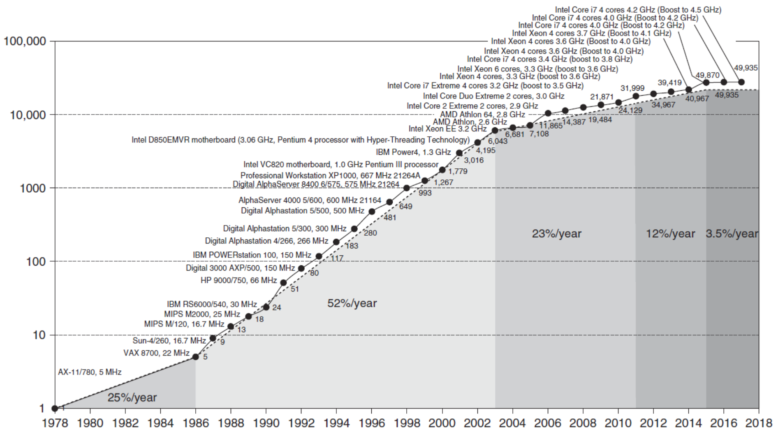
An End to Moore’s Law
Where will speedup come from? ILP, DLP, TLP, Request-level parallelism
and the use of vector processors (including GPUs)

Slide 10
What are ILP, DLP, TLP, RLP?
Consider we have extra space on the processor due to miniaturization, how do we use it?
  more processing elements (parallel components)
Code is implicitly sequential, how do we take advantage of the parallel elements?
  ILP – instruction level parallelism (pipelining)
  DLP – data level parallelism (pipelined arithmetic units, loop unrolling)
  TLP – thread-level processing (using multiple processors/cores)
  RLP – request-level processing (multiple processors/cores plus OS help)

Slide 11
Performance Measures
Many different values can be used
  MIPS, MegaFLOPS – misleading values
  clock Speed
  execution time –compare processor performance on benchmark programs (loaded vs unloaded system)
  throughput – number of programs per unit of time, possibly useful for servers
  CPU time, user CPU time, system CPU time
  CPU performance = 1 / execution time
What does it really mean for one processor to be faster than another?
  processor must outperform the other processor on the benchmarks using some form of average across benchmarks (e.g., geometric mean)

Slide 12
Benchmark Comparisons

Slide 13
Design Concepts
Take advantage of parallelism
  multiple hardware components
    ALU units, register ports, caches/memory modules
  distribute instructions to hardware components
Principle of locality of reference
  design memory systems to support this aspect of program and data access (memory hierarchy, cache layout)
Focus on the common case
  Amdahl’s Law (next slide) demonstrates that minor improvements to the common case are more useful than large improvements to rare cases
  find ways to enhance the hardware for common cases over rare cases

Slide 14
Amdahl’s Law
Speedup of one enhancement
  1 / (1 – F + F / k)
    F = fraction of the time the enhancement can be used
    k = the speedup of the enhancement itself (that is, how much faster the computer runs when the enhancement is in use)
Example
  integer processor performs FP operations in software routines
  benchmark consists of 14% FP operations
  co-processor performs FP operations 4 times faster
  what is the speedup of adding the co-processor?
  1 / (1 - .14 + .14 / 4) = 1.12, or a 12% speedup

Slide 15
Another Example
A benchmark has 20% FP square root operations, 50% total FP operations, 50% other
  add FP sqrt unit with a speedup of 10
    speedup = 1 / (1 - .2 + .2 / 10) = 1.22
  add new FP ALU with a speedup of 1.6 for all FP ops
    speedup = 1 / (1 - .5 + .5 / 1.6) = 1.23
  common case is (slightly) better
We might consider other aspects when the enhancements are nearly identical in improvement
  which is less costly? which is simpler to implement?

Slide 16
Why “Common Case?”
We have a reciprocal
  the smaller the value in the denominator, the greater the speedup
The denominator subtracts F from 1 and adds F / k
  –F has a larger impact than F / k
Example
Web server enhancements:
  enhancement 1: faster processor (10 times faster)
  enhancement 2: faster hard drive (2 times faster)
  assume our system spends 30% on computation and 70% on disk access
    speedup of enhancement 1 = 1 / (1 - .3 + .3 / 10) = 1.37 (37% speedup)
    speedup of enhancement 2= 1 / (1 - .7 + .7 / 2) = 1.54 (74% speedup)
  even though the processor’s speedup is a speedup 5 times over the hard drive speedup, the common case wins out

Slide 17
Another Example
Architects have suggested a new feature that can be used 20% of the time and offers a speedup of 3
  one architect feels that she can provide a better enhancement that will offer a 7 time speedup for that particular feature
What percentage of the time would the second feature have to be used to match the first enhancement?
  speedup from feature 1 = 1 / (1 - .2 + .2 / 3) = 1.154
  speedup from feature 2 = 1 / (1 – x + x / 7) = 1.154
    solve for x using some algebra
    1 – x + x / 7 = 1 / 1.154 = .867
    1 - .867 = x – x / 7 → .133 = 6x / 7, x = 7 * .133 / 6 = .156

Slide 18
CPU Performance Formulae
We can also compare performances by computing CPU time (time it takes CPU to execute a program)
  CPU time = CPU clock cycles * clock cycle time
    clock cycle time (CCT) = 1 / clock rate
    CPU clock cycles = number of elapsed clock cycles =
    instruction count (IC) * clock cycles per instruction (CPI)
      not all instructions have the same CPI so we can sum up for every instruction type, its CPI * its IC
    CPU time = (Σ CPI_{i} * IC_{i} ) * clock cycle time
To determine speedup given two CPU times, divide the faster by the slower
  CPU time _{slower machine} / CPU time _{faster machine}

Slide 19
Example
Either enhance FP sqrt unit or all FP units
  IC breakdown: 25% FP operations, 2% of which are FP square root operations, 75% all other instructions
  CPI: 4.0 for FP operations on average across all FP operations, 20 for FP sqrt, 1.33 for all other instructions
CPI _{original machine} = 25% * 4.0 + 75% * 1.33 = 2.00
Enh 1: improve all FP units so that, on average CPI is 2.5
Enh 2: improve FP sqrt to 2.0
  NOTE: both enhancements retain the same IC and CCT
CPI _{enh1} = 75% * 1.33 + 25% * 2.5 = 1.625
Speedup _{enh 1} = (IC * 2.00 * CCT) / (IC * 1.625 * CCT) = 1.23
CPI _{enh2} = CPI _{original} – 2% * (20 – 2) = 1.64
Speedup _{enh 2} = (IC * 2.00 * CCT) / (IC * 1.64 * CCT) = 1.22
  this is the same problem as 4 slides ago

Slide 20
Another Example
Our current machine has a load-store architecture and we want to know whether we should introduce a register-memory mode for ALU operations
  assume a benchmark with 21% loads, 12% stores, 43% ALU operations and 24% branches
  CPI is 2 for all instructions except ALU which is 1
New mode lengthens ALU CPI to 2 but also, as a side effect, lengthens Branch CPI to 3
  IC is reduced because with fewer loads
  assume this new mode is used in 25% of all ALU operations
Use the CPU execution time formula to determine the speedup of the new addressing mode

Slide 21
Solution
Number of ALU operations using this new mode = 43% * 25% = 11%
Program’s IC is reduced to IC_{new} = 89% * IC_{old}
  reduction in instructions are all loads, we have a new breakdown of instructions:
    Loads = (21% - 11%) / 89% = 11%
    Stores = 12% / 89% = 13%
    ALU = 43% / 89% = 48%
    Branches = 24% / 89% = 27%
  CPI_{old} = 43% * 1 + 57% * 2 = 1.57
  CPI_{new} = (48% + 11% + 13%) * 2 + 27% * 3 = 1.89
  CPU execution time old = IC * 1.57 * CCT
  CPU execution time new = .89 * IC * 1.89 * CCT
Speedup = 1.57 / (.89 * 1.89) = .933
  actually a slowdown!

Slide 22
Which Formula?
When we are given a problem with a change in CPI, which approach should we use?
We could use Amdahl’s Law with
  the change in CPI being k and the frequency of instruction being F
We could use the CPU time formula with
  changes to CPI, IC or CCT
In the case of the FP enhancements (a couple of slides back)
  we could convert CPI and IC into frequency of usage (change in IC)
  speedup in enhanced mode (change in CPI)
  and apply Amdahl

Slide 23
Comparison
Let’s try another example to show how we can go from CPI and IC to Amdahl’s Law
Benchmark consists of
  35% loads, 15% stores, 40% ALU and 10% branches
  CPI breakdown is 5 for loads/stores, 4 for ALU/branches
Enhancement
  we have separate INT and FP registers and this benchmark does not use the FP registers so we have the compiler move values from INT to FP registers and back to reduce the number of loads and stores
  assume the compiler can reduce the loads/stores by 20% because of this enhancement

Slide 24
Solution
CPI goes down, IC and CCT are unchanged
  CPI_{old} = 50% * 5 + 50% * 4 = 4.5
    20% of the loads/stores become register moves giving us a new breakdown of 40% load/store, 60% ALU/branch
  CPI_{new} = 40% * 5 + 60% * 4 = 4.4
  Speedup = (4.5 * IC * CPU clock time) / (4.4 * IC * CPU clock time) = 4.5 / 4.4 = 1.023 or 2.3% speedup
Amdahl’s Law
  speedup of enhancement = 5 cycles /4 cycles = 1.25
  fraction the enhancement can be used in 20% of loads/stores each of which had a CPI of 5, so F = 20% * 50% * 5 / 4.5 (the original overall CPI) = .111
  speedup = 1 / (1 - .111 + .111 / 1.25) = 1.023

Slide 25
Fallacies and Pitfalls
P: All exponential laws must come to an end (the end of Moore’s Law requires other innovations)
F: Multiprocessors are a silver bullet (we are limited by the amount of inherent parallelism within any given process)
P: Falling prey to Amdahl’s Law (people still work excessively on improvements that have small Fs)
F: Benchmarks remain valid indefinitely
F: Peak performance tracks observed performance

