Slide 1
Software Exploits for ILP
We have already looked at compiler scheduling to support ILP
  altering code to reduce stalls
  loop unrolling and scheduling
  compiler-based scheduling for superscalars
  VLIW
Appendix H focuses on several additional compiler-based approaches to support ILP
  few architectures have focused on static-based approaches aside from minimal support with compiler scheduling
  but one architecture, EPIC, heavily relied on these

Slide 2
Loop Dependencies
To support loop unrolling, the compiler must detect any dependencies that exist both within and between loop iterations
  we’ve already seen dependencies within the loop
  across a loop iteration are harder to detect because variable names may differ
  consider the following two loop bodies, both iterate over i from 1 to 100
    x[i] = x[i] + s; // RAW hazard, easily detectable
    x[i] = x[i-1] + s; // RAW hazard across iterations
  the compiler may not detect the RAW hazard here because the array indices do not match

Slide 3
Example Examined
Consider this code:
  x[0] = …;
  for(i=1;i<=100;i++) x[i] = x[i-1] + s;
x is an FP array, FP addition takes 4 cycles
  unrolling the loop to contain 4 iterations per loop gives us
    x[1] = x[0] + s;
    x[2] = x[1] + s;
    x[3] = x[2] + s;
    x[4] = x[3] + s;
If scheduled, we would first attempt to load x[0], x[1], x[2], x[3], then do the adds and finally the stores
  but here, each store is needed before the next add!

Slide 4
Example
Dependencies occur both within and across loop iterations
  let’s find them and determine if this the loop is parallelizable (unrollable)
for (i=1;i<=100;i=i+1) { for(i=1;i<=100;i=i+1) {
y[i]=x[i]/c; /* S1 */ t[i]=x[i]/c;
x[i]=x[i]+c; /* S2 */ x1[i]=x[i]+c;
z[i]=y[i]+c; /* S3 */ z[i]=t[i]+c;
y[i]=c-y[i]; /* S4 */ y[i]=c-t[i];
} }
True dependence: from S1 to S3 (y), from S1 to S4 (y)
Antidependence: from S1 to S2 (x), from S3 to S4 (y)
Output dependence: from S1 to S4 (y)
The loop is parallelizable because all dependencies occur within an iteration
– but to unroll it, we need to do some renaming, as shown on the right

Slide 5
Example
The previous example had no loop-carried dependencies
  here’s an example with a loop-carried dependence
  for(i=1;i<=100;i++) {
    a[i+1] = a[i] + c[i]; // S1
    b[i+1] = b[i] + a[i+1]; // S2
    }
  this code has the following true dependencies
    a from S1 to S2
    a from S1 to S1 (loop carried)
    b from S2 to S2 (loop carried)
  the loop carried dependencies, at least in this case, prevent the loop from being parallelizable

Slide 6
Example
Not all loop carried dependencies prevent a loop from being parallelizable, consider this example
  for(i=1;i<=100;i++) {
    a[i] = a[i] + b[i]; // S1
    b[i+1] = c[i] + d[i]; // S2
    }
    loop-carried dependence on b from S2 to S1
      the dependence from a to a in S1 is not loop carried
  to parallelize this loop, eliminate the dependence
    reorder S1 and S2 so that S1 operations on b[i+1]
    to do this, we need an initial S1 before the loop and a final S2 after
  a[1] = a[1] + b[1]; // initial S1
  for(i=1;i<=100;i++) {
    b[i+1] = c[i] + d[i]; // S2
    a[i+1] = a[i+1] + b[i+1]; // S1
    }
  b[101] = c[101] + d[101]; // final S2

Slide 7
Recurrences
The key to identifying if a loop carries a dependence across iterations is to find if a recurrence of loop indices arises
  recurrence is when a loop index for a given variable is reused in another iteration
  with a[i], a[i+1], the recurrence is easy to detect, but consider these two statements:
    a[i] = b[2*i] + c; // S1
    b[2*i+1] = d[i] * e; // S2
  there is no recurrence of b between S1 and S2 because the index in S1 is always even and the index in S2 is always odd
    y[i] = y[i-5] + y[i]; // S3
  in S3, the recurrence exists in every fifth iteration which may or may not prevent loop unrolling
Identifying a recurrence can be computationally challenging, there are a number of tests we can apply

Slide 8
GCD Test
One easy test is applied when array indices are affine
  affine index can be written in the from a*i + b
    i is the loop index, a and b are integer constants
  GCD test – if two indices of the same array are affine then a dependence exists if these three conditions hold:
    there are two iteration indices, j and k, within the bounds of the loop
    the loop stores into an array element by a*j+b and later fetches from the same array at c*k+d
    the value of d – b is evenly divisible by the greatest common divisor of c and a
  Examples:
    x[2*i+3] = x[2*i]: 2 does not divide -3, test fails (does not mean there is a recurrence, we cannot conclude anything)
    y[5*i – 4] = y[15*i + 6]: 5 does divide 10 (6 - -4) so there is a loop carried dependence (for instance when i = 8 and i = 2)

Slide 9
Dependence Challenges
There are a number of challenges that complicate loop dependence analysis
  storage referenced by pointer rather than array index
  array indexing is indirect through another array
  dependencies exist for a subset of inputs but do not all inputs
Pointers pose a very difficult problem to static analysis since pointers take on their values at run time
  there are some forms of analysis available
    if two pointers cannot point to the same type, there can be no dependence
    if an object being referenced by a pointer is only allocated under conditions that differ from those of another pointer
    if one pointer can only point to a local referent while another points only to a global

Slide 10
Eliminating Computation
Another potentially useful pursuit is to replace some common computations by storing the first result in a register
  consider the following high level language code
    x = y * 3;
    …
    z = y * 3 + 1;
    if we store y * 3 in a register and then store it in x, we should retain the register’s value for the later computation of z
  another example is when we have a partial computation which we do not use other than when completing a computation
  for instance below if x1 is not used before the second ADDI then we can collapse the two instructions into one
    ADDI x1, x2, #4
    …
    ADDI x1, x1, #4
    to
    ADDI x1, x2, #8

Slide 11
Another Example
When performing integer arithmetic, we might take advantage of associativity to reduce potential RAW hazard stalls
Consider the following
  equivalent to a = b + c; d = a + e; f = d + g;
    addw x1, x2, x3
    addw x4, x1, x6
    addw x8, x4, x7
  we replace it with the following code which, if there were 1 cycle RAW hazard stalls, would one of the two stalls
    addw x1, x2, x3
    addw x4, x6, x7
    addw x8, x1, x4
  this assumes we do not need d or f at a later time

Slide 12
Software Pipelining
The compiler can rearrange code to hide true dependencies found within a loop iteration using symbolic loop unrolling
  rather than unrolling a loop so that the new loop contains multiple iterations’ worth of code, here a new loop is formed out of combining instructions from multiple iterations
    this allows us to “swallow up” the latency between an FP operation and its store
    it also allows us to use a minimal number of registers, unlike unrolling a loop where we needed multiple sets of registers
  the approach is to identify in each iteration the instructions that can be paired with previous and successive loop iterations’ instructions
    this may require adding “startup” and “cleanup” code

Slide 13
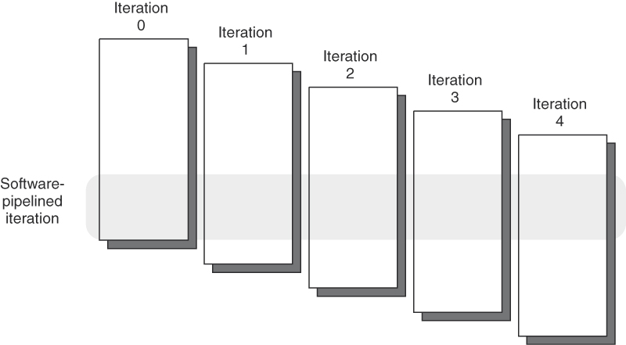
Continued
Pictorially, the concept works as follows:
  iteration 0: select the last instruction involved in the dependence
  iteration 1: select the second to last instruction, etc
  iteration n: select the first instruction involved in the dependence
    n will vary depending on the number of instructions involved in the dependence
The new loop has the instructions in opposite order, to accommodate this, we need to add
  startup code from the preceding iterations that let the last instruction (now positioned first) complete its task
  cleanup code from the successive iteration(s) to complete its task

Slide 14
Example
Loop: fld f0,0(x1)
fadd f4, f0, f2
fsd f4,0(x1)
subi x1,x1,8
bne x1,x2,Loop
Iteration i:
fld f0,0(x1)
fadd f4,f0,f2
fsd f4,0(x1)
Iteration i+1:
fld f0,0(x1)
fadd f4,f0,f2
fsd f4,0(x1)
Iteration i+2:
fld f0,0(x1)
fadd f4,f0,f2
fsd f4,0(x1)
Bold-faced instructions are unrolled
fld f0, 16(x1)
fld f6, 8(x1)
fadd f4, f6, f2
Loop: fsd f4,16(x1)
fadd f4,f0,f2
fld f0,0(x1)
subi x1,x1,8
bne x1,x2,Loop
fadd f8, f0, f2
fsd f4, 8(x1)
fsd f8, 0(x1)
Startup
Cleanup
Note there are stalls here between startup
and the first iteration and in the cleanup code

Slide 15
Code Scheduling
Code scheduling, so far, has been limited to
  moving code within a basic block to fill stalls
  loop unrolling and scheduling
What about moving code across conditional branches?
  with branch history, we can make predictions on whether a branch will be taken or not
  are the benefits of moving code to avoid branch delays worth the risk of guessing wrong?
Branch speculation requires several supporting mechanisms
  buffer to provide branch prediction and branch target location
    a precompiled file that the compiler uses at compile time, unlike a branch prediction or target buffer which is implemented in a cache
  mechanism for “killing off” miss-speculated code
  mechanism to ensure that speculated code does not raise an exception unless/until the speculation is proved correct

Slide 16
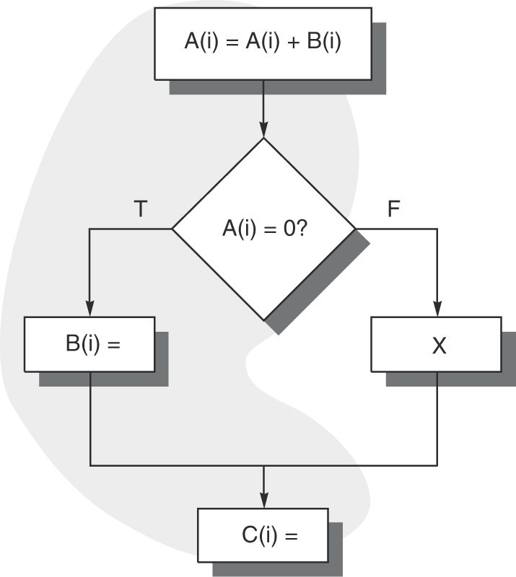
Example
Consider the skeleton of an if-else statement to the right, we have some options for code scheduling
  move B(i) before the condition
    if condition is usually true changing B has no impact on either A(i) or C(i)
  move X before the condition
    if condition is usually false and changing X has no impact on A(i), B(i) or C(i)
  move C(i) before the condition, or into one of the clauses
    if changing C(i) has no impact on A(i), B(i) or X
See the code on page H-17 which
shows the original code and discusses
how to make changes as described here

Slide 17
Example
Our code is
  if(x > y) x++; else y--;
Assume x > y 90% of the time
Original code shown to the right
  if true, 4 instructions are executed and if false, 3 instructions are executed
  let’s assume no stalls and each instruction has a CPI of 1
  average CPI = 4 * .9 + 3 * .1 = 3.9
With the prediction x > y, the compiler generates the code to the right
  if true, 3 instructions are executed and if false, 5
  average CPI = 3 * .9 + 5 * .1 = 3.2,
  a speedup of 3.9 / 3.2 = 1.22 (22%)
slt x3, x2, x1
beq x3, x0, else
addi x1, x1, 1
j next
else: subi x2, x2, 1
next: …
slt x3, x2, x1
addi x1, x1, 1
bne x3, x0, next
subi x1, x1, 1
subi x2, x2, 1
next: …

Slide 18
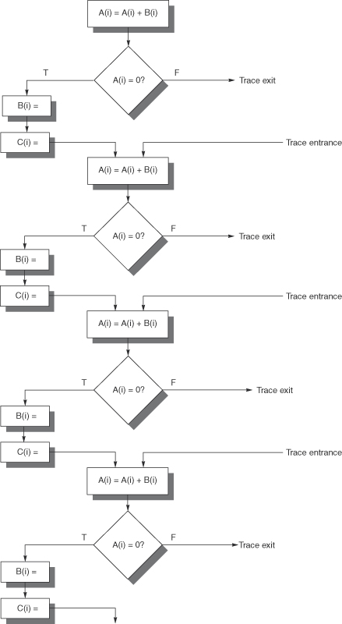
Trace Scheduling
In the previous example, we selected the “critical path”
  that is, we selected the most common path through the selection statement
  such a situation is typically found inside of a loop
In trace scheduling, we combine selecting the critical path across loop iterations and combine it with loop unrolling
  we try to make a straight-line set of code across loop iteratinos
  miss-prediction requires exits out of the unrolled code and entrances to re-enter after handling the miss-prediction

Slide 19
Superblocks
The numerous entries and exits of trace scheduling make it far more complicated than its value
  it requires the compiler build mechanisms for recovering from miss-predictions into the unrolled code
    imagine we unroll a loop 4 times, each with an if-else statement
    the compiler must build exits and entrances for each condition if the prediction is inaccurate
  it increases the amount of code required and complicates the code
A superblock uses the same idea but is simpler
  there are multiple exits but only one entrance
  if there is any miss-speculation, branch to a different loop that contains no speculation at all
  that is, we gain advantage of speculation if we are correct, if incorrect, we do other code that does not “gamble” with speculation – the result is less efficient code

Slide 20
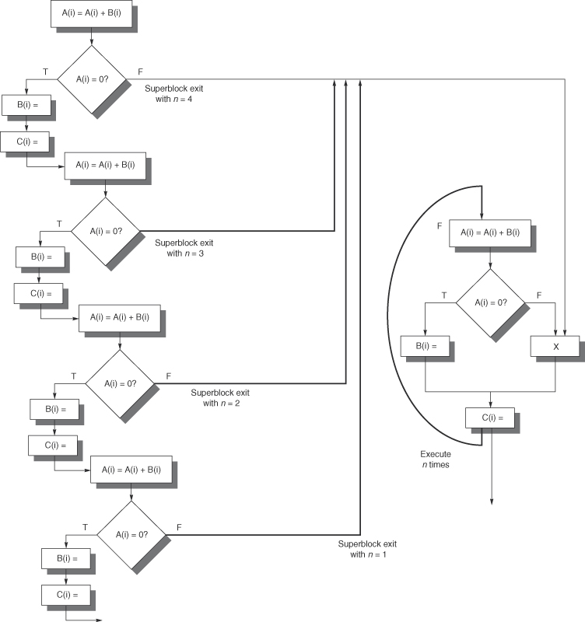
Example Superblock

Slide 21
Example
Assume our code is:
for(i=0;i<n;i++)
if(a[i]>0) x++; else x--;
In most cases, a[i] is positive
  we move x++ out of the selection statement and replace the selection with if(a[i]<=0) x=x-2;
We unroll the new loop giving us the following (in C)
  for(i=0;i<n/4;i+=4) {
    x+=4; if(a[i]<=0) {…} // code in the { } requires
    if(a[i+1]<=0) {…} // subtracting from x
    if(a[i+2]<=0) {…} // the assembly code would
    if(a[i+3]<=0 {…} // branch to a different loop
  } // if any miss-speculation

Slide 22
Predicated Instructions
We can further reduce the impact of branches because of selection statements with new assembly instructions, called predicated (or conditional) instructions
  the condition and action are both performed
  if the condition is determined false, the register write is canceled
In most cases, predicated instructions consist of
  simple condition: value == 0 or value != 0
  simple action such as x = y
Here, we consider two:
  CMOVZ – conditional move if variable == 0
  LWC – conditional load if variable != 0

Slide 23
Examples
if(A==0) {S=T;}
  bnez x1, L
  add x2, x3, x0
  L: …
Becomes CMOVZ x2, x3, x1
  meaning if x1 is zero, move x3 into x2
  if x1 is not zero, the move is canceled
Here, we see code to convert an if statement with a load into a conditional load
  bnez x1, L
  lw x2, 0(x3)
  L: …
Becomes LWC x2, 0(x3), x1
  load x2 with 0(x3) if x1 is not zero, otherwise cancel the load
    the load is not stopped, but the value from memory is not stored in R2

Slide 24
Example Improvement
Two-issue superscalar can issue 1 load and 1 ALU operation
  lw x1, 40(x2) add x3, x4, x5
  add x6, x3, x7
  beq x10, x0, L
  lw x8, 0(x11)
  lw x9, 0(x8)
  L:
Code only fills 1 slot with 2 instructions, contains numerous stalls
  1 cycle between first lw and second add, branch delay slot, 1 cycle after second lw (notice the second lw is an indirect memory reference)
Assume branch is not taken most of the time
Using a conditional load gives us the following
  lw x1, 40(x2) add x3, x4, x5
  lwc x8, 0(x11), x10 add x6, x3, x7 // still have a stall before add
  beq x10, x0, L
  lw x9, 0(x8)
  L

Slide 25
Handling Exceptions
Imagine the LWC was LWC x8, 0(x10), x10
This is an interesting situation
  if x10 == 0 then we do not perform the load
  the load of 0(x10) is actually loading address 0, part of the OS
  this will almost certainly cause a memory violation error
  but the way the conditional load works is that the access to memory continues, we just don’t bother to store the result in x8
  thus, if we miss-speculate on the condition, we get an exception
When using a predicated instruction, a miss-speculation should not cause an exception
  similarly, compiler scheduling (e.g., trace scheduling) that is incorrectly speculated should not cause an exception
    we need a way to recover from a miss-speculated exception situation
  in speculation is inaccurate, invoke the exception handler and cancel it once we know we have miss-speculated
    this wastes some time and effort but preserves proper behavior

Slide 26
Four Approaches
Hardware and OS work cooperatively to ignore exceptions of speculative instructions
  this only works for correct programs
Speculative instructions are not permitted to raise exceptions
  speculative instructions are annotated as such
    for instance a speculative load might be sLW
    disallow this type of instruction from raising an exception
Poison bits are attached to registers
  speculated instruction that writes to a register sets this bit
  any register written to as a result of a register with the set poison bit is also set
  once speculation results are known, if correctly speculated, clear poison bit
  exceptions are disallowed for any instruction which references a register with a set poison bit
Buffers store results of speculated instructions (like a ROB)
  only permit results to move beyond the buffer once the speculation is know, until then, exceptions are buffered

Slide 27
Example
Imagine we have the following instruction:
  if (A==0) A = B; else A = A + 4;
Original code on the left, compiler uses speculation to generate better code on the right
  if speculation accuracy is 90%, we go from .90 * 5 + .10 * 4 = 4.9 to .90 * 4 +.10 * 5 = 4.1 cycles (speedup of about 19%)
lw x1, 0(x3)
bne x1, x0, l1
lw x1, 0(x2)
j l2
l1: addi x1, x1, 4
l2: sw x1, 0(x3)
lw x1, 0(x3)
lw x14, 0(x2)
beq x1, x0, l3
addi x14, x1, 4
l3: sw x14, 0(x3)
The revised code improves performance but does not handle
possible exceptions raised upon miss-speculation

Slide 28
Preventing the Exception
We improve the code by using a speculative load (slw)
  we want to prevent an exception from arising when we access 0(x2) if we determine that the branch is miss-speculated
  we do this with the instruction SPECCK (a speculative check) after the branch
  should we reach this instruction, then the branch was incorrectly speculated and the reference to 0(x2) should not cause an exception
lw x1,0(x3)
sld x14,0(x2)
bne x1,x0,l1
specck 0(x2)
j l2
l1: addi x14,x1,4
l2: sw x14,0(x3)

Slide 29
Using a Poison Bit
The speculated load is not canceled but if miss-speculated, we then perform a check to see if it caused an exception
  this can be wasteful
Instead, we might use a simple poison bit
  in this way, miss-speculation is “carried” ahead but prevented from impacting memory or causing an exception
  here, x14 has its poison bit set during the slw instruction and cleared if the speculation (the branch) is confirmed as true
lw x1, 0(x3)
slw x14, 0(x2)
beq x1, x0, l3
addi x14, x1, 4
l3: sw x14, 0(x3)

Slide 30
Intel IA-64/EPIC
Very few processors have attempted to aggressively schedule parallel instructions through the compiler
  Instead, most rely on hardware scheduling
The IA-64 is one of the few
  here we look at a few highlights of the instruction set and see how instructions are bundled together to issue in a VLIW-like way
    128 65-bit registers (1 poison bit included)
    128 82-bit FP registers
    64 1-bit predicate registers
    8 64-bit branch registers (for indirect branching)
    registers used for system control, memory mapping, etc

Slide 31
Compiler Techniques
To promote ILP
  loop unrolling
  speculation
  various forms of scheduling
Compiler selects up to 3 consecutive instructions to place into a “bundle”
  instruction consists of 5-bit template and three 41-bit instructions (or no-ops if an instruction is not available)
  the template describes the instruction type (format):
    A – ALU (+, -, AND, OR, compare)
    I – non-ALU (shift, bit tests, moves)
    M – load/store
    F – FP operation
    B – branch
    L + X – operations with extended immediate data, no-ops, and stops (a boundary between instruction groups indicating a dependency between an instruction in one group and the next)

Slide 32
Bundle Components
The 3 instructions are filled as follows:
  slot 0: M or B
  slot 1: any
  slot 2: any but M
Template # | Slot 0 | Slot 1 | Slot 2
0 | M | I | I
1 | M | I | I
2 | M | I | I
3 | M | I | I
…
8 | M | M | I
9 | M | M | I
…
12 | M | F | I
13 | M | F | I
14 | M | M | F
15 | M | M | F
…
29 | M | F | B
See figure H.7 on page
H-36 for full table

Slide 33
Example
Unroll the x[i]=x[i]+s; loop seven times and schedule the instructions in IA-64 bundles, on the next slide we see
  how to schedule it to minimize bundles (top)
  how to schedule it to minimize number of cycles (bottom)
Loop: ld f0, 0(x1) sd f4, 0(x1)
ld f6, -8(x1) sd f8, -8(x1)
ld f10, -16(x1) sd f12, -16(x1)
ld f14, -24(x1) sd f16, -24(x1)
ld f18, -32(x1) sd f20, -32(x1)
ld f22, -40(x1) sd f24, -40(x1)
ld f26, -48(x1) sd f28, -48(x1)
fadd f4, f0, f2 addi x1, x1, -56
fadd f8, f6, f2 bne x1, x2, Loop
fadd f12, f10, f2
fadd f16, f14, f2
fadd f20, f18, f2
fadd f24, f22, f2
fadd f28, f26, f2

Slide 34
Bundle
Execute
Slot 0
Slot 1
Slot 2
Template
Cycle
9: MMI
ld f0, 0(x1)
ld f6, -8(x1)
1
14: MMF
ld f10, -16(x1)
ld f14, -24(x1)
dadd f4, f0, f2
3
15: MMF
ld f18, -32(x1)
ld f22, -40(x1)
dadd f8, f6, f2
4
15: MMF
ld f26, -48(x1)
sd f4, 0(x1)
dadd f12, f10, f2
6
15: MMF
sd f8, -8(x1)
sd f12, -16(x1)
dadd f16, f14, f2
9
15: MMF
sd f16, -24(x1)
dadd f20, f18, f2
12
15: MMF
sd f20, -32(x1)
dadd f24, f22, f2
15
15: MMF
sd f24, -40(x1)
dadd f28, f26, f2
18
16: MIB
sd f28, -48(x1)
addui x1, x1, -56
bne x1, x2, Loop
21
Bundle
Execute
Slot 0
Slot 1
Slot 2
Template
Cycle
8: MMI
ld f0, 0(x1)
ld f6, -8(x1)
1
9: MMI
ld f10, -16(x1)
ld f14, -24(x1)
2
14: MMF
ld f18, -32(x1)
ld f22, -40(x1)
dadd f4, f0, f2
3
14: MMF
ld f26, -48(x1)
dadd f8, f6, f2
4
15: MMF
dadd f12, f10, f2
5
14: MMF
dadd f16, f14, f2
6
14: MMF
sd f8, -8(x1)
dadd f20, f18, f2
7
15: MMF
sd f12, -8(x1)
dadd f24, f22, f2
8
14: MMF
sd f16, -8(x1)
dadd f28, f26, f2
9
9: MMI
sd f24, -8(x1)
sd f24, -8(x1)
11
16: MIB
sd f28, -8(x1)
addui x1, x1, -56
bne x1, x2, Loop
12

Slide 35
Speculation Support
Nearly every instruction can be predicated
  use a predicate register
    conditional branch becomes an unconditional branch with a predicate register
  predicate registers set using compare instruction
Hardware supports predication by
  controlling when exceptions are handled
    for a predicated instruction, exception only handled once the predicate’s result is known and by using registers with poison bits
    compiler tasked with generating recovery code for exceptions that arise because of miss-speculation
  speculated loads use a special table so that if the load is miss-speculated, it does not wipe out a current register value

Slide 36
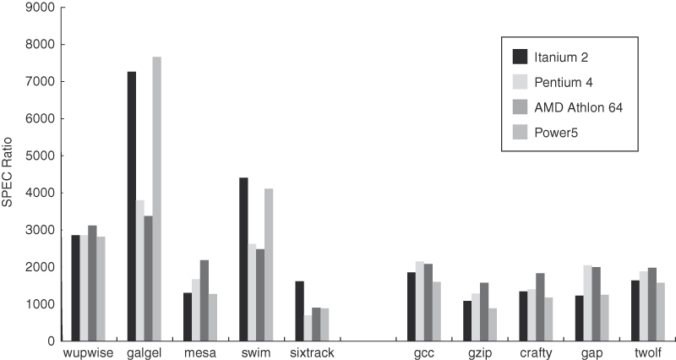
Itanium 2 Performance
The IA-64/EPIC instruction set was implemented in the Itanium 2 processor with a 1.5 GHz clock
  performance compared to other processors shown below on int and FP benchmarks
    Pentium IV had a 3.8 GHz clock cycle
  Itanium 2 compares favorably to Pentium IV & Athlon for FP benchmarks, slower on int benchmarks

