Slide 1
Pipelining
Two forms of pipelining
  instruction unit
    overlap fetch-execute cycle so that multiple instructions are being processed at the same time, each instruction in a different portion of the fetch-execute cycle
  operation (functional) unit
    overlap execution of ALU operations
    only useful if execution takes > 1 cycle
      e.g., floating point operations
We will concentrate mostly on instruction unit-level
  but we will see the necessity for functional unit pipelining later in the semester

Slide 2
Pipeline Related Terms
Stage
  a portion of the pipeline that can accommodate one instruction, the length of the pipeline is in stages
Throughput
  how often the pipeline delivers a completed instruction, our goal is 1.0 (or less!)
    one instruction leaves the pipeline at the end of each clock cycle would give us an ideal CPI of 1.0 and a speedup equal to the number of stages
Stall
  the need to postpone instructions from moving down the pipeline, stalls are caused by hazards

Slide 3
From Non-pipelined to Pipelined
Latches are registers,
Denoted as IF/ID.IR
And ID/EX.A for example
Add latches between
stages to control when
the instructions can
move into the next
pipe stages
Latches contain logic
used to handle forwarding
and insert stalls

Slide 4
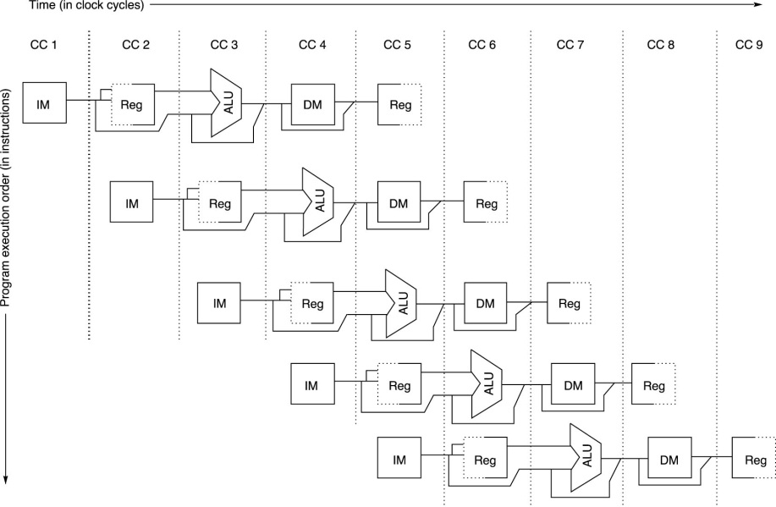
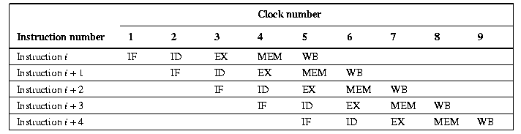
5-Stage Pipeline Timing Diagrams

Slide 5
5-Stage Pipeline Performance
CPU Cycles = (n + k – 1 + s) * overhead
  n = number of instructions
  k = 5 (number of stages)
  s = stalls, number of stalls inserted is based on the code
  overhead = pipeline latency
    which primarily is the time it takes for the logic in the latches to compute as well as extra time to open latches, etc
  Ideal CPI = 1, actual CPI = 1 + number of stalls per instruction
Speedup over non-pipelined machine
  k / [ (1 + stalls per instruction) * overhead ]

Slide 6
Example Comparison
Two processors use the RISC-V ISA
  both with 4 GHz clock speeds (.5 ns per clock cycle)
  pipelined processor has latency of .1 ns
    assume no stalls so CPI = 1
  non-pipelined processor has a CPI of
    4 cycles for ALU and branches (ALU doesn’t use the MEM stage, branches don’t use the WB stage)
    5 cycles for loads and stores
  benchmark consists of 40% ALU, 20% branches, 30% loads, 10% stores
    Non-pipelined CPI = 60% * 4 + 40% * 5 = 4.4
    Non-pipelined execution time =.5 ns * 4.4 * IC = 2.2 ns * IC
    Pipelined machine execution = (.5 ns + 1.ns) * 1 * IC = .6 ns * IC
  speedup of pipelined machine = 2.2 / .6 = 3.7

Slide 7
Assume Stalls
Unrealistic for a pipeline to not stall
Assume stalls are needed after Loads and ALU operations of 2 cycles per instruction
Branches cause 3 cycle stalls
  pipeline CPI = 1 + 70% * 2 + 20% * 3 = 3.0
  pipeline execution time = 3.0 * 0.6 * IC = 1.8 * IC
  speedup = 2.2 / 1.8 = 1.22
    nearly as slow as the non-pipelined machine!
Is the pipeline worth it?
  yes, we can reduce the number of stalls by modifying the hardware and using the compiler to optimize the code

Slide 8
Problems with the Pipeline
Instructions might try to alter the PC at the same time
  PC incremented in IF
  branch instruction in EX could alter the PC
  use a MUX (in the MEM stage) to decide which PC to use
Two instructions could attempt to access memory at the same time
  instruction fetch in IF and data access in MEM
  use 2 separate caches, an instruction cache for the IF stage and a data cache for the MEM stage
Stages take different amounts of time
  set system clock to slowest stages (those that involve cache access, IF and MEM stages)
Hazards
  these cause stalls, we cover this shortly

Slide 9
Another Example
What is the impact different stage speeds?
  assume IF/MEM take .5 ns each, ID, WB take .35 ns each and EX takes .4 ns
  non-pipelined machine: execution speed varies by instruction type
    loads: all 5 stages, ALU: all but MEM, branches and stores: all but WB, time per instruction:
      loads: .5 + .35 + .4 + .5 + .35 = 2.1 ns
      ALU: .5 + .35 + .4 + .35 = 1.6 ns
      branches/stores: .5 + .35 + .4 + .5 = 1.75 ns
    CPU execution time =
      2.1 * 30% + 1.6 * 40% + 1.75 * 30% = 1.795 ns
    pipeline machine w/ stalls (from previous example) has CPU execution time of 1.8
  Now the non-pipelined machine is faster!

Slide 10
Structural Hazards
We have already resolved one structural hazard
  two possible cache accesses in one cycle
The other source of structural hazard occurs in the EX stage if an operation takes more than 1 cycle to complete
  happens with longer ALU operations: multiplication, division, floating point operations
  we will resolve this problem later when we add FP to our pipeline
  for now, assume all ALU operations take 1 cycle
    we will not factor in * or / operations (they will use the FP hardware)

Slide 11
Data Hazards
The data hazard arises when a value is needed in a later instruction but earlier in the pipeline
Consider the following (s = stall)
  value of x1 is not available until the lw reaches its WB stage resulting in 3 cycles of stalls for the addi
Stalls are needed to prevent the latter instruction from moving into the ID stage as the datum is not yet ready in the register file for reading
  data hazards arise when
    load followed by ALU operation that needs loaded value
    ALU operation followed by store of computed value
    loads/ALU operations followed by a conditional branch that uses the loaded/computed value
lw x1, 0(x2) IF ID EX MEM WB
addi x3, x1, 1 IF s s s ID

Slide 12
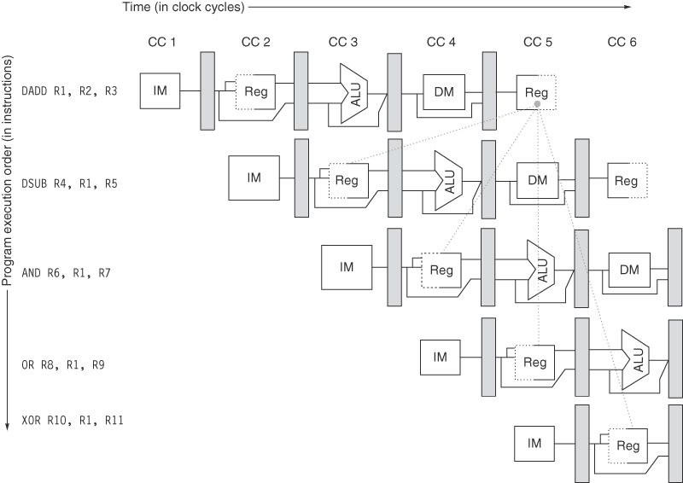
Data Hazards

Slide 13
Solutions
We will implement 3 solutions to data hazards
  as registers are accessed in both ID and WB stages, let WB “go first” in any clock cycle
    instructions in ID stage can still access the datum being written to because they access after the WB write – this reduce the stalls by 1
  implement forwarding (covered in the next slide)
    shunt value directly from where it was obtained to the waiting stage
      ALU output to ALU input
      MEM (from a load) to ALU input
      MEM (from a load) to MEM (for a store)
  let the compiler schedule instructions to remove stalls

Slide 14
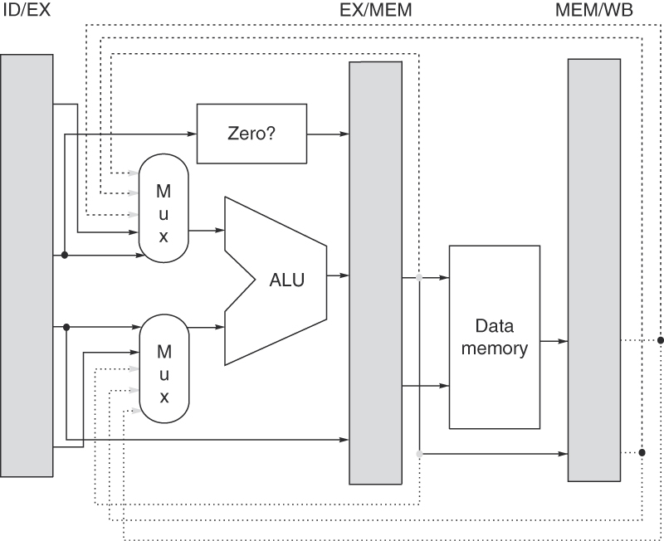
Forwarding
Add logic to latches to determine when forwarding should take place

Slide 15
Forwarding Logic

Slide 16
Forwarding Examples

Slide 17
Forwarding is Not Enough
Forwarding will resolve the following situations:
  addi x1, x1, #4
  subi x2, x1, x3
    the value of x1 is passed from ALU output to ALU input
  lw x1, 0(x3)
  sw x1, 0(x4)
    the value of x1 is passed from MEM output to MEM input
  slt x1, x2, x3
  beq x1, x2, foo
    the value of x1 is passed from ALU output to ALU input
It does not resolve these two problems
  lw x1, 0(x2) IF ID EX MEM WB
  addi x1, x1, 1 IF ID …. EX
    the value of x1 is available at the end of MEM but needed by the addi at the beginning of its EX, need a 1 cycle stall
  lw x1, 0(x2)
  beq x1, x2, foo
    same

Slide 18
Stalling Logic
If instruction entering EX stage is a load
  and instruction entering ID stage requires the use of the loaded value (ALU, load/store where datum is part of the address, branch where datum is part of the branch condition)
  then stall instruction from entering the ID stage for 1 cycle

Slide 19
Examples of Forwarding/Stalling

Slide 20
Stalling or Scheduling
We might be able to remove some of the stalls
Compilers can be written to look for these stalling situations
  loaded datum needed by the next instruction in its EX stage
  search code for an independent instruction
  if found, move it into the location after the load
  code on left requires 1 cycle stalls after each of the lw’s, the code on the right does not
lw x1, 0(x5)
addi x1, x1, 1
sw x1, 0(x5)
addi x5, x5, 4
lw x1, 0(x5)
addi x1, x1, 1
sw x1, 0(x5)
addi x6, x5, 4
lw x1, 0(x5)
lw x2, 0(x6)
addi x1, x1, 1
addi x2, x2, 1
sw x1, 0(x5)
sw x2, 0(x6)

Slide 21
Impact of Stalls
Benchmark: 35% loads, 15% stores, 10% branches, 40% ALU
  of the loads
    50% have ALU/branch operations immediately after (case 1)
    10% have store operations immediately after (case 2)
  of the ALU operations
    25% have ALU/branch/store operations immediately after (case 3)
With no forwarding, each case requires a 2 cycle stall
With no forwarding:
  CPI = 1 + stalls = 1 + .35 * (.5 + .1) * 2 + .40 * .25 * 2 = 1.62

Slide 22
Continued
With forwarding
  1 stall for case 1 only
With forwarding
  CPI = 1 + stalls =
    1 + .35 * .5 * 1 = 1.175
  forwarding provides 1.62 / 1.175 = 1.39 speedup
Assume compiler can remove 60% of stalls from case 1
  CPI = 1 + .35 * .5 * 1 * .4 = 1.07
  speedup = 1.62 / 1.07 = 1.51

Slide 23
Branch Hazards
PC is updated in MEM stage if branch is taken
Three incorrect instructions will have been fetched
Three forms of branch
  unconditional branches, always taken
  conditional branches, taken when condition is true
  conditional branches, not taken when condition is false
In our 5-stage pipeline
  we don’t worry about untaken branches because we are already fetching the next sequential instruction
  but taken branches are common and result in a heavy penalty

Slide 24
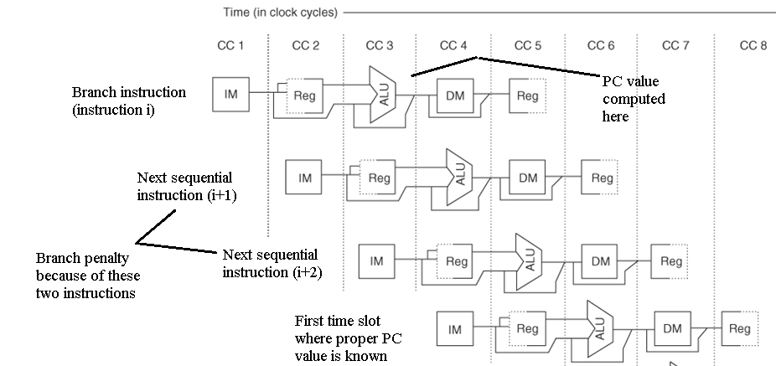
Branch Penalty
If the branch is taken, instructions i+1 and i+2 should not have been fetched,
but we do not know this until instruction i completes its EX stage
If the branch is not taken, i+1 and i+2 would need to be fetched anyway,
no penalty

Slide 25
Branch Penalty
The reason for the penalty is
  we have to wait until the new PC is computed
    PC + offset, using the adder in the EX stage
    perform the condition testing in EX (for conditional branches)
  both of these steps take place in the EX stage but the MUX to update the PC is in the MEM stage
    as this is the 4th stage of our pipeline, 3 additional instructions will be fetched by the time we know if and where to branch to
    3-cycle branch penalty
    these 3 instructions are flushed from the pipeline
  we can slightly improve over the 3-cycle penalty by moving the MUX into the EX stage
    gives us a 2 cycle penalty – can we do even better?

Slide 26
RISC-V Solutions to Branch Penalty
Hardware solution
  both PC and offset are available in ID stage
    offset needs to be sign extended during ID stage
    remember that the ID & WB stages are the shortest, can we do more in the ID stage?
  conditional branches compare two registers
    both registers are fetched during the second half of the ID stage
    comparison test is quick, move it to ID stage
    offset is already sign extended, add an adder to the ID stage to compute PC + offset
    move MUX to ID stage to select PC + 4 or PC + offset
  cost: 1 adder
  benefit: 1 cycle penalty instead of 2 (or 3)
Software solution
  compiler tries to move a neutral instruction into that penalty location
    known as the branch delay slot

Slide 27
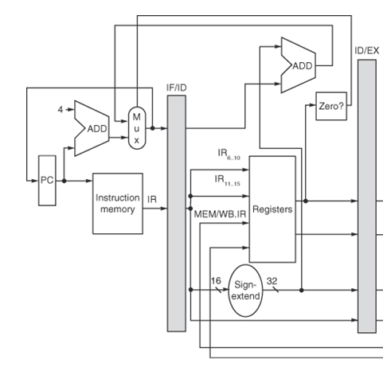
Revised Hardware
ID stage receives instruction in IR including offset, and PC
  offset sign extended
  PC + Offset computed
  registers accessed during second half of the cycle
  comparison performed
  based on result, MUX in IF stage used to determine whether PC is modified PC (PC + 4) or result of PC + offset

Slide 28
New Source of Stall
Consider the following sequence of instructions
  lw x1, 0(x2)
  beq x1, x3, foo
Before we implemented forwarding, we would need to postpone the beq in its IF/ID latch while the lw moved through its MEM stage
After forwarding, we needed a 1-cycle stall
  lw IF ID EX MEM WB
  beq IF ID s EX WB
But with branches moved to the ID stage, we need a two cycle stall
  lw IF ID EX MEM WB
  beq IF s s ID EX WB

Slide 29
Filling the Branch Delay Slot
Compiler looks for a neutral instruction to move into the branch delay
  without this, if branch is taken, instruction after branch is incorrect and must be flushed
  with this, whether branch is taken or not, this instruction will execute and so no penalty

Slide 30
Impact of Branch Hazards
Assume a benchmark of
  30% loads, 10% stores, 40% ALU operations, 16% conditional branches and 4% unconditional branches, assume 67% of conditional branches are taken
  assume for all conditional branches that none of the registers are loaded from memory but instead computed using ALU operations
Compute impact of branches if
  original pipeline with no compiler scheduling
  revised pipeline with no compiler scheduling
  revised pipeline where compiler can fill branch delay slot 60% of the time

Slide 31
Solution
% of instructions with branches taken:
  16% * 67% + 4% * 100% = 14.7%
Original pipeline, no scheduling = 3 cycle penalty per branch taken
  CPI = 1 + .147 * 3 = 1.44
Revised pipeline, no scheduling = 1 cycle penalty per branch taken
  CPI = 1 + .147 * 1 = 1.147
Revised pipeline, scheduling removes 60% of penalties, 1 cycle penalty for the other 40%
  CPI = 1 + .147 * .4 = 1.059
    speedup of revised pipeline with scheduling over original = 1.44 / 1.059 = 1.359
    speedup of revised pipeline with scheduling over revised pipeline without scheduling = 1.147 / 1.059 = 1.083

Slide 32
Scheduling Example
Loop: | lw | x1, 0(x2) | IF | ID | EX | MEM | WB
 | addi | x1, x1, 1 |  | IF | ID | s | EX | MEM | WB
 | sw | x1, 0(x2) |  |  | IF | s | ID | EX | MEM | WB
 | addi | x2, x2, 4 |  |  |  |  | IF | ID | EX | MEM | WB
 | subw | x4, x3, x2 |  |  |  |  |  | IF | ID | EX | MEM | WB
 | bne | x0, x4, Loop |  |  |  |  |  |  | IF | s | ID | EX | MEM | WB
branch delay (lw or next instruction sequential) |  |  |  |  |  |  |  |  |  |  | s | IF | …
Stalls arise after the lw (data hazard), after the subw (data hazard caused by moving the branch computation to ID) and after the bne (branch penalty)
Below, the code has been scheduled by the compiler to remove all stalls with the sw filling the branch delay slot
  note the adjustment made to the address for storing x1, x2 has already been incremented
Loop: | lw | x1, 0(x2) | IF | ID | EX | MEM | WB
 | addi | x2, x2, 4 |  | IF | ID | EX | MEM | WB
 | addi | x1, x1, 1 |  |  | IF | ID | EX | MEM | WB
 | subw | x4, x3, x2 |  |  |  | IF | ID | EX | MEM | WB
 | bne | x0, x4, Loop |  |  |  |  | IF | ID | EX | MEM | WB
 | sw | x1, -4(x2) |  |  |  |  |  | IF | ID | EX | MEM | WB

Slide 33
Branches in Other Pipelines
Our 5-stage pipeline has a fairly simple solution to branch penalties
Some pipelines though are not as simple and so have complicating factors to improve branch penalties
  stage where target PC is computed might occur earlier than the stage in which the condition is determined
    this might happen because the PC and sign extended offset are available earlier than when the registers are read
  if so, we know where to branch earlier than we know if we are branching
    since most branches are taken, we might take the branch immediately on knowing where to branch to, and only flush the pipeline if later we determine that the branch condition is false

Slide 34
Why Assume Taken?
All unconditional branches are taken
What about conditional branches?
  assume 30% of conditional branches are loops
    a for-loop that iterates 100 times takes its conditional branch 99 times, let’s assume 90% of all loop branches are taken
  the other source of conditional branch is for if/if-else
    assume 50% of all if-else statements have a conditional branch that is taken
  let’s further assume 75% of all branches are conditional branches
  percentage of branches taken:
    25% (unconditional branches) + 75% * 30% * 90% (90% of all loop branches are taken) + 75% * 70% * 50% (50% of all if-else statement branches are taken) =
    71.5% of all branches are taken

Slide 35
Example
The MIPS R4000 pipeline has 8 stages
  branch target locations known in stage 3
  branch conditions evaluated in stage 4
From our previous slide
  all unconditional branches are taken (25% of all branches)
  62% of conditional branches are taken
Predict taken penalty =
  .25 * 2 + .75 * .38 * 3 + .75 * .62 * 2 = 2.285
Predict not taken penalty =
  .25 * 2 + .75 * .62 * 3 = 1.895
This argues that we should assume branches are not taken for this pipeline
 | unconditional branch | conditional branch not taken | conditional branch taken
Predict taken | 2 | 3 | 2
Predict not taken | 2 | 0 | 3

Slide 36
Revised 5-Stage Pipeline
Assume we can sign extend the offset and add to the PC in the IF stage
  requires increasing our clock cycle time by 10%
  conditions are still evaluated in ID
Alternatively, 60% of all branch delay slots can be filled by the compiler
Assume a benchmark of 20% branches with 75% being conditional branches
  which is better, the current 5-stage pipeline with scheduling or this revised pipeline with no scheduling?

Slide 37
Solution
5-Stage pipeline with scheduling
  1 cycle penalty arises when branch delay slot cannot be filled (40% for all branches)
    note: we assume no stalls for loads followed by branches
Revised pipeline without scheduling
  0 cycle penalty when branch is taken
  1 cycle penalty when branch is not taken
CPU time without revision =
  IC * (1 + .2 * .4) * CCT = 1.08 * IC * CCT
CPU time with revision =
  IC * (1 + .2 * (1 – 71.5%) * 1) * CCT *1.1 = 1.063 * IC * CCT
Slowing down the clock but assuming branches taken pays off in this case

Slide 38
Another Strategy: Speculation
With branch locations and branch conditions being computed in the same stage, there is no point to assuming taken versus not taken
  there is also a minimal penalty in the 5-stage pipeline if we can schedule the branch delay slot
Other pipelines may benefit by using branch speculation, which we might use in a longer pipeline
  where branch locations are computed earlier than branch conditions
The idea is to predict whether the branch is taken and immediately branch there once we’ve computed the new location if we predict taken
  if we predict not taken, continue fetching instructions sequentially as normal

Slide 39
Implementing Speculation
Prediction buffer stored in a cache
  stores for each branch reached so far its last outcome
    stored in the cache using the branch instruction’s address
  prediction is merely a binary value – taken or not taken
  in the IF stage when fetching an instruction, access the prediction buffer using the same address
    only branches are found in the buffer, non-branches result in a miss which we can ignore because by the ID stage we know its not a branch
    if the buffer gives us a hit and the prediction is to branch, we branch as soon as possible
    if the instruction is a branch and an entry is not found in the buffer, wait until we know the outcome of the branch condition, perform the branch and store the result in the cache

Slide 40
Poor Prediction Accuracy
This approach is not as accurate as we might desire
Consider a for-loop that iterates 10 times
  initially, no entry, no prediction
  followed by 8 consecutive hits where it predicts taken each time
  the last iteration is a misprediction as we exit after 10 iterations
We reach the same loop again
  last time through we reset the prediction to not taken because we left the loop so our first prediction is not taken, as is the last iteration
We have 2 misses/miss-predictions out of 10
In general, we have 2 mispredictions in a loop rather than 1
Use a 2-bit predictor instead of a
1-bit predictor in which it takes 2
miss-predictions to change a prediction
This version gives us n-1 correct
predictions for a loop of n iterations

Slide 41
Miss-prediction Rate of 2-bit Predictions
Notice little
difference
between
4096 entry
cache vs
larger cache
This is in part
because you
don’t tend to
have more
than a few
thousand
branches

Slide 42
Floating Point
FP operations take longer than integer
  need to unnormalize the FP values, perform the arithmetic, normalize the result back
    even an FP add might take four times as long as an int add
  either lengthen the clock cycle time or alter our EX stage to handle variable length operations
    the former is not preferred as it impacts all operations
We replace the current EX stage with a 4-device EX stage
  integer ALU (for all integer operations except * and /)
  FP adder
  FP multiplier (including all integer multiplications)
  FP divider (including all integer divisions)

Slide 43
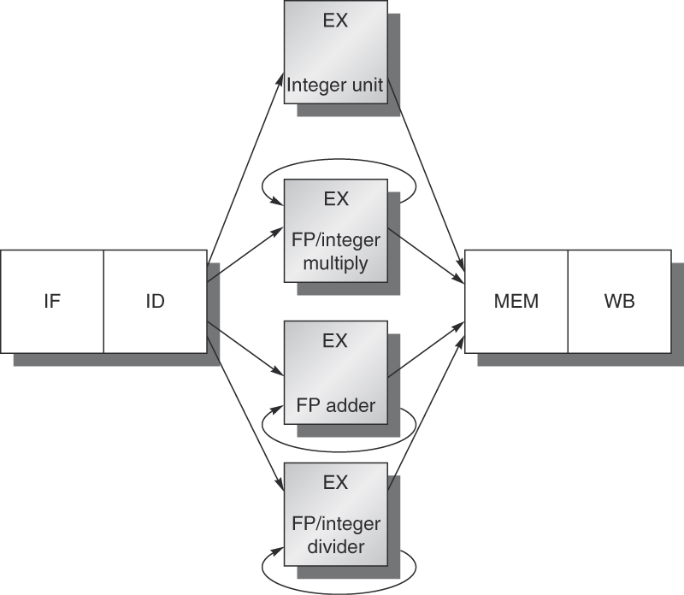
New Pipeline
Integer unit takes 1 cycle to complete operation
FP adder takes 4 cycles
FP/int multiplier takes 7 cycles
FP/int divider takes 25 cycles
FP adder and FP/int multiplier will be pipelined
  allows a second operation to start rather than stalling until current operation is done
  no need to pipeline the integer unit
  divider not used often enough to warrant it being pipelined

Slide 44
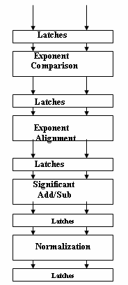
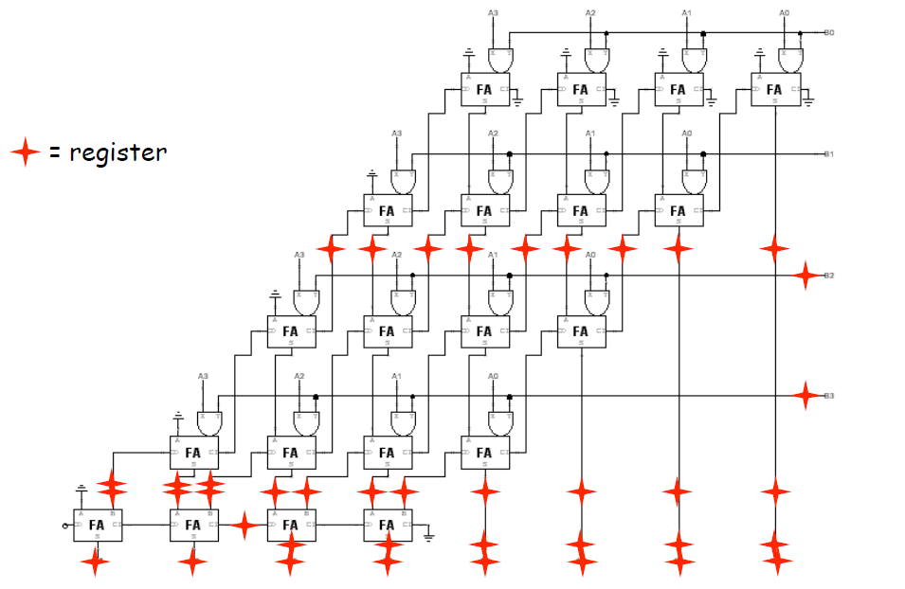
Pipelining FP Adder

Slide 45
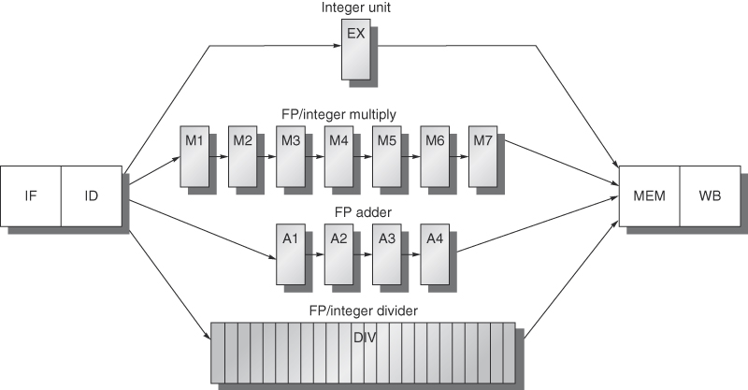
New Complications
Forwarding available from M7/A4/Div/Ex to Ex/M1/A1/Div
  but more data hazard stalls may be needed
Two instructions cannot be permitted to reach MEM at the same time – requires a stall
Two instructions could reach MEM out of order
  an int multiplication followed immediately by a FP add will result in the add reaching MEM before the multiplication
  this introduces new types of data hazards
  also a problem if the multiplication causes an interrupt after the add has left the pipeline
Two divisions cannot be accommodated within 25 cycles of each other

Slide 46
New Stalls
fmul.d stalled 1 cycle because of the data hazard with fld
fadd.d stalled 6 cycles waiting for fmul.d result
  forwarded from M7 to A1
fsd stalled 2 cycles waiting for fadd.d result
  forwarded from A4 to MEM
fds stalled 1 additional cycle because otherwise fsd will reach MEM stage at the same time as fadd.d
  this structural hazard could be eliminated (and thus the stall removed) if the fadd.d could bypass MEM as it does nothing in its MEM stage (we would shunt the fadd.d right to WB)
  we won’t do this because this situation is rare and the solution will require more logic in our latches (greater expense)

Slide 47
Data Hazards Revised
We classify data hazards into three categories
  RAW (read after write)
    a later instruction needs to read from a register before the write of an earlier instruction has provided it
    we have handled this through forwarded and/or stalls
  WAW (write after write)
    the same register is written to by 2 instructions, but the writes are out of order thanks to different length instructions
    this form of hazard can not arise with the 5-stage pipeline but can arise with our revised FP pipeline
  WAR (write after read)
    this cannot happen in the 5-stage pipeline because all reads are in the ID stage and all writes in the WB stage
    other pipelines might suffer from this hazard (example shown on next slide)

Slide 48
WAW and WAR Hazards
The WAW hazard could not arise in the 5-stage pipeline but could happen in the floating point pipeline
  f0 being written to by both instructions but out of order, the result is that the earlier instruction wipes out the result of the latter instruction
Consider a pipeline with 2 MEM stages to allow for indirect addressing where each MEM stage is 2 cycles long, and where ALU operations can bypass MEM
  in this example, the lw reads x2 in ID but x3 in Mem2a and since writes happen before reads, the new value of x3 (produced by the addiw) overwrites the original address needed by the lw
fmult.d | f0, f2, f4 | IF | ID | M1 | M2 | M3 | M4 | M5 | M6 | M7 | MEM | WB
fadd.d | f0, f6, f8 |  | IF | ID | A1 | A2 | A3 | A4 | MEM | WB
lw | x1, (x2+x3) | IF | ID | Mem1a | Mem1b | Mem2a | Mem2b | WB
addiw | x3, x4, 5 |  | IF | ID | EX | WB

Slide 49
Handling WAW Hazards
The WAW hazard cannot arise in the 5-stage pipeline but can arise in our revised pipeline with the FP units since instructions can finish out of order
Logically, WAW hazard makes no sense
  we are using the same destination without any intervening loads so the first result is never used
  its like doing the following two instructions sequentially in a program
    x = y * 5;
    x = z + 1;
  in spite of them being illogical, WAW hazards can arise
    compiler optimizations dealing with branch delays and speculation
    dynamic scheduling (something we cover in chapter 3)
To handle WAW hazards, when detected, the pipeline shuts off the earlier instruction so that it does not reach the WB stage
  WAR hazards can also arise because of dynamic scheduling but not with standard pipelines – we’ll find another mechanism for coping with WAR hazards

Slide 50
Handling Interrupts
In a non-pipelined machine, interrupts are handled at the end of each fetch-execute cycle
  handling the interrupt requires saving the important register values (PC, IR, etc)
In a pipelined machine, there are multiple instructions and so multiple register values
  which PC do we save? which IR?
Exceptions are somewhat simplified in our 5-stage pipeline
  IF: page fault, memory violation, misaligned memory access
  ID: undefined or illegal op code
  EX: arithmetic exception
  MEM: same as IF
  WB: none
This list does not include break points or hardware interrupts

Slide 51
Simple Solution
At the stage an interrupt arises
  shut down all register writes and memory writes for instructions earlier in the pipeline
    instructions further down the pipeline can be permitted to complete
  insert a TRAP instruction in the next IF stage rather than an instruction fetch (the trap is a branch to the OS)
  save the PC of the faulting instruction when the TRAP is executed so that we can resume executing from that point

Slide 52
Problems
What if the faulting instruction is in the branch delay slot?
  if the branch is taken, the PC value is already replaced with the branch target location
  to resolve this problem, we can pass the PC value down the pipeline in the latches
What if we have out-of-order completion so that a later instruction has completed before an earlier instruction raises the interrupt?
  consider a fmult.d followed by an integer add
    the add completes and updates a register and then the fmult.d causes an overflow, the add’s result has already altered a register

Slide 53
Another problem: Multiple Exceptions
Consider the following two instructions
What if the lw raises an exception in the MEM stage and the add raises an exception earlier in time in the IF stage?
  exceptions need to be handled in the order they arise sequentially, not temporally
  to resolve this, only handle an exception when the instruction reaches the WB stage
  similar to passing down the PC value of each instruction as it moves down the pipeline, we also pass down a status vector regarding possible interrupts

Slide 54
Other Concerns
Handling exceptions is trickier in longer pipelines
  multiple stages where registers might be written to
  multiple stages for memory writes
  if condition codes are used, they also have to be passed down the pipeline
A precise exception is one that can be handled as if the machine were not pipelined
  pipelined machines may not be able to easily handle precise exceptions
  some pipelines use two modes, imprecise modes in which exceptions can be handled out of order (which may lead to errors) or precise mode which may cause a slower performance

Slide 55
MIPS R4000 Pipeline
We wrap up our look at pipelines with an 8-stage pipeline
This pipeline is similar to the 5-stage pipeline but to keep the clock cycle time down, the IF/MEM stages are extended to 2/3 stages apiece
  known as superpipelining
IF stage is now two stages known as IF and IS
  IF –send PC to cache, start cache access, MUX to modify PC is at this stage (PC + 4 or result of branch)
  IS – complete cache access, instruction to IR
MEM stage is now DF, DS, TC
  DF and DS are like IF and IS
  TC is tag check – test cache tag to ensure that cache access is a hit

Slide 56
Forwarding and Stalls
Instead of MEM to EX forwarding
  MIPS R4000 has DS to EX forwarding (as well as EX to EX forwarding)
  RAW hazard requires a 2 cycle stall when instruction reaches the EX stage, waiting for the result from the DS stage
    note though that if it is a cache miss in the TC stage, then the EX instruction must resume after the datum is found lower in the memory hierarchy

Slide 57
Branch Penalties
Branches are determined in the EX stage (4th stage)
Pipeline assumes branches are not taken
  3 cycle penalty for taken branches
  0 cycle penalty for non-taken branches
Compiler attempts to fill the slot after a branch with a neutral instruction
  if successful, taken branches have a 2 cycle penalty and untaken branches remain with a 0 cycle penalty

Slide 59
Comparison to 5-Stage Pipeline
Being superpipelined, let’s assume the MIPS R4000 clock is 50% faster than the 5-Stage pipeline’s
Assume a benchmark of
  30% loads (of which 80% cause RAW hazards of which 75% can be scheduled to remove 1 stall, the MIPS R4000 does not attempt to fill the second stall)
  10% stores (of which, 20% are storing values loaded from the previous instruction, this requires a 1 cycle stall in MIPS R4000, assume 50% of these can be removed through scheduling)
  40% ALU operations
  20% branches (70% are taken, of which 75% can have 1 branch delay slot filled)

Slide 60
Solution
5-stage pipeline CPI
  1 + 30% * 80% * 25% + 20% * 25% = 1.11
MIPS R4000 CPI
  1 + 30% * 80% * 75% * 1 + 30% * 80% * 25% * 2 + 10% * 20% * 50% * 1 + 20% * 30% * 0 + 20% * 70% * 75% * 2 + 20% * 70% * 25% * 3 = 1.625
Since the MIPS R4000 clock speed is twice as fast, we have the following CPU times
  5-stage pipeline = IC * 1.11 * CCT * 1.5
  MIPS R4000 = IC * 1.661 * CCT
  The MIPS R4000 is faster by 1.11 * 1.5 / 1.625 = 1.025 (2.5% faster)

Slide 61
More on the R4000
The FP version of the pipeline is similar to the 5-stage pipeline
  separate units
  out of order completion permitted
  FP units are pipelined
  forwarding available from end of unit to beginning of EX stage
    details are shown in figures C.41-C.46 on pages C-60 – C-63, we skip them here
Recall the ideal CPI for a pipelined machine is 1.0
  various benchmarks have a CPI ranging from slightly over 1.0 (compress) to about 2.7 (doduc)
    most of the stalls are due to FP operations
    the average branch delay for a benchmark is 0.36
    details shown in figures C.47 and C.48 on page C-64

Slide 62
Dynamic Scheduling in Pipelines
We study this in detail in chapter 3
  static scheduling has the compiler rearranging instructions to remove stalling situations
  dynamic scheduling requires hardware to select instructions to launch down the pipeline (known as issuing)
  having fetched an instruction in the IF stage, the ID stage
    decodes the instruction to determine what hardware is required
    checks for structural hazards (is the appropriate functional unit available?), if so, issues the instruction to that unit (EX, FP add, FP/int mult, FP/int divide)
    operands are read at the functional unit itself once they become available from their source (load unit, other functional unit)
    as operands are read later, there can be WAR hazards
Implemented in the CDC 6600 using a scoreboard
  16 functional units (4 FP, 5 memory, 7 integer)

Slide 63
Revised Pipeline for Dynamic Issue
IF – same as before
ID – divided into
  issue stage (issue to hardware unit when available)
  read operand (when data are available)
    watch for WAW and WAR hazards
EX – handled strictly within the hardware unit, including memory access in memory units
  since memory operations handled in functional units, there is no MEM stage
WB – store result in register and forward result to other EX units
  if WAR hazard is detected, WB stage is postponed
  we will cover the details in chapter 3

Slide 64
Fallacies and Pitfalls
P: Unexpected execution sequences can cause unexpected data hazards (primarily WAW)
P: Extensive pipelining can impact other aspects of a design
  longer pipelines tend to have faster clock speeds but are more susceptible to stalls – we saw that the 5-stage pipeline and the MIPS R4000 had similar performances but the MIPS R4000 was more costly to build
P: Evaluating dynamic or static scheduling of unoptimized code
  we need the compiler’s assistance to take the most advantage of the pipeline, without that, results may not be encouraging

