Slide 1
The Semantic Web
Asset: the web stores a large portion of all of human knowledge
Problem: it takes human intelligence to identify and interpret the knowledge available
Reason: most web content is “unstructured”, not in a common representation or language, most search mechanisms are limited to keyword (syntactic) matching approaches rather than semantic techniques
Semantic Web: AI attempt to resolve this issue by combining various technologies (* denotes AI technologies)
  Ontologies* and ontology languages (e.g., OWL)
  Agents*
  RDF/RDFS, XML, SPARQL
  Web pages (HTML, CSS) and other resources hyperlinked together
  HTTP, web servers, search engines
  Internet

Slide 2
Challenges
Keep in mind that the web was developed for human consumption, not machine
  Size: number of web documents is in the trillions, most of which is unstructured and quite possibly erroneous and/or out of date
    enhancing the web to the semantic web will be an enormous undertaking
  Lack of semantics: web documents are free form and use human languages leading to vagueness of terms
  Uncertainty and trust issues: information may or may not be true, how do you reason regarding what you can trust?
  Inconsistency: similar (or same) terms may be defined differently at different sites leading to logical inconsistencies
    we need mechanisms to translate from one person’s vocabulary set to another (or to a generic set)

Slide 3
Linked Data
The web consists of hyperlinked web pages
  These pages may include data but the data may be unstructured and data may not link to other, related data
  The Linked Open Data Project is an attempt to make useful data available online that is both structured and defined via hyperlinks
  Data will be represented primarily using RDFS (RDF Schema) where links are represented using URIs
  Data can be distributed across many web sites
    a defined structure at one location can then be utilized by another so that we can build upon what others have defined
    the structure can include links to existing files, links to non-file resources (people, places, locations, organizations), and data

Slide 4
RDF
Resource Description Framework is a language for representing information about web resources
RDF combines URIs from HTML and XML notation, namespaces and pre-defined types within the given namespace(s)
  URIs do not have to be of files but can be of people, places, things, concepts in which case they are either not dereferenceable (do not point to a file) or can point to a file containing further RDF definitions
An RDF expression is a collection of triples where each triple is a subject, an object and a predicate (or property)
There are many different ways to express the RDF expression
  Through HTML
  Through RDF tags
  Through other formats that will be processed into RDF such as Turtle or JSON

Slide 5
Examples
<http://www.nku.edu/~foxr#me> <http://www.nku.edu/~foxr#FullName> “Richard Fox” .
<rdf:Description rdf:about=“http://www.nku.edu/~foxr”>
<person:fullName>Richard Fox</person:fullName>
</rdf:Description>
<rdf:Description rdf:about=“http://www.nku.edu/~foxr”>
<rdf:type rdf:resource=“xmlns.com/foaf/0.1/Person/”>
<foaf:name>Richard Fox</foaf:name>
@prefix: rf <http://www.nku.edu/~foxr”>
rf: person:fullName “Richard Fox” .
rf: rdf:type person:Person .

Slide 6
RDFS
The RDF schema defines a number of types used to define classes and properties of resources
  rdf:Property – the class of RDF properties
  rdfs:Resource – all things in RDF are resources, so this represents any thing (the topmost parent class)
  rdfs:Class – declares a resource as a class
  rdfs:subClassOf – declares a subclass of a defined class
  rdfs:subPropertyOf – an instance of a property of a class (that is, a legal value for a property for this class)
  rdfs:Literal – defines literal value types
  rdfs:Datatype – class of datatypes
  rdfs:domain – the class of subjects for a type of predicate in a triple
  rdfs:source – the class of objects (datatypes) for a type of predicate in a triple
  rdf:type – instance of a class
  rdfs:label – instance of rdf:Property to provide a human-readable name/label
  foaf:relation – friend of a friend, used to describe a relation to someone else

Slide 7
RDF Example
From http://www.w3schools.com/webservices/ws_rdf_example.asp, this example demonstrates an entry for a [fake] Bob Dylan CD, building on top of a previously defined RDF class CD
<?xml version="1.0"?>
<rdf:RDF xmlns:rdf="http://www.w3.org/1999/02/22-rdf-syntax-ns#"
xmlns:cd="http://www.recshop.fake/cd#">
<rdf:Description rdf:about="http://www.recshop.fake/cd/Empire Burlesque">
<cd:artist>Bob Dylan</cd:artist>
<cd:country>USA</cd:country>
<cd:company>Columbia</cd:company>
<cd:price>10.90</cd:price>
<cd:year>1985</cd:year>
</rdf:Description>
…
</rdf:RDF>

Slide 8
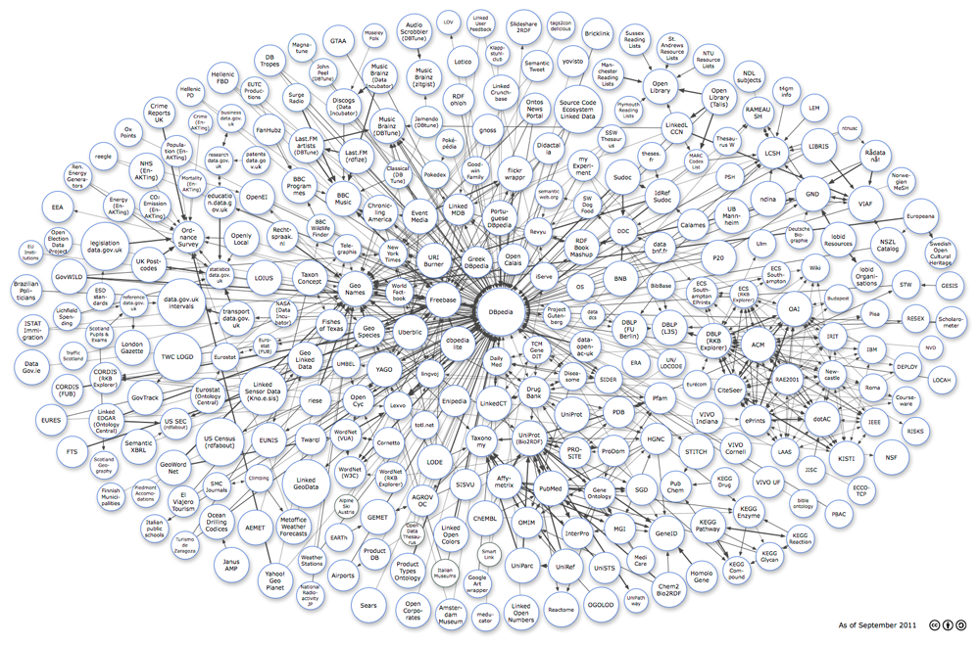
The Linked Data Cloud
From http://lod-cloud.net/

Slide 9
Ontologies
Linked data presents us a way to describe resources
However, the way one person describes a resource may not match how others will describe the same resource
Additionally, a resource presented in this way may (or will) be incomplete, lacking details of the domain of which it resides
To be complete so that others can make inference over the collection of data, we want to build a full structure that defines classes and their properties
We need to go beyond simple Linked Data to an ontology

Slide 10
Ontologies
The formal definition of ontology is
  (1) a branch of metaphysics concerned with the nature and relations of being and
  (2) a particular theory about the nature of being or the kinds of existents
  The term comes from philosophy
For the semantic web, we define an ontology as
  A representation vocabulary, often specialized to some domain (or subject matter)
  The ontology typically represents class/subclass relations and class/property relations
  Further, ontologies should share the same vocabulary in how they express the pieces of knowledge found within their domains so that ontologies can form a foundation of underlying knowledge used throughout the semantic web

Slide 11
Types of Ontologies
Domain ontology
  Represents concepts of a particular domain or category of knowledge
    E.g., a music ontology, an ontology of computer hardware, etc
Upper ontology
  Represents knowledge about knowledge – that is, meta-knowledge
    Objects such as physical object, abstract object and within them, living object, inanimate object, or for abstract: word, action, etc
Hybrid ontology
  An ontology that cuts between the two, for instance a common sense ontology which does not exist in a particular domain and includes both general and specific pieces of knowledge

Slide 12
Ontologies vs Linked Data
Both support class/subclass and class/property definitions so what is the difference between them?
  Think of Linked Data as being incomplete, messy, inconsistent within itself and across to other data sources, not particularly trustworthy, data driven (that is, starts with data or resources)
  Think of an ontology as a well-thought out structure which is as complete as possible, concept and application driven (starts with the domain and the intended use of the ontology)
Early on, most semantic web researchers were interested in building ontologies
  Today, Linked Data is a quicker, possibly more effective approach

Slide 13
Ontology Components
Class: specify the superclass (all classes are members of at least one class, Thing)
Individuals: instances or objects, almost always at the bottom level of any ontology hierarchy
Attributes: properties/features/characteristics which can be defined for a class or an individual
Relations: ways that classes and/or individuals relate to each other
Functions: means of manipulating classes or individuals
Rules: if-then statements that describe logical inferences on classes/individuals
Axioms: assumptions made within the domain
Events: occurrences which change attributes or relations between individuals (or possibly classes)

Slide 14
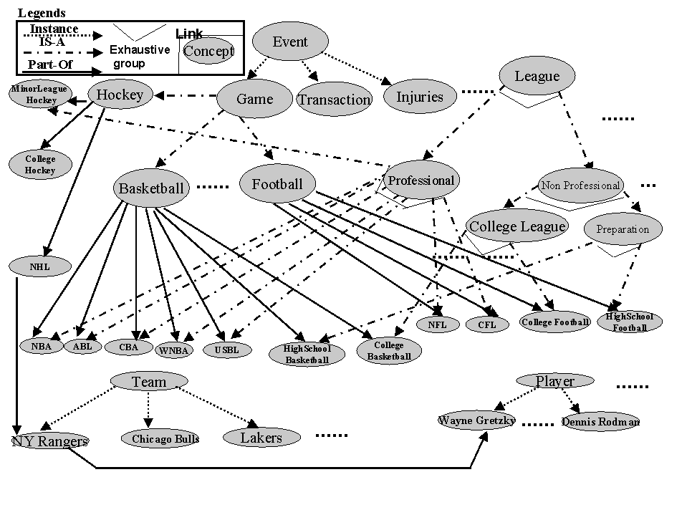
Example Ontology: Sports
Question: who decides what should be represented and how?
  here, the ontology is tangled (multiple parents)
  we may disagree about whether about the layout, for instance would you define Event and then Game and then the individual sports? (is Football a subclass of Event?)

Slide 15
Linked Open Vocabulary (LOV)
A pursuit headed up by library science which builds upon Linked Data using RDFS and OWL
  specifically building online vocabularies
Similar to the Linked Open Data cloud, this draws on numerous ontologies such as
  Audio features ontology
  Algorithms ontology
  BBC ontology
  Data category ontology, datatype ontrology
  Event ontology
  Food ontology
These ontologies provide new name spaces such as dcat (data category), vann (vocabulary for annotating vocabulary descriptors), skos (simple knowledge organization system) and foaf

Slide 16
WordNet
A related project is WordNet which is a large database of English words
  Words are grouped together into “cognitive synonyms” called synsets (117,000) and hypernyms
    Synsets are linked together by both semantic relations (e.g., links as in a semantic network) and by lexical relations
    Links include isa, instance, part (as in “is a part of”), generic verb forms (somewhat like ATRANS, PTRANS) and word-specific relationships such as “volume” for “talk” and “whisper”
  Words are also stored with definitions
Primarily used for language processing when words might be deemed synonymous or have some other form of relation that needs to be discovered, or by services that input natural language and need to translate that input into a more structured form

Slide 17
The Envisioned Uses of Ontologies
The primary use of the ontology is as a resource by a web-based agent (whether human or program)
Through ontologies, knowledge can be presented such that
  Relationships of entities within a domain are explicitly listed
  Domain assumptions are explicitly listed
  Vocabularies for the given domain are explicitly listed
  Translational rules to convert terms in the domain’s vocabulary into other vocabularies are explicitly listed
Through the ontology, agents can retrieve and aggregate data from multiple sources and perform inferences

Slide 18
Using an Ontology
How will we use our ontologies?
  To enhance search engines beyond keyword searches
    Search query keyword terms can be translated by adding semantics to the meaning behind the terms
  To annotate multimedia data files
    we can’t currently search for the content of image or sound files
  To annotate design components
    imagine an expert system that needs to replace component 1 with component 2 based on the component functions and sizes
  Intelligent agents
    so that two agents can find a common vocabulary to communicate together
  To support ubiquitous computing endeavors

Slide 19
Agents
Knowledge-based (Expert) System research reached several interesting conclusions
  extremely useful but enormous undertakings
  with proper tools (shells, languages), non-AI people can construct these systems
  automated knowledge acquisition reduces effort
  brittle because they lack general knowledge
KBS construction moved out of the active realm of AI research, but it was realized that we still need autonomous problem solving systems
  this becomes even more critical as we focus on how we might use the distributed knowledge available on the WWW
  this led to research into more primitive forms of reasoners: the intelligent agent

Slide 20
Agents: Some Definitions
There is no single definition that adequately covers what everyone wants an agent to be but there are several commonly cited features:
  Autonomous – must be able to work on its own to solve the problem
  Communicative – must be able to communicate with other agents or knowledge sources to acquire knowledge or data
  Goal-oriented – must be able to, given a task, figure out how to solve the task and work toward that go
  Perceptive – must be able to sense its “environment”
  Mobility – must be able to move within its environment *
  Sociability – ability to communicate with a human during problem solving *
To define an agent, which features are necessary?
      * these features are not required by all researchers
Will these features help us identify what an agent is?

Slide 21
The Problem of Mobility
True mobility means some degrees of freedom
  This may be physical motion like a robot that has a robotic arm, or an autonomous vehicle
  Or it may be a process that is able to move from one processor to another – it’s freedom is in that it can choose to migrate elsewhere
If we restrict “mobile” to the above two forms of degrees of freedom, then we disallow most forms of software as not being agents, or we have to remove this attribute from the list of what agents should do
  Communication is not mobility and most software on the Internet (or other networks) do not move from processor to processor but instead send out messages/requests
Is the distinction important?
  If a process cannot migrate but can communicate, why should we care?

Slide 22
What is and What is Not an Agent?
We have to be careful in defining an agent
  All too often, the definition is so loosely based that it can include any software product
  For instance, any computer program can be thought to be the following
    autonomous – program works on its own to solve the problem
    communicative –program communicates with other programs
    perceptive – program receives input from various sources
    goal-oriented – program has an implicit function (goal)
So how do intelligent agents differ?
  For one, we hope that an intelligent agent can plan and handle surprising circumstances
  For another, the environment might be more than merely user input

Slide 23
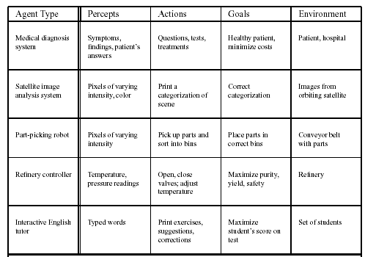
Examples: Are They All Agents?

Slide 24
Representative Agents
An agent which represents your interests
  This implies that the agent has some knowledge or understanding of your desires, goals, interests
  Examples:
    email filter agent – not only to filter out spam, but to prioritize messages
    shop-bot agent – knows your preferences on the items being shopped, and knows your monetary restrictions
    FAX – an email responding agent (or even a phone answering agent) that will mimic your responses to anticipated inquiries
  Representative agents may require
    the ability to communicate in natural language
    the ability to explain itself to the person being represented
    some common sense reasoning capability
    the ability to judge what is trivial and therefore does not require your attention
  Planning capabilities may not necessarily be needed

Slide 25
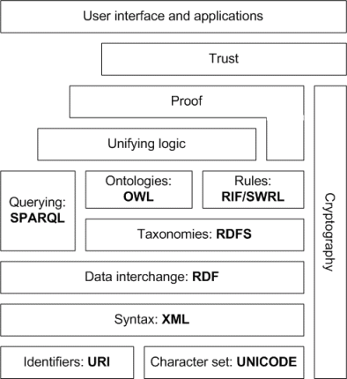
How the Semantic Web Works
The semantic web as
a protocol stack

