Slide 1
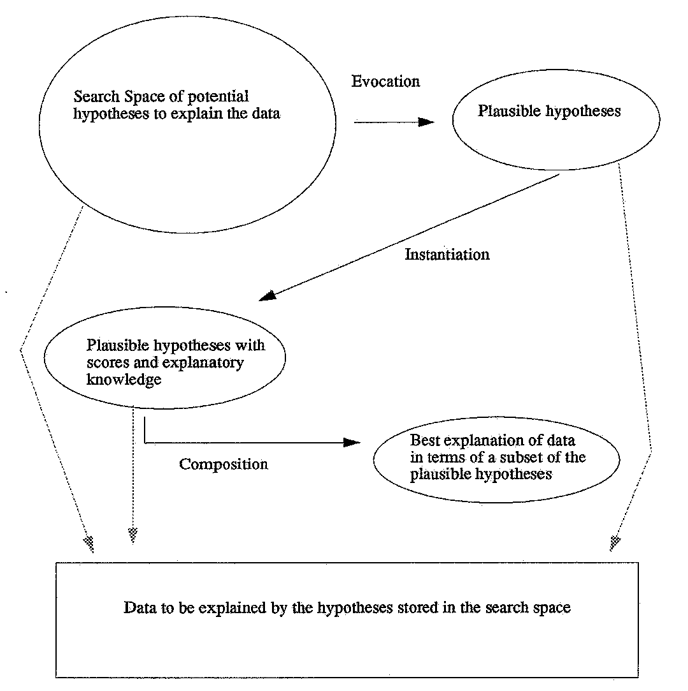
My Research: Abduction
Given data to explain, search for possible explanaiers (hypotheses)
Score them
Assemble them into a composite explanation

Slide 2
Hypothesis Assembly Algorithm
Look for essential hypotheses
  a hypothesis that is the only way to explain some data
Include/propagate/remove (see the next slide) and repeat from top
Look for superior hypotheses
  a hypothesis that is clearly superior at explaining some data because its plausibility value is substantially higher than any other explainer
Include/propagate/remove and repeat from top
Look for better hypotheses
  any hypothesis that explains remaining data better than any other
Include/propagate/remove and repeat from top
If there are still data to explain, either guess or quit with unexplained data

Slide 3
Include/Propagate/Remove
If a hypothesis is found as essential, superior or better (or guessed at) then
  include it in the composite
  propagate the results of including this hypothesis
    if this hypothesis is incompatible with other potential explainers, remove those other hypotheses – this could create new essentials
    if this hypothesis is either associated with or lends support to another hypothesis, increase that hypothesis’ plausibility – this could create new superior or better hypotheses
    If this hypothesis diminishes support from another hypothesis, reduce that hypothesis’ plausibility – in doing so, this could allow another hypothesis to become superior or better
  remove all data that the newly included hypothesis explains

Slide 4
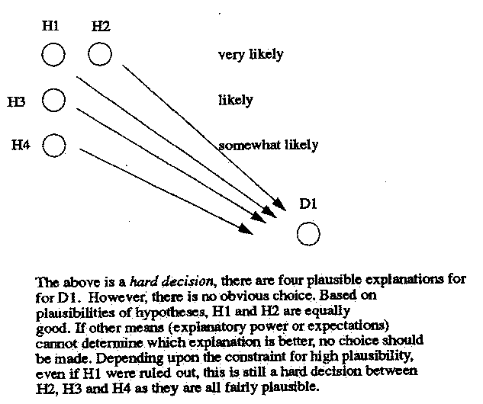
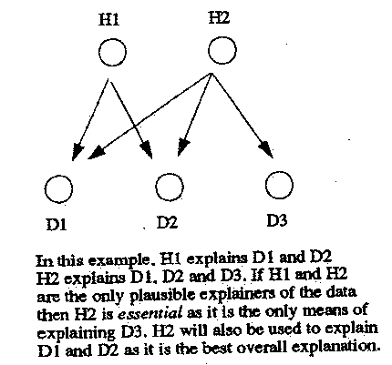
Two Concepts

Slide 5
Abduction Applied
Red blood cell typing (data interpretation)
  given blood cell reactions, explain them in terms of blood antigens
Medical diagnosis (liver disorder diagnosis)
Speech recognition
  ARTREC input was microbeam pellet data, so this was more like a “lip reading” system
Natural language understanding
Theory formation
  which theory better supports life on Earth, evolution or creationism?
  which theory better supports evidence produced in a trial, a person was the murderer or not?
Hand-written character recognition

Slide 6
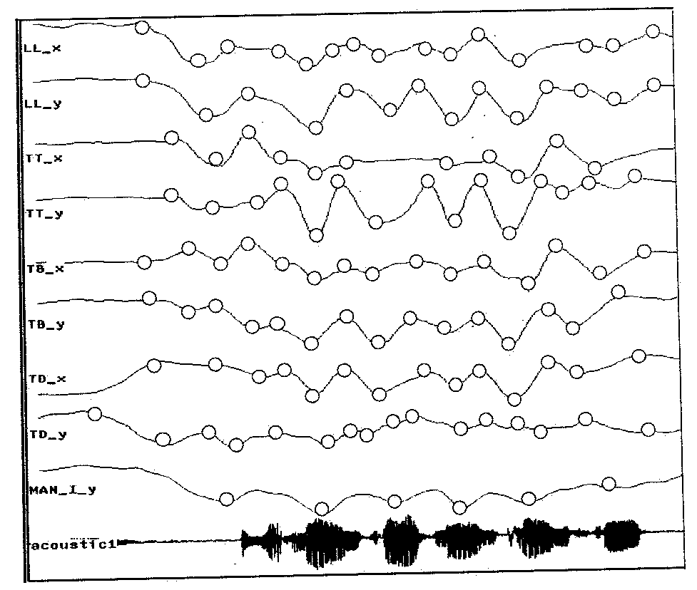
ARTREC: the data

Slide 7
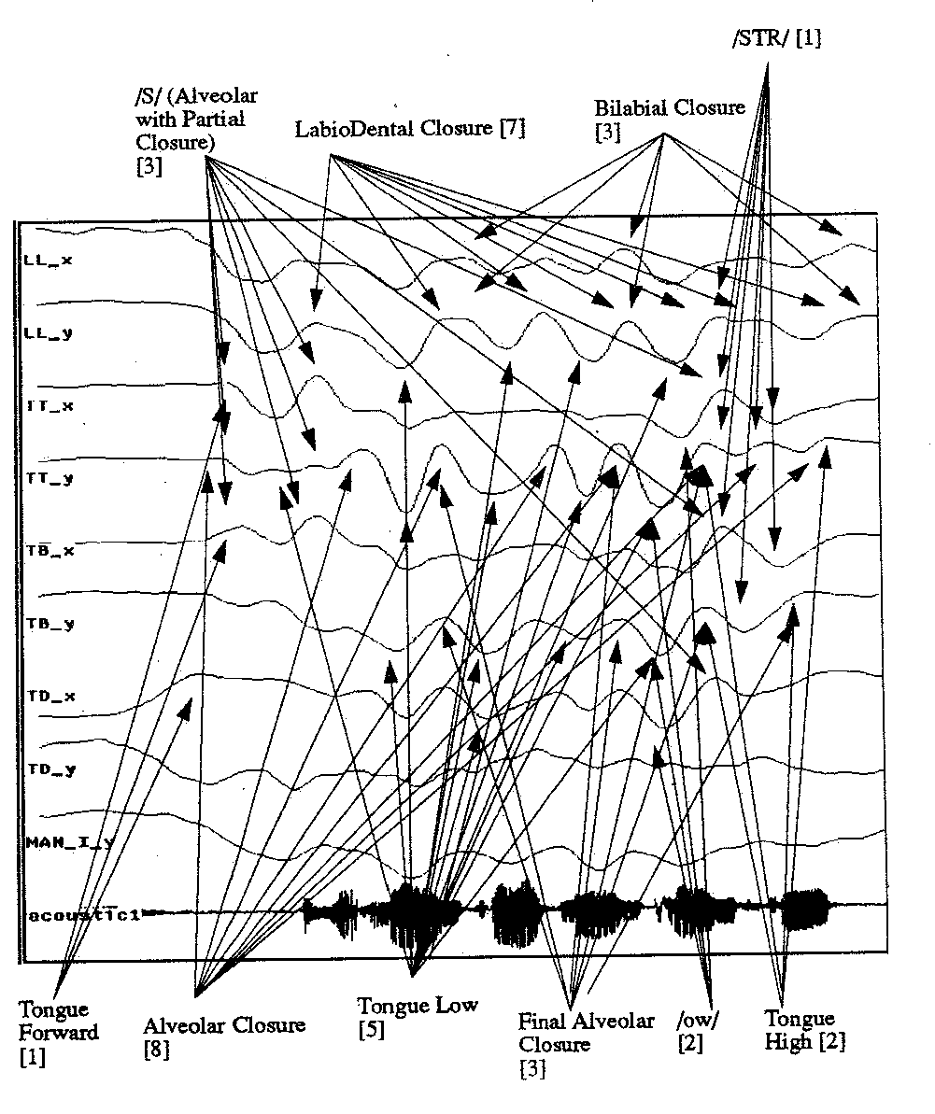
ARTREC: Gestures

Slide 8
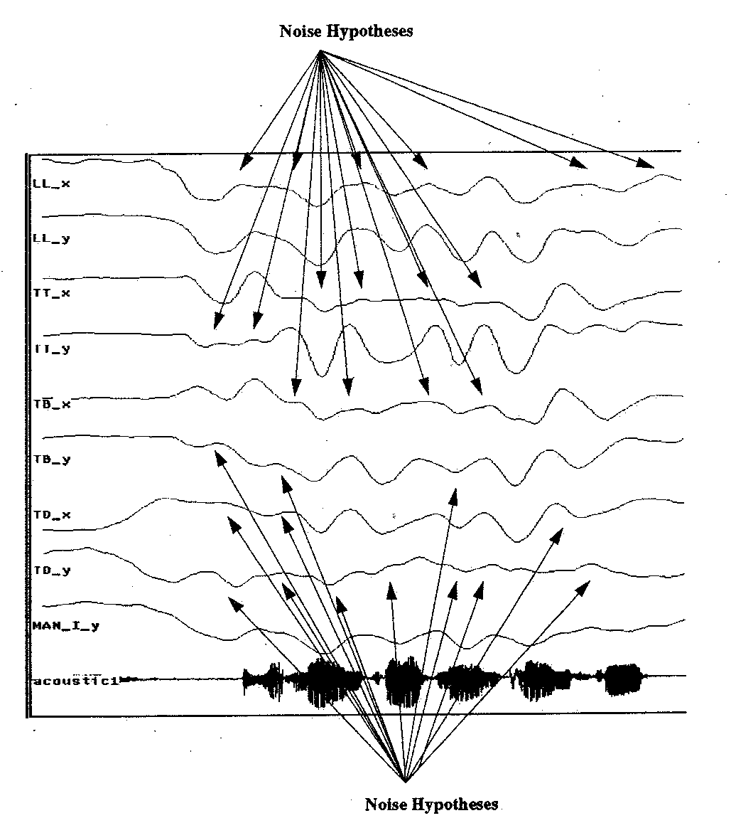
ARTREC: Noise Hypotheses

Slide 9
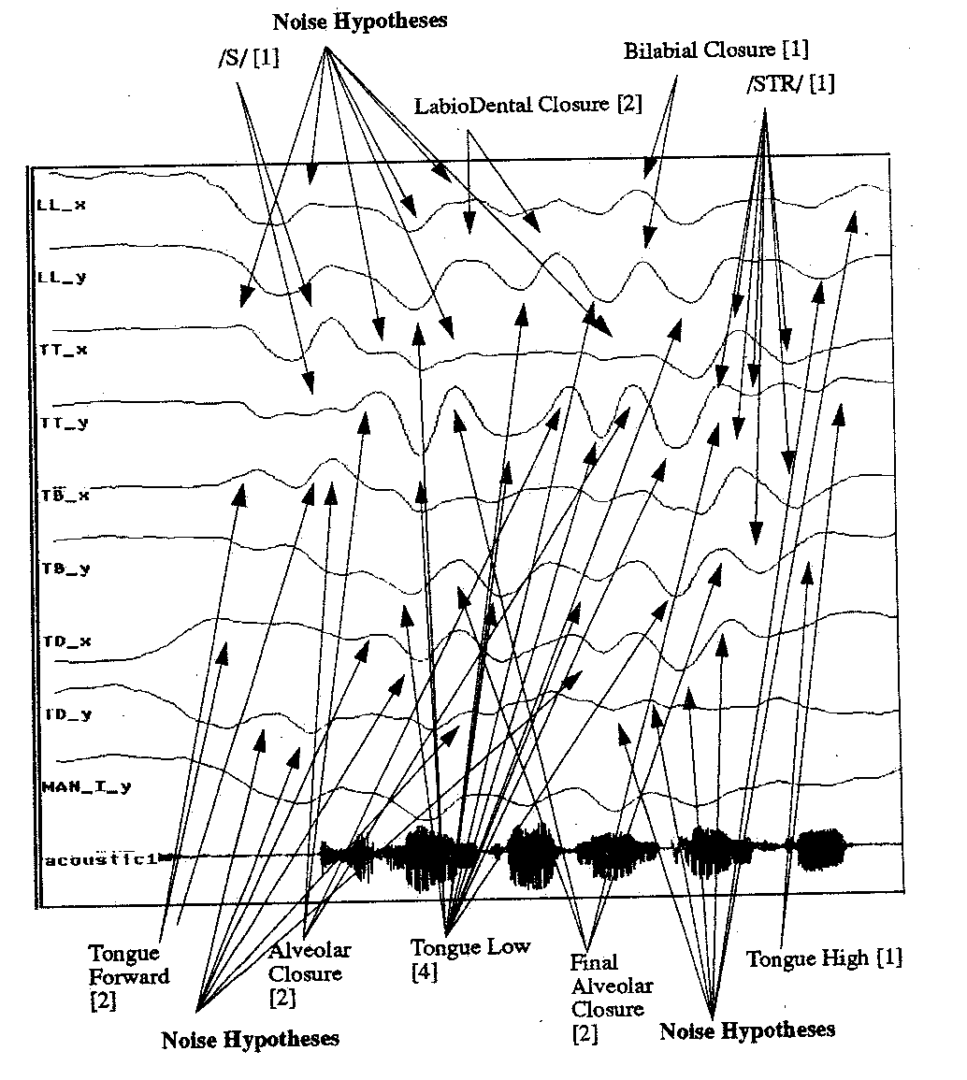
ARTREC: Abductive Inference 1

Slide 10
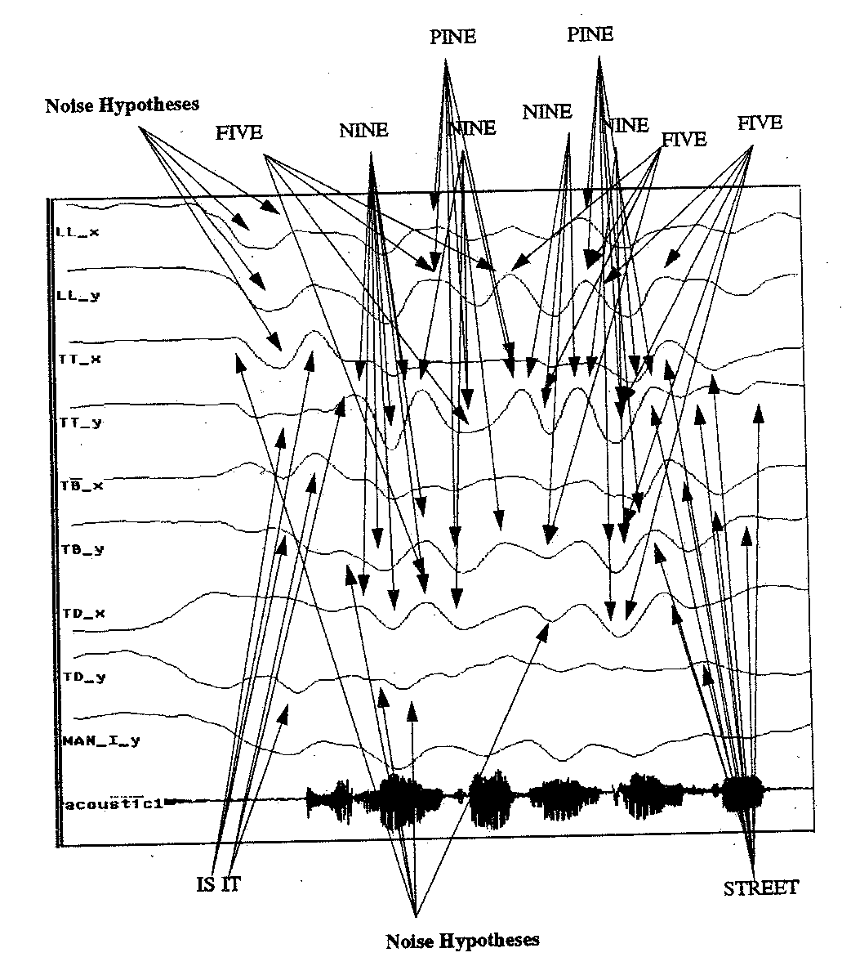
ARTREC: Word Hypotheses

Slide 11
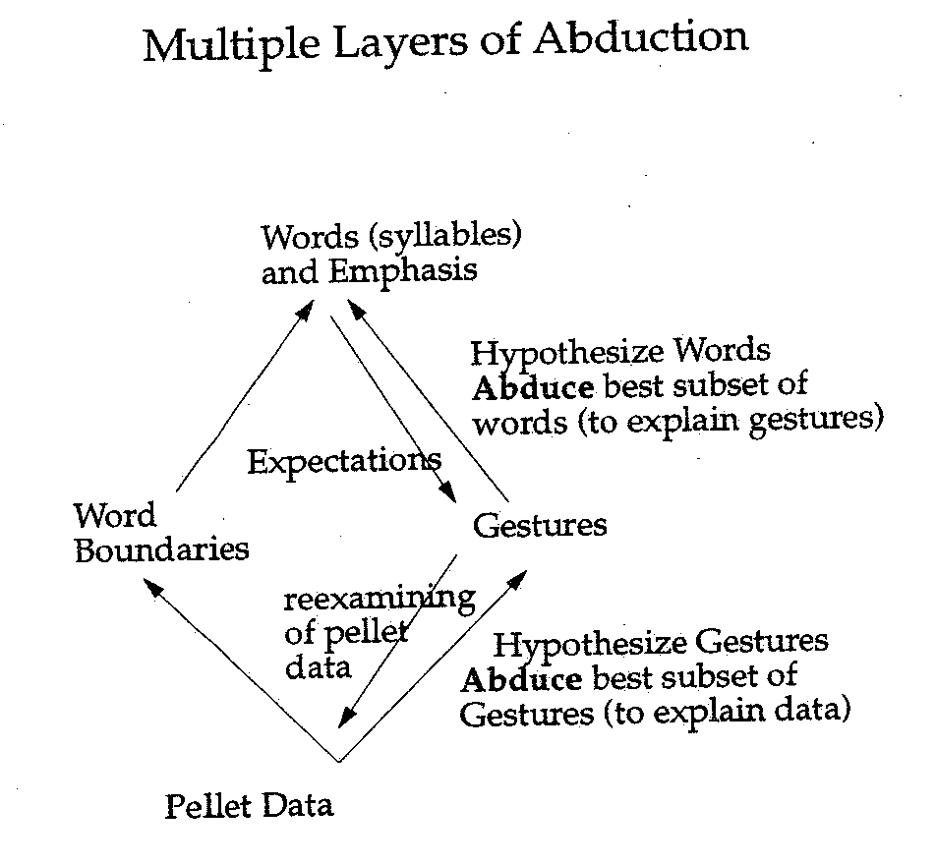
Layered Abduction

Slide 12
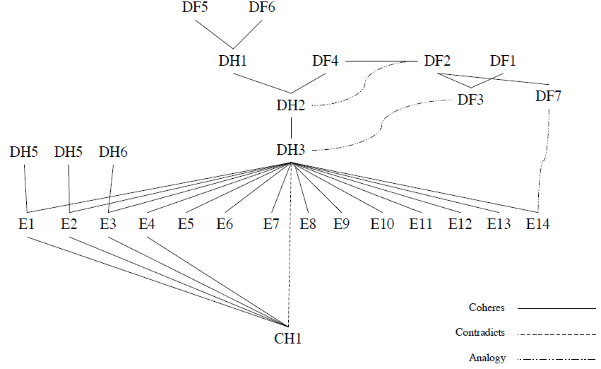
Evolution vs Creationism

Slide 13
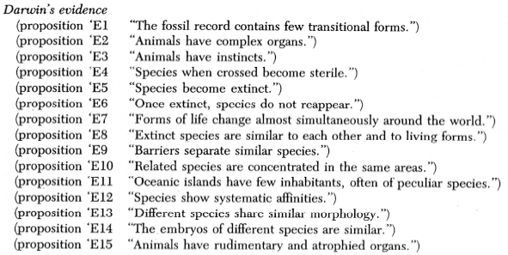
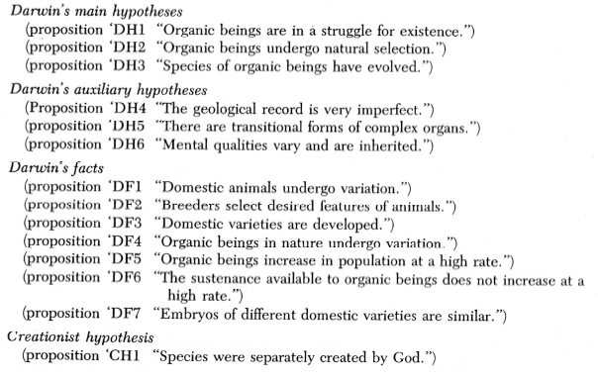
Continued

Slide 14
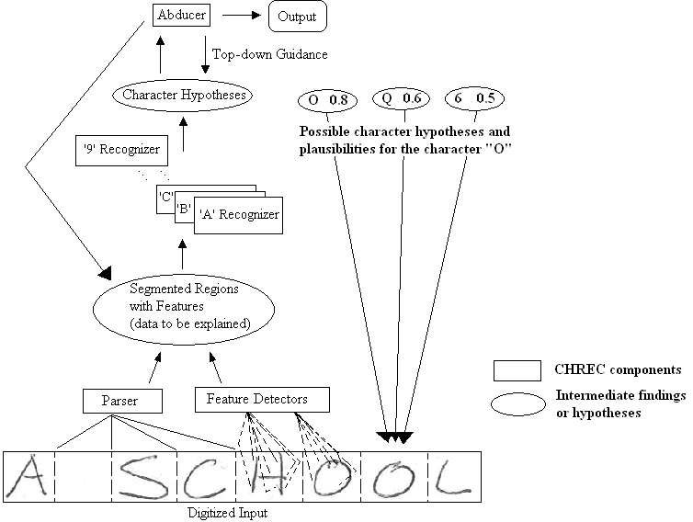
Hand-written Character Recognition

Slide 15
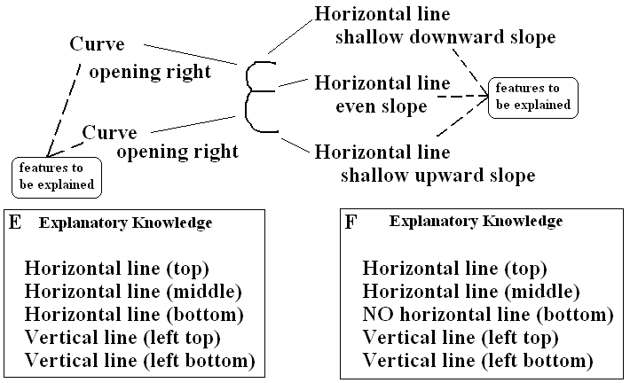
Explaining a Character
The features (data) found to be explained for this character are three horizontal lines and two curves
While both the E and F characters were highly rated, “E” can explain all of the features while “F” cannot, so “E” is the better explanation

Slide 16

Top-down Guidance
One benefit of this approach is that, by using domain dependent knowledge
  the abductive assembler can increase or decrease individual character hypothesis beliefs based on partially formed explanations
  for instance, in the postal mail domain, if the assembler detects that it is working on the zip code (because it already found the city and state on one line), then it can rule out any letters that it thinks it found
    since we know we are looking at Saint James, NY, the following five characters must be numbers, so “I” (for one of the 1’s, “B” for the 8, and “O” for the 0 can all be ruled out (or at least scored less highly)

Slide 17
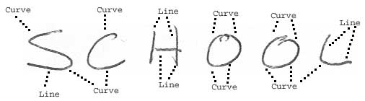
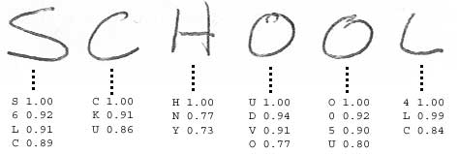
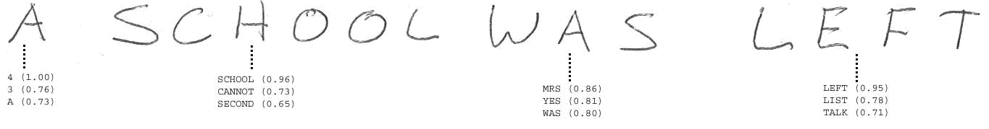
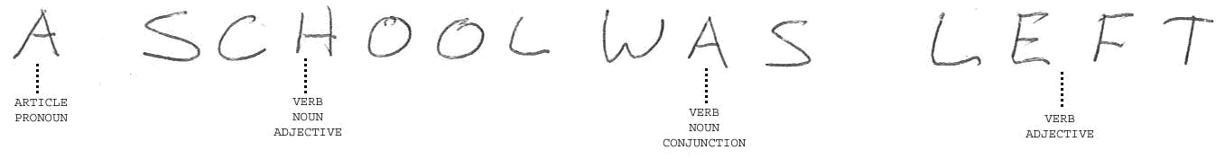
Full Example in
a Natural Language Domain

Slide 18
Decision Making
Based on the abduction algorithm
  used to solve 3 different problems
    grocery shopping list generation
    meal planning
    departmental course scheduling

Slide 19
Other Research Areas
Classification
  automated syntax error debugging
  Linux user classification
  grammatical errors of non-native English speakers
  student error classification CAI tool
Music creation
  combination of routine design and genetic algorithms
Automated software creation
  combination of case-based reasoning and routine design
  select code components from a code library based on function (goals)
  use pseudocode plans as prior cases
Intelligent search engines
  classification, perceptrons and NNs using user feedback

