Slide 1
Common Sense Reasoning
Humans use their common sense all the time
  what is it?
  can we instill it in our AI programs?
  if not, what are the consequences for AI?
We might think of common sense reasoning as the knowledge accumulated through experience that gives us the ability to
  reason with defaults
  reason over uncertainty
  reason over multiple domains even those we are not experts in
  reason naively over such domains a physics, time, space, etc
There have been two general approaches to common sense reasoning
  naïve physics
  cyc

Slide 2
Types of Common Sense Reasoning
There are many different forms of common sense
  understanding when to employ an assumption
  using non-expertly acquired knowledge
  recognizing when an assumption is being violated (two people “not being on the same page”)
  knowing when you can employ shallow knowledge versus needing deeper knowledge
  identifying whether knowledge/data can be trusted
  ability to move from one context to another without being told or prompted to
There is also a notion of what context we might be in so that we can use context-specific knowledge and assumptions

Slide 3
A Lack of Common Sense
AI systems in general (including nearly all expert systems) lack common sense of any kind
  it is difficult to enumerate common sense
  it is difficult to know when to use common sense
Example: Conversation between medical diagnostic system and Human
  System: How old is the patient?
  Human (looking at 1957 Chevrolet): 33
  System: Are there any spots on the patient’s body?
  Human (noticing rust spots): Yes
  System: What color are the spots?
  Human: Reddish-brown
  System: The patient has measles (probability 0.9)

Slide 4
Naïve Reasoning Approaches
Humans often reason naively over such issues as physics, time (events) and spatial relationships without understanding underlying mechanisms or reasoning very deeply
  what comes up must come down
  an object that is propelled will eventually slow down unless it is in a vacuum (because of friction or air resistance)
  if an event occurs from time x1 to time x2 and a second event occurs from time y1 to time y2 and x2 < y1 then the first event occurs entirely before the second event
Equipping an AI program with such knowledge and reasoning abilities can improve the AI system’s capabilities

Slide 5
Naïve (Qualitative) Physics
As in physics, we have variables and equations, but our equations do not use numeric values (instead, we employ qualitative states)
  a container will be: Empty, Between, Full
    Empty + Empty = Empty
    Empty + Full = Full
    Empty + Between = Between
    Between + Between = {Between, Full}
    Full + Between = Overflow
    Full + Full = Overflow
  a reasoner might simulate state changes
    what happens to this ball when I drop it from the air?
    what happens to the liquid if the pipe is cracked?
    will the glass be full when I pour some wine into it?

Slide 6


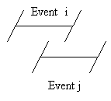
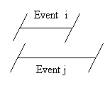
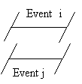
Temporal Relationships
As with qualitative physics, we temporal relationship:
  before/after
  meets/is met by
  overlaps/is overlapped by
  starts/is started by
  ends/is ended by
  equals
We might reason over such relationships in
a problem like medical diagnosis where
need to understand distinct events and
overlapping events

Slide 7
Spatial Relationships
There are similar spatial relationships to reason about objects in space and how they might interact without having to result to actual physics
  these relationships can help us naively reason about friction, obstructions, weight, etc
  for instance, if object A is on top of object B and you lift B, you are lifting A
  but, if object A is on top of object B and object A is too heavy to lift, you cannot lift B
Temporal relationships are 2 dimensional (before and after) but spatial relationships are 3 dimensional
  therefore there are far more relationships (13³ by one person’s reasoning)

Slide 8
Continued
  Fortunately, many of the possible 13³ relationships will not be necessary
  for instance, if an object is solid, we don’t have to worry about situations where another object is inside this one
Some spatial relationships
  adjacency, along, perpendicular, parallel, across from, contains, distance, direction, equals, meets
    if X contains Y then X is larger than Y
    if X is parallel to Y then X does not touch Y
We can also define shapes of which some relationships are important and others are not
  circular, oval, square, rectangular/oblong, triangle, line, ribbon
And shape features
  angle, line, curve, node, terminal, etc

Slide 9
Material Properties
Since different materials have properties special to them, we might use frames/objects to represent such items where they can inherit the properties useful in reasoning about them
  liquids and gases can seep into things, solids cannot
  liquids are naturally still, but can flow when put under pressure (including gravity)
  solids can be rigid or flexible, but do not usually move unless energy is exerted on them
We could also include attributes for these properties
  weight/mass, friction/viscosity, cost/worth/value
  but recall that we are reasoning naively, we do not want to enumerate properties at the level of chemistry or physics

Slide 10
Cyc
Attempt to construct a common sense knowledge-base
  effort of about 30+ years of coding,
  5,000,000 common sense facts and rules
  general-purpose knowledge-base to be used with other applications
    CYC is an underlying bed of knowledge for applications to use if and when necessary
Originally, Cyc knowledge was merely a collection of rules
  later, the rules were grouped into various domains and areas (called theories)
  now, Cyc is predominantly a collection of ontologies

Slide 11
Cyc vs OpenCyc
The full version of Cyc is an enterprise system that must be purchased
A reduced version of Cyc is available called OpenCyc which is open source
  OpenCyc comes with an API and can be used to support the semantic web, wikipedia and other open source community endeavors and has an Oracle interface
  OpenCyc (as of 2012) consists of ~239,000 terms and over 2 million triples (unique pieces of knowledge)
  Cyc has built-in reasoners while OpenCyc does not and does not include any specific instance data
    requires 3G RAM, 64 bit system, 1G hard disk space

Slide 12
CycL
Cyc was originally written in Lisp but was later rewritten using a predicate calculus-like language called CycL
  Some of the terms to define information available in CycL are
    #$Collection – define a class that has instances
    #$Individual – define an instance which can include relations, strings, numbers
    #$isa – instance of (not child)
    #$genls – subclass of
  Many built-in operators such as #$and, #$or, #$not, #$implies, #$arity, #$thereexists, #$assertedSentence, #$knownSentence, #$arg1Isa, #$resultIsa
  Assertions placed into ( ) as in Lisp
    (isa FrankZappa Individual)

Slide 13
Sample CycL Code
Instance data:
  (#$and (#$isa #$NeilArmstrong #$Astronaut) (#$performedBy #$FirstLunarLanding #$NeilArmstrong) (#$eventOccursAt #$FirstLunarLanding #$MoonOfEarth))
Class/subclass relationship as a rule
  (#$implies (#$isa X #$Person) (#$isa X #$Primate))
Family relationship rule
  (#$implies (#$and (#$father X Y) (#$siblings Y Z) (#$isa Z #$FemalePerson)) (#$daughter Z X))
More complex rule
  (#$implies (#$orbits X Y) (#$thereExists Z (#$thereExists Q (#$and (#$isa Z #$OrbitalPath) (#$surrounds-Ringlike Z Y) (#$traverses-Complete Q Z) (#$objectMoving Q X)))))

Slide 14
Cyc Ontology
Cyc has 3 levels of ontologies
  Upper: abstract concepts (such as categories), universal truths
    events, collections, quotes, relationships
  Middle: truths attached to contexts, relationships, every day items
    types of events, types of collections, types of entities
  Lower: domain specific knowledge and specific instances including scripts
Examples
  (isa BurningOfPapalBull SocialGathering)
  (dateOfEvent BurningOfPapalBull
  (DayFn 10 (MonthFn December (YearFn 1520))))
  (relationInstanceExistsMin BurningOfPapalBull attendees UniversityStudent 40)

Slide 15
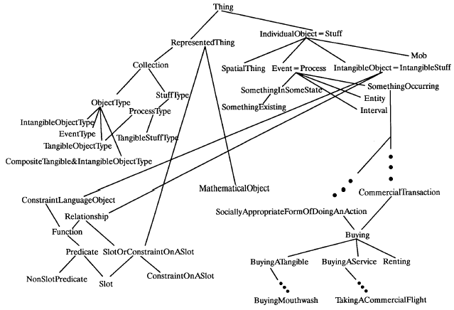
Part of Cyc’s Ontology

Slide 16
Cyc Inferencing
Cyc primarily uses logical deduction using a best-first search strategy and a set of proprietary heuristics
  modus ponens
  modus tollens
  universal and existential quantification
Cyc also uses inheritance and automatic classification to reason over taxonomic relationships
Special-purpose inferences and heuristics (for efficiency) are applied to specific domains and contexts (micro-theories)
  temporal and spatial reasoning
  domain specific axioms (e.g., medical diagnostic rules)
  inferences for specific syntactic structures
  general-purpose axioms to be applied when special-purpose axioms are not available or do not work

Slide 17
Micro Theories
Microtheories (contexts) partition CYC’s knowledge base into different (but possibly overlapping) domains/concepts/problems and belief states
Examples include:
  medical diagnosis, manufacturing, weather during the winter, what to look for when buying a car, northern hemisphere, the 1960s, etc…
Information can be “lifted” from one context to another
Each microtheory has its own categories, predicates (although many are shared between microtheories but they may have different parameters), inference rules, assumptions
Reasoning within a microtheory might be thought of as a separate belief state (although in fact it is just a separate namespace)

Slide 18
Using Context
Assertions are true within a given context but not universally
  the rules behind dining in restaurants differ from those of dining at home
The context is specified in a statement
A statement may be true in one context and false in another
  for instance, an assumption that gas costs $2+ a gallon is valid today but if we are reasoning about the 1960s, it is an invalid assumption
We might have to “lift” elements from one context into another
  this provides a mechanism for reasoning about items in different contexts – when “lifting” items from one context to another, assumptions, vocabulary, axioms and other elements that differ must be resolved in the new context
For example:
  a mother with a child will be expected to behave a certain way but she would be expected to behave like anyone else in a grocery store
  under exceptional situations, we lift behavior from the mother/child context to override the behavior in the grocery store

Slide 19
Sample Cyc Inferences
You have to be awake to eat
You can usually see people’s noses but not their hearts
You cannot remember events that have not yet happened yet
If you cut a lump of peanut butter in half, each half is also a lump of peanut butter, but if you cut a table in half, neither half is a table
If you are carrying a container that's open on one side, you should carry it with the open end up
Vampires don’t exist (but one microtheory states that “Dracula is a vampire”)
The U.S.A. is a big country
When people die, they stay dead

