Slide 1
Reasoning with Uncertainty
We have only examined knowledge that is true/false or truth preserving, but the world is full of uncertainty
we need mechanisms to reason with that uncertainty
We find two forms of uncertainty
unsure input
unknown – do not know the answer so you have to say unknown
unclear – answer doesn’t fit the question (e.g., not yes but 80% yes)
vague data – is a 100 degree temp a “high fever” or just “fever”?
ambiguous/noisy data – data may not be easily interpretable
non-truth preserving knowledge (most rules are associational, not truth preserving)
unlike “if you are a man then you are mortal”, a doctor might reason from symptoms to diseases
“all men are mortal” denotes a class/subclass relationship, which is truth preserving
but the symptom to disease reasoning is based on associations and is not guaranteed to be true

Slide 2
Monotonicity
Monotonicity – starting with a set of axioms, assume we draw certain conclusions
if we add new axioms, previous conclusions must remain true
the knowledge space can only increase
example: assume that person X was murdered and through various axioms about suspects and alibis, we conclude person Y committed the murder
later, if we add new evidence, our previous conclusion that Y committed the murder must remain true
obviously, the real world doesn’t work this way (assume for instance that we find that Y has a valid alibi and Z’s alibi was a person who we discovered was lying because of extortion)

Slide 3
The Closed World Assumption
In monotonic reasoning, if something is not explicitly known or provable, then it is false
this assumption in our reasoning can easily lead to faulty reasoning because its impossible to know everything
How can we resolve this problem?
we must either introduce all knowledge that is required to solve the problem at the beginning of problem solving
or we need another form of reasoning aside from monotonic logic
The logic that we have explored so far (first order predicate calculus with chaining or resolution) is monotonic (so is the Prolog system)
so now we turn to non-monotonic logics

Slide 4
Non-monotonicity
Non-monotonic logic is a logic in which, if new axioms are introduced, previous conclusions can change
this requires that we update/modify previous proofs which can be computationally costly
We can enhance our previous strategies
in logic, add M before a clause
M means “it is consistent with”
for all X: bright(X) & student(X) & studies(X,CSC) & M good_economy(time_of_graduation) → job(X, time_of_graduation)
in a production system, add unless clauses to rules
if X is bright, X is a student and X studies computer science, then X will get a job at the time of graduation unless the economy is not good at that time
these are forms of assumption-based reasoning

Slide 5
Dependency Directed Backtracking
To reduce the computational cost of non-monotonic logic, we need to be able to avoid re-searching the entire search space when a new piece of evidence is introduced
otherwise, we have to backtrack to the location where our assumption was introduced and start searching anew from there
In dependency directed backtracking, we move to the location of our assumption, make the change and propagate it forward without necessarily having to re-search from that point
you have scheduled a meeting on Tuesday at noon because everyone indicated that they were available
you cannot find a room, but rather than backtracking to find a new day and time, you just change the day to Thursday

Slide 6
Truth Maintenance Systems
In a TMS, inferences are supported by evidence
support is directly annotated in the representation so that new evidence can be mapped to conclusions easily
if some new piece of evidence is introduced which may overturn a previous conclusion, we need to know if this violates an assumption
if so, we negate the assumption and follow through to see what conclusions are no longer true
The TMS supports dependency-directed backtracking so that you can easily make changes without having to repeat your search
there are several forms of TMS, we will concentrate on the justification TMS (JTMS) but others include assumption-based TMS (ATMS), logic-based TMS (LTMS), and multiple belief reasoners (MBR)

Slide 7
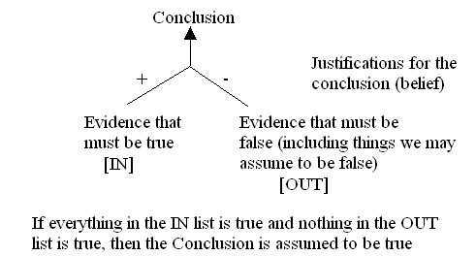
Justification Truth Maintenance System
The JTMS is a graph implementation whereby each inference is supported by evidence
an inference is supported by items that must be true (labeled as IN items) and those that must be false (labeled as OUT items), things we assume false will be labeled OUT
when a new piece of
evidence is introduced,
we examine the pieces
of evidence to see if
this either changes it
to false or contradicts
an assumption, and
if so, we change any
inferences that were
drawn from this
evidence to false, and propagate this across the graph

Slide 8
How a JTMS Works
The JTMS has three operations
inspection – through inspection, the JTMS can determine what must be true for a given proposition to be true or what assumptions underlie a proposition
modification – when new evidence comes to light, modification allows the JTMS to update its beliefs and change its conclusion(s) – modification includes the addition or removal of premises, and the addition of new propositions and contradictions to assumptions
updating – this propagates a modification throughout the entire JTMS by following only those branches impacted
It is the updating process in a JTMS that makes it more efficient than a normal backtracker – it only backtracks where needed (dependency-directed)

Slide 9
The ABC Murder Mystery
Here is an example: a murder has taken place, our suspects are Abbott, Babbitt and Cabot
We have the following rules (among others)
a person who stands to benefit from a murder is a suspect unless the person has an alibi
a person who is an enemy of a murdered person is a suspect unless the person has an alibi
an heir stands to benefit from the death of the donor unless the donor is poor
a rival stands to benefit from the death of their rival unless the rivalry is not important
an alibi is valid if you were out of town at the time unless you have no evidence to support this
a picture counts as evidence
a signature in a hotel registry is evidence unless it is forged
an alibi is valid if someone vouches for you unless that person is a liar

Slide 10
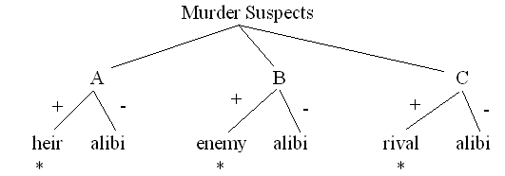
ABC Murder Mystery Continued
We know that A is the only heir of the victim
and we have no knowledge that the victim was poor
We know that B is an enemy of the victim
We know that C is a rivalry in business of the victim
Currently, we have no evidence of alibis
* denotes evidence directly supported by input
+ denotes IN evidence (must be true)
– denotes OUT evidence (assumed false)
Since we have no evidence of an alibi for any of A, B, C, and because each is a known heir/enemy/rival, we conclude all three are suspects

Slide 11
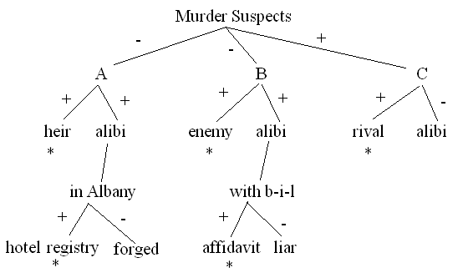
New Evidence Comes To Light
Abbott produces evidence that he was out of town
his signature is found in the hotel registry of a respectable hotel in Albany, NY
Babbitt’s brother-in-law signs an affidavit stating that Babbitt did in fact spend the weekend with him
B has an alibi (not in town) and is no longer a suspect
We have an alibi for A changing the assumption to true and therefore ruling him out as a suspect
Similarly for B, but there is no change made to C, so C remains a suspect

Slide 12
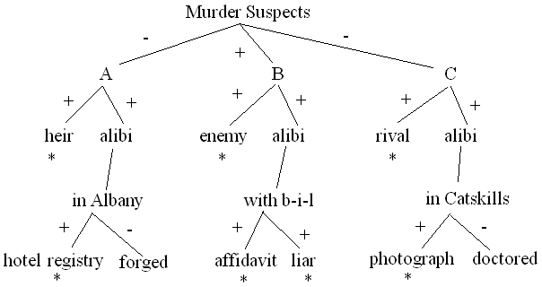
And Finally
B’s brother-in-law has a criminal record for perjury, so he is a known liar
thus, B’s alibi is not valid and B again becomes a suspect
A friend of C’s produces a photograph of C at the meet, shown with the winner
the photograph supports C’s claim that he was not in town and therefore is a valid alibi, C is no longer a suspect
With these final
modifications,
B becomes our
only suspect

Slide 13
Assumption-based TMS (ATMS)
The ATMS is the same as a JTMS with two minor changes
assumptions can fall into two categories
universally accepted as true
those that the problem solver is assuming are true but may be retracted (thus, universal assumptions are introduced here)
evidence is no longer enumerated as + or -, instead they make up sets of premises
Although the latter difference seems irrelevant, it permits the ATMS to entertain multiple belief states at once by changing the assumptions
that is, by taking a set of premises and seeing what happens if these assumptions are false
there is no single state of the ATMS but instead different subsets of beliefs that can be examined

Slide 14
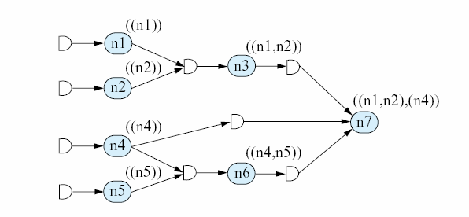
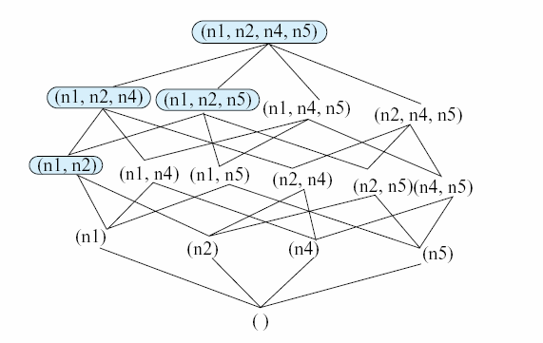
Example ATMS
Dependencies among
premises
The currently possible
belief states (the
collection of premises
that can be considered
true at this at this time)

Slide 15
Abduction
In traditional logic, Modus Ponens tell us that if we have
A → B
A
we conclude B
In abduction, we have instead
A → B
B
we conclude A
The idea here is that we are saying “A can cause B”, “B happened”, we conclude “A was its cause”
this form of reasoning is useful for diagnosis (as an example) but it is not truth-preserving

Slide 16
Using Abductive Reasoning
We know that if the battery has lost its charge then the car won’t start
if the car doesn’t start, we can conclude that the battery lost its charge
The reason this isn’t truth preserving is because there are other possible causes for the car not starting (bad starter, no fuel, bad carburetor, etc)
In order to justify our answer, we should examine other causes for the car not starting and disprove those
we know there is gas in the car
we know the engine is cranking
the car was running yesterday
etc

Slide 17
How Abduction Can be Truth-Preserving
We can still use abduction in a truth-preserving way, but it now takes more work:
assume there are several causes for B:
A1 → B, A2 → B, A3 → B, A4 → B
we can rule out A1, A2 and A3 (that is, we introduce ~A1, ~A2, ~A3), therefore we conclude A4
Diagnosis is commonly performed through abduction
although in the case of a medical doctor, the possible causes A1, A2, A3, A4 are not ruled out
but instead the doctor assigns plausibility values (likelihoods) to each of A1, A2, A3 and A4
how do we get these plausibility values?
what if the plausibilities of A1, A2, A3 were all < .5 but A4 was just .5, do we conclude A4?

Slide 18
Set Covering
In diagnosis, there may be multiple contributing factors or multiple causes of the symptoms
Assume that the following malfunctions (H1-H5, which we will call our hypotheses) can cause the symptoms (observations, O1-O5) as shown
H1 → O1, O2, O3 H2 → O1, O4
H3 → O2, O3, O5 H4 → O5
H5 → O2, O4, O5
O1, O2 and O5 are observed, what is our best explanation?
{H1, H4} explains them all but includes O3 (not observed)
{H2, H5} explains them all but includes O4 (twice) (not observed)
{H1, H3} explains them all but includes O3 (twice)
{H1, H4, H5} explains them all but H4 is superfluous
Mathematically, this problem is known as set covering
abduction is a possible solution to set covering

Slide 19
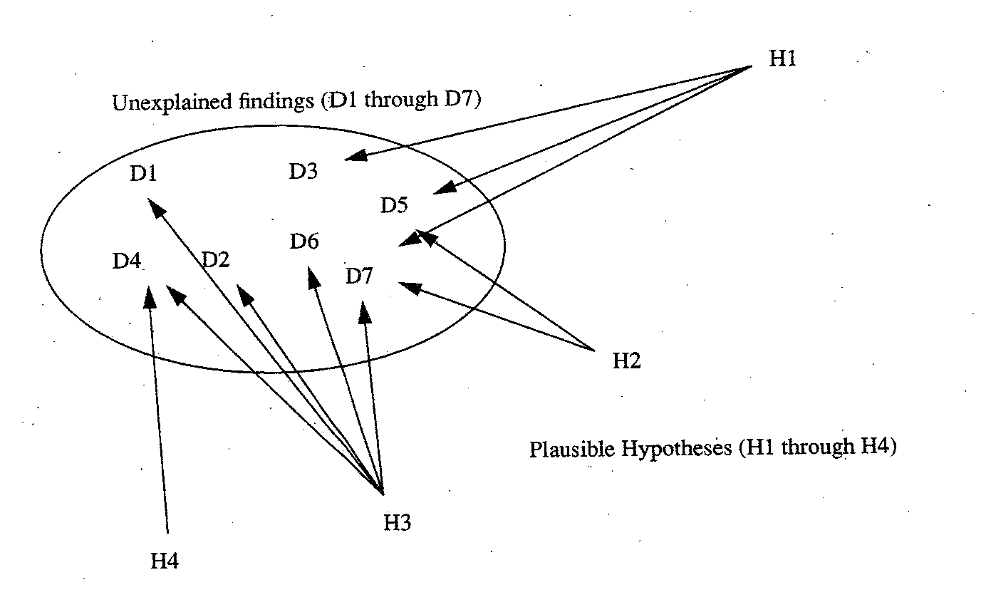

Slide 20
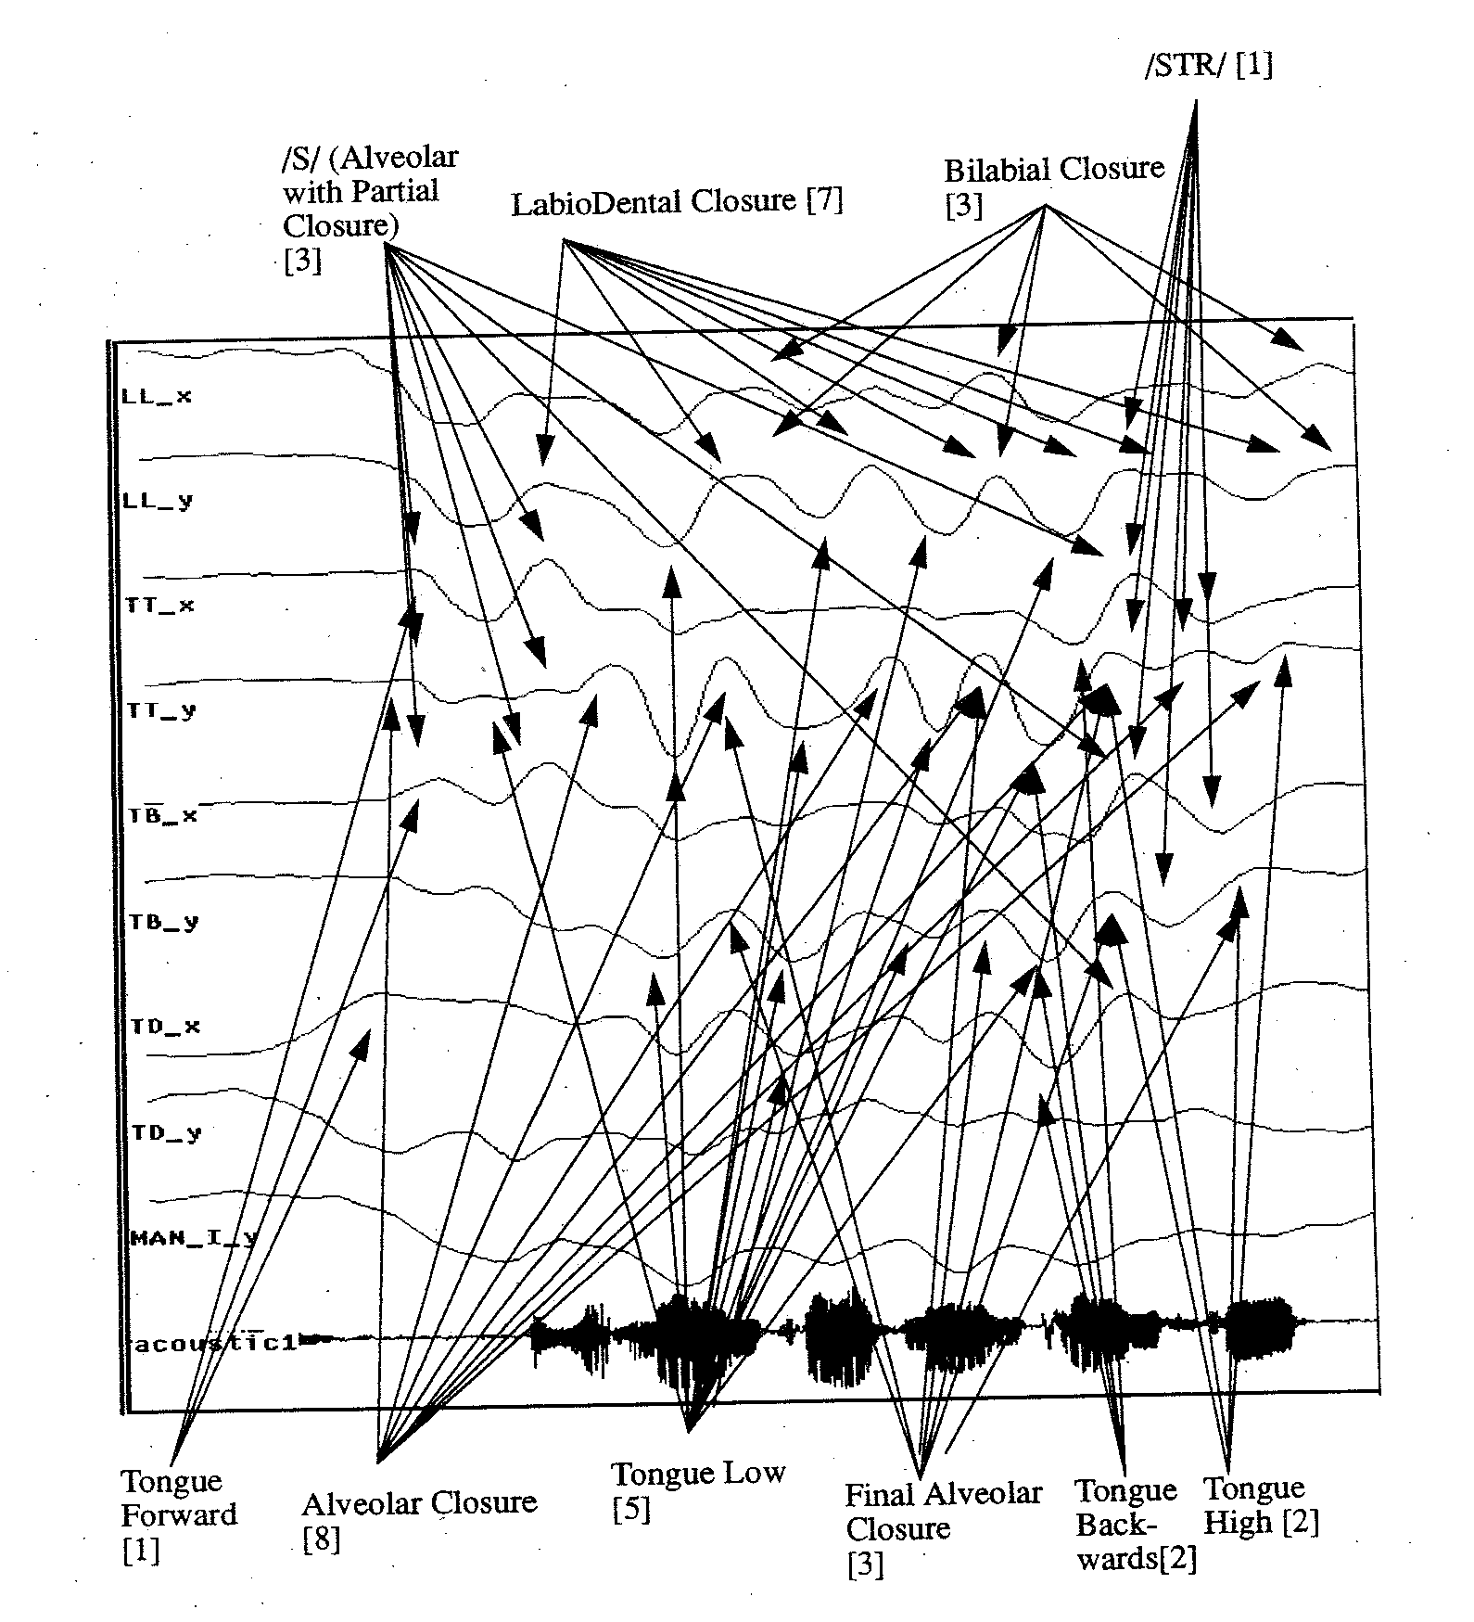
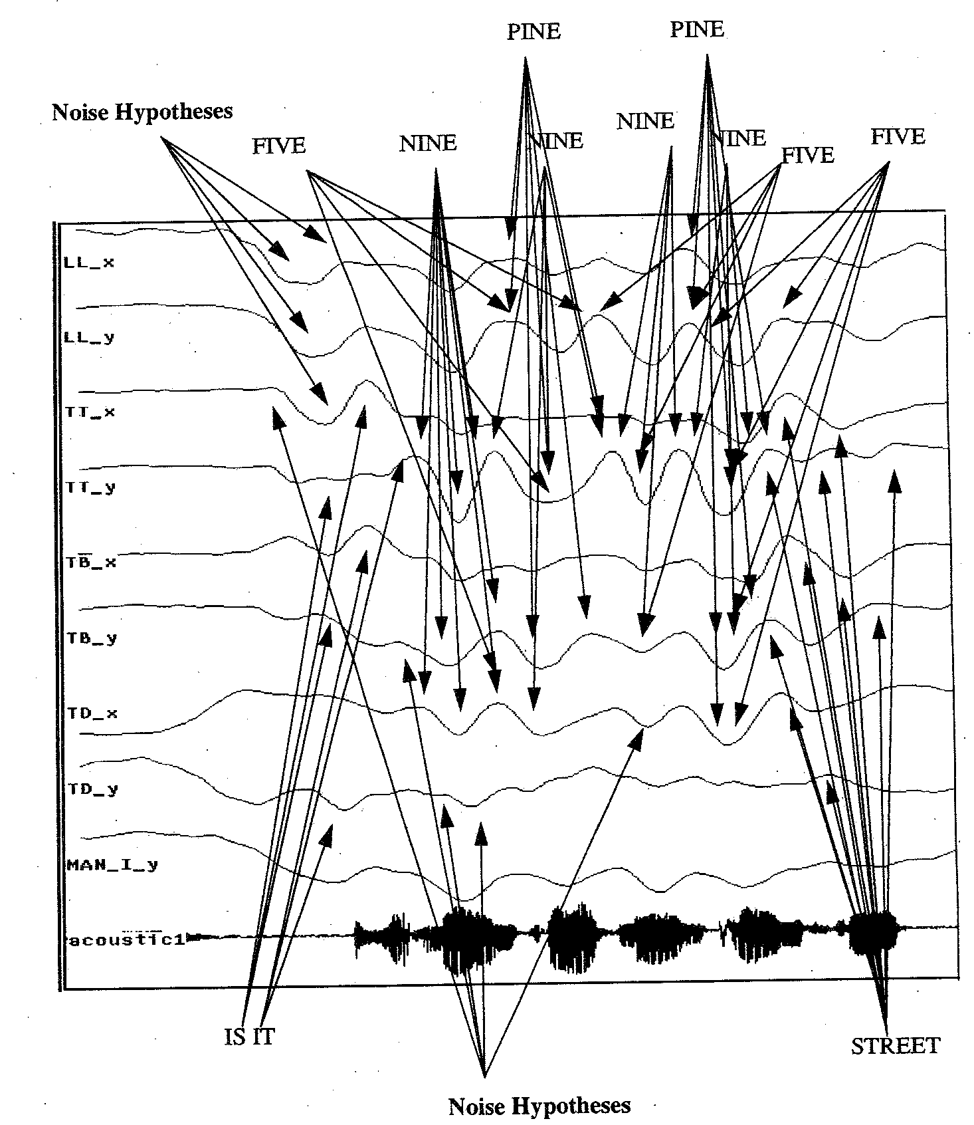
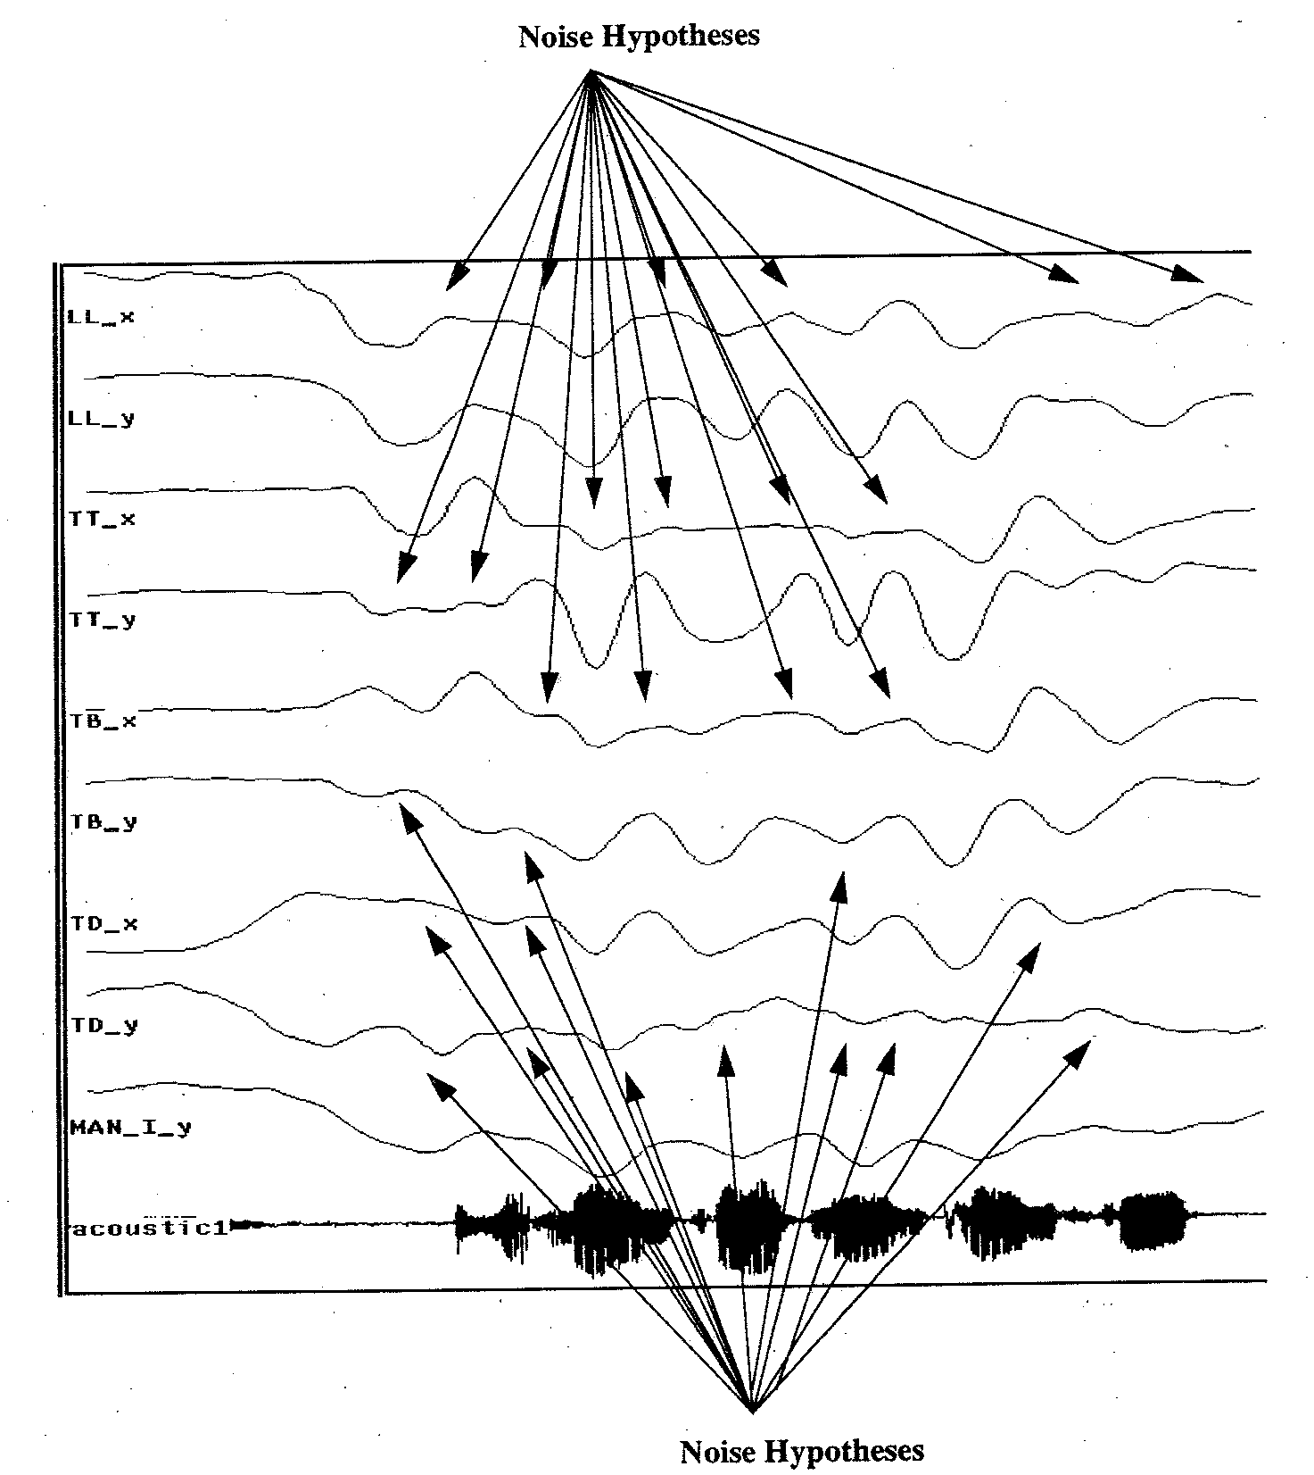
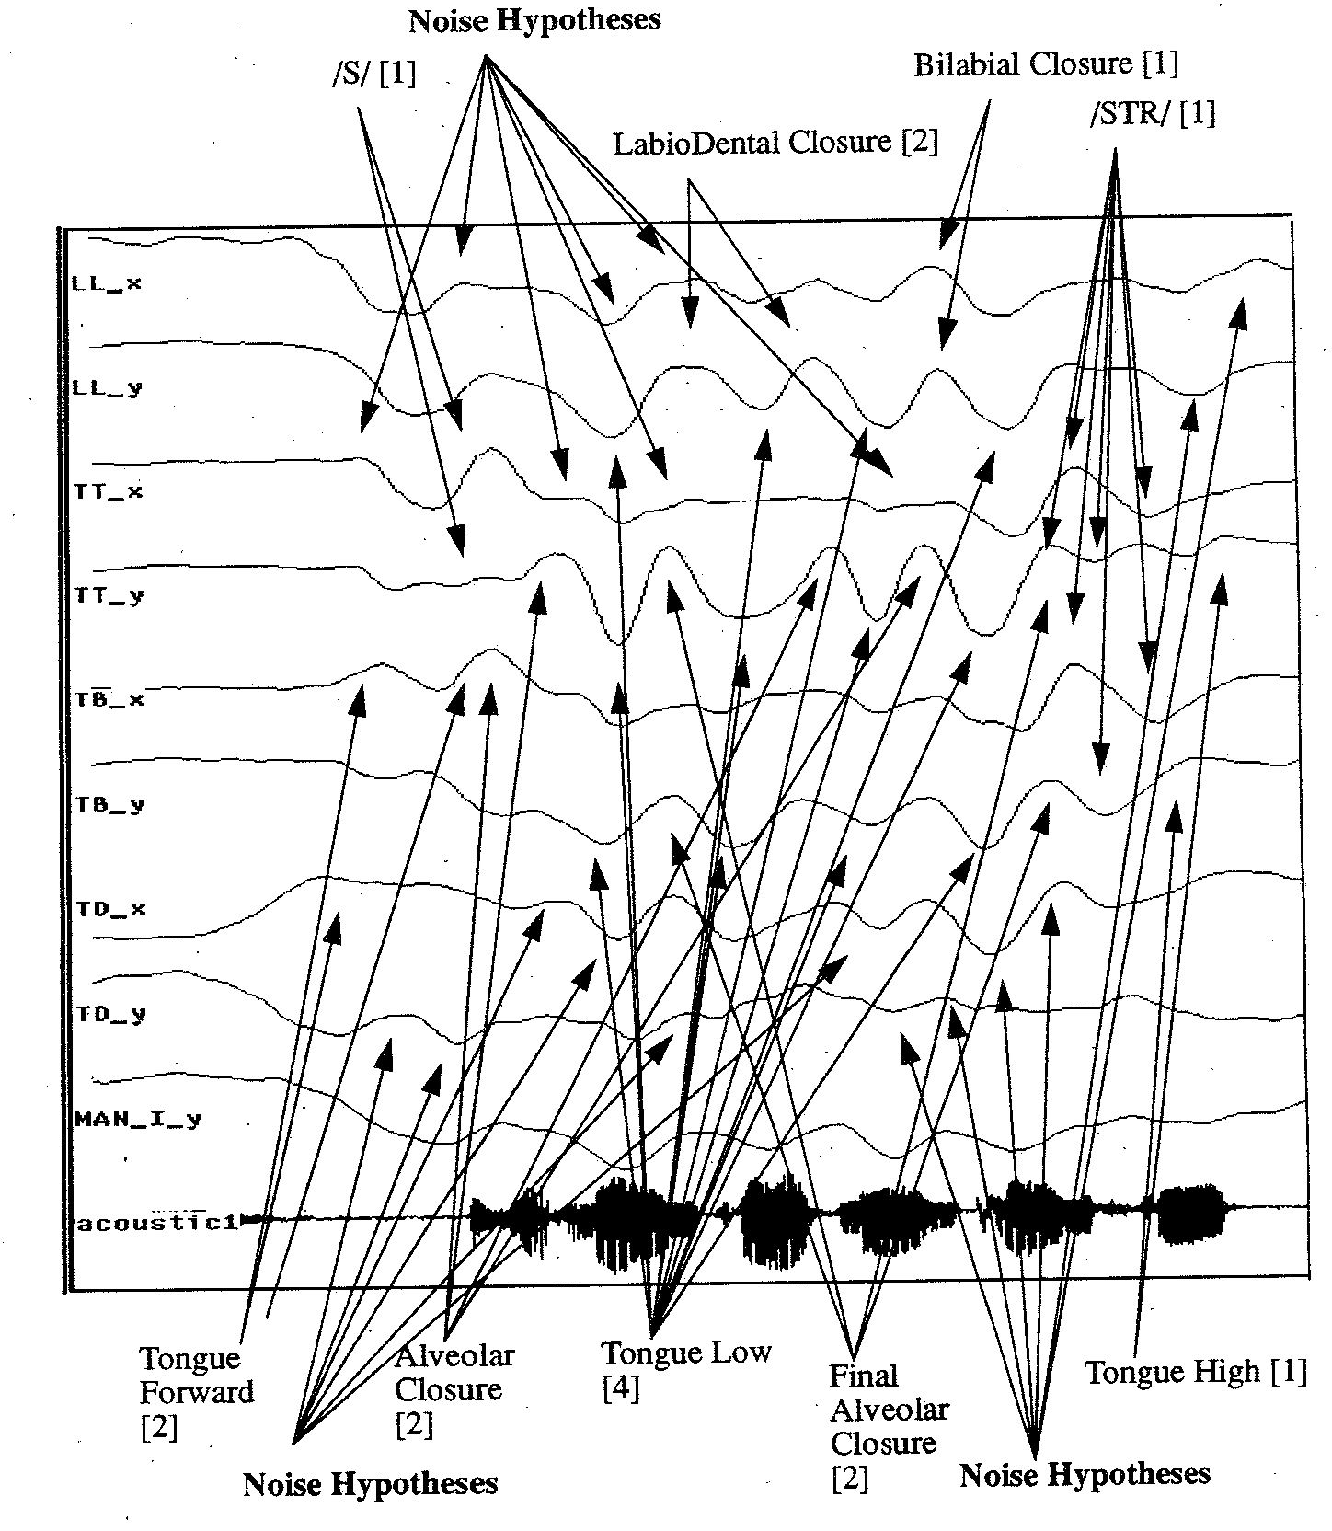

Slide 21
Controlling Abduction
Set covering is an NP-complete problem
it is computationally expensive because it requires trying all combinations of subsets (of H’s) until we have a cover
diagnosticians do not perform set covering
Some options for set covering/abduction
minimal explanation – the explanation with the fewest hypotheses
parsimonious explanation – no superfluous parts
highest rated explanation – the explanation should contain the most highly evaluated hypotheses (if we evaluate them)
these first three combined are known as cost-based abduction
consistent explanation – the explanation should not include hypotheses that contradict each other
this last one is known as coherence-based abduction

Slide 22
Forms of Abduction
Aside from trying to build a complete and consistent explanation without superfluous parts, we often want to select the explanation that best explains the data
this requires that we somehow gage the hypotheses in terms of their plausibilities
How?
many different approaches have been taken
certainty factors
fuzzy logic
Dempster Schaeffer, Bayesian forms of reasoning
feature based pattern matching
neural networks
we explore the first four of these in this chapter

Slide 23
Certainty Factors
First used in the Mycin system, the idea is that we will attribute a measure of belief to any conclusion that we draw
CF(H | E) = MB(H | E) – MD(H | E)
certainty factor for hypothesis H given evidence E is the measure of belief we have for H minus measure of disbelief we have for H
CFs are applied to any hypothesis that we draw by combining CFs of previous hypotheses that are used in the condition portion of the given rule and the CF given to the rule itself
To use CFs, we need
to annotate every rule with a CF value
this comes from the expert
ways to combine CFs when we use AND, OR, →
Combining rules are straightforward:
for AND use min
for OR use max
for NOT, use 1 – value (if A is .3, then NOT A is .7)
for → use * (multiplication)

Slide 24
CF Example
Assume we have the following rules:
A → B (.7)
A → C (.4)
D → F (.6)
B AND G → E (.8)
C OR F → H (.5)
We know A, D and G are true (so each have a value of 1.0)
B is .7 (A is 1.0, the rule is true at .7, so B is true at 1.0 * .7 = .7)
C is .4
F is .6
B AND G is min(.7, 1.0) = .7 (G is 1.0, B is .7)
E is .7 * .8 = .56
C OR F is max(.4, .6) = .6
H is .6 * .5 = .30

Slide 25
Continued
Another combining rule is needed when we can conclude the same hypothesis from two or more rules
we already used C OR F → H (.5) to conclude H with a CF of .30
let’s assume that we also have the rule E → H (.5)
since E is .56, we have H at .56 * .5 = .28
We now believe H at .30 and at .28, which is true?
the two rules both support H, so we want to draw a stronger conclusion in H since we have two independent means of support for H
We will use the formula CF1 + CF2 – CF1*CF2
CF(H) = .30 + .28 - .30 * .28 = .496
our belief in H has been strengthened through two different chains of logic

Slide 26
CF Advantages and Disadvantages
The nice aspects of CFs is that
it gives us a mechanism to evaluate hypotheses in order to select the best one(s) for our explanation
the formulas are simple to apply
experts often think in terms of plausibilities, so getting an expert to supply the CF for a given rule is straight-forward
The disadvantages are that
CFs are ad hoc (not defined through any formal algebra)
no guideline for providing CFs for rules
multiple experts may give you inconsistent CFs
a single expert may give you less consistent values over time
CFs are only provided for rules
input is always given the value of 1.0
Many researchers liked the idea of CFs but were not encouraged by the lack of formalism, so other approaches have been developed

Slide 27
Fuzzy Logic
Prior to CFs, Zadeh introduced fuzzy logic to introduce “shades of grey” into logic
other logics are two-valued, true or false only
Here, any proposition can take on a value in the interval [0, 1]
Being a logic, Zadeh introduced the algebra to support logical operators of AND, OR, NOT, →
X AND Y = min(X, Y)
X OR Y = max(X, Y)
NOT X = (1 – X)
X → Y = X * Y
Where the values of X, Y are determined by where they fall in the interval [0, 1]

Slide 28
Fuzzy Set Theory
Fuzzy sets are to normal sets what fuzzy logic is to logic
fuzzy set theory is based on fuzzy values from fuzzy logic but includes set operations instead of logic operations
The basis for fuzzy sets is defining a fuzzy membership function for a set
a fuzzy set is a set of items along with their membership values in the set where the membership value defines how closely that item is to being in that set
Example: the set tall might be denoted as
tall = { x | f(x) = 1.0 if x > 6’2”, .8 if x > 6’, .6 if x > 5’10”, .4 if x > 5’8”, .2 if x > 5’6”, 0 otherwise}
so we can say that a person is tall at .8 if they are 6’1” or we can say that the set of tall people are {Anne/.2, Bill/1.0, Chuck/.6, Fred/.8, Sue/.6}

Slide 29
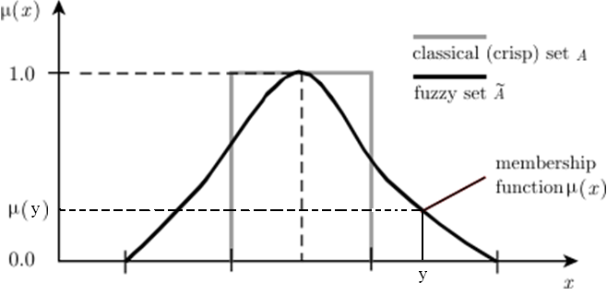
Fuzzy Membership Function
Typically, a membership function is a continuous function (often represented in a graph form like above)
given a value y, the membership value for y is u(y), determined by tracing the curve and seeing where it falls on the u(x) axis
How do we define a membership function?
this is an open question

Slide 30
Using Fuzzy Logic/Sets
1. fuzzify the input(s) using fuzzy membership functions
2. apply fuzzy logic rules to draw conclusions
we use the previous rules for AND, OR, NOT, →
3. if conclusions are supported by multiple rules, combine the conclusions
like CF, we need a combining function, this may be done by computing a “center of gravity” using calculus
4. defuzzify conclusions to get specific conclusions
defuzzification requires translating a numeric value into an actionable item
Fuzzy logic is often applied to domains where we can easily derive fuzzy membership functions and have a few rules but not a lot
fuzzy logic begins to break down when we have more than a dozen or two rules

Slide 31
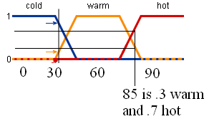
Example
We have an atmospheric controller which can increase or decrease the temperature of the air and can increase or decrease the fan based on these simple rules
if air is warm and dry, decrease the fan and increase the coolant
if air is warm and not dry, increase the fan
if air is hot and dry, increase the fan and the increase the coolant slightly
if air is hot and not dry, increase the fan and coolant
if air is cold, turn off the fan and decrease the coolant
Our input obviously requires the air temperature and the humidity, the membership function for air temperature is shown to the right
if it is 60, it would be considered
cold 0, warm 1, hot 0
if it is 85, it would be cold 0,
warm .3 and hot .7

Slide 32
Continued
Temperature = 85, humidity indicates dry .6
hot .7, warm .3, cold 0, dry .6, not dry .4 (not dry = 1 – dry = 1 - .6)
Rule 1 has “warm and dry”
warm is .3, dry is .6, so “warm and dry” = min(.3, .6) = .3
Rule 2 has “warm and not dry”
min(.3, .4) = .3
Rule 3 has “hot and dry” = min(.7, .3) = .3
our fourth and fifth rules give us 0 since cold is 0
Our conclusions from the first three rules are to
decrease the coolant and increase the fan at levels of .3
increase the fan at level of .3
increase the fan at .3 and increase the coolant slightly
To combine our results, we might increase the fan by .9 and decrease the coolant (assume “increase slightly” means increase by ¼) by .3 - .3/4 = .9/4
Finally, we defuzzify “decrease by .9/4” and “increase by .9” to actionable amounts

Slide 33
Using Fuzzy Logic
The most common applications for fuzzy logic are for controllers
devices that, based on input, make minor modifications to their settings – for instance
air conditioner controller that uses the current temperature, the desired temperature, and the number of open vents to determine how much to turn up or down the blower
camera aperture control (up/down, focus, negate a shaky hand)
a subway car for braking and acceleration
Fuzzy logic has been used for expert systems
but the systems tend to perform poorly when more than just a few rules are chained together
in our previous example, we just had 5 stand-alone rules
when we chain rules, the fuzzy values are multiplied (e.g., .5 from one rule * .3 from another rule * .4 from another rule, our result is .06)

Slide 34
Dempster-Shaeffer Theory
The D-S Theory goes beyond CF and Fuzzy Logic by providing us two values to indicate the utility of a hypothesis
belief – as before, like the CF or fuzzy membership value
plausibility – adds to our belief by determining if there is any evidence (belief) for opposing the hypothesis
We want to know if h is a reasonable hypothesis
we have evidence in favor of h giving us a belief of .7
we have no evidence against h, this would imply that the plausibility is greater than the belief
p(h) = 1 – b(~h) = 1 (since we have no evidence against h, ~h = 0)
Consider two hypotheses, h1 and h2 where we have no evidence in favor of either, so b(h1) = b(h2) = .5
we have evidence that suggests ~h2 is less believable than ~h1 so that b(~h2) = .3 and b(~h1) = .5
h1 = [.5, .5] and h2 = [.5, .7] so h2 is more believable

Slide 35
Computing Multiple Beliefs
D-S theory gives us a way to compute the belief for any number of subsets of the hypotheses, and modify the beliefs as new evidence is introduced
the formula to compute belief (given below) is a bit complex
so we present an example to better understand it
but the basic idea is this: we have a belief value for how well some piece of evidence supports a group (subset) of hypotheses
we introduce a new evidence and multiply the belief from the first with the belief in support of the new evidence for those hypotheses that are in the intersection of the two subsets
the denominator is used to normalize the computed beliefs, and is 1 unless the intersection includes some null subsets

Slide 36
Example
There are four possible hypotheses for a given patient, cold (C), flu (F), migraine (H), meningitis (M)
we introduce a piece of evidence, m1 = fever, which supports {C, F, M} at .6
we also have {Q} (the entire set) with support 1 - .6 = .4
now we add the evidence m2 = nausea which can support {C, F, H} at .7 so that Q = .3
we combine the two sets of beliefs into m3 as follows:
Since m3 has no empty sets, the denominator is 1, so the set of values in m3
is already normalized and we do not have to do anything else

Slide 37
Continued
When we had m1, we had two sets, {C, F, M} and {Q}
When we combined it with m2 (with two sets of its own,{C, F, H} and {Q}), the result was four sets
the intersection of {C, F, M} and {C, F, H} = {C, F}
the intersection of {C, F, M} and {Q} = {C, F, M}
the intersection of {C, F, H} and {Q} = {C, F, H}
the intersection of {Q} and {Q} = {Q}
We now add evidence m4 = lab culture result that suggest Meningitis, with belief = .8
m4{M} = .8 and m4{Q} = .2
In adding m4, with {M} and {Q}, we intersect these with the four intersected sets above which results in 8 sets
shown on the next slide, with some empty sets so our denominator will no longer be 1 and we will have to compute it after computing the numerators

Slide 38
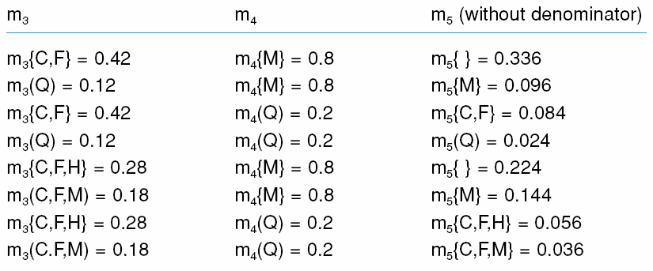
End of Example
Sum of empty sets = .336+ .224 = .56, the denominator is 1 - .56 = .44
m5{M} = (.096 + .144) / .44 = .545 m5{C, F, M} = .036 / .44 = .082
m5{ } = (.336 + .224) / .44 = .56 m5{C, F} = .084 / .44 = .191
m5{C, F, H} = .056 / .44 = .127 m5{Q} = .036 / .44 = .055
The most plausible explanation is { } because the evidence tends to contradict (some symptoms indicate Meningitis, another symptom indicates no Meningitis)

Slide 39
Bayesian Probabilities
Bayes derived the following formula
p(h | E) = p(E | h) * p(h) / sum for all i (p(E | h_{i}) * p(h_{i}))
the probability that h is true given evidence E
p(h | E) – conditional probability
what is the probability that h is true given the evidence E
p(E | h) – evidential probability
what is the probability that evidence E will appear if h is true?
p(h) – prior probability (or a priori probability)
what is the probability that h is true in general without any evidence?
the denominator normalizes the conditional probabilities to add up to 1
To solve a problem with Bayesian probabilities
we need to accumulate the probabilities for all hypotheses h1, h2, h3 of p(h1 | E), p(h2 | E), p(h3 | E), …, p(E | h1), p(E | h2), p(E | h3), … and p(h1), p(h2), p(h3), … and then its just a straightforward series of calculations

Slide 40
Example
The sidewalk is wet, we want to determine the most likely cause
it rained overnight (h1)
we ran the sprinkler overnight (h2)
wet sidewalk (E)
Assume the following
there was a 50% chance of rain – p(h1) = .5
sprinkler is run two nights a week – p(h2) = 2/7 = .28
p(wet sidewalk | rain overnight) = .8
p(wet sidewalk | sprinkler) = .9
Now we compute the two conditional probabilities
p(h1 | E) = (.5 * .8) / (.5 * .8 + .28 * .9) = .61
p(h2 | E) = (.28 * .9) / (.5 * .8 + .28 * .9) = .39

Slide 41
Independent Events
There is a flaw with our previous example
if it is likely that it will rain, we will probably not run the sprinkler even if it is the night we usually run it, and if it does not rain, we will probably be more likely to run the sprinkler the next night
So we have to be aware of whether events are independent or not
two events are independent if P(A & B) = P(A) * P(B)
where & means “intersect”
when P(B) <> 0, then P(A) = P(A | B)
knowing B is true does not affect the probability of A being true
We can also modify our computation by using the formula for conditional independent events
P(A & B | C) = P(A | C) * P(B | C)
again, & is used to mean intersection
we will expand on this shortly

Slide 42
Multiple Pieces of Evidence
In our wet sidewalk example, E consisted of one piece of evidence, wet sidewalk
what if we have many pieces of evidence?
Consider a diagnostic case where there are 10 possible symptoms that we might look for to determine whether a patient has a cold (h1), flu (h2) or sinus infection (h3)
E is some subset of {e1, e2, e3, e4, e5, e6, e7, e8, e9, e10}
To use Bayes’ formula, we need to know
p(h1), p(h2), p(h3) as well as
p(e1 | h1), p(e1 | h2), p(e1 | h3)
p(e2 | h1), p(e2 | h2), p(e2 | h3)
p(e3 | h1), p(e3 | h2), p(e3 | h3)

Slide 43
Continued
But our patient may have several symptoms
So we also need
p(e1, e2 | h1), p(e1, e2 | h2), p(e1, e2 | h3)
p(e1, e3 | h1), p(e1, e3 | h2), p(e1, e3 | h3)
p(e2, e3 | h1), p(e2, e3 | h2), p(e2, e3 | h3)
p(e1, e2, e3 | h1), p(e1, e2, e3 | h2), p(e1, e2, e3 | h3)
How many different probabilities will we need?
with 10 pieces of evidence, there are 2¹⁰ = 1024 different combinations for E, so we will need 3 * 1024 = 3072 evidential probabilities (to go along with the 3 prior probabilities, one for each hypothesis)
imagine if E comprised a set of 50 pieces of evidence instead!

Slide 44
Advantages and Disadvantages
There two appealing features of probabilities
the approach is formal (unlike CFs and unlike the creation of fuzzy membership functions, which are ad hoc)
probabilities are easy to compile through statistics
p(flu) = number of people who had the flu this year / number of people in the pool
p(fever | flu) = number of people with the flu who had a fever / number of people in the pool
The primary disadvantages are
the need for a great number of probabilities
probabilities can be biased
for instance, is p(flu) accurate if we gather the data in the summer time rather than in the winter, or year round?
the awkwardness if events are not independent (an example follows)

Slide 45
Bayesian Net
We can apply the Bayesian formulas for independent and conditionally dependent events in a network form
we want to determine the likely cause for seeing orange barrels, flashing lights and bad traffic on the highway
two hypotheses: construction, accident (see the figure below)
notice T (bad traffic) can be caused by either construction or an accident, orange barrels are only evidence of construction and flashing lights are only evidence of an accident (although it could also be that a driver has been pulled over)
construction and accident are not directly related to each other – this will help simplify the problem

Slide 46
Computing the Cause
We want to compute the cause: construction or accident?
first we derive a chain rule to compute a chain of probabilities to handle the dependencies as shown in the figure
p(a & b) = p(a | b) * p(b) (again, & means intersection)
so p(a & b & c) = p(a) * p(b | a) * p(c | a, b)
Therefore, p(C, A, B, T, L) = p(C) * p(A | C) * p(B | C, A) * p(T | B, C, A, B) * p(L | C, A, B, T)
with 5 items, we need 2⁵ = 32 probabilities
We can reduce p(C, A, B, T, L) to p(C) * p(A) * p(B | C) * p(T | C, A) * p(L, A)
because C and A are not linked, p(A | C) = p(A), p(B | C, A) = p(B | C)
thus we reduce the total number of terms from 32 to 20
Lets turn to a more complicated problem requiring a slightly different approach

Slide 47
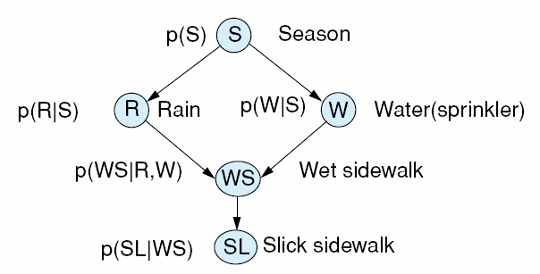
Directed Graph Models
We return to the wet sidewalk example but include the season (summer or winter, denoted as hot or cold)
the season will impact the probabilities of rain and running the sprinkler
our Bayesian network is shown below, notice that unlike the traffic example, we have a cycle (if we remove the directed edges)
p(S) – prob of the given
season
p(R | S) – prob of rain given
the season
p(W | S) – prob of sprinkler
given the season
p(WS) – prob of a wet
sidewalk
p(SL | WS) – prob of slick sidewalk given it is wet

Slide 48
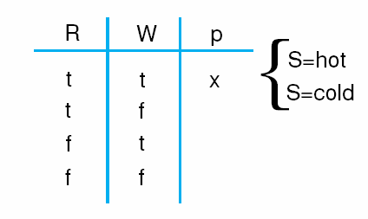
Continued
Notice this network contains a cycle (if we change the links to be undirected, we have a cycle)
We cannot apply the chain rule in such a case
How do we compute p(WS)?
we must remove nodes from the graph to make it acyclic
we do this by instantiating various probabilities to either T or F so that we no longer require a specific probability that is leading to the need for the chain rule
WS depends on both R and W, so we will generate p(WS) for each of the four values of R and W as shown below
we will actually have to do this twice, once for S = hot and once for S = cold
x = p(R = t, W = t, S = hot) +
p(R = t, W = t, S = cold)
we similarly compute the probability p(WS) for
each of the other combinations of R and W
p(WS) is the sum of these values

Slide 49
Junction Trees
The problem with the approach taken in the previous example is having to compute a probability for each combination of nodes that create the cycle
what if, instead of R and W, we had 20 nodes that made up the cycle? then we would have to compute 2²⁰ combination of probabilities
With more forethought in our design, we may be able to avoid this altogether by creating what is known as a junction tree
any Bayesian network can be transformed by
adding links between the parent nodes of any given node
adding links to any cycle of length more than three so that cycles are all of length three or shorter (this helps complete the graph)
Each cycle is a clique of no more than 3 nodes
each of which forms a junction resulting in dependencies of no more than 3 nodes to restrict the number of probabilities needed

Slide 50
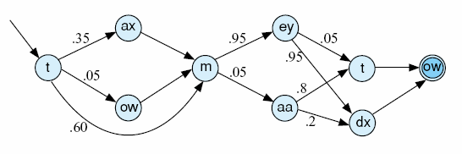
Dynamic Bayesian Networks
Cause-effect situations are temporal
at time i, an event arises and causes an event at time i+1
the Bayesian belief network is static, it captures a situation at a singular point in time
we need a dynamic network instead
The dynamic Bayesian network is similar to our previous networks except that each edge represents not merely a dependency, but a temporal change
when you take the branch from state i to state i+1, you are not only indicating that state i can cause i+1 but that i was at a time prior to i+1
Here is a state diagram to
represents possible utterances
for the word “tomato”
Each node represents both a
sound and a segment of time

Slide 51
Markov Models
Like the dynamic Bayesian network, a Markov model is a graph composed of
states that represent the state of a process
edges that indicate how to move from one state to another where edge is annotated with a probability indicating the likelihood of taking that transition
An ordinary Markov model contains states that are observable so that the transition probabilities are the only mechanism that determines the state transitions
a hidden Markov model (HMM) is a Markov model where the probabilities are actually probabilistic functions that are based in part on the current state, which is hidden (unknown or unobservable)
determining which transition to take will require additional knowledge than merely the state transition probabilities

Slide 52
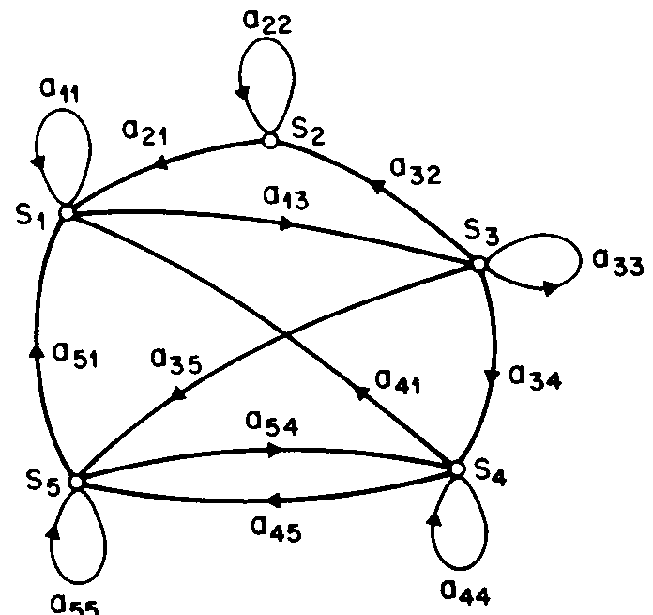
A Markov Model
In the Markov model, we move from state to state based on simple probabilities
likelihoods are usually computed stochastically (statistically)
a₃₂ = likelihood of transitioning from S3 to S2
a₃₃ = likelihood of transitioning from S3 to S3
a₃₄ = likelihood of transitioning from S3 to S4

Slide 53
Example: Weather Forecasting
On any day, it will either be
rainy/snowy, cloudy or sunny
we have the following probability matrix to denote given any particular day, what the weather will be like tomorrow
so the probability, given today is sunny that tomorrow will be sunny is 0.8
the probability, given today is rainy/snowy that tomorrow is cloudy is .2
to compute a sequence, we multiply them together, so if today is sunny then the probability that the next two days will be sunny is 0.8 * 0.8, and the probability that the next three days will be cloudy is 0.1 * 0.1 * 0.1
 | R/S | Cloudy | Sunny
R/S | .4 | .3 | .3
Cloudy | .2 | .6 | .2
Sunny | .1 | .1 | .8

Slide 54
HMM
Most problems cannot be solved by a Markov model because there are unknown states
in speech recognition, we can build a Markov model to predict the next word in an utterance by using the probabilities of how often any given word follows another
how often does “lamb” follow “little”?
But in speech recognition, there is intention here
we do not know what the speaker is intending to say, but we must identify it, so, we add to our model hidden (unobservable) states and appropriate probabilities for transitions
the observable states are the elements of the acoustic signal, that is, things we can analyze
and the hidden states are the elements of the utterance (e.g., phonemes), we must search the HMM to determine what hidden state best represents the input utterance

Slide 55
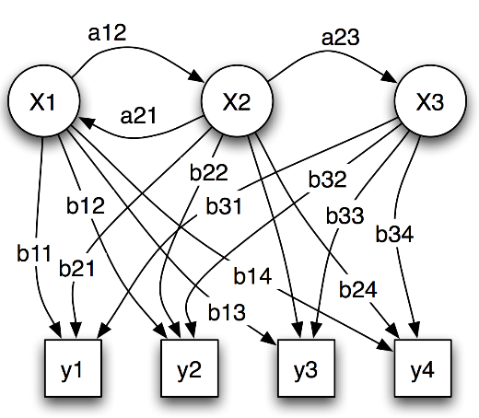
Example HMM
Here, X1, X2 and X3 are the hidden states
y1, y2, y3, y4 are observations
A_{ij} are the transition probabilities of moving from state i to state j
b_{ij} make up the output probabilities from hidden node i to observation j – that is, what is the probability of seeing output y_{j} given that we are in state x_{i}?
Three problems associated with HMMs
Given HMM and output sequence, compute most likely state transitions
Given HMM, compute the probability of a given output sequence
Given HMM and output sequence, compute the transition probabilities
This last problem requires learning, we look at this in chapter 13

Slide 56
The Viterbi Algorithm
Of the three problems listed on the previous slide, we really aren’t too interested in #2 and we will explore the solution to #3 in chapter 13
problem #1 is the one that we want to use when implementing reasoning systems that deal with uncertainty, particularly in domains like speech recognition where we cannot easily construct knowledge based approaches
We solve problem #1 using the Viterbi algorithm – which itself uses dynamic programming
the algorithm assumes that hidden states are aligned in some sequence (e.g., temporally) so that a state at position t+1 will always succeed a state at position t where an observation will correspond to exactly one hidden state
the algorithm generates a path (in the algorithm, called argmax) with probability valmax

Slide 57
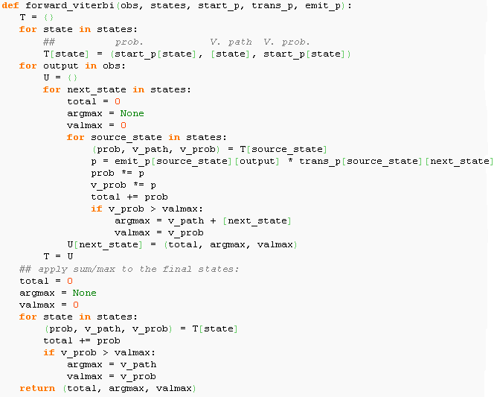
The Algorithm

Slide 58
Example: Rainy and Sunny Days
There are two hidden states, rainy and sunny
A person is observed either walking, shopping or cleaning every day, and we use these to determine the hidden states for each day
transitional probabilities
rainy given yesterday was (rainy = .7, sunny = .3)
sunny given yesterday was (rainy = .4, sunny = .6)
output (emission) probabilities
rainy given (walking = .1, shopping = .4, cleaning = 5)
sunny given walking = .6, shopping = .3, cleaning = .1)
we have observed walk, shop, clean on three consecutive days
using the Viterbi algorithm, the most likely sequence of events was sunny, rainy, rainy with a probability of .00948

Slide 59
Another Example
We see a sequence of 4 die rolls of 1, 6, 6, 2
We want to determine if the die is fair or loaded
0.05
0.95
0.95
FAIR
LOADED
Model =
P(1|F) = 1/6
P(2|F) = 1/6
P(3|F) = 1/6
P(4|F) = 1/6
P(5|F) = 1/6
P(6|F) = 1/6
P(1|L) = 1/10
P(2|L) = 1/10
P(3|L) = 1/10
P(4|L) = 1/10
P(5|L) = 1/10
P(6|L) = 1/2
0.05
Start prob
P (fair) = .7
P (loaded) = .3
Observation sequence = 1,6,6,2
α₁(i)
α₂(i)
α₃(i)
α₄(i)
0.7*1/6
α₁(1)*0.05*1/6+
α₁(2)*0.05*1/6
α₂(1)*0.05*1/6+
α₂(2)*0.05*1/6
α₃(1)*0.05*1/6+
α₃(2)*0.05*1/6
State 1 (fair)
α₁(1)*0.95*1/2+
α₁(2)*0.95*1/2
α₂(1)*0.95*1/2+
α₂(2)*0.95*1/2
α₃(1)*0.95*1/10+
α₃(2)*0.95*1/10
State 2 (loaded)
0.3*1/10

Slide 60
Concerns
CFs and FL require a means of obtaining the real values – with CFs, they come from experts, with FL they come from membership functions
as chains of logic get longer, these values (which are not normalized) get smaller and smaller so that shorter chains will be favored
The various forms of probabilities require that we obtain too many statistics – unrealistic to have that much data
consider a situation where we can have up to 30 symptoms and 20 diseases, we would need 20*2³⁰ conditional probabilities!
None of these approaches seem to “capture” human-like reasoning under uncertainty

Slide 61
Feature Based Pattern Matching
For each hypothesis, enumerate the features you associate with it
Which are necessary? Which are sufficient? In what combinations?
Provide a series of possible patterns for the features along with what “certainty” value should be returned for that pattern of features
Certainty values do not need to be real numbers, we can use a more qualitative description like “likely”, “unlikely” and “don’t know”
F1 | F2 | F3 | F4 | F5 | Result
Yes | Yes | No | ? | ? | Likely
Yes | ? | No | Yes | ? | Somewhat likely
? | No | Yes | ? | ? | Unlikely
? | ? | ? | ? | Yes | Don’t know

Slide 62
Example
Hypothesis: Patient has biliary stone
Consult 2 knowledge sources
Clinical evidence
Historical evidence
If clinical evidence is very likely && historical evidence exists → very likely
If clinical evidence is somewhat likely or higher && historical evidence exists → likely
Otherwise unlikely
Clinical evidence pattern matching shown below
Cholangitis | Colicky pain | Vomiting | Nausea | Result
Yes | Yes | Yes | Yes | Very likely
Yes | Yes | ? | ? | Likely
? | Yes | Yes | Yes | Somewhat likely
Yes | ? | Yes | Yes | Somewhat likely
? | ? | Yes | Yes | Don’t know
? | ? | ? | ? | Unlikely

