Slide 1
Knowledge and Expert Systems
So far, we have examined weak methods
  approaches and algorithms that are generic across problems, ones that do not take advantage of domain-specific knowledge or problem-specific methods
    note: method here is used a bit differently than in OOP, a method is a problem solving strategy, but not necessarily a specific solution or algorithm
  in this chapter, we examine how expertise can be used to both specify the knowledge needed to solve a problem as well as the process(es) required to solve the problem
    thus, we have strong methods, problem specific in some ways, and knowledge-intensive processes
    we will use this approach to solve problems that are themselves knowledge-intensive: diagnosis, planning/design, etc

Slide 2
Expert System
An expert system is an AI system that
  solves a problem like a human expert
  or that requires the use of expert knowledge
Today, we refer to these systems as knowledge-based systems
  because the emphasis is on the knowledge that they employ, not necessarily on expert knowledge or expert problem solving
    systems that require knowledge may not solve the problem like an expert
    for instance, daily planning does not require expertise in planning or human activities
  while we will use the term “expert system” throughout the chapter, it is synonymous with knowledge-based system
Expert systems in general
  support inspection of their reasoning process (can explain or justify their conclusions)
  allow easy modification in adding and deleting skills from the knowledge base
  reason heuristically (with imperfect knowledge)

Slide 3
Expert System Problem Categories
Interpretation – given raw data, draw conclusion about the data
  recognition from data, test result interpretation
Diagnosis – determine the cause of the malfunction(s) given the observable symptoms
Recognition – identify the specific item(s) in the given data (whether this is visual, auditory or other)
  the above three problems are all forms of credit assignment problems
Monitoring – a form of interpretation to make sure a system’s behavior matches the expectations
Control – related to monitoring, making changes to a system so that the behavior continues as expected even under unusual (erroneous, malfunction) situations

Slide 4
Continued
Planning/Design – devise a sequence of actions/configurations of plan steps/component parts to achieve some set of goals
  a plan is an abstract design with goals that are achieved when the plan is implemented
  components in a plan/design have functions that, when combined, achieve the given goal such that each component fulfills some subgoal(s)
  plans/designs have constraints and specifications
Prediction – projecting probable outcomes of given situations
Instruction – a tutorial that assists with the education process
  often requires modeling the user’s belief state(s) and diagnosing why some beliefs are wrong

Slide 5
Knowledge-based Engineers
Software engineering owes much of its early existence to AI which pioneered the large-scale system construction
  early AI systems were toy systems, written in Lisp (or whatever language) by the researchers themselves
By the 1970s, expert systems were being constructed
  large scale endeavors, taking many man-years to produce
  often built from scratch in Lisp, the programmers needed to have knowledge of programming, knowledge representations, and domain knowledge acquired from domain experts
A clear subdivision was made between the programmers and the domain experts who were brought it to impart their expertise
  these programmers were given the title knowledge-based engineers (KBE)
  they pioneered prototyping, programming tools, iterative lifecycle construction, and other concepts now found in SE

Slide 6
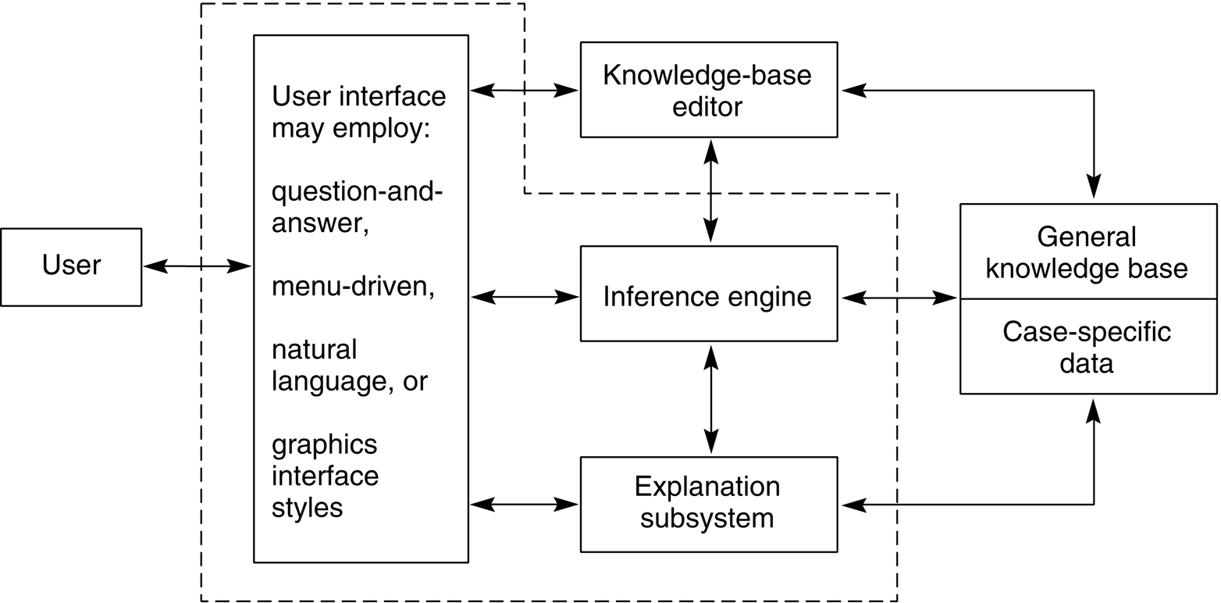
Expert System (ES) Architecture
Below is the basic architecture of any expert system
  the interface is largely unimportant, what we need to concentrate on is the inference engine and the knowledge base (KB) including the form(s) of representation and the specific knowledge included
The explanation
subsystem and
case-specific data
are optional
The knowledge
base editor is only
included if non
KBEs will be
editing the KB

Slide 7
Inference Engine
What steps (processes) will the ES take when problem solving?
  this makes up the inference engine
    the typical form of knowledge representation was the rule (if-then statement) so typical inference engine either employed forward or backward chaining
    there are many other alternatives
  control mechanisms would be added to the inference engine both to provide a more efficient system and use problem specific forms of reasoning
    conflict resolution
    focus of attention on knowledge
    focus of attention on subproblems (e.g., data gathering, reasoning, explanation, treatment)
    recover from error by employing failure handling techniques
    learning capabilities (e.g., to save the solution in a case library)

Slide 8
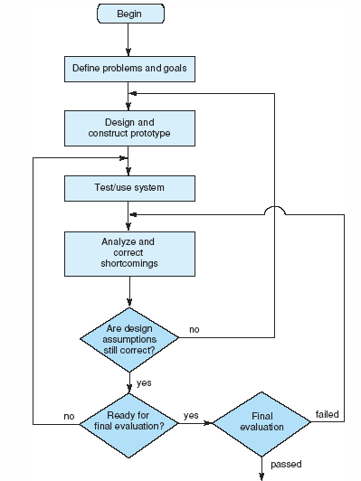
KBE Development Cycle
We should first determine if the problem is even one that should be solved by this approach
  does this problem require domain knowledge and symbolic reasoning?
  is human expertise available?
  does the need for the system justify the cost in building it?
  is the problem of reasonable size and scope?
  is the problem’s domain well enough structured so that both domain knowledge and problem solving methods are available?

Slide 9
The Rule Based Approach
Whether explicitly enumerated as if-then statements, or captured as predicate clauses, much knowledge comes in the form of a rule
  so much of AI revolved around rule-based systems
  as already noted, Mycin was such a success that the Emycin shell was developed (and later, OPS5 and others)
ES construction could be as simple as:
  collect all domain knowledge in the form or rules
  decide on forward or backward chaining (and thus select OPS5 or Emycin)
  enumerate the rules in the selected language
  run, test, debug, enhance until done
Many systems were developed in this fashion from SACON to R1/XCON to GUIDON (based on MYCIN, taught medical students about performing diagnosis) to ONCONCIN (drug treatment prescription and management for cancer patients) to TATR (tactical air targeting system for the Air Force)

Slide 10
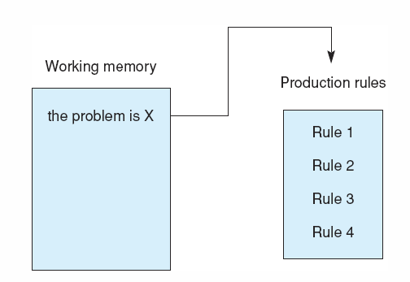
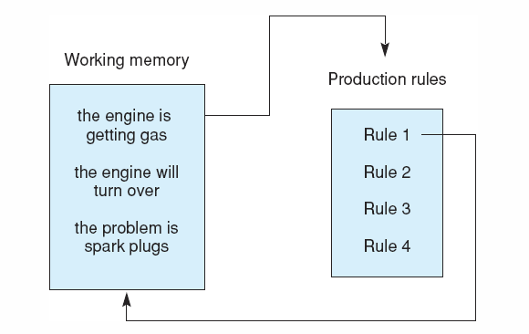
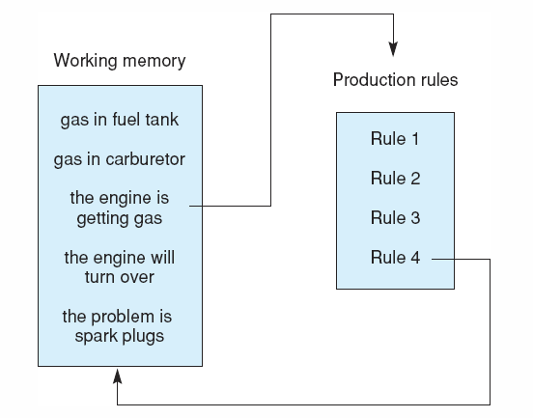
Example:
Automotive System
Rule 1: if
the engine is getting gas, and
the engine will turn over,
then
the problem is spark plugs.
Rule 2: if
the engine does not turn over, and
the lights do not come on
then
the problem is battery or cables.
Rule 3: if
the engine does not turn over, and
the lights do come on
then
the problem is the starter motor.
Rule 4: if
there is gas in the fuel tank, and
there is gas in the carburetor
then
the engine is getting gas.

Slide 11
Running the System
Gas in fuel tank? Yes
Gas in carburetor? Yes
Engine will turn over? Why
It has been established that:
1. The engine is getting gas,
2. The engine will turn over,
Then the problem is the spark plugs.
How the engine is getting gas
This follows from rule 4:
If gas in fuel tank, and
gas in carburetor
then engine is getting gas.
gas in fuel tank was given by the user
gas in carburetor was given by the user
Here, we see a session
The system is trying to match a rule by asking questions pertaining to the conditions
The user may ask “why” in response to a
question to find out why the system is asking that question – that is, what information is the system working on and why is it important?
The system responds by displaying the rule in an English-like way and what it is trying to establish at this point in time

Slide 12
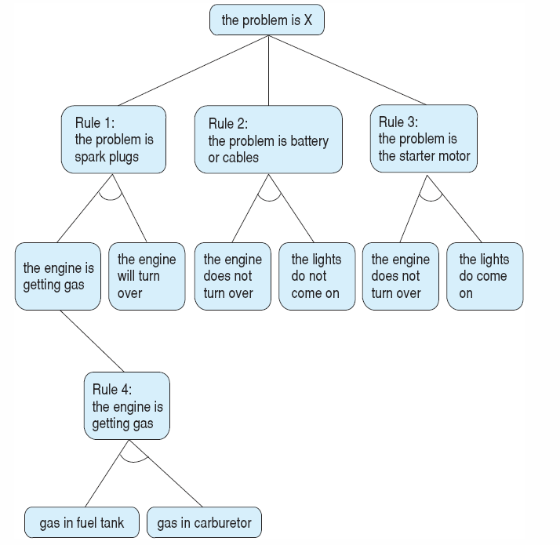
Rules as an And/Or Graph
We segment the rules into classifications
If the rule(s) of a node is(are) true, then descend that branch
If not, prune away that branch
This allows us to focus only on the relevant rules rather than re-examining all of the rules in every iteration of the rule-based algorithm
Left nodes are diagnostic conclusions

Slide 13
Data-Driven vs. Goal-Driven
Most diagnostic systems take a data-driven approach
  start with the known data (observations, symptoms) and chain through the rules to conclusions – what caused those symptoms?
    Mycin is an exception, it performed Goal-driven reasoning with the goal of treating an illness, so the main goals were diagnose and treat, but we won’t worry about that
Planning is often a goal-driven approach
  start with the goals (what are trying to plan or design?) and then select rules to help us select the actual plan steps or design components, and then configure them always working from larger concepts to more specific components/steps
    R1/XCON is an exception being data-driven by starting with the data – the user specs
So, in general, we will use data-driven for problems that start with data (diagnosis, interpretation) and goal-driven for problems that start with goals (planning, design)

Slide 14
Rule-based Control
The simple Rule-based system relies solely on a conflict resolution strategy for control, this may not be sufficient and may not adequately mimic the expert problem solver
  the best idea is to break the problem into phases and have rule groupings that model this
    in a diagnostic situation, it might be
      data gathering and completion
      initial hypothesization
      further test ordering
      hypothesis refinement and confirmation
      treatment
  Mycin had phases like this, but were implicitly posed by organizing rules so that the system would not move on until a rule had stated that the current phase was over
    we might want to have rules that reason over the status of the problem and then shift the focus to a subset of rules within that focus – but when does the system apply this “metaknowledge” versus working within the current focus?

Slide 15
Alternatives to Rules
Rule-base is the only one way to implement a diagnostic reasoner
  most diagnostic reasoners will contain rules, but they do not have to be constructed solely of rules
Object (frame) approach
  PUFF – to diagnose pulmonary disorders, each disorder was represented as an object and organized in a hierarchy – each frame had rules to determine that particular disorder’s relevance (ask these questions and if the answers are as expected, continue down that branch of the class hierarchy)
Classification
  organize diagnostic categories as nodes in a hierarchy
  associate with each node the questions necessary to establish that category
  perform a top-down search, pruning away categories and their subtrees that cannot be established
    heuristic classification, hierarchical classification
Decision trees
  diagnostic categories are leaf nodes of a tree, each interior node is a decision made based on the response of a question (e.g., “does the motor start?”, “do the lights come on?”

Slide 16
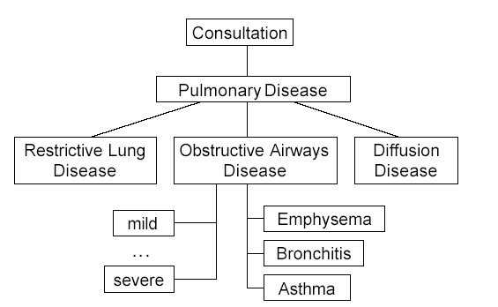
Puff Detail
Sample rule (RULE31)
IF:
1. The severity of obstructive airways
disease of the patient is greater than or equal
to mild, and
2. the degree of diffusion defect of the
patient is greater than or equal to mild, and
3. the TLC observed/predicted of the patient
is greater than or equal to 110, and
4. the observed/predicted difference in
RV/TLC of the patient is greater than or
equal to 10
THEN:
1. There is strongly suggestive evidence
(0.9) that the subtype of obstructive airways
disease is emphysema, and
2. It is definite (1.0) that "OAD, Diffusion
Defect, elevated TLC, and elevated RV
together indicate emphysema" is one of the
findings
Originally built using E-Mycin, it was
re-implemented as Centaur using
a frame-based implementation with
rules embedded into frames
This approach is known as
hierarchical hypothesize and test

Slide 17
Hierarchical Classification Ex.

Slide 18
Knowledge Acquisition and Modeling
ES construction used to be a trial-and-error sort of approach with the KEs
  once they had knowledge from the experts, they would fill in their KB and test it out
By the end of the 80s, it was discovered that creating an actual domain model was the way to go – build a model of the knowledge before implementing anything
A model might be
  a dependency graph of what can cause what to happen
  or an associational model which is a collection of malfunctions and the manifestations we would expect to see from those malfunctions
  or a functional model where component parts are enumerated and described by function and behavior
The emphasis changed to knowledge acquisition tools (KADS)
  domain experts enter their knowledge as a graphical model that contains the component parts of the item being diagnosed/designed, their functions, and rules for deciding how to diagnose or design each one

Slide 19
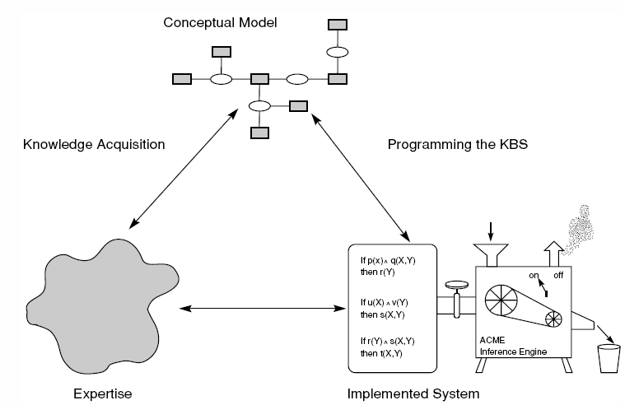
The KBE Cycle with KADS
Expert provides the model through KADS approach
KE builds KB based on domain model
Inference engine may be “off the shelf” or tailor-made or some combination based on choice of KE

Slide 20
Why Models?
Rules generally represent causal reasoning
  If you see X then conclude it was caused by Y
A model will show that Y causes X
Example:
  If patient is confused and has unequal pupils then conclude stroke
  If stroke patient then patient is confused and pupils are unequal
There might be many reasons why X arises
  With associational knowledge we may assume the wrong cause
  With a model, we can reason about all possible cause to effect results to have a broader, more comprehensive diagnosis
The level of specificity of the model will determine the model’s usefulness
  A shallower or less complete model may not be as useful as a deeper or more complete model
  The larger the model, the longer it takes to create and debug

Slide 21
Types of Models
Models can vary depending on the type of problem being solved
  no model will be all-inclusive – for instance, we would not construct a model that is used for both design and diagnosis (although we should!)
One early approach was the qualitative model
  describe a device by its components and their behaviors but the description is not mathematically precise, instead it is based on qualitative state changes
    for instance, if the water is on, then the water pressure increases and the amount of water in the basin increases until filled
    if the basin is full and water is added, it overflows
  general diagnosis can be performed with a reasonable qualitative model so that we do not need one that is 100% complete or accurate
  while this approach will work in some domains, in general, it is not going to be specific enough

Slide 22
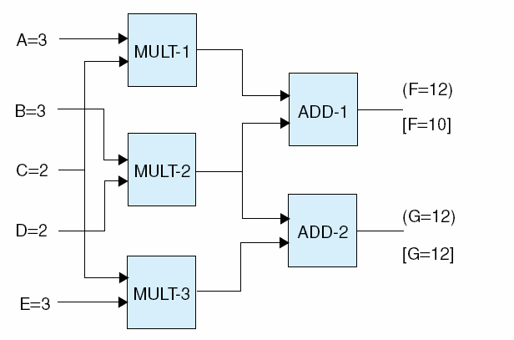
Model-Based Reasoning
We model the domain/device causally and structurally
Here, we have a device of 5 inputs and 2 outputs
  The device uses 3 multipliers and 2 adders
  Given the inputs (as shown), we expect F to be 12 and G to be 12 but F is 10, what could lead to this error?
    {M1}, {M2}, {M1, M2}, {A1}, {M1, A1}, {M2, A1}, {M1, M2, A1}
We don’t know enough for a definitive solution
but what if we assume that there is only 1 fault?
We can rule out M2 because G is correct so the
error must either be M1 or A1
If we had probabilities of faults, we could use
that to find the most likely fault

Slide 23
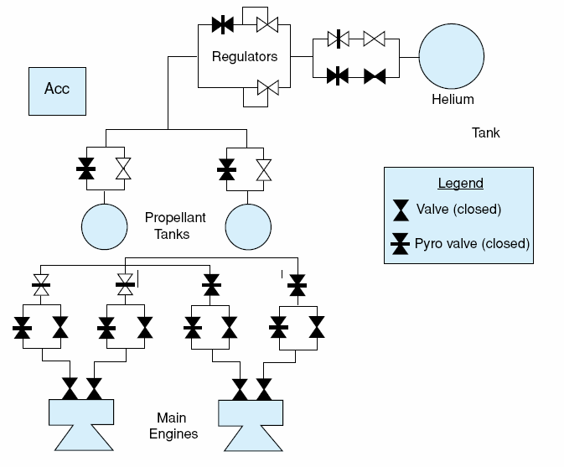
A NASA Example
Here, we view a better model developed by NASA for a Livingston propulsion system
  a reactive self-configuring autonomous system
  knowledge modeled using propositional calc (instead of predicate calc – there are a finite number of elements, each will be modeled by its own proposition)
Helium is the fuel tank
Oxidizer is mixed to cause the fuel to burn
Acc is the accelerometer which, along with sensors in the valves, is used as input to control the system
Pryo valves are used as control – once they
Change state, they stay in that state – so they are used to change the flow of fuel when an error is detected, opening or closing a new pathway from tank to engine

Slide 24
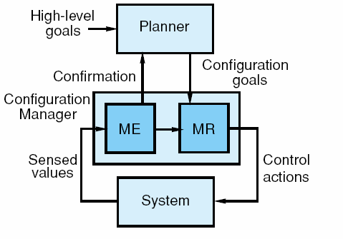
Model (Architecture) for the System
The idea is that the configuration manager tries to keep the spacecraft moving but at the lowest cost configuration
Sensors feed into the ME (mode estimator) to determine if the system is functioning and in the lowest configuration
If not, the MR (mode reconfiguration) plans a new mode by determining what valves to open and close
Since this is a spacecraft, the output of the MR is a set of actions that cause valves to open or close directly
The high level planner generates a sequence of hardware configurations goals such as the amount of propellant that should be used , it is the configuration manager that must translate these goals into actions

Slide 25
Variation of MBR: Functional Representation
We model the system structurally like we have previously, but we model each component functionally (what its function is) and behaviorally (how the function is derived)
  this gives us a hierarchical design in that components are themselves represented functionally and their components are represented functionally
  some behaviors are specified as laws such as law of gravity or Kirchoff’s law
  there are several function types
    toMake – the device’s function is to produce something
    toMaintain – the device’s function is to keep a state at its current level
    toPrevent – the device itself might only operate when certain conditions arise and its function is to keep one or more values from reaching a specified level
    toControl – a combination of the three

Slide 26
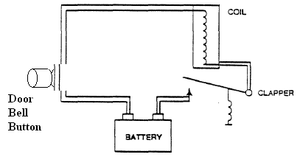
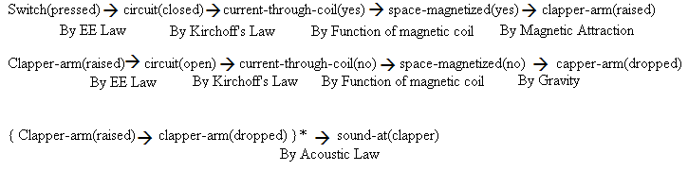
With this type of representation, we can reason about “what would happen if” or try to
pinpoint the failure based on which function(s) is(are) occurring and which is(are) not

Slide 27
Case-Based Reasoning
Another form of reasoning is to draw on an actual previously existing solution and adapt it as much as possible to fit the new problem
  the process works like this, given a problem
    select from among a library of previous cases (solutions), one that meets the same specifications
    compare the selected case’s results to the desired results and find the differences
    modify the case appropriately
    apply the transformed case
    if successful, capture the new solution as a case and save it in the library otherwise repeat the entire process by selecting another case to try
The original CBR system was Chef
  given a library of recipes
  input a desired meal specification (type of dish to prepare, taste, texture, method of cooking)
  select a previous recipe and alter it to meet the new specification(s)
  test the new recipe and if successful, save it otherwise modify it until it passes the test

Slide 28
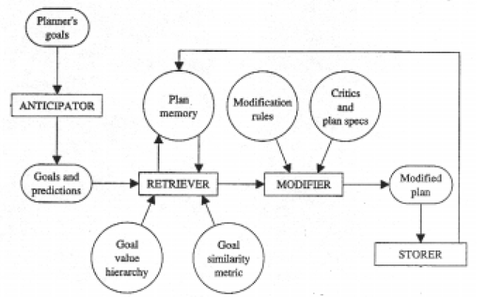
More on Chef
the Chef architecture is shown here
sorry about the poor quality of this image!
The Anticipator would generate potential problems (predictions) from the input specification (the goals)
Modification rules would include two forms: structural changes to the meal (additional items, reordered items) and ingredient critics (substitutions for any food item)

Slide 29
Example Knowledge in Chef
Here we see the two forms of knowledge as examples (in Lisp)
  a structural modification says that a souffle with fruit should be performed in these three steps: chop the fruit up into pulp sized units, pour the contents of the souffle into the baking dish, then mix the fruit in
  a critic that specifies that shrimp, if in a recipe, might be shelled before it is cooked
(add:mod
index (fruit style-souffle)
amount (cup number (1))
steps ((do (chop object ?new-item size (pulp)))
(before (pour object ?object
into (nine-inch-baking-dish))
do (mix object ?new-item with ?object))))
(add:crit shrimp
binds (shrimp *new-item*)
steps ((before (cook-step object *new-item*)
do (shell object *new-item*))))

Slide 30
Critiquing and Fixing the Recipe
Once a recipe is generated, we need to test it
  critiquing knowledge will check the recipe for logic and then suggest critics (like the two previous rules) to make alterations
Lets look at a complete example
  user input: stir-fry dish, include beef, include broccoli
  Chef retrieves stir-fry dish with chicken and green beans (both broccoli and green beans are green vegetables, so the match is approximate)
  Chef applies modification rule to substitute broccoli for green beans and applies ingredient critic to add chopping step and adjust cooking time
  resulting recipe (see next slide) is tested and it is discovered that
    beef releases water → “dry wok” condition is disabled, a repair strategy is retrieved for this problem of the form “split-and-reform” – that is, split the cooking step of beef and broccoli into two steps, then add them at the end
  the revised plan is tested and passes
  the final recipe is saved as a new dish

Slide 31
The Final Recipe After Repair
Obviously, Chef is not very interesting
  but CBR has found uses in problems as diverse as bioprocess planning and military force deployment
  CBR offers a primitive form of learning – by remembering our new solutions, we build upon our knowledge
  There are a number of difficulties with CBR – capturing appropriate adaption knowledge, indexing and selection of partially matching plans
Ingredients: 1/2 pound beef, 1 tsp sugar, 2 Tbs soy sauce, 1/2 lb. Broccoli, 1 tsp rice wine,1 tsp salt, 1/2 tsp corn starch,1 clove garlic
• Chop garlic into pieces the size of
matchheads.
• Shred beef.
• Marinate beef in garlic, sugar, corn starch,
rice wine and soy sauce.
• Chop the broccoli into chunks.
• Stir fry spices, rice wine and beef for 1
minute.
• Add broccoli to spices, rice wine and beef.
• Stir fry spices, rice wine, broccoli and beef
for 3 minutes.
• Add salt.

Slide 32
Indexing and Retrieval of Cases
Kolodner, one of the leading CBR researchers, proposes the following heuristics
  goal-directed preference – organize cases (at least in part) by goal descriptions and retrieve cases with the same goals as the current situation
  salient-feature preference – prefer cases that match the most important features or the largest number of matching features
  specify preference – look for as exact a match as possible
  frequency preference – check the most frequently matched cases first
  recency preference – check the most recently matched cases first
  ease of adaption preference – use the cases that are most easily adapted to the current situation
    the last one is very similar to salient-feature preference where the salient features are those that require the greatest amount of modification – that is, if we find a case that matches those features that would be the most significant to change, then it is both the most salient and easiest to adapt

Slide 33
Comparing Approaches
We have looked at various forms of rule-based reasoning, case-based reasoning and model-based reasoning
  while there might be some overlap between them, they have enough differences that a KBE needs to make an early choice of the approach to use – so what approach should be used?
Rule-based approach
  easy to capture knowledge as rules
  rules lead to an easy explanation facility which can help with debugging
  rules allow a clean separation between knowledge and process to control the system
  but, rules are only useful when they can be kept to a reasonable number (no more than a few thousand) and/or can be clearly subdivided into groups, they tend to be brittle (an ES based on rules can break easily because it has no underlying knowledge)
    the system’s accuracy will degrade rapidly when tested at the limits of its knowledge and rules tend to be more associational than functional and this can lead to faulty reasoning

Slide 34
Comparison Continued
  rules also do not permit easy expansion of knowledge
    you have to have a very thorough knowledge of the previous rules before you can add to them or else you might add contradictory knowledge
CBR
  no need for knowledge acquisition, merely provide the system with an ample set of initial cases
  system can learn and improve, allows shortcuts in reasoning, and exploit past successes to get past potential erroneous situations and does not require an extensive amount of domain knowledge
  but cases do not deepen the knowledge of the system, only provide alternative choices, and a large number of cases can lead to poorer performance and finally, indexing and retrieval remain large problems

Slide 35
Comparison Continued
Model-based
  the application of functional/structural knowledge is superior to associational knowledge and increases the robustness of the system (less brittleness), being able to reason from first principles, and such a system can provide an even better explanation than a rule-based system
  creating an explicit domain model is very challenging and in many domains, not possible (e.g., we do not understand the human body well enough for an appropriate diagnostic model!), and such a model can be highly complex leading to poor efficiency and/or poor accuracy and in some cases, exceptional situations, that could be handled by a simple rule, cannot be modeled

Slide 36
Diagnosis vs. Planning
As already described, diagnosis is typically a data-driven problem and planning is goal-driven
The idea behind planning is to generate a sequence of operations that, when taken, will fulfill the given goals
  so the process is one of given goals and generating operators in a proper sequence
  like previous problems, we can view this as a state space to search, but we can be more intelligent about how we generate our plan to reduce the complexity
  instead of viewing it as a state space like a tree, we will instead use a production-system type of approach
  all of our operations will have
    preconditions to tell us if the given action is applicable at this state of the problem
    postconditions to tell us what goals they can fulfill when applied

Slide 37
Planning by Subgoaling
This lets us view planning as a process of subgoaling
  given a goal
    find an operator that accomplishes that goal
    but the operator must first be in the proper state before it can be selected
  generate the conditions that need to be true to select that operator
    these are new goals, or subgoals
    add these subgoals to our list of goals
  repeat until the conditions are met by the initial state
We may use a goal stack – to accomplish goal g1, we select operator o1, which itself requires goals g2 and g3, so we push g2 and g3 on to the stack
  when we eventually solve g3, we pop it off the stack, when we accomplish g2, we pop it off the stack, now we can pop g1 off the stack because we accomplished the preconditions for o1 and thus g1

Slide 38
Example: Blocks World Robot
Operators:
  goto(x, y, z) – move robot to location x, y, z
  pickup(w) – pickup the block w, block w must be clear and robotic hand empty to apply this operator
  putdown(w) – place w on the table, block w must already be in the robotic hand
  stack(u, v) – stack block u on top of block v, block u must already be in the robotic hand and v must be clear
  unstack(u, v) – place block u in the robotic hand, block u must be clear and on top of v and the robotic hand must be empty
A state of the world may be given using predicates like
  on(b, a), on(c, b), ontable(a), clear(c), gripping( )
To accomplish unstack(b, a) we must first achieve clear(b),
  so clear(b) becomes a subgoal of unstack(b, a)

Slide 39
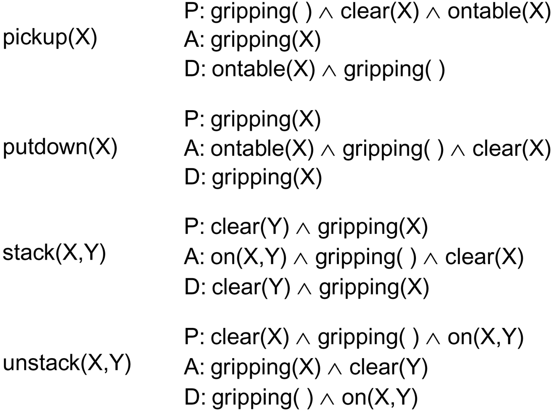
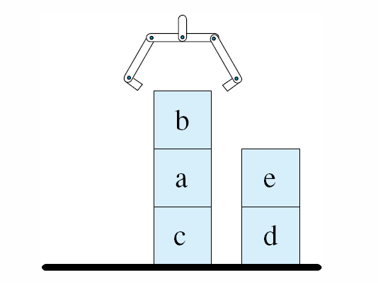
STRIPS
The Stanford Research Institute (SRI) Planning System
  a subgoaling system used to control a robotic arm that could plan and carry out blocks world actions to accomplish stated goals
  The STRIPS operators were denoted with preconditions (what had to be true to perform the operator), add actions and delete actions (how to modify the current state)
defined as on(b, a), on(a, c),
ontable(c), on(e, d), ontable(d),
gripping( )

Slide 40
Non-Linear Planning
STRIPS uses simple linear planning which means that the selection of one operator to accomplish a goal could “clobber” a previously obtained goal
  non-linear planning does not generate the plan in a sequence but instead generates plan solution segments, and then attempts to order them
  in the previous example, imagine that we want to achieve the goal on(e, b), on(b, a), on(a, c), on(c, d), ontable(d)
  we might place e on top of b as an early step only to have to remove b from e when it is realized that we have to remove b from a and a from c so that we can place c on d
Another example is cleaning your kitchen
  Consider operators like “move X”, “clean X”, “mop X”
    you would not want to clean the floor, mop the floor, then move the refrigerator and clean and mop under the fridge because moving the refrigerator will most likely make the rest of the floor dirty again

Slide 41
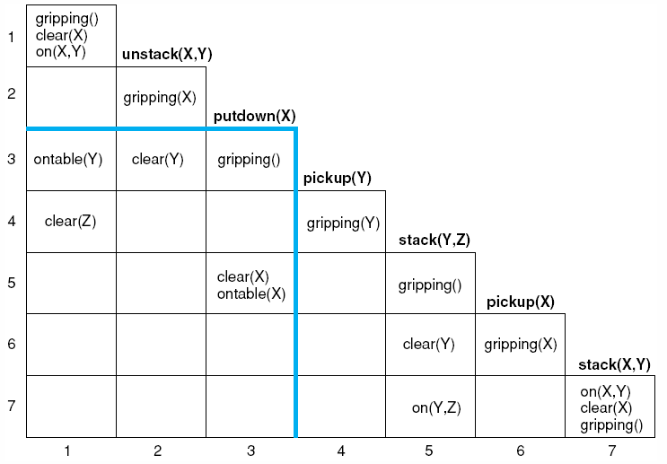
Non-Linear Strategies
Nilsson developed the triangle table representation to solve the problem of non-linear planning
  the table demonstrates dependencies among operators
  an operator’s preconditions are shown in the row to its left and its postconditions are shown below it
Putdown(X) has a dependency with
Pickup(X) as can be seen by finding
two conditions in the intersection

Slide 42
Least Commitment
Another strategy is least commitment where operators are selected but their sequence (order) is not determined until necessary
  first, generate all operators (or as many as possible)
  next, generate any needed operators and sequence those that can clearly be sequenced
  continue until all operators and sequences are sequenced
Example: daily planning
  your daily goals include going to class, work, running errands (grocery store and dry cleaners) and the typical tasks of showering, getting dressed, eating, etc

Slide 43
Continued
Some aspects of your day are dictated by hard constraints
  you have to be at work from 8 am to 12 pm
  you have to be on campus from 1-2 pm and 6:15-7:30 pm for classes and you need an extra 15-20 minutes to park and 15 minutes to drive there from work
  grocery shopping will take you 45 minutes (including travel time)
  the dry cleaners will take you 20 minutes (including travel time)
While the various tasks dictate the operators
  drive to work, work, drive to campus, go to class, drive to the grocery store, do shopping, drive home, put groceries away
Pre- and post-conditions dictate some of the ordering
  you won’t go from the grocery store right to campus, or you won’t go to work, go to campus, and then go home to shower

Slide 44
Other Planning Strategies
Constraint satisfaction – apply constraints whenever possible to prune away possible choices
  for instance, some operators would not be applicable because they would take too much time or cost too much
    consider that you need to pick up your lawnmower, but you brought your small car to work, so this constrains when you can pick up the lawnmower – you must first go home from work to get your larger car
Operator Preference – operators that are more likely to be of use, or to succeed, might be tried first
  operator preference might be dictated by the programmer or it might be specified as part of user input
  operator preference might also be learned, for instance based on statistical usage (operator X has been used more often in the past so X is considered before Y)

Slide 45
Hierarchical Planning/Plan Decomposition
Planning (and design) often require that a given plan step be solved by decomposing it into lesser steps
  consider a plan of taking a trip – to generate our solution, rather than generating specific steps, we first generate a broader solution
    select city to visit and time to visit
    check on air fare and hotel availability and price
    rent car
  this makes more sense than spending a lot of time figuring out the city first – what if there are no available hotels during the time of our planned visit? it makes the first step useless
Design, in general, requires plan decomposition so that each component part can be individually designed
  after plan/design decomposition, we then must combine the component parts/operators into a linear sequence

Slide 46
Case-Based Planning
We already saw that Chef used previous recipes (plans) to generate new plans
  we can use this approach for nearly any kind of planning or design as long as
    we have a set of previous plans/designs to work with
    we have a way of determining where the prior plan/design will break down
    we have a way to modify the selected plan/design to fit the new situation
Consider having a library of component parts for a device (e.g., a rocket motor) and a set of design plans for the device
  now we use the library to generate possible new designs for a new type of motor or a more efficient motor, or a motor that uses different types of parts (e.g., aluminum instead of steel)

Slide 47
Transformational Analogy
Humans use analogy all the time in their reasoning
  this would make a powerful tool for transforming a previous case’s solution into a new solution
  how do we program analogy is difficult?
  we are unsure how analogy works
In transformational analogy, the transformation is more of a formulaic approach
  for instance, we know that the distance between A & B = distance between C & D where A < B < C < D and we can use this to infer that the distance between A & C = distance between B & D
  we can then use this solution to transform a problem that reasons over angles instead of distances

Slide 48
Reactive Planning
Planning takes place at run-time when an unexpected situation arises
  an autonomous robot whose path is suddenly blocked
  the importance here is to make a quick decision but also make a decision that still permits the planner to complete its goals
Simple rules might be used but they could be too brittle
  if there is no rule that adequately handles the new situation, it could be disasterous
Consider our robot which has rolled off the path into a ditch because the ground was softer than expected
One strategy is to replan from this point
  but this may be too time consuming
Or employ case-based reasoning to fix the previous plan
A compromise is to use a model to generate a plan and then simple failure-handling rules to modify the plan as it is carried out
  the book offers a model-based approach to reactive planning using teleo-reactive planning (see pages 323-326, we will skip this)

Slide 49
Rule-based Planning
R1/XCON demonstrated that planning (design) could be done strictly by rules (R1 had about 10,000 rules)
  to build a planning system with rules, a great amount of domain knowledge is needed, unlike the STRIPS approach with just a few operators
Another rule-based planning system was VT (Vertical Transportation) for elevator design
  the design components are shown on the next slide
  design requires establishing values for various physical dimensions, weights, component parts and the materials used for the parts
    decisions were made first based on user constraints/specifications and later by constraints from already established components
  many rules were “failure-handling” rules, that is, solutions when constraints would be exceeded such as
    if traction-ratio is exceeded then increase car-supplement-weight
    if machine-groove-pressure is exceeded then decrease car-supplement-weight
      note that the above two rules can contradict each other, this was corrected when VT was re-implemented using a KADS-based approach

Slide 50
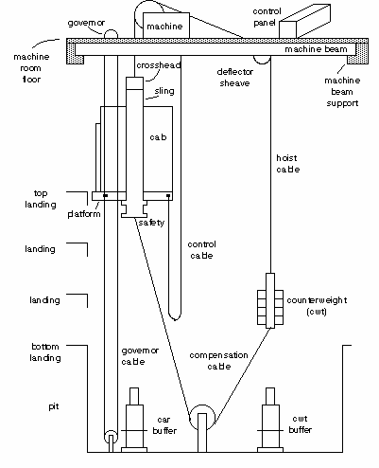
VT – an Elevator’s Design

Slide 51
Meta-Planning
MOLGEN – expert system to design laboratory genetics experiments
A plan would work through 3 levels of reasoning
  strategy steps – deciding what part of a lab to develop next, uses meta knowledge that dictate which of the general planning strategies should be applied (such as focus on a specific operation, undo a previous choice, and resume a previous partial plan)
  design steps – meta knowledge which contain design knowledge to sequence steps and check to see that a given step’s preconditions are met or goal satisfies other steps’ preconditions, etc
  lab steps – contain domain knowledge for performing an experiment
MOLGEN used least commitment and moves between plan stages using meta-knowledge
  so unlike previous forms of planning, MOLGEN would spend part of its time reasoning about what to work on next

Slide 52
Model-based Planning
Just as a model can be used to reason over for diagnosis, a model can be used to reason over for reactive planning
  returning to our NASA rocket, the model is used to diagnose a problem such as a stuck valve
  the same model can then be used to generate what action(s) should take place to fix the problem
    actions are: open/close valves and pyro valves
    state transition diagram used to reason about the state of a valve
    the mode estimation unit (ME) reasons over the current state of the engine and the mode reconfiguration unit (MR) generates plans to move back into the desired state
    since there are multiple pathways for fuel to travel, there are many potential solutions, the MR consults with the Planner Executive for high level goals in order to make a choice
      for instance, is our goal to achieve the action in the fewest number of changes, the shortest path for fuel to travel, the least amount of fuel usage?
      figures shown on the next slide

Slide 53
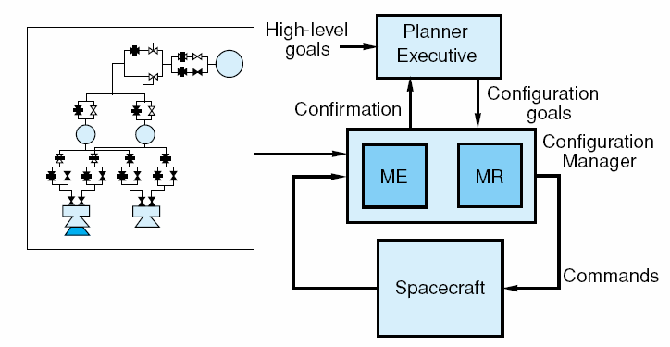
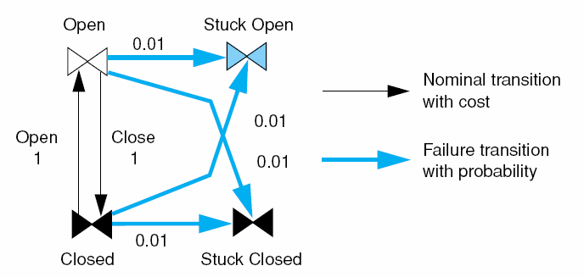
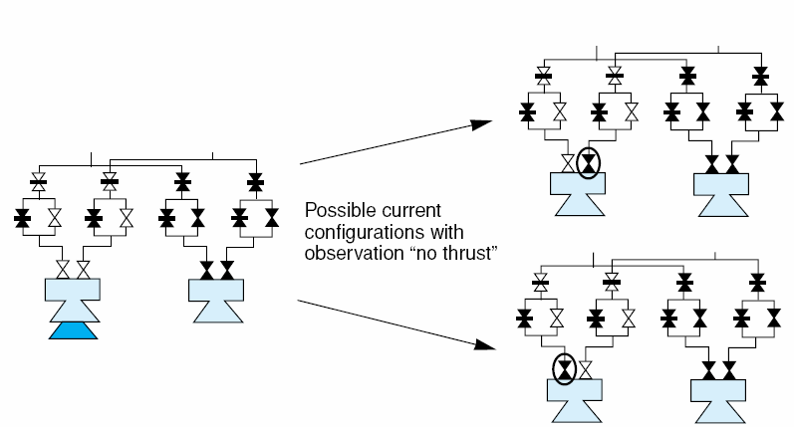
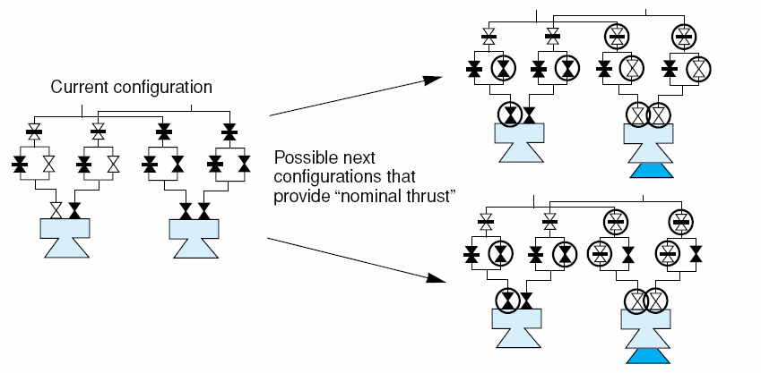
Overview, Transition Diagram
Sample Plans

Slide 54
The Generic Task Approach
With the various approaches to diagnosis and planning/design available, what should you use?
  many preferred the rule-based approach because it required little programming
  others found rules to lead to difficulties in debugging so opted for frame-based or model-based approaches
In the mid 1980s, a series of tasks were identified that seemed to be present across problems
  classification
  matching
  assembly (we discuss this briefly in the next chapter)
  plan decomposition

Slide 55
More on GTs
Instead of implementing a problem solver by a specific approach like rules, might it be better to perform a task decomposition and then identify which generic task(s) should be applied?
  this approach was found to be very successful in construction diagnostic, interpretation, design/planning and perception systems
  some argued, much like Schank’s 11 primitive actions, that tasks should be defined at a different level (e.g., proponents of the SOAR architecture thought that tasks were lower level derived through basic rule chaining and learning)
GT tools were constructed:
  CSRL – classification
  DSPL – routine design
  Peirce – abductive assembly
  Hyper/RA – hypothesis matching/structured matching
  FunRep – functional representation for simulation and what would happen if reasoning

