Slide 1
Representations
One of the major distinctions between ordinary software and AI is the need to represent domain knowledge (or other forms of worldly knowledge)
  this knowledge must be represented in some form
    we have already examined some basic forms of representation: predicates, rules, states of search space
    there are many other forms that might be more useful for a given problem, we examine some of these here and others in later chapters
When we represent knowledge, we must decide
  how much knowledge to retain
    if we receive information as input, do we retain the actual English sentences, or just the meaning behind them?
  at what level of specificity should information be represented?
    consider the differences between: “Spot is a dog”, “Spot is a poodle”, “Spot is my dog”, and “Spot is my 3 year old poodle”

Slide 2
Knowledge
We differentiate knowledge as
  Knowledge Level: what we know
  Symbol Level: how it is represented
    knowledge level will give a problem solver the ability to know what it can and cannot solve
    symbol level dictates the mechanisms needed to process the knowledge
Knowledge itself can be broken into
  Procedural knowledge – how to solve a problem
  Domain knowledge – information pertaining to a particular domain
  Common sense knowledge – experiential knowledge that arises from a variety of different circumstances
We might categorize knowledge as: facts, axioms, cases, statements (beliefs), rules, associations, descriptions
Knowledge may be available in many forms: rules, experiences, pictures (or other media), statistics

Slide 3
Relationships
When it comes to knowledge, we know about things (objects, whether physical or abstract)
  these things have attributes (components, values) and/or relationships with other things
One way to represent knowledge is to
  enumerate the objects
  describe the objects through their attributes
  describe the relationships between objects
Two common forms of such representations are
  semantic networks – a network consists of nodes which are objects and values, and edges (links/arcs) which are annotated to include how the nodes are related
  frames – in essence, objects (from object-oriented programming) where attributes are the data members and the values are the specific values stored in those members – in some cases, they are pointers to other objects

Slide 4
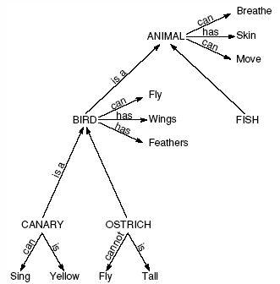
Semantic Networks
Collins and Quillian were the first to use semantic networks in AI by storing in the network the objects and their relationships
  their intention was to represent English sentences
  edges would typically be annotated with these descriptors or relations
    isa – class/subclass
    instance – the first object is an instance of the class
    has – contains or has this as a physical property
    can – has the ability to
    made of, color, texture, etc
A semantic network to represent the
sentences “a canary can sing/fly”, “a canary
is a bird/animal”, “a canary has skin”

Slide 5
Using The Semantic Network
Collins and Quillian used the semantic network for information retrieval
  the idea was to see how long it would take for a human to respond to a question about the knowledge represented in the network such as “can a canary fly?”
  more importantly though, the representation demonstrated how a computer could be programmed to respond, by following edges
    starting at the “canary” node, follow “can” link(s) (and isa links) until you find “fly”
    alternatively, is there a path between canary and fly that consists of isa and can links?

Slide 6
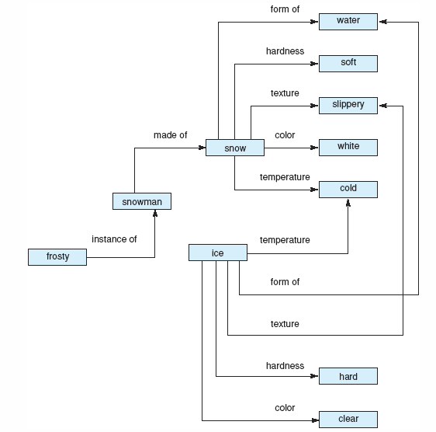
Representing Facts of Objects
Here, we see various information about snow and ice
We might use this semantic network to answer questions about snow, ice and frosty the snowman
  For instance: What color is frosty? Can frosty exist in warm weather? Or which is harder, snow or ice?

Slide 7
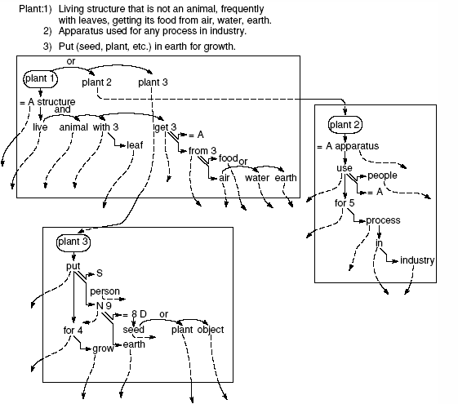
Representing Word Meanings
Quillian demonstrated how to use the semantic network to represent word meanings
  each word would have one or more networks, with links that attach words to their definition “planes”
  the word plant is represented as three planes, each of which has links to additional word planes

Slide 8

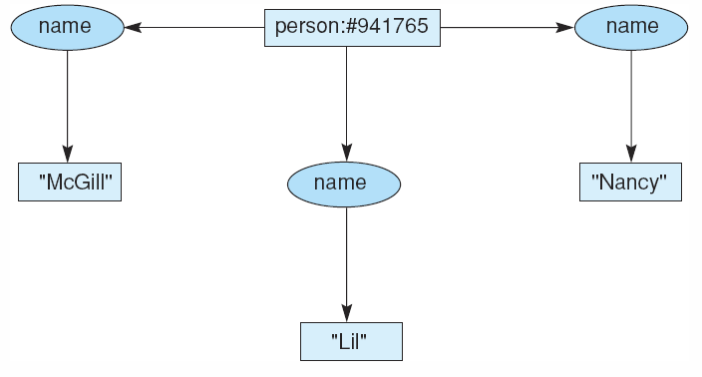

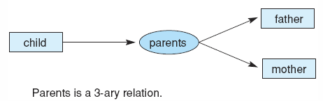
Conceptual Graphs
Another, related, type of structure
  links are not annotated,
    instead there are different types of nodes – each which defines an attribute between other nodes
  relationship nodes will be denoted differently
    in the figures, an oval shape
Conceptual graphs, like semantic networks, can be used to
  represent entity relationships and general purpose knowledge
  represent entities and their identifications (and attributes)
  sentences

Slide 9
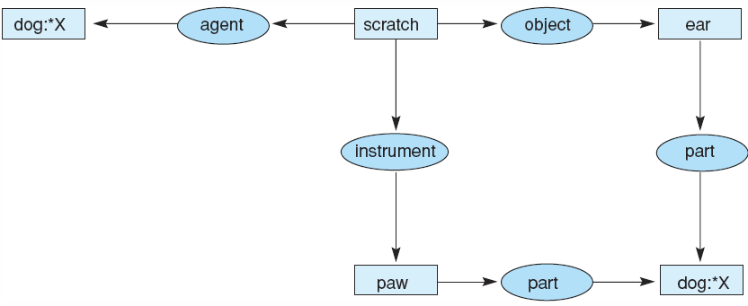
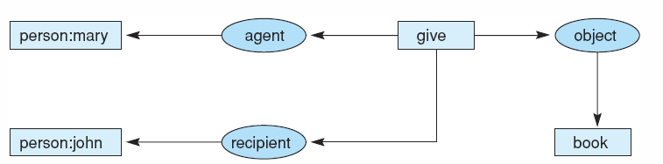
Representing Sentences
The dog scratches its ears with its paws.
Mary gave john the book.
[notice that this is different from Mary gave John a book]

Slide 10
Operations on Conceptual Graphs
The idea is that given a series of graphs that represent a problem solver’s knowledge
There are four operations that can take some of these graphs and create new graphs
  copy – create an exact copy of a graph
  restrict – take a given node or a set of nodes and replace them with a node that represents a specialization of that knowledge – replace a generic marker with an individual marker (that is, replace a class with an instance), or replace a type label with a subtype
  join – take two graphs and combine them into a single graph
  simplify – take a graph with two duplicate relations and delete one of them along with all edges of that subgraph

Slide 11
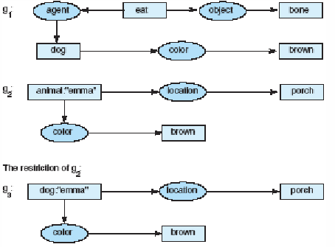
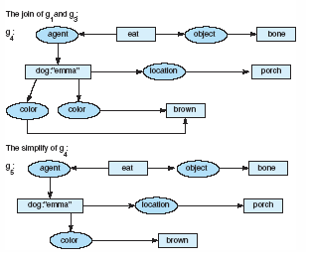
Example
We know that
  a brown dog is eating a bone
  Emma is brown and on a porch
  the restriction allows us to combine g2 with a new fact, that Emma is a dog
  next, a join allows us to combine g1 and g3 into a single graph so that we know that the dog from g2 is the same dog from g1
  after simplification, we have all of the knowledge combined into a more efficient (scaled down) graph

Slide 12
Case Relationships
To help formalize semantic networks, certain types of attributes were defined for relationships between nouns
  Agent – the object doing the action
  Object – the object being acted upon
  Instrument – another object that is allowing the agent to act upon the object (e.g., “the man shot the dog” would imply that the instrument was a gun)
  Location – where the action took place
  Time – when the action took place
    These last two may not be absolute values but relative to other actions

Slide 13
Frames
The semantic network requires a graph representation which may not be a very efficient use of memory
Another representation is the frame
  the idea behind a frame was originally that it would represent a “frame of memory” – for instance, by capturing the objects and their attributes for a given situation or moment in time
  a frame would contain slots where a slot could contain
    identification information (including whether this frame is a subclass of another frame)
    relationships to other frames
    descriptors of this frame
    procedural information on how to use this frame (code to be executed)
    defaults for slots
    instance information (or an identification of whether the frame represents a class or an instance)

Slide 14
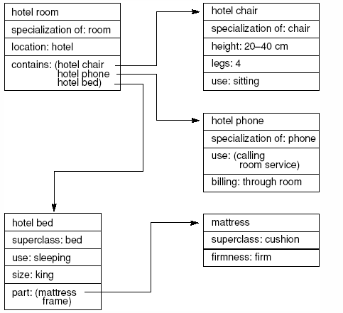
Frame Example
Here is a partial frame
representing a hotel room
The room contains a chair,
bed, and phone where the bed
contains a mattress and a bed
frame (not shown)

Slide 15
Reasoning Mechanisms
How do we use our semantic net/frame to reason over?
  reasoning with defaults
    the semantic network or frame will contain default values, we can infer that the default values are correct unless otherwise specified
    what if default values are not given? what if default values are given but we have an exceptional case that is not explicitly noted?
  reasoning with inheritance
    we can inherit any properties from parent types unless overridden
    what about multiple inheritance?
  reasoning with attribute-specific values
    Implement a process to reason over a “has” link
      if A has B, we might assume A and B are physically connected and in close proximity
      this doesn’t work if we are using “has” somewhat more loosely like “that man has three children” or “she has the chicken pox”

Slide 16
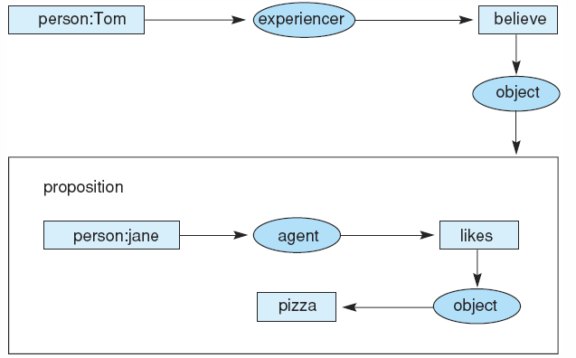
Representing Belief
Belief is an interesting thing – consider the following sentences
  Jane likes pizza
  Tom believes that Jane likes pizza
Modeling belief lets us differentiate between truth and belief
  here, we can reason over why Tom ordered a pizza for Jane or why Jane did not eat it

Slide 17
Problems
The main problem with semantic networks and frames is that they lack formality
There is no specific guideline on how to form a representation
  the word “has” may be used in a way other than “physical property”
    the man has two dogs – has is not a physical attribute of man but ownership
  unlike predicate calculus, there are no formal mechanisms for reasoning
    inheritance can be flawed when dealing with multiple parents for a given node (multiple inheritance)
    there are no defined methods for “can”, “has”, etc
The frame problem
  when things change, we need to modify all frames that are relevant – this can be time consuming

Slide 18
Strong Slot-n-Filler Structures
To avoid the difficulties with Frames and Nets, Schank and Rieger offered two network-like representations that would have implied uses and built-in semantics: conceptual dependencies and scripts
  the conceptual dependency was derived as a form of semantic network that would have specific types of links to be used for representing specific pieces of information in English sentences
    the action of the sentence
    the objects affected by the action or that brought about the action
    modifiers of both actions and objects
  they defined 11 primitive actions, called ACTs
    every possible action can be categorized as one of these 11
    an ACT would form the center of the CD, with links attaching the objects and modifiers

Slide 19
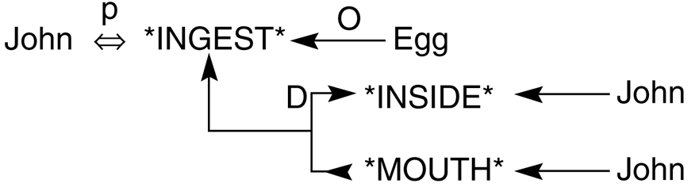
Example CD
The sentence is “John ate the egg”
The INGEST act means to ingest an object (eat, drink, swallow)
  the P above the double arrow indicates past test
  the INGEST action must have an object (the O indicates it was the object Egg) and a direction (the object went from John’s mouth to John’s insides)
  we might infer that it was “an egg” instead of “the egg” as there is nothing specific to indicate which egg was eaten
  we might also infer that John swallowed the egg whole as there is nothing to indicate that John chewed the egg!

Slide 20
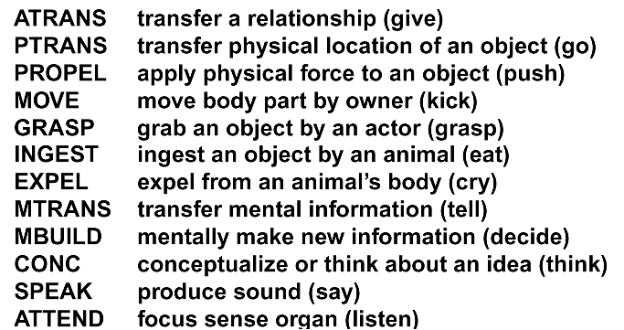
The CD Theory ACTs
Is this list complete?
  what actions are missing?
Could we reduce this list to make it more concise?
  other researchers have developed other lists of primitive actions including just 3 – physical actions, mental actions and abstract actions

Slide 21
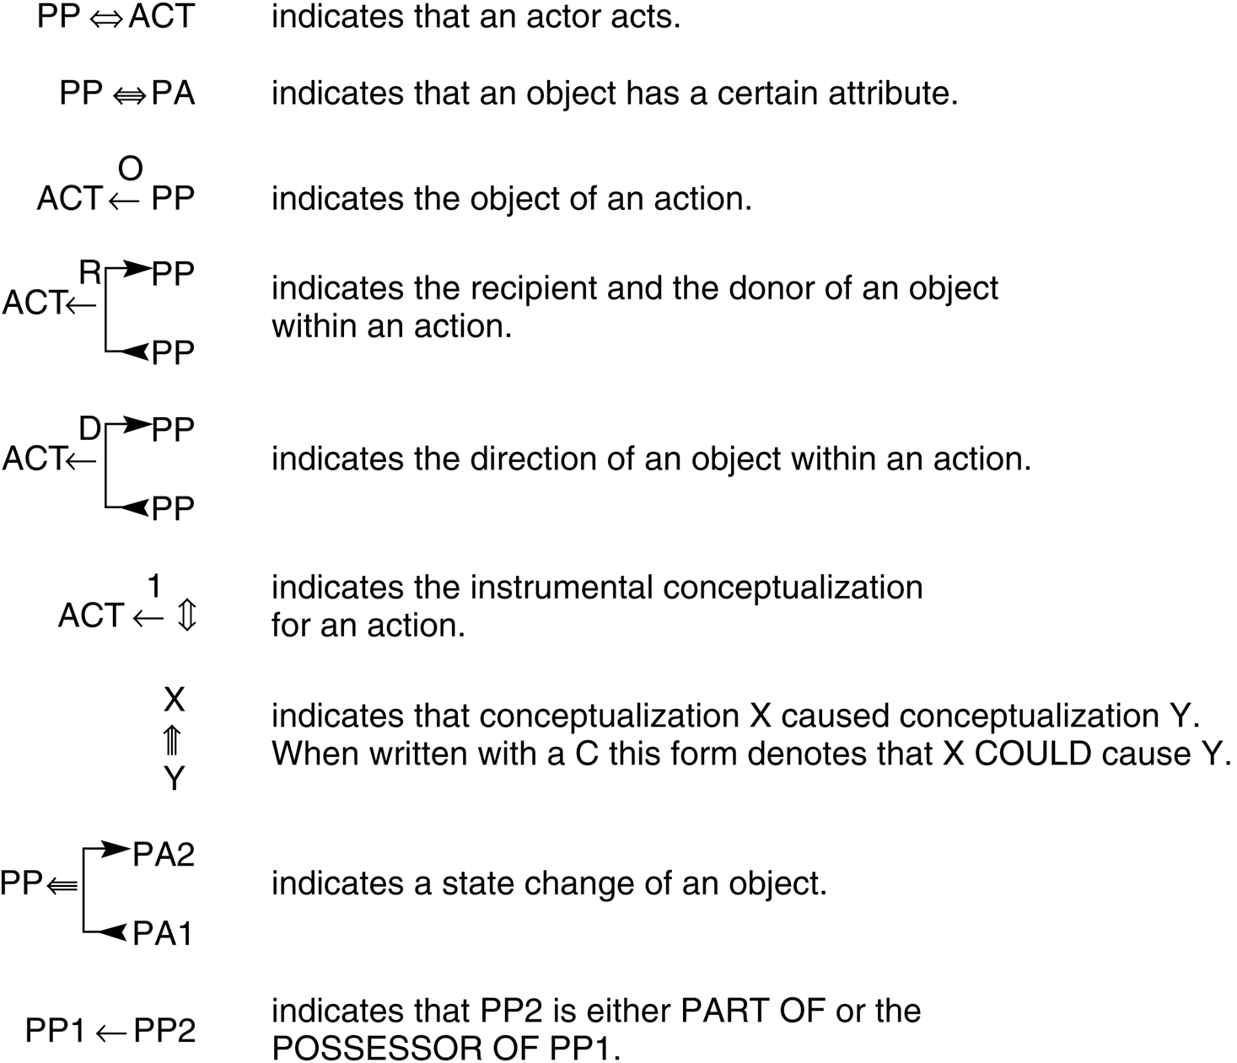
Example CD Links

Slide 22
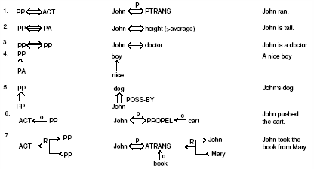
Example CDs

Slide 23
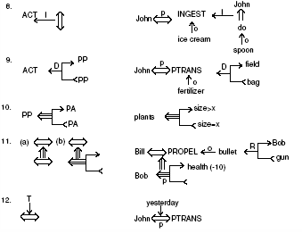
More Examples

Slide 24
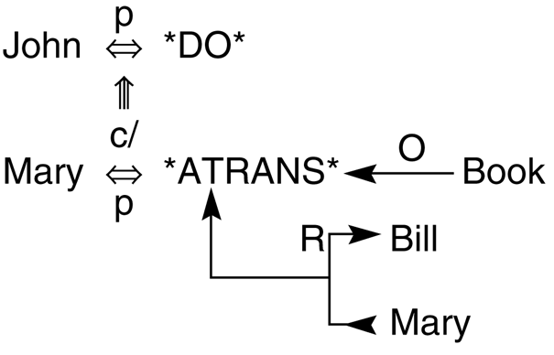
Complex Example
The sentence is “John prevented Mary from giving a book to Bill”
This sentence has two ACTs, DO and ATRANS
  DO was not in the list of 11, but can be thought of as “caused to happen”
The c/ means a negative conditional, in this case it means that John caused this not to happen
The ATRANS is a giving relationship with the object being a Book and the action being from Mary to Bill – “Mary gave a book to Bill”
  like with the previous example, there is no way of telling whether it is “a book” or “the book”

Slide 25
Scripts
The other structured representation developed by Schank (along with Abelson) is the script
  a description of the typical actions that are involved in a typical situation
    they defined a script for going to a restaurant
  scripts provide an ability for default reasoning when information is not available that directly states that an action occurred
  so we may assume, unless otherwise stated, that a diner at a restaurant was served food, that the diner paid for the food, and that the diner was served by a waiter/waitress
A script would contain
  entry condition(s) and results (exit conditions)
  actors (the people involved)
  props (physical items at the location used by the actors)
  scenes (individual events that take place)
The script would use the 11 ACTs from CD theory

Slide 26
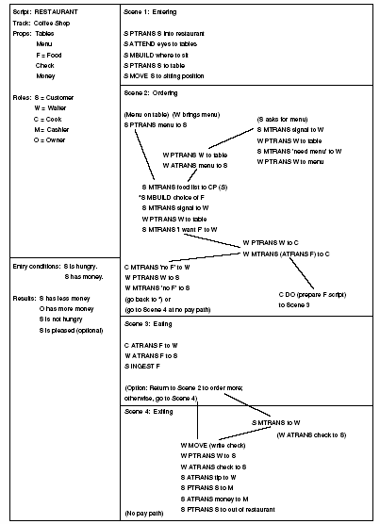
Restaurant Script
The script does not contain atypical actions
  although there are options such as whether the customer was pleased or not
There are multiple paths through the scenes to make for a robust script
  what would a “going to the movies” script look like? would it have similar props, actors, scenes? how about “going to class”?

Slide 27
Using CDs and Scripts
Schank and his coresearchers developed two software systems
  PAM – given a few sentences, they would be represented using CDs so that PAM could answer questions about what took place
  SAM – given a short story of a restaurant situation, it could answer questions from the story
    the script was used as a guide to parse the story and store information – who were the customers and waiter, what was the name of the restaurant, what did they order and eat, how much did they pay?
    questions were then answered by referencing the script and using the default information when there was none in the story (did they pay? yes, unless the story indicated otherwise)

Slide 28
Knowledge Groups
One of the drawbacks of the knowledge representations demonstrated thus far is that all knowledge is grouped into a single, large collection of representations
  for instance, a large collection of rules does not help us understand which rules are applicable in a given context
We could instead divide representations into logical groupings
  for instance, we might divide the diagnostic problem into steps such as “gathering patient symptoms”, “inferring a general cause”, “selecting specific tests”, “analyzing test results”, “drawing conclusions” and “deriving a treatment”
  we might then separate our rules to fit into the proper diagnostic stage and only deal with rules pertaining to the stage we are currently in
  this permits easier design, implementation, testing and debugging because you know what that particular group is supposed to do and what knowledge should go into it
  there are many different ways to organize knowledge groups, we will explore some of these ideas in the next chapter

Slide 29
Knowledge Sources and Agents
Another option is to have multiple problem solving agents
  each agent is responsible for solving some specialized type of problem(s) and knows where to obtain its own input
  each agent has its own knowledge sources, some internal, some external (each agent may have its own form of representation and process(es))
  questions:
    how does an agent find other agents?
    how do they communicate with each other?
    how does one agent interpret information received from another?
    how does an agent proceed when another, expected, agent is unavailable?
    can agents “doubt” information supplied by others?

Slide 30
What is an Agent?
Agents are interactive problem solvers that have these properties
  situated – the agent is part of the problem solving environment – it can obtain its own input from its environment and it can affect its environment through its output
  autonomous – the agent operates independently of other agents and can control its own actions and internal states
  flexible – the agent is both responsive and proactive – it can go out and find what it needs to solve its problem(s)
  social – the agent can interact with other agents including humans
Some researchers also insist that agents be
  mobile – have the ability to move from their current environment to a new environment (e.g., migrate to another processor)
  delegation –hand off portions of the problem to other agents
  cooperation – if multiple agents are tasked with the same problem, can their solutions be combined?

Slide 31
An Example of Using Agents
The most impressive use of agents today is the creation of the semantic web
  the world wide web is a collection of data and knowledge in an unstructured format
    humans often can take knowledge from disparate sources and put together a coherent picture, can problem solving agents?
  agents on the semantic web all have their own capabilities and know where to look for knowledge
    whether a static source, or an agent that can provide the needed information through its own processing, or from a human
  the common approach is to model the knowledge of a web site using an ontology
    typically, an ontology for a given set of domain knowledge, contains a hierarchy that relates the domain concepts, and for each concept, an enumeration of important facts
    ontologies are usually represented using XML-like tags in an ontology language, OWL being one of the most common
    we will take a deeper look at ontologies and the semantic web later in the semester

Slide 32
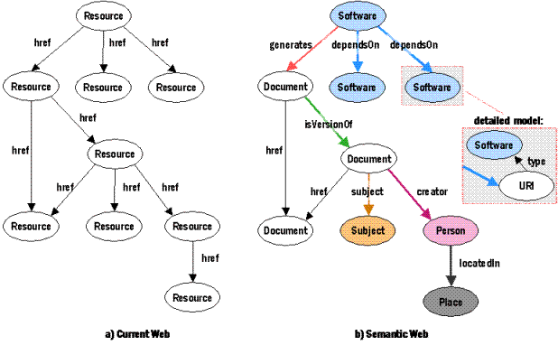
Semantic Web vs. Current Web
Software agents are inserted into the web to perform tasks for us, and use
ontologies to be able to understand responses from other software agents,
if time permits, we will explore ontologies later in the semester

