Slide 1
Production Systems
A production system is
  a set of rules (if-then or condition-action statements)
  working memory
    the current state of the problem solving, which includes new pieces of information created by previously applied rules
  inference engine (the author calls this a “recognize-act” cycle)
    forward-chaining, backward-chaining, a combination, or some other form of reasoning such as a sponsor-selector, or agenda-driven scheduler
  conflict resolution strategy
    when it comes to selecting a rule, there may be several applicable rules, which one should we select? the choice may be based on a conflict resolution strategy such as “first rule”, “most specific rule”, “most salient rule”, “rule with most actions”, “random”, etc

Slide 2
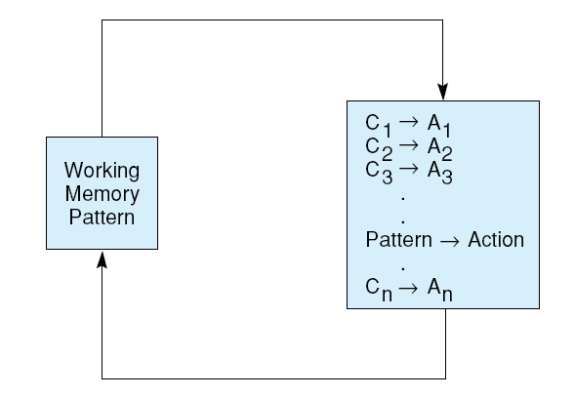
Production System Cycle
Select a rule whose left hand side matches a pattern in working memory
Fire the right hand side
  this usually manipulates working memory (removing item(s), modifying item(s), adding item(s))
We need an algorithm to match
conditions to working memory
As with predicate calculus, we
may not have an exact match
for instance, if working
memory stores
dog(fido).
this does not match dog(X)
Conditions will often have multiple parts and-ed or or-ed together

Slide 3
Chaining
The idea behind a production system’s reasoning is that rules will describe steps in the problem solving space where a rule might
  be an operation in a game like a chess move
  translate a piece of input data into an intermediate conclusion
  piece together several intermediate conclusions into a specific conclusion
  translate a goal into substeps
A solution is a collection of rules chained together
  forward chaining – reasoning from data to conclusions where working memory is searched for pieces of information known to be true and matched against the left-hand side of rules which, when fired, alter what is known in working memory
  backward chaining – reasoning from goals to operations where working memory is searched for successful goals or subgoals to fulfill and matched against right-hand side of rules which, when fired, generate new subgoals, remove subgoals, and generate specific operations to execute

Slide 4
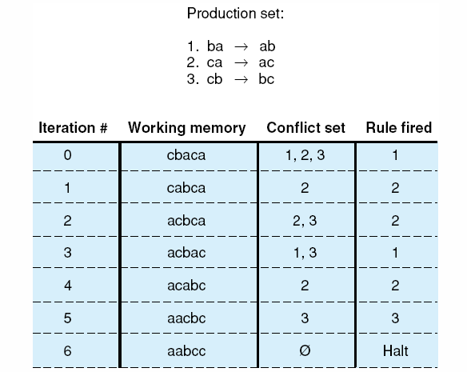
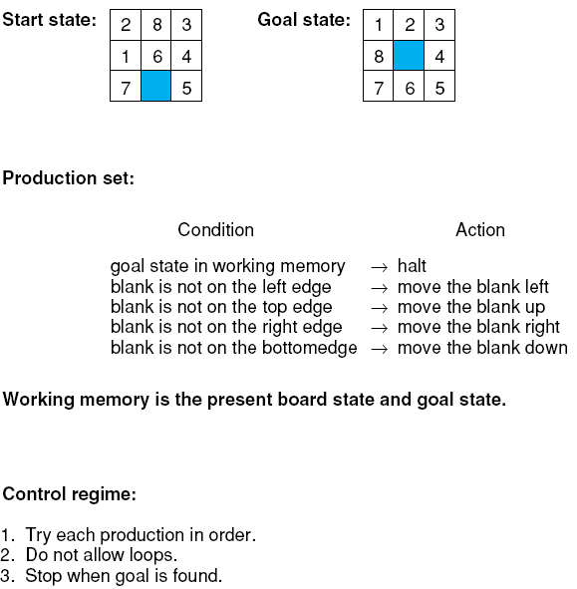
Two Example Production Systems

Slide 5
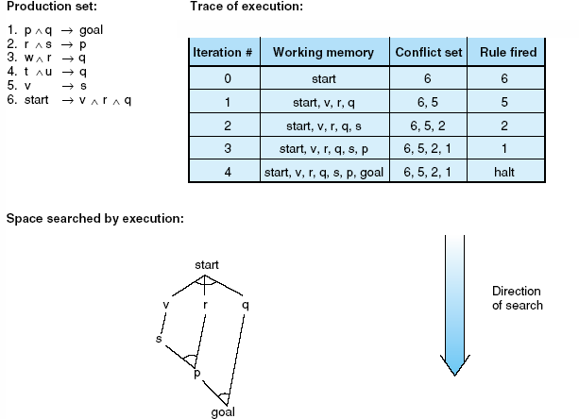
Forward Chaining Example

Slide 6
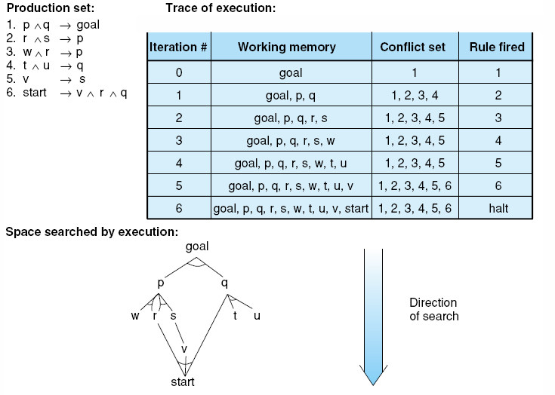
Backward Chaining Example

Slide 7
Example System: Water Jugs
Problem: given a 4-gallon jug (X) and a 3-gallon jug (Y), fill X with exactly 2 gallons of water
  assume an infinite amount of water is available
Rules/operators
  1. If X = 0 then X = 4 (fill X)
  2. If Y = 0 then Y = 3 (fill Y)
  3. If X > 0 then X = 0 (empty X)
  4. If Y > 0 then Y = 0 (empty Y)
  5. If X + Y >= 3 and X > 0 then X = X – (3 – y) and Y = 3 (fill Y from X)
  6. If X + Y >= 4 and Y > 0 then X = 4 and Y = Y – (4 – X) (fill X from Y)
  7. If X + Y <= 3 and X > 0 then X = 0 and Y = X + Y (empty X into Y)
  8. If X + Y <= 4 and Y > 0 then X = X + Y and Y = 0 (empty Y into X)
    rule numbers used on the next slide

Slide 8
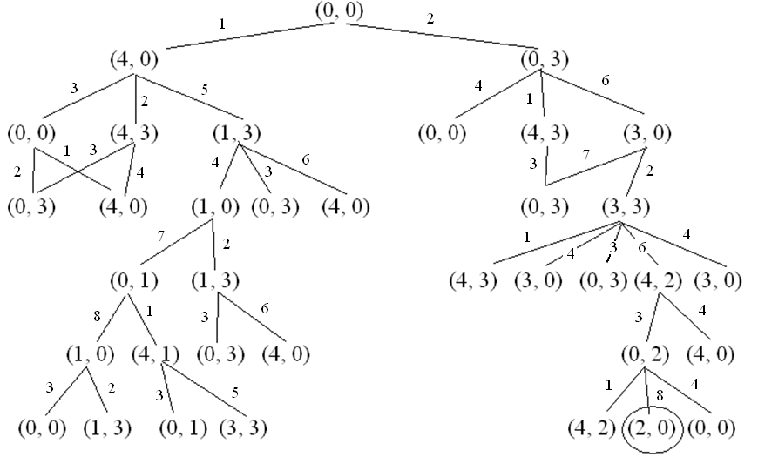
Solution Space
Note: the solution space does not show cycles (for instance, the second (4, 0) on the left does not have a subtree underneath it, we assume we will not continue from that point because (4, 0) is in the closed list

Slide 9
Eliza
We briefly explored Eliza in chapter 1, lets take a look at how it worked
The program would generate an English response/question based on a group of patterns
  if the user sentence matched a pattern, this pattern would be used to generate the next sentence/question
Eliza algorithm
  repeat
    input a sentence
    match a rule in the Eliza knowledge-base
      attempt to perform pattern match (see next slide)
      attempt to perform segment match (see two slides)
    if rule found, select a response randomly (some patterns have multiple responses)
    fill in variables, substitute values
  until user quits

Slide 10
Eliza Rules
(defparameter *eliza-rules*
'((((?* ?x) hello (?* ?y))
(How do you do. Please state your problem.))
(((?* ?x) I want (?* ?y))
(What would it mean if you got ?y)
(Why do you want ?y) (Suppose you got ?y soon))
(((?* ?x) if (?* ?y))
(Do you really think its likely that ?y)
(Do you wish that ?y)
(What do you think about ?y) (Really-- if ?y))
(((?* ?x) no (?* ?y))
(Why not?) (You are being a bit negative)
(Are you saying "NO" just to be negative?))
(((?* ?x) I was (?* ?y))
(Were you really?)
(Perhaps I already knew you were ?y)
(Why do you tell me you were ?y now?))
(((?* ?x) I feel (?* ?y))
(Do you often feel ?y ?))
(((?* ?x) I felt (?* ?y))
(What other feelings do you have?))))
If the input contains
*something* hello *something*,
Eliza responds with
“How do you do.”
If the input contains
*something* if *something else*
Eliza responds with
Do you really think its likely
that *something else*?
or with
Do you wish that
*something else*?

Slide 11
Eliza Pattern Matching
pat ➔ var match any one expression to a variable
constant or to a constant (see below)
segment-pat match against a sequence
single-pat match against one expression
(pat . pat) match the first and the rest of a list
single-pat ➔
(?is var predicate) test predicate on one expression
(?or pat1 pat2 …) match on any of the patterns
(?and pat1 pat2 …) match on every of the expressions
(?not pat) match if expression does not match
segment-pat ➔
((?* var) …) match on zero or more expressions
((?+ var) …) match on one or more expressions
((?? var) …) match zero or one expression
((?if expr) …) test if expression is true
var ➔ ?chars variables of the form ?name
constant ➔ atom constants are atoms (symbols, #, chars)

Slide 12
Example Rules: Mycin
Medical diagnosis
  (defrule 52
    if (site culture is blood)
    (gram organism is neg)
    (morphology organism is rod)
    (burn patient is serious)
  then .4
    (identity organism is pseudomonas))
The .4 is a certainty factor, used to specify how likely the conclusion is to be true
  we look at certainty factors and other methods of uncertainty handling in chapter 9
Mycin had over 600 rules that dealt with all aspects of the diagnostic process
  filling in missing data, test ordering, partial conclusions, diagnostic conclusions, treatments

Slide 13
R1 (XCON) Sample Rules
For designing Vax computers
  Constraint rules:
    if device requires battery then select battery for device
    if select battery for device then pick battery with voltage(battery) = voltage(device)
  Configuration rules:
    if we are in the floor plan stage and there is space for a power supply and there is no power supply available then add a power supply to the order
    if step is configuring, propose alternatives and there is an unconfigured device and no container was chosen and no other device that can hold it was chosen and selecting a container wasn’t proposed yet and no problems for selecting containers were identified then propose selecting a container
R1 had over 10,000 rules!

Slide 14
Conflict Resolution Strategies
What happens when more than one rule matches?
  a conflict resolution strategy dictates how to select from between multiple matching rules
Simple conflict resolution strategies include
  random
  first match
  most/least recently matched rule
  rule which has matched for the longest/shortest number of cycles (refractoriness)
  most salient rule (each rule is given a salience before you run the production system)
More complex resolution strategies might
  select the rule with the most/least number of conditions (specificity/generality)
  or most/least number of actions (biggest/smallest change to the state)

Slide 15
Advantages of Production Systems
Separation of knowledge and control
  these systems contain two (or more) distinct forms of knowledge – the knowledge base (rules) and the inference engine
    this makes it easy to update/change knowledge and debug the system
Easy to map knowledge into rule format
  a lot of expert knowledge is already in this form, in fact, a production system is a plausible model for human problem solving
Rules can be grouped into logical sets
  promotes modularity and allows meta-knowledge to select which set of rules to concentrate on
Easy to enhance a system to explain its behavior
  just add code to output the selected rules to demonstrate the chain of logic that led to the conclusion(s)
Easy to construct shell languages

Slide 16
Disadvantages of Production Systems
There is a lack of focus
  that is, the system will just continue to fire rules
  a human problem solver might discover a pattern early on so that the expert refocuses attention on some specific set of rules, this is not typically done in production systems
Computationally complex
  as with nearly any AI system, search means inefficiency, a production system is just another means of searching through a space of knowledge
Difficult to debug
  odd behavior begins to occur with thousands of rules and its hard to figure out why or just what rules should be changed
  changing a rule may cause problems with other rules – for instance, am I altering a rule that will be needed by another rule? am I altering a rule so that it overlaps with another rule?

Slide 17
Rule-based Shells
Once Mycin was running, the researchers realized that other systems could be built by replacing Mycin’s knowledge base (the specific rules) with other rules
They created E-Mycin
  E for empty or essential
  This is called a shell, the control
E-Mycin contains
  Mycin’s backward chaining process
  Working memory
  Conflict resolution strategies
  Certainty factor formulas (if needed)

Slide 18
SACON
A system built from E-Mycin
Structural analysis in engineering problems
Example rule
  if the material composing and the sub-structure is one of: the metals, and the analysis error (in percent) is between 5 and 30, and the non-dimensional stress of the sub-structure > .9 and the number of cycles the loading is to be applied is between 1000 and 10000 then the fatigue is one of the stress behavior phenomena in the sub-structure (1.0)
    all certainty factors were 1.0 in SACON

Slide 19
Rule-based Languages
Since E-Mycin, there have been many rule-based languages
  Prolog – no uncertainty at all, uses backward chaining, has some modest computational capabilities, almost no conflict resolution
  OPS5 – uses forward chaining only, several forms of conflict resolution, mathematical abilities to permit certainty factors
  CLIPS and Jess – support forward and backward chaining, object-oriented allows you to write your own data structures and methods

Slide 20
Blackboard Architectures (6.3)
When a problem has different “levels” of problem solving, when do you shift from one level to another?
Hearsay (speech recognition) pioneered the blackboard
Groups of rules for a “level” would operate on one section of the blackboard, producing results for another section
  they called a group of rules a knowledge source (KS)
A set of rules is applied to decide where Hearsay should focus
  KSi would read information from level i (and possibly others) and produce conclusions for level i+1

Slide 21
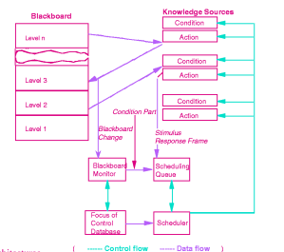

Slide 22
Levels in Hearsay
Auditory features → phonetic units
Phonetic units → syllables
Syllables → words
Words → phrases
Phrases → sentences
Sentences → syntactic units
Syntactic units → semantic units

