Slide 1
Heuristic Search
Heuristic - a “rule of thumb” used to help guide search
often, something learned experientially and recalled when needed
Heuristic Function - function applied to a state in a search space to indicate a likelihood of success if that state is selected
heuristic search methods are known as “weak methods” because of their generality and because they do not apply a great deal of knowledge
the methods themselves are not domain or problem specific, only the heuristic function is problem specific
Heuristic Search –
given a search space, a current state and a goal state
generate all successor states and evaluate each with our heuristic function
select the move that yields the best heuristic value
Here and in the accompanying notes, we examine various heuristic search algorithms
heuristic functions can be generated for a number of problems like games, but what about a planning or diagnostic situation?

Slide 2
Example Heuristic Function
Simple heuristic for 8-puzzle:
add 1 point for each tile in the right location
subtract 1 point for each tile in the wrong location
Better heuristic for 8-puzzle
add 1 point for each tile in the right location
subtract 1 point for each move to get a tile to the right location
The first heuristic only takes into account the local tile position
it doesn’t consider such factors as groups of tiles in proper position
we might differentiate between the two types of heuristics as local vs global
Goal: Current: Moves:
2 3
5 6
7 8
4 2 3
5 7 1
6 8
7 down (simple: -5, better: -8)
6 right (simple: -5, better: -8)
8 left (simple: -3, better: -7)

Slide 3
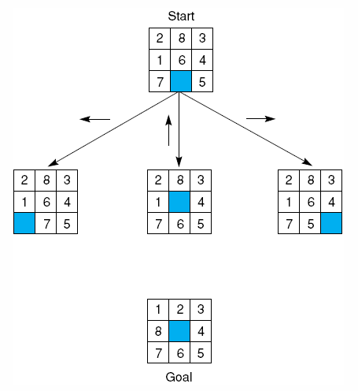
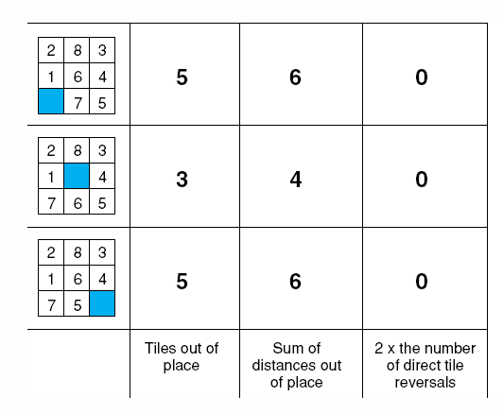
Example Heuristics: 8 Puzzle
From the start state, which operator do we select (which state do we move
into)? The first two heuristics would recommend the middle choice (in this case,
we want the lowest heuristic value) while the third heuristic tells us nothing
useful (at this point because too much of the puzzle is not yet solved)

Slide 4
Hill Climbing
Visualize the search space as a 3-dimensional space
a state is located at position <x, y> where these values represent the state’s variables, and its z value (height) is its heuristic worth
this creates a topology where you want to reach the highest point
in actuality, most problems have states that have more than just <x, y> values
so in fact, hill climbing takes place in some n+1 dimensions where n is the number of variables that define the state and the last value is the heuristic value, again, indicated as height
to solve a problem, pick a next state that moves you “uphill”
Given an initial state perform the following until you reach a goal state or a deadend
generate all successor states
evaluate each state with the heuristic function
move to the state that is highest
This algorithm only tries to improve during each selection, but not find the best solution

Slide 5
Variations of Hill Climbing
In simple hill climbing, generate and evaluate states until you find one with a higher value, then immediately move on to it
In steepest ascent hill climbing, generate all successor states, evaluate them, and then move to the highest value available (as long as it is greater than the current value)
in both of these, you can get stuck in a local maxima but not reach a global maxima
Another idea is simulated annealing
the idea is that early in the search, we haven’t invested much yet, so we can make some downhill moves
in the 8 puzzle, we have to be willing to “mess up” part of the solution to move other tiles into better positions
the heuristic worth of each state is multiplied by a probability and the probability becomes more stable as time goes on
simulated annealing is actually applied to neural networks
Note: we are skipping dynamic programming, a topic more appropriate for 464/564

Slide 6
Best-first search
One problem with hill climbing is that you are throwing out old states when you move uphill and yet some of those old states may wind up being better than a few uphill moves
the best-first search algorithm uses two sets
open nodes (those generated but not yet selected)
closed nodes (already selected)
start with Open containing the initial state
while current <> goal and there are nodes left in Open do
set current = best node* in Open and move current to Closed
generate current’s successors
add successors to Open if they are not already in Open or Closed
Below, after exploring A’s
children, we select D. But
E and F are not better than
B, so next we select B,
followed by G.
Closed
A (5)
B (4) C (3) D (6)
G (6) H (4) E (2) F (3)
I (3) J (8)
Open
- this requires searching through the list of
Open nodes, or using a priority queue
Now, our possible choices
are I, J, H, E and F

Slide 7
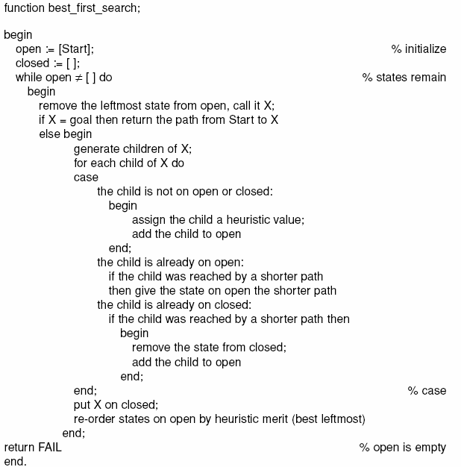
Best-First Search Algorithm

Slide 8
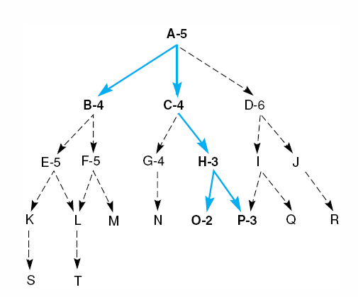
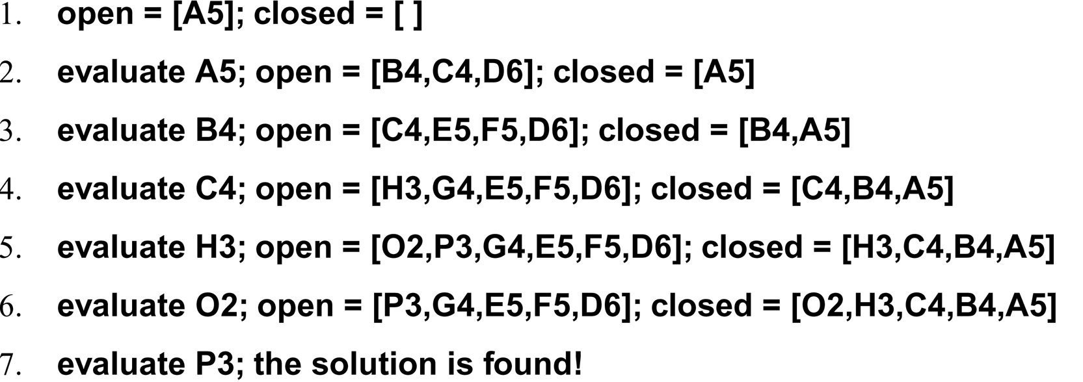
Best-first Search Example

Slide 9
Heuristic Search and Cost
Consider in any search problem there are several different considerations regarding how good a solution is
does it solve the problem adequately?
how much time does it take to find the solution (computational cost)?
how much effort does the solution take? (practical cost)
notice that the second and third considerations may be the same, but not always
It will often be the case that we want to factor in the length of the path of our search as part of our selection strategy
we enhance our selection mechanism from finding the highest heuristic value to finding the best value f(n) = g(n) + h(n)
f(n) – cost of selecting state n
g(n) – cost of reaching state n from the start state
h(n) – heuristic value for state n
if we use this revised selection mechanism in our best-first search algorithm, it is called the the A Algorithm
Since we want to minimize f(n), we will change our heuristic functions to give smaller values for better states
some of our previous functions gave higher scores for better states

Slide 10
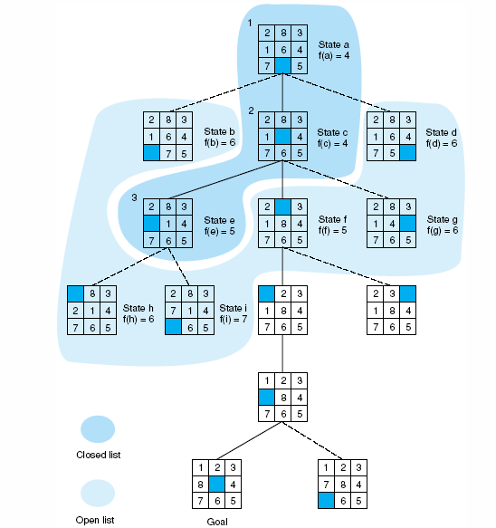
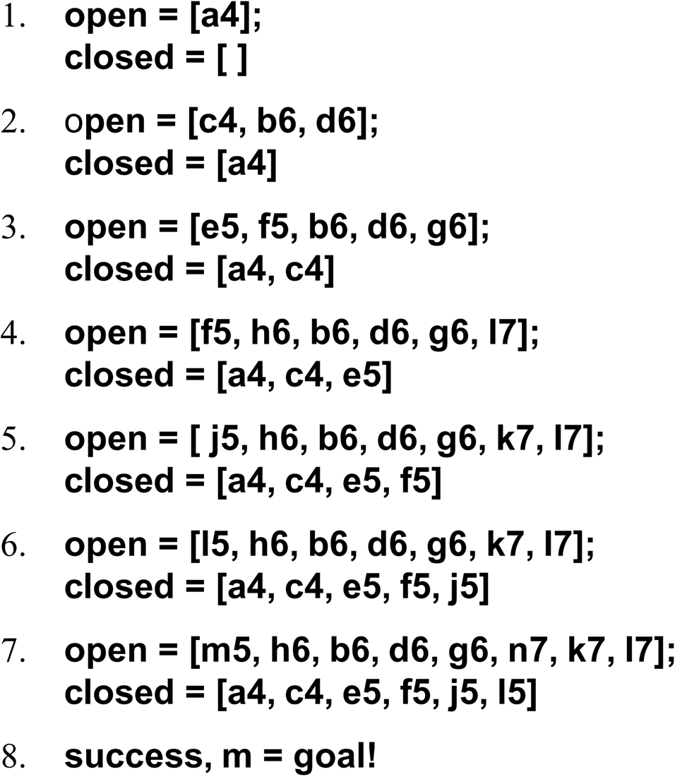
Example: 8 Puzzle Redux

Slide 11
Other Factors in Heuristic Search
Admissibility
if the search algorithm is guaranteed to find a minimal path solution (if one exists) – that is, minimize practical cost, not search cost
a breadth-first search will find one
if our A Algorithm guarantees admissibility, it is known as an A* Algorithm with the selection formula f*(n) = g*(n) + h*(n) where g*(n) is the shortest path to reach n and h*(n) is the cost of finding a solution from n
h(n) is an estimated cost derived by a heuristic function, h*(n) may not be possible, it requires an oracle
Informedness
a way to compare two or more heuristics – if one heuristic always gives you a more accurate prediction in the A* algorithm, then that heuristic is more informed
Monotonicity – we will skip this
there are other search strategies covered in the notes accompanying this chapter

Slide 12
Constraint Satisfaction
Many branches of a search space can be ruled out by applying constraints
Constraint satisfaction is a form of best-first search where constraints are applied to eliminate branches
consider the Cryptorithmetic problem, we can rule out several possibilities for some of the letters
After making a decision, propagate any new constraints that come into existence
constraint Satisfaction can also be applied to planning where a certain partial plan may exceed specified constraints and so can be eliminated
SEND
+ MORE
MONEY
M = 1 ➔
S = 8 or 9 ➔
O = 0 or 1 ➔
O = 0 …
N = E + 1 (since N != E)
Now we might
try an exhaustive search from here

