Slide 1
Propositional Calculus
Composed of symbols
  P – some true statement
    P might represent something like “It is Monday” or “the car is red”
And sentences
  a sentence is a symbol or a combination of symbols and connectives
Connectives are AND, OR, NOT, → (implication) and : (equivalence)
  sentences can also contain ( ) and [ ] to denote order of operator precedence
  sentences can also contain truth symbols (the words true and false)
A legal sentence is called a well-formed sentence
  see page 46 for some definitions and page 47 for some examples
All legal sentences will evaluate to true or false

Slide 2
Semantics of Propositional Calculus
An interpretation of a propositional calculus sentence is the mapping of propositions to true or false values and the application of the operators
AND, OR and NOT are as you would expect them to be from what you have studied in 260, 360, 362
  for instance, assume P is true and Q and R are false
  the sentence P AND Q AND R is false, P OR Q AND R is true (AND has higher operator precedence than OR so Q AND R is false, P OR Q is true)
  the sentence (P OR Q) AND R is false
A → B is true if A and B are true, or if A is false and B is true, or if A is false and B is false, → is false only if A is true and B is false
A : B is true if A and B have the same truth value
  we can use truth tables to derive the interpretation for a sentence

Slide 3
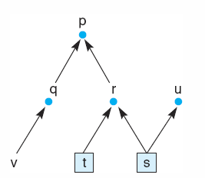
Example (from 3.3.1)
Assume s & t are true, what else is true?
  by starting with items we know are true/false and deriving other items, we are performing data-driven reasoning
The following implications can be applied
  s → r (so r is true)
  t → r (two ways to prove r is true)
  s → u
With s, t, r and u true, we can apply
  r → p
Therefore we know s, t, r, u, and p are true
We have the following knowledge
  q → p
  r → p
  v → q
  s → r
  t → r
  s → u
  s
  t

Slide 4
Predicates
Propositions are too limited to be useful in AI
  we cannot represent rules like “if you are human, then you have intelligence” or “all men are mortal”
We turn to predicates to enhance our representation
  a predicate is a symbol that describes a relationship between entities
  predicates have arguments (entities)
    in a way, you can think of a predicate as a boolean function, you pass it parameters and it returns true or false
  arguments can be specific instances or variables
    human(frank_zappa) or human(X)
We expand our calculus to predicate calculus
  more precisely known as first order predicate calculus
Predicate calculus is like propositional calculus except that it includes predicates and quantifiers

Slide 5
Predicate Calculus
Predicate calculus statements contain
  symbols (propositions, truth values)
  terms (predicates with specific values known as constant symbols and/or variables and/or functions)
    functions must be placed inside of terms, for example friends(Dave, father_of(Fred)) where father_of is a function that returns a constant symbol so that father_of(Fred) will return the person who is the father of Fred
  sentences contain symbols, terms, connectives (AND, OR, NOT, →, : ) and quantifiers
    functions by themselves are not legal sentences
In general, propositions are capitalized, constant symbols are all lower case and variables start with a capital letter but are then lower cased
  we will often use single letters for variables, predicates are often verbs, nouns or adjectives while constants will be personal nouns

Slide 6
Quantifiers
What does the statement tall(X) mean?
Since X is a variable, should we interpret this as saying that anything is tall or that there are things that are tall?
  we enhance our predicates to include one of two quantifiers so that we can specify what a variable represents
    universal – all things in the universe, written as ∀
    existential – there exists at least one item in the universe, written as ∃
Quantifiers are usually used inside of implications (rules) such as
  ∀ X ∃ Y : human(X) → father(Y, X).
  for all X in the universe there exists a Y such that if X is human then Y is X’s father
  every human has a father

Slide 7
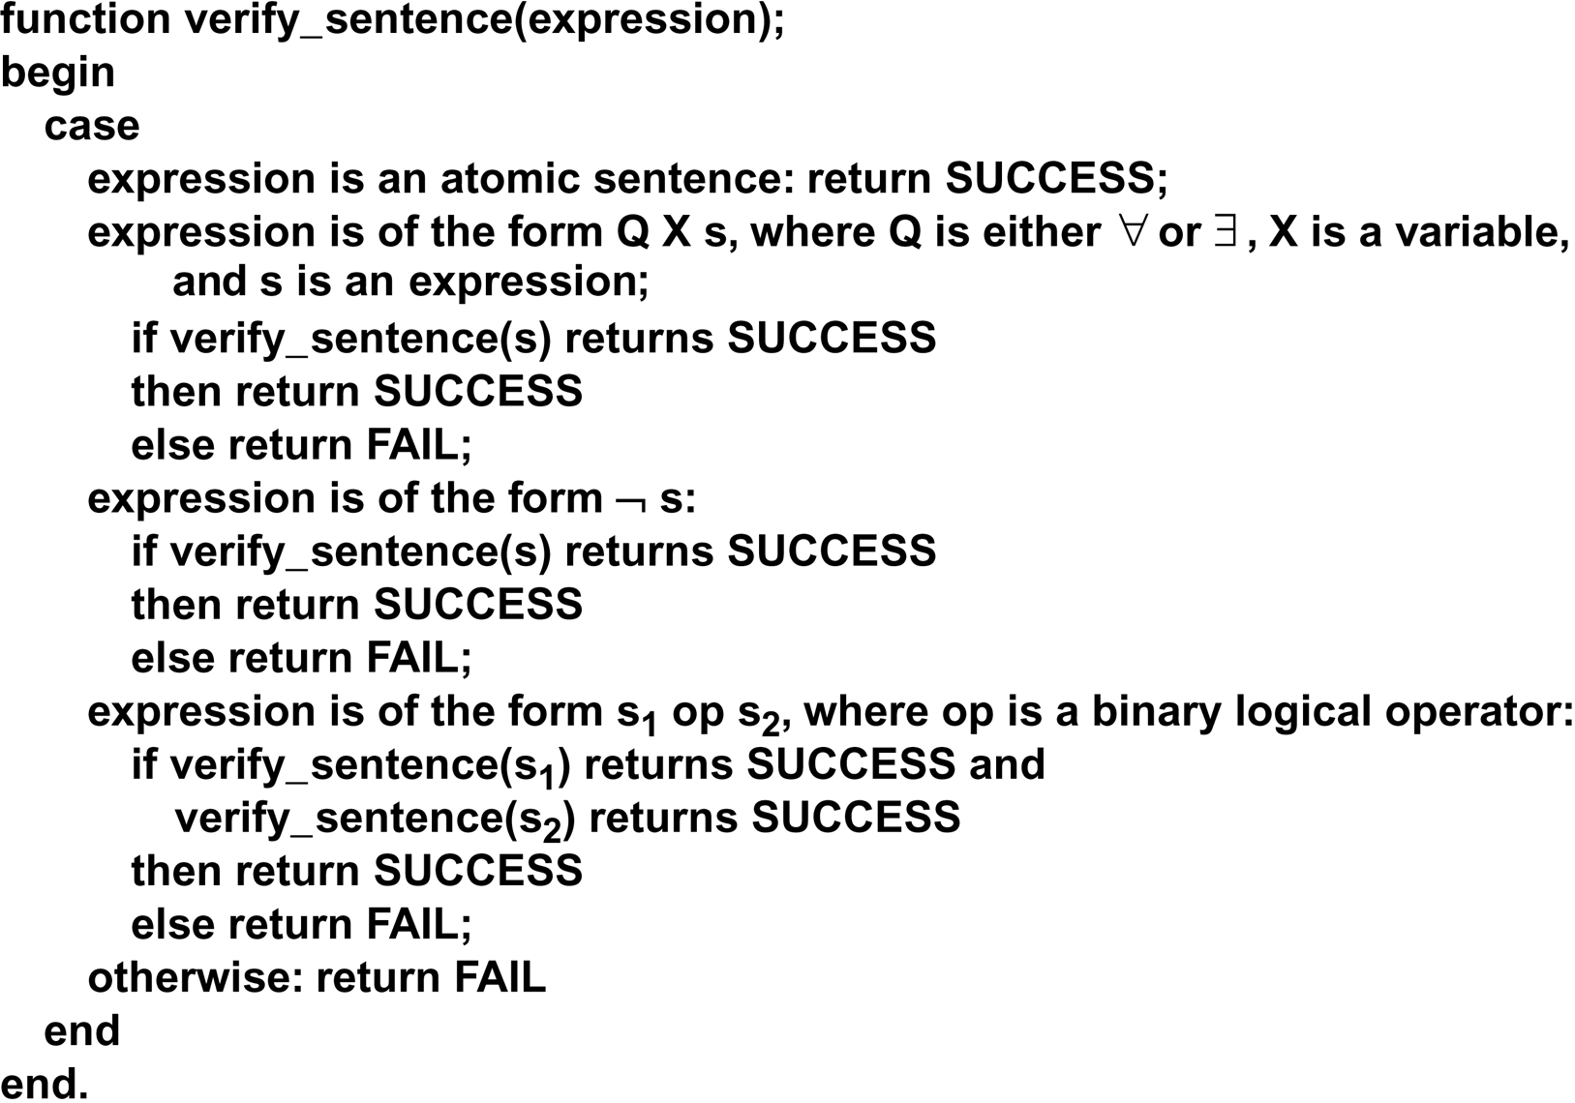
Verifying that a Sentence is Legal

Slide 8
Semantics of Predicate Calculus
We again define an interpretation as the derivation of true and false values to sentences by applying the truth values of propositions and predicates
  if there are functions, then each function provides a mapping (that is, returns a value to be used within a predicate)
  apply the operators as you would in normal logic (AND, OR, NOT as per 260/360/362, implication is false only if the left hand side is true and the right hand side is false, equivalence is true if both sides have the same truth value)

Slide 9
Interpreting Predicate Calculus
Notice that the semantics of predicate calculus are deriving the truth/falseness of statements
But we also have to know how to understand the predicate calculus terms (and/or write them)
Unfortunately, predicates and their arguments are merely symbols
  consider: friend(jim, bob), we would interpret this as Bob is a friend of Jim
  could it also mean Jim is a friend of Bob’s?
    is the predicate symmetric? (consider father(jim, bob) instead)
  friend is merely a symbol so that this might mean something different like
    Jim has friended Bob on Facebook
    Jim considers himself to be a friend but Bob does not
    Jim and Bob both are friends of someone (not necessarily each other)

Slide 10
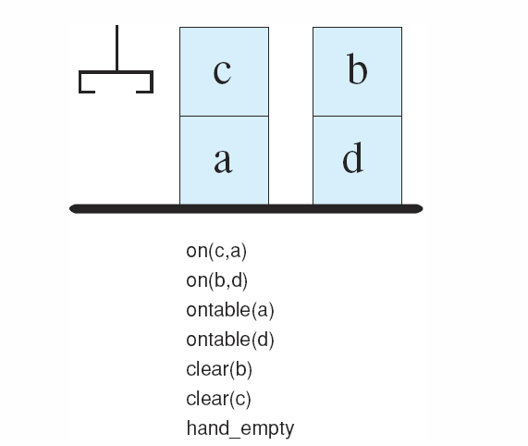
Blocks World Example
We further define rules for
clear, stack, pick_up,
put_down and hand_empty
For instance:
for all X, if(ontable(X)
OR on(X, Y)
→ hand_empty
That is, the hand is empty
if every block is either on
the table or on another block
See the textbook for the
clear and stack rules
Our “pick_up” rule might be stated as
if(hand_empty & clear(X) → pick_up(X)
Given the above knowledge, we could pick up either c or b

Slide 11
Reasoning with Predicate Calculus
In general, there are two ways to reason given a predicate calculus representation
  Modus Ponens
    starting with known items that are true, use implication rules in a left-to-right manner to conclude new true terms
      match left hand sides with known items and conclude whats on the right hand side
    this left-to-right approach is known as form of forward chaining
  Modus Tollens
    starting with known items that are false, use implication rules in a right-to-left manner to conclude new false terms
      this is known as backward chaining

Slide 12
Unification
Lets consider an example of Modus Ponens
  we know that “all men are mortal” and we know that “Frank Zappa is a man”
  ∀ X: man(X) → mortal(X).
    man(frank_zappa).
  can we conclude mortal(frank_zappa)?
  Modus Ponens seems to apply but man(X) is not the same as man(frank_zappa) so we cannot apply Modus Ponens yet
First, we must unify the variable X to a specific instance (symbol constant), frank_zappa
Now, mortal(frank_zappa) follows and we can conclude this as being true
  unifications are often denoted formally with the notation {X/frank_zappa} and can be thought of as bindings, much like variables are bound to values at run-time

Slide 13
Other Techniques
If we know X AND Y is true, we can conclude X is true, and we can conclude Y is true (or both)
  this is known as elimination
If we know X is true, and we know Y is true, then we can conclude X AND Y is true
  this is known as introduction
If we know ∀ X: p(X) is true, then we can replace X with any known symbol constant and the result is true
  this is known as universal instantiation
  we need this to perform unification
If we have an existential quantifier, we can replace it with a function that will return an appropriate value
  this is known as Skolemization and requires a skolem function
  if we know ∃ X: father(X, bob) and we have a skolem function get_father(X) which returns an instance that fulfills the function, and we know father(jim, bob) then we can generate X using get_father(bob)

Slide 14
Predicate Calculus and Complexity
Problem solving with predicate calculus is relatively simple
  codify what you know into predicates and implications
  use forward (or backward) chaining and unification to prove new things
Unfortunately, this approach is computationally complex
  how do you select an implication to try?
    if you know hundreds of things, you might try them all one at a time to see where it leads
  how do you know what symbol constant to unify to a variable?
Assume you know n things with m variables (m is probably < n) and there are k constants to unify
You might find that you have as many as 2^{n*k} different things to try when applying the previous techniques!

Slide 15
Example: Financial Advisor
We use logic to advise a person on whether to invest in
  savings, stocks or a combination
Based on the person’s
  current savings and income level
We evaluate savings and income as adequate or inadequate
A rules is used to draw the conclusion of whether a person has adequate or inadequate income based on income, number of dependents
  you will see on the next slide how, when dealing with numbers, we need a function like “greater(X, Y)” which returns true if X > Y
And a rule is used to determine whether to conclude that the person should invest in savings, stocks or a combination

Slide 16
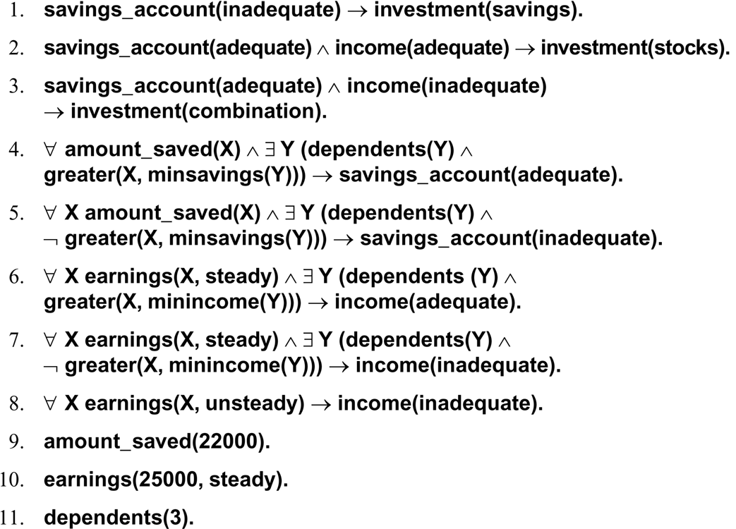
Using a Data Driven Approach
#1-8 are our rules
#9-11 is the knowledge for a particular person to evaluate

Slide 17
Example Continued
NOTE: the previous figure is lacking the functions
  minincome(X) = 15000 + (4000 * X)
  minsavings(X) = 5000 * X
Now lets see what the Financial Advisor will conclude (recommend)
  we plug in X = 3 for minincome which gives us 27000 and minsavings which gives us 15000
  rule 7 applies by unifying X to 25000 and Y to 27000 (we use rule 7 because ~greater(25000, minincome(3)) so we conclude income(inadequate)
  rule 4 applies by unifying X to 22000 and Y to 15000 so we conclude savings(adequate)
  rule 3 then applies so we conclude invest(combination) – this person should invest in both
Assume a person has 4 dependents, a steady income of $30,000 and $15,000 in savings, what should we conclude?

Slide 18
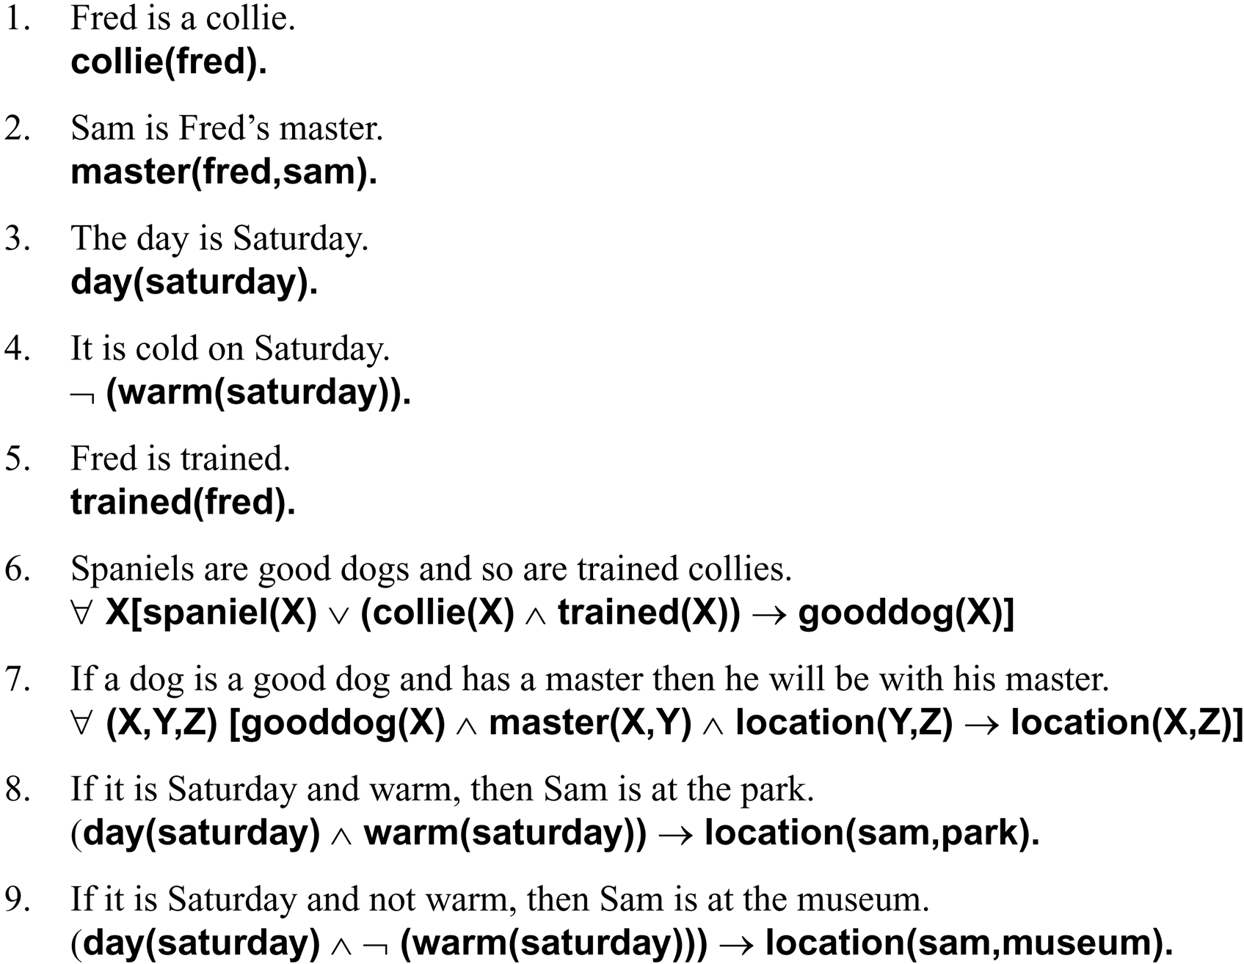
Goal-driven Example: Find Fred

Slide 19
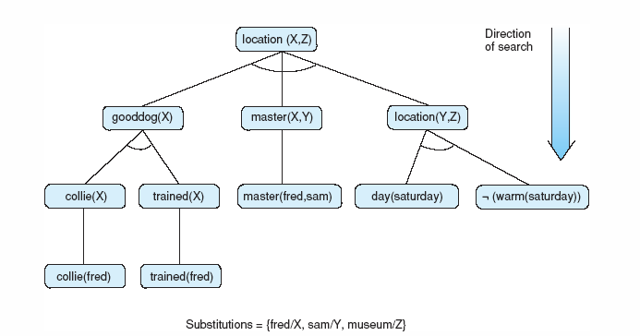
Solution
We want to know location(fred, Y)
As a goal-driven problem, we start with this and find a rule that can conclude location(X, Y), which is rule 7, 8 or 9
Rule 8 will fail because we cannot prove warm(Saturday)
Rule 9 is applied since day(saturday) is true and ~warm(saturday) is true
Rule 9’s conclusion is that sam is in the museum
Rule 7 tells us that fred is with his master, sam, so fred is in the museum

