Slide 1
Representation and Search
The function of a representation is to capture the critical features of the problem domain
  and make the information accessible
The representation must
  be expressive
  be efficiently accessible
Given knowledge stored in some form of representation, a problem solver will have to search through the knowledge
  should the search be exhaustive or will there be additional knowledge available to reduce the search space?

Slide 2
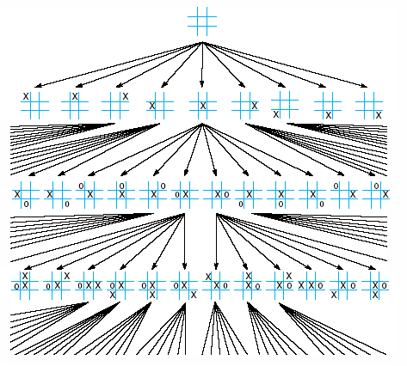
A Tic-Tac-Toe Search Space
The full search
space will consist
of 9! entries
What would a chess
search space look
like?

Slide 3
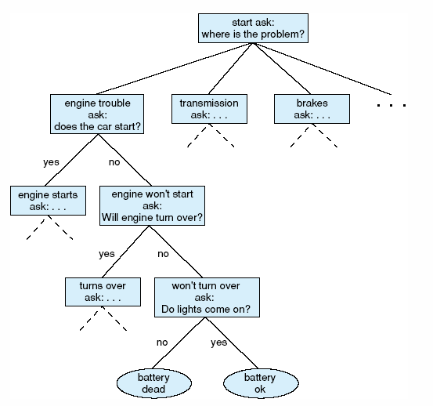
Automotive Diagnosis Search Space
This form of representation
is known as a decision tree
At each node, a question
exists to steer the decision
making process
If you answer “engine” to
the first question, you
descend the left-most branch
of this tree
Search is simplified because
you only descend one branch
until you reach a conclusion
state

Slide 4
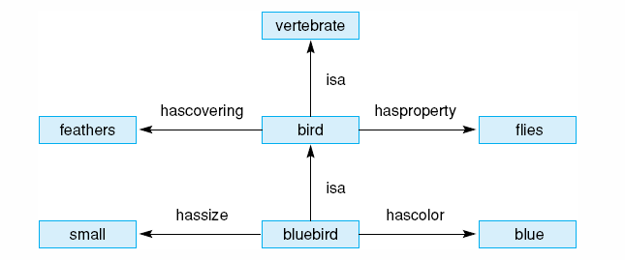
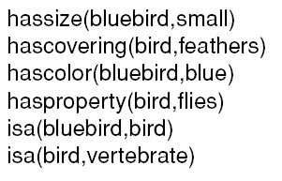
Two Representations
Here, we see the same information being
represented using two different representational
techniques – a semantic network (above) and
predicates (to the left)

Slide 5
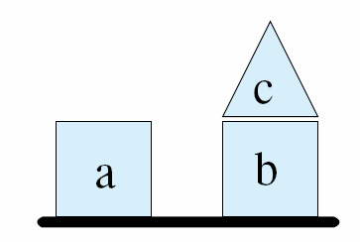
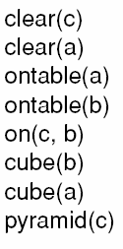

Another Example: Blocks World
Here we see a real-world situation of three blocks and a predicate
calculus representation for expressing this knowledge
We equip our system with rules such as the below rule to reason
over how to draw conclusions and manipulate this block’s world
This rule says “if there does not exist a Y
that is on X, then X is clear

Slide 6
Representation/Search Techniques
We will study various forms of representation and search during the first half of this course
  Predicate calculus
  Graphs and trees
  Production systems
  Semantic networks and frames
  Cases and models
  Logic/resolution/unification
  Graph searches and heuristic methods
  Chaining
  Stochastic methods, fuzzy methods, abduction
  Cased-based reasoning
As we cover this material, we will be combining chapters 2-9 as the textbook generally separates the representations from the search techniques used

