Slide 1
Understanding Language
So much of intelligence seems to revolve around language understanding
one of AI’s primary pursuits has been speech recognition and natural language processing (NLU and NLG)
SR/NL processing is not merely a matter of mapping words to meanings
for SR, we have to analyze the spoken input, obtain auditory features, identify those features as phonetic units and map them to words and phrases
for NL, we need to
capture word roles (grammatical categories) and their meanings
construct representations for the semantic meanings of phrases, individual sentences and groups of sentences
interpret the meaning of the message within the context of other messages and the domain of discourse
apply context for references
apply worldly knowledge

Slide 2
SR Problems
Continuous versus discrete speech
if speech is spoken continuously, how do we find the borders between words?
without borders, the search space becomes much larger
sounds influence each other
a particular phonetic unit sounds different when it is followed by one phonetic unit versus another versus silence, and also influenced by what comes after it
People speak differently
accents, dialects
people’s voices will change when excited/angry, bored, reading versus naturally speaking, etc
there are over 1 million words in English, and many different ways to utter the same thing

Slide 3
NLU Problems
Sentences can be vague but people will apply a variety of knowledge to disambiguate
what is the weather like? It looks nice out.
what does “it” refer to? the weather
what does “nice” mean? in this context, we might assume warm and sunny
The same statement could mean different things in different contexts
where is the water?
pure water in a chemistry lab, potable water if you are thirsty, and dirty water if you are a plumber looking for a leak
Language changes over time so a NLP system may never be complete
new words are added, words take on new meanings, new expressions are created (e.g., “my bad”, “snap”)
There are many ways to convey one meaning

Slide 4
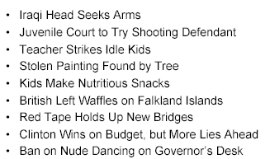
Fun Headlines
Hospitals are Sued by 7 Foot Doctors
Astronaut Takes Blame for Gas in Spacecraft
New Study of Obesity Looks for Larger Test Group
Chef Throws His Heart into Helping Feed Needy
Include your Children when Baking Cookies

Slide 5
Ways to Not Solve This Problem
Simple machine translation
we do not want to perform a one-to-one mapping of words in a sentence to components of a representation
this approach was tried in the 1960s with language translation from Russian to English
“the spirit is willing but the flesh is weak” → “the vodka is good but the meat is rotten”
“out of sight out of mind” → “blind idiot”
Use dictionary meanings
we cannot derive a meaning by just combining the dictionary meanings of words together
similar to the above, concentrating on individual word translation or meaning is not the same as full statement understanding

Slide 6
What Is Needed to Solve the Problem
Since language is (so far) only used between humans, language use can take advantage of the large amounts of knowledge that any person might have
thus, to solve NLU, we need access to a great deal and large variety of knowledge
Language understanding includes recognizing many forms of patterns
combining phonetic units into words
identifying grammatical categories for words
identifying proper meanings for words
identifying references from previous messages
Language use implies intention
we have to also be able to identify the message’s context and often, communication is intention based
“do you know what time it is?” should not be answered with yes or no

Slide 7
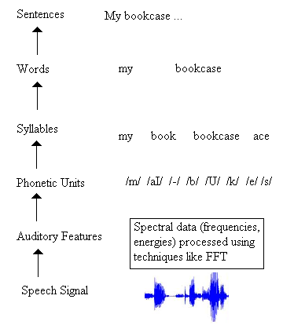
SR/NLU Through Mapping

Slide 8
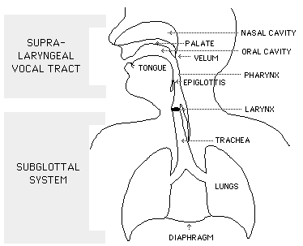
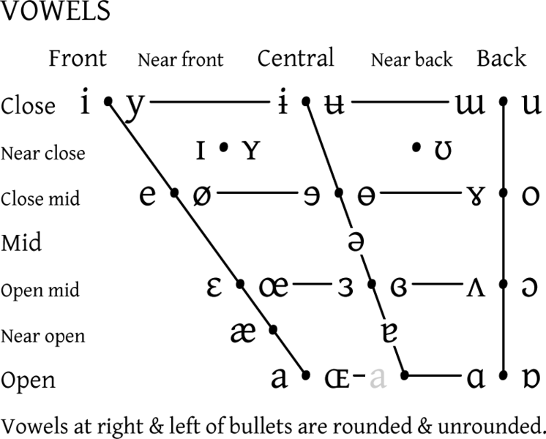
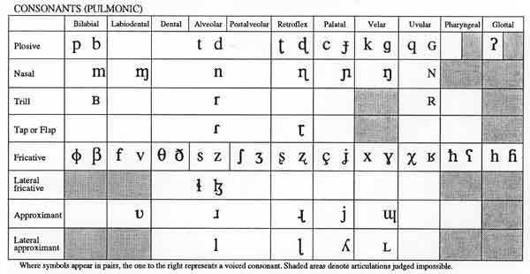
Speech Production

Slide 9
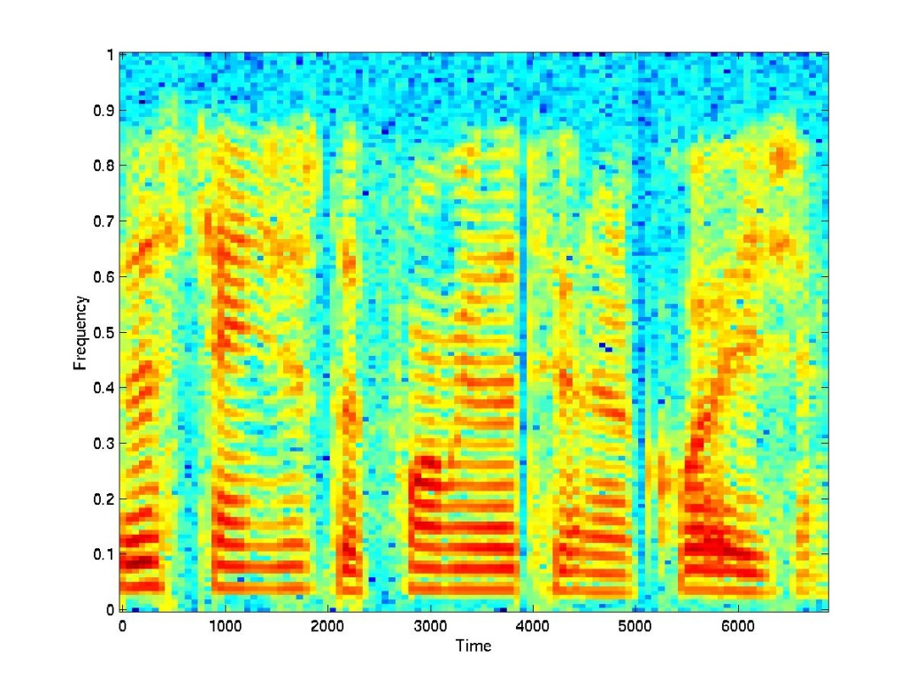
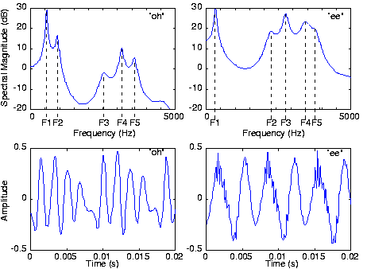
Speech Visualization
Cepstral features represent the frequency of the frequencies
Mel-frequency cepstral coefficients (MFCC) are the most
common variety

Slide 10
Radio Rex
A toy from 1922
A dog mounted on an iron base with an electromagnetic to counteract the force of a spring that would push “Rex” out of his house
The electromagnetic was interrupted if an acoustic signal at 500 Hz was detected
The sound “e” (/eh/) as found in Rex is at about 500 Hz
So the dog comes when called

Slide 11
ARPA SR Research
ARPA started an initiative in 1970 for SR research
Multispeaker, continuous speech of a decent sized vocabulary (1000 words) and grammar
4 systems constructed
HEARSAY (CMU) – symbolic/rule-based using a blackboard/distributed architecture
HARPY (CMU) – giant lattice and beam search
HWIM (BBN) – HMM approach
SRI and SDC – never completed

Slide 12
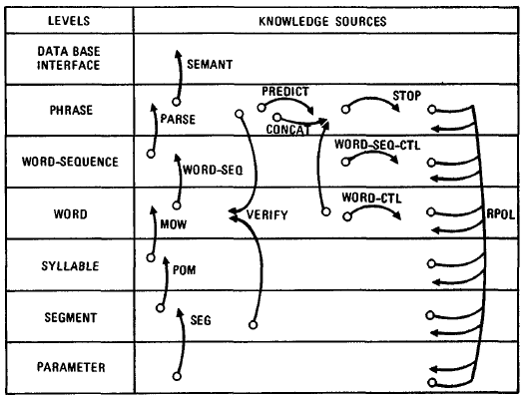
Hearsay-II
The original system implemented
between 1971 and 1973
Hearsay-II was an improved
version implemented between
1973 and 1976
Hearsay-II’s grammar was
simplified as a 1011x1011
binary matrix to indicate
which words could follow
which words
Hearsay is more noted for pioneering the blackboard architecture
And agent-based reasoning
Hearsay spent a lot of time dealing with scheduling agents (KSs)

Slide 13
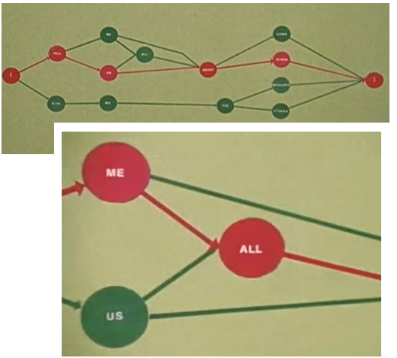
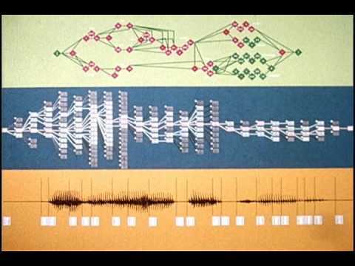
HARPY
Unfolded a giant lattice of all possible utterances given the words and vocabulary
Performed a beam search through this lattice matching expectations of a node with the acoustic signal for a match

Slide 14
ARPA and Beyond
Results of the 4 systems shown below
AT&T carried on from HWIM by implementing Byblos, a full HMM approach
This was followed by Dragon which became the norm for SR systems
System | Words | Speakers | Sentences | Error Rate
Harpy | 1011 | 3 male, 2 female | 184 | 5%
Hearsay II | 1011 | 1 male | 22 | 9%, 26%
HWIM | 1097 | 3 male | 124 | 56%
SRI/SDC | 1000 | 1 male | 54 | 76%

Slide 15
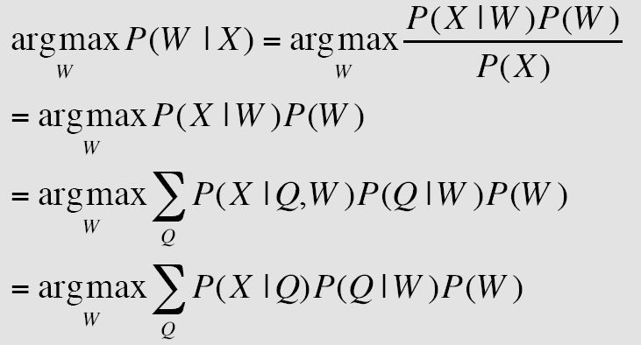
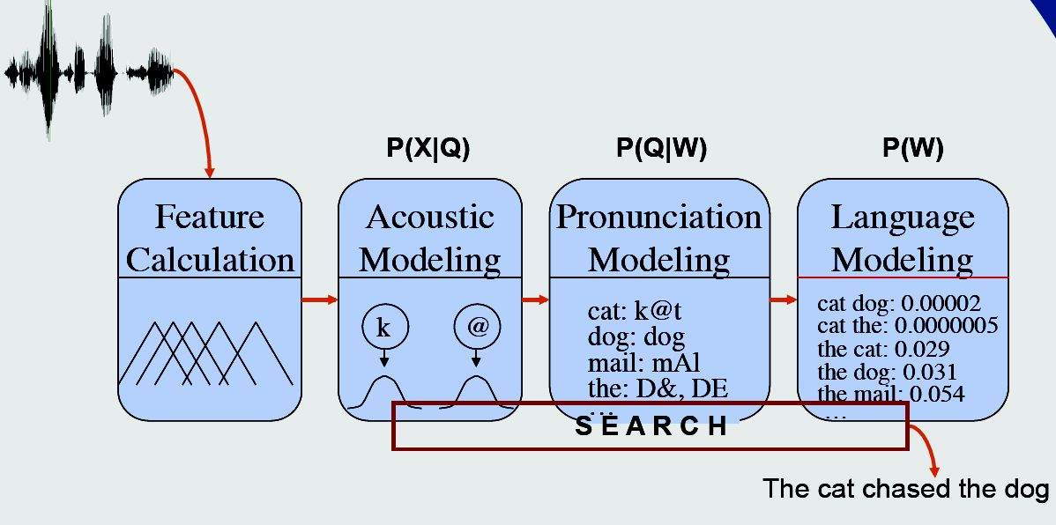
Modern Statistical ASR

Slide 16
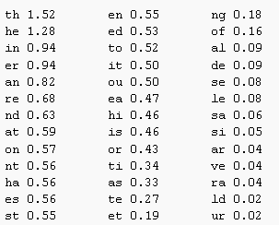
Bi-Grams and N-Grams
Models the “grammar” by providing transition probabilities of going from one phonetic unit to another
Bi-grams require about 29² different combinations, tri-grams about 29³ combinations
Here is a bi-gram (partial)
model for English letters
in a word
NOTE: this is not the same
as what we need in SR since
these are letters, not
phonetic units

Slide 17
HMMs and Codebooks
The HMM is essentially a network that provides all transitions from phonetic unit to phonetic unit available in English
Or the scaled down version that is dictated by the vocabulary and grammar
Emission probabilities are based on how closely the expectation is from a given node in the HMM to a “codebook”
The codebook is a listing of 256 different possible groupings of discretized values from the speech signal – do a closest match search

Slide 18
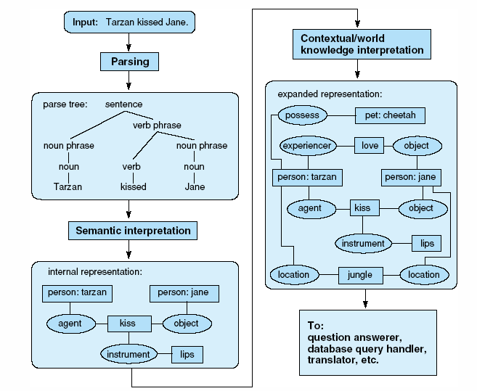
The NLU Process

Slide 19
Restricted Domains
NLU has succeeded within restricted domains
LUNAR – a front end to a database on lunar rocks
SABRE – reservation system (uses a speech recognition front end and a database backend)
used by American Airlines for instance to automate airline reservation and assistance over the phone
SHRDLU – a blocks world system that permitted NLU input for commands and questions
what is sitting on the red block?
what shapes is the blue block on the table?
place the green pyramid on the red brick
is there a red brick? pick it up
By restricting the domain, it reduces
the lexicon of words
the target representation (in the above cases, the input can be reduced to DB queries or blocks world commands)

Slide 20
Morphology
In many languages, we can gain knowledge about a word by looking at the prefix and suffix attached to the root, for instance in English:
an ‘s’ usually indicates plural, which means the word is a noun
adding ‘-ed’ makes a verb past tense, so words ending in ‘ed’ are often verbs
we add ‘-ing’ to verbs
we add de-, non-, im-, or in- to words
Although morphology by itself is insufficient, we can use morphology along with syntactic analysis and semantic analysis
to provide additional clues to the grammatical category and meaning of a word

Slide 21
Syntactic Analysis
Given a sentence, our first task is to determine the grammatical roles of each word of the sentence
alternatively, we want to identify if the sentence is syntactically correct or incorrect
The process is one of parsing the sentence and breaking the components into categories and subcategories
e.g., the big red ball is a noun phrase, the is an article, big and red are adjectives, ball is a noun
And then generating a parse tree that reflect the parse
Syntactic parsing is computationally complex because words can take on multiple roles
we generally tackle this problem in a bottom-up manner (start with the words) but an alterative is top-down where we start with the grammar and use it to generate the sentence
both forms will result in our parse tree

Slide 22
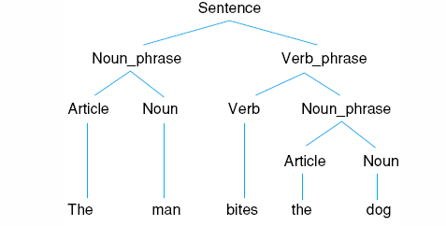
Parse Tree Example
A parse tree for a simple sentence is shown to the left
notice how the NP category can be in multiple places
similarly, a NP or a VP might contain a PP, which itself will contain a NP
Our parsing algorithm must accommodate this by recursion

Slide 23
Parsing by Dynamic Programming
This is also known as chart parsing
we start with our grammar, a series of rules which map grammatical categories into more specific things (more categories or actual words)
S → NP VP | VP | aux V NP VP
we select a rule to apply and as we work through it, we keep track of where we are with a dot (initial, middle, end/complete)
the chart is a data structure, a simple table that is filled in as processing occurs, using dynamic programming
the chart parsing algorithm consists of three parts:
prediction: select a rule whose LHS matches the current state, this triggers a new row in the chart
scan: the rule and match to the sentence to see if we are using an appropriate rule
complete: once we reach the end of a rule, we complete the given row and return recursively

Slide 24
Parsing by TNs
A transition network is a simple finite state automata – a network whose nodes represent states and whose edges are grammatical classifications
A recursive transition network is the same, but can be recursive
we need the RTN for parsing (instead of just a TN) because of the recursive nature of natural languages
Given a grammar, we can automatically generate an RTN by just “unfolding” rules that have the same LHS non-terminal into a single graph (see the next slide)
We use the RTN by starting with a sentence and following the edge that matches the grammatical role of the current word in our parse
we have a successful parse if we reach a state that is a terminating state
since we traverse the RTN recursively, if we get stuck in a deadend, we have to backtrack and try another route

Slide 25
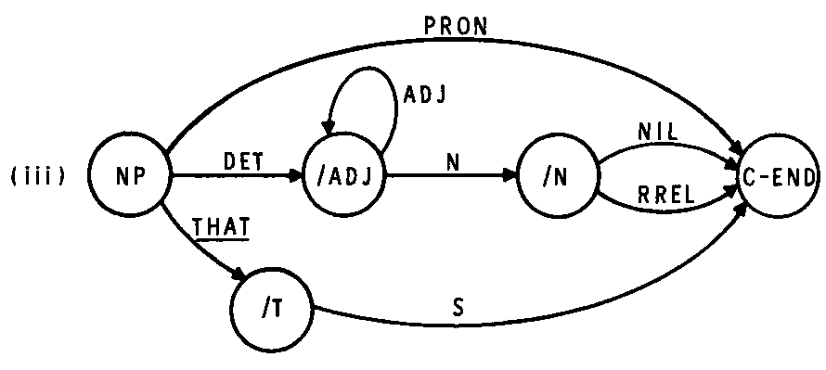
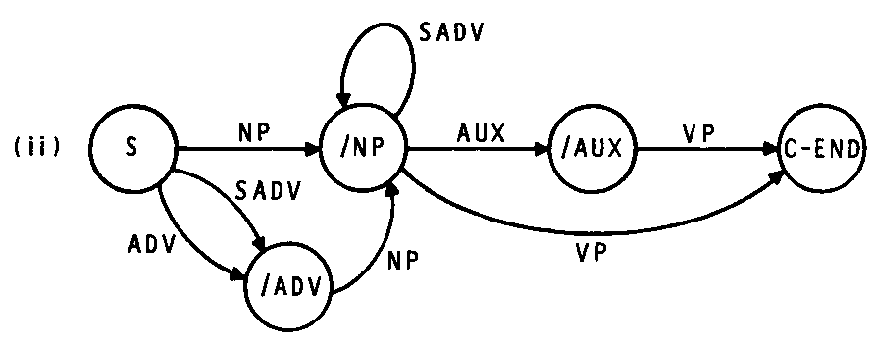
Example Grammar and RTN
S → NP VP
S → NP Aux VP
NP → NP1 Adv | Adv NP1
NP1 → Det N | Det Adj N |
Pron | That S
N → Noun | Noun Rrel
etc…

Slide 26
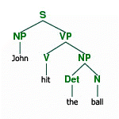
Parsing Output
We conceptually think of the result of syntactic parsing as a parse tree
see below for the parse tree of “John hit the ball”
The tree shows the decomposition of S into constituents and those constituents into further constituents until we reach the leafs (words)
the actual output of a parser though is a nested chain of constituents and words, generated from the recursive descent through the chart parsing or RTN
[S
[NP
(N John)]
[VP
[V hit]
[NP
(Det the)
(N ball)] ] ] ]

Slide 27
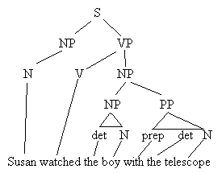
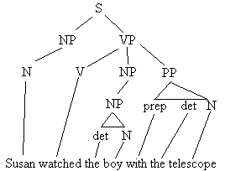
Ambiguity
Natural languages are ambiguous because
words can take on multiple grammatical roles
a LHS non-terminal can be unfolded into multiple RHS rules, for example
S → NP VP | NP VP
NP → Det N | Det N PP
VP → V NP | V NP PP
is the PP below attached to the VP (did Susan see a boy who had a telescope?) or the NP (did Susan see the boy by looking through the telescope?)

Slide 28
Augmented Transition Networks
An RTN can be easily generated from a grammar and then parsing is a matter of following the RTN and having a stack (for recursion)
the parser generates the labels used as grammatical constituents as it traverses the RTN
we can augment each of the RTN links to have code that does more than just annotates constituents, we can provide functions that will translate words into representations, or supply additional information
is the NP plural?
what is the verb’s tense?
what might a reference refer to?
This is an ATN, which makes the transition to semantic analysis somewhat easier

Slide 29
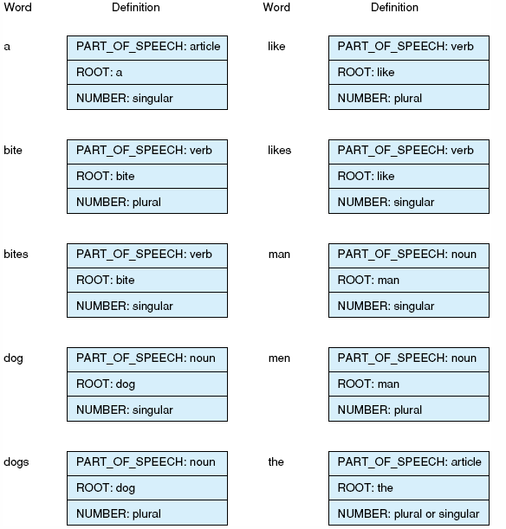
ATN “Dictionary” Entries
Each word is tagged by the ATN to include its part of speech (lowest level constituent) along with other information, perhaps obtained through morphological analysis

Slide 30
Semantic Analysis
Now that we have parsed the sentence, how do we proscribe a meaning to the sentence?
the first step is to determine the meaning of each word and then attempt to combine the word meanings (word sense disambiguation)
this is easy if our target representation is a command
if the NLU system is the front end to a DB
“Which rocks were retrieved on June 21, 1969?”
translate into SQL
if NLU is the front end to an OS shell
Print the newest textfile to printer1
translate into an OS command, e.g., lp –p printer1 filename where filename is the name of the newest file in the current directory

Slide 31
Continued
In general, how do we attribute meaning?
what form of representation should the sentence be stored in?
how do we disambiguate when words have multiple meanings?
how do we handle references to previous sentences?
what if the sentence should not be taken literally?
Without the domain/problem, we have to come up with a general strategy
As we’ve seen, there is no single general representation for AI – should we use CDs, conceptual graphs, semantic networks, frames?
We will explore some ideas in the next few slides

Slide 32
Semantic Grammars
In a restricted domain and restricted grammar, we might combine the syntactic parsing with words in the lexicon
this allows us not only find the grammatical roles of the words but also their meanings
the RHS of our rules could be the target representations rather than an intermediate representation like a parse
S → I want to ACTION OBJECT | ACTION OBJECT | please ACTION OBJECT
ACTION → print | save | …
print → lp
OBJECT → filename | programname | …
filename → get_lexical_name( )
This approach is not useful in a general NLU case

Slide 33
Semantic Markers
One way to disambiguate word meanings is to define each word with semantic markers and then use other words in the sentence to determine which marker makes the most sense
Example: I will meet you at the diamond
diamond can be
an abstract object (the geometric shape)
a physical object (a gem stone, usually small)
a location (a baseball diamond)
here, we will probably infer location because of the sentence says “meet you at”
you could not meet at a shape, and while you might meet at a gemstone, it is an odd way of saying it
What about the word tank?

Slide 34
Case Grammars
Rather than tying the semantics to the grammar as with the semantic grammar, or with the nouns of the sentence as with semantic markers
we instead supply every verb with the types of attributes we associate with that verb
for instance, does this verb have an agent? an object? an instrument?
to open: [Object (Instrument) (Agent)]
we should know what was opened (a door, a jar, a window, a bank vault) and possibly how it was opened (with a door knob, with a stick of dynamite) and possibly who opened it (the bank robber, the wind, etc)
semantic analysis becomes a problem of filling in the blanks – finding which word(s) in the sentence should be filled into Object or Instrument or Agent

Slide 35
Case Grammar Roles
Agent – instigator of the action
Instrument – cause of the event or object used in the event (typically inanimate)
Dative – entity affected by the action (typically animate)
Factitive – object or being resulting from the event
Locative – place of the event
Source – place from which something moves
Goal – place to which something moves
Beneficiary – being on whose behalf the event occurred (typically animate)
Time – time the event occurred
Object – entity acted upon or that is changed
To kill: [agent instrument (object) (dative) {locative time}]
To run: [agent (locative) (time) (source) (goal)]
To want: [agent object (beneficiary)]

Slide 36
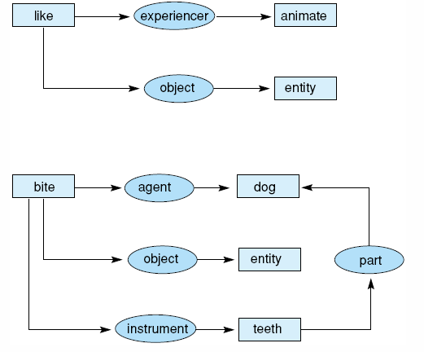
Example:
Storing case
grammars using
conceptual graphs
Here, we have the
grammars for
like and bite

Slide 37
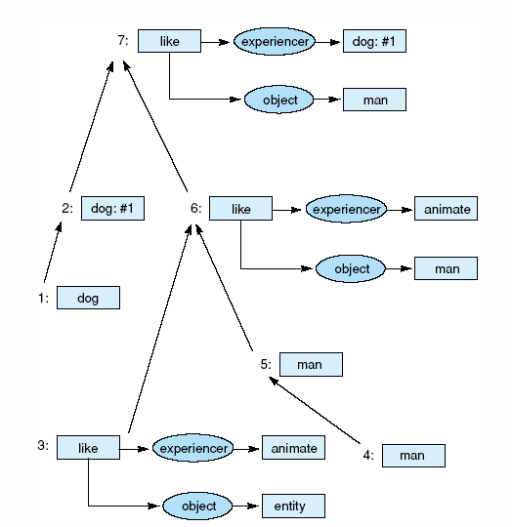
Combining the
conceptual graphs
of sentences

Slide 38
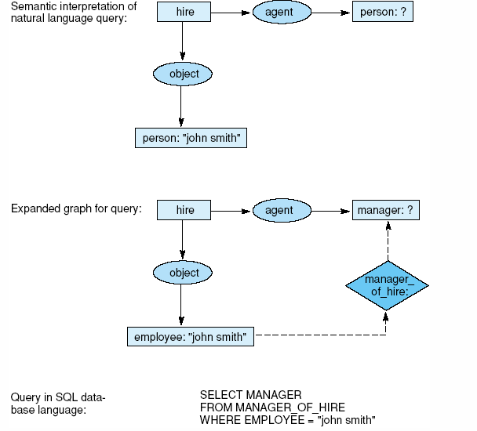
To Generate an SQL Query

Slide 39
Discourse Processing
Because a sentence is not a stand-alone entity, to fully understand a statement, we must unite it with previous statements
anaphoric references
Bill went to the movie. He thought it was good.
parts of objects
Bill bought a new book. The last page was missing.
parts of an action
Bill went to New York on a business trip. He left on an early morning flight.
causal chains
There was a snow storm yesterday. The schools were closed today
illocutionary force
It sure is cold in here.

Slide 40
Handling References
How do we track references?
consider the following paragraph:
Bill went to the clothing store. A sales clerk asked him if he could help. Bill said that he needed a blue shirt to go with his blue hair. The clerk looked in the back and found one for him. Bill thanked him for his help.
in the second sentence, we find “him” and “he”, do they refer to the same person?
in the third sentence, we have “he” and “his”, do they refer to the sales clerk, Bill or both?
in the fourth sentence, “one” and “him” refer back to the previous sentence, but “him” could refer back to the first sentence as well
the final sentence as “him” and “his”
Whew, lots of work, we get the references easily but how do we automate the task?
is it simply a matter of using a stack and looking back at the most recent noun?

Slide 41
Pragmatics
Aside from discourse, to fully understand NL statements, we need to bring in worldly knowledge
it sure is cold in here – this is not a statement, it is a polite request to turn the heat up
do you know what time it is – is not a yes/no question
Other forms of statements requiring pragmatics
speech acts – the statement itself is the action, as in “you are under arrest”
understanding and modeling beliefs – a statement may be made because someone has a false belief, so the listener must adjust from analyzing the sentence to analyzing the sentence within a certain context
conversational postulates – adding such factors as politeness, appropriateness, political correctness to our speech
idioms – often what we say is based on colloquialisms and slang – “my bad” shouldn’t be interpreted literally

Slide 42
Stochastic Approaches
Most NLU was solved through symbolic approaches
parsing (chart or RTN)
semantic analysis using one of the approaches described earlier (probably no attempt was made to implement discourse or pragmatic understanding)
But some of the tasks can be solved perhaps more effectively using stochastic and probabilistic approaches
we might use a naïve Bayesian classifier to perform word sense disambiguation
count how often the other words in the sentence are found when a given word is a noun versus when it is a verb, etc

Slide 43
Markov Model Approach
We might use a HMM to perform syntactic parsing
hidden states are the grammatical categories
The observables are the words
The HMM itself is merely a finite state automata of all of the possible sequences of grammatical categories in the language – we can generate this from the grammar
we can compute transition probabilities by simply counting how often in a set of training sentences a given grammatical category follows another
e.g., how often do we have “det noun” versus “det adj noun”
we can similarly compute the observation probabilities by counting for our training sentences the number of times a given word acts as a noun versus a verb (or whatever other categories it can take on)
Parsing uses the Viterbi algorithm to find the most likely path through the HMM given the input (observations)

Slide 44
Other Learning Methods for POS
SVMs – train an SVM for a given grammatical role, use a collection of SVMs and vote, resistant to overfitting unlike stochastic approaches
NNs/Perceptrons – require less training data than HMMs and are quickly computationally
Nearest-neighbor on trained classifiers
Fuzzy set taggers – use fuzzy membership functions to for the POS for a given word and a series of rules to compute the most likely tags for the words
Ontologies – we can withdraw information from ontologies to provide clues (such as word origins or unusual uses of a word) – useful when our knowledge is incomplete or some words are unknown (not in the dictionary/rules/HMM)

Slide 45
Probabilistic Grammars
We use a rule-based grammar as before but we annotate to each rule its likelihood of usage
We need training data to acquire the probabilities (likelihoods) for each rule
The system selects the most likely parse
This approach assumes
independency of rules
which is not true
and so accuracy
can suffer

Slide 46
Features for Word Sense Disambiguation
To determine a word’s sense, we look at the word’s POS, the surrounding words’ POS’ and what those words are
Statistical analysis can help tie a word to a meaning
“Pesticide” immediately preceding plant indicates a processing/manufacturing plant but “pesticide” anywhere else in the sentence would primarily indicate a life form plant
The word “open” on either side of plant (within a few words) is equally probable for either sense of the word plant
the window size for comparison is usually the same sentence although it has been shown that context up to 10,000 words away could still impact another word!
For “pen”, a trigram analysis might help, for instance “in the pen” would be the child’s structure, “with the pen” would probably be the writing utensil

Slide 47
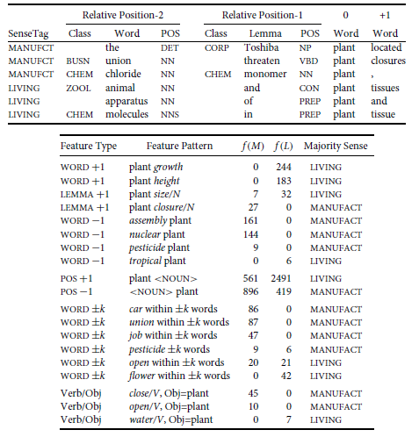

Slide 48
Application Areas
MS Word – spell checker/corrector, grammar checker, thesaurus
WordNet
Search engines (more generically, information retrieval including library searches)
Database front ends
Question-answering systems within restricted domains
Automated documentation generation
News categorization/summation
Information extraction
Machine translation
for instance, web page translation
Language composition assistants – help non-native speakers with the language
On-line dictionaries

Slide 49
Information Retrieval
Originally, this was limited to queries for library references
“find all computer science textbooks that discuss abduction” translated into a DB query and submitted to a library DB
Today, it is found in search engines
take an NLU input and use it to search for the referenced items
Not only do we need to perform NLU, we also have to understand the context of the request and disambiguate what a word might mean
do a Google search on abduction and see what you find
simple keyword matching isn’t good enough

Slide 50
Template Based Information Extraction
Similar to case grammars, an approach to information retrieval is to provide templates to be extracted from given text (or web pages)
specifically, once a page has been identified as being relevant to a topic, a summary of this text can be created by excerpting text into a template
in the example on the next slide
a web page has been identified as a job ad
the job ad template is brought up and information is filled in by identifying such target information as “employer”, “location city”, “skills required”, etc
identifying the right items for extraction is partially based on keyword matching and partially based on using the tags provided by previous syntactic and semantic parsing
for instance, the verb “hire” will have an agent (contact person or employer) and object (hiree)

Slide 51
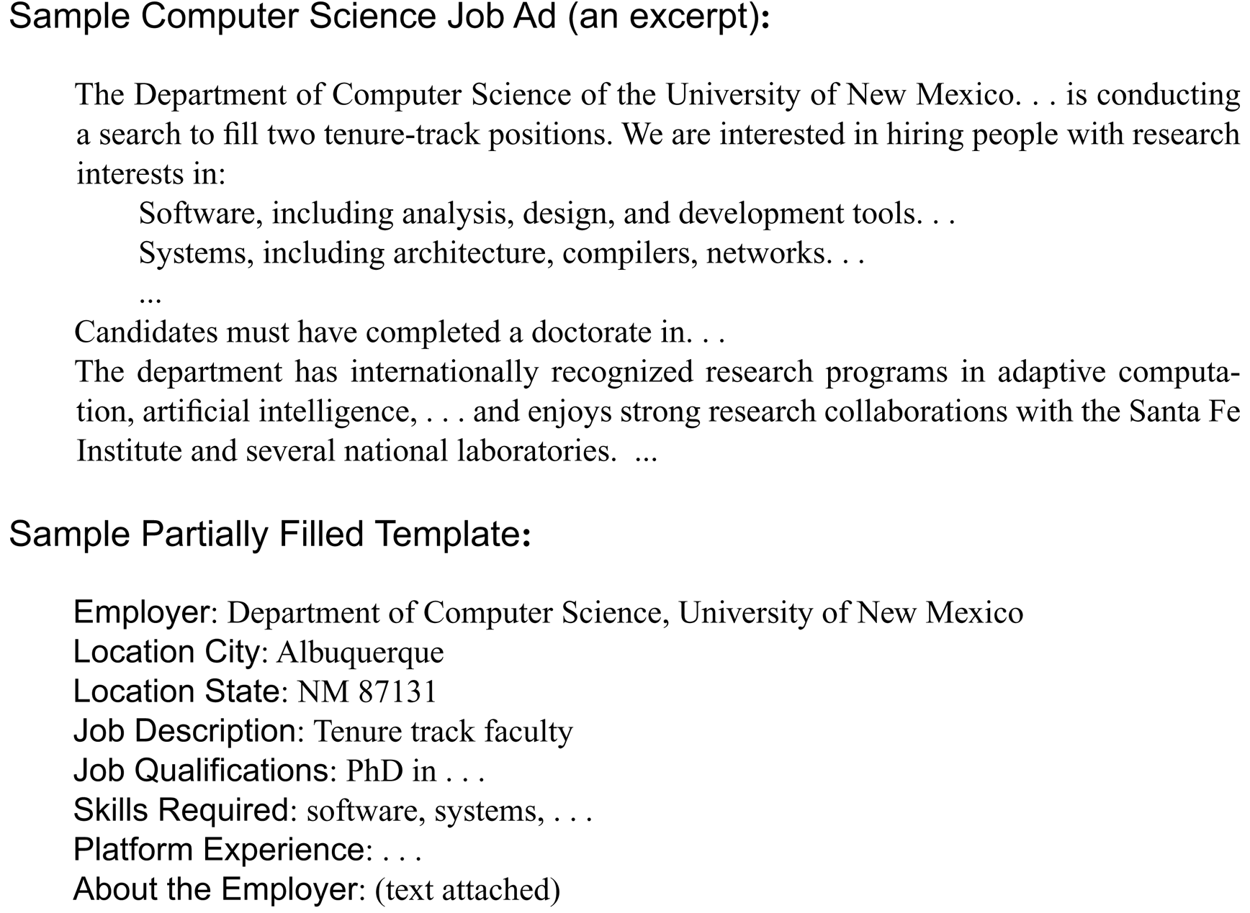

Slide 52
Search Engine Technology
Search engines generally comprise three components
Web crawler (non-AI)
given web page, accumulate all URLs, add them to a queue or stack
retrieve and store next page given the URL from the queue (breadth-first) or stack (depth-first/recursive)
Summary extractor
summarize each web page by its content (possibly just create a bag of words, possibly attempt some form of classification)
store summary, classification and URL in DB
create index of terms to web pages (possibly a hash table)
Search engine portal and information retrieval unit
accept query
find related items in the DB via hashing
sort using some form of rating scheme and eliminate poorly rated items
display URLs, titles and possibly brief summaries

Slide 53
Page Categorization/Summaries
The tricky part of the search engine is to properly categorize or summarize a web page
information retrieval techniques are common
keywords from a bag of words
statistical analysis to gauge similarities between pages
link information such as page rank, hits, hubs, etc
filtering
many web pages (e.g., stores) try to take advantage of the syntactic nature of search engines and place meta tags in their pages that contain all English words
filtering is useful in eliminating pages that attempt such tricks
sorting
using word count, giving extra credit if any of the words are found in the page’s title or the link text, examine font size and style for importance of the words in the document, etc

Slide 54
Page Ranking
Based on the idea of academic citation to determine something’s importance
PR(A) = (1 – d) + d * (PR(T1) / C(T1) + … + PR(Tn)/C(Tn))
PR(A) – page rank of page A
d – a “damping factor” between 0 and 1 (usually set to .85)
C(A) – number of links leaving page A
T1..Tn are the n pages that point at A
The page rank corresponds to the principle eigenvector of a normalized matrix of pages and their links
Page rank is basically how likely it is for an average web surfer to randomly reach a page by clicking on links
the page rank is in essence the probability that this page will be reached randomly and the damping factor is the likelihood that the surfer will get bored at this page and request another random page

Slide 55
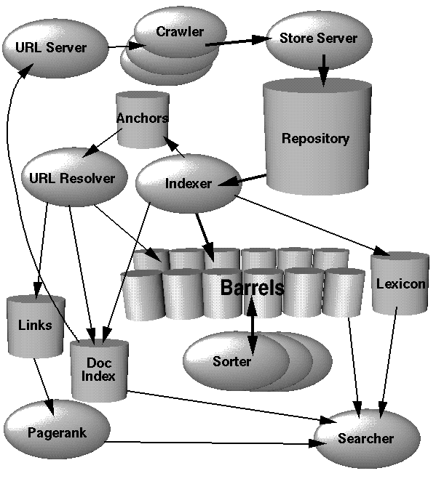
Google’s Architecture
Numerous distributed crawlers working all the time
Web pages are compressed
Each page has a unique document ID provided by the store server
The indexer uncompresses files and parses them into word occurrences
Word occurrences are stored in “barrels” to create an index of word-to-document mappings (using ISAM)
The Sorter resorts the barrel information by word to create a reverse index
The URL resolver converts relative URLs into absolute URLs

Slide 56
Semantic Web
The ultimate need for natural language understanding is to modify the WWW to permit software agents to “understand” web page content
currently, we have to find our own web resources
search engines or other devices
read and interpret the information for ourselves
to reach useful conclusions
The semantic web is a largescale agent system where a user (human or AI) seeks information through the use of agents
agents know where to go to get the information
beyond the agents we introduced earlier in the semester, these agents need to be able to interpret and understand the information provided
this may include translating information from one “form” to another
representation, language, domain, context

Slide 57
Example
I want to schedule a meeting between myself, a student, another professor, and a software engineer from company X
I invoke my software agent to do this for me
the agent must identify, using resources on the web, how to find each person’s schedule
my schedule and the other professor’s schedule are on our web sites
my web site lists times when I have classes so the agent must interpret this to determine free times
the other professor lists only times he is available but lists times in military time, they must be converted
the student’s schedule can be obtained by looking at his/her course schedule
the software engineer does not have a posted schedule, but publishes his schedule through Outlook’s calendar, and so the agent must query the Outlook portal for the information

Slide 58
Continued
My scheduling agent does not actually perform all of these tasks, it assigns the tasks to information retrieval agents
obtain and interpret information from the web directly, handled by an agent who knows how to find relevant web pages, analyze them and return the results
another agent will know how to communicate with Outlook and another with Norse Express
Now that the information has been gathered
my agent accumulates the information by obtaining just the free times for each person and hands that data to a scheduling agent
the scheduling agent comes up with a day and time where everyone can meet
my agent contacts another agent that schedules rooms and finds a room for that day and time
my agent then communicates the result to me directly, and to an email agent who disseminates the results to the other people

Slide 59
NLG, Machine Translation
NLG: given a concept to relate, translate it into a legal statement
like NLU, a mapping process, but this time in reverse
much more straight forward than NLU because ambiguity is not present
but there are many ways to say something, a good NLG will know its audience and select the proper words through register (audience context)
a sophisticated NLG will use reference and possibly even parts of speech
Machine Translation:
this is perhaps the hardest problem in NLP becomes it must combine NLU and NLG
simple word-to-word translation is insufficient
meaning, references, idioms, etc must all be taken care of
current MT systems are highly inaccurate

