Slide 1
Automated Reasoning
Early AI explored how to automate several reasoning tasks
these were solved by what we might call weak problem solving methods
as opposed to strong methods because they do not require a great deal of knowledge
formal mechanism for representation and precise inference rules
search processes but unlike the search spaces we examined in chapters 3 & 4, these processes identify rule(s) to apply and on what data to apply them through a matching algorithm
we focus on two forms of reasoning here to perform automated theorem proving in predicate calculus
the general problem solver strategy and means-ends analysis
resolution and unification

Slide 2
Theorem Proving
We first examine the Logic Theorist system
given two statements in propositional calculus, it would try to prove their equality
it would use a collection of rules (shown in a few slides)
LT’s rules performed one of three types of operations
substitution – substitute one expression for every occurrence of a symbol that is already known to be true
(X v X) → X can be replaced by (!A v !A) → !A
This is a form of unification, here unifying X to !A
replacement – substitute an expression that has a connective (e.g., →) by its equivalent form or definition
A → B can be replaced by !A v B since they are equivalent
detachment – apply modus ponens to introduce a new, true statement or clause

Slide 3
Means-Ends Analysis, GPS and LT
Means-ends analysis – weak method approach
compare current state to goal state to determine differences
select an operator to reduce some of these differences
GPS is the general problem solver, a system that embodies this weak method approach
GPS is a generalized version of the process used in LT
GPS requires a difference table which maps differences (between current and goal states) to operators so that the GPS can select an operator at each step
LT is an example implementation using GPS
In LT, two logical statements are introduced: the start state and the goal state
LT attempts to show their equivalence by reducing one into the other
the difference table consists of actions to either reduce a term, add a term, or change a term including
changes in sign (AND to OR, OR to AND) and connective (→ to OR)
the rules to apply (there were 12 of them) would all be based on boolean algebra laws such as DeMorgan’s Law

Slide 4
How LT Works
LT applies inference rules in a breadth-first, goal-driven manner, using four methods
substitute a symbol in the current goal to see if it matches any known axiom or theorem, if so, that goal has been proved
try all possible detachments and replacements to the goal
test each generated term using substitution
any that fail to prove the goal are added to a subproblem list
employ transitivity of implication to see if it would solve the problem and if so, add the new term as a new subprogram
e.g., if we are trying to prove A→C and we know B→C, then we add A→B as a step to be proven, if we can prove it, then we have proven A→C
if none of the above work, remove the first term off the subproblem list and repeat with this as the goal – that is, use the first term as a subgoal

Slide 5
Example
LT attempts to prove (p→!p)→!p is true
first, (AvA)→A is the closest axiom to match the structure of our target expression (the goal)
so we attempt to use substitution first
(!Av!A) → !A by substituting !A for A
(A→!A)→ !A by replacement
recall that !x v y is the same as x → y, so here !A v !A is A → !A
(p→!p)→!p by substituting p for A, done
Notice how LT works backward
LT starts with an axiom that best matches the goal
then LT applies substitution, replacement, detachment, as necessary to alter the axiom until we reach the goal or generates a new subgoal to reach
if LT reaches a deadend, it introduces new terms as subgoals to solve and repeats the entire process by attempting to solve the first subgoal

Slide 6
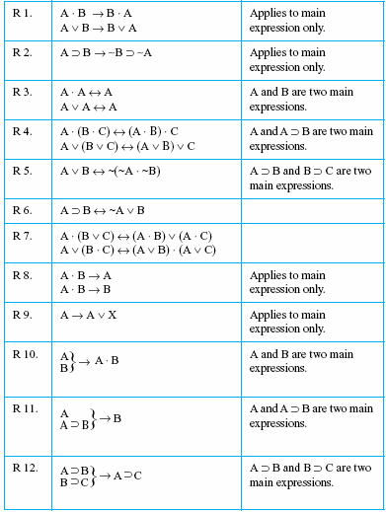
LT Rules and Examples
If we have (X * Y), by rule 1, we
can change this to (Y * X) or by
rule 8, we can conclude X is true
and/or Y is true
If we have X * Y → !Z, by rule 2,
we can change this to !(X * Y) v !Z
and then apply rule 5 to obtain
!X v !Y v !Z
If we know X is true and Y is true,
we can use rule 10 to obtain X * Y
If we need to have X, and we know
A and B are true and
(A & B) → (X & Y),
we can use rules 10, 11 and 8 to
obtain X

Slide 7
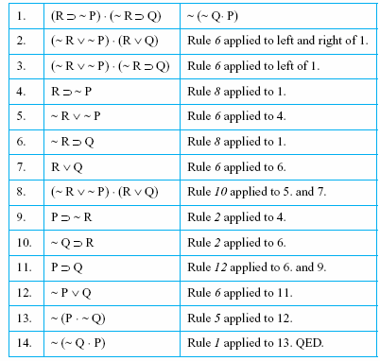
Longer Example
We want to prove that
The proof is shown to the left with the rules used to denote how the proof was generated
Note this solution is not the most efficient proof
$$\left(R→!P\right)∗\left(!R →Q\right)$$
$$≡!(!Q ∗P)$$

Slide 8
How Does LT Select a Rule?
LT uses means-ends analysis given the difference table below
given a goal, determine the difference between goal and current state
select a rule to reduce this difference
if the rule can reduce the difference directly, great, otherwise produce a subgoal and add it to the list of goals/subgoals
In the reduction table for instance,
to delete a term, use rule 3, 7, 8, 11 or 12
to change a sign, use rule 5

Slide 9
Example Goals and Strategies

Slide 10
Resolution
When we first examined first order predicate calculus, we used our representation by applying chaining, modus ponens/tollens and unification
another way to use predicate calculus is resolution and unification
In resolution, introduce the negation of what you want to prove into your knowledge base
in first order predicate calculus, everything known is true
you have assumed the new piece of knowledge is true
now, resolve terms by combining terms together
If you have X v Y and introduce !X, this resolves into Y (the !X and X cancel each other out)
add unification as necessary
continue to resolve clauses until you reach the empty clause (all terms have been canceled out)
this is an inconsistency – you have started with true statements but end up knowing nothing is true, thus either you have something incorrect in your original knowledge base (which was all assumed to be true) or the item you just introduced as true is actually false
if the new term is false, then its opposite must be true (if you introduced !x which we have proved is false, then x must be true)

Slide 11
Clausal Form
To use resolution, you must translate your knowledge into predicate calculus statements and then into clausal form
eliminate → by using the equivalent form
A → B = !A v B
reduce negation so that it appears immediately before predicates, not terms by applying DeMorgan’s Law
for instance !(A AND B) becomes !A v !B
apply Double Negation if needed
move quantifiers to immediately before each term (see page 586)
remove any universal quantifiers by renaming variables
if you have for all x:… for all x: …, change the latter grouping into y
remove any existential quantifiers by replacing the variables with constants
convert all clauses to be conjuncts of disjuncts
each term should consist of only ANDs, ORs, and NOTs
arrange them so that they are all sums of products (ORed items of individual predicates or of ANDed predicates as in A*B v !B*C*D v !A)
separate each conjunct into its own term – these terms will only comprise predicates, NOTs and ANDs in some combination
Now, introduce the negation of what you want to prove

Slide 12
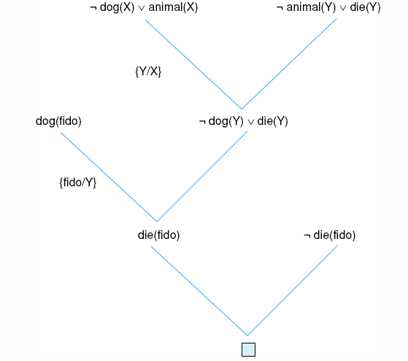
Example: Dead Dog Problem
All dogs are animal
V(X) (dog(X) → animal(X)).
V(X) (!dog(X) v animal(X)).
!dog(X) v animal(X)
Fido is a dog
dog(Fido).
All animals die
V(X) (animal(X) → die(X)).
V(X) (!animal(X) v die(X)).
!animal(Y) v die(Y)
We want to prove that Fido will die, so we introduce !die(Fido)
proof shown to the right
since we reach an empty clause, it proves !die(Fido) is false, so die(Fido) is true, Fido will die

Slide 13
Example: Is John Happy?

Slide 14
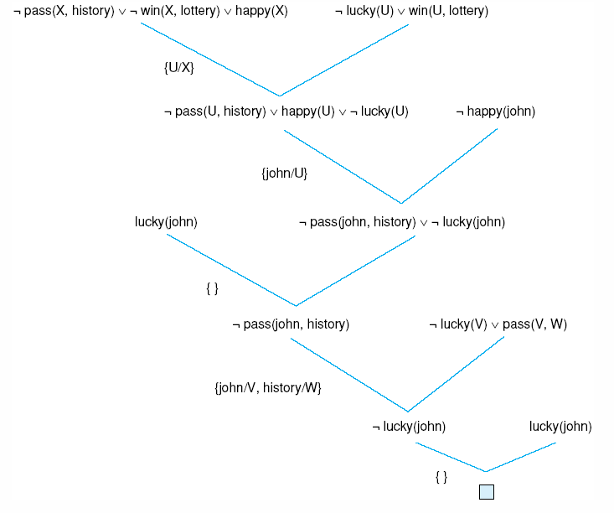
Proof of John’s Happiness

Slide 15
Question Answering
Given a KB with knowledge of specific instances, we can use resolution to pose a question
e.g., who is ready to graduate?
The process is almost identical to our previous resolution where we tried to prove something was true
here, we introduce the negation of the question we want to answer (e.g., ~ready_to_graduate(X))
through unification, we are hoping to find an X that makes the above statement false, and therefore the person that we unified to X is ready to graduate
this process can only work by having instances that can unify to the term that we are attempting to prove
the answer is the instance(s) that unified to X
in the Prolog language, the system will find all X’s but in resolution, we usually stop when we have found an X

Slide 16
Exciting Life Example

Slide 17
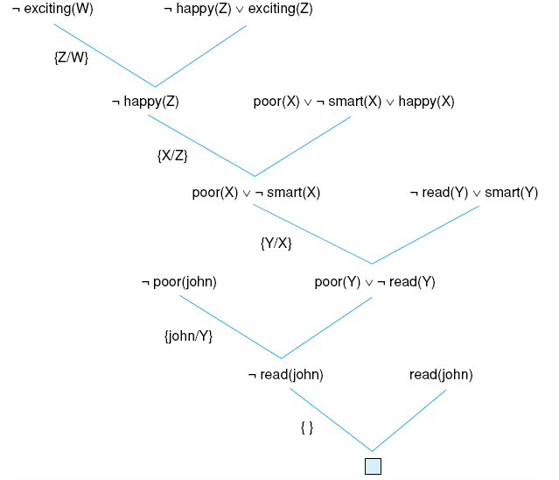
Continued
By unifying Y to
John, our answer is
that John has an
exciting life

Slide 18
Clause Selection Strategies
As with our previous AI solutions, resolution is search based
which clause should we select to attempt to resolve?
what instance do we unify with a variable?
so resolution/unification is intractable (too computationally complex)
There are many different approaches to tackling the search problem
breadth-first – while this strategy computationally is poor because it generates all possible solution spaces until one is found, the proof itself will take the fewest steps
depth-first – this strategy may “luck” into a solution much quicker than breadth-first and is easy to implement using recursion
We can also use one or more heuristic approaches
support – select a clause to unify where one of the terms is related to a term to be resolved (related in terms of hierarchical)
unit preference – select a clause with the fewest terms (1 preferably)
linear input – always select a clause that has the negation of at least one term in the resolvent – that is, make sure you are always removing clauses as you go

