Slide 1
Auto-Regressive HMM
Recall the hidden Markov model (HMM)
  a finite state automata with nodes that represent hidden states (that is, things we cannot necessarily observe, but must infer from data) and two sets of links
    transition – probability that this state will follow from the previous state
    emission – probability that this state is true given observation
The standard HMM is not very interesting for AI learning because, as a model, it cannot capture the knowledge of an interesting problem
  see the textbook which gives as examples coin flipping
Many problems that we solve in AI require a temporal component
  the auto-regressive HMM can handle this where a state S_{t} follows from state S_{t-1} where the t represents a time unit
    we want to compute the probability of a particular sequence through the HMM given some observations

Slide 2
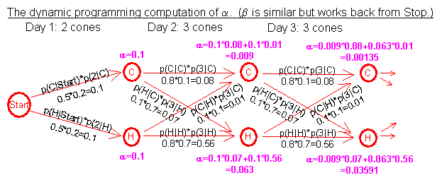
Example: Determining the Weather
Here, we have an HMM that attempts to determine for each day, whether it was hot or cold
  observations are the number of ice cream cones a person ate (1-3)
  the following probabilities are estimates that we will correct through learning
 | p(…|C) | p(…|H) | p(…|START)
p(1|…) | 0.7 | 0.1 |  | If today is cold (C) or hot (H), how many cones did I prob. eat?
p(2|…) | 0.2 | 0.2
p(3|…) | 0.1 | 0.7
p(C|…) | 0.8 | 0.1 | 0.5 | If today is cold or hot, what will tomorrow probably be?
p(H|…) | 0.1 | 0.8 | 0.5
p(STOP|…) | 0.1 | 0.1 | 0

Slide 3
Computing a Path Through the HMM
Assume we know that the person ate in order, the following cones: 2, 3, 3, 2, 3, 2, 3, 2, 2, 3, 1, …
What days were hot and what days were cold?
  P(day i is hot | j cones) =
    α_{i}(H) * β_{i}(H) / (α_{i}(C) * β_{i}(C) + α_{i}(H) * β_{i}(H) )
  α_{i}(H) is the probability of arriving at the state H on day i given the sequence of cones observed
  β_{i}(H) is the probability of starting at the state H on day i and going until the end while eating the sequence of ones observed
    for day 1, we have a 50/50 chance of the day being hot or cold, and there is a 20% chance of eating 2 cones whether hot or cold, so α₁(H) = .5 * .2 = .1 = α₁(C)
  to calculate β₁(H) and β₁(C) is more involved, we must start at the end of the chain (day 33) and work backward to day 1
    that is, β_{i}(H) = β_{i+1}(H) * p(H | j cones for day i)
  this is called the forward-backward algorithm, α is forward, β is backward

Slide 4
The “Learning” Algorithm
We started with guesses for our initial probabilities
  we can do better by re-estimating these probabilities by doing the following
  at the end of day 33, we sum up the values of P(C | 1) during our 33 days
  we sum up the values of P(C) for the 33 days
  we now compute P(1 | C) = sum P(C | 1) / P(C)
We do the same for P(C | 2), and P(C | 3) to compute P(2 | C) and P(3 | C)
  we do the same hot days to recompute P(1 | H), P(2 | H), P(3 | H)
Now we have better probabilities than the originals which were merely guesses
This algorithm is known as the Baum-Welch algorithm which has two parts: the forward-backward component, and the re-estimation component

Slide 5
Continued
We update the probabilities (see below)
  since our original probabilities will impact how good these estimates are, we repeat the entire process with another iteration of forward-backward followed by re-estimation
  we continue to do this until our probabilities converge into a stable state
So, our initial probabilities will be important only in that they will impact the number of iterations required to reach these stable probabilities
 | p(…|C) | p(…|H) | p(…|START)
p(1|…) | 0.6765 | 0.0584
p(2|…) | 0.2188 | 0.4251
p(3|…) | 0.1047 | 0.5165
p(C|…) | 0.8757 | 0.0925 | 0.1291
p(H|…) | 0.109 | 0.8652 | 0.8709
p(STOP|…) | 0.0153 | 0.0423 | 0

Slide 6
Convergence and Perplexity
After 10 iterations, our probabilities are as shown in the table below
  our observations not only impacted the emission probabilities (how many cones we eat when hot or cold), it also impacted the transitional probabilities (hot day follows cold day, etc)
Our original transition probabilities were part of our “model” of weather
  updating them is fine, but what would happen if we had started with different probabilities? say p(H|C) = .25 instead of .1?
  the perplexity of a model is essentially the degree to which we will be surprised by the results of our model because of the “guesses” we made when assigning a random probability like p(H|C)
    We want our model to have a minimal
    perplexity so that it is most realistic
 | p(…|C) | p(…|H) | p(…|START)
p(1|…) | 0.6406 | 7.1E-05
p(2|…) | 0.1481 | 0.5343
p(3|…) | 0.2113 | 0.4657
p(C|…) | 0.9338 | 0.0719 | 5.1E-15
p(H|…) | 0.0662 | 0.865 | 1.0
p(STOP|…) | 1.0E-15 | 0.0632 | 0
View this entire example in at
http://www.cs.jhu.edu/~jason/papers/eisner.hmm.xls

Slide 7
A Slightly Better Example
We want to know what the weather was over a sequence of days given a person’s activities:
  walked, shopped, cleaned
Hidden states = {Rainy, Sunny}
Observations = {Walk, Shop, Clean}
Starting probabilities = Rainy: 0.6, Sunny: 0.4
Transition probabilities
  Rainy - Rainy: 0.7
  Rainy - Sunny: 0.3
  Sunny - Rainy: 0.4
  Sunny - Sunny: 0.6
Emission probabilities
  Rainy - walk: 0.1, shop: 0.4, clean: 0.5
  Sunny - walk: 0.6, shop: 0.3, clean: 0.1

Slide 8
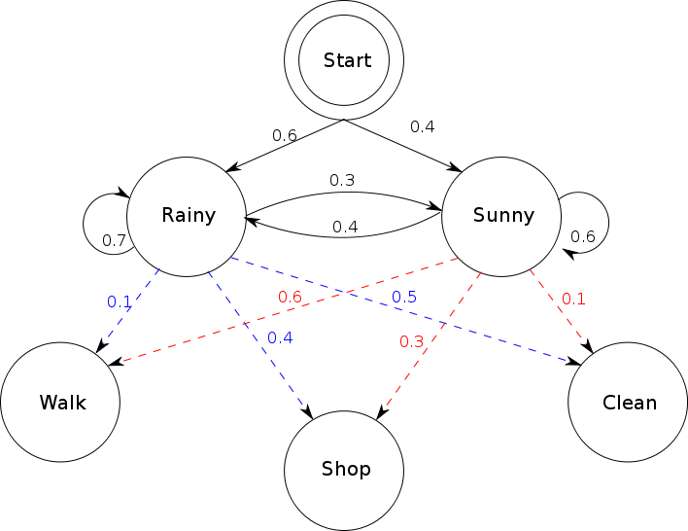
Continued
Given a sequence of observations, what was the most likely whether for the days observed?
  E.g.: walk, walk, walk, shop, walk, clean, clean
We can also adjust the
previous start probabilities,
transition probabilities and
emission probabilities given
some examples
We need observations/weather
days to adjust emission
probabilities
We need sequences of days’
weather to adjust starting and
transition probabilities

Slide 9
N-Grams
The typical HMM uses a Bi-gram which means that we factor in only one transitional probability from a state at time i to a state at time i+1
  for our weather examples, this might be sufficient
  for speech recognition, the impact that one sound makes on other sounds extends beyond just one transition, we might want to expand to tri-grams
  an N-gram means that we consider a sequence of n transitions for each transition probabilities
The tri-gram will give us more realistic probabilities but we need 26 times more (there are 26² bi-grams, 26³ tri-grams in English)

Slide 10
Factorial HMM
Factorial HMMs – when the system is so complex that a given state cannot represent the process of a single state in the model
  at time i, there will be multiple states, all of which lead to multiple successor states and all of which have emission probabilities from the observations input
  in other words, the goal is to identify multiple independent paths through the HMM because there are multiple hidden variables that we need to identify
We might for instance identify
that the most likely sequence is
both S11 → S22 → S13 and
S21 → S22 → S23 so that
at time 1, we are in both states
S11 and S21, at time 2 we are
in state S22 and at time 3 we are
in states S13 and S23

Slide 11
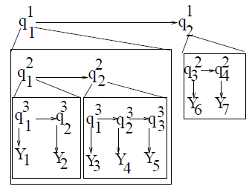
Hierarchical HMM
Hierarchical HMMs – each state is itself a self-contained probabilistic model including their own hidden nodes
  that is, reaching node qi at time j means that you are actually traversing an HMM as represented by node qi
  here we see that q11 and q12 both consist of lesser HMMs where q11 consists of two time units and each of these is further divisible
Both the factorial and hierarchical
HMM models require their own
training algorithms although
they are based on Baum-Welch

Slide 12
Bayesian Forms of Learning
There are three forms of Bayesian learning
  learning probabilities
  learning structure
  supervised learning of probabilities
In the first form, we merely want to learn the probabilities needed for Bayesian reasoning
  this can be done merely by counting occurrences
    take all the training data and compute every necessary probability
  we might adopt the naïve stance that data are conditionally independent
    P(d | h) = P(a1, a2, a3, …, an | h) = P(a1 | h) * P(a2 | h) * … * P(an | h)
  this assumption is used for Naïve Bayesian Classifiers

Slide 13
Spam Filters
One of the most common uses of a NBC is to construct a spam filter
  the spam filter works by learning a “bag of words” – that is, the words that are typically associated with spam
We want to learn one of two classes: spam and not spam
  so we want to compute P(spam | words in message) and P(!spam | words in message)
  P(spam | word1, word2, word3, …, wordn) = P(spam) * P(word1, word2, word3, … | spam) = P(spam) * P(word1 | spam) * P(word2, word3, … | spam) = P(spam) * P(word1 | spam) * P(word1 & word2 | spam) * P(word3, … | spam) and so forth
  unfortunately, if we have say 50,000 words in English, we would need 2⁵⁰⁰⁰⁰ probabilities!
So instead, we adopt the naïve approach
  P(spam | word1, word2, word3, …) = P(spam) * P(word1 | spam) * P(word2 | spam) * P(word3 | spam) *…

Slide 14
More on Spam Filters
  To learn these probabilities, we start with n spam messages and n non spam messages and count the number of times word1 appears in both sets, the number of times word2 appears in both, etc for the entire set of words
  The nice thing about the spam filter is that it can continue to learn
  every time you receive an email, we can recompute the probabilities
  every time the classifier mis-classifies a message, we can update P(spam) and P(!spam)
So we have software that can improve over time because the probabilities should improve as it sees more and more examples
  note: in order to reduce the number of calculations and probabilities needed, we will first discard the common words (I, of, the, is, etc)

Slide 15
Another Example of Naïve Bayesian Learning
We want to learn, given some conditions, whether to play tennis or not
  see the table on the next page
The data available generated tells us from previous occurrences what the conditions were and whether we played tennis or not during those conditions
  there are 14 previous days’ worth of data
To compute our prior probabilities, we just do
  P(tennis) = days we played tennis / totals days = 9 / 14
  P(!tennis) = days we didn’t play tennis = 5 / 14
The evidential probabilities are computed by adding up the number of Tennis = yes and Tennis = no for that evidence, for instance
  P(wind = strong | tennis) = 3 / 9 = .33 and P(wind = strong | !tennis) = 3 / 5 = .60

Slide 16
Continued
We have a problem in computing our evidential probabilities
  we do not have enough data to tell us if we played in some of the various combinations of conditions
  did we play when it was overcast, mild, normal humidity and weak winds? No, so we have no probability for that
  do we use 0% if we have no probability?
We must rely on the Naïve Bayesian assumption of conditional independence to get around this problem
  it also allows us to solve the problem have far fewer probabilities
P(Sunny & Hot & Weak | Yes) =
P(Sunny | Yes) * P(Hot | Yes) * P(Weak | Yes)

Slide 17
Learning Structure
For either an HMM or a Bayesian network, how do we know what states should exist in our structure? How do we know what links should exist between states?
There are two forms of learning here
  to learn the states that should exist
  to learn which transitions should exist between states
Learning states is less common as we usually have a model in mind before we get started
  for instance, we knew in our previous example that we wanted to determine the sequence of hot and cold days, so for every day, we would have a state for H and a state for C
  we can derive the states by looking at the conclusions to be found in the data
Learning transitions is more common and more interesting

Slide 18
Learning Transitions
One approach is to start with a fully connected graph
  we learn the transition probabilities using the Baum-Welch algorithm and remove any links whose probabilities are 0 (or negligible)
    but this approach will be impractical
Another approach is to create a model using neighbor-merging
  start with each observation of each test case representing its own node (one test case will represent one sequence through an HMM)
  as each new test case is introduced, merge nodes that have the same observation at time t
  the HMMs begin to collapse
Another approach is to use V-merging
  here, we not only collapse states that are the same, but also states that share the same transitions
  for instance, if we have a situation where in case j si-1 goes to si goes to si+1 and we match that in case k, then we collapse that entire set of transitions into a single set of transitions
  notice there is nothing probabilistic about learning the structure

Slide 19
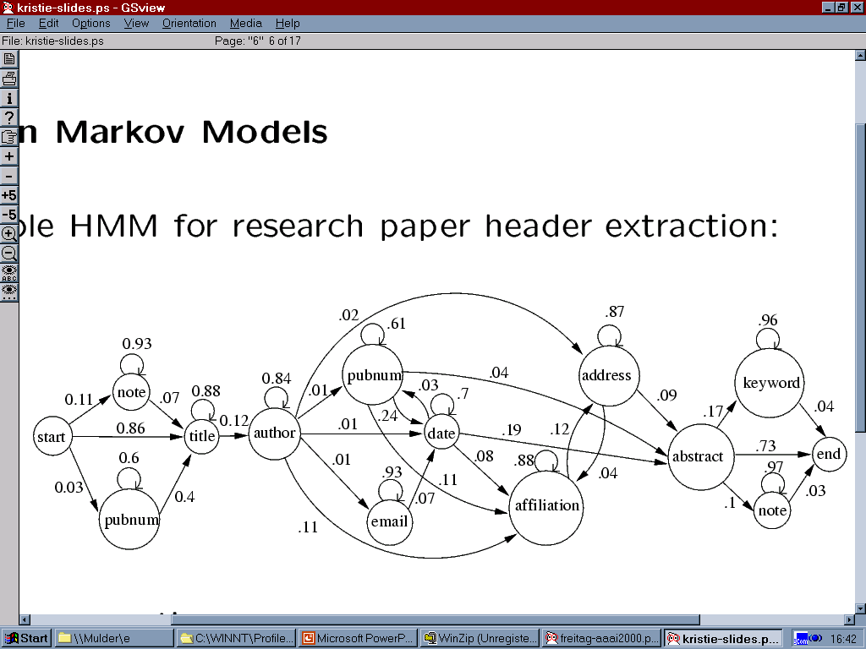
Example
Given a collection of research articles, learn the structure of a paper’s header
  that is, the fields that go into a paper
Data came in three forms: labeled (by human), unlabeled, distantly labeled (data came from bibtex entries, which contains all of the relevant data but had extra fields that were to be discarded) from approximately 5700 papers
  the transition probabilities were learned by simple counting

Slide 20
Bayesian Network Learning
Recall a Bayesian network is a directed graph
  before we can use the Bayesian network, we have to remove cycles (we see how to do this in the next slide)
A HMM is a finite state automata, and so is also a directed [acyclic] graph
  we can apply the Viterbi and Baum-Welch algorithms on a Bayesian network just as we can an HMM to perform problem solving
The process
  first, create your network from your domain model
  second, generate prior and evidential probabilities (these might initially be random, derived through sample data, or generated using some distribution like Gaussian)
  third, train the network using the Baum-Welch algorithm
Once the network converges to a stable state
  introduce a test case and use Viterbi to compute the most likely path through the network

Slide 21
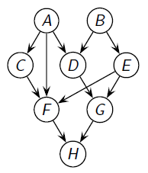
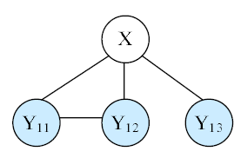
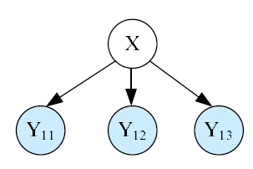
Removing Cycles
Here we see a Bayesian network with cycles
  we cannot use the network as is
There seem to be three different approaches
  assume independence of probabilities
  this allows us to remove links between “independent nodes”
  attempt to remove edges to remove cycles that are deemed unnecesssary
  identify nodes that cause cycles to occur, and then instantiate them to true/false values, and run Viterbi on each subsequent network
    in the above graph, D and F create cycles, we can remove them and run our Viterbi algorithm with D, F = {{T, T}, {T, F}, {F, T}, {F, F}}

Slide 22
How do HMMs and BNs Differ?
The Bayesian network conveys a sense of causality
  Transitioning from one node to another means that there is a cause-effect relationship
The HMM typically conveys a sense of temporal change or state change
  Transitioning from state to state
The HMM represents the state using a single discrete random variable while the BN uses a set of random variables
The HMM may be far more computationally expensive to search than the BN

