Slide 1
A-Life
The dumbest thing an intelligence can do is stay alive
that is, staying alive is the minimal accomplishment for an intelligence
rather than building AI, building A-Life means to train a system to accomplish at least this minimal level
A-Life is to some extent modeled on the “Game of Life”
A-Life attempts to solve the learning problem by learning to interact properly among a larger community
A-Life is not so much AI as it is a combination of AI techniques and modeling of biological or evolutionary systems

Slide 2
A-Life Approaches
Artificial chemistry – modeling chemical reactions and processes to evolve better “life forms”
Neural networks – training a system to improve its performance
Rodney Brooks’ robots learn to not hurt themselves (e.g., not fall off a table)
Multi-agent systems
Evolutionary algorithms – this is what we will study in chapter 12
Genetic algorithms
Genetic programming
Evolutionary programing
Cellular automata such as ant colony optimization, bacterial colony optimization and swarm intelligence (we will not examine these approaches)

Slide 3
Genetic Algorithms
Most AI problems revolve around search
searching for a solution in a state space
searching the combinations of production rules through chaining
searching for the pattern of operators in planning
searching for a representation that captures positive but not negative examples in various learning algorithms
searching for the global minima error state in neural network weights
The GA is an approach to reduce search complexity by adding
random changes to the current state(s)
a fitness function to identify which state(s) should be used for the next step in the search
The ideas of making random changes and selecting the fittest is based on evolution and natural selection
GAs are in fact a form of heuristic search

Slide 4
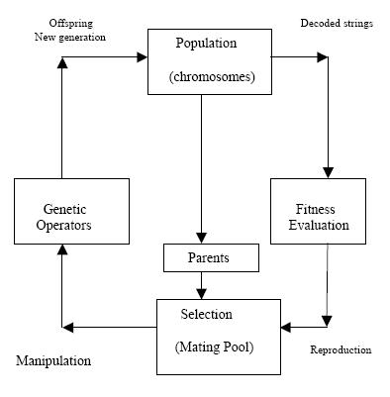
The GA Cycle
We start with a population of solutions (chromosomes)
We evaluate them using a fitness function
We select those that should become the parents of the next generation
selection may not be the most fit, there are numerous forms of selection
We create offspring of the parents through genetic operators
Repeat until we have a chromosome that adequately solves the problem
Choices to be made
how big should our population be?
how many offspring do we generate?
what genetic operators do we use?

Slide 5
Representations and Fitness Functions
The two principle challenges for GAs are
how to represent the problem space in terms of chromosomes?
such that we can manipulate them through genetic operators without creating chromosomes that are useless or violate the problem
how do we evaluate a chromosome for its fitness?
consider – if we know enough about the problem to generate a fitness function, can’t we just generate the solution instead?
Example: the CNF Satisfaction problem
a conjunctive normal form (CNF) is a propositional sentence that comprises disjunctions of conjunctions
e.g., (A OR !B OR C) & (B OR C) & (A OR !D))
our chromosomes will consist of n binary values, one for each proposition
for A-D, we have 4 values, for instance (1, 0, 0, 1) and (0, 0, 1, 0) would be chromosomes for this problem
our fitness function can be the number of true disjunctions
f(1, 0, 0, 1) = 2 and f(0, 0, 1, 0) = 3 (in fact, (0, 0, 1, 0) is a solution)

Slide 6
Other Examples
The knapsack problem is:
Given n objects, each has a different weight and value
Find the collection of objects such that their combined weight does not exceed the capacity of the knapsack which provides the largest overall value
for instance, our objects might be: {(.3, 100), (.5, 150), (.8, 200), (.3, 90), (.1, 25), (.6, 120), (.7, 130), (.2, 70), (.4, 80), (.3, 80)}
if the knapsack can hold 2.0, which of the 10 objects should we put in the knapsack to maximize the total value?
This is an optimization problem which has a complexity of O(2^{n})
We might try to solve this with a GA

Slide 7
Representation and Fitness
If there are n items available, then our chromosome is an n-bit vector where bit i is 0 if the item is not in the knapsack and 1 if it is
for instance, our 10-item example might have chromosomes of {1, 1, 1, 1, 1, 0, 0, 0, 0, 0} and {1, 0, 1, 0, 1, 0, 1, 0, 1, 0}
Our fitness function is the sum of the values of the items in the knapsack, or 0 if the weight of the items > capacity
fitness({1, 1, 1, 1, 1, 0, 0, 0, 0, 0}) = 565
fitness({1, 0, 1, 0, 1, 0, 1, 0, 1, 0}) = 0 (exceeds capacity)

Slide 8
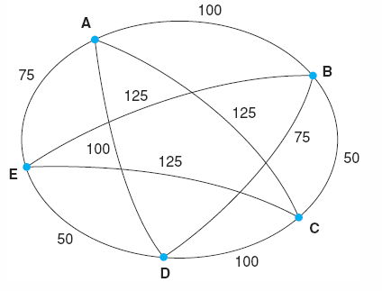
Traveling Salesman Problem
We have a network of cities and we want to generate the path from a start city that goes through every city one time and returns to the start city which has the minimal cost (minimal sum of edge weights)
this is an NP-hard problem requiring n! computations for a network of n cities
Binary chromosomes won’t work here
we could order the city names in the order that they would be visited in the path
the chromosome (A, B, C, D, E) represents the path from A to B to C to D to E and back to A

Slide 9
Continued
The fitness function can simply be the sum of the edge weights
e.g., f(A, B, C, D, E) = e[A, B] + e[B, C] + e[C, D] + e[D, E] + e[E, A] = 375
We might use a selection mechanism of picking the chromosomes with the best fitness function values
Unlike the Satisfiability problem
we do not know what the best fitness function value should be
we can determine if we are improving our previous chromosomes
But when do we know when to stop?
we may never know if the solution generated is the optimal traveling salesman problem solution or just a good one

Slide 10
Genetic Operators
How do we generate the offspring of our selected parents?
we want to preserve the best traits of the parents but make changes (randomly) to the remainder of the chromosome
unfortunately, our fitness function is giving us a single value of how good the chromosome is, but it is not telling us which parts of the chromosome are worth preserving
we also want to make sure that we neither make too small of changes to the previous generation nor too great of changes
too little change means that we aren’t moving around the search space very far
too great change means that we are skipping around too randomly
There are generally three forms of operators to randomly manipulate a chromosome, all found in genetics
cross-over
inversion
mutation

Slide 11
Cross-over
Given a pair of chromosomes (parents), select some random portion of each and swap them
usually we select the same portion of the two chromosomes
parent 1 = (A, B, C, D, E, F, G)
parent 2 = (H, I, J, K, L, M, N)
child 1 = (A, B, C, D, L, M, N)
child 2 = (H, I, J, K, E, F, G)
but we might use domain knowledge to dictate what features can be crossed over
child 3 = (A, B, C, D, H, I, J)
child 4 = (E, F, G, K, L, M, N)
this can be tricky if some features cannot take on some values
consider if the first three features are binary and the last four are integer, then child 3 and 4 make no sense
if we were to cross-over two TSP chromosomes, we might wind up with repeat cities and missing cities in an offspring
(A, B, C, D, E) & (B, D, A, C, E) → (B, D, C, D, E) & (A, B, A, C, E)

Slide 12
Mutation/Inversion
Cross-over is a preferred operator because it comes right from heredity
two parents have four children
one child usually acquires the best genes from the parents
one child usually acquires the worst
the other two usually acquire an equal number of good and bad genes
The superior child is a natural selection
but cross-over may not work well (if at all)
Mutation – arbitrarily select a feature and then arbitrarily change it
for a binary value, flip the bit
for a value within a range, randomly generate a new value in that range or randomly increase or decrease the current value
Inversion – take a group of values and invert them
reverse the order of a selection of values
flip the position of two values
create a random ordering of the values

Slide 13
Example: CNF Satisfiability
Our problem is
(a||b)&&(!a||!b||c)&&(!a||!d)&&(b||!c||e)&&(!d||!e)&&(c||e)
A chromosome will have 5 binary values
the fitness function will apply the binary values to the above CNF and output the number of disjunctions that were true (0-6)
We will use 2 parents and generate 4 offspring
At the end of each generation, we will select the fittest offspring plus a random offspring to be our new parents
we will cross over the two parents using 2 or 3 consecutive values for two children
we will mutate on one random parent
we will use inversion on one random parent
for inversion, we will randomly select the area and randomly select the area’s size (2, 3 or 4) and reverse the values
for mutation, we will randomly select whether to mutate 1 or 2 values

Slide 14
Continued
We start with 11011 and 00000 as parents
first step is to generate a new generation of offspring
we use cross-over on our two parents, giving us 10001 and 01010 with scores of 4 each
we use mutation on the second parent and generate 01000 with a score of 5
we use inversion on the first parent and generate 10111 with a score of 4
we select 01000 as the fittest, and 10001 randomly
With new parents 01000 and 10001, we generate new children as follows
11001, 00000 (cross-over), 00101(inversion), 01010 (mutation) with scores 5, 4, 5, 5
select 01010 and 11001 as parents

Slide 15
Continued
With parents 01010 and 11001, generate new children
11011, 01000 (cross-over), 10011 (inversion), 01011 (mutation) with scores 3, 4, 4, 5
select 01011 and 10011 as the new parents
Generate children
10011, 01011 (cross-over), 00011 (inversion), 10101 (mutation) with scores of 4,4, 4, 6
10101 solves the problem, it took 4 generations
solving Satisfiability by trying all combinations would take 2^5 = 32 attempts
Note: there are other solutions including 01110 and 11101

Slide 16
GA Search
Using the GA, we are performing a variation of best-first search
here, rather than taking one step from our current position
we use genetic operators to take us to a new location
which is probably near to where we were
use the fitness function as our heuristic
use a selection process to decide what new states to explore next
and because we select > 1 parent, we are actually taking some parallel steps into the search space
Recall that heuristic search had the possibility of reducing the complexity of search, but did not guarantee it
GAs are the same
In heuristic search, we used a “closed” set to store what nodes have already been explored to avoid an infinite loop
we are not necessarily doing that in GAs, we could easily generate a chromosome that had previously been generated

Slide 17
Selection Mechanisms
If we merely select the best chromosomes for the next generation
we might find ourselves in a space where our parents are too close together so that we cannot easily generate changes to move us into a different area of the space
instead, we should based our selection only partially on the best chromosome as identified by the fitness function
Some alternatives
sort the chromosomes on fitness scores and use a probabilistic approach (for instance, if the scores were .8, .5, .3, .1, then there is a .8/1.7 chance of selecting the first one, .5/1.7 of selecting the second, etc
or we could select the fittest and then randomly select the other(s)
or we could select the fittest, and use it to determine which remaining candidate(s) is/are the most diverse and pick the most diverse (this will help ensure that we don’t converge onto the same pattern)

Slide 18
Solving TSP Using GAs
We face some problems trying to solve TSP using GAs
consider the 5-node network earlier, a chromosome could be represented as (A, B, C, D, E) for instance
what does it mean to mutate this chromosome?
could we for instance just change an entry?
this would not ensure that we still have a complete path
can we just invert some sequence of values?
if the network is not completely connected then there are chances that such a change would result in a path that does not exist (two consecutive cities in our path but without an edge between them in the network)
we already saw that cross-over will not work because some nodes will be removed and others duplicated – but see pages 514-515 for a way to use cross-over

Slide 19
Continued
The fitness function is simple enough, just some up the edge weights of the path represented by the chromosome
finding the best child is easy, just to the one with the minimal fitness function value
But how do we know if we have reached the solution?
since we would have to solve the TSP (which is N!) to find the minimal path, we won’t know when to stop our GA approach since we won’t know what that minimal path is in advance
so we have to instead either set an upper bound for what we would be willing to spend on a solution, or set an upper bound on the number of iterations for the GA cycle

Slide 20
Coming Up With Fitness Functions
Some problems do not have easily constructed fitness functions
consider using GAs for music creation
the GA starts with some randomly generated notes in a sequence
we create offspring by using crossover, mutation and inversion on the sequence(s)
but what fitness function do we apply to see which musical sequence is best?
we might ask a human to generate the score, but putting a human in the cycle will drastically slow down the process!
consider a design problem
we want to use GAs to come up with a recipe for a new cookie by determining the amount of each ingredient to use (flour, egg, sugar, chocolate chips, butter)
how do we evaluate a chromosome like (10, 1, 2, 4, 2)? bake that cookie and taste it?

Slide 21
Choices
How many parents/children for a population?
too few will make slow progress through the search space
too many may cause us to skip all over the search space
What is the mutation rate?
how much change between generations?
if too low, changes occur infrequently
if too high, there is no guided search
Is mating allowed? That is, do we use cross-over at all?
Are duplicate chromosomes allowed?
across generations? within a generation?
Do we stop after we find the best solution or do we limit our search on some number of generations?
if so, how many?
Answers to all of these will be based on the domain and problem, these are not answers we can generate in general

Slide 22
GAs Applied to a Production System
Recall that a production system may consist of thousands of rules, designing and debugging such a system is problematic
what if rules conflict?
are some rules too general (not enough conditions) and others too specific (too many conditions)?
did we provide proper certainty factors?
GAs offer a way to “tune” a production system
run the system and accumulate errors caused by
rules that should have fired but did not
rules that fired but should not
make random changes to these rules and see if you improve the system’s performance
Random changes can include
mutating conditions or actions
crossing over rule conditions
crossing over rule actions
mutating certainty factors
inversion is not useful because order of conditions is irrelevant

Slide 23
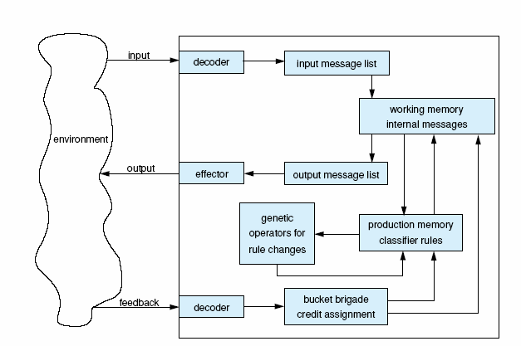
A Classifier System’s Architecture
The top decoder is
really a detector, it
accepts input to
the system from
the environment
The bottom
decoder receives
feedback from the
environment
based on the
response of the
system -- did
the system provide
a correct answer?
GA operators randomly alter rules selected by the
bucket brigade credit assignment module
(this module examines the rules and decides which rule(s)
led to erroneous behavior)

Slide 24
GA Application Areas
Scheduling – examples would include aircraft to the gates in an airport, employee work hours, tasks to available personnel or machines, etc
Design – use GAs to come up with a good design of component parts in a mechanical device or floor plan layouts, cell phone tower layouts, computer network layouts
Clustering – rather than using a clustering algorithm, find a reasonable fit of data into clusters through GAs
Code breaking – reduce the search space with GAs
Economics – use GAs to try to adjust an economic model to current spending trends
Neural networks – use GAs to provide initial random weights for a NN, particularly used in recurrent NNs
Optimization problems – use GAs for an approximate solution

Slide 25
Genetic Programming
Programming is a problem that we solve through design
GAs seem to be reasonable methods for solving design problems
can we use GAs to design programs? Yes, in a way
Genetic Programming is using the genetic operators to evolve computer programs
we have to change some of our GA ideas
what is the fitness of a program? how well it works
what is the “chromosome” of a program? a syntactic parse tree
what genetic operators make sense on a parse tree? cross-over, mutation and possibly inversion, but all within restrictions

Slide 26
Restrictions?
The goal of a genetic operation is to generate a program that can be run to test it for its fitness
therefore, the random changes cannot cause syntax errors
Consider using cross-over on the following two assignment statements
a = b * c; d = e + f;
if a, b, c are int and d, e, f are double, crossing these over will lead to a syntax error, for instance, we might wind up with a = b + f;
If we use inversion in an expression like
a + b * (c – d);
we might wind up with a + b (d – c) *;
While making a random mutation by changing an operator may make sense, other forms of mutation do not
a + b * c → a – b * c; (ok)
if(a > b) c++; → for(a > b) c++; (not ok)

Slide 27
The GP Cycle
Start with an initial set of program structures
not whole programs, just sets of code
The structures need to be checked in that they can be manipulated through operators
e.g., arithmetic expressions and operators, variables and literal values, conditions
Provide a fitness function
one possible approach is to examine the output and count the number of right and wrong answers when running the program
we might run the program on a file of 10 data and count the number of correct responses, 10 is a perfect score, 0 means it did nothing right
Repeat
randomly select some of the initial structures
randomly select some genetic operations to form new structures
evaluate each new program
select the fittest (or some combination of fittest and random or diverse)
Until a program is found that solves the problem with 0 errors

Slide 28
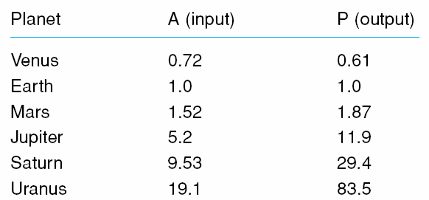
Example: Kepler’s Third Law
As an example, we want to evolve a program to solve Kepler’s third law of planetary motion
see the table of below
the actual equation to evolve is
P = sqrt(A³) = sqrt(A * A * A)
Assume we start with three programs that have differing assignment statements
P = A * (A * A – sqrt(A))
P = A / ((A / A) / (A / A))
P = A + sqrt(A) * A
We will use genetic operators on
the assignment statement portion
of the program only to evolve
a program that computes the
correct formula to fit the data

Slide 29
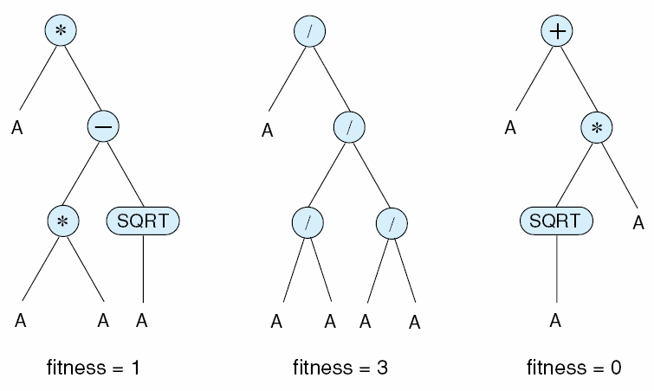
Continued
The three parse trees from the previous slide’s code are shown below
fitness is how many of the 6 data from the table when applied had correct output values (within a 20% error rate)

Slide 30
Genetic Operators
For cross-over
because all of the variables are the same (A) we don’t have to worry about type mismatches
because we are only dealing with expressions, we don’t have to worry about syntactically ill-formed expressions
If we choose mutation, we can replace an operator with another
+ becomes -, / becomes *, etc
we do need to ensure that we do not place
an expression that could evaluate to 0 in a denominator
an expression that could evaluate to a negative number in a sqrt function
we want to ensure our code will not cause run-time errors
With only a single variable, we will not mutate A into another variable
Inversion could change the order of a parse tree,
for instance, we could change the order of the subtrees for the first tree so that Sqrt(A) is performed first followed by A*A

Slide 31
Comments
As with many instances of using GAs, the previous example was not worth pursuing
we already knew the proper formula that we are trying to evolve, so writing the program would be easy
In a more general case, we could use GP to generate truly novel programs
we want a new sorting algorithm
our fitness function is based on the number of items correctly sorted AND the number of comparisons performed
we want a program that can monitor a nuclear power plant
we start by using code from monitoring systems of chemical processing plants, spacecraft, etc
our fitness function is based on the number of correct procedures that are run plus the number of emergency situations that are handled correctly

Slide 32
Example: GP For Othello
One idea is to use genetic operations to help evolve a proper heuristic for a computer game
as an example, there are many possible strategies for playing Othello
to write an AI system that uses best-first search to play Othello, we need to come up with a heuristic
which strategy (or strategies) do we want our system to apply?
Like the previous example, the basic program will stay the same
what we are evolving is the heuristic(s) to be used by the best-first search strategy
Initial heuristic strategies will be provided and manipulated through cross-over, inversion and mutation
The fitness function will consist of running the program multiple times against another AI Othello and count the number of wins

Slide 33
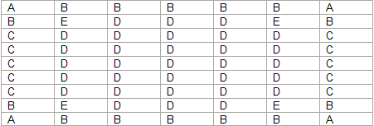
Heuristic Strategies
The Othello game was divided into five different regions as shown below for weights
for instance, region A is the most critical of the game so a piece in A is worth more than a piece anywhere else
The various heuristics were based on these strategies
player mobility (number of moves available)
value of game piece position (A, B, C, D, E)
number of pieces based on position

Slide 34
Using Operators on Other Code
For GP to really work, we will need to use GAs to manipulate control structures
mutation might change a while loop into a do loop
cross-over conditions in if statements
invert the if and else clauses
invert the order of function calls
We have to be careful here – what if we
mutated or inverted the order of parameters in a function call
crossed-over two different function calls
crossed-over an if statement with a nested if-else statement
inverted the order of the items in a for loop?
Each of these could result in syntax errors
wrong number or type of parameters
an else without an if
wrong type f structure for a for loop initialization or increment, etc

Slide 35
More Comments
There are some concerns about using GPs
from the Kepler example, the fitness function scored a program using a margin of 80% accuracy
would you feel comfortable running a program that was considered correct even though it only achieved 80% accuracy on its results?
the amount of randomness involved makes the search space enormous (basically, the search space is the space of all possible program configurations)
would you truly feel confident with a system that evolved rather than was programmed?
If we ever get this working perfectly, we will be putting ourselves out of a job!

Slide 36
Evolutionary Programming
In GAs and GPs, we use genetic operators to create children for a new generation
we always have several chromosomes/program code to work from
In evolutionary programming, we use our genetic operators as before, but we use them to manipulate a single program
we make a random change and see if that change is for the better, if so, we retain the new version, otherwise we return to the old version
This might seem like a set back
we will make slower progress in our search
However, we might use this approach if we start with an almost working program
For instance, we want to merely adapt a program to perform a similar task, or we have a moderate change in specification
modify a power plant monitoring program for a different plant
modify an automotive diagnostic system for the new version of the same car
Randomness may not lead to a fully working program so its debatable as to how useful this approach might be

Slide 37
What Does a GA Learn?
This chapter is under a section of material on machine learning
but does the GA truly learn?
in our examples, the output of the GA/GP/EP was a solution to a problem
we solved the CNF-Satisfiability or TSP problem
or we generated a new program
but the system did not learn a new structure (representation) or any new parameter values to improve its performance, or a new method of problem solving, unlike the various forms of learning we saw in chapters 10-11
so the idea of GAs as a method for learning is a little misleading unless the output of the GA is
a representation that is to be used by another system, in which case we are using the GA search to learn a proper representation
stored in a repository and re-used like we saw with case based reasoning

Slide 38
GA Hybrids
GAs can be used to evolve a better structure for a NN
for instance, we construct a few NNs of different structures (different number of hidden layers, different number of nodes in each layer)
we train the NNs and use the number of epochs and/or their performance after convergence as fitness function values to eventually evolve the best structure for the NN to solve the given problem
GAs can be used to evolve better fuzzy membership functions
we start with some basic membership functions and run a fuzzy logic controller
the fitness function used to evaluate a given membership function is how well the controller did
we randomly manipulate membership functions until we can improve it to a satisfactory point

