Slide 1
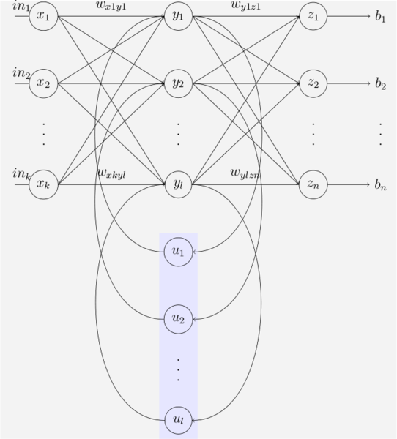
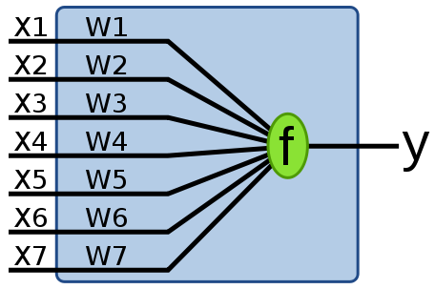
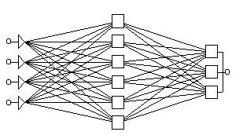
Neural Networks
NNs are a study of parallel and distributed processing systems (PDPs)
  the idea is that the representation is distributed across a network structure
    an individual node itself does not have meaning, or does not represent a concept, unlike a semantic network
    NN terminology is similar to that of neurology, but don’t confuse a NN and the brain, there are far more differences than similarities
    below are some example NN structures

Slide 2
NN Appeal
They are trained rather than programmed
  so development does not entail the cost of an expert system
They provide a form of graceful degradation
  if part of the representation is damaged (destroyed, removed), the performance degrades “gracefully” rather than completely as with a brittle expert system which might lack the proper knowledge
They are particularly useful at solving certain classes of problems
  low-level classification/recognition
  optimization
  content addressable memory
Most of these problems are very difficult to solve by expert system

Slide 3
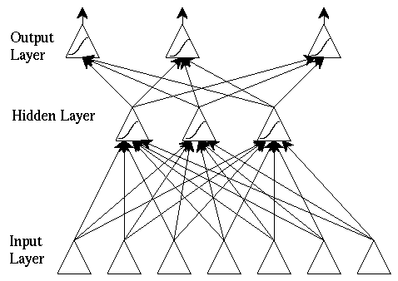
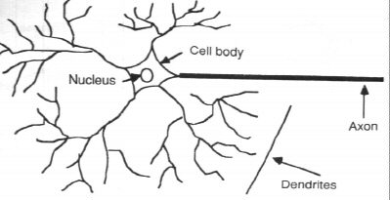
Inspiration from the Brain
NNs are inspired by the structure of neurons in the brain
  neurons connect to other neurons by synapses
  neurons will “fire” which sends electrochemical activity to neighboring neurons across synapses
    if the neuron excites another neuron, then the excited neuron has a greater chance to fire – such a connection (or link) is known as an excitation link
    if the neuron inhibits another neuron, then the inhibited neuron has less of a chance to fire – this is an inhibition link

Slide 4
NNs Are Not Brains
  The NN uses the idea of “spreading activation” to determine which nodes fire and which nodes do not
  The NN learns whether a node should excite or inhibit another node by adjusting the edge weights on the link between them
    but this analogy should not be taken too far!
NNs differ greatly in structure and learning algorithms, we will explore the earliest form for an introduction before looking at several newer and more useful forms
  the interesting aspects, as noted, are that NNs are trained rather than programmed
  that they are superior at solving certain low-level tasks than symbolic systems
  that they can achieve graceful degradation

Slide 5
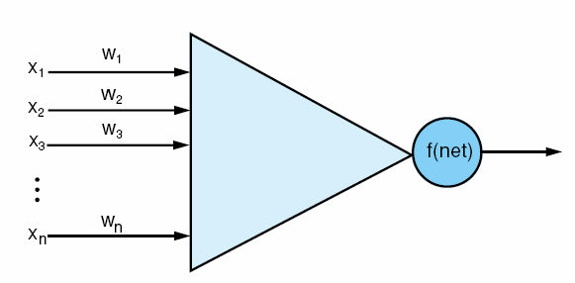
An Artificial Neuron
What should the values of
the weights be? These are
usually learned using
a training data set and
a learning algorithm
A neural network is a collection of artificial neurons
  the neuron responds to input, in this case coming from x1, x2, …, xn
  the neuron computes its output value, denoted here as f(net)
  the computation for f(net) takes the values of the inputs and multiplies each input by its corresponding weight
    x1*w1 + x2*w2 + … + xn*wn
  different types of neurons will use different activation functions with the simplest being
    if x1*w1 + x2*w2 + … + xn*wn >= t then f(net) = 1 else f(net) = -1

Slide 6
Early NNs
First proposed in 1943, the McCulloch-Pitts neuron uses the simple comparison shown on the previous slide for activation
The perceptron, introduced in 1958 is similar but has a learning algorithm so that the weights can be adjusted when training examples are used so that the perceptron learns
What the perceptron is learning is the proper weights on each edge so that the function f(net) properly computes whether an input is in a class or not
  if instance I is in the class, we expect the weights to be adjusted so that f(I) = 1 and if J is not in the class, we expect f(J) = -1

Slide 7
Perceptron Learning Algorithm
Let the expected output of the perceptron be d_{i}
Let the real output of the perceptron for this input be o_{i}
Let c be some constant training weight constant
Let x_{j} be the input value for input j
For training, repeat for each training example i
  w_{i} = (d_{i} – o_{i}) * x_{i}
  collect all w_{i} into a vector and then set Δw = Δw + Δw * c
  that is, w_{i} = w_{i} + c * (d_{i} - o_{i}) * x_{i} for each i
Repeat the training set until the weights are not changing
Notice that d_{j} – o_{j} will either be +2, 0, or -2
  so in fact we will always be altering the weights by +2*c, 0*c or -2*c
Note that in a perceptron, we add an n+1st input value with a weight of 1, known as the bias

Slide 8
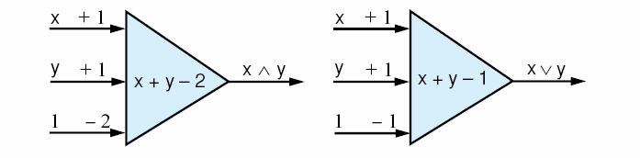
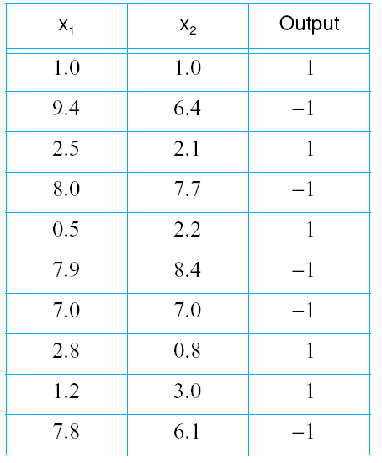
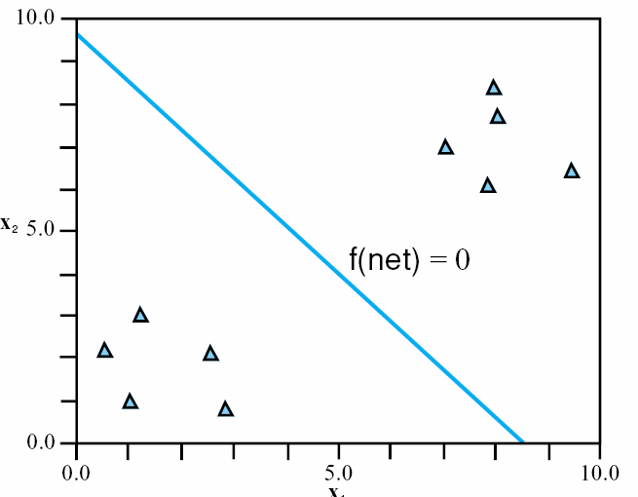
Examples
The above perceptrons perform the functions X AND Y and X OR Y
  notice that the weights have been pre-set, we would prefer to use the training algorithm instead
  the table on the
  right can be used
  to train a perceptron
  to output the desired
  value (this table
  represents the data
  points shown to
  the left)

Slide 9
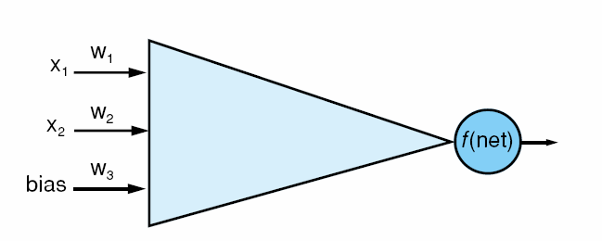
Learning the Weights
Given the previous table for data, we train the above perceptron as follows
  starting off with edge weights of [.75, .5, -.6] for w1, w2, w3 respectively and c = .2
    these weights are randomly generated
  f(data₁) = f(.75*1+.5*1+-.6*1) = 1 → correct answer, do not adjust the weights
  f(data₂) = f(.75*9.4 + .5*6.4+-.6*1) = 1 → incorrect answer, so adjust weights by -2*.2 = -.4 → [.75 + -.4*9.4, .5 + -.4*6.4, -.6 + -.4*1] = [-3.01, -2.06, -1.00]
  f(data₃) = f(3.01*2.5+-2.06*2.1+-1.00*1) = -1, incorrect answer, so adjust weights again by -.4 → [-3.01+-.4*2.5, -2.06+-.4*2.1, -1.00+-.4*1] = [-2.01, -1.22, -.60]

Slide 10
Continued
We do this for the entire training set (in this case, 10 data from the previous table)
  at this point, the weights have not become stable
  to be stable, the weights cannot change (more than some small amount) between training examples
So we repeat the entire process again, redoing each training example
For this example, it took 10 iterations of the entire training set before the edge weights became stable
  that is, the weights converge to a stable set of values
The final weights are [-1.3, -1.1, 10.9]
  this creates a formula for f(net) of
    1 if x1*-1.3 + x2*-1.1 + 1*10.9 >= 0
    0 otherwise

Slide 11
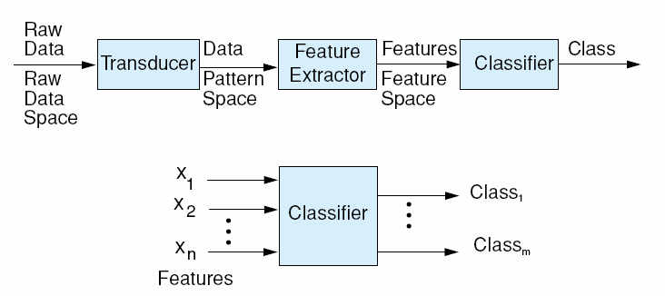
Perceptron Networks
The idea behind a single perceptron is that it can learn a simple function
  but a single perceptron can be one neuron in a larger neural network that can perform a larger operation based on lesser functions
  unfortunately, the perceptron learning algorithm can only train a single perceptron, not perceptrons connected into a network
The intention of a perceptron network is to
  have some perceptrons act as low-level data transformers
  have some perceptrons act as low level pattern matchers
  have some perceptrons act as feature detectors
  have some perceptrons act as classifiers

Slide 12
Linear Separability
Imagine the data as points in an n-dimensional space
  for instance, the figure below shows data points in a 2-D space (because each datum has two values, x1 and x2)
  what a perceptron is able to learn is a dividing point between data that are in the learned class and data that are not in the learned class
This only works if the division is
linearly separable
  in a 2-D case, it’s a simple line
  in a 3-D case, it’s a plane
  in a 4-D case, it’s a hyperplane
The figure to the right shows a line that separates the two sets of data
  those where the perceptron output is 1 (in the learned class) and those where the perceptron output is -1 (not in the learned class)

Slide 13
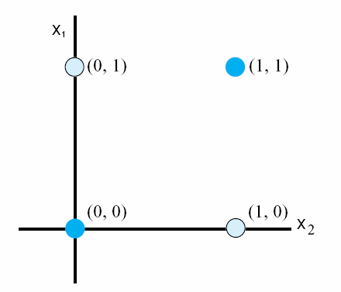
What Problems Are Linearly Separable?
This leads to a serious concern about perceptrons – just what problems are linearly separable?
  if a function is not linearly separable, a perceptron can’t learn it
  we have seen the functions X AND Y, X OR Y, and a function to classify the data in the previous figure are linearly separable
  what about the XOR function?
    see the figure to the right
There is no single line that
can separate the points where the
output is 1 from the points where
the output is 0!
    XOR cannot be learned by perceptron!
A perceptron network can solve XOR but we cannot train an entire network

Slide 14
Threshold Functions
The perceptron provides a binary output based on whether the function computed (x1*w1+x2*w2+…) >= t or <t
  such a function is known as a linear threshold (or a bipolar linear threshold)
When we connect multiple neurons together to form a perceptron network, we may want to allow for perceptron nodes to output other values, for instance, values in between the extremes
To accomplish this, we need a different threshold function
The most common threshold function is known as the sigmoid function
  This not only gives us “in-between” responses, but is also a continuous function, which will be important for our new training algorithm covered next
The sigmoid function is denoted as 1/(1+e^{-gamma*net})
  where net is again the summation of the inputs * weights
    x1 * w1 + x2 * w2 + x3 * w3 + … xn * wn
  and gamma is a “squashing parameter, often set to 1”

Slide 15
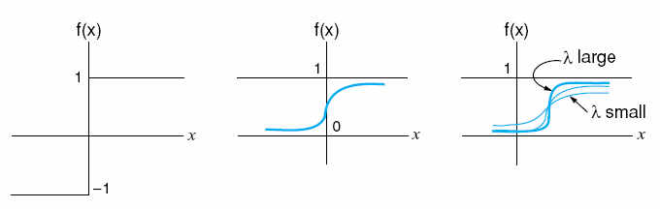
Comparing Threshold Functions
a squashed sigmoid function makes the
steepness more pronounced
  In the sigmoid function, output is a real number between 1 and 0
    the slope increases dramatically near the threshold point but is much more shallow once you get beyond the threshold
    for instance net = 0 means 1 / (1 + e⁻⁰) = ½
    net = 100 means 1 / (1 + e⁻¹⁰⁰) which is nearly 1
    net = -100 means 1 / (1 + e¹⁰⁰) which is nearly 0

Slide 16
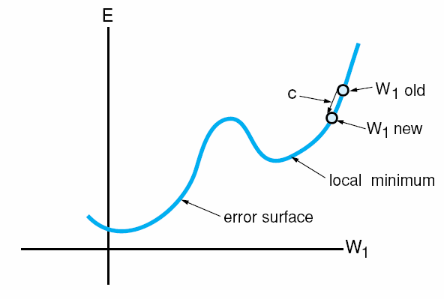
Gradient Descent Learning
Imagine that the n edge weights of a perceptron are plotted in an n+1 dimensional space where one axis represents the error rate of the perceptron
  the optimal value of those edge weights represents the weights that will ensure that the perceptron is always correct (no error)
  we want a learning algorithm that will move the edge weights closer and closer to that optimal location
    this is a process called gradient descent – see the figure below
  the idea is to minimize the error
  for a perceptron, we can guarantee that we will reach the global minima (the best set of values for the edge weights) after enough training iterations
  but for other forms of neural networks, training might cause the edge weights to descend to a local minima

Slide 17
Delta Rule
Many of the training algorithms will take a partial differential of the summation value used to compute activation (what we have referred to as f(net))
  we have to move from the bipolar linear threshold of the perceptron to the sigmoid function because the linear threshold function is not a continuous function
We will skip over most of the math, but here’s the basic idea, with respect to the perceptron using the sigmoid function
  weight adjustment for the edges into perceptron node i is
  c * (d_{i} – O_{i}) * f’(net_{i}) x_{j}
    c is the constant training rate of adjustment
    d_{i} is the value we expect out of the perceptron
    O_{i} is the actual output of the perceptron
    f is the threshold function so f’ is its partial derivative
    x_{j} is the jth input into the perceptron

Slide 18
Feed-Forward Back-Propagation Network
The most common form of NN today is the feed-forward network
  we have layers of perceptrons where each layer is completely connected to the next layer and the preceeding layer
  each node is a perceptron whose activiation function is the sigmoid function
We train the network using an algorithm called back-propagation
  so the network is sometimes referred to as a feed-forward back-prop network
  unlike a perceptron network, all of the edge weights in this network can be trained because the back-prop algorithm is more powerful, but it is not guaranteed to learn, and may in fact get stuck in a local minima

Slide 19
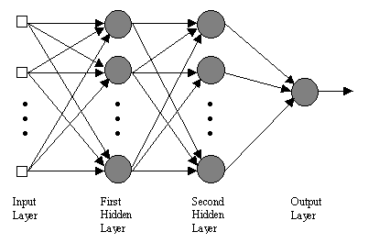
The FF/BP Network
The network consists of some number of input nodes, most likely binary inputs, one for each feature in the domain
There is at least one hidden layer, possibly more
  the network is strongly connected between layers
  an edge between every pair of nodes between two consecutive layers
Most likely, there will be multiple output nodes, one for each class being recognized
The output node(s) will deliver a real value
between 0 and 1 but not exactly 0 or 1, so
we might assume the highest valued output
node is the proper class if we have separate
nodes for every class being recognized

Slide 20
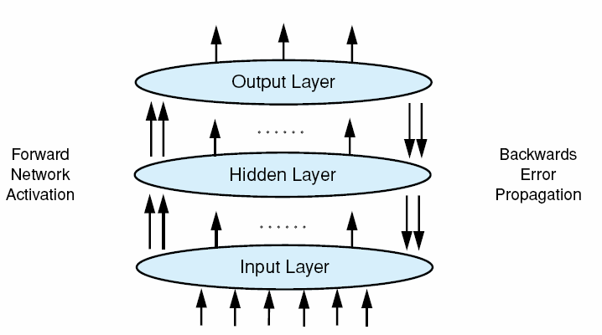
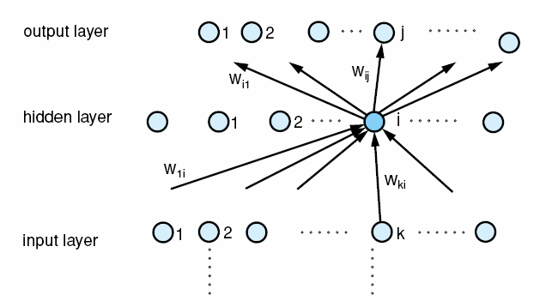
Training
For each item in the training set
  take the input values and compute the activation value for each node in the first hidden layer
  pass those values forward so that node w_{ki} gets its input from the previous layer and broadcasts its results to the next layer
  continue to feed values forward until you reach the output layer
  compute what the output should have been
  back propagate the error to the previous level, adjusting weights
  continue to back propagate errors to prior levels until you reach the final set of weights
Repeat until training set is complete
  if the edge weights have not reached a stable state, repeat

Slide 21
More Details
The output of any node (aside from the input nodes which are 1 or 0) are computed as
  f(net) = 1 / (1 + e^{-g*net})
  where g is the “squashing parameter” and can be 1 if desired (note: in the book, g is the Greek letter gamma)
  and net is the summation x_{i}*w_{i} for all i
    recall for the perceptron, f(net) was either -1 or +1
    here, f(net) will be a real number > 0 and <= 1
Compute the error for the edge weight from node k to output i to readjust the weight
  weight_{ki} = weight_{ki} + -c * (d_{i} – O_{i}) * O_{i} * (1 – O_{i}) * x_{k}
    c is the training constant
    d_{i} is the expected value of the output node I
    O_{i} is the actual value computed for node I
    x_{k} is the value of node x_{k} from the previous layer

Slide 22
The Hidden Layer Nodes
What about correcting the edge weights leading to hidden layer nodes?
  this takes some extra work
In a perceptron network, a node represented a classifier
In a FF/BP network
  input nodes represent whether an input feature is present or not
  output nodes represent the final value of the network (for instance, which of n classes the input was classified as)
  but hidden layer nodes don’t represent anything specifically
    unlike a semantic network or perceptron network or any other form of network that we have investigated where a node represents something

Slide 23
Continued
A node in a hidden layer makes up a subsymbolic representation
  it is a contributing factor toward recognizing whether something is in a class or not, but does not itself represent a specific feature or category
When correcting the output layer’s weights (that is, the weights from the last hidden layer to the output layer), we know what an output node’s value should be
  for instance, if we are trying a cat example, then the dog node should output a 0, if it output a non-zero value, we know it is wrong
To correct a hidden layer node, k, we need to know what the output of i should have been (d_{i})
  but since the node doesn’t represent anything specific (a calss, a feature), how do we know what the value should have been?
  so we need to use a different approach when adjusting weights of hidden layer nodes

Slide 24
Training a Hidden Layer Node
Since we don’t know what di should be, we can’t use it to compute d_{i} – O_{i} as we did with the output layer
  this is where the partial differential of the error rate (the delta rule) comes in
For a hidden layer node i, we adjust the weight from node k of the previous (lower) level as
w_{ik} = w_{ik} + -c * O_{i} * (1 – O_{i}) * Sum_{j} (- delta_{j} * w_{ij}) * x_{k}
  where Sum_{j} adds up all of the errors * edge weights of edges coming out of node i to the next level (-delta_{j} is the error from the jth node in the next level that this node connects too)
  the error is either the error directly computed if the next level is an output level, or the error computed using the above formula if it is a hidden layer
    in a network with a single hidden layer, the value of deltaj is merely the error of output node j, which is merely (d_{j} – O_{j})
  note that the minus signs in -c and -delta will cancel giving us
w_{ik} = w_{ik} + c * O_{i} * (1 – O_{i}) * Sum_{j} (delta_{j} * w_{ij}) * x_{k}

Slide 25
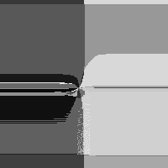
Training the NN
While a perceptron can often be trained using a few training examples, the NN requires dozens to hundreds of training examples
  one iteration through the entire training set is called an epoch
  it usually takes hundreds or thousands of epochs to train a NN
    with 50 training examples, if it takes 1,000 epochs for edge weights to converge, then you would run the algorithm 20,000 times!
The interesting thing to note about a NN is that the training time is deeply affected by initial conditions
  size, shape of the NN or initial weights
  The figure to the right, although not very clear, demonstrates training a 2x2x1 NN to compute XOR using different starting conditions where the shade of grey represent approximate number of epochs required
  A slight change to the initial conditions can result in a drastically changed training time

Slide 26
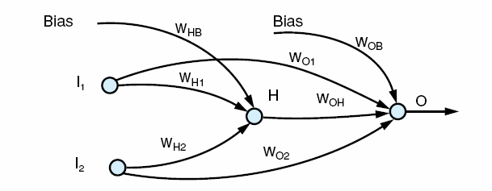
FF/BP Example: Learning XOR
A perceptron cannot learn XOR and a perceptron network does not learn at all (we can build a perceptron network with weights in place, but we derive those weights)
Here is a FF/BP net that learns XOR
Our training set is multiple instances of the same 4 data
  [0, 0] → 0
  [1, 0] → 1
  [0, 1] → 1
  [1, 1] → 0
Initial weights are
  W_{H1} = -7, W_{H2} = -7
  W_{HB} = 2.6, W_{OB} = 7
  W_{O1} = -5, W_{O2} = -4,
  W_{HO} = -11
The network converges in 1400 epochs
Notice that the input nodes go to both the hidden layer and the output node adding two extra edge weights and both layers have a bias
See pages 473-474 for some examples of how the values are fed forward

Slide 27
FF/BP Example: NETtalk
English pronunciation for a given letter (phoneme) depends in part on the phonemes that surround it
  for instance, the “th” in “with” differs from “the” and “wither”
NETtalk is a program that uses a neural network to generate what an output should sound like
  input is a window of 7 letters (each represented one of 29 phonemic sounds) – so the input is 7*29 nodes
    the desired sound is the middle of the 7 letters, for instance if the input is “– a – c a t –” then we are looking for the sound for the “c”
      “–” represent word boundaries
  there is a hidden layer of 80 nodes including 1 bias node
  the output consists of 21 phonetic sounds and 5 other values that indicate stress and syllable boundary
  the network consists of 18,629 edges/edge weights
NETtalk was trained in 100 epochs and achieved an accuracy of about 60%
  ID3 was trained with the same data set (ID3 only performs 1 pass through the training set) and achieved similar results

Slide 28
Competitive Learning
A “winner-take-all” competitive form of learning can be applied to FF networks without using the reinforcement step of backprop
  when an example is first introduced, the output node with the highest value is selected as a “winner”
  edge weights from node i to this output node are adjusted by c*(x_{i} – w_{i})
    c is our training constant
    x_{i} is the value of input node i
    w_{i} is the previous edge weight from node i to this node
We are strengthening the connection of this input pattern to this node
If input patterns differ sufficiently, different output nodes will be strengthened for different types of inputs
  the common application for this learning algorithm is to build self-organizing networks (or maps), often called Kohonen networks

Slide 29
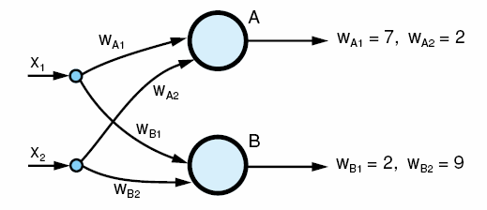
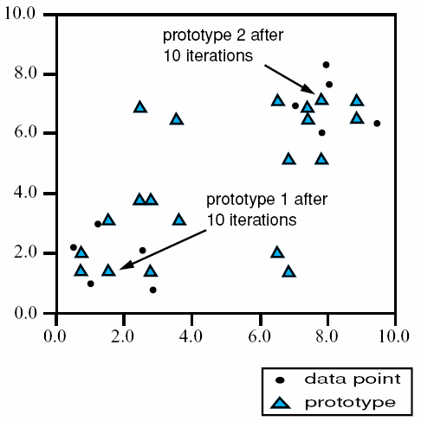
Example: Clustering
Using the data from our previous clustering example
  the Kohonen network to the left learns to classify the data clusters as prototype 1 (node A) and prototype 2 (node B)
  over time, the network organizes itself so that one node represents one cluster and the other node represents the other cluster
Like the clustering algorithm mentioned in chapter 10, this is an example of unsupervised learning
See page 477-478 for example iterations of the
training of this network

Slide 30
Support Vector Machines
SVMs are not actually neural networks but they act similar to perceptrons so we briefly cover them here
An SVM uses a set of data points to learn a separation point between data in a class versus not in the class
  the SVM typically uses linear regression analysis by comparing the data points in versus not in the class
This separation point is an n-dimensional hyperplane where each data point has n values – we refer to the SVM as a linear classifier
  this is the same as a perceptron
Recall that what doomed the perceptron was the discovery that most problems are not linearly separable

Slide 31
Why SVMs?
Given that an SVM does the same thing as a perceptron (in a different way), why would SVMs be of any interest?
Two reasons
  first, the SVM does not guarantee that the hyperplane completely subdivides the data into “ins” versus “outs”, instead it attempts to create a hyperplane which gives the best probability of being correct – this is known as a soft margin
  second, while a hyperplane in n dimensions may not be possible, a hyperplane of fewer dimensions is, the SVM uses various transformation algorithms to reduce the dimensionality of the problem into one where a hyperplane can be fitted – this is known as a kernel trick
    the most common kernel functions are polynomial functions, Gaussian distribution-based (radial basis) functions and hyperbolic tangent functions

Slide 32
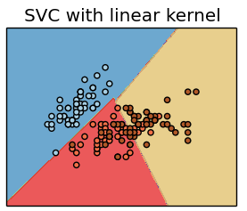
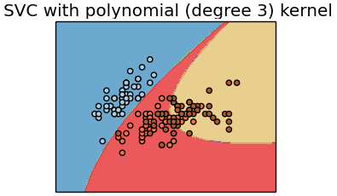
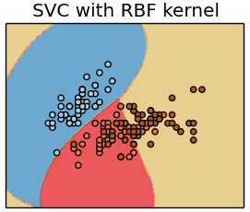
Example
Here we see the result of applying 4 different kernels to a collection of data
  Notice the linear kernel only creates hyperplanes while the polynomial kernel creates curves and the RBF (radial basis function) kernel creates a more complex geometric shape

Slide 33
Variations of SVMs
The SVM doesn’t have to be limited to “ins” versus “outs” but instead is often used to classify between one of two classes
  this doesn’t need anything special in that we might consider the data in class 1 to be the “ins” and the data in class 2 to be the “outs”
Multiclass SVMs are really just a collection of SVMs, one per class being learned
  that is, each SVM is a binary classifier (a datum is in that class or it is not)
  the collection of SVMs then should lead to any datum being classified by exactly one in the collection
Transductive SVMs use semi-supervised learning
  only some of the data in the training set is correctly classified, the rest is unclassified
  these types of SVMs are often used in natural language understanding situations where we don’t have the ability to clearly annotate every training sentence

Slide 34
SVM Applications
There are a number of different reasons to use SVMs but to date, their biggest AI uses have been
  Text mining – for instance, classifying the grammatical role of a word in a sentence (verb, noun, adverb, etc)
  Image classification
  Hand-written character classification
  Classification of proteins in medical science
  Disease classification (e.g., cancer diagnosis)
  Financial forecasting and decision trees
  Speaker recognition (i.e., identifying a speaker, not the words)
  Prediction of traffic patterns
  Computer system intrusion detection
  Environment sciences data analysis
  Optimization problems

Slide 35
Coincidence Learning
This is a condition-response form of learning
In this type of learning, there are two sets of inputs
  the first set is a condition that should elicit the desired response
  the second set of inputs is a second condition that needs to learn the same response as the first set of inputs
The author, by way of an example, uses the Pavlovian example of training a dog to salivated at the sound of a bell no matter if there is food present or not
  initially, the dog salivates when food is present
  a bell is chimed whenever food is presented so that the dog becomes conditioned to salivate whenever the bell chimes
  once conditioned, the dog salivates at the sound of the bell whether food is present or not

Slide 36
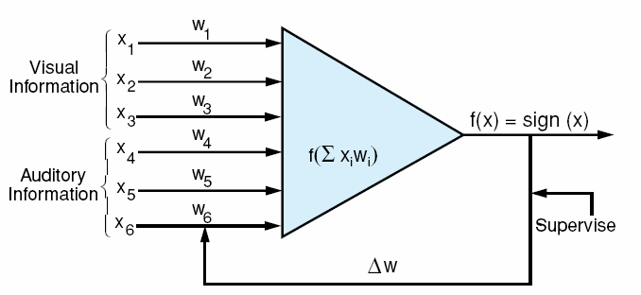
Hebbian Network
A Hebbian network (see below) is used for this form of learning
  the top three inputs below represent the initial condition that we learn first
  once learned, the task is for the network to learn the weights for the bottom three inputs so that a different input condition will elicit the same output response
We will use Hebbian learning in both supervised and unsupervised ways

Slide 37
Unsupervised Hebbian Learning
Assume the network is already trained on the initial condition (e.g., sight of food)
And we train it on the second condition (e.g., sound of a bell)
  the first set of edge weights are stable, we will not adjust those
  the second set of edge weights are initialized randomly (or to all 0s)
Provide training examples that include both initial and new conditions
But update only the second set of edge weights
  using the formula: w_{i} = w_{i} + c * f(X, W) * x_{i}
    w_{i} is the current edge weight
    c is the training constant
    f(X, W) is the output of the node (a +1 or a -1)
    x_{i} is the input value
What we are in essence doing here is altering the latter set of edge weights to respond in the same way as the first set of edge weights when the training example contains the same condition for both sets of inputs
  the book steps through an example on pages 486-488

Slide 38
Supervised Hebbian Learning
Here, we want the network to learn associations
  map an input to an output
  we already know the associations
Use a single layered network where inputs map directly to outputs
  the network will be fully connected with n inputs and m outputs
We do not need to train our edge weights but instead compute them using a simple vector dot product of the training examples combined
  the formula to determine the edge weight from input i to output k is Δw_{ik} = c * d_{k} * x_{i}
  where c is our training constant
  d_{k} is the desired output of the kth output node and x_{i} is the ith input
We can compute a vector to adjust all weights as once with
  ΔW = c * Y * X
  where W is the vector of weights and Y * X is the outer product of a matrix that stores the associations (see the next slide)

Slide 39
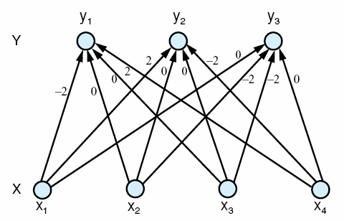

Example
We have the following two associations
  [1, -1, -1, -1] → [-1, 1, 1]
  [-1, -1, -1, 1] → [1, -1, 1]
That is, input of x1 = 1, x2 = -1, x3 = -1 and x4 = -1 should provide the output of y1 = -1, y2 = 1, y3 = 1
The resulting network is shown to the right – notice every weight is either +2, 0 or -2
  this is computed using the matrix sum shown to the right

Slide 40
Associative Memories
Supervised Hebbian networks are forms of linear associators
  heteroassociative – the output provided by the linear associator is based on whatever vector the input comes closest to matching
  autoassociative – same as above except that if an input matches an exact training input, the same answer is provided
    this form of associator gives us the ability to map near matches to the same output – that is, to handle mildly degraded input
  interpolative – if the input is not an exact match of an association input, then the output is altered based on the distance from the input

Slide 41
More on Interpolative Associators
This associator must compute the difference (or distance) between the input and the learned patterns
The closest match will be “picked” to generate an output
  closeness is defined by Hamming distance – the number of mismatches between an association input and a given input
    if our input is [1, 1, -1, 1, 1, -1], then
    [1, 1, -1, -1, 1, -1] has a distance of 1 from the above example
    [1, 1, -1, -1, -1, 1] has a distnace of 3 from the above example
  for instance, if the above input pattern maps to output pattern [1, 1, 1] and we introduce an input that nearly matches the above, then the output will be close to [1, 1, 1] but may be slightly altered

Slide 42
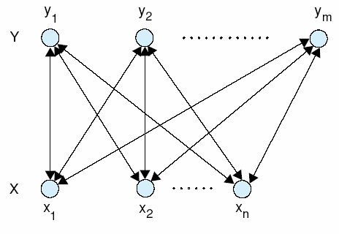
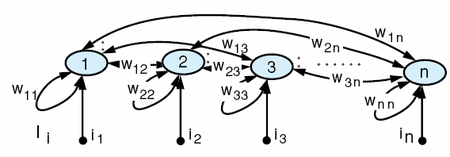
Attractor Networks
The preceding forms of NNs were all feed-forward types
  given input, values are propagated forward to compute the result
A Bi-directional Associative Memory (BAM) consists of bi-directional edges so that information can flow in either direction
  nodes can also have recurrent edges – that is, edges that connect to themselves
  two different BAM networks are shown below

Slide 43
Using a BAM Network
Since the BAM network has bidirectional edges, propagation moves in both directions, first from one layer to another, and then back to the first layer
  we need edge weights for both directions of an edge, w_{ij} = w_{ji} for all edges
Propagation continues until the nodes are no longer changing values
  that is, once all nodes stay the same for one cycle (a stable state)
We use BAM networks as attractor networks which provide a form of content addressable memory
  given an input, we reach the nearest stable state
Edge weights are worked out in advance without training by computing a vector matrix
  this is the same process as the linear associator

Slide 44
Using a BAM Network
Introduce an input and propagate to the other layer
  a node’s activation (state) will be
    = 1 if its activation function value > 0
    stay the same state if its activation function value = 0
    = -1 if its activation function value < 0
  take the activation values (states) of the computed layer and use them as input and feed back into the previous layer to modify those nodes’ states
  repeat until a full iteration occurs where no node changes state – this is a stable state – the output is whatever the non-input layer values are indicating
Notice that we have moved from FF/BP training to FF/BP activations for this form of network
  the book offers an example if you are interested

Slide 45
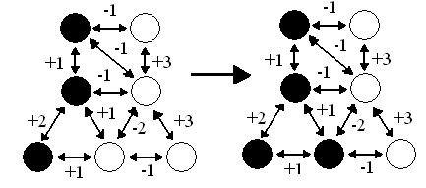
Hopfield Network
This is a form of BAM network
  in this case, the Hopfield network has four stable states
    no matter what input is introduced, the network will settle into one of these four states
  the idea is that this becomes a content addressable, or autoassociative memory
    the stable state we reach is whatever state is “closest” to the input
      closest here is not defined by Hamming distance but instead by minimal energy – the least amount of work to reach a stable state
Two of the four stable
states for this Hopfield
network are shown
to the right (a third
stable state has all
nodes being off (white)

Slide 46
Recurrent Networks
One problem with NNs as presented so far is that the input represents a “snapshot” of a situation
  what happens if the situation is dynamic or where one state can influence the next state?
    in speech recognition, we do not merely want to classify a sound based on this time slice of acoustic data, we need to also feed in the last state because it can influence this sound
  in a recurrent network, we take or ordinary multi-layered FF/BP network and wrap the output nodes into some of (or all of) the input nodes
    in this way, some of the input nodes represent “the last state” and other input nodes represent “the input for the new state”
  recurrent networks are a good deal more complex than ordinary multi-layered networks and so training them is more challenging

Slide 47
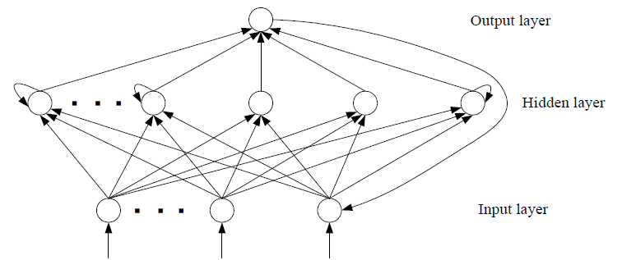
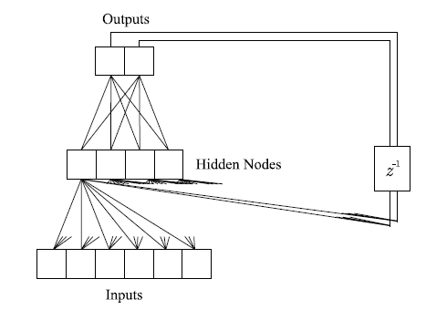
Examples
Above, the recurrence takes the
single output value and feed it
into a single input node
To the right, the outputs are fed
into hidden layer nodes instead
of input nodes

Slide 48
Strengths of NNs
Through training, the NN learns to solve a problem without the need for a lot of programming
  in fact, while training times might be hours to days, this is far better than the expert systems that take several man-years
Capable of solving low level recognition problems where knowledge is not readily available
  we have had a lot of difficulty building symbolic recognition systems for speech recognition, character recognition, visual recognition, etc
Can solve optimization problems
Able to handle fuzziness and ambiguity
Uses distributed representations for graceful degradation
Capable of supervised & unsupervised learning

Slide 49
Weaknesses of NNs
Unpredictable training behavior
  changes to initial conditions can cause training times to vary greatly
  not possible to know what structure a FF/BP network should have to achieve the accuracy desired
    10x20x5 network might have vastly different performance than a 10x21x5 network
Most NNs are often unable to cope with problems that have dynamic input (input that changes over time)
  fixed-size input restricts dynamic changes in the problem
NNs are not process-oriented so that they are unable to solve many classes of problems (e.g., design, diagnosis)
NNs cannot use symbolic knowledge
May overgeneralize if training set is biased and may specialize too much if overtrained
Once trained, the NN is locked, so it cannot learn over time like symbolic approaches

Slide 50
Hybrid NNs
NN strengths are used mostly in areas where symbolic approaches have weaknesses
  can we combine the two?
NNs are not capable of handling many knowledge-intensive problems or process-specific problem
  but symbolic systems often cannot perform low-level recognition or learning
some example approaches are to
  use NNs as low-level feature detectors in problems like speech recognition and visual recognition combining them with rules or HMMs
  use NNs to train membership functions to be used by fuzzy controllers
  use NNs for nonlinear modeling, feeding results into a genetic algorithm to provide an optimal solution to the problem

Slide 51
NNs are Not Brains Redux
In the brain, an individual neuron is either an excitory or inhibitory neuron, in a NN, a neuron may excite some neurons and inhibit others
In the brain, neuron firing rates range from a few firings per second to as many as 500 and the firing is asynchronous but in a NN, firings are completely dictated by the FF algorithm and the machine’s clock cycle speed
There are different types of neurons in the brain with some being specialized (for tasks like vision or speech) whereas all NN neurons are identical and the only difference lies in the edge weights
There are at least 150 billion neurons in a brain with as many as 1000 to 10000 connections per neuron and neurons are not connected symmetrically or fully connected unlike in a NN which will usually have no more than a few hundred neurons
A NN will learn a task and then stop learning (remaining static from that point forward), the brain is always learning and changing

