Slide 1
Learning
Learning is a very broad topic and so we cover it in parts
machine learning implies that a machine will learn how to do something new but this is not quite accurate – what is it that the machine is to learn?
is there a process in place and the machine needs to learn domain knowledge?
is there a model in place but the process needs to be learned?
does the problem solver need to refine its knowledge?
According to Simon (recall the PSS hypothesis), learning is “any change in a system that allows it to perform better the second time on repetition of the same task or on another task drawn from the same population”
In machine learning, we are talking about modifying either the inference engine or knowledge base of our AI system or some combination of the two

Slide 2
A Spectrum of Types
Learning encompasses a vast spectrum of types
At one extreme is skill refinement
the system already knows how to solve a given problem but through experience it improves either by becoming more efficient at the task or more accurate (or even across a wider range of problems)
At the other extreme is knowledge acquisition
the system does not have the proper knowledge in place and must learn it
this might be learning from scratch, or adding related knowledge to what it already knows
for instance, a medical diagnostic system may know about liver disease but then expands to learn about heart disease

Slide 3
Spectrum of Learning Types
Caching and new cases: just adding input-output combinations
Chunking – possibly generalizing of what a group of I/O cases convey
Refinement – adjustment what we already know to improve
usually done while problem solving based on feedback
Knowledge acquisition – learning beyond what we already know
may be done while problem solving, more often done based on reading or when introduced to a new topic

Slide 4
Another Way to View Learning
Supervised – when learning, is someone giving you feedback?
You did this wrong
Or more specifically, this is where you went wrong
And possibly accompanies by feedback that tells you how to solve the problem
Unsupervised – no feedback
You are given enough information/knowledge to discover your own internal structures of the information/knowledge
Humans learn using both approaches but humans start with a base of knowledge to build upon
In AI, supervised learning is far easier than unsupervised learning and unsupervised learning may not actually accomplish what we want

Slide 5
What We Will Study
There are many different algorithms and approaches for learning based on what type of knowledge representation is being used
In this chapter, we focus on symbolic learning
learning concepts that are represented symbolically
we start by looking at two inductive forms
representations are learned by examining positive and negative instances one at a time
In chapter 11, we focus on subsymbolic forms of learning (neural networks)
In chapter 12, we focus on the genetic algorithm and its related forms – this may or may not be considered learning
In chapter 13, we look at probabilistic forms of learning, which may or may not be considered learning as well

Slide 6
Learning Within a Concept Space
Consider: we already know a concept space
the features used to represent classes (and the range of values each feature can take on)
our task is to learn the proper values for the features for a given class/concept by examining a series of examples
This is inductive learning
Winston introduced an approach in the 1970s using semantic network representations
instances are hits and near misses of a class
working one example at a time, a class representation is formed by manipulating a target semantic network
generalizing the network when a positive instance is examined
specializing the network when a negative instance is examined
he used the blocks world domain, and his famous example is to represent what makes up an arch using three blocks

Slide 7
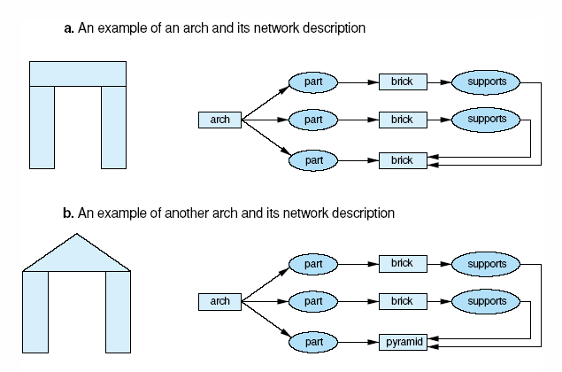
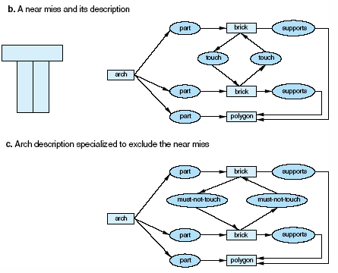
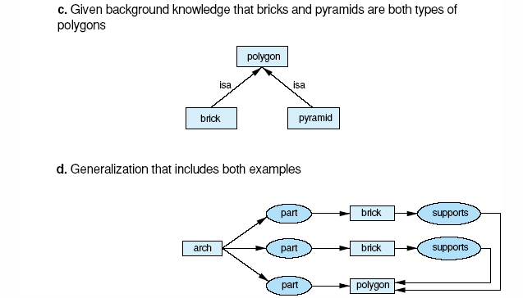
Learning the Arch Concept
We start with a description of an arch in part a and introduce a second arch in part b, using knowledge that both a brick and a pyramid are polygons, we generalize to part d
A near miss is shown above in part b allowing us to specialize in part c

Slide 8
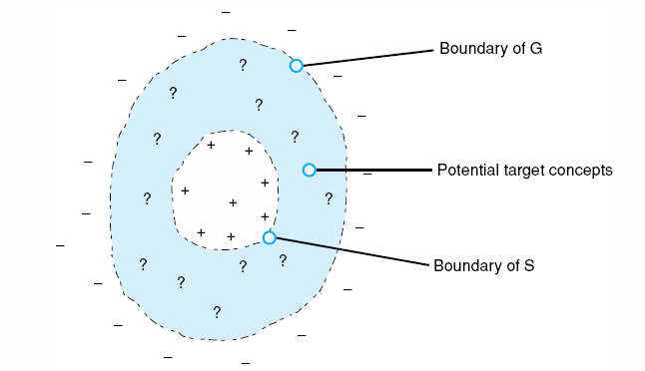
Version Space Search
Mitchell offered an improved learning approach called Candidate Elimination similar to Winston’s but with two representations
a general description (G) of the concept specialized to avoid containing any negative examples
a specific description (S) of the concept generalized to encompass all positive examples
process iterates over + and - examples
specialize G with - ex
generalize S with + ex
until the two representations are equal
or until they become empty, in which case the examples do not lead to a single representation for the given class

Slide 9
The Algorithm

Slide 10
How It Works
There are generalization operators
replace a constant with a variable
color(ball, red) → color(X, red)
drop a condition
shape(X, round) ^ size(X, small) ^ color(X, red) → shape(X, round) ^ color(X, red)
add a disjunct
shape(X, round) ^ size(X, small) ^ color(X, red) → shape(X, round) ^ size(X, small) ^ (color(X, red) v color(X, blue))
replace a property with a more generalized version
color(X, red) → color(X, primary_color)
in the arch example, we used this to go from an instance that was a brick and an instance that was a pyramid to the more generic polygon, we need to have a predefined hierarchy of classes

Slide 11
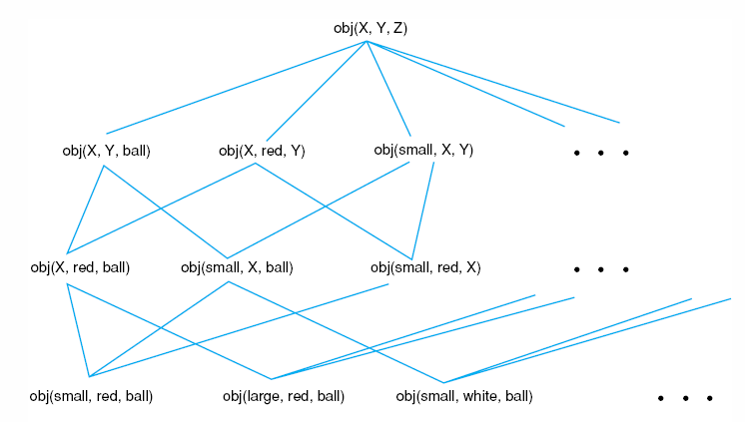
Example
Our domain will be of objects that have attributes of size, color shape
The possible values of these attributes make up our concept space
We want to learn the proper portion of the concept space that contains our positive examples and does not include any negative examples
Examples to introduce might include:
+ small, red, ball
- small, blue, ball
+ large, red, ball
- large, red, cube

Slide 12
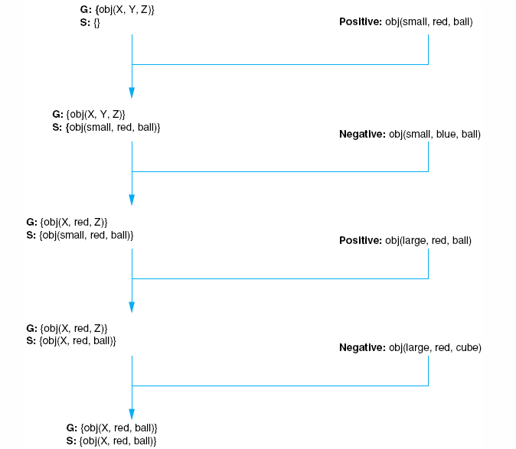
Example Continued
How useful is this
algorithm? After
introducing positive
and negative
examples, we are
able to represent
the concept as
objects that are
red balls

Slide 13
Problems
Both of the algorithms rely on having classes that can be clearly segmented by features in the concept space
consider a class called “good car deal” which uses features of “year”, “price”, “blue book value”, “mileage”, “wear and tear”
would we be able to form a single representation that denoted for each feature, what value(s) a good car deal should have?
consider for diagnosing the flu
would all patients have the same symptoms?
would the patients have enough overlapping symptoms to clearly identify flu over cold or sinus infection?
These two algorithms also suffer from inductive bias
the order that examples are offered could influence the amount of time it takes to reach a final representation
And of course, since both are search oriented processes, they suffer from combinatoric problems

Slide 14
LEX: Learning Heuristics
To focus on a concrete example, the author shows us LEX
LEX solves integration (calculus) problems through best-first search
There are four operators to select between where the operators are generic and so must be unified to aspects of the current problem state
e.g., convert the value 3 x² into r x² or 3 f(x) by unifying 3 to r or x² to f(x)
thus, there are more than 4 choices to make
LEX learns and improves on heuristics to guide the best-first search
LEX uses candidate elimination to take multiple heuristics that seem to be of the same “family” and attempts to generalize them while also removing elements of a generalized heuristic which fails to improve on the search process

Slide 15
How LEX Works
The four operators that LEX employs are
To move any constant in front of the integration
To employ integration by parts
To perform mathematical calculations to simplify a term
To separate a sum in an integration to a sum of two (or more integrations)
There are four parts to LEX
generalizer – to use candidate elimination on heuristics
problem solver – to actually perform the best-first search and apply the operators to the integration problem
critic – produces positive and negative heuristic instances from the problem solver for use by the generalizer
problem generator – to generate a new problem to solve

Slide 16
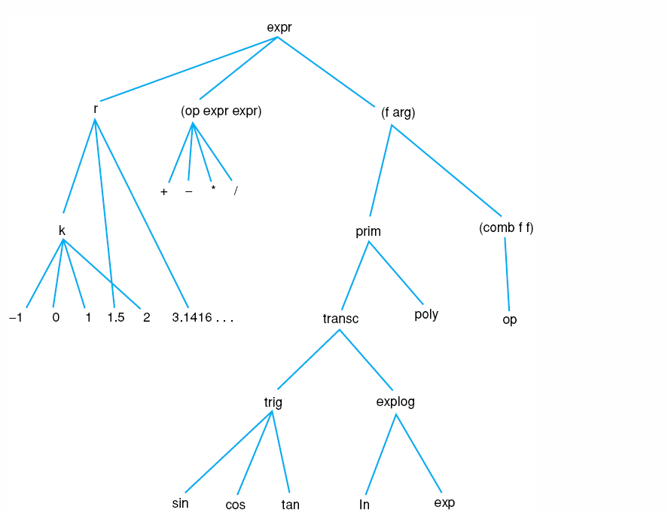
LEX’s Hierarchy of Concepts (partial)
From here, we
can generalize
that some
constant
value becomes
k and some
cosine function
becomes “trig” or
“transandental”

Slide 17
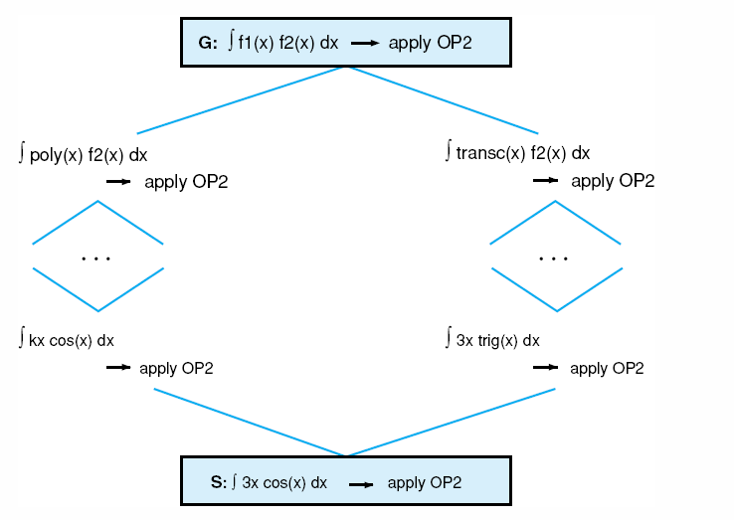
Concept Space For Integration by Parts
LEX was able to
learn heuristics
that reduced its
search from 200
steps to 20

Slide 18
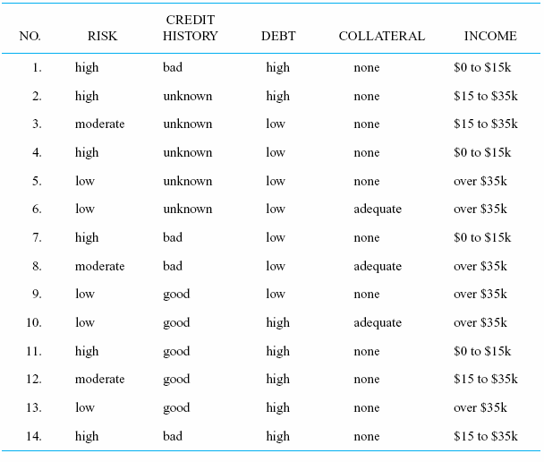
Learning Decision Trees
The decision tree is a tree that has questions as its nodes and conclusions as leaf nodes (diagnostic conclusions, decisions)
the process is to follow a path based on user responses
Quinlan introduced an inductive learning algorithm to automate the construction of decision trees given data of specific decision cases
see the data to the right which shows the proper decision of whether a person is a high, moderate or low credit risk based on credit history, debt, collateral and income

Slide 19
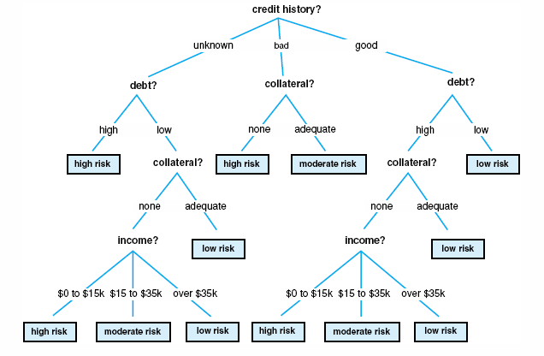
Decision Tree Formed From the Data

Slide 20
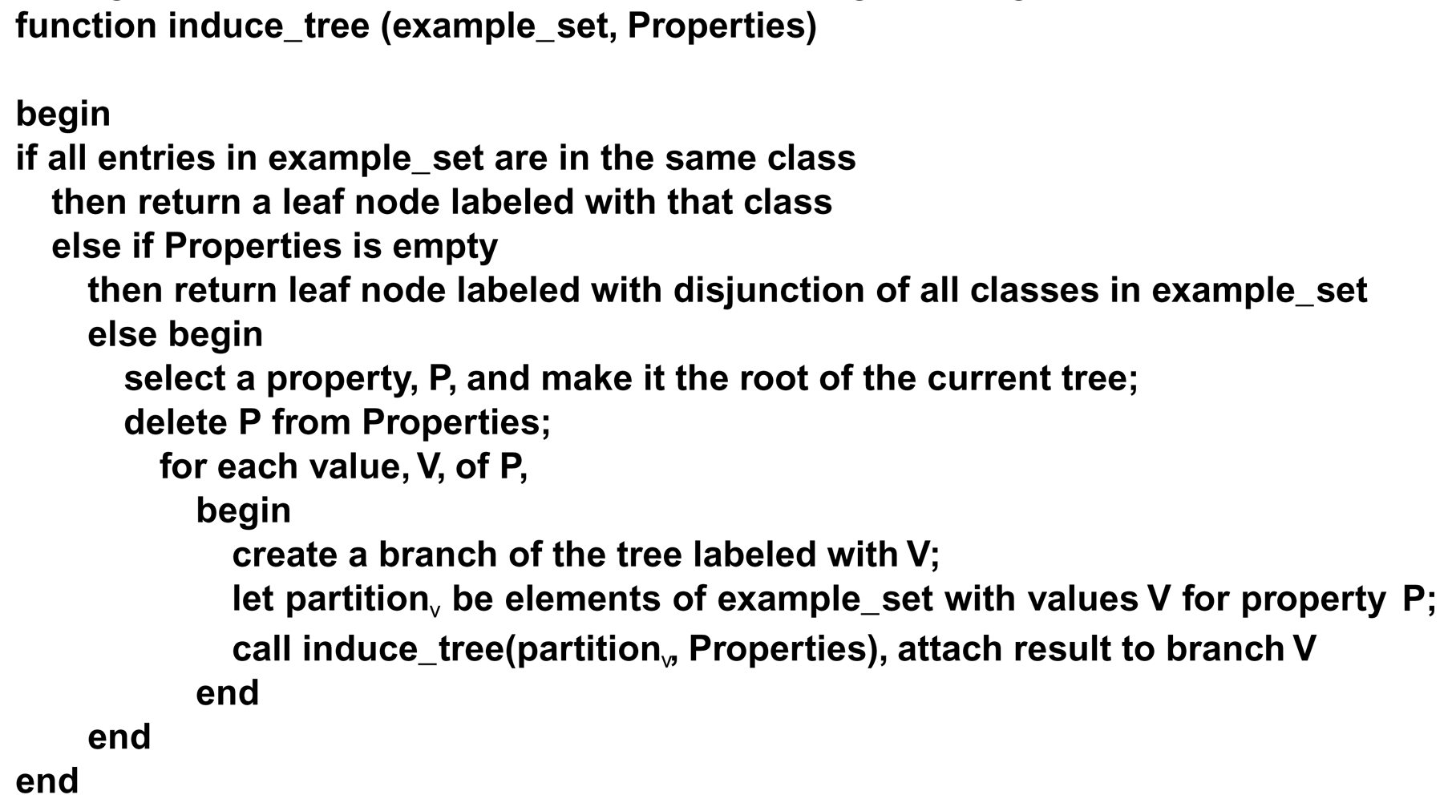
The ID3 Algorithm
The key to the algorithm is the selection of P, a property (feature) to subdivide the tree
Selecting the wrong P will cause the algorithm to spend more time building the tree and
will create a larger tree which will be less efficient

Slide 21
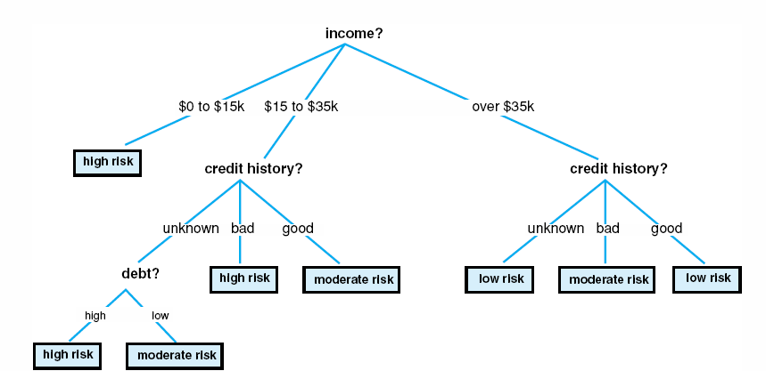
Simplified Tree
In the first tree, the topmost node asked whether credit history was good, bad or
unknown, but if you already know the person’s income is <= 15K, it means high
risk no matter what else, so using income as the first decision simplifies the tree

Slide 22
Information Theory
Information Theory is a mathematical basis for measuring the amount of information content of a message (or data)
applied in telecommunications and computer science, for instance to select a communications channel given the available carrying capacity, and applied to data compression
Quinlan uses it to compute the information gain obtained by selecting a feature out of a collection of data
the math gets ugly, so we will skip these details, but feel free to read about it on pages 413-415 and how we can use it to select the best feature in our credit risk data set
the idea is that for each iteration in ID3 to select P, we compute the information gain of each P and select the P that has the maximum information gain, and then remove P from the data set so that it is not selected again
until we get to a point in the problem solving where there are too few features left to make the computation worthwhile

Slide 23
ID3 Problems
There are still significant problems with ID3
what if some of the data is bad, how will that impact the accuracy of the decision tree?
what if features have continuous data rather than discrete values?
this is a problem that is faced in data mining all the time
one technique is to discretize the data by finding reasonable regions
for instance by dividing income into 0-15K, 15K-35K, 35K+,
identifying these regions can be computationally complex
what if data is missing from the set (some of the records have no values for given features)?
can we extrapolate? should we discard those records?
what if the data set is too large for ID3 to handle?
Quinlan has offered newer algorithms including C4.5 that get around many of these problems
introducing new algorithm components: bagging and boosting (see page 417 for brief details)

Slide 24
Rule Induction
A similar idea to decision trees is to use data to learn rules, called rule induction
given a collection of data in a database
analyze combinations of features to see if a generalized rule can be formed
for instance, consider a database of students which includes major, minor, GPA and number of years it took to graduate
when examining the data, we find the correlation that students with a CSC major and CIT minor and a GPA > 3.0 graduate in 4 or 4 ½ years
this allows us to generate a rule that we might use to predict future students’ performance
we might even assign a probability or certainty on this rule based on the number of times it was found to be true in the database

Slide 25
More on Rule Induction
A simple (but not efficient) algorithm for RI is
As an example, a store manager might use this to predict shopping behavior
if a rule is generated that says “if shopper buys milk and bread then the shopper will likely buy peanut butter”
then the manager may decide to place the peanut butter in the same aisle as the bread
or the manager might run a special whereby if you buy milk and bread, your peanut butter is discounted
For each attribute A:
For each value V of that attribute:
create a rule:
1. count how often each class appears
2. find the most frequent class, c
3. make a rule "if A=V then C=c"
4. calculate the error rate of this rule
Pick the attribute whose rules produce the lowest error rate

Slide 26
Learning New Concepts
Our algorithms so far have learned concepts within an already established concept space
What about learning some new concept that is outside of what we already know?
Two approaches are presented in the text
learning of new rules to explain problem solutions (Meta-DENDRAL) and explanation-based learning
both approaches require some predefined concept space but not merely learning classes through identifying features
This follows more closely with scientific learning
you already understand some concepts, now you build upon the domain by learning new concepts
consider that you first learned about loops and then you learned about infinite loops by building on your loop knowledge
we are instead adding new pieces of knowledge to the model/concept space itself

Slide 27
Meta-Dendral
Dendral was the first expert system, built in the mid 1960s
it worked with a chemist to identify the chemical composition of some molecules based on the output of a mass spectrometer
Dendral uses constraint satisfaction search along with a series of chemistry rules, and the chemist also input constraints to reduce the search
Dendral rules are based on identifying sites of “cleavage” in the molecule using a theory that is incomplete (so that it cannot account for the entire identification task)
Meta-Dendral takes the output of a Dendral session of some known substance, and attempts to established new cleavage rules to add to Dendral
some example rules in Dendral are:
double and triple bonds to not break
only fragments larger than two carbon atoms show up in the data
Dendral will add rules to specialize a pattern such as
adding an atom to a rule such as x1*x2 (two atoms with a cleavage between them) to X3 – X1*X2 (where – means a chemical bond)
instantiating an atom to a specific element such as X1*X2 → C*X2

Slide 28
Explanation-Based Theory
Consider as a computer science student that you first learn about
control structures (loops, selection statements)
and then learn specifically about while loops
and then you learn about infinite loops
You start with a model of the material to be learned, and then you learn a new concept (infinite loops)
you are shown an example or two along with an explanation and now you have a new concept in your model
EBL requires
a target concept – what the learner is attempting to form a new representation for
a training example
a domain theory (a model)
operationality criteria – a representation for the example and model so that the new example can be “understood” within the context of what has already been learned

Slide 29
Example: Learning what a Cup is
Given the following domain theory
liftable(X) & holds_liquid(X) → cup(X)
part(Z, W) & concave(W) & points_up(W) → holds_liquid(Z)
light(Y) & part(Y, handle) → liftable(Y)
small(A) → light(A)
made_of(A, features) → light(A)
We are given a training example:
cup(obj1), small(obj1), part(obj1, handle), owns(bob, obj1), part(obj1, bottom), part(obj1, bowl), points_up(bowl), concave(bowl), color(obj1, red)
Automated theorem proving can construct an explanation of why obj1 is an example of the training concept
first, derive a proof that the example is a cup
next, remove any irrelevant portions of the proof (e.g., owner, color)
finally, the remaining axioms consist of an explanation of how the example fits the domain theory definition of a cup
see the next two slides

Slide 30
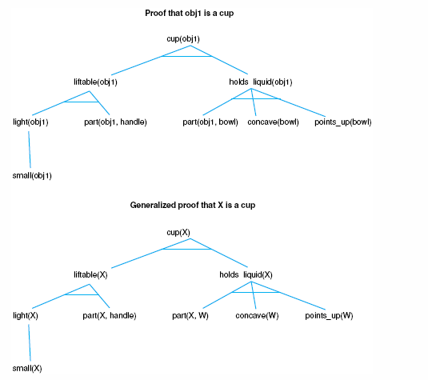
Proof of a Cup

Slide 31
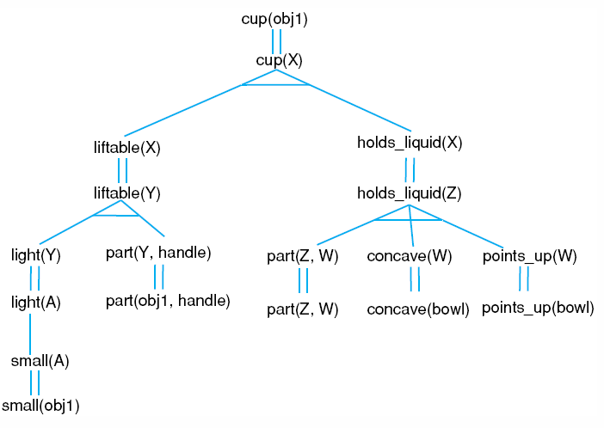
Final Representation of a Cup

Slide 32
How do we use EBL?
Consider building an automated programming system (an expert system that can write new programs)
We have already implemented a representation for control structures
when to use them, how they work, the control mechanisms (number of iterations, loop indices, terminating conditions)
Now we want to teach the system what an infinite loop is so that it won’t ever write one
the domain theory for loops includes
loop variable(s)
loop variable(s) initialization
loop variable(s) increment
loop termination condition that tests the loop variable(s)
the concept to introduce is that the loop variable incrementing moves the loop variable(s) closer to the loop termination condition
As an example of an infinite loop we offer
loop_variable(x), loop_variable_initialization(x=0), loop_variable_increment(x++), loop_termination_condition(x<0)

Slide 33
Analogical Reasoning
EBL is based on deduction
anything newly learned could actually have been discovered by exhaustive search of the axioms presented
We want to be able to learn beyond what we already knew
one approach is through analogical reasoning
reasoning by analogy
unlike EBL, what we learn through analogical reasoning is not necessarily correct (it is not logically sound)
the idea is that we have some source set of knowledge such as a previous problem solution, a theory that is partially understood (represented), a target concept in mind, and a set of transforms
We apply a transform to the previous case to derive a new piece of knowledge
whether the new piece of knowledge is useful, relevant or even true may not be knowable in general, nor may a system be able to infer whether the new piece of knowledge is useful

Slide 34
This is Like CBR
The process is one of
retrieving a previous solution from a library of solutions
elaborating upon the solution to derive features of use for the target
mapping (transforming) the previous solution into the target domain
justifying (determining) if the mapping was valid and useful
indexing and storing the newly learned piece of knowledge
But CBR’s result can be tested to see if it solves the given problem, here we are using the same approach to generate a new piece of knowledge
is the knowledge relevant and useful? how do we perform the justification step?
we also have to be careful, since we are taking knowledge from a different domain, that we don’t try to be too literal with the analogy

Slide 35
Example
Consider that we already know about the solar system with such concepts as
Sun and earth, attraction (gravity), orbit, mass and heat
we want to learn that “an atom is like the solar system” – that is, both systems have similar properties
we have the following source knowledge:
yellow(sun), blue(earth), hotter_than(sun, earth), causes(more_massive(sun, earth) attract(sun, earth), causes(attract(sun, earth), revolves_around(earth, sun))
the target domain includes:
more_massive(nucleus, electron) and revolves_around(electron, nucleus)
For us to learn something useful, we can’t merely map from the source to target because we will obtain incorrect or irrelevant information (such as a nucleus is yellow)
mapping rules must constrain what is generated
properties are dropped from the source
relations are mapped unchanged but higher-order relations are preferred to lower-order relations so that relations may be dropped

Slide 36
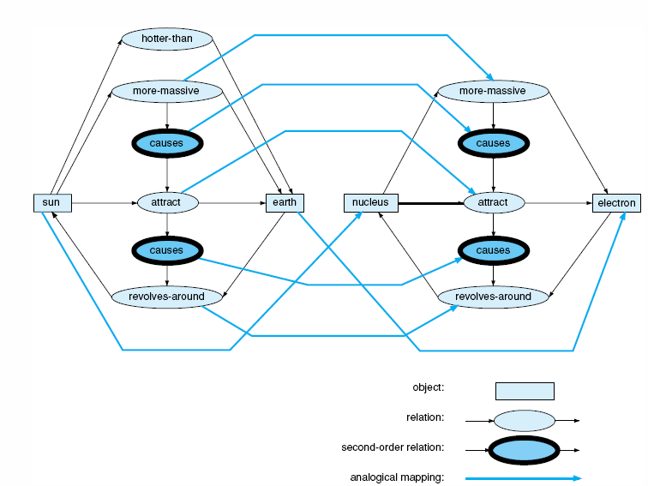
Analogical Mapping
So we start with two pieces of knowledge in our target
more_massive(nucleus, electron) and attract(nucleus_electron)
And we use a previously known piece of domain knowledge about the solar system and learn the following

Slide 37
Example System
To understand how we can automate this, we consider the VivoMind Analogy Engine (VAE)
conceptual graphs are used for knowledge representations
previous human analogies are represented
to find an analogy, VAE uses three methods of comparison (separately or in combination)
matching type labels to see if two items have a class/subclass relationship of some kind
matching subgraphs where a match is successful if two subgraphs are isomorphic (the two graphs match aside from labels on the graphs)
matching transformation, that is, trying different transforms on a subgraph to see if it creates another subgraph (this form of matching is tried last)

Slide 38
VAE Example
Given WordNet (a dictionary of English where words are stored as conceptual graphs with pointers linking words to other words)
VAE generated the analogy to the right when comparing the entries for cat and car
since there is an enormous number of links in WordNet between words, VAE generated a greater number of analogies and then used weight of evidence to prune down its analogy to the conclusion shown on the right
Analogy of Cat to Car
Cat | Car
head | hood
eye | headlight
cornea | glass plate
mouth | fuel cap
stomach | fuel tank
bowel | combustion chamber
anus | exhaust pipe
skeleton | chassis
heart | engine
paw | wheel
fur | paint

Slide 39
Unsupervised Learning
In our previous examples, all forms of learning were supervised by having us either provide
data and classifications
or some of the target information
Discovery is a form of learning where we have data without classifications and must discern the classes
we may not have names for the classes, but we can identify what features/values place an instance into each class
there are a number of forms of unsupervised learning, many of them today are used in data mining and revolve around mathematical forms of data clustering
assume that classes are describable by attribute (feature) values
the possible values of the attributes make up a space
with n features, we have an n-dimensional space
clustering places each datum into this space
we look to see where instances are close together, and if we see distinct clusters, we can infer each is its own class

Slide 40
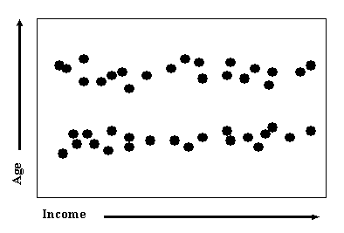
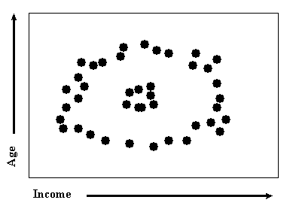
A Clustering Algorithm
Assume that we have data represented as n-valued tuples x₀ = {x₀₀, x₀₁, x₀₂, …, x_{0n-1}} and x₁ = {x₁₀, x₁₁, x₁₂, …, x_{1n-1}} etc
1. Start by arbitrarily selecting k data to be the centers of k clusters
2. Take datum x_{i} and compute its Euclidean distance between it and each cluster center
distance between x_{i} and x_{j} = ((x_{i0} – x_{j0})² + (x_{i1} – x_{j1})² + … + (x_{in-1} – x_{jn-1})²)^{1/2}
3. Place x_{i} into the cluster where the distance is shortest
4. After placing all n elements into a cluster, identify the datum in the middle of each cluster and make it that cluster’s new center
repeat steps 2-4 until all clusters remain with the same data
Notice that since you recompute the center of each cluster in each iteration, the initial selection of central points is not very important
although it may impact the number of iterations until the algorithm converges
On the left, the data
clusters into two
groups, on the right
though, there is no
distinct cluster

Slide 41
Problems with Clustering
Data may not come in an easy-to-cluster form
consider as data records containing the values of name, age, ethnicity, sex, eye color, height, weight, exercise level, cholesterol
Imagine our goal is to identify why people might have high cholesterol, then we cannot use the data as is:
some of the data’s features are irrelevant like eye color, name
some of the data’s features should contribute more than others
for instance, age might be more significant than weight, and height and weight together will tell us more than just weight alone
data like ethnicity is not easily captured numerically, so how do we alter the data to fit a distance formula?
We might want to use weights so that some features have a greater impact on the distance formula
some weights might be 0 to indicate that a feature is irrelevant, like eye color
One must understand the data in order cluster it

Slide 42
Other Forms of Discovery
AM: derived mathematical theorems about number theory from a collection of heuristic rules and simple search techniques
example: generate a new concept if some element of B are in A but not all elements of B (i.e. why is B not A?)
one concept was # of divisors for numbers
AM used this to learn about prime numbers and squares
since AM did not learn new heuristics, it was limited in what it could discover
BACON: given data, analyze it for concepts within the domain
was able to derive the ideal gas law from data relating the variable values in the equation (pV/nT=8.32)
AUTOCLASS: learned new classes of stars from infrared spectral data

Slide 43
Supervised Learning
In supervised learning, a teacher/trainer is responsible for correcting the problem solving behavior of the system through some form of feedback
this differs from the inductive and EBL approaches of earlier as the feedback is provided after the problem solver has tried to solve the problem
here the feedback corrects the problem solver so that next time it performs better
An early attempt was through parameter adjustment in Samuel’s checkers playing program
based on whether the system won or lost, parameters used in judging heuristic values were adjusted
those selections that led to a win had their heuristic values increased
those selections that led to a loss had their heuristic values lowered
this idea can be carried through to other types of systems such as altering certainty factors of rules that lead to correct or incorrect solutions in diagnosis or planning

Slide 44
Supervised Learning by Adding Knowledge
Another way to use supervised learning is to have the problem solver ask
“where did I go wrong?”
The user (supervisor/teacher) must specify what the system did wrong and the system can then use the data for the particular case to add the new knowledge
consider an attempt to classify an object where the given class is missing from the classification hierarchy
the user provides the new class which is added to the knowledge base and the system takes the data for the class to generate the rules to identify that new class by comparing the rules to the other nodes who share the same parent
if the class already exists, then some of the matching knowledge is wrong, so the new case must be added as an example of that class by altering the knowledge (e.g., rules) that lead to that node in the hierarchy being selected

Slide 45
Numeric Forms of Reinforcement
The book discusses three additional approaches
each of these forms work toward a solution and feeds values back to adjust heuristic values or edge weights
with temporal difference learning, the heuristic value discovered at node a_{i+1} is used to modify the heuristic value at node a_{i}
in a game like Tic-Tac-Toe, it would be a_{i+2} to a_{i} (since a_{i+1} is your opponent’s choice)
with dynamic programming, a table is filled out from the end of the problem backward to make adjustments – that is, the process must terminate and then work backward
since not all paths of the search space need modification, this approach is more computationally complex than necessary
with the Monte Carlo method, samples of the sample space (from the current state to an end state) are tested and used for feedback
these topics will be explored in more detail in chapter 13

