Slide 1
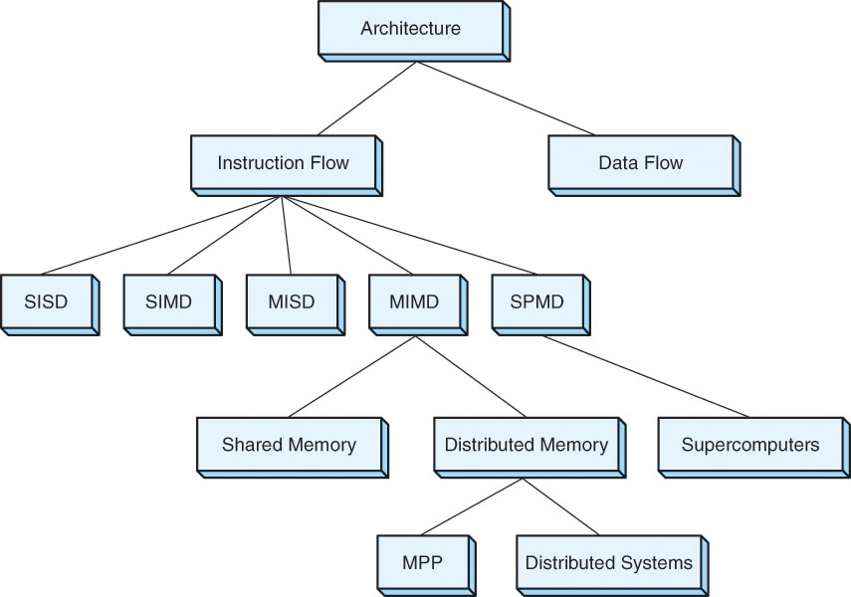
Chapter 9: Alternative Architectures
In this course, we have concentrated on single processor systems
But there are many other breeds of architectures:
  RISC vs. CISC
  SIMD
  MIMD
  Supercomputers
  Dataflow machines
  Neural networks
  We will briefly look at the differences in the top 3 of this list
NOTE: we do not use MISD machines
Notes:
Dataflow computers: computers do not use a PC, instead instructions execute once data becomes available – as the order that data is made available is not predictable, these are non-deterministic machines. We do not have commercially available dataflow computers although they have been implemented for specialized purposes like data warehousing, signal processing, and network routing.
Neural networks do not require their own architecture. A neural network is a collection of nodes and edges in layers. Between each layer, nodes are fully connected. Using a NN requires a feedforward algorithm: for a given node, compute the sum of its inputs * edge weights (summation from 0 to n-1 of xi * wi). Plus this summation into an activation function to determine what this node should output. Repeat for all nodes at the next layer. The NN weights are usually initially random and need to be “trained”. This is a form of machine learning. The learning algorithm takes the result (the output of the last layer), compares it against expectations, and adjusts edge weights based on error. The feedforward computation and the backpropagation computation for each node can be executed in parallel. A few massive parallel processing computers have been built for this task, known as Connection Machines. In general though, we can do all of the computation on a single processing computer. Today, most commonly , neural networks are trained and used on computers with GPUs (massively parallel SIMD architectures).

Slide 2
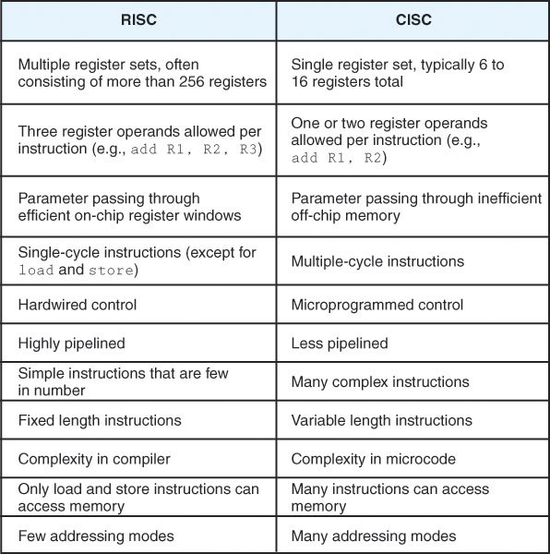
RISC vs. CISC
We’ve already look at some RISC features (chapter 5), here we compare RISC vs CISC
  recall to keep a pipeline running effectively, we make sacrifices to the instruction set – this is why RISC has these restrictions
  CISC generally tries to limit program sizes by having instructions that can do multiple things

Slide 3
SISD vs. SIMD
Our traditional computer is SISD:
  single instruction executed on a single datum during each fetch-execute cycle
SIMD: single instruction executed on multiple data
  fetch a vector instruction and all the vector data and execute the one instruction on all data simultaneously
  reduces execution time not only because of the parallelism but we no longer need a loop!
  often used for processes where each datum is computed in isolation – image processing, weather prediction, speech recognition
Two forms of SIMD architectures are:
  vector processors (1-D array)
  matrix processors (2-D array)
We often use tournament algorithms – see the notes section of this page
Notes:
Consider having an array of 16 values and 8 processors. We want to find the largest value or compute the sum of the values. We use a tournament algorithm. We take pairs of values and compare them (or add them), storing the result in the first of the pair of items. We repeat. See below.
Comparison:
6 5 8 12 7 4 3 13 2 3 14 10 9 7 6 4 – compare a[i] and a[i+1], place larger at a[i]
6 5 12 12 7 4 13 13 3 3 14 10 9 7 6 4 – compare a[i] and a[2*i], place larger at a[i]
12 5 12 12 13 4 13 13 14 3 14 10 9 7 6 4 - repeat for a[i] and a[4*i]
13 5 12 12 13 4 13 13 14 3 14 10 9 7 6 4 - and finally compare a[i] and a[8*i]
14 5 12 12 13 4 13 13 14 3 14 10 9 7 6 4 - and finally compare a[i] and a[8*i]
Largest value is at a[0], in parallel, it took 4 time units instead of 15.
We can use tournament algorithms to reduce an O(n) operation to O(log n) or an O(n^2) to as low as O(n) (including sorting!)

Slide 4
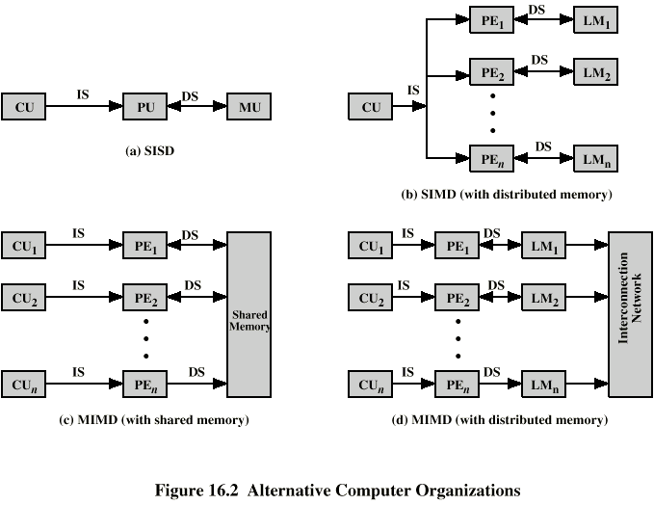
SISD architecture
1 control unit
1 processing unit (ALU)
1 pathway to datum (memory)
How we view an SIMD
In practice, our SIMDs use
one (or more) pipelined
processing elements
1 control unit
1 processing unit for each datum
Direct connection from each
processor to each datum

Slide 5
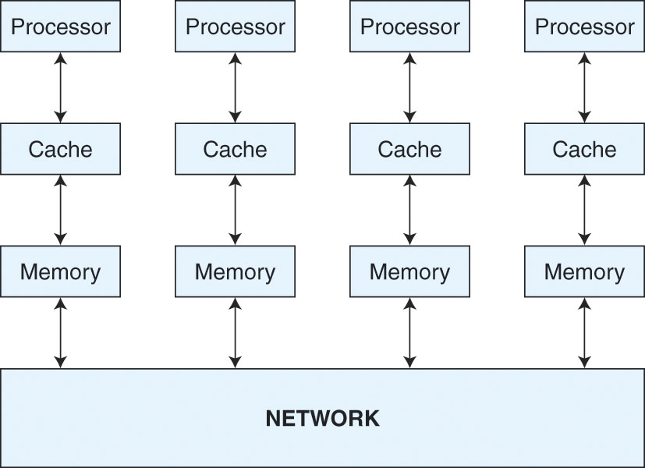
MIMD
The MIMD has numerous full processors (or processor cores)
  this permits multiple instructions to execute simultaneously, each on separate data
  we might execute multiple parts of one program, multiple threads of the same program, or multiple processes
Two forms:
  tightly coupled – all processors connect to a single shared main memory, communication between running processes is through the shared memory
  Loosely coupled – each processor has its own main memory, communication is less time critical and so is often sent over an interconnection network
A loosely coupled machine
Notes:
NOTE: we do not use MISD (multiple instructions on a single datum) as processes performed on a datum should be done in sequence. If we do one in parallel, it makes no sense. Consider x = (x + 5) * 2 – 3. If we do x + 5, x * 2, x – 3 simultaneously, we get the wrong result!

Slide 6
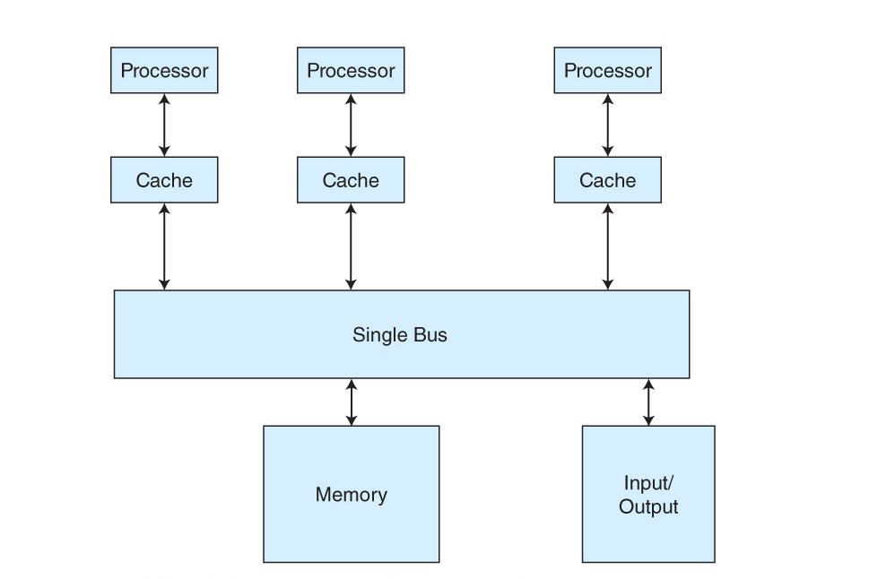
Tightly Coupled Machines
The loosely coupled machine can be any network of computers
  usually the processes running are unrelated
The tightly coupled machines are more interesting
  this is true parallel processing of a given program
  how do we distribute a program into somewhat independent pieces to run in parallel?
A problem with shared memory is cache coherence – assume X has been copied from memory into processor 1 and 2’s caches, if one processor modifies X, the other has a stale copy

Slide 7
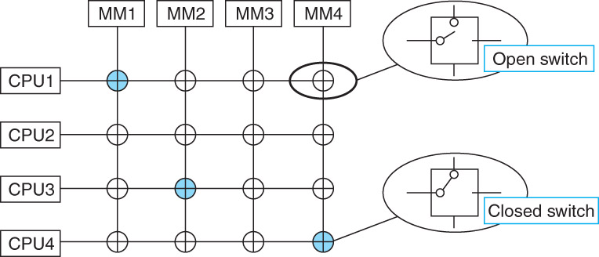
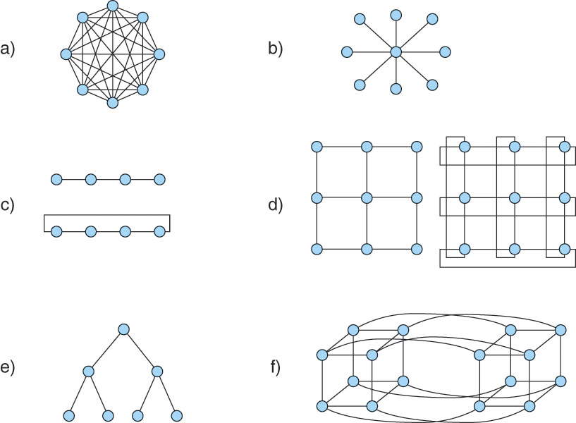
Interconnection Networks
Connects the processors together
Or the processors and memory modules together
  many different shapes of ICNs
  below are many nearest neighbor types plus a full mesh (a) and star (b)
A mesh like that above is
often too expensive, see
instead figure 9.7 on page 547
f is known as a hypercube network
It is a nearest neighbor with degree = 4

Slide 8
Distributed Computing
With affordable networks, the question now becomes:
  how can we use all of these resources efficiently?
  massive parallel processing computers are expensive, but at moment in time, there are perhaps billions of processors sitting idle – how can we use them?
Distributed computing: the ability to launch processes across the network to other machines
  requires that each machine be able to transmit and accept remote procedure calls (RPCs)
    one machine must keep track of the progress of the processes running on the various processors and there must be adequate communication between the machines (the local-area network will hopefully serve us here)
    will you trust another processor launching a process on your machine?
  need a way to identify idle processors
Notes:
NOTE: NASA/JPL have used a form of distributed computing. You visit their website and install their software. Now, when your processor is idle for some time (for instance, while you are away or asleep), the OS launches the process into the foreground (it had been in the background). The process asks for a chunk of data from the NASA/JPL website. The process runs on the data until it finishes, sending results back, or the processor starts being used by you, in which case the finished portion’s data is sent back. But for this to work, you must download the software yourself to initiate the whole process.
NASA originally set this up for SETI data but now is doing this for Kepler data (looking for exoplanets).

