Slide 1
Chapter 3: Boolean Algebra
We have seen how we can represent information in binary, now we will explore
Why we use binary
How to compute using binary
How to implement binary operations using Boolean algebra (such as binary addition)
How to implement Boolean algebra through digital circuits
How to store things using digital circuits
We will explore logic gates and use these to implement basic combinational circuits for adding, comparing, etc and sequential circuits for storage

Slide 2
Boolean Algebra
The basis for all digital circuits is Boolean algebra:
Boolean algebra is the algebra of binary values
or of 2 values
we refer to these values as 0 and 1
although we could also refer to them as true and false
the basic Boolean algebra operations are
AND, OR, NOT, XOR, NAND and NOR (also COINCIDENCE)
you will have seen most of these in 260 and 262 but new ones are:
XOR – true if the two Boolean variables differ
true if x1 = 1 and x2 = 0 or x1 = 0 and x2 = 1, false otherwise
NAND and NOR are NOT of AND, and NOT of NOR respectively
COINCIDENCE is NOT of XOR
Each of these operations takes 2 inputs except NOT which takes 1 input
However, AND, OR, NAND and NOR can be generalized to accept any number of inputs

Slide 3
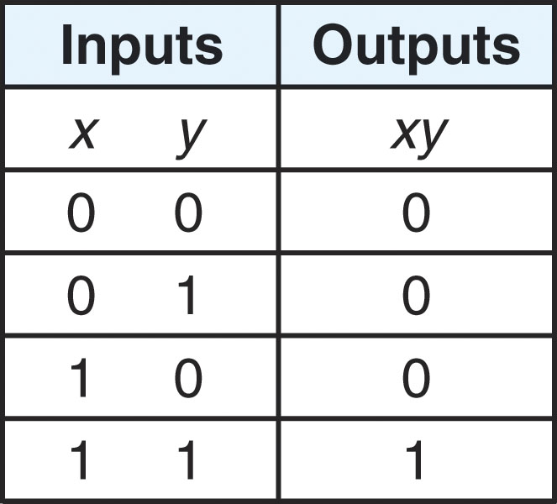
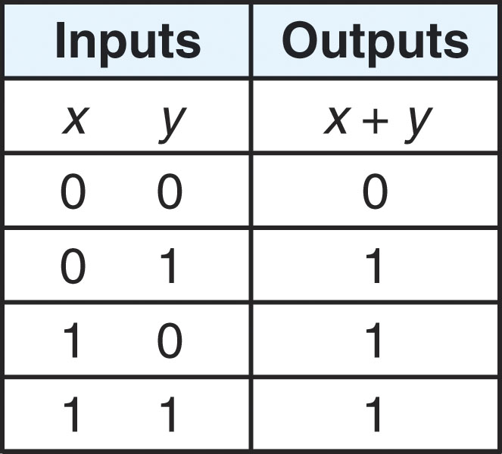
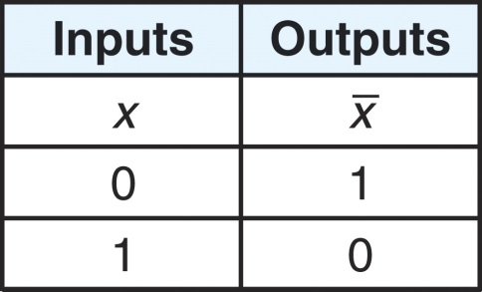
Truth Tables
xy = x AND y = x * y x + y = x OR y x bar = NOT x
AND is true only if OR is true if either NOT inverts the bit
both inputs are true inputs are true We will denote x bar as ~X
NOR is NOT of OR NAND is NOT of AND XOR is true if both inputs
differ

Slide 4
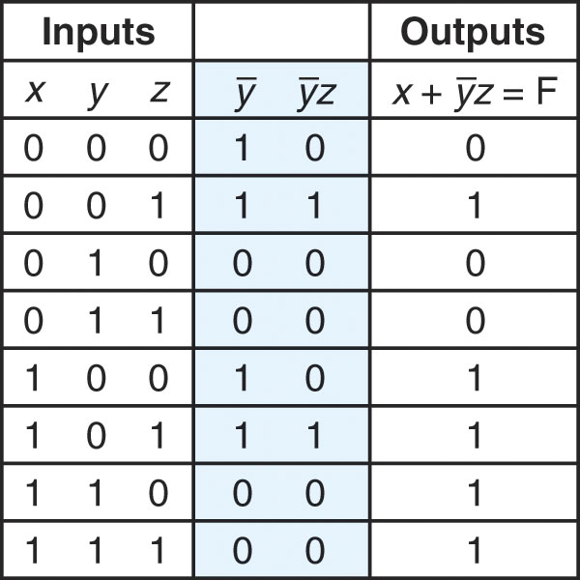
Boolean Expressions
We form Boolean expressions out of Boolean operations on Boolean variables or Boolean values
So, like algebraic expressions, we can create more complex Boolean expressions as we might need
Consider the expression:
F = X + ~Y*Z
What is it’s truth table?
Notice that it is easier to derive the
truth table for the entire expression
by breaking it into subexpressions
So first we determine ~Y
next, ~Y * Z
finally, X + ~Y*Z
Notes:
Students often have problems writing a truth table properly. Notice that the inputs are listed in increasing order as binary numbers. For instance, the first row is 000, the second row is 001, the next row is 010, the next row is 011, the next row is 100, etc, for the binary equivalents of 0-7. If we had 4 inputs, we would use letters w, x, y, z in that order and the rows would be 0000 through 1111 (0 through 15).
Here is another truth table example for the expression (~x*y) + ~(x*~z):

Slide 5
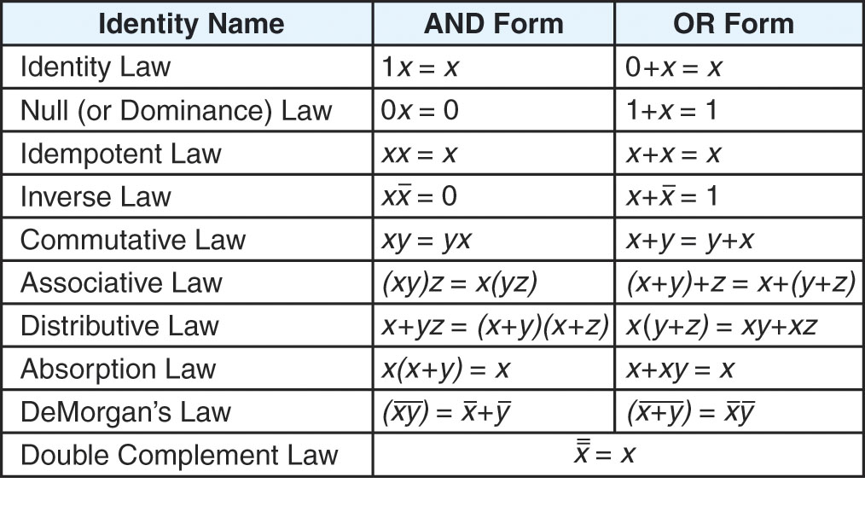
Basic Boolean Identities
As with algebra, there will be Boolean operations that we will want to simplify
We apply the following Boolean identities to help
For instance, in algebra, x = y * (z + 0) + (z * 0) can be simplified to just x = y * z
Notes:
Most of these identities should be easy to understand:
Identity: 1 * x will be x because 1 is always true, so the result depends on x, if x is true, 1 and x is true, and if x is false, 1 and x is false. Similarly, 0 + x is x because 0 is always false, so 0 or x is true if x is true and 0 or x is false if x is false.
Null: 0 * x = 0 since false and anything is always false whereas 1 + x = 1 since true or anything is always true.
Inverse: x*~x = 0 and x + ~x = 1 because one will be true and the other false
Commutative and Associative are just like in normal algebra.
The AND form of the Distributive law is different, see if you can work out why it is true (draw the truth table for both sides) but notice that the OR form is the same as in algebra. Also, (w + x) * (y + z) is distributed just like using the FOIL method in algebra (first, outer, inner, last), so we would get w*y + x*y + w*z + x*z
If we do (w+x)*(~w+y) = w*~w + x*~w + w*y + x*y = 0 + x*~w + w*y + x*y = x*~w + w*y + x*y
Absorption: Again, use a truth table to prove both sides are true
DeMorgan’s Law is very important. It shows us how to distribute a ~. If we have ~(xy) = ~x + ~y and if we have ~(x+y) = ~x*~y. This will be important when we work on reductions over the next slide. Notice that ~(xy) != ~x*~y. The idea behind DeMorgan is that when you distribute the negation to appear in front of both terms, it also changes the operator (+ becomes *, * becomes +).
What is ~(~(xy)+z)? We must apply DeMorgan to the outer term first giving us ~~(xy)*~z. Since xy has a double negation, they cancel giving us xy*~z.
What about ~(xz+~yz)? Again, distribute the negation giving us ~(xz)*~(~yz). Now we have to distribute the negation to each individual term giving us (~x+~z)*(~~y+~z) = (~x+~z)*(y+~z). Using the Distributive property (AND form) we can reduce this to ~z+~x*y.

Slide 6
Some Examples
Example: use algebraic simplification rules to reduce ~xyz+~xy~z+xz
~xyz + ~xy~z + xz = ~xy(z+~z)+xz (distributive law) =
~xy(1)+xz (inverse law) = ~xy+xz (identity law)
Example: xy+~xz+yz = xy+~xz+yz*1 (identity) = xy+~xz+yz*(x+~x)
(inverse) = xy+~xz+xyz+~xyz (distributive) = xy(1+z)+~xz(y+1)
(distributive) = xy(1)+~xz(1) (null) = xy*1+~xz*1 (absorption)
= xy+~xz (identity)
Example: (x+y)(~x+y) = ~x(x+y)+y(x+y) (distributive) = ~xx+~xy+xy+yy (distributive)
= 0+~xy+xy+yy (inverse) = ~xy+xy+yy (identity) = y(~x+x+y) (distributive)
= y(1+y) (inverse) = y(1) (identity) = y (idempotent)
Here we have an example specifically to see how DeMorgan’s Law works
DeMorgan’s Law states that
~(X*Y) = ~X+~Y
Boolean expressions are equal
if their truth tables give the
same values – we see that here
Notes:
The trickiest reduction above is the second one where we actually introduce a new term (*1) so that we can change 1 = (x + ~x). This is similar in normal algebra to introducing a term in order to reduce a denominator. But just as in algebra, learning when to introduce a term is a matter of practice, there are no easy rules to tell you what law to apply or how to apply it!
Here are more examples.
(~x*~(y+z)) = ~x*(~y*~z) (DeMorgan) = ~x*~y*~z (Distributive).
~(x*y) + ~(~x*z) = ~x+~y + ~~x+~z (DeMorgan) = ~x + ~y + x + ~z (Double Negative) = (~x + x) + ~y + ~z (Associative) = 1 + ~y + ~z (Inverse) = 1 (Null). So notice that no matter what x, y and z are, this expression is always true! We can reason this out as follows: if x is false, then the first term is always true (false*y is always false, and the ~ makes it always true, so we don’t care about the second term), and if x is true, the second term is always true (~x is false, so it doesn’t matter what z is, and the ~ before the term makes it always true).
x+~y*~(x+z) = x+~y*(~x*~z) (DeMorgan) = x+~y*~x*~z (Distributive) = x + ~x*~y*~z (Associative).

Slide 7
Logic Gates
Here we see the logic gates
that represent the boolean
operations previously
discussed
XOR looks like OR
but with the added
curved line
We typically represent NOR and NAND by the two
on the left, but the two on the right are also correct
Notes:
The symbols above are used to represent the gates. The actual implementation of these gates use different circuit devices, particularly registers, transistors, voltage units and grounds. See http://en.wikipedia.org/wiki/Logic_gate if you are interested in more details, and follow the links to the specific gates (AND, OR, NOT, etc) to see what the actual circuit layout looks like. Basically though, the AND and OR gates require approximately 3 transistors and 2 registers each to construct.
One gate that is missing from above is called COINCIDENCE. It is NOT of XOR. COINCIDENCE is true if the two inputs are the same (they coincide). We will often write XOR like this: and COINCIDENCE like this:
It should be noted that each type of gate expects exactly 2 inputs except for NOT, which only has a single input. Each gate has a single output.
With the exception of XOR and COINCIDENCE, we are permitted to have more than 2 inputs as a shorthand for drawing cascaded gates (see the next slide).

Slide 8
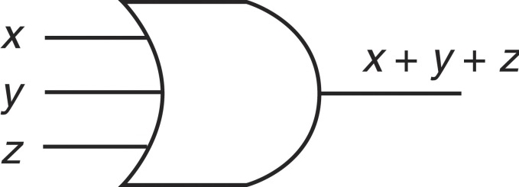
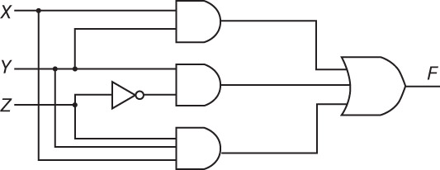
Some Circuits
AND and OR gates can have more than 2
inputs, as seen here
Notice for ~Y, we can either use a NOT gate or
simply specify that the value is ~Y
Here is the truth table for this circuit
What does
this circuit
compute?
(what is F?)
Notes:
As stated on the previous slide, a logic gate should have exactly 2 inputs (except for NOT), but as a shorthand way of specifying something like x + y + z, we can use the notations above. Here is what that first OR gate would actually look like if we drew it all out:
As shown in the second figure above, we can skip the NOT gates by simply listing the input as ~y. In addition, if we have input going into two or more gates, we do not have to have separate variables listed, we can split the input off, as shown below for x*y + x*z.

Slide 9
Using only NAND
NAND (and NOR) have unique properties different from the other boolean operations
This allows us to use one or more NAND gates (or one or more NOR gates) and create gates that can compute AND, OR and NOT
See the examples below
Notes:
The book covers this. We will skip over it except to note that NAND and NOR are universal gates – you can build any gate out of one or more NAND or one or more NOR gates. They used to manufacture chips that contain several NAND or several NOR gates from which you could build any circuit you wanted. Such a NAND chip is shown on the next slide.

Slide 10
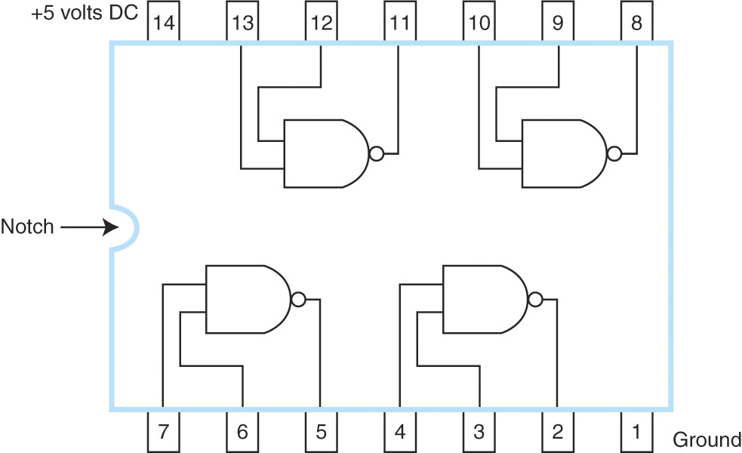
NAND Chip
Early integrated circuits
were several gates on a
single chip, you would
connect this chip to other
chips by adding wires
between the pins
To do ~(A*B) + ~(C*D)
You would connect A and
B to pins 7 and 6,
C and D to 4 and 3,
and send 5 and 2 to
an AND chip
This is a NAND chip

Slide 11
Combinational Circuits
We will combine logic gates together for calculations
Example: ~(A*B) and ~(C*D) with an OR gate – shown to the right
The resulting circuit is a combinational circuit
Electrical current flows from one gate to the next
By combining gates, we can compute a boolean expression
What we want to do is:
Derive the boolean expression for some binary calculation (e.g., addition)
Then build the circuit using the various logic gates
This is how we will build the digital circuits that make up the ALU (arithmetic-logic unit) and other parts of the computer
Notes:
We will commonly build a combinational circuit by first drawing the truth table of what needs to be computed, and then constructing the circuit as a sum of products.
What is a sum of products? We look at the output of the truth table and identify each row where the output is a 1. We use an AND gate for each of these rows. An AND gate will output a 1 if all inputs are a 1. So we take our inputs and pass them through an AND gate, sending the inputs directly into the AND gate if those inputs are expected to be 1s and sending the inputs through NOT gates if those inputs are expected to be 0s. We take the output of all AND gates and pass it through an OR gate. What follows is a circuit to compute XOR given the truth table.
X Y XOR
0 0 0
0 1 1 ← this row outputs a 1, so we need an AND gate the takes ~X and Y
0 1 ← this row outputs a 1, so we need an AND gate that takes X and ~Y
1 1 0

Slide 12
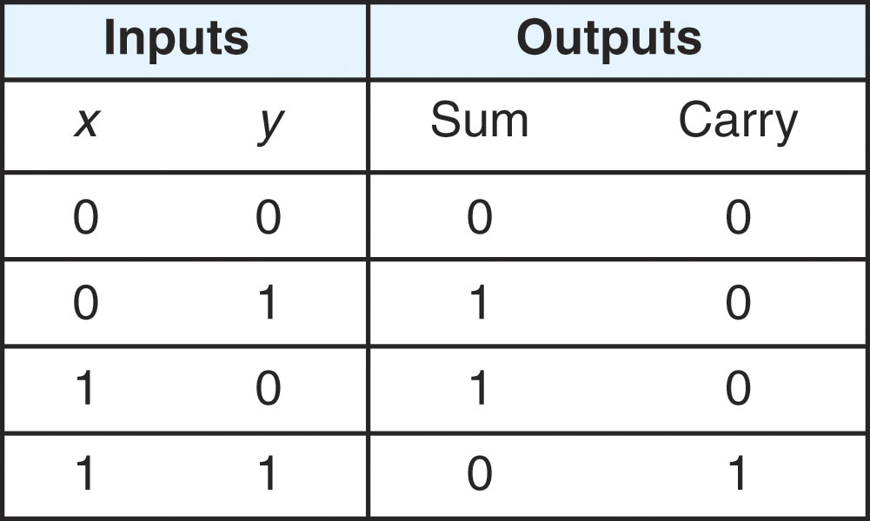
An Example: Half Adder
There are 4 possibilities when adding 2 bits together:
0 + 0 0 + 1 1 + 0 1 + 1
In the first case, we have a sum of 0 and a carry of 0
In the second and third cases, we have a sum of 1 and a carry of 0
In the last case, we have a sum of 0 and a carry of 1
These patterns are demonstrated in the truth table above to the right
Notice that sum computes the same as XOR and carry computes the same as AND
We build an Adder using just one XOR and one AND gate
The truth table for Sum and Carry
and a circuit to compute these
Notes:
The Half Adders has 2 inputs and 2 outputs. Most circuits should have a single output, but in this case, we are actually computing 2 values, not just one. The half adder is not useful for us since it only adds two 1-bit numbers. We want instead to build an adder that can add two n-bit numbers. How?

Slide 13
Full Adder
The half adder really only does half the work
adds 2 bits, but only 2 bits
If we want to add 2 n-bit numbers, we need to also include the carry in from the previous half adder
So, our circuit becomes more complicated
In adding 3 bits (one bit from x, one bit from y, and the carry in from the previous addition), we have 8 possibilities
The sum will either be 0 or 1 and the carry out will either be 0 or 1
The truth table is given to the right
Notes:
The 8 possibilities are listed in the 8 rows of the truth table, but boil down to these situations:
Sum:
0 (all inputs are 0 or 2 of the inputs are 1)
1 (1 input is 1 or all inputs are 1)
Carry out:
0 (sum is 0 or 1)
1 (sum is 1 or 2)
The full adder comprises two circuits. Both circuits receive one bit of input x and one bit of input y and one bit from the previous full adder’s carry out. We could build the circuit as a sum of products circuit. The Boolean expression is derived right from the truth table. We take each 1 output for Sum and create an AND. The first one is for the row 001. So we have to negate X and Y but not Carry In. The second one is for row 010. We would negate X and Carry In but not Y. The third one is for the row 100 so we would negate Y and Carry In, and the final one is for row 111 where we do not negate any of the inputs. We take the output of each AND gate and pass it through an OR. Here is the Boolean expression (where C stands for Carry In). Sum = ~X*~Y~C + ~X*Y*~C + X*~Y*~C + X*Y*C.
See the website for this diagram for Sum.
Can you similarly draw the circuit for Carry Out?
The main problem with our Full Adder as we have drawn it is that it requires too many gates. We can use some of the Boolean Laws to simplify the expressions for Sum and Carry Out.

Slide 14
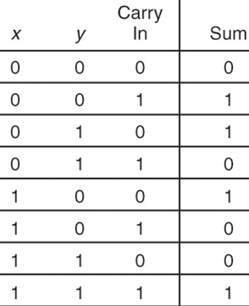
Sum of Products
We can derive a “sum of products” for a boolean expression given a truth table
a sum of products is an expression of the form a * b * c + d * e * f + g * h * i
that is, a sum (+) of several product terms (*)
Our expression should output 1 for each set of inputs in the truth table where the output is a 1
so we look at each row in the truth table where the output is 1 and the inputs form an ANDed term
e.g., x * y * Carry In (the last row of the table)
how can we take an input like x = 0 & y = 0 & Carry in = 1 and make it a 1?
we take any input that we expect to be 0 and negate it
row 2: $\overline{x} ∗ \overline{y} ∗c$
The full expression is
$\overline{x} ∗ \overline{y} ∗c$ + $\overline{x} ∗y∗c$
+ $\overline{x} ∗y ∗ \overline{c}$ + x * y * c
Now we can draw the
circuit

Slide 15
Building a Full Adder Circuit
Building a full adder using SOP is easy enough but not efficient, we can make a smaller circuit
the sum is 1 only if one of x, y and carry in are 1, or if all three are 1, the sum is 0 otherwise
the carry out is 1 if two or three of x, y and carry in were 1, 0 otherwise
the circuit to the right captures this by using 2 XOR gates for Sum and 2 AND gates and an OR gate for Carry Out
We combine several full adders together to build an Adder, as shown below:
Called a “ripple” adder because
carrys ripple upward
A 16-bit adder, comprised of 16 Full Adders connected so that each
full adder’s carry out becomes the next full adder’s carry in
Notes:
The circuit above shows us the simpler Full Adder. Here is how it works:
x and y are passed through an AND gate. It is 1 only if both x and y are 1. If x and y are 1, then this should product a carry out, so the AND gate connects the carry out. The sum is a 1 only if the sum of x, y, carry in are 1 or 3. So this occurs if x and y differ and carry in is a 0, or if x and y are the same and carry in is a 1. So we pass x and y through an XOR (this will output 1 only if x and y differ) and the result is passed through an XOR with carry in (this will output a 1 only if x and y are the same and carry in is a 1, or if x and y are different and carry in is a 0). See if you can understand this. Now we have other possible cases for carry out. So far we have only seen if x and y are both 1. But if x and/or y are 1 and carry in is a 1, we also get a carry out. So we also AND the result of x XOR y with carry in. The result of this AND is 1 only if x XOR y is a 1 (the two values differ so only one is a 1) and carry in is a 1. If all 3 (x, y, carry in) are 1s, then the first AND get is a 1.
In order to build an n-bit adder for our computer, we take n Full Adders and connect them so that the carry out of one full adder is the carry in to the next full adder. Each full adder then gets an input from x, an input from y, a carry in from the previous full adder, and produces a sum and a carry out.
Full Adder i receives x_{i}, y_{i}, and carry out_{i-1} and produces sum_{i} and carry out_{i}. Note that the figure above does not show the sum outputs, which would come out of the bottom of the boxes.

Slide 16
Complementor
Let’s design another circuit to take a two’s complement number and negate it (complement it)
Change a positive number to a negative number
Change a negative number to a positive number
Recall to do this, you flip all of the bits and add 1
To flip the bits, we pass each bit through a NOT gate
To add one, send it to a full adder with the other number being 000…001
Notes:
As we covered in chapter 2, to negate a two’s complement number (that is, change it from positive to negative or negative to positive), flip all the bits and add 1. To flip a bit, use a NOT gate. To add 1, use an n-bit adder with each y input wired to 0 except for the right-most bit which is wired to 1.
So if we had the 8-bit number 00101101 (45), we would convert this to -45 by flipping each bit (11010010) and adding 1, giving us 11010011. We will call this circuit either a negator or complementor (or complementer).

Slide 17
Adder/Subtracter
Recall from chapter 2
two’s complement subtraction can be performed by negating the second number and adding it to the first
We revise our adder as shown to the right
It can now perform addition (as normal)
Or subtraction by sending the second number through the complementor
The switch (SW) is a multiplexer,
covered in a few slides
Notes:
We could build a subtracter circuit, but we really don’t need one since we have an adder and a complementor. So we build a combined adder/subtracter. The circuit works as follows:
We place our two values into registers, A and B. A goes into the Adder along with either B or the value –B. We obtain the value –B by passing B through the complementor from the previous slide. How do we select whether to pass B or –B into the Adder with A? We use a device called a switch, a multiplexor. A multiplexor (which is covered in a few slides) is a device which excepts multiple inputs and selects one to pass on as output. So in this case, SW receives two inputs, B and –B, and selects whether to pass B on or –B on. The choice is based on a control signal passed in from the control unit as to whether the adder/subtractor should add or subtract. If we want to add, then SW passes on B, if we want to subtract, then SW passes on –B.
The adder’s last carry out is fed into a location called the overflow bit. The overflow bit is stored in a special CPU register called the status flags (which also store other bits, such as the zero bit – was the last result a 0?, the interrupt bit – did an interrupt arise during the most recent fetch-execute cycle, and others). We discuss the status flags in more detail in later chapters.

Slide 18
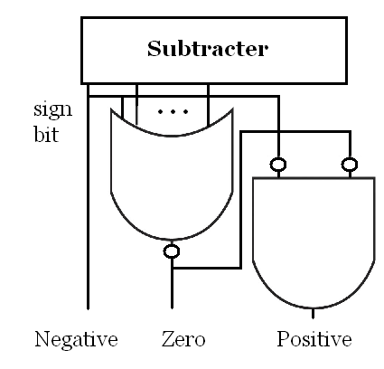
Comparator
We have covered + and -, how about <, >, =
To compare A to B, we use a simple tactic
Compute A – B and look at the result
if the result is -, then A < B
if the result is 0, then A = B
if the result is +, then A > B
if the result is not 0, then A != B
how do we determine if the result is -? look at the sign bit, if the sign bit is 1, then the result is negative and A < B
how do we determine if the result is 0? are all bits of the result 0? if so, then the result is 0 and A = B
we will build a zero tester which is simply going to NOR all of the bits together
how do we determine if the result is +? if the result of A – B is not negative and not 0, it must be positive, so we negate the results of the first two and pass them through an AND gate
The comparator circuit is shown above (notice that the circuit outputs 3 values, only 1 of which will be a 1, the others must be 0)
NOTE: to compute !=, we can simply negate the Zero output
Notes:
There are 3 results of the comparator circuit, each is sent to the status flag where there is a Negative Flag, a Zero Flag and a Positive Flag.
We will use the comparator to set one of the three flags and then we will use the result of one of the flags in our program.
For instance, if we have if(x < y) x++; then this code becomes something like this:
Load R1, X
Load R2, Y
Subt R1, R2 // this sets one of the three flags
JumpN clause // if the negative flag is set, then jump to location clause
Jump next // continue with the program by skipping the if clause
clause: Load R1, X // if clause, do x++ here
Add R1, #1
Store R1, X
next: // continue with remainder of program

Slide 19
Multiplier
The circuit below is a multiplication circuit
Given two values, the multiplicand and the multiplier, both stored in temporary registers
The addition takes place by checking the Q0 bit and deciding whether to add the multiplicand to the register A or not, followed by right shifting the carry bit, A and Q together
shift/add control logic
set counter = n
compare Q0 to 1
if equal, signal adder to add
signal the shifter to shift
decrement counter
repeat until counter = 0
Notes:
Here, we implement the multiplication algorithm from chapter 2 for unsigned binary values. Assume two n-bit values, stored in the registers Q and M. We already have an n-big adder. We will discuss shifting later in this chapter.
The Shift & Add Control Logic works like this:
Input Q0. If Q0 = 1 then trigger the adder to take A + M and store the result in C and A. Now signal C, A and Q to perform a 1-bit right shift.
Notice that the multiplier requires n units of time to perform an n-bit multiplication where a unit of time equals the time for 1 compare (Q0), add and shift. Thus multiplication is slower than addition.
How would you modify this for Booth’s algorithm and two’s complement numbers? Consider the differences between the unsigned multiplication and Booth’s:
we compare Q0 and Q-1
we do addition or subtraction
we do an arithmetic right shift
we do not need the C bit
What would an n-bit divider look like?

Slide 20
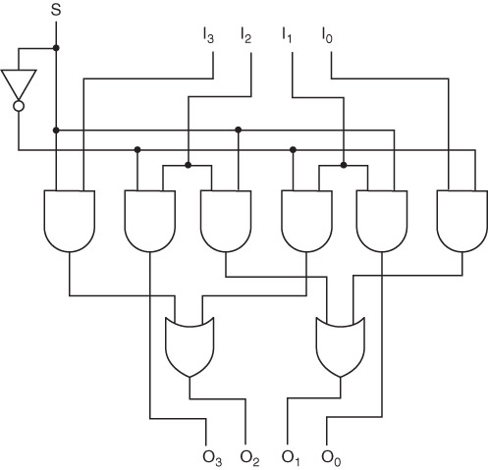
4-bit Shifter
Shift I₃I₂I₁I₀
to the left or
the right to
become O₃O₂O₁O₀
based on S
Notes:
Here is the author’s version of a shifter. This can shift to the left (if S = 0) or to the right (if S = 1). Can you figure this out on your own? I suggest that you try with a sample value. Use I = 1011. When S = 0, you should wind up with 0101. When S = 1, you should wind up with 0110.
We will create an easier to understand shifter later in this chapter although this easier one will be more expensive in terms of logic gates.

Slide 21
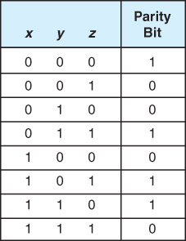
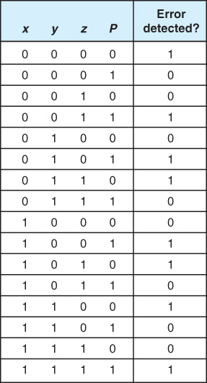
Parity Functions
The table on the left shows the Boolean values to indicate what parity value a 3 bit input should have
The table on the right indicates whether an error should be signaled upon receiving 3 inputs and the parity info
The error detection
circuit is more complex
and will require that we
either build it as a sum
of products or use a
simplification method
What will this circuit look like?
Notice that parity = Not(sum)
Notes:
Here is another function to implement. We can build a circuit to generate the parity bit for a 3 bit value. The truth table is shown to the left. Given that we have a 3 bit value plus its parity bit, the truth table on the right will determine if an error should arise or not. We can build both of these circuits using sum of products. Here is the Boolean expression for the circuit for the left truth table: Parity bit = ~x*~y*~z + ~x*y*z + x*~y*z + x*y*z. However, if you look at this circuit, you might notice something. The parity bit is 1 if and only if the number of 1’s for x, y and z are even (the first row has zero 1s, the other three rows have two 1s). How can we determine if we have an even or odd number of 1 bits? Recall that XOR tells us if two bits differ. If XOR is true, then we have exactly one 1 and one 0. If we chain together two XOR gates, we have an “odd detector”. It outputs a 1 only if we have one 1 or three 1s. Since we want an “even detector”, we negate the output. Here is the circuit:
What would the circuit for the error detector look like?

Slide 22
A Decoder
The Decoder is a circuit that takes a binary pattern and translates it into a single output
This is often used to convert a binary value into a decimal value
For an n-bit input, there are 2^{n} outputs
Below is a 2 input – 4 output decoder
if input = 01, the second line (x*~y) on the right has current
the line 01 would be considered line 1, where we start counting at 0
Notes:
The decoder is a device used to translate from a binary number into a single output. If we have a 4-bit binary number, then there are 16 possible outputs. So the decoder is an n-input to 2^{n} output device. Some of the input lines will be active, these will represent 1s, so that the collection of inputs is a binary number. For instance, a set of inputs could be 1101 (i3=1, i2=1, i1=0, i0=1). Only a single output will be active based on the input. In the above example, the output corresponding to line 13 would be active since 1101 is binary for 13.
The way this works is by having 2^{n} AND gates, each one corresponding the inputs coming into the AND gate where some inputs are going in directly and others are NOTed. The pattern is based on what number the AND gate represents. For instance, the AND gate for 13 would expect 1101, so only i1 would be negated, i3, i2 and i0 would go in directly. Above, we have a 2-input 4-output decoder. The first AND gate represents 11 (that AND gate will only be active if the input is 11, or if x = 1 and y = 1). Notice that they have drawn the decoder with the outputs representing 3 (11), 2 (10), 1 (01) and 0 (00) from top to bottom. Usually we draw the decoder from bottom up instead.
The decoder is a basic device that will be used to take a binary number as input and output a selection. That is, each output line goes to a different device. The single output line that is active is selecting a particular device. The input usually comes from the control unit which knows what device should be activated based on the current instruction.

Slide 23
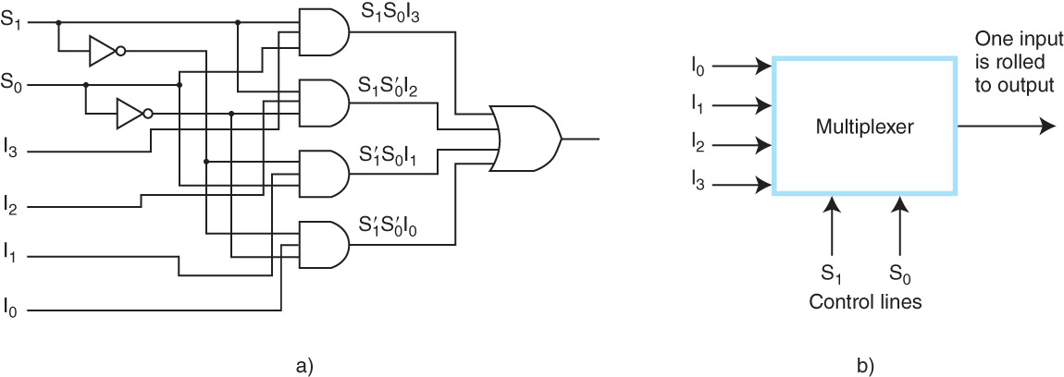
A Multiplexer
Multiplexer (abbreviated as MUX) is used to select from a group of inputs which one to pass on as output
Here, 1 of 4 single-bit inputs is passed on using a 2-bit selector (00 for input 0, 01 for input 1,10 for input 2, 11 for input 3)
While this circuit is more complex than previous ones, this is simplified for a MUX – imagine what it would look like if we wanted to pass on 16 bits from 1 of 4 inputs
A related circuit is the demultiplexer (DEMUX) – it receives 1 input and a select and passes the input onto one of several outputs
Notes:
The multiplexor uses the decoder but takes one further step – it selects an input to pass on as output. The multiplexor outputs only one of its inputs. For instance, if we have 4 1-bit devices, we can select one of those bits to pass on as output. In order to output all bits from a device, we need several multiplexors.
You might recall that we used a MUX for our adder/subtractor. It was actually a collection of MUX’s. Each MUX received 1 input from B and 1 input from –B, and a control signal. The control signal stated whether to pass on the bit from B or from –B. This was a 2:1 MUX (2 devices input, 1 output). If our adder/subtractor operated on an n-bit number, we would need n 2:1 MUXs.
The MUX works as follows: all devices send their input into a different AND gate. Also going into each AND gate are bits from the control lines – some going in directly and some going in after being negated. Above, we have a 1-bit 4:1 MUX. It receives 2 control lines (S1, S0) to select between input 3, 2, 1 or 0. If the control lines receive 10 (the number 2), then it outputs input 2. If the control lines receive 00 (the number 0), then it outputs input 0. You can probably see the decoder portion of the MUX – the control lines and the AND gates. Added to the MUX are the device inputs and the OR gate. Every MUX will have n AND gates for n devices, log ₂ n control lines, and 1 OR gate.

Slide 24
A Simple 2-bit ALU
Putting all these ideas together
We have a 2-bit ALU
Given 2 values,
A and B, each
of which are 2
bits (A0, A1,
B0, B1) and
a selection from
the control unit (f0, f1)
This circuit computes
A+B (if f0 f1 = 00)
NOT A (if f0 f1 = 01)
A OR B (if f0 f1 = 10)
A AND B (if f0 f1 = 11)
And passes the result out as C0 C1
along with overflow if the addition
caused an overflow
Notes:
Now we put together everything we’ve talked about in this chapter to build a very simplistic ALU. This ALU works on 2-bit data and only performs one of four operations, AND, OR, NOT or ADDITION. The inputs from the two devices are B0 and B1, and A0 and A1. The outputs are C0 and C1.
The decoder on the left hand side is part of a multiplexor (the rest of the multiplexor is the OR gates prior to C0 and C1, and the input from the “devices” (the AND gate near the top is the AND device, the NOT gate is the NOT device, the OR gate is the OR device, and in the lower center and lower right are the components that make up the ADDITION circuit).
The control unit passes in a control signal (for instance, 10 to perform A OR B). A and B are connected to registers. The B inputs are received from one register and the A inputs from the other register. Notice that current flows through the entire circuit, but the decoder makes sure that only the third and sixth AND gates are active to pass on the results of the two OR gates. Had the selector input been 00, then only the first and fourth AND gates would have been active. All of the AND gates output 0s except for the two that were selected. They output their inputs, which in this example, is the result of the two OR gates. So C0 gets the value of B0 OR A0 and C1 gets the value of B1 or A1. See if you can trace through the circuit to figure this out.
The addition operation is far more complex because of the need to have both a carry and a sum (C0 is A0 + B0, and C1 is A1 + B1 + carry in). The carry out of the second adder is sent on to the overflow flag.
How would this circuit change if we wanted to implement 8 different operations on two 2-bit values?
How would this circuit change if we wanted to implement the 4 operations above on two 8-bit values?

Slide 25
Sequential Circuits
All of the previous circuits were combinational circuits
Current flowed in at one end and out the other
Combinational circuits cannot retain values
If we want to build a kind of memory, we need to use a sequential circuit
In a sequential circuit, current flows into the circuit and stays there
This is done by looping the output back into the input
Sequential circuits will be used to implement 1-bit storage
We can then combine 1-bit storage circuits into groups for n-bit storage (registers, cache)
These circuits will be known as flip-flops because they can flip from one state (storing 1) to another (storing 0) or vice versa

Slide 26
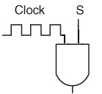
The Clock
The clock will control when certain actions should take place
The clock simply generates a sequence of electrical current “pulses”
In the figure below, when the line is high, it means current is flowing, when low it means current is not flowing
Thus, if we want to control when to shift, we connect the S input to an AND gate that includes the clock as another input
We will use the clock to control a number of
things in the CPU, such as flip-flop changes
of state, or when ALU components should
perform their operation

Slide 27
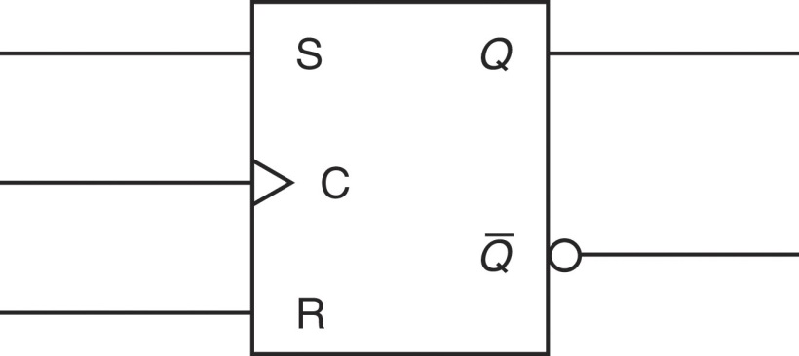
An S-R Flip-Flop
The S-R flip-flop has 2 inputs and 2 outputs
The 2 inputs represent Set (storing a 1 in the flip-flop) and Reset (storing a 0 in the flip-flop)
It has two outputs although Q is the only one we will regularly use
To place a new value in the flip-flop, send a current over either S or R depending on the value we want, to get a value, just examine Q
Note that the S-R flip-flop is not
controlled by the clock
the S-R flip-flop circuit diagram and truth
table are given above, and can be represented
abstractly by the figure to the right
Notes:
Trace through the S-R flip-flop (FF) above. Assume currently the FF is storing no value. This means that Q is outputting 0 (which means that ~Q is outputting 1). S and R are both 0 at the moment. Q NOR S = ~Q which is 1 (0 NOR 0 is 1). ~Q NOR R = Q which is 0 (1 NOR 0 is 0). This remains stable until we pass in either S = 1 or R = 1. Lets pass in S = 1 (Set the FF). Now the top NOR gate is 1 NOR 0 = 0, so ~Q switches from 1 to 0. The bottom FF gets 0 NOR 0 = 1, so Q has switched from 0 to 1. Eventually, S turns off. Q is still 1, so the top NOR gate gets 1 NOR 0 = 0 and the bottom NOR gate gets 0 NOR 0 = 1. Again, the FF is in a stable state. If we pass in R = 1 (reset), then we have 1 NOR 0 = 0 in the bottom NOR gate, or Q becomes 0, and then we get 0 NOR 0 = 1 in the upper NOR gate so ~Q becomes 1. After R becomes 0, the FF remains stable.
The only time this FF is not stable is if both S and R get 1 inputs in which case the FF oscillates until one or both lines shut off. The resulting state of the FF depends on which line shut off last. If R stayed on slightly longer, then the FF resets to 0. If S stayed on longer, the FF sets to 1.
So the FF can either retain a value of 0 or 1 for an indeterminate amount of time as long as the circuit continues getting voltage. Thus, the FF is a convenient way to store 1 bit in memory. We will use FFs for registers and cache, but not main memory. This gets explained in chapter 6.

Slide 28
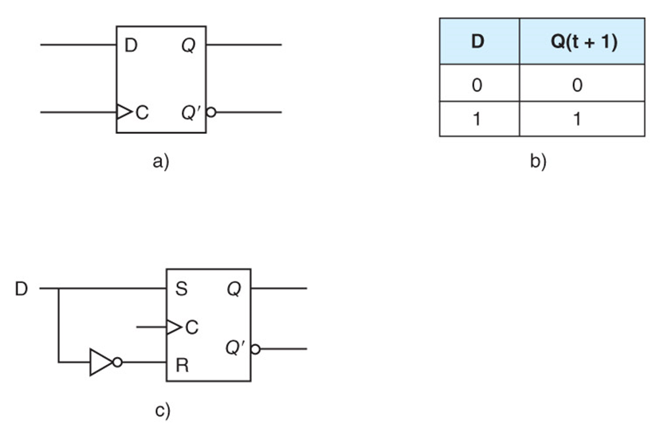
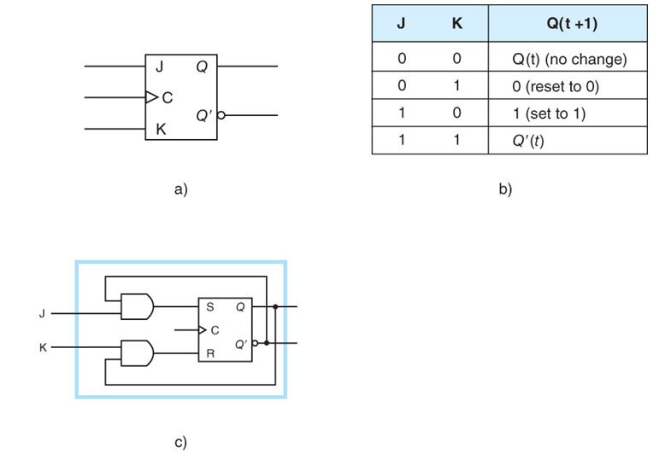
D and JK Flip-Flops

Slide 29
Registers
Since a single flip-flop stores a single bit, we combine n of them to create an n-bit register
However, the S-R flip-flop can be set or reset at any time, we instead want to use the system clock to determine when to change the value
So, we will use a D flip-flop instead
In the D flip-flop, there are 2 input lines, but they represent different things than the S-R flip-flop
One input is the clock – the flip-flop can only change when the clock pulses
The other input, labeled as D – is the input
if 0, then the flip-flop will store 0,
if 1 then the flip-flop will store 1
See figure 3.22 for a D flip-flop
Note: another flip-flop often used for storage is the J-K flip-flop, but since it is more complicated, we will skip it
Notes:
We will actually use the D-flip flop instead of the SR-flip flop because the D FF is easier to build and can only change value on a clock pulse, plus it cannot get into an indeterminate state. Here is the truth table for the D FF (where X means don’t care, could be a 0 or a 1) where D is the input and Q is the output. Notice that Q is constant (or Qprev) unless the clock is pusling.
Clock D Q Qprev
Rising edge 0 0 X
Rising edge 1 1 X
Non-Rising X constant

Slide 30
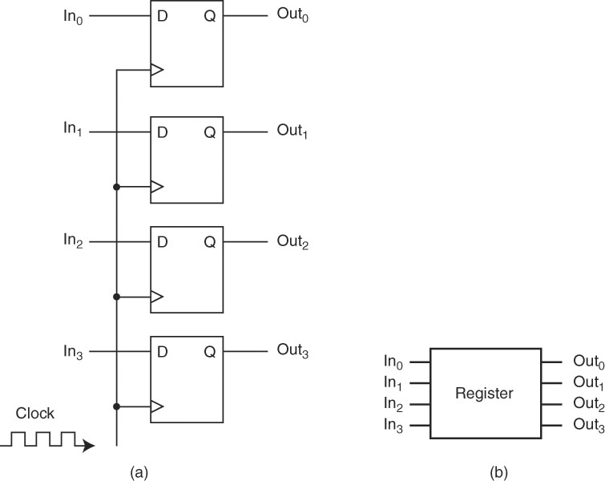
Registers From D Flip-Flops
To the right is a 4-bit register
Triggered by the system clock
And connected to an input bus and
An output bus
Below is an 8-bit register with a
single I/O bus
Notes:
Now we take a collection of D FFs and build a register. The top diagram is a 4-bit register. The bottom figure is an 8-bit register where there is a single bus connecting to the register. In the top figure, we have two separate buses, one for input and one for output. This is impractical. Instead, we use enable gates (the little triangles) to “protect” the bus and FFs. The bus will usually be active, but the D FFs will only receive an input from the bus when the Enable input gates are signaled (from the control unit) and the FFs will only change values when the Clock pulses. So the D FFs are stable until both enable input and clock signals are received. The FFs are always releasing their values out of the Q output but the enable output prevents them from going out onto the bus unless the control unit has selected the enable output gate to “open”.

Slide 31
Shift and Rotate Registers
The shift circuit we saw earlier is difficult to trace through although efficient in terms of hardware
we can also build a special kind of register called a shift register or a rotate register by connecting SR flip flops
this register will store a bit in each FF as any register, but the Q and ~Q outputs are connected to the SR inputs of a neighboring FF
below is a 4-bit right rotate (it rotates the rightmost bit to the leftmost FF, so 1001 becomes 1100 and 0001 becomes 1000)
Upon a clock pulse, each Q output is connected to the FF to the
right’s S input and each ~Q output is connected to the FF to the
right’s R input, so an output of Q = 1 causes the next FF to set
(become 1) and an output of ~Q = 1 causes the next FF to reset (0)
Notes:
To build a right shift, the output of the rightmost FF is not connected to anything, and the leftmost FF has an input of R = 1always. To build a left shift or left rotate, we redirect the outputs so that the output of one FF goes to the FF on the left, not the right.
How would you implement an arithmetic shift?

Slide 32
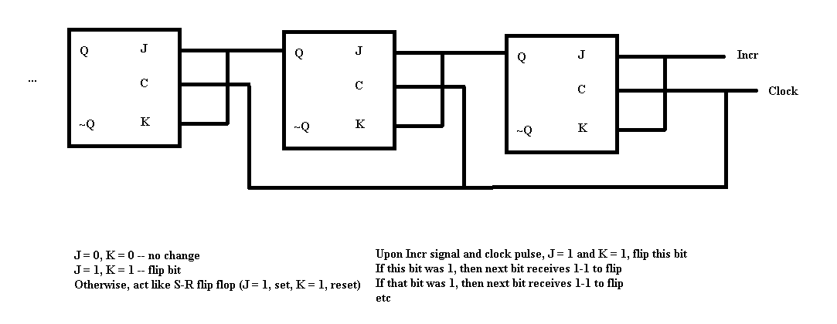
Increment Register
The J-K flip flop is like the S-R flip flop except
J = 1 and K = 1 flips the bit
Flip flop only changes state on clock pulse
Use J-K to implement an increment register – increments the value stored when it receives and Incr signal and a clock pulse

Slide 33
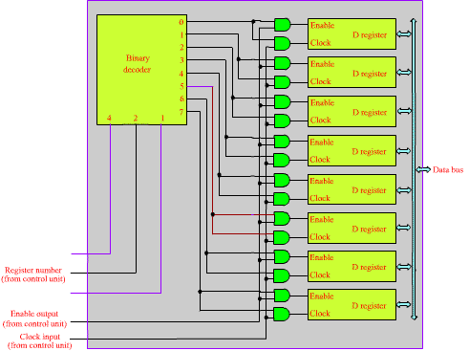
A Register File
The decoder accepts
a 3-bit register number from the control unit
This along with the system clock selects the register
The data bus is used for both input and output to the selected register
Notes:
Here we build a register file, a collection of 8 registers. Each D register is based on the D register from the previous slide. We select one register by sending a 3-bit binary number from the control unit to the decoder. In the figure above, we are selecting register 5 (101). The control unit also passes in either clock input to perform input from the bus, or enable output to take the values from the D FF and pass them onto the bus.

Slide 34
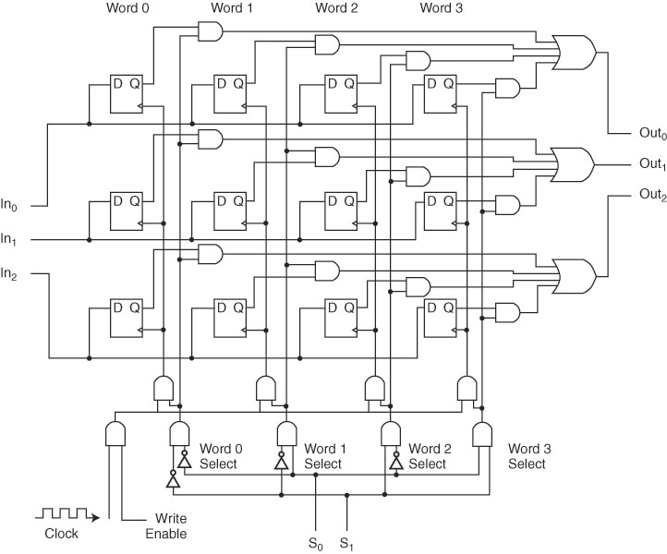
A 4x3 Memory
This is a collection of
flip-flops that can store 4 items (each consisting of 3 bits)
The two bit selector S0 S1
chooses which of the 4 items is desired
It should be noted that computer memory uses a different technology than flip-flops
Notes:
We wrap up with another complex circuit, a 4x3 memory. The idea here is we have 4 memory locations, each of which can store 1 word. A word in this case is merely 3 bits.
The circuit receives a 3-bit input from the input bus and delivers a 3-bit output to the output bus. Each storage location (bit) is a D FF. To select a word, a decoder is used (see the bottom of the figure), controlled by S0, S1 from the control bus. The inputs for each FF are protected by the decoder. The output bus is controlled by a MUX which combines the Q outputs from all FFs, the decoder, the OR gates (on the right hand side), and also additional AND gates – one combines the clock and Write enable (unless both are active, we don’t output), and the AND gate combine out of each Q output (which ANDs the output of the FF with the selector).
Obviously, a real memory would be far larger. Imagine that we want a 16K cache where each word stores 32 bits. We would have 16K * 32 total FFs, one for each bit of each word. Our selector would have to select between the 16K words, so we would have log ₂ 16K = 14 selector bits (instead of 2). We would have 32 input lines, one line going to each D FF of each word (so we would have 32 rows). With 16K words, we would have 16K columns. Finally, we would have 32 output lines, so we would have 32 OR gates. See if you can visualization what this would look like.
We would build main memory out of DRAM, which uses capacitors instead of FFs, so while it would look somewhat like the above, it has several differences. Again, we will discuss this in chapter 6.

