Slide 1
Objects and Classes
Object-oriented programming (OOP) revolves around
Defining classes
Creating instances of classes (objects) and interacting with the objects through message passing
This paradigm differs from traditional procedural programming where you have
Procedures/functions that call other procedures/functions because interaction with an object can only be done through the class’ interface
This promotes such concepts as information hiding and encapsulation
OOP also permits inheritance so that we can extend a class into a more specific class without rewriting the original class from scratch

Slide 2
States and Behaviors
The state of an object is the collection of instance data and their current values
The behavior of an object is how it responds to messages, which is dictated by the methods that are implemented in the class
All objects of the same class will share the same methods and the same instance data
but each object has its own state because it will have its own unique storage in memory with (possibly) differing values for its instance data
Objects share the same interface
you access each object of a class in the same way
but objects differ as you use them because of their differing states

Slide 3
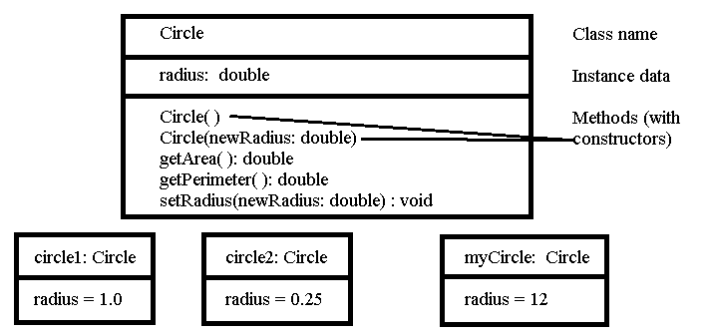
Defining Classes: UML
UML is the Unified Modeling Language
It is a representation used to illustrate the components of a class without necessarily seeing the details
This representation is provided as a box segmented into 3 areas: the class name, the instance data (type and name) and the methods’ names (including their return type if any and their parameters)
We can also express objects of a class in UML by filling in their state
Below, we see UML for a Circle class (shown in the next slides)

Slide 4
Circle Class Defined
public class Circle {
private double radius;
public Circle( ) { radius=1.0; }
public Circle(double newRadius) {
radius=newRadius;
}
public double getRadius() {
return radius;
}
public void setRadius(double newRadius) {
radius = newRadius;
}
public double getArea() {
return radius*radius*Math.PI;
}
public double getPerimeter() {
return 2*radius*Math.PI;
}

Slide 5
A Class Explained
As our classes are to model real world things (whether physical objects, abstract objects or concepts)
We need to model them through instance data
for the circle, we have radius
A constructor is a method that will be used to initialize any instance data
We need to define an interface – how other programs will interact with the object
We will usually want to protect the instance data from external access, so to access and effect them, we need methods
accessor methods will return values of instance data (like getArea, getPerimeter)
mutator methods will (or can) alter instance data (like setRadius)

Slide 6
Using a Class
Once defined, we use the class by
Declaring variables of that type of class
Circle circle1, circle2, mycircle;
Instantiate the variables into objects (instantiation calls upon the class’ constructor)
circle1=new Circle( ); // use the first constructor
mycircle=new Circle(12); // use the second constructor
Pass messages to those objects
perimeter=mycircle.getPerimeter( );
mycircle.setRadius(10);
We place these instructions in another class
Often a “user class” which is defined in a class with a main method
A class with a main method is the only type of class that can be directly executed in Java

Slide 7
Visibility Modifiers
There are four modifiers that control who can access the various components of a class (methods, instance data): public, private, protected, default
To support information hiding, we generally want to make all instance data private (accessible only from within the class) so that another object cannot alter this object’s data
constants can be public because they cannot be altered
To provide an interface, those methods that can be called from outside the class will be made public
other methods that are called only from within the class are also made private
Protected items will be discussed when we look at inheritance
The default modifier means that you do not list any of public, private or protected – this modifier means that items are treated as private unless the classes are defined in the same package (library)

Slide 8
Example
y and m2 are default, available to C1 and C2 alike but not to C3

Slide 9
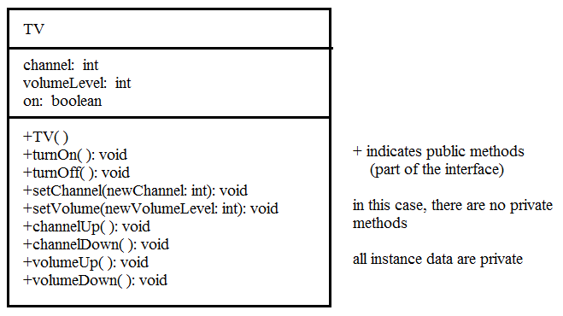
Example: TV Class
public class TV {
int channel = 1; // Default channel
int volumeLevel = 1; // Default volume
boolean on = false; // Default TV is off
public TV( ) { }
public void turnOn( ) {
on = true;
}
public void turnOff( ) {
on = false;
}
public void setChannel(int newChannel) {
if (on && newChannel >= 1 && newChannel <= 120)
channel = newChannel;
}
}

Slide 10
public void setVolume(int newVolumeLevel) {
if (on && newVolumeLevel >= 1 &&
newVolumeLevel <= 7)
volumeLevel = newVolumeLevel;
}
public void channelUp( ) {
if (on && channel < 120) channel++;
}
public void channelDown( ) {
if (on && channel > 1) channel--;
}
public void volumeUp( ) {
if (on && volumeLevel < 7) volumeLevel++;
}
public void volumeDown( ) {
if (on && volumeLevel > 1) volumeLevel--;
}
}

Slide 11
TestTV
public class TestTV {
public static void main(String[] args) {
TV tv1 = new TV();
tv1.turnOn();
tv1.setChannel(30);
tv1.setVolume(3);
TV tv2 = new TV();
tv2.turnOn();
tv2.channelUp();
tv2.channelUp();
tv2.volumeUp();
System.out.println("tv1's channel is " +
tv1.channel + " and volume level is " +
tv1.volumeLevel);
System.out.println("tv2's channel is " +
tv2.channel + " and volume level is " +
tv2.volumeLevel);
}
}

Slide 12
Constructors
All classes require a constructor
if you do not define one, a default constructor will be provided by the Java compiler
this default constructor is a no-arg constructor (no parameters)
you may (and probably should) overload your constructor so that you can define a constructor for each possible set of parameters that you might expect to the constructor
recall Circle had two, one with no parameter and one with a double as a parameter
The constructor is called when you do a new Class(…) operation
Constructors must share the same name as the class and must be public to be of use
Constructors have no return type (not even void)

Slide 13
Accessors and Mutators
Since we hide our instance data (make them private), how do we access and change the data in an object?
Accessor methods are usually simple methods that return a single instance datum
its name will usually be getVariableName such as getX or getRadius
Mutator methods are usually simple methods that change a single instance datum as in setRadius
however, we can also make mutators that change multiple data as needed
We usually want to ensure that any data change make sense – for setRadius, we might make sure the parameter passed is positive (a negative or 0 radius doesn’t make sense)
public void setRadius(double newRadius){
if(newRadius > 0) radius = newRadius;
}

Slide 14
Additional Examples
Here we see the Random and Date classes using UML

Slide 15
Reference Variables
All variables in Java are of one of two types
A primitive – int, char, double, float, boolean, etc
A reference variable – this serves as a means to reference an object
in most programming languages, we call the reference a pointer because it stores a memory location of the item being referenced instead of the actual item
You declare reference variables like any other type
The reference variable is the size of an address
You point the reference variable by assigning it to the location of an object
if the object doesn’t exist yet, use new Class(…)
if an object of this type exists, you can point this variable at it using var=existingObject;

Slide 16
Reference Variables vs Primitive Data

Slide 17
Reference vs What is Being Referred
With a primitive datum, the datum is stored in an easily accessible area of memory (the stack) where you access the datum by variable name
With an object, the datum is stored in the heap
The heap stores nameless items
You can only access these items through a pointer (reference variable)
Usually the reference variable itself is stored in the stack, pointing to an area of the heap
Heap memory when no longer of use must be deallocated so that the heap can reuse it
In some languages like C/C++, you have to explicitly deallocate heap memory use a special instruction
In Java, if you reassign the reference to point elsewhere, the Java garbage collection will deallocate that heap memory

Slide 18
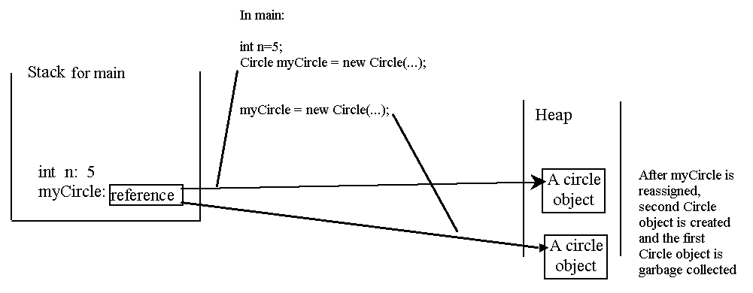
Stack vs Heap Memory
For every method, you are given a location in the run time stack to store each local variable and parameter
Objects are referenced by reference variables, stored on the stack
Objects are physically stored in heap memory, created whenever you use new and deallocated whenever the reference variable is reassigned

Slide 19
Passing Objects as Parameters
We can pass primitive data or reference variables as parameters to methods
foo(var);
If var is a primitive, we are passing a copy of var
changing the value in the method does not impact var
If var is a reference, we are passing a copy of the object’s address in memory, not a copy of the object
changing var (via message passing) in the method changes the object itself

Slide 20
Example
public class IncrementClassUser {
public static void main
(String[] args){
IncrementClass foo=new
IncrementClass(0);
int x=0;
increment(foo);
increment(x);
System.out.println(
foo.getValue( ));
System.out.println(x);
}
public static void increment
(int value) {
value++;
}
public static void increment
(IncrementClass foo) {
foo.inc( );
}
}
public class ExampleClass {
private int x;
public ExampleClass(int value)
{x = value;}
public void inc( ){x++;}
public int getValue( )
{return x;}
}
Output is
1
0
See how foo changes but x does not

Slide 21
The null Value
Reference variables that are not currently pointing at an object in the heap will have the value null
You can alter the reference variable’s value by instantiating a new object
Using var=new Class(…);
Or by assigning the variable to point at an already existing object as in var=var2;
for this to work, var2 must be the same class of object as var (we refine this idea later when we learn about inheritance and polymorphism)
Passing a message to an object whose value will yield a NullPointerException
We can avoid this by testing the variable first
if(var!=null) var.someMessage( );

Slide 22
Static
The term static is meant to convey that all instances of a class share this item
We can use static to modify a variable, a constant and/or a method
if an instance data is static, then that variable is shared among all objects of the class
in such a case, the instance datum is thought of as a class variable (or a class-wide variable) – we only do this if we intend that no single object has its own unique variable but instead the one variable is shared across all objects of the class
if a method is static, then the method cannot access instance data of the class (but it can access class variables)
we might use this to access any static variables
We generally only use static when we are defining methods and variables in a class with main

Slide 23
Example
public class StaticExample {
private int x;
private static int y;
public StaticExample() {
x=y=0;
}
public StaticExample(int x) {
this.x=x;
y=0;
}
public void change(int x) {
this.x=x;
y++;
}
public void inc() {
x++; y++;
}
public static int getY() {
return y;
}
}
public class StaticUser
{
public static void
main(String[] args){
StaticExample s1=
new StaticExample();
StaticExample s2=
new StaticExample(5);
StaticExample s3=
new StaticExample(10);
s1.inc();
s2.change(15);
s3.change(22);
s3.inc();
System.out.println(
StaticExample.getY());
}
}
Outputs 4

Slide 24
Another Example
The CircleWithStaticMembers class is defined on p. 313-314
We add a static int variable numberOfObjects
this variable is a class-wide variable, incremented whenever the constructor is called
And a static method getNumberOfObjects to return this class-wide variable
Notice that since we do not have an explicit deconstructor, we do not know when to decrement numberOfObjects

Slide 25
Summary of Static
A non-static method
can invoke another non-static method
can access a non-static instance datum
can invoke a static method
can access a static instance datum (classwide variable)
A static method
can invoke a static method
can access a static instance datum
cannot invoke a non-static method
cannot access a non-static instance datum
Typically you will define a static method to operate on parameters passed to the method, for instance
public static int compareCircle(Circle c1, Circle c2) {…} // code will compare two circles and return an int indicating which is larger, for instance, -1, 0 or 1 for c1 < c2, c1 == c2, and c1 > c2 respectively

Slide 26
Arrays of Objects
Arrays are objects and so need to be instantiated
int[ ] x = new int[10];
Notice how this instantiation differs from an ordinary object where we pass parameters as in
Car c = new Car(“ferrari”, 2013);
But an array of objects requires two levels of instantiation
Car[ ] cars = new Car[100];
cars[0] = new Car(“ferrari”, 2013);
cars[1] = new Car(“prius”, 2010, “used”);
cars[2] through cars[99] are currently equal to null and so passing one a message (e.g., cars[2].getYear( );) would cause a NullPointerException

Slide 27
Java as a Compiled Language
High level programming languages are either compiled or interpreted
An interpreted language runs in an environment maintained by an interpreter
The interpreter takes each program instruction, one at a time, converts it to machine language and executes it
In this way, you can execute instructions from a command line interface to test each instruction out
Compiled languages are translated into machine language all at once requiring that the program be complete (or complete enough to permit compilation)
Java is a compiled language and yet the Java compiler does not compile a Java program into machine language

Slide 28
The Java Compiler and the JVM
The Java compiler compiles your code into an intermediate form called byte code
Byte code is machine independent but consists of primitive operations
more like machine or assembly language instructions
To execute your byte code, you need a Java Virtual Machine which translates the byte code into executable code
The JVM runs in any web browser and also in the JRE (Java Runtime Environment)
Although interpreted languages will run more slowly then compiled languages because of the need for interpreting code at run time, Java is somewhat of an exception
Because the JVM is only doing minimal interpretation as byte code is already at a low level
The advantage of this approach is that byte code is platform independent allowing Java programs to be compiled once but can then run nearly anywhere

Slide 29
What the Java Compiler Does
Obviously the Java compiler compiles your Java code
It will convert a Java class into a .class file
Consider the TV and TestTV classes from earlier
Compiling TV.java creates TV.class
Compiling TestTV.java creates TestTV.class
you cannot directly run a .class file as if it were a .exe file
instead you run it via the JRE
Note that we will see later how to define classes inside of other classes (nested or inner classes)
an inner class is compiled into its own .class file separate from the outer class
e.g., public class Foo {… private class Bar {…} } will create Foo.class and Foo$Bar.class
As with any compiled language, the compiler will also locate compiler errors
We call these syntax errors
The Java compiler will not be able to compile a Java class with syntax errors and so you must fix all syntax errors before successfully compiling the class

