Slide 1
Threads
We think of a process (a running program) as a single entity
Our modern operating systems can run multiple concurrent processes, switching off quickly between them
Multitasking
But any single process may entail multiple components which could potentially also run concurrently
We would call these components threads
A multi-threaded program is one that is made up of threads where each thread could run concurrently
All threads share the same code but each thread may execute the code in different ways (take different branches) – we refer to the path a thread takes through the code as its flow – the threads have different flows
Here we see a CPU
switching off between
threads

Slide 2
Threads in Java
Many programming languages do not have a facility for threads instead requiring that your program place system calls to the operating system to create and manage the threads
Java though has very powerful but easy to use facilities for threading based on the interface Runnable
Define your class which implements Runnable
To implement Runnable, you need to define a method called run – no parameters, no return type
Then in a user class, create instances of your class and then use those instances to generate threads
Thread is a built-in class with a method called start( ) which itself will invoke your class’ run method (in a similar way that repaint( ) will invoke paintComponent)

Slide 3
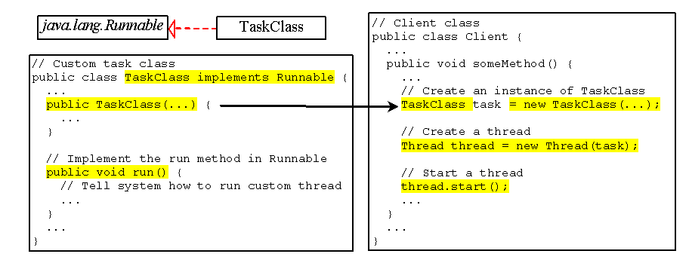
Implementing Threads
Below we see a “TaskClass” – that is, a class that contains a task to become a thread
The user class creates an instance of the task and then generates a Thread from it and then starts the Thread

Slide 4
Example
To demonstrate that the OS is switching off between threads, we implement a simple class that contains a char variable to output
When running, all it does is print out its char variable
We also add a count variable to add some new line characters so that the output doesn’t look too awful
We create a user class which instantiates 3 variables of the task class, each with a different character to output
We start each thread and now we are at the mercy of the OS to switch between the threads
Below we see an example of the output, the code is on the next slide
aaaaaaaaaaaaaaacccccccccccccccccccccccccccccccccccccccccccccccccc
cccccccccccccccccccccccccccccccccccccccccccccccccc
cccccccccccccccccccccccccccccccccccccccccccccccccc
cccccccccccccccccccccccccccccccccccccccccccccccccc
cccccccccccccccccccccccccccccccccccccccccccccccccc
cccccccccccccccccccccccccccccccccccccccccccccccccc
cccccccccccccccccccccccccccccccccccccccccccccccccc
cccccccccccccccccccccccccccccccccccccccccccccccccc
ccccccccccccccccccccccccccccccccccccccccccacacacacbabbcbabbbbcbbbabbcbabbc
babbbcbabbcbabbcbabbcbabcbbbbbabbbbbbbbbbbbbb

Slide 5
public class RandomCharacters implements Runnable {
private char c;
private int count=0;
public RandomCharacters(char c){
this.c=c;
}
public void run(){
while(true){
System.out.print(c);
count++;
if(count==100) {
System.out.println();
count=0;
}
}
}
}
The following code would be
part of main
RandomCharacters r1, r2, r3;
r1=new RandomCharacters('a');
r2=new RandomCharacters('b');
r3=new RandomCharacters('c');
Thread t1,t2,t3;
t1=new Thread(r1);
t2=new Thread(r2);
t3=new Thread(r3);
t1.start();
t2.start();
t3.start();

Slide 6
Threads and Exceptions
Threads will execute and be interrupted by the OS so that the OS can switch from one Thread to another
While a Thread might be in some state of execution (it has been started, has not ended, but is not active because the OS has switched to another Thread) then another Thread could interrupt this Thread by using Thread.interrupt( );
In such a case, then this Thread has been interrupted
If this happens and this Thread is currently executing one of several methods such as sleep, join or wait, then it unblocks (becomes active momentarily) and throws an InterruptedException
Therefore Thread has CheckedExceptions for some of its methods and we must therefore implement exception handling for InterruptedException
If possible, we may want to handle the exception by throwing it out of this method by adding throws InterruptedException to the method’s header
However, this may not be possible, for instance if we are invoking a method like join or sleep inside of the run method (since run is part of the Runnable interface, the compiler will not accept “throws InterrutpedException” in run’s header)

Slide 7
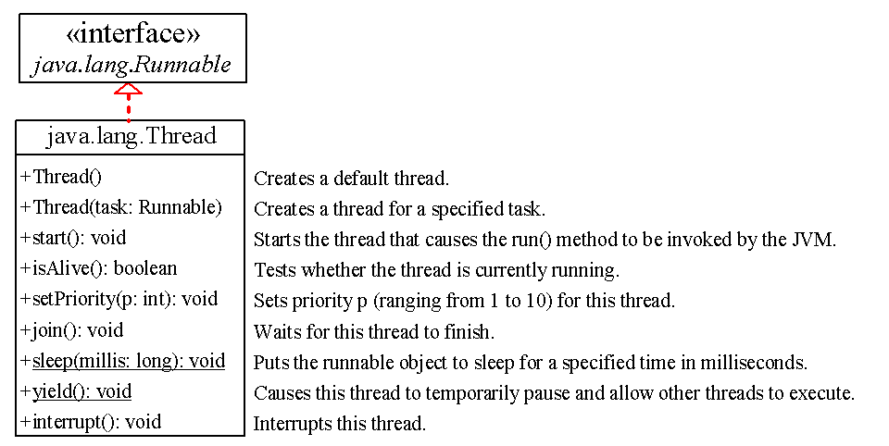
The Thread Class UML
We can establish priorities so that the OS can alter the number of cycles given to any single thread
join, sleep, yield, interrupt – all allow us to control more precisely when a Thread will execute and stop executing (we cover them next)

Slide 8
setPriority
This method expects an int value between 1 and 10 to set the Thread’s priority
1 is the lowest priority, 10 is the highest (5 is the default)
If we established t1 and t3 with priorities of 1 and t2 with a priority of 5, we would expect to see a lot more b’s printed out (although it will not always be the case depending on OS load and other factors)
Notice that the three threads execute the same code so their only differences are 1. their priority, 2. their internal data (the values of c and count), and 3. their path through the code (t2 will execute more often instructions and so will execute the if statement more often, for example)
bbbaaaaaaabbbbbbbbbbbbbbbbbbbbbbbbbbbbbbbbbbbbbbbbbbbbbbb
bbbbbbbbbbbbbbbbbbbbbbbbbbbbbbbbbbbbbbbbbbbbbbbbbb
bbbbbbbbbbbbbbbbbbbbbbbbbbbbbbbbbbbbbbbbbbbbbbbbbb
bbbbbbbbbbbbbbbbbbbbbbbbbbbbbbbbbbbbbbbbbbbbbbbbbb
bbbbbbbbbbbbbbbbbbbbbbbbbbbbbbbbbbbbbbbbbbbbbbbbbb
bbbbbbbbbbbbbbbbbbbbbbbbbbbbbbbbbbbbbbbbbbbbbbbbbb
bbbbbbbbbbbbbbbbbbbbbbbbbbbbbbbbbbbbbbbbbbbbbbbbbb
bbbbbbbbbbbbbbbbbbbbbbbbbbbbbbbbbbbbbbbbbbbbbbbbbb
bbbbbbbbbbbbbcbbbbbbbbbbbbbbbbbbbbbbbabcbabbc
Example output with
t2’s priority at 5 and
t1 and t3 at 1

Slide 9
The join Method
The join method causes the current object to suspend until the Thread which is passed the message completes
For instance, imagine that we have two threads running
One thread is producing values for another thread
we refer to these as a producer and a consumer
The consumer wants to consume the value produced by the producer
Since the OS determines when to switch off between threads, we do not want to risk that the consumer attempts to consume the value produced by the producer until the producer is done
So we will use the join method from the consumer to join the producer
This forces the consumer to wait until the producer’s run method terminates before the consumer resumes
We can let the consumer execute until it reaches the point where it will try to consume, prior to the consume instruction, we join the producer to cause the consumer to pause

Slide 10
public class JoinExample {
private static int count=0;
private static Thread t1, t2;
public static void main(String[] args) {
Producer p=new Producer(); Consumer c=new Consumer();
t1=new Thread(p); t2=new Thread(c);
t1.start(); t2.start();
}
public static class Producer implements Runnable {
public void run(){
System.out.println("running producer");
for(int i=0;i<1000000;i++)count++;
System.out.println("producer ending");
}
public static class Consumer implements Runnable {
public void run() {
System.out.println("running consumer");
try{
t1.join();
System.out.println("rejoining consumer");
}
catch(InterruptedException e) {
System.out.println(e);
}
System.out.println(count);
System.out.println("consumer ending");
}}}
Output:
running producer
running consumer
producer ending
rejoining consumer
1000000
consumer ending
Pause
consumer
before
“consuming”

Slide 11
sleep and yield methods
The sleep method receives the number of milliseconds (as a long) to put this thread to sleep
while asleep, the CPU ignores it (does not execute it)
you might use sleep to allow temporarily other Threads to get access to the CPU (thus temporarily lowering the priority of this Thread) or you might use sleep if you only want this Thread to occasionally be awake
such as a Thread that should check for changes in status occasionally like every .5 seconds
yield is similar in that this Thread gives us access to the CPU temporarily, but in this case you do not control the time period that the Thread waits
in effect, yield causes this Thread to give up 1 turn in the queue of the Threads being executed so it is a sleep for a very short period
you could accomplish something similar by lowering the Thread’s priority and then raising it again although yield is more precise

Slide 12
Timer Example
Here we use the sleep method to build our own timer so that we do not need to use the Timer class
In our Task’s run method, we output the value of some int value i and increment it, and then sleep for 1000 milliseconds (1 second)
Thus, this simple Task outputs the number of elapsed seconds
public static class SleepThread implements Runnable {
public void run() {
int i=0;
while(true) {
try{
System.out.println(i++);
Thread.sleep(1000);
}
catch(InterruptedException e) {
System.out.println(e);
}
}
}

Slide 13
Deprecated Methods
The first version of Java had additional methods of stop, suspend and resume
These methods were deemed unsafe because you could potentially control others’ threads by stopping or suspending them
Instead, suspend and resume are replaced by yield/sleep and join
Instead of stop, you can stop a Thread by setting the Thread variable to null
if(somecondition) t=null;
Note that by setting t to null, a command like t.setPriority(1) or t. sleep(1000) will yield a NullPointerException so we might want to test t for null before passing it a message (or use additional catch blocks)

Slide 14
A Thread Problem
Recall our earlier RandomCharacters class which printed out what looked like truly random characters because of how the CPU was switching off between the Threads
Imagine that instead of using System.out.println, the three Threads were outputting to a File
The result would be that one Thread might interrupt another resulting in some of the second Thread’s output interfering with the first Thread’s output
aaaaaaaaaaaaaaacccccccccccccccccccccccccccccccccccccccccccccccccc
cccccccccccccccccccccccccccccccccccccccccccccccccc
cccccccccccccccccccccccccccccccccccccccccccccccccc
cccccccccccccccccccccccccccccccccccccccccccccccccc
cccccccccccccccccccccccccccccccccccccccccccccccccc
ccccccccccccccccccccccccccccccccccccccccccacacacacbabbcbabbbbcbbbabbcbabbc
babbbcbabbcbabbcbabbcbabcbbbbbabbbbbbbbbbbbbb
Thread 3 interrupts
Thread 1 and later
they are all interrupting
each other!

Slide 15
Data Corruption
This problem with our Threads arises because the Threads share a resource (in this example, System.out, but it could be a file or shared variable in memory)
By allowing one Thread to interrupt another while one Thread is already using the resource can lead to data corruption
Consider a banking situation where two Tellers are sharing one customer database
Two customers share the same account, they are both being served by the two Tellers separately but at the same time
If we are not careful, the two Tellers may try to access the shared datum (the customer’s account balance)
If Teller 1 accesses account balance and finds $1000 there and then the OS interrupts Teller 1 for Teller 2, Teller 2 will also find $1000 there, customer 2 asks Teller 2 to deduct $1000 and does so, but Teller 1’s program has already copied $1000 from the database into a local variable, so according to Teller 1, there is still $1000 there even though Teller 2 already deducted it!
Thus, the two customers can potentially walk away with $2000

Slide 16
Revised Example
public class RandomCharacters2 implements Runnable {
private char c;
private MyOutput o;
private int count=0,i=0;
public RandomCharacters2(char c, MyOutput o) {
this.c=c;
this.o=o;
}
public void run(){
while(i<100) {
i++;
o.output(c);
count++;
if(count==50) { o.output('\n');
count=0;
}
}
}
}
MyOutput is a simple class that represents a shared resource (think of it as a file so that different Threads are outputting to the same file)
We want to ensure that the Threads do not overlap in writing to the output or else we get corrupt output
public class MyOutput {
public void output(char c) {
System.out.print(c);
}
}

Slide 17
Synchronization
There are three solutions to this problem
Don’t use multitasking
Without multitasking, the process/thread cannot be interrupted so there is no risk of data corruption as the process/thread uses it until completion
Use multitasking/multithreading but don’t permit shared resources
One reason for networks is to share resources, if we cannot share resources, we have to ensure that resources are only available to one process/one computer which is not very practical
Use synchronization
This is the solution we prefer – we implement a shared resource so that, once one process/thread starts to use it, all other processes/threads are blocked from using
The result is that the blocked processes/threads must wait for the resource to become free, so a Thread may have to use a join, yield or sleep to await the time when the resource is next available for it to use

Slide 18
Implementing Synchronization
There are many ways to implement synchronization on top of the Java code that we have already seen but Java already gives us an easy mechanism
If a method is to operate on a critical section, we can force synchronized access to the critical section by making the method “synchronized”
This is a modifier that we add to the method header after the visibility modifier and before the return type
In our revised example, the method that operates on the shared resource is MyOutput’s output method
public synchronized void output(char c) {…}
Our revised output, remember
Thread 2 had the highest
priority, it runs and even if it
is interrupted the other
Threads are blocked from
calling output until Thread 2
finishes with it!
bbbbbbbbbbbbbbbbbbbbbbbbbbbbbbbbbbbbbbbbbbbbbbbbbb
bbbbbbbbbbbbbbbbbbbbbbbbbbbbbbbbbbbbbbbbbbbbbbbbbb
aaaaaaaaaaaaaaaaaaaaaaaaaaaaaaaaaaaaaaaaaaaaaaaaa
aaaaaaaaaaaaaaaaaaaaaaaaaaaaaaaaaaaaaaaaaaaaaaaaaa
cccccccccccccccccccccccccccccccccccccccccccccccccc
cccccccccccccccccccccccccccccccccccccccccccccccccc

Slide 19
Producer/Consumer Revisited
Earlier, we mentioned one Thread producing data that can be consumed by another Thread
We usually refer to such Threads as Producers and Consumers
Imagine that we have one or more Producers placing values into a shared buffer (an array) and one or more Consumers taking values out of the shared buffer
remember that with Threads, their execution order can be seemingly random based on the operating system
Problem: what happens if a Consumer attempts to remove an item from the buffer but the buffer is currently empty (that is, the Producer has not yet produced)?
Problem: what happens if the Producer produces so many values that it fills the buffer before the Consumer can consume any of them?

Slide 20
Continued
We will assume the buffer is a queue
the Producer always produces at the rear of the queue
The Consumer always consumes from the front of the queue
the two arrows in the figure below indicate the current front of the queue with a value to be consumed and rear of the queue for the next item to be produced into
We have an empty queue when front >= rear
We have a full queue when rear == queue’s size
we must prevent the Consumer from consuming when the queue is empty – how? Put it to sleep
we must prevent the Producer from producing when the queue is full

Slide 21
Structure of a Producer/Consumer
Producer:
while(true) {
wait some random time (e.g., sleep)
create a new item to insert into buffer
if buffer is not full then insert
else wait until a Consumer consumes
increment rear pointer
}
Consumer:
while(true) {
wait some random time (e.g., sleep)
if buffer is not empty consume from buffer
else wait until a Producer produces
increment front pointer
}
Implement this
using join (join the
consumer)
Implement this
using join (join the
producer)

Slide 22
Implementing the Buffer
Notice if we continue to increment rear, we will eventually reach rear==size
In such a case, there is no more room to insert a new item by the Producer
Assume we have consumed some elements, then front is not 0
If front is not 0, then we have space in the front of the buffer for new elements, but since rear==size, we have run out of space!
We need to use a circular array to implement our buffer/queue
When front or rear reach size, reset it to 0
How do we know how many elements are in the buffer then to determine if the buffer is full (or empty)?
simple solution – add a size variable to the buffer
increment size when we insert
decrement size when we remove
buffer is full if size == size of array
buffer is empty if size == 0

Slide 23
Structure of the Producer
while(!done) {
try{
// let this Thread sleep some amount of time
}
catch(InterruptedException e) {...}
if(size>=buffer.length) { // can’t produce, join Consumer
try{
// randomly select a Consumer to join
}
catch(InterruptedException e) {...}
}
else {
// produce a value, call it temp
buffer[rear]=temp;
rear++;
if(rear==10) rear=0;
size++;
}
}

Slide 24
Structure of Consumer
while(!done) {
try{
// let this Thread sleep some amount of time
}
catch(InterruptedException e) {...}
if(size==0) { // can’t consume, join Producer
try{
// randomly select a Producer to join
}
catch(InterruptedException e) {...}
}
else {
// consume a value, call it temp
temp=buffer[front];
front++;
if(front==10) front=0;
size--;
}
}
See the 4 ProducerConsumer examples on the website for full details – run each
one to see how they cause or prevent errors

