Slide 1
Graphics
You draw on a Graphics object
The Graphics object cannot directly be created by your code, instead one is generated when the method paintComponent is invoked
You cannot directly invoke paintComponent either, but it is called whenever a JPanel is made visible on a JFrame or whenever the JFrame is moved
You can also invoke paintComponent by calling the panel’s repaint( ) method as in panel.repaint( );
Graphics has a number of easy to use methods like drawLine and setColor
To draw something, specify locations using x, y (int) coordinates
0,0 is the upper left hand corner rather than either the middle or the lower left hand corner, x and y increase as you move to the right and down respectively

Slide 2
Creating a Graphics Program
To use a Graphics object, create a JFrame, insert a JPanel and in your JPanel class implement the paintComponent method
import java.awt.*;
import javax.swing.*;
public class GraphicsDrawer {
public static final int X_SIZE=600,Y_SIZE=600;
public static void main(String[] args)
{
JFrame frame=new JFrame("");
frame.setSize(X_SIZE,Y_SIZE);
GraphicsPanel p=new GraphicsPanel();
frame.add(p);
frame.setDefaultCloseOperation(JFrame.EXIT_ON_CLOSE);
frame.setVisible(true);
}
public static class GraphicsPanel extends JPanel
{
public void paintComponent(Graphics g)
{
// Graphics code here
}
}

Slide 3
Graphics Methods
When drawing
anything, the color
used is the color
last set in setColor
The default color
is black

Slide 4
Drawing/Filling Rectangles/Ovals
For a line, you specify the two endpoints
But for a rectangle or oval, you specify the upper left hand corner and the width and height
For an oval or rounded oval, the x, y coordinate is the upper left hand corner of the “bounding box”
For a rounded oval, you also specify the amount of curvature at the corners as aw and ah (the width and height arcs of the corners)

Slide 5
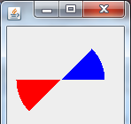
Other Shapes of Note
Arcs require the x, y coordinate and width, height of the bounding box and then the starting arc’s angle (0 meaning horizontal to the right) and arc’s size as an angle (360 degrees is a full circle, 90 would be ¼ of a circle)
g.setColor(Color.blue);
g.fillArc(10,10,100,100,0,45);
g.setColor(Color.red);
g.fillArc(10,10,100,100,180,45);
Polygons are drawn by specifying two arrays of x and y coordinates and the number of points to draw from those arrays
int x[]={10,20,30,30,20,10};
int y[]={20,10,20,30,40,30};
int n=6;
g.setColor(Color.blue);
g.drawPolygon(x,y,n);
Polylines are the same as polygons except that the first and last points are not connected

Slide 6
Drawing Images
An image is not the same as an Icon from chapter 12 (recall icons can be placed on JButtons or JLabels)
We convert an Icon into an Image as follows
ImageIcon icon = new ImageIcon(filename);
Image anImage = icon.getImage( );
g.drawImage(anImage, x, y, width, height, Color.white, this);
The drawImage method receives parameters of
the image
the x, y coordinate and its width and height
if height/width are omitted the actual size of the image is used
a color to use in the background if any pixels in the image are transparent (optional)
an object that is used as an “observer” for the image (this object which will receive notifications as the image is constructed) – use this
Remember that the only image types are jpg, gif and png
if the file is not found, you do not receive any error or exception notice

Slide 7
Drawing Strings
To output text graphically, use drawString
g.drawString(string, x, y);
You can set the font of the text using setFont
In order to better format how the text appears, there is also the FontMetrics class
We can use this to measure the width and height of text in the given font so that we can better determine the x,y coordinate to draw the text
First, get the font type’s metrics using getFontMetrics(font) and then you can pass this variable methods as shown below
getLeading()
getHeight()
getAscent()
getDescent()

Slide 8
Example
Display “Welcome to Java” in the center of a JPanel
Obtain width/height of the JPanel
Use getWidth( ) and getHeight( ) assuming that we store these values in variables w and h
Obtain the font metric using
FontMetrics fm = g.getFontMetrics( );
note that getFontMetrics is of the font currently set for the Graphics object, we may have preceded this with g.setFont(new Font(…));
Determine width of the String with
sw=fm.stringWidth(“Welcome to Java”);
Determine height that the String will require using
as=fm.getAscent( );
we do not supply the string here, the ascent is based solely on the font being used as part of the FontMetric
g.drawString(“Welcome to Java”, w/2-sw2/2, h/2+as/2);

Slide 9
Recursive Graphics
Fractal images are generated recursively
Since they are created by a mathematical equation, we can zoom in on any part and never “lose focus” (that is, the image never blurs)
Rather than seeing a true fractal design, we will do a couple of simplistic recursive designs
Recursive I
Draw an I and then for each end of the line recursively draw Is
3-line design
From our starting point, draw 3 lines (one up, one at each of 45 and -45 degrees from the starting point) and recursively do the same
note that in both cases, we will eventually reach a point where the sizes used for the endpoints of our lines are equal, this will be our base case to stop recursing (no point in further recursion as we can’t draw any smaller pixels)

Slide 10
Drawing Recursive Is
Given two points, x1, y1 and x2, y2, we want to draw a line between them and then recursively add 2 lines at the end points
We need to alternate drawing horizontal and vertical lines
we do this by setting x1=x2 or y1=y2
We also have a special case for our first output in that we will just draw a single top-down line
We will use three conditions
If c==0 then draw a single line and recurse with c=1
If x1==x2 && y1==y2 stop recursing
Otherwise if c is even, draw a horizontal line and recurse twice with c+1 and the same y values and if c is odd, draw a vertical line and recurse twice with c+1 and the same x values

Slide 11
public static class DrawPanel extends Jpanel {
public void paintComponent(Graphics g) {
int x1=300, y1=200, x2=300, y2=500;
create(g, x1,y1, x2, y2, 0, 300);
}
public void create(Graphics g, int x1, int y1, int x2, int y2,
int c, int size) {
if(c==0) {
g.drawLine(x1,y1,x2,y2);
create(g,x1-size/2,y1,x2+size/2,y1,c+1,size/2);
create(g,x1-size/2,y2,x2+size/2,y2,c+1,size/2);
}
else if(x1!=x2||y1!=y2) {
if(c%2==0) {
g.drawLine(x1,y1,x2,y2);
create(g,x1-size/2,y1,x1+size/2,y1,c+1,size/2);
create(g,x2-size/2,y2,x2+size/2,y2,c+1,size/2);
}
else {
g.drawLine(x1,y1,x2,y2);
create(g,x1,y1-size/2,x1,y1+size/2,c+1,size/2);
create(g,x2,y1-size/2,x2,y1+size/2,c+1,size/2);
}
}
}
}

Slide 12
public static class DrawPanel extends JPanel
{
public void paintComponent(Graphics g)
{
draw(g, 350,300,250,0);
}
public void draw(Graphics g, int x, int y, int size, int c)
{
if(c<8)
{
g.drawLine(x-size/4,y-size/4,x,y);
g.drawLine(x,y-size/2,x,y);
g.drawLine(x+size/4,y-size/4,x,y);
draw(g,x-size/4,y-size/4,size/2,c+1);
draw(g,x+size/4,y-size/4,size/2,c+1);
draw(g,x,y-size/2,size/2,c+1);
}
}
}

Slide 13
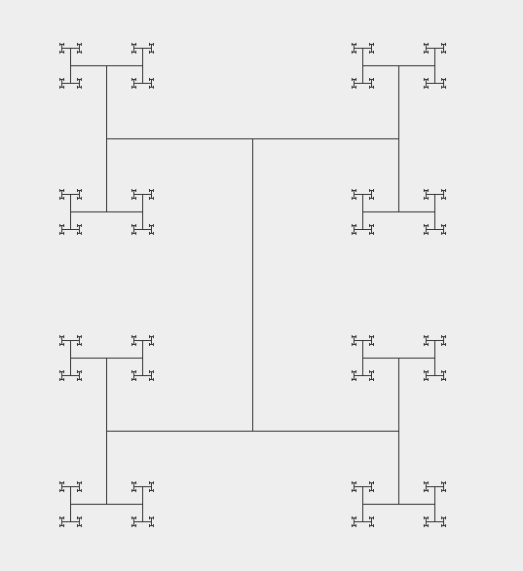

Slide 14
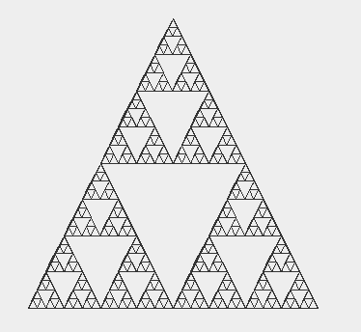
Sierpinski
Triangles
public static class GP extends JPanel {
public void paintComponent(Graphics g)
draw(g,250,100,400,400,100,400,6);
}
public void draw(Graphics g, int x1, int y1,
int x2, int y2, int x3, int y3, int n) {
if(n>0){
g.drawLine(x1,y1,x2,y2);
g.drawLine(x2,y2,x3,y3);
g.drawLine(x3,y3,x1,y1);
draw(g,x1,y1,(x1+x2)/2,(y1+y2)/2,(x1+x3)/2,(y1+y3)/2,n-1);
draw(g,(x1+x2)/2,(y1+y2)/2,x2,y2,(x2+x3)/2,(y2+y3)/2,n-1);
draw(g,(x1+x3)/2,(y1+y3)/2,(x2+x3)/2,(y2+y3)/2,x3,y3,n-1);
}
}

