Slide 1
Designing and Exploring Classes
We look further into classes and objects here, emphasizing the differences between OOP and procedural programming
Cohesion – a class should describe a single entity
the class methods should all support that one entity
Consistency – be consistent with naming conventions (across all classes, not just within a class)
Encapsulation – use private for all instance data, providing adequate accessor and mutator methods, all of which should be public
methods called only from within the class should be private
Clarity – do not impose restrictions on how the class should be used in terms of whether it can be used within another class or must be used in sequence with other classes
Completeness – make sure that you define all of the methods needed for that class to model the actual entity

Slide 2
More Design Issues
Visibility issues
Do you plan on having this class be extended? If so, use protected instead of private
Will this class be placed in a package which might share access with private items? If so, use the default modifier (no modifier) – this can be risky
Do you expect multiple objects of this class to share a datum? If so, you must use static on the datum and should create static methods
This will usually not be the case, each object should stand alone
Will you implement methods that do not operate on this object but on multiple objects?
If so, make the method static and pass all objects to be operated on to the method

Slide 3
OOP vs Procedural Programming
In procedural programming (found in such languages as C, Pascal, Ada, FORTRAN and C++)
The focus is on having code that alters the state of the program
the state are the variables defined in the program
there are no instance data, instead each procedure/function has its own local variables
the procedure/function operates on its local variables and any parameters passed to it
The design emphasis is on the procedures/functions to perform tasks related to the overall problem
local variables are defined to support the procedure/function’s task
parameters are used for communication between procedures/functions

Slide 4
OOP vs Procedural Programming
In OOP, the focus is on designing classes
Select classes needed to solve the problem
Each class describes just its own data and the operations needed to manipulate/access that data
Class methods can have local variables while classes themselves have instance data
in a way, this is like global variables of procedural programming except that these data are limited in scope to the class
Parameters are still used but are usually limited to telling a method how to access or modify an instance datum
Class instance data can be objects of other classes

Slide 5
Class Abstraction and Encapsulation
If we properly implement information hiding, then we are hiding the details of the class from any user of the class
We refer to this view of the class as class abstraction
Users know how to use the class but not how it works internally
In order to know how to use the class, we make an interface available – the public methods
We encapsulate into the class the hidden details and the interface – that is, all of this code is defined inside the class
Yet from outside, all users can see is the from the interface
Our classes can contain other (already defined) classes as part of their instance data
In such a case we have a “has-a” relationship – the class we are currently defining “has-a” the class we have already defined
We might refer to these as an aggregating class and an aggregated class respectively

Slide 6
Aggregation
There are two forms of aggregation
Composition means that the instance datum is “owned” by the object
For instance, a Student object might have a Name object as a member, the Student owns his/her Name
Otherwise, the aggregation is not exclusively owned and therefore might be or is shared among others
In such a case, we might specify a multiplicity that dictates how many might share the given datum
A value of 1 means that the datum is owned exclusively
A range, from instance 1..3 would indicate that up to 3 objects can share the same datum
We modify the UML notation by using a diamond to indicate aggregation/composition
White diamond = aggregation, black diamond = composition

Slide 7
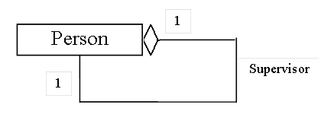
Indicating Aggregation
public class Person {
private Person supervisor;
...
}
A class can contain an
instance datum whose
type is the class
being defined
Here a Person has a
Supervisor which is
a Person

Slide 8
Designing a Loan Class
Code on
pages 377-378
Loan user
program on
page 376-377
Loan is an
aggregating
class because
it contains an
object of type
Date, which is
an aggregated
class

Slide 9
Immutable Objects
Once set to a value, an object is known as immutable if that value cannot be changed
Strings are immutable
String foo=“Frank Zappa”;
foo.toUpperCase( ); -- does not change foo, it merely returns the letters in foo all upper cased
A class is immutable if objects of its type are immutable
To make a class immutable
Make all instance data private, or
Do not provide any mutator methods, and
If any instance data are themselves objects, do not provide any accessors that return reference variables to those objects

Slide 10
Scope of a Variable
Scope of a variable consists of the locations where that variable can be accessed
For a local variable, its scope is the entire method from the point it is declared until the end of the method UNLESS
an inner block declares a variable of the same name
For a parameter, its scope is the entire method it was passed to
For an instance data, its scope is the entire class UNLESS
a method declares a variable of the same name as a local variable or parameter

Slide 11
public class ScopeExample
{
private int x, y;
public ScopeExample
(int a, int x) {
x=a;
y=x; // x refers to?
}
public void method1()
{
x++;
}
public void method2(int x)
{
y=y+x; // x refers to?
}
public void method3(int a)
{
int x;
x=a*2; // x refers to?
y=x-2;
}
public void method4(int a)
{
int b=a;
b++;
{
int b=y;
x=b*2; // b refers to?
}
x=x-b; // b refers to?
}
}
This is a dumb example – do not name parameters using the same
name as any instance data in your class (except possibly the constructor
-- see the next slide

Slide 12
The this Reference
this refers to this object
We can use this when specifying a listener (we cover this later in the semester) responsible for handling actions
We can also use this to refine a variable’s name when there are scope issues like we saw in method3 from the previous example
We will commonly use this in a constructor to differentiate between an instance datum and a parameter of the same name
public void SomeClass(String name) {
name=name;
}
public void SomeClass(String name) {
this.name=name;
}
Wrong – both name’s refer to the param Correct – this.name refers to instance datum

Slide 13
Example: BMI Class
We see the UML for the BMI (body mass index) class which computes a person’s BMI based on weight and height
What might we
add to make this
class more
complete?
See the code on
pages 380-381

Slide 14
Building a Stack Class
A stack is a data structure (container class) that stores items such that you can only add and remove items from one end
Think of a stack of trays in a cafeteria, you push your used tray onto the stack and the next person pops that tray off of the stack
this represents a first-in last-out access (FILO) or a last-in first-out (LIFO) access
Let’s assume that we want to store int values in our Stack
We will implement an array of ints and then provide methods to manipulate the array
as we only want to access the stack at one end, the top, we won’t have to shuffle array elements around
our “top” will move down the array and then back up as we push and pop elements, we keep track of this with an int variable top (stores the index in the array of the top of stack)

Slide 15
StackOfIntegers Class
elements stores the stack (the int values)
As we push an element onto the stack, we add it to elements at location size (our “top”) and increment size

Slide 16
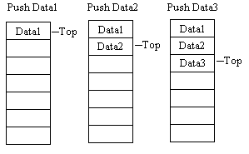
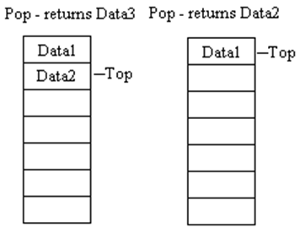

Slide 17
public class StackOfIntegers {
private int[] elements;
private int size;
public static final int CAPACITY=100;
public StackOfIntegers() {
this(CAPACITY);
}
public StackOfIntegers(int capacity) {
elements=new int[capacity];
size=0;
}
public void push(int value) {
if(size==elements.length) System.out.println
("Cannot push onto full stack");
else {
elements[size]=value;
size++;
}
}
public int getSize() {
return size;
}

Slide 18
public int pop() {
if(size==0) {
System.out.println
("Cannot pop from empty stack");
return -999999;
}
else {
size--;
return elements[size];
}
}
public int peek() {
if(size==0) {
System.out.println("Stack is empty!");
return -999999;
}
else return elements[size];
}
public boolean empty() {
return size==0;
}
}

Slide 19
Primitive Types vs Wrapper Types
We may wish to treat all data as objects for consistency
Each of the 8 primitive types in Java have a corresponding class called a wrapper class
e.g., Integer, Double, Character, Boolean
there are also types called BigInteger and BigDouble that allow for any precision rather than a preset precision as with int, double, long
We can create one using Type var=new Type(value); where value is a primitive
For instance, we might take an int x and make it into
Integer xAsObject=new Integer(x);
Placing a primitive into a wrapper type is called boxing
This will work if we declare an array of a wrapper type as well as in Integer[ ] ints={1, 2, 3}; making ints[0] an Integer storing the boxed int 1

Slide 20
Numeric Wrappers
The numeric wrapper classes have several static methods and some constants
constants: MAX_VALUE, MIN_VALUE
These methods are used to convert a String to either the numeric type of this class (e.g., to an Integer) or the corresponding primitive type
Integer.parseInt(someStringOfAnInteger);
Double.parseDouble(someStringOfADouble);
Integer.valueOf(someStringOfAnInteger);
Double.valueOf(someStringOfADouble);
Each of these classes also contain two constructors (one of a String and one of the primitive type, e.g., String and int for Integer, String and double for Double)
Methods are shown on the next slide

Slide 21
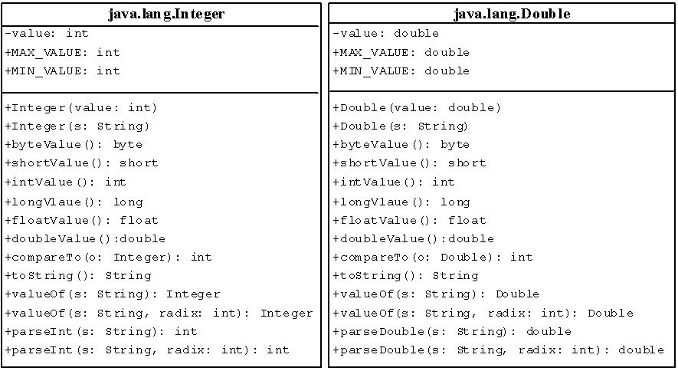
Integer and Double in UML
NOTE: since there are no mutator methods, these classes are immutable

Slide 22
BigInteger and BigDecimal Classes
Used for storing very large values
Recall an int can store a number as large as about 2 billion and a long can store up to 9,223,372,036,854,775,807
Methods include bitCount, bitLength, toString, and various conversions of the stored BigInteger/BigDouble
Static methods, which are passed another BigInteger or BigDouble (or in some cases, and Object) include add, subtract, multiply, divide, mod, compareTo, equals, and, or, xor, gcd
Both classes are part of java.math
Both classes are immutable
Both classes accept Strings in their constructors
BigInteger a = new BigInteger(“12345678901234567890”);
BigDouble can also accept doubles but BigInteger cannot accept ints!
The integer’s value is stored in 2’s complement

Slide 23
Using BigInteger & BigDecimal
To perform one of the arithmetic operators, use the following approach
BigInteger x=new BigInteger(…);
BigInteger y=new BigInteger(…);
x=x.add(y);
or
x=x.add(new BigInteger(…));
There is no limit to the precision for these two classes
Although it is possible that the divide method can throw an ArithmeticException if the division does not terminate
For instance:
BigDecimal x=new BigDecimal(1);
x=x.divide(new BigDecimal(3));
Results in Exception in thread "main" java.lang.ArithmeticException: Non-terminating decimal expansion; no exact representable decimal result.

