Slide 1
Recursion
You may have seen mathematical functions defined using recursion
  Factorial(x) = 1 if x <= 1
  = Factorial(x-1) * x otherwise
Recursion means that the definition for a function is defined with reference to itself
  In programming, recursion calls for writing a method that calls itself with a “smaller” set of data
  In the case of factorial above, each recursive call is with a small value of x
  Upon x reaching 1 (or smaller), recursion ends – this condition is known as the base case
Recursion is often a challenging topic for programmers
  Its hard to think recursively
  Its hard to debug recursive code
So why use it? Because there are some problems that must be solved recursively and others that actually are easy to solve recursively

Slide 2
Some Recursive methods
Call factorial with
int f = factorial(n);
Call fibonacci with
int fib = fibonacci(x);
Call search with
int index = search(a, n, t, 0);
Call count with
int count = search(a, n, t, 0);
public int factorial(int x) {
if(x<=1) return 1;
else return x * factorial(x-1);
}
public int fibonacci(int x) {
if(x<=0) return 0;
else if(x<=2) return 1;
else return fibonacci(x-1) + fibonacci(x-2);
}
public int search(int[] array, int n, int target, int i) {
if(i>=n) return -1; // not found
else if(array[i]==target) return i;
else return search(array, n, target, i+1);
}
public int count(int[] array, int n, int target, int i) {
if(i>=n) return 0;
else if(array[i]==target) return count(array, n, target, i+1) + 1;
else return count(array, n, target, i+1);
}

Slide 3
Why Recursion Works
We rely on temporary values stored on the run-time stack
  To the right we see how the stack changes for factorial(4)

Slide 4
Recursion vs Iteration
We can solve the previous problems with iteration
In fact, many problems can be solved either iteratively or recursively
  With iteration, we need extra local variables, for instance to store loop variables
  With recursion, the code is more concise
  Some would call the recursive approach more “elegant”
  The recursive solution is easy if you can define the function recursively
Note that not all problems solved through recursion are considered “functions” – they don’t necessarily return a computed value (search for instance would not really be thought of as a mathematical function)
Why use iteration?
  Recursion comes at a cost – every method call requires using the run-time stack in memory which is slower than references local variables most likely stored in registers

Slide 5
Recursive vs Iterative Palindrome Checker
Given a String, test to see if it is a palindrome (same backward as forward)
  Iteratively – loop starting at char 0 until you reach the halfway point, comparing each character against the opposite character at the other half of the String, immediately stop if you find a mismatch
  Recursively – compare the current character to the character on the opposite side of the String and if not equal, return false, otherwise recursively call the method incrementing the index pointing at the character, if you reach the midpoint, return true
public boolean iterativePalindrome(String s) {
for(int i=0;i<s.length();i++)
if(s.charAt(i)!=s.charAt(s.length()-i-1) return false;
return true;
}
public boolean recursivePalindrome(String s, int i) {
if(i>s.length()/2) return true;
else if(s.charAt(i)!=s.charAt(s.length()-i-1)) return false;
else return recursivePalindrom(s, i+1);
}

Slide 6
Recursive vs Iterate Reverse String Methods
Three approaches to reverse a String (two recursively, one iteratively)
  the first recursive version uses an index passed to the method to indicate which character to output while the second uses substring to continually chop the front character off the String
public static String reverse1(String s, int i) {
if(i==s.length()) return "";
else return reverse1(s, i+1)+s.charAt(i);
}
public static String reverse2(String s) {
if(s.length()==0) return "";
else return reverse2(s.substring(1,s.length()))+s.charAt(0);
}
public static String reverse3(String s) {
String temp=“”;
for(int i=s.length()-1;i>=0;i--) temp+= s.charAt(i);
return temp;
}

Slide 7
Recursive Binary Search
Binary search is often cited as an excellent algorithm to implement recursively
Our base case is that we either have found the item at mid, or low > high and the item does not exist in the array
Otherwise, if the value at mid < target, call binary search with the value of low set to mid+1
Otherwise call binary search with the value of high set to mid-1
public int binarySearch(int[] a, int low, int high, int target) {
if(low > high) return -1;
else {
int mid = (low+high)/2;
if(a[mid]==target) return mid;
else if(a[mid]<target) return binarySearch(a, mid+1, high, target);
else return binarySearch(a, low, mid-1, target);
}
}

Slide 8
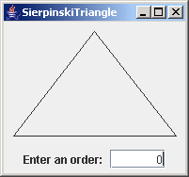
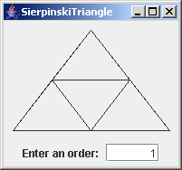
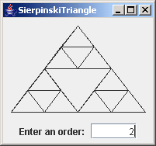
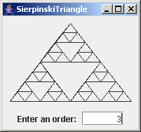
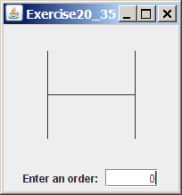
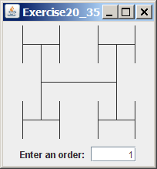

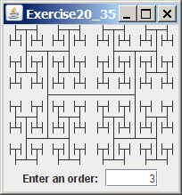
Problems Not (easily) Solvable by Iteration
The main reason to use recursion is that there are many problems not easily solvable using loops
  Towers of Hanoi
  Generating fractal images (see right and below)
  Some search algorithms (mergesort, quicksort)
  Search problems (8 queens, Knight’s tour, Knapsack)

Slide 9
Towers of Hanoi
A historic problem (possibly developed by monks in what is now Vietnam)
  Given 3 “towers” (spikes) and n disks where each disk is smaller than the one it sits on
  Move all disks, one at a time, from tower 1 to tower 3 such that you never place a larger disk on a smaller disk
  What pattern of movements can we take to solve the problem?
Using iteration is challenging, but the recursive solution is almost trivially simple

Slide 10
Towers of Hanoi Solution
public static void hanoi(int n, int a, int b, int c) {
if(n==1) System.out.println(“Move disk “ + n + “ from “ + a + “ to “ + b);
else {
hanoi(n-1, a, c, b);
System.out.println(“Move disk “ + n + “ from “ + a + “ to “ + b);
hanoi(n-1, c, a, b);
}
}
Solution for hanoi(3, 1, 2, 3) (move 3 disks from tower 1 to tower 2)
n = 3, recursively call hanoi(2, 1, 3, 2)
n = 2, recursively call hanoi(1, 1, 2, 3)
n = 1, print Move disk 1 from 1 to 2
print Move disk 2 from 1 to 3
recursively call hanoi(1, 2, 3, 1)
n = 1, print Move disk 1 from 2 to 3
print Move disk 3 from 1 to 2
recursively call hanoi(2, 3, 2, 1)
n = 2, recursively call hanoi(1, 3, 1, 2)
n = 1, print Move disk 1 from 3 to 1
print Move disk 2 from 3 to 2
recursively call hanoi(1, 1, 2, 3)
n = 1, print Move disk 1 from 1 to 2
done

Slide 11
Computing GCD Recursively
if(m>=n) System.out.println("The gcd of " + m + " and " + n
+ " is " + computeGCD(m, n));
else System.out.println("The gcd of " + m + " and " + n
+ " is " + computeGCD(n, m));
public static int computeGCD(int a, int b) {
if(a%b==0) return b;
else return computeGCD(b, a%b);
}
Consider m = 45, n = 87
m < n so call computeGCD(n, m)
a = 87, b = 45
a%b!=0
computeGCD(45, 87%45 = 42
a = 45, b = 42
a%b != 0
computeGCD(42, 45%42 = 3
a = 42, b = 3
a%b == 0, return b (3)

Slide 12
Other Recursive Problems (without solutions)
8 Queens
  Given 8 queens and a chess board, position each queen on the board such that no queen can capture another queen
    generalize to the N queens problem
Knight’s Tour
  Given a knight on a chess board, find the sequence of moves that allow you to move the knight from square to square such that it lands on every square of the chess board exactly 1 time
Knapsack
  Given n items, each with its own weight and value, and a knapsack that can store a given capacity in weight, find the collection of items that do not exceed the capacity that maximum the value (see the next slide)

Slide 13
Knapsack
Consider these items:
  item 1, weight 15, value 13
  item 2, weight 12, value 6
  item 3, weight 20, value 16
  item 4, weight 22, value 15
  item 5, weight 14, value 10
  item 6, weight 18, value 15
  item 7, weight 22, value 19
  item 8, weight 14, value 12
  item 9, weight 13, value 9
  item 10, weight 17, value 15
  item 11, weight 16, value 14
  item 12, weight 15, value 12
The knapsack can hold a total weight of 88, which items do you place in it to maximum the value?
With 12 items, there are 4096 possible combinations of items
This is reduced because some combinations exceed the
maximum well before we consider all items
This is one of a class of problems that have a computational
complexity of O(2^{n}) (at least as provable today)

