Slide 1
Identifiers
We have to name things in our program
  places to store values (variables, constants)
  methods
  classes
These names are called identifiers
There are specific rules for identifier names in Java
  use only letters, digits, _ and $ (we don’t actually use the $ ourselves)
  must start with a letter or _
  cannot be a reserved word (e.g., public, int)
  Java is case sensitive
    Public is legal, public is not (a reserved word), x and X are different variables
Make your identifier names descriptive
  don’t be afraid to make them lengthy like number_of_dependents
  we often use camelNotation instead of the _ but either is fine
  use only CAPS for constants
  for classes, capitalize each word in a class as in MyNewClass
  for variables and methods, start with lower case letters
    these are known as naming conventions
    misusing naming conventions is not an error

Slide 2
Variables and Constants
These are named memory locations
  we do not select the memory location, the compiler does
  we refer to the memory location by the name we give it
Each variable and constant is typed (e.g., int, double)
We must declare any variable/constant before we can use it
  the declaration includes its type
  once declared, the type cannot change during the variable’s scope
Syntax for declaration
  type name; // variable declaration without initialization
  type name = value; // variable declaration with initialization
  final type NAME = value; // constant declaration
You can have any number of variables declared on one line as in
  int x, y, z;

Slide 3
Types
There are 8 types we use for simple data, these are known as primitive types
  everything else in Java is an object of some class
  one popular class is the String
The 8 primitive types are
  int – 32-bit integer
  long – 64-bit integer
  float – 32-bit floating point
  double – 64-bit floating point
    we tend to use doubles instead of floats
  char – a single character, placed inside of ‘’ as in ‘a’, ‘5’, ‘%’ or ‘ ’
  boolean – the value true or the value false (these are not Strings!)
  short – 16-bit integer
  byte – 8-bit integer
    we will rarely if ever use shorts or bytes

Slide 4
Numeric Type Ranges

Slide 5
Instructions that Use Variables and Constants
We primarily use variables and constants in computations
  to compute and store a value, we use assignment statements
  syntax: variable = expression;
  the expression can be a literal value, a constant, a variable, method calls and/or arithmetic operators in some combination
    example: a = b * (Math.abs(c) – AGE);
    AGE is a constant, a, b, c are variables, Math.abs is a method call (absolute value)
We can also input values into variables
  to perform input, we need to use one of Java’s classes that permit input
  the one we will use is called Scanner (see the next slide)
  prior to any input statement, we will want to prompt the user using a System.out.println statement
  when we have computed results, we will often want to output the results, again using System.out.println

Slide 6
Scanner Class
The Scanner class is used to obtain input from either disk file or keyboard
  for now, we concentrate only on keyboard input
To use most classes
  we have to create a variable of that type
    Scanner in; // declare in as a variable
  and then instantiate the variable by creating an object using new
    in = new Scanner(System.in); // instantiate in as a new Scanner
We can combine the two instructions into
  Scanner in = new Scanner(System.in);
We refer to a variable of a type of class as an object
To communicate with an object, we use message passing
  syntax: object.message(parameters);
Scanner messages are next( ) (to input a String), nextInt( ), nextDouble( ), etc
  note that there is no message to input a char – we’ll deal with this later

Slide 7
Example Program
We must import classes (with a few
exceptions)
Declare variables and constants
Declare and instantiate our Scanner
Prompt the user for input then obtain
a String from the user
import java.util.Scanner;
public class FirstProgram
{
public static void main(String[] args)
{
String name;
final int YEAR=2016;
int age, birth;
Scanner in = new Scanner(System.in);
System.out.print("Enter your name: ");
name = in.next();
System.out.println("Hello " + name + ", how old are you?");
age = in.nextInt();
birth = YEAR - age;
System.out.println("You were born in either " + birth +
" or " + (birth-1));
}
}
Input an int, do a computation,
output the result
To fix this problem of outputting the right birth year, we need
to add a selection statement (if) which we cover in the next chapter

Slide 8
Assignment Statements
The assignment statement allows us to assign a variable a value
  the value can be a literal value (e.g., x = 0;), the value of a variable or constant (y = a; z = AGE;) or the result of some arithmetic expression
The arithmetic operators are:
  + (addition)
  - (subtraction)
  * (multiplication)
  / (division)
  % (modulo or remainder)
  ( ) (alter order of operator precedence)
We can assign multiple variables the same value using
  x = y = z = 0;
  this works from the right to the left assigning z to 0, then y to z (0), then x to y (0)
Scanner in = new Scanner(System.in);
System.out.print(“Enter number of seconds”);
int seconds = in.nextInt( );
int minutes = seconds / 60;
int remainingSeconds = seconds % 60;
System.out.println(seconds + “ is ” +
minutes + “ minutes and ” +
remainingSeconds + “ seconds.”);

Slide 9
Putting It Together
Let’s put these concepts together to write a program
  input from the user the radius of a circle
  compute and output the circle’s circumference and area
  assume radius will be an int but area and circumference will be doubles
  we need the value for pi which we will store in a constant
  need to input radius, we will use the Scanner and nextInt
    before any input, we should prompt the user with a print statement
    the difference between print and println is that println automatically starts a new line after this output
    for a prompting message we can use print so that the user’s input appears on the same line as the prompting message
  need assignment statements to compute area and circumference
    area = pi * r²
    circumference = 2 * pi * r
  need 1 or more output statements to output the results

Slide 10
Our Program
import java.util.Scanner;
public class Circle {
public static void main(String[] args) {
Scanner in = new Scanner(System.in);
double area, circumference;
final double PI = 3.14159;
System.out.print("Enter the circle's radius ");
int radius = in.nextInt();
area = PI * Math.pow(radius, 2);
circumference = 2 * PI * radius;
System.out.println("A circle of radius " + radius +
" has an area of " + area + " and a circumference of "
+ circumference);
}
}
Why do we have these spaces here?
How would the program change
if we made this println?
Program output (and input, notice how 21 appears on the same line as the prompting message)
Enter the circle's radius 21
A circle of radius 21 has an area of 1385.44119 and a circumference of 131.94678

Slide 11
Some Comments
We have to import Scanner to use it
Some classes are built-in and do not need to be imported including System, String and Math
  additionally, when using some classes like System and Math we do not create separate variables, we just pass the class itself a message like Math.pow
Instead of radius * radius, we can use Math.pow(radius, 2);
  pow is “raised to the power of”, we could replace this with radius * radius if we prefer
Our print and println statements expect String parameters
If we have multiple items to print out, we conjoin the Strings with +
  this is known as String concatenation
  notice the syntax is tricky:
    “String 1 goes here” + variable1 + “String2 goes here”
    we add blank spaces after here and before ” and after “ and before String2, why?
We did not need to create a constant for PI, we could have just used 3.14159 in the assignment statement for computing area, so why did we?
  note that Math defines pi so we could also do Math.PI

Slide 12
Exploring Division
What is 3 / 2? 1.5 right?
In Java, there are three forms of division
  int / int – returns an int value only, so 3 / 2 is 1
  non-int / int or int / non-int or non-int / non-int – computes and returns a double or float depending on what type the non-int is so 3.0 / 2 = 1.5
  int % int – returns the remainder of the division
Here are some examples:
  12 / 7 – computes 1
  12 / 7.0 – computes 1.7142857, we get the same result with 12.0 / 7 or 12.0 / 7.0
  12 % 7 – computes 5 (12 / 7 is 1 and 5 / 7, % returns the remainder, 5)
What is the value stored in c after the following code executes?
  int a = 12, b = 7;
  double c = a / b;
  c is 1.0, why? a / b is an int division, so we get 1, c is a double so we convert 1 into a double, or 1.0

Slide 13
Floating Point Numbers
1.0 and 1.7142857 are all floating point numbers
  we call them floating point numbers because of how they are stored in memory using a “floating decimal point” – but there are two types in Java to store floating point values, double and float
  by default, a literal floating point number is a double, not a float
  to make a literal a float, add the letter ‘f’ (or ‘F’) at the end of the number
  float x = 3.14159; // this is an error because 3.14159 is a double
  float x = 3.14159f; // there is no error here
As we aren’t concerned with extra memory usage, we tend to only use doubles in Java – in this class, do not bother using floats
  you can add a ‘d’ or ‘D’ after a floating point literal to state that the literal is a double, but this is the default so it is not necessary
  you can also express a floating point number using scientific notation as in 6.34551E2 (6.34551*10² or 634.551) or 1.2345E-2 (1.2345*10⁻² or .012345) (you can use ‘e’ instead of ‘E’)

Slide 14
Arithmetic Operator Precedence
Precedence rules describe the order of operator application when an expression contains multiple types of operators
  if two operators of the same type are applied, then the operation is performed left to right
  for instance, x + y + z is handled as x + y and then that sum + z (or (x + y) + z)
  notice that in mathematics (x + y) + z = x + (y + z), this may not always be the case in Java if we are dealing with doubles because of issues with precision
Java uses the same operator precedence that we see in math
  ( ) – do whatever is inside ( ) first
  *, /, % - apply these operators next
  +, - apply these operators last
Example:
  5 * (3 – 2) % 4 + 1
    3 – 2 = 1
    5 * 1 = 5
    5 % 4 = 1
    1 + 1 = 2
Java has a number of shortcut operators (see the next slide) to make writing certain types of expressions and assignment statements easier

Slide 15
Reassignment Statements
A reassignment means that we are taking the value from a variable, altering it through some arithmetic expression and then placing the result back into the same variable
A common reassignment is an increment: x = x + 1;
  notice mathematically that x = x + 1 makes no sense, but in a program it means “add 1 to x and store the new value back into x”
Increments and Decrements can be handled using prefix or postfix increment/decrement operators
  x++; ++x; x--; --x;
We can use these within an assignment statement in which case prefix and postfix differ
  y = x++; // assign y = x, then add 1 to x
  y = ++x; // add 1 to x and then assign y = x (the new value of x)

Slide 16
More on Assignments and Reassignments
Aside from increment/decrement, we can shorten an instruction like
  x = x + …;
  where … is some expression
  into x += …;
  thus eliminating the “x +” portion
We have shortcut operators for each arithmetic opertor
    +=, -=, *=, /=, %/
  example: abc *= 5; // same as abc = abc * 5;
  example: x += y * z; // same as x = x + y * z;
  example: a %= z + 2; // same as a = a % z + 2; (this is (a%z) + 2)
We can also embed assignments in expressions
  a = b + (c = 2); // c is set to 2, a = b + c (the new c)
  a = b += c = 5; // c = 5, b = b + c, a = b

Slide 17
Coercion
Recall what happened when we did
  double c = a / b;
  where a and b are ints
Java first computes a / b as an integer division
The integer result, before being placed into c, becomes a double by adding a .0
  when Java automatically converts for us, this is known as a coercion
Other coercion examples
  double x = 0; // becomes 0.0
  double y = 1.2f; // becomes 1.2d
  double z = in.nextInt( );
    whatever int you enter becomes a double
Coercion occurs when you want to widen a value
  coercions are handled by the compiler and JRE, not us as programmers

Slide 18
Casting
You can cause a value to change into another type by casting
  a cast is handled by using the notation (type) immediately before the variable or value in the assignment statement
  double c = (double)a / b;
    causes the value in a to be treated as a double
  double c = a / (double)b;
Notice that a and b do not change, this is only changing the value we retrieve from a or b
  System.out.println((int)1.5); outputs 1
  double d = 4.5; int i = (int) d;
    d remains 4.5, i stores 4
There are occasions where we will want to cast and times where we must cast
  you can think of a coercion as an implicit cast – Java is casting for you

Slide 19
Type Errors
A type error occurs when you are trying to place the wrong type of value into a variable (that is, of a different type)
Type errors arise when your variable is of a narrower type than the value
  int a = b / 2.5; // this is an error whether b is an int or not
Or when you have a clearly incompatible type
  int x = “abc”;
Type errors are usually caught at compile time
But you can also get a run-time Exception if you try to input a value and the user inputs the wrong type
  System.out.print(“Enter an int value ”);
  int x = in.nextInt( ); // expects an int value
  if the user inputs a double or a String, this generates a run-time Exception
You can also get logical errors when using the wrong types, for instance by not properly casting an integer division
  System.out.println(1/2); // we would expect .5 but we get 0

Slide 20
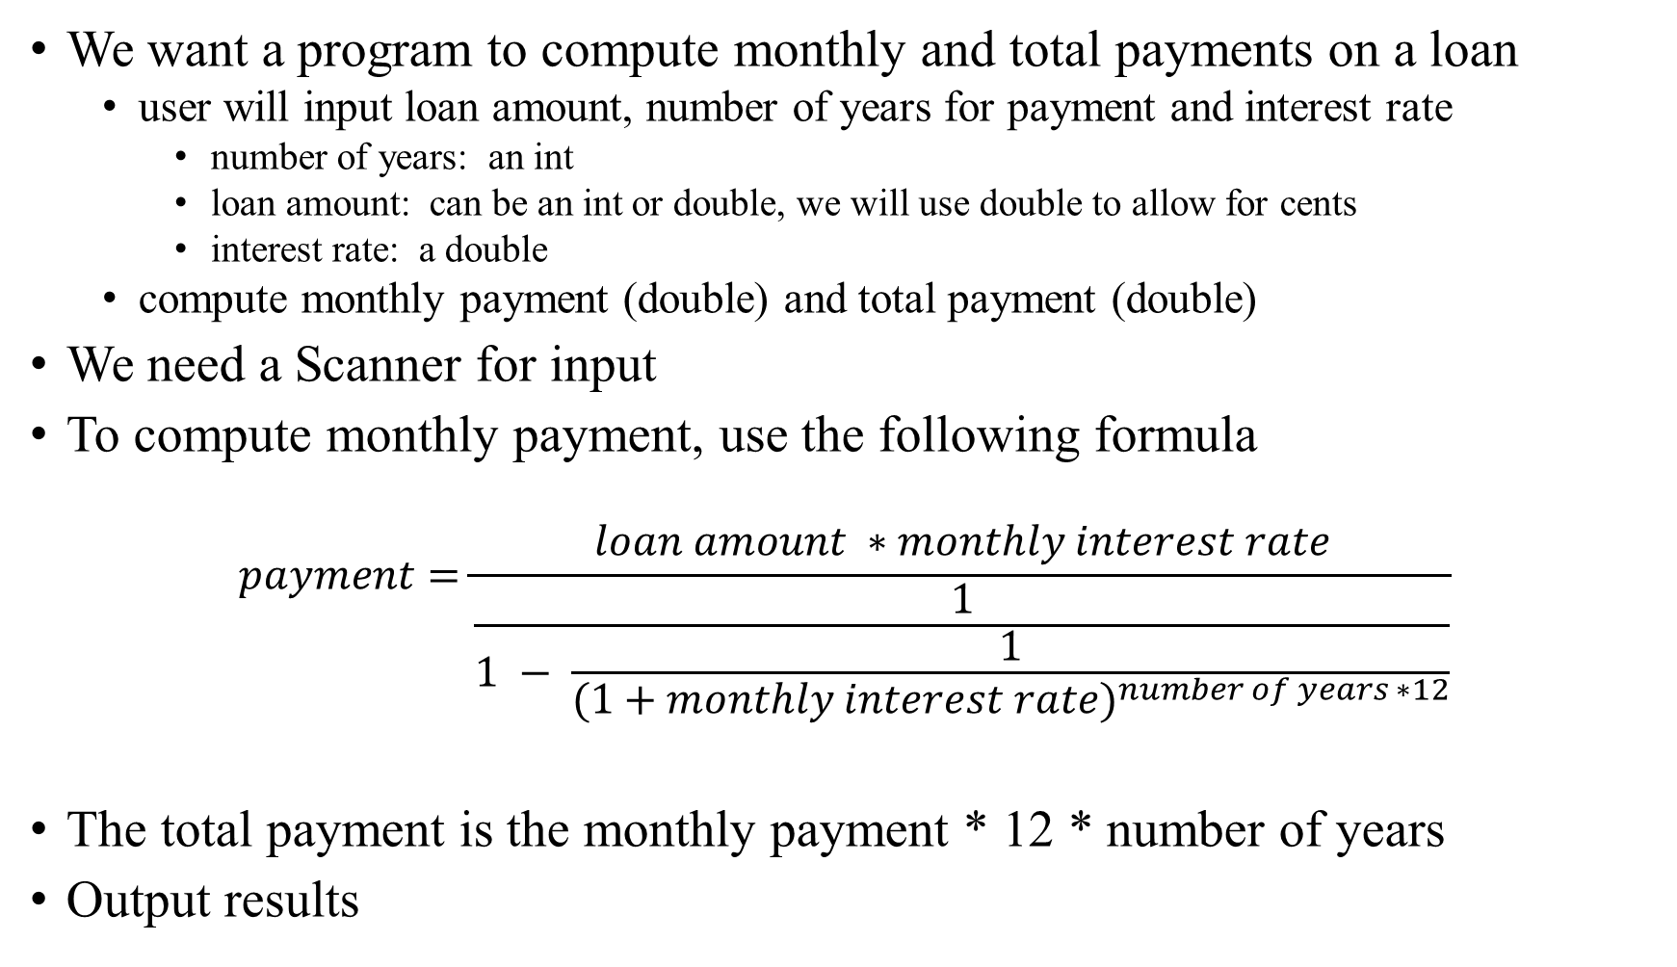
Putting It Together
We want a program to compute monthly and total payments on a loan
  user will input loan amount, number of years for payment and interest rate
    number of years: an int
    loan amount: can be an int or double, we will use double to allow for cents
    interest rate: a double
  compute monthly payment (double) and total payment (double)
We need a Scanner for input
To compute monthly payment, use the following formula
$$payment=\frac{loan amount ∗monthly interest rate}{\frac{1}{1 − \frac{1}{{(1+monthly interest rate)}^{number of years ∗12}}}}$$
The total payment is the monthly payment * 12 * number of years
Output results

Slide 21
Our Program
import java.util.Scanner;
public class ComputeLoan {
public static void main(String[] args) {
Scanner in=new Scanner(System.in);
System.out.print("Enter the loan amount ");
double loanAmount = in.nextDouble();
System.out.print("Enter the interest rate such as 5.25 for 5.25% ");
double interestRate = in.nextDouble();
System.out.print("Enter the total number of years for the loan ");
int numberOfYears = in.nextInt();
double monthlyInterestRate = interestRate / 1200;
double monthlyPayment = loanAmount * monthlyInterestRate / (1 - 1 /
Math.pow(1 + monthlyInterestRate, numberOfYears * 12));
double totalPayment = monthlyPayment * numberOfYears * 12;
System.out.println("For " + numberOfYears + " years, you need to make $" +
monthlyPayment + " monthly payments and a total payment of $" +
totalPayment);
}
}

Slide 22
Sample Input and Output
Enter the loan amount 250000
Enter the interest rate such as 5.25 for 5.25% 5.75
Enter the total number of years for the loan 15
For 15 years, you need to make $2076.025217549142 monthly payments and a total payment
of $373684.53915884555
Notice how messy the output looks with all of those decimal points
The double is able to store a lot of decimal points of precision
We can resolve this problem in two ways
  format the output using printf (we cover this later in the semester)
  multiply the double by 100, cast to an int, divide by 100.0
    (int)(monthlyPayment * 100) / 100.0;
Our println statement becomes
  System.out.println("For " + numberOfYears + " years, you need to make $" + (int)(monthlyPayment * 100)/100.0 + " monthly payments and a total payment of $" + (int)(totalPayment * 100) / 100.0);

Slide 23
Some Common Errors and Pitfalls
Forgetting to declare variables
Misspelling variables
  especially if you forget the proper case or using camel notation versus _
Uninitialized and unused variables
  before you use a variable on the right side of an assignment statement or an output statement, it needs to be initialized (given an initial value)
    numeric variables are usually initialized to 0
    chars might be initialized to ‘ ’ and Strings to either “” or nil
  an unused variable is not an error but there is no need to keep it in the program
Arithmetic errors
  overflow or underflow or dividing by 0
  round-off errors – computations with doubles can result in slight precision errors
  System.out.println(1.0 – 0.1 – 0.1 – 0.1 – 0.1 – 0.1); does not output 0.5!
  forgetting to cast when doing integer divisions

