Slide 1
Regular Expressions
A regular expression defines a pattern of characters to be found in a string
Regular expressions are made up of
Literal characters to match in the string like “abc”
Metacharacters are characters that specify how we can interpret a sequence of literal characters
Example:
[abc]+[def]* - find any sequence of one or more of the letters a, b, c followed by any sequence of zero or more of the letters d, e, f, for instance abacabdddd or aaaaaab or adefdef but not ddddeeefff – why not?
Regular expressions are a powerful tool that a Linux user can use to search files for particular types of information

Slide 2
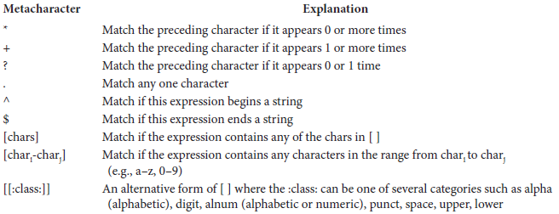
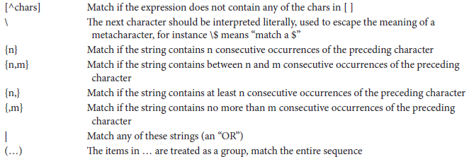
Metacharacters

Slide 3
*, +
* - match the preceding character 0 or more times including the empty string
+ - match the preceding character 1 or more times but not including the empty string
0* - any number of 0s (including no 0s)
0*1* - any number of 0s followed by any number of 1s
will match 0001111111, 0111111, 0000000 and the empty string but not 0000111110, 0000a1111
0+1+ - will match 000111111, 0111111, 00000001 but not 0001111110, 0000a11111, 11111 (no 0s)
We can combine the use of * and + in one expression
0*1+

Slide 4
?, .
? matches the preceding character if it occurs exactly 0 or 1 time
With ?, we limit the number of occurrences
0?1? Will match only the empty string, 0, 1 and 01
0?1+ will match 1111111, 0111111, 1 but not 001, 0 or the empty string
. (period) matches any single character
b.t will match a ‘b’ followed by anything followed by a ‘t’ such as bat, bet, bit, bot, but, bbt, bct, btt, bzt, b0t, b#t, etc
We can use the *, + and ? to modify the .
b.+t will match any string that has a b followed by 1 or more of any character(s) followed by t as in
bat, baat, bbt, bcdet, b123456789t but will not match bt
b.*t will match everything that b.+t matches but will also match bt

Slide 5
[…]
Match any character that appears in the [ ]
The list of characters in [ ] can be an enumerated list or a range
[aeiou] – enumerated list
[a-z] – range
[b-df-hj-np-tv-z] – both enumerated lists and ranges
*, + and ? can modify the [ ]
[a-z]+ will match any sequence of 1 or more lower case letters
[A-Z][a-z]+ will match any sequence of an upper case letter followed by 1 or more lower case letters
To match tif/tiff, use:
[tT][iI][fF][fF]? but not
[tT][iI][fF]+ [tT][iI][fF][fF]*

Slide 6
[[…]]
In some cases, the range or list of characters is already represented using POSIX classes
POSIX – portable operating system interface – a standard that has defined among other things these classes
Each class is denoted using :classname:
:alpha: :digit:
:alnum: - alphabetic character or digit
:upper: :lower:
:punct: :cntrl:
:space: - white space (blank, tab, enter)
:print: - any visible character
[A-Z][A-Za-z]+ is the same as [[:upper:]][[:alpha:]]+

Slide 7
{n,m}
Match the preceding character between n and m times (n & m are integers where n < m)
{n} – exactly n times
{n, } – at least n times
{, m} – no more than m times (including 0)
{ } can modify [ ] and .
[a-z]{3,4} – 3 or 4 lower case letters
0.{5}1 – 0 followed by 5 of any character(s) followed by 1
A social security number
[0-9]{3}-[0-9]{2}-[0-9]{4}
A phone number
[0-9]{3}-[0-9]{4}
([0-9]{3}) [0-9]{3}-[0-9]{4}

Slide 8
\
Recall in the previous examples we used ( ) for an area code
( ) are reserved for another purpose
We used . in our regular expression for IP addresses (but . can match any character)
\ preceding a metacharacter is used to “escape” the meaning of the metacharacter
Without \, . matches any character but \. matches only the period
We would have to revise our previous example of an area code to read \([0-9]{3}\) so that we match the ( ) exactly

Slide 9
[^…]
The ^ has two uses, here we focus on the use inside the [ ]
Inside of [ ], we use ^ to indicate “do not match” or “match anything except”
[^a] will match a character that is not “a”
[^0-9]+ will match anything that is not some number of digits
The use of [^…] can be challenging though
Assume we have the string abCDefg
Unfortunately, the regex [^A-Z]+ will still match this string! Why?

Slide 10
Matching Substrings
A regular expression matches a substring of a string
It will try to match any substring of the string, not necessarily the first substring or the entire string
Consider the regex 0{1,2}[a-zA-Z0-9]+
This will match the string 0000abcd0000 because the substring 0abcd appears in the string and the substring 0abcd matches the regex
actually, the substring 0a matches
Returning to the previous slide
abCDefg contains the substring “a” which matches the expression [^A-Z]+
at least one character that is not an upper case letter

Slide 11
^ and $
We will return to the use of [^…] in a bit
What if we want to match a substring of a string such that it begins or ends the string?
The ^ (outside of [ ]) indicates that the regex will only match a substring of a string if the regex matches at the beginning of the string
The $ indicates that the regex will match only at the end of the string
Using both ^ and $ means that the regex will only match the entire string (not substrings)
For instance, ^[0-9]+$ will match any string that contains only digits

Slide 12
Examples
^[A-Z][a-z]+ [0-9]{1,2}, [12][0-9][0-9]
Match any string that starts with a date as in March 21, 2004
[A-Z]{2} [0-9]{5}$
Match any string that ends with 2 upper case letters, a space, and 5 digits (the end of an address)
note this does not ensure that the 2 letter state abbreviation is a legal state, it could for instance match AB or ZZ
^[A-Z][a-z]* [A-Z]\. [A-Z][a-z]+$
Match any string that consists entirely of a capitalized word, an initial and a capitalized word (presumably a person’s full name with middle initial)
^$
Match the empty string

Slide 13
Using [^…]
To make sure that a string contains no digits
We could use ^[^0-9]+$
match anything as long as there is no digit anywhere in the string
Without the use of ^ and $ it is hard to control the [^…]
Notice with the + (^[^0-9]$), we are saying “match a string that starts with a non-digit and then ends”
that is, a string of 1 character which is not a digit
^[^0-9] – does not start with a digit
[^A-Z]{2}$ – does not end with a 2 letter abbreviation
^[^$]+$ – does not contain a dollar sign
notice when used in [ ], the metacharacter being evaluated, $ in this case, does not need to be preceded by \

Slide 14
( )
To apply a metacharacter to a group of characters (rather than just the preceding character), use the group in ( )
Example: match a list of words
A word will be any lower case letters followed by a space
A word will be [a-z]+
A list of words would not be: [a-z]+ +
The second + would apply to only the space, not the entire regex
We will use
([a-z]+ )+
The second + applies to the entire group of characters ([a-z]+ and the space)

Slide 15
| for OR
We use […] to match any single character in a list of characters
What if we want to match any one of a group of characters?
Use | to separate each group
For instance, we want to match any of IN, KY or OH
[IKO][NYH] does not do this because it would also match IY, IH, KN, KH, ON and OY
Use IN|KY|OH
Or use (IN|KY|OH) which is more preferred

Slide 16
Examples
Phone numbers with and without area codes
\([0-9]{3}\) [0-9]{3}-[0-9]{4} | [0-9]{3}-[0-9]{4}
note: the blank space around the | should not be there but is shown here to make the regex readable
5 and 9 digit zip codes
[0-9]{5} | [0-9]{5}-[0-9]{4}
A name with and without a middle initial
[A-Z][a-z]* [A-Z]\. [A-Z][a-z]+ | [A-Z][a-z]* [A-Z][a-z]+
IP address: [0-255].[0-255].[0-255].[0-255]
What’s wrong with this? How about:
[0-9]{1,3}\.[0-9]{1,3}\.[0-9]{1,3}\. [0-9]{1,3}

Slide 17

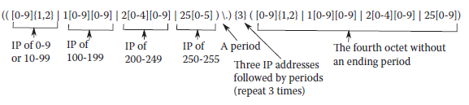
IP Addresses
[0-9]{1,2} – covers 0-99
Now we need to also cover 100-255
Note that [0-9]{1,2} is not
correct either because we
would not normally use
00 or 09, instead just 0 or 9,
How can we fix this?

Slide 18
Spam Filters
One common use of regex is to build spam filters to search not just for keywords, but variations
Consider we want a regex to spot “viagra” but clever spammers will try to hide the word by using non-standard characters or by altering the spelling
v!agra
vi@gra
v_i_a_g_r_a
We might try any number of regexs to spot this
[Vv][1Ii!][Aa@][Gg9][Rr][Aa@] would catch the first two but not the third
[Vv].*[1Ii!].*[Aa@].*[Gg9].*[Rr].*[Aa@] would catch all three

Slide 19
Wildcards in Linux
Recall from chapter 9 that we use *, ?, [ ] as wildcards when specifying filenames
The bash interpreter performs filename expansion by attempting to match all files in the current directory to the name listed
This is a process referred to as globbing
But we saw that *, ?, and [ ] are also used in regex
This is confusing!
We have to differentiate when we use these characters in such commands as ls, rm, mv, etc from when we use them in regular expressions

Slide 20
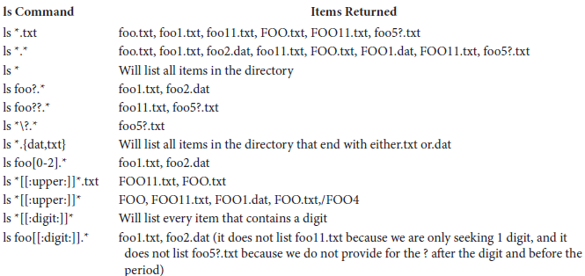
Examples
The contents of our current directory are:

Slide 21
grep
The most common usage of regex in Linux is through the program grep
global regular expression print
Usage: grep pattern file(s)
will return every line in the file(s) listed that contain a substring that matches the pattern
Very useful for finding content of file(s) that you are interested in
e.g., searching all files in a directory that have IP addresses

Slide 22
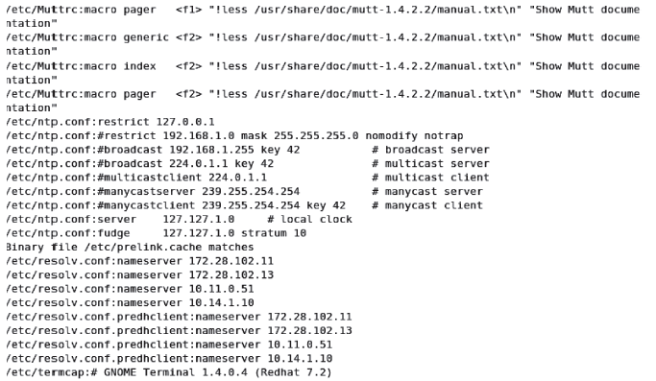
Applying grep
When the IP address pattern is used in grep for all files in /etc, we get the following (partial) output

Slide 23
Continued
You might notice that grep matches lines that contain “mutt-1.4.2.2” thinking this is an IP address when it is actually a version name
Our regex was not specific enough although in reality 1.4.2.2 could be an IP address
We also see the entry “Binary file /etc/prelink.cache matches” indicate that there was a match of our pattern to a binary file
We generally want to ignore binary files, we cannot view their contents
The output also tells us the file(s) that matched
We can add options that eliminate file names or include the line number(s) that matched

Slide 24
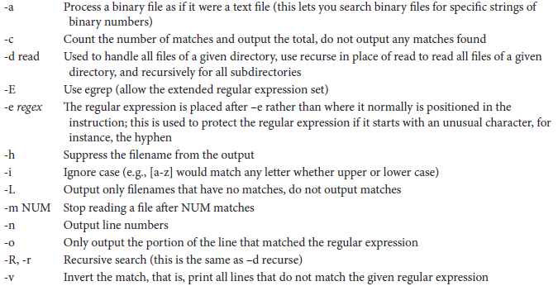
Useful grep Options

Slide 25
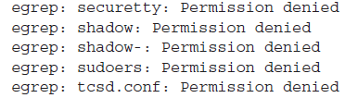
More on grep
grep only uses the standard regular expression set, which does not include some of the metacharacters like { } and ( )
To use the full set of metacharacters, you must use the extended version of grep, either:
egrep
grep –E
Also, be aware that if you try the IP address search on /etc as a normal user, you will be given some permission denied errors since you do not have read access to all of /etc

Slide 26
Piping to grep/egrep
Imagine that you want to find all files whose permissions start with rwx, you could not do
ls ^rwx
because ls applies wildcards, not regex
But you could do this
ls –l | grep ^rwx
Similarly, you could pipe ps aux to grep
ps aux | grep foxr – to find all processes owned by foxr
ps aux | 0:00 – find all processes that have used no CPU time

