Slide 1
The Linux Shell
The shell contains
  an interpreter
  an environment of previously defined entities (e.g., variables, functions) and the results of previously executed instructions
  a command line
You are placed into a shell when you
  open a new terminal/console window
  start a shell from a terminal/console window, e.g., by running bash
  open a remote text-based connection as with through the program ssh
Linux provides several different shells
  sh (the bourne shell)
  csh – incorporated new ideas like history and command line editing
  tcsh – updated version of tcsh
  bash – updated version of Bourne shell (bourne again shell)

Slide 2
Command Line
When you are in a shell, you are presented with a prompt
  typically the user prompt will look like $ (if you log in as root, the prompt will be #)
  the prompt is your command line, enter a command and press <enter>
  whatever you enter is executed and if any output is provided, it will be displayed to the window you are operating in
Once a command is on your command line
  You can edit it as if it were a line in a word processor
  This allows you to recall a previous command (from history) and change it
  Command line editing features are similar to the commands used in emacs to move the cursor and edit a line

Slide 3
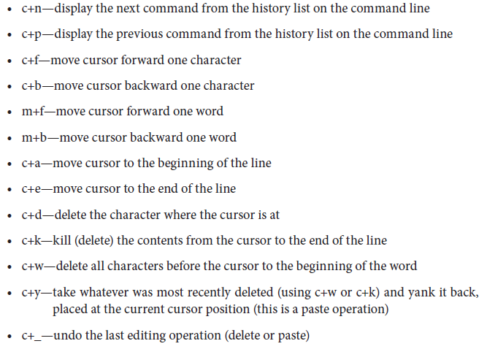
Commands

Slide 4
History
The first feature built into bash to examine is history
  Every time you enter a command, it is stored in your history list for that shell
  You can recall the history list to see what you did, or select instructions from the history list to be re-executed
history – show history list
  history –n # where # is a number displays the last # instructions on your history list
  to the right is an example of a partial history list

Slide 5
Recalling Commands from History
To recall the last command use
  !!
  control+p – this places that command on your command line (you can edit it, discussed in the next slide)
To move through the history list
  control+p – go back through history (also up arrow)
  control+n – go forward through history (also down arrow)
To re-execute instruction # from the history list
  !#
To re-execute the last instruction that started with string
  !string
From the history list on the right:
  #7 will re-execute ls –l
  #l (lower case L) will re-execute ls –al
  #ls / will re-execute ls /home

Slide 6
Tab Completion
Saves you from having to type a full directory or file name
  Type part of the name<tab>
  If unique, Bash completes the name
  If not unique, Bash beeps at you, type <tab><tab> to get a listing of all matches
Example: current directory contains these files
  forgotten.txt frank.txt fresh.txt
  functions.txt funny.txt other_stuff.txt
You type less fo<tab>
  bash completes with forgotten.txt
You type less fr<tab>
  bash beeps at you
You type less fr<tab><tab>
  bash lists frank.txt fresh.txt

Slide 7
Aliases
Alias – a substitute name for a command
  alias name=command
  If command includes spaces, place the full thing in ‘ ’ as in alias up=‘cd ..’
The new name can be the same as an old name
  alias rm=‘rm –i’
You will define aliases to
  save typing (shorten commands)
  simplify complex commands
  eliminate directory paths
  safety (for instance, forcing the –i option with rm)
  typos (if you are commonly making the same mistake, for instance typing sl instead of ls)
    alias sl=ls
Defined aliases at the command line prompt
  but the alias is then only known for this session, close the shell, lose the alias

Slide 8
Examples
alias add=/usr/sbin/useradd
  now you do not need to remember the path to perform useadd
alias rm=‘rm –i’ (safety)
alias lsl=‘ls –l’ (shorten a common instruction)
alias ..=‘cd ..’ (aliases do not have to be letters)
alias mr=rm (common typo)
alias md=mkdir (shorten)
alias h10=‘history –n 10’ (shorten)
alias xt=‘xterm –bg black –fg white &’
  shorten hard to remember command

Slide 9
Filename Expansion
There are wildcard characters available in Linux
  ls * - list everything in the current directory
  ls *.txt – list everything that ends with .txt
  ls *.* - list everything that contains a period
The * means “everything”
The ? means “any one character”
  ls file?.txt – list everything whose name starts with file, has one character, followed by .txt such as file1.txt, filea.txt and file_.txt but not file1a.txt
Use [ ] to enumerate a possible list or range as in
  ls file[0-9].txt or ls file[123].txt or ls file[a-z].txt
    we explore these in more detail in the next chapter

Slide 10
Variables
You are allowed to create and use variables in your shell
To create a variable use as assignment statement
  NAME=value
Variables store strings only
  You can override this to store integer numbers by placing the value in ( ) as in AGE=(21)
To set a variable to the value in another variable use
  NAME=$VAR
If the right hand side string has one or more spaces, enclose the entire thing in “” (although ‘’ is available, don’t use it)
  NAME=“Frank Zappa”
  NAME=“$FIRST $LAST”
If the right hand side is a computation, place it in $((…))
  X=$((Y+1))
if a Linux instruction, use either $(…) or `…`

Slide 11
Examples
AGE=(21)
AGE=$((AGE+1)) // AGE becomes 22
AGE=$AGE+1
  this sets AGE to be “21+1” (that is, the characters 2, 1, +, 1)
NAME=“$FIRST $LAST”
  if $FIRST is Frank and $Last is Zappa then NAME is “Frank Zappa”
MESSAGE=“Today is `date`”
  Sets MESSAGE to the string “Today is ” followed by the result from the Linux instruction date
X=$((Y/5))
  integer division, X is the quotient
Q=$((Y%5))
  integer remainder, Q is the remainder
  NOTE: the remainder will be between 0 and 4
A=$(((X+1)*Y))
  added parens to control order of operations

Slide 12
echo
Output instruction, form is
  echo string
  Where string is any combination of literal characters, $variables or $(Linux commands) `Linux commands`
If you forget a $ you get the variable name without its value
  echo Hello $FIRST LAST
    outputs Hello followed by the value in FIRST followed by LAST literally because we forgot the $
Assume FIRST=Frank, LAST=Zappa
  echo Hello $FIRST $LAST
    outputs Hello Frank Zappa
  echo “Hello $FIRST $LAST”
    outputs Hello Frank Zappa
  echo ‘Hello $FIRST $LAST’
    outputs Hello $FIRST $LAST

Slide 13
Environment Variables
We don’t generally use our own variables (unless we are shell scripting) but there are useful environment variables, defined by the OS
To see your environment variables, type env
  HOSTNAME – name of your computer
  SHELL – name of the current shell (e.g., /bin/bash)
  USER – your user name
  HOME – your home directory
  PWD – current working directory (this is used by the pwd command)
  HISTLIST – number of commands to be retained in your history list
  PS1 – your prompt defined (details in two slides)
  PATH – a list of directories that bash will examine with every command (see next slide)

Slide 14
PATH & PS1
You will place commonly used directories in PATH (this is already established for you)
  Assume PATH stores /usr/bin:/usr/local/bin:/bin
    you can issue a command that is stored in /usr/bin, /usr/local/bin or /bin without including the path
    if the command is not found in those directories (or the current directory), you will receive an error
To add to PATH type
  PATH=$PATH:nextdir
  To view your PATH variable, type echo $PATH
PS1 defines your prompt
It includes special characters to denote date, instruction number, username, etc
For instance: PS1=“\u@\t $”
  will define your prompt to display your user name, the @ symbol, the command number, a space and a $ to indicate that you are a normal user (and not root)

Slide 15
Redirection
By default, most Linux programs expect input to come from disk file and output to go to the window
  You can redirect input and output as follows
  command > file – redirect output to file, if file already exists, override it
  command >> file – redirect output to append to file, if file does not already exist, create it
  command < file – redirect input to come from file (this is the typical case for most instructions, so is not particularly useful except when running shell scripts)
  command << string – redirect input to come from keyboard, end the input when “string” is encountered
  command | command – this is known as a pipe, take the output of one command and use it as input to the next

Slide 16
Examples
cat file1.txt file2.txt file3.txt >> file4.txt
  Take the contents of 3 files and append them to file4.txt
cat << quit > list
  input items from keyboard one at a time until the word “quit” is entered, save list to the file list
cat << quit | sort > list
  same as above except the items are sorted
ls –l *.txt | less
  obtain the long listing of all items in the current directory that end with .txt and pass them to the less program to display the contents one screen at a time

Slide 17
Help
Three forms of help in Linux
  man – manual page
    exists for most commands
    informs you of what the command does, what the options are for using the command, related files and instructions to this command, and in some cases, examples
  help – help page
    only exists for some instructions
    man is more commonly used and more useful
  Apropos – given a string, lists all commands that contain that string as part of the command’s description
    useful if you are not sure of a command’s name before you try to obtain its man page

Slide 18
How the bash Interpreter Works
Enter command
  Interpreter breaks input into words, operators
  Handle quote marks
  Replace aliases
  Separate command into individual commands if there are multiple commands
  Perform brace expansion, tilde expansion (convert ~ to home directory), assign variables their values
  Handle commands in ` ` or $( ), execute arithmetic operations
  Perform redirections
  Perform filename expansion (match against wildcard characters)
  Execute command and display results

Slide 19
Tailoring your bash Shell
If you enter a variable or alias from the command line, that item is only defined in the current session
  If you type bash, you enter a new session
  If you exit this session, you lose those definitions
  If you open another window, you do not have those definitions
It is easier to define these items in a script that is executed at the start of each shell session
This is where we will define our initial PATH variable and any aliases
  We, as users, are free to edit these files to add to or change these definitions and add our own definitions

Slide 20
Order of Script Execution
There are several scripts involved and are executed in this order
  /etc/profile – for any new log in
  /etc/bashrc – for any new bash session
    these two files are controlled by the system administrator to define common variables and aliases for all users
  .profile – for any new log in
  .bash_profile – for any new log in into a bash shell
  .bashrc – for any new bash session
    .bash_profile invokes .bashrc and .bash_login so it is best to put your definitions in .bashrc

