Slide 1
Computer vs Other Human Inventions
When we examine the role of the computer in our lives, we find that it plays a part in nearly everything we do
Communication
Commerce
Transportation
Education
Manufacturing
Research, etc
What other human inventions have had the same impact?
Language
Taming (controlling) fire
Electricity
Refrigeration
The automobile
The airplane

Slide 2
Computers from 1950s to Today
1950s | Today
Cost: hundreds of thousands of $ to millions of $ | $300 - $1200 for normal (desktop/laptop) computers
Thousands of instructions per second | Billions of instructions per second (supercomputers > 1 trillion per second)
Little main memory (a few thousand bytes?) | 4-8 Billion bytes or more
Very large machines | Can be carried in your pocket or your brief case
Few users (mostly the engineers and programmers) | Billions of users

Slide 3
Before the Generations
We describe computer technology by generation
We are currently in the 4th generation
Prior to the 1st generation, we still had computational devices
The abacus (2000-4000 BC?), unknown inventors
used for simple counting
Mechanical calculators
Pascal and Leibniz (early to mid 1600s)
Programmable device
Jacquard’s Loom (circa 1800)
Babbage’s programmable devices
Difference engine (1822)
Analytical engine (1832)
neither device was completed by Babbage at the time as he ran out of funds

Slide 4
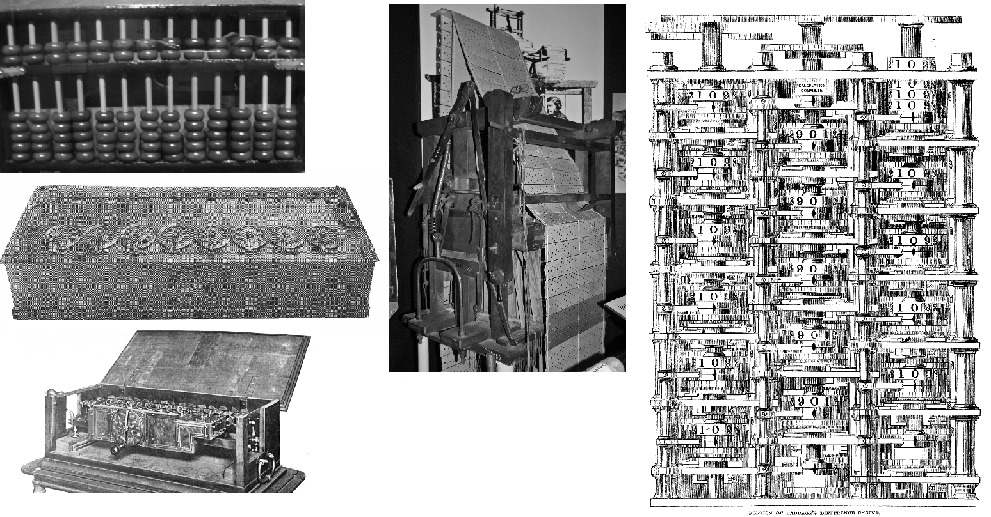
Abacus, Calculators, Loom, Analytical Engine

Slide 5
More on Babbage
Device to compute mathematical tables
Use difference equations
Steam powered to rotate stalks of gears
Rotation of gears performs + and –
Analytical engine programmable for different types of equations – IPOS cycle, first computer!
Input equation
Process
Output results (via printing press)
Storage results (orientation of gears)
Initial programs written by mathematician Lady Ada Lovelace (world’s first programmer)

Slide 6
The 1930s-1940s
Leading up to the first generation
Electricity used instead of steam power
Some electronic circuits replace mechanical computing
Not general purpose – computers could compute one type of operation, e.g., code breaking, rocket trajectories
Circuits used switches and possibly vacuum tubes
Some of these early devices were still analog in nature (not using 1s and 0s)
Slow, expensive, unreliable
Demand for computers came from World War II

Slide 7
Notable Early Computers
Name | Year | Nationality | Comments
Zuse Z3 | 1941 | German | Electromechanical, programmable
Atanasoff-Berry | 1942 | US | Electronic, non-programmable
Colossus Mark 1 | 1944 | UK | Electronic, programmable
Harvard (Mark 1) | 1944 | US | Decimal, electronic, programmable
Colossus Mark 2 | 1944 | UK | Electronic, programmable
Zuse Z4 | 1945 | German | Electromechanical, programmable
ENIAC | 1946 | US | Electronic, programmable

Slide 8
First Generation
ENIAC (Electronic Numerical Integrator and Computer), Univ of Pennsylvania, Feb 1946, $500K
First general purpose programmable electronic computer
Weighed 30 tons, about 1800 square feet, 17,468 vacuum tubes, 7200 crystal diodes, 1500 relays, 70,000 resistors, 10,000 capacitors, millions of hand-soldered joints
Input from punch cards, output using an offline accounting machine for a printer, magnetic tape used to move output
Most first generation computers were one-of-a kind laboratory machines
Experimental, large, costly, slow, unreliable because of vacuum tubes, programmed using machine language
Used only be the engineers and technicians of the lab
By the mid 1950s, computer companies were selling mainframe computers to those who could afford them

Slide 9
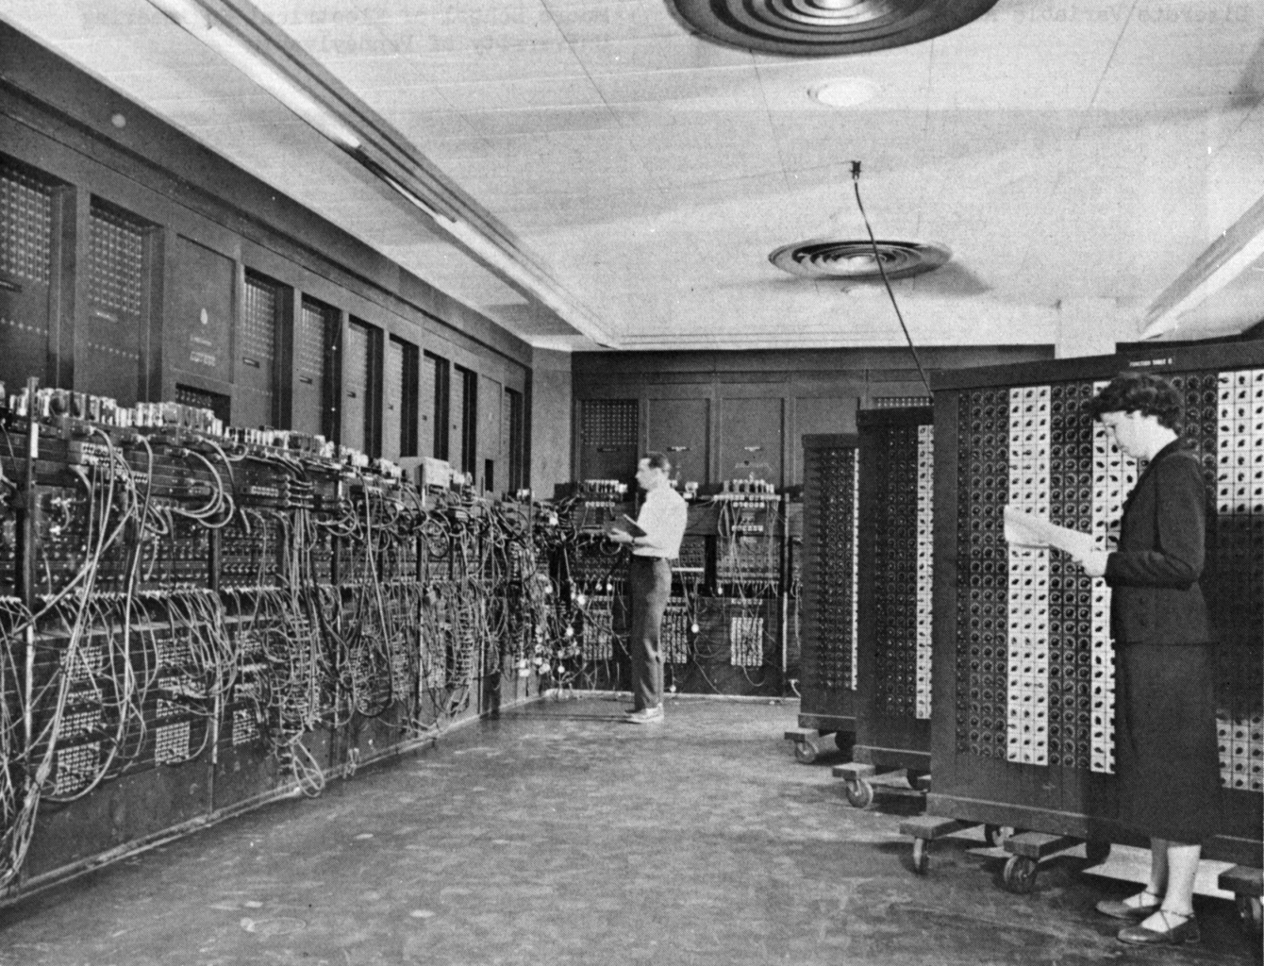
The ENIAC

Slide 10
Second Generation
Started around 1959
Transistors replaced vacuum tubes
Magnetic core memories introduced for memory storage
expensive but permitted up to 1MByte of storage
Disk drum (data drum) introduced for storage
Smaller computers meant faster computers
Less distance for current to travel
Cheaper computers
Components were less costly, computer companies were formed, computers were no longer “1 of a kind”
Led to increased number of computers and therefore increased usage
Need for software support to run programs
the resident monitor

Slide 11
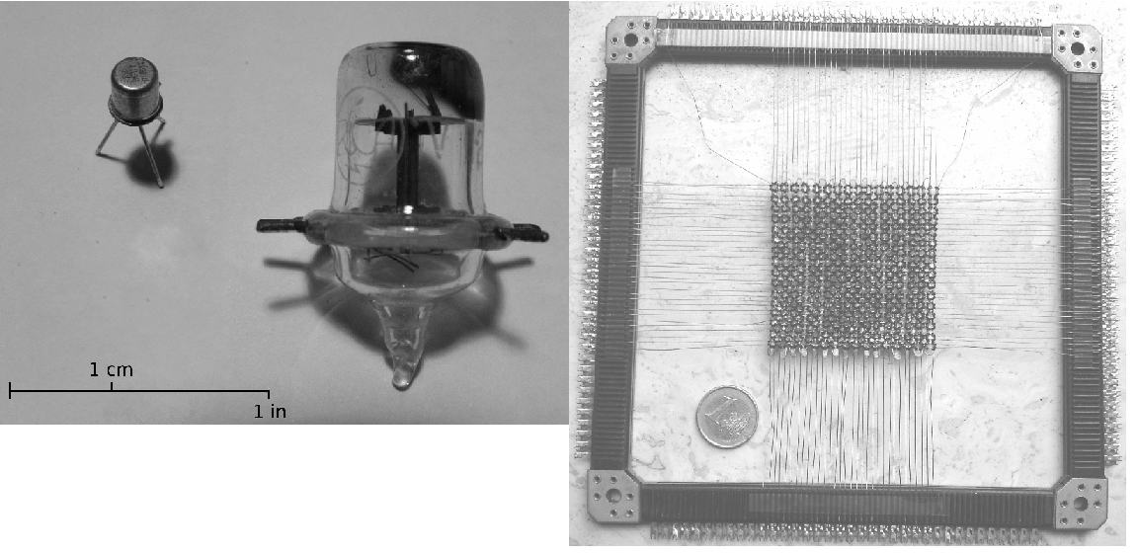
Vacuum Tube, Transistor, Magnetic Core Memory

Slide 12
Third Generation
Started around 1963 (or as late as 1965)
Circuits placed on silicon chips (integrated circuits) were used to replace transistors (logic) and mag core memory
Made computers smaller, faster, cheaper, more easily produced
Led to more computers being manufactured and purchased
Computer users were no longer (necessarily) programmers/engineers or even highly trained
Resident monitor upgraded to full operating system
Networks and dumb terminals permitted access remotely (from outside of the computer room)
Minicomputers introduced (scaled down mainframes, cheaper, not as powerful) allowed smaller organizations to own computers
Computer families introduced

Slide 13
Fourth Generation
Started as early as 1971 (or maybe 1974)
Miniaturization led to CPU on one chip
The transistor count has increased exponentially over time, roughly doubling every 18-24 months
SSI – 10-20 (early 60s) MSI – 100s (mid to late 60s)
LSI – 1000s (early 70s) VLSI – 100,000s (late 70s)
ULSI – millions+ (80s and beyond)
2012: up to 2.5 billion transistors on a CPU
Led to the creation of the microprocessor
Microprocessor led to the first called microcomputers
The first personal computers introduced in the 1970s, largely hobbyist toys, little main memory, few software titles, I/O largely limited to keyboard, printer or tv set, cassette drive

Slide 14
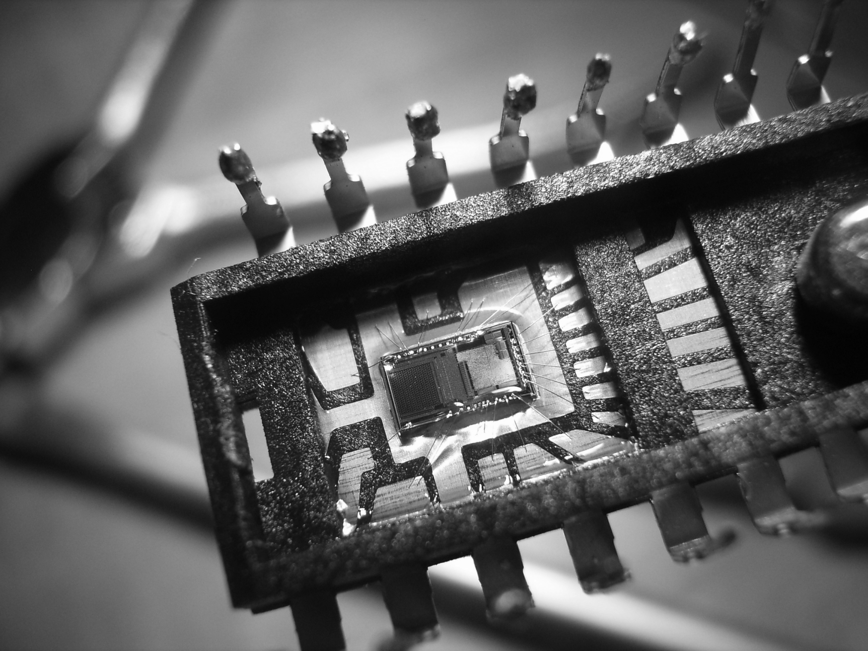
Chip with Miniaturized Circuitry

Slide 15
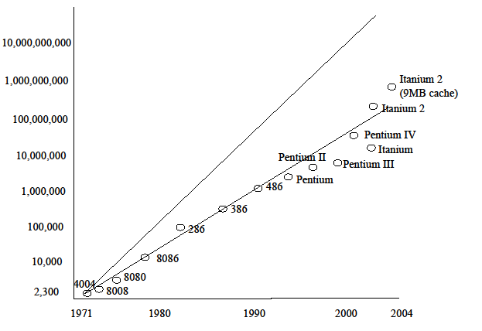
Moore’s Law
Gordon Moore, one of the founders of Intel
Noticed the increased transistor count as early as 1965
Used it to predict transistor count for the future
Doubling of transistors every 18-24 months
If we explore microprocessors, we see that Moore’s Law has come true since 1970 until present day! (see the next slide)
This is not a physical law, it is an observation and a prediction
Computer engineers predict that we
will no longer be able to fulfill
Moore’s Law
hasn’t happened yet
but might happen any year now

Slide 16
Other 4th Generation Inventions
Laptop (and smaller) computers using LCD screens, long lasting batteries
Laser printers, touch screens
Broadband wireless network access
Gigabyte memory storage, terabyte disk storage
CPU innovations
Pipelined CPUs
Parallel processing
Multicore processors
On-chip and off-chip cache memories
Register windows
Branch speculation

Slide 17
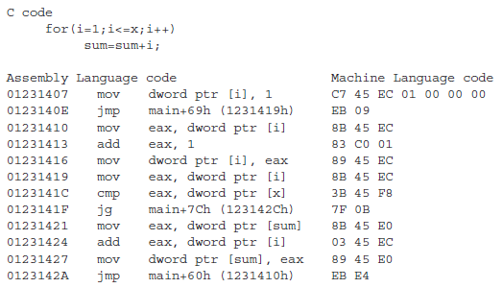
Evolution of Computer Software
Programming language evolution
Machine language (1st generation)
Assembly language (1st and 2nd generations)
High level languages (2nd generations and onward)
Structured Programming (3rd and 4th generations)
Object-oriented languages (4th generation)
Visual programming (4th generation)

Slide 18
Evolution of the Computer User
1950s – users were engineers and programmers
They wrote programs and the code needed for I/O
Tested them out, debugged the code and fixed the hardware
1960s and 1970s – users were highly trained employees but not necessarily programmers
Used operating system commands to run their “jobs” including for instance JCL commands in IBM mainframes and VMS commands on DEC’s Vax computers
1980s – PCs became available
Simple DOS commands, later GUIs
1990s up to today – point and click, look and feel

Slide 19
Impact on our Society
Our parents (our grandparents) generation used to think of computers as
Scary, unknowable, threatening, big brother
Today, nearly everyone on the planet has Internet access
When do you not use a computer in same aspect of your life?
Driving? GPS, digital radio, antilock brakes
News? Gathered and disseminated by computer, possibly read on-line
Movies? writing, editing, special effects, marketing, etc all involve computers
Communication? Cell phones, satellites, etc.
Shopping? credit card communication, store inventory, computerized cash registers
Going outside? Weather prediction modeling on computers

Slide 20
From Resident Monitor To OS
Early computers had no OS
Programmers had to include code to handle all input/output and program startup
Resident monitor alleviated need for some of these duties
Resident monitor developed starting in the 1950s to handle punch card instructions for I/O
OS developed out of resident monitors by adding more and more utilities and support for the user
This evolution started in the late 1950s and continues today
Most early operating systems were developed to support only one hardware platform

Slide 21
Noteworthy Operating Systems
GM-NAA I/O – General Motors for IBM 701, collection of resident monitors to support the user, 1955
Atlas Supervisor – Manchester University, first true OS, permitted concurrent user access and virtual memory
BESYS – Bell Labs, 1957 for IBM 704, handle input from punch cards and tape, output to printer or tape, supported FORTRAN programs
IBSYS – for IBM 7090 and 7094, 1960, OS commands were embedded in programs using $ to indicate OS command rather than program instruction (JCL would copy this format later)
CTSS – MIT, 1961, first true time-sharing system
EXEC 8 – Remington Rand’s UNIVAC, 1964, supported batch, time sharing and real-time processing
TOPS-10 – DEC PDP-10, 1964, time sharing with shared memory
MULTICS – 1964, hardware independent through modules, dynamic linking of program code, access control lists, storing process memory like files, hierarchical file system
OS 360 – IBM 360 (and later IBM 370), 1966, batch processing with threading within a single task, JCL commands for I/O, virtual memory, hierarchical file system, virtual storage access method (used for database access), parent/child spawning, network communications
Unics – AT&T, 1969, an early precursor to Unix based on MULTICS

Slide 22
History of Unix
Up until this time, most OSs were developed for specific hardware
One goal behind Unix was to be portable
Hardware independent, or an OS that could run on multiple platforms
Features to include
File system administration
Strong network components, TCP/IP
Security
Custom software installation
Define your own kernel programs
Shells, scripting
Command line interpreter, redirection and pipes

Slide 23
Unix/Linux Timeline
Up until the mid 1970s, Unix was only available commercially (for sale)
Thompson, in a sabbatical at UC Berkeley developed the Berkeley Standard Distribution (BSD) which would compete with Bell Labs’ Unix
BSD spawned SunOS, FreeBSD, NetBSD and eventually MacOS X
Bell Labs Unix spawned AT&T Unix, Solaris (Sun), HP-UX, AIX (IBM) and others
GNU’s was a project developed by Richard Stallman at MIT
1991 – Linus Torvalds, unhappy with his OS class’ OS begins developing Linux, asking OS programming community for help
1993 – first major distribution of Linux released

Slide 24
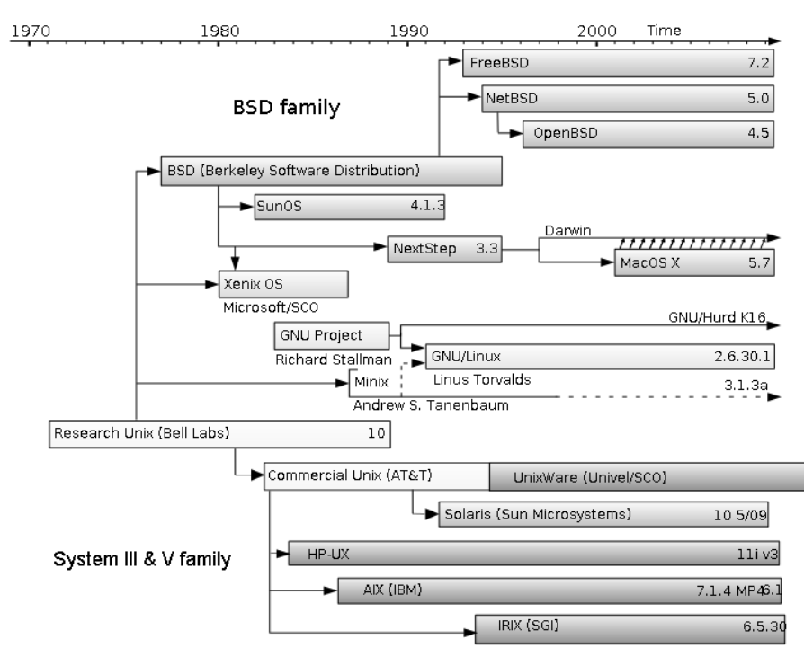
Unix/Linux Timeline

Slide 25
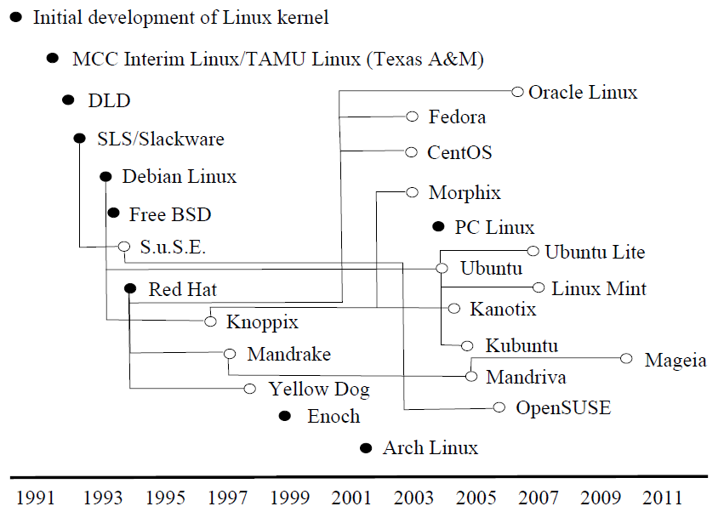
Linux Distributions

Slide 26
Popular Linux Distros
Two most popular distributions are Red Hat and Debian
Both have splintered to create many sub-distributions
Red Hat – both open source and commercial versions available, SELinux, Red Hat Package Manager (rpm)
Fedora
CentOS
Debian – completely open source (not commercially available), has over 20,000 software packages available for it, uses APT package manager, can boot from live CD
Ubuntu
SLS/Slackware – German version of Linux, bought by Novel in 2003
SuSE

Slide 27
Free Software Movement
Started by Richard Stallman as part of the GNU’s project
GNUs – GNUs not Unix – a joke by Stallman to define his project using a recursive definition
He attempted to enlist help in the development of GNUs – a completely open source Unix-like OS
The goal was to build an open source operating system
Free as in freedom, not beer
Software are ideas and ideas should not be owned, so all software should be made available not just for free but in source code so that code could be shared and developed
Others embraced the open source initiative, they did not necessarily think that all programming endeavors should be free

Slide 28
Open Source and GPL
Stallman felt all software should be free, particularly anything developed out of other free software
Torvalds adopted an attitude that Linux and the other software created for Linux
can be available in open source
can be sold if the programmer chooses
This led to a split
Free Software Foundation – Stallman’s group
Open Source Movement – those who work in the open source community but permit commercial products to be built from partially open source software
Stallman defined the GNUs Public License
Anything created with open source tools must be published using the GPL
Stallman called this a “copyleft” instead of a copyright
Both groups use the GPL (most of Linux is published under the GPL)
The GPL is now used in other forms of publishing
see for instance wikimedia

Slide 29
Pre-Windows PC History
MS-DOS – released in 1981 for the IBM PC
IBM published their architecture and used off-the-shelf components
This led to “clones” (or compatibles)
Since software available for IBM PC would run on clones, these computers captured a larger marketshare
MS-DOS ran on all of these
Thus, MS-DOS was very popular
MS-DOS
Single tasking
Text-based
Most commands revolved around file operations (DOS = disk operating system)

Slide 30
Xerox PARC → Macintosh
Xerox Palo Alto Research Center
Artificial intelligence research, programmers implemented windows based operating system in the 1970s using object-oriented programming
They offered tours of their facility where they showed off their operating system (Jobs and Wozniak of Apple saw this when they took a tour of Xerox Parc in the late 70s)
With the success of the Apple I and II personal computers, Jobs and Wozniak started development of other projects
Jobs project was Apple Lisa but he was kicked off the project when it ran into delays and went over budget!
Lisa released first (1983), too expensive to be successful ($10K/computer), Mac released in 1984, was very successful

Slide 31
Microsoft Windows
During the development of the Macintosh and Lisa, Apple hired Microsoft to develop software for the Macintosh
Supposedly, this led to Bill Gates designing and implementing Windows
Windows 1.0 released in 1985 ran on top of MS-DOS
Windows 2.0 released in 1987, 3.03 in 1990, 3.1 became very popular
Windows NT – networking based version, 32-bits, supported client-server networks and competitive multitasking
Windows 95 became the first PC (stand-alone) OS from Windows to support multitasking and networking, also introduced plug-and-play
Windows 98, Windows 2000, Windows ME and Windows XP, Windows Server (2003), Windows Vista in 2007 was a failure, Windows 7 (2009), Windows 8 (late 2012)

Slide 32
Mac Developments
Mac
Multitasking for background processes in 1987, Virtual memory support in 1991, Desktop shortcuts in 1991, TCP/IP networking in 1999, Unix-like kernel in 2001
In an ironic twist, Microsoft in 2005 invested heavily in Apple to help support the struggling company
Their condition: change from the PowerPC processor to the Intel processor so that Microsoft software would run on Macintosh
Mac hardware had always been superior to PC hardware but not any longer
The more expensive hardware was partially why Macintoshes have been more expensive

