Slide 1
Process Management
We studied process management in chapter 4
Here, we examine managing processes from a user’s and system administrator’s perspective
how to start a process
moving processes between foreground and background
how to monitor processes
how to change process priority
scheduling processes
terminating processes
We then look at special processes known as services
how to configure them
how to control them
how to alter when they start

Slide 2
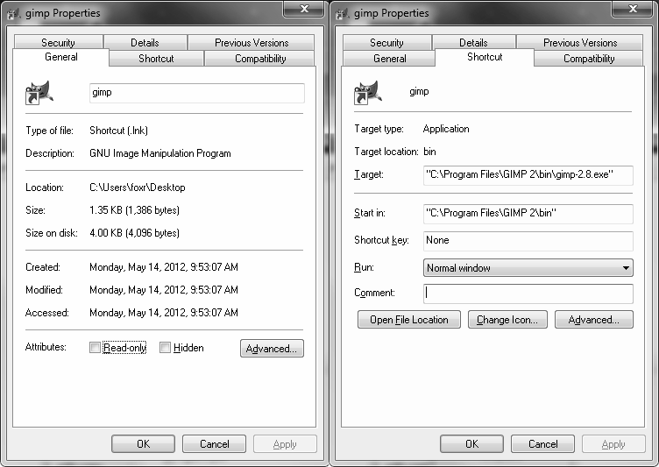
Starting a Process
To user issues a command requesting that the operating system start a new process
Through the GUI
Double clicking on a short cut icon
Selecting the process name from a menu
From the command line
Typing the name of the process (including the proper path if necessary to the process’ executable)
A Windows shortcut contains the
executable instruction as if you entered
it from the command line

Slide 3
What the OS does Now
No matter how the user requests a process, the OS now takes over
the OS interprets the command
if from the command line, it includes the location of the executable
if from the GUI, the shortcut icon or menu property for the program includes the location of the executable
the OS then finds the executable, loads it into swap space and then loads initial pages into memory
the OS creates a data structure that stores the process’ status information
if room exists, the OS moves the process into the ready queue

Slide 4
Types of Processes in Linux
In Linux, a process is created by a parent process which “spawns” the child process
For instance, the bash shell might be the parent or the Windows environment might be the parent
Commonly, child processes will report their status to the parent process for book keeping
If a parent process dies it causes the child process to become an “orphan” in which case the child is usually adopted by the first process, init
A child process is not allowed to exit the system until the parent acknowledges that it can leave, the parent may not be ready to do so if the parent is asleep
this causes the child to become a zombie process – defunct but still in the system

Slide 5
Foreground vs Background
The active process(es) is in the foreground
Background processes are those that are not
receiving user interaction (minimized, not at the top on the desktop)
currently part of the ready queue so that they do not receive CPU attention
You can move processes between foreground and background
In Windows, you move a process from foreground to background by
Minimizing it
Moving another process “on top” of it in the desktop
In Linux, start a process in the background by adding & to the command
e.g., find ~ -name core* &
Look at available processes in the shell by typing jobs
Move jobs between foreground and background using bg # and fg # (where # is the job number)

Slide 6
Example Linux Interaction
Below is a user’s interaction in bash, moving processes between foreground and background – comments listed after //
$ top // issue top, an interactive program, in the foreground
control+z // suspend top, prompt returns
$ jobs // ask for jobs listing
[1]+ Stopped top // + indicates the most recent fg process
fg // resumes top
control+z
$ vi // start vi
control+z // suspend vi
$ jobs
[1]- Stopped top
[2]+ Stopped vi // vi is the most recent fg process, top is next most recent
$ fg 1 // resumes top rather than vi
control+c // exit top
$ top & // launch top directly into the bg
$ // returns the prompt because there are no fg jobs

Slide 7
Changing Process Priority
Aside from moving processes between fg and bg, the user can also impact a process by changing its priority
In Windows, go to task manager, in Processes tab, right click on process name and select Set Priority
realtime/high/above normal/normal/below normal/low
In Linux
You control priority by changing the process’ niceness value
a nicer process is willing to give away some of its CPU time, so it has lower priority (higher niceness = lower priority)
niceness values range from -20 (least nice, highest priority) to +19
nice process-name –n value
NOTE: only root can lower a niceness value (raise the priority), users are only allowed to raise the niceness value

Slide 8
Process Status - Windows
Use the task manager
Tabs display
Applications – start, stop, move between fg and bg
Processes – end process (useful when a process hangs), end process tree (end process and child processes), change priority, set affinity (which processors or cores this process can run on), obtain properties of process
see the next slide
Services – start and stop them, start the services GUI
Performance – shown in two slides
Networking – specifically, network performance and usage
Users – those users logged in

Slide 9
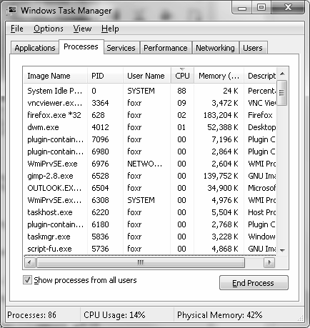
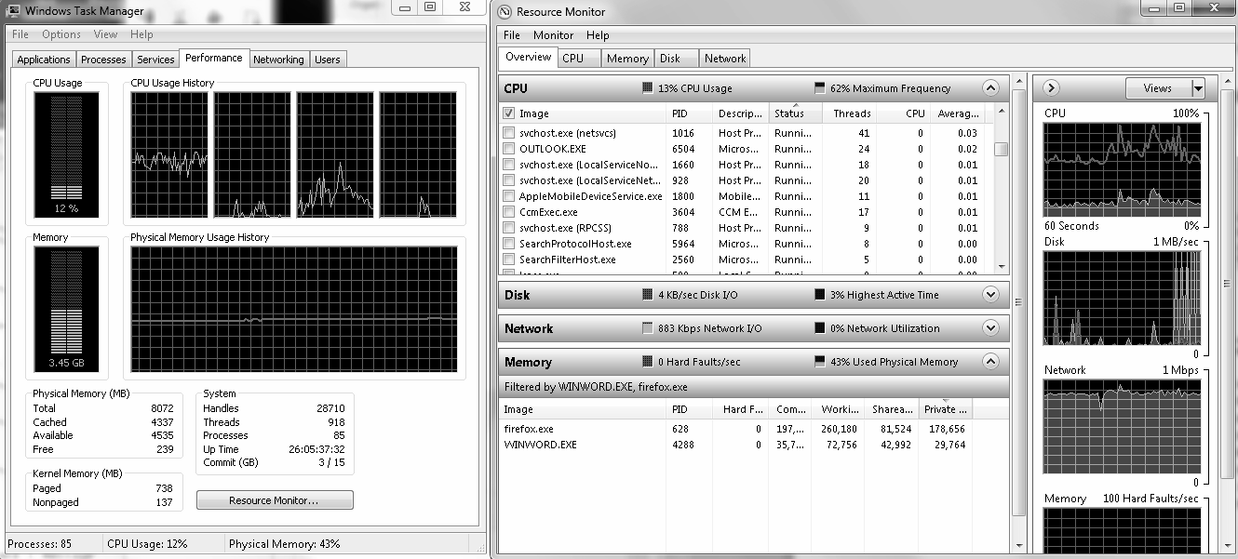
Process Status – Windows Continued

Slide 10
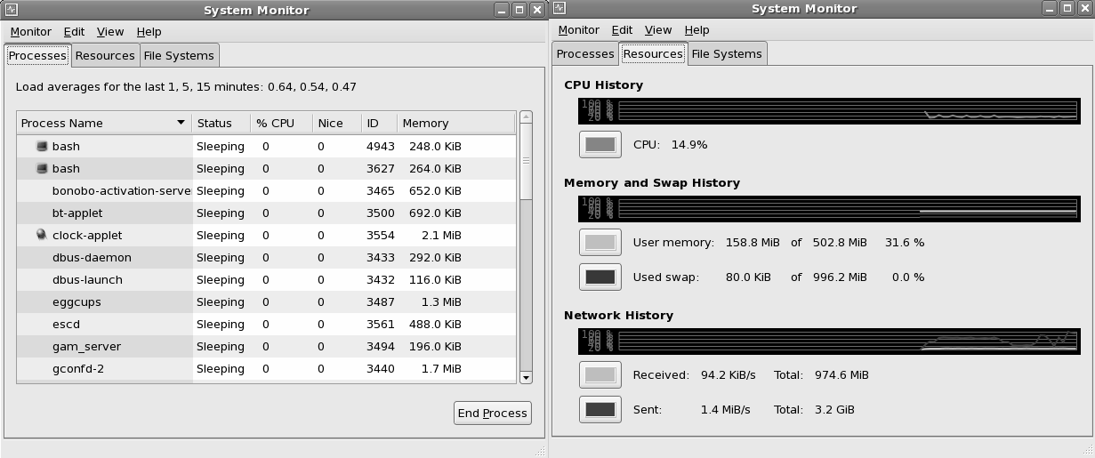
Process Status - Linux
Like Windows, Linux has a GUI called the System Monitor
processes tab, resources tab, file systems information

Slide 11
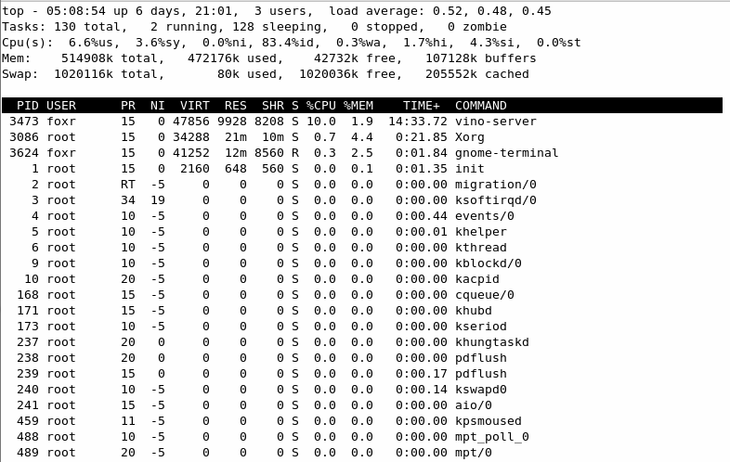
Process Status – Linux top
Interactive, text-based, runs in a terminal window
Displays
system
stats at top
and individual
process stats
at the bottom

Slide 12
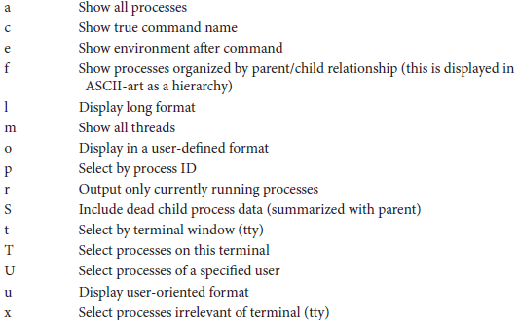
Process Status – Linux ps
Command line instruction to provide a “snapshot” of process information
Many different options available

Slide 13
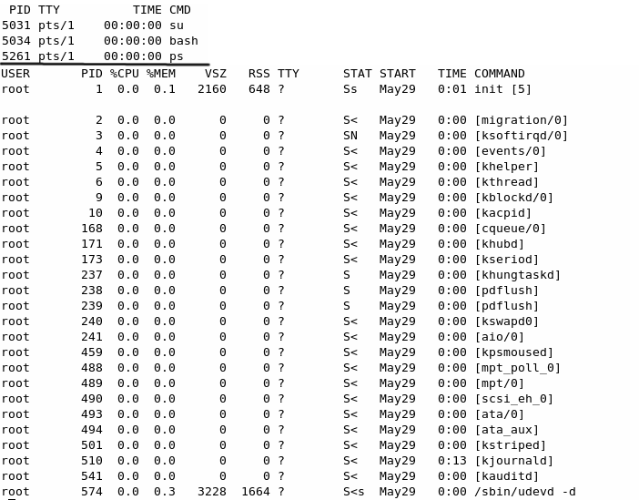
ps vs ps aux

Slide 14
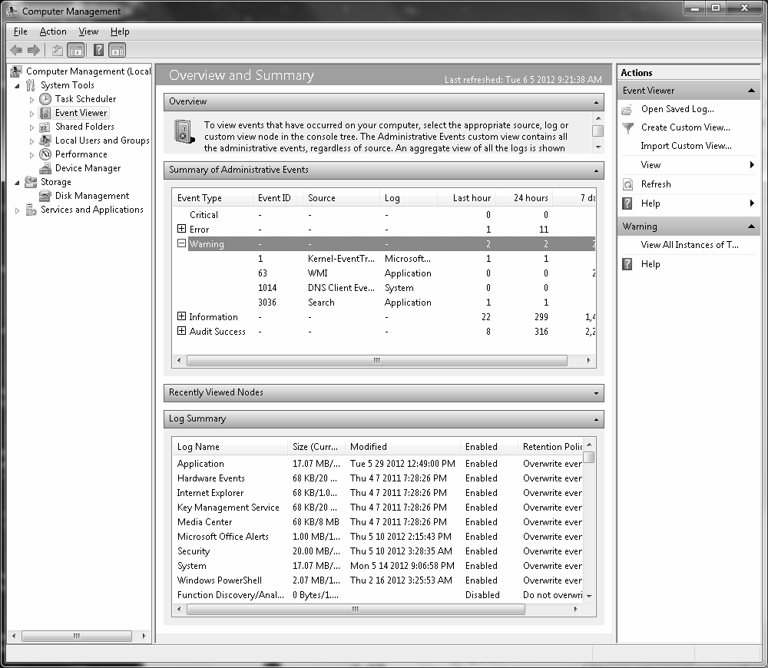
Process Scheduling - Windows
Windows task scheduler
Schedule the task (action)
start a program or script
send an email
display a text message
The time
daily
weekly
monthly
one-time occurrence with starting time

Slide 15
Process Scheduling – Linux at
at –f filename time [date]
at –f filename now + value
if you omit –f filename, you are placed at a prompt to input one at a time the scheduled task(s)
Once issued, you can inspect scheduled tasks using atq
Delete scheduled tasks using atrm
time specified as HH:MM[am|pm]
uses military time if am or pm is not supplied
executes within 24 hours at the next occurrence of that time
Also available are noon, midnight and teateam (4pm)
date specified using mmddyy, mm/dd/yy, dd.mm.yy, today or tomorrow
value is a numeric value and a time unit like now + 3 days

Slide 16
Process Scheduling – Linux cron
at schedules a 1 time task, crontab schedules recurring tasks
Create a file that contains the recurrence and task
Issue the command crontab filename
Inspect scheduled tasks using crontab –l
Recurrence is indicated by 5 values: minute, hour (military time), date, month, day of week (0 to 7, 0 and 7 for Sunday, 1 for Monday)
Examples:
15 3 1 * * -first day of every month at 3:15 am
0 14 * * 0 – every Sunday at 2 pm
0 0 12 31 * - every December 31 at midnight
You can list multiple times using either by separating the times by commas or using */number where number is degree of recurrence
*/10 * * * * - every 10 minutes of every hour of every day
0 0 1,15 * * - midnight of every 1st and 15th of the month

Slide 17
Terminating Processes
Processes usually terminate normally
User ends the program or the program reaches its ending state
Some processes will terminate abnormally
Reach a run-time error such as a memory violation or arithmetic error
In Linux, such a process may leave behind a core dump
the image of the process in memory so that a programmer can debug it
Other processes hang requiring that the user terminate them
Through Windows task manager’s Processes tab
In Linux, use the kill command
kill –s signal pid
the signal indicates what level to kill the process, with 9 meaning “kill immediately” to ensure that the process terminates

Slide 18
Services
A service is a special type of process
Owned by the OS
Runs in the background
this keeps services from negatively impacting processor performance
Handles services from various agents (users, software, the OS, network clients)
In Linux, services are often called daemons
A service will read its configuration file to determine how to act
We can edit configuration files to alter the service’s behavior
In both Windows and Linux we can establish if and when a service should start

Slide 19
Types of Services
Logging
Create log file entries for running software and operating system operations
Useful for determining if an event happened as planned or for troubleshooting
Scheduling
Services that determine if a scheduled task should be executed during this minute or hour
Network
Handling communication (incoming, outgoing), dealing with IP addressing, dealing with specific applications (e.g., ssh, ftp, http, email), firewall, DNS caching, etc
File system
Mounting remote file systems, dealing with RAID storage, encryption, backups, etc

Slide 20
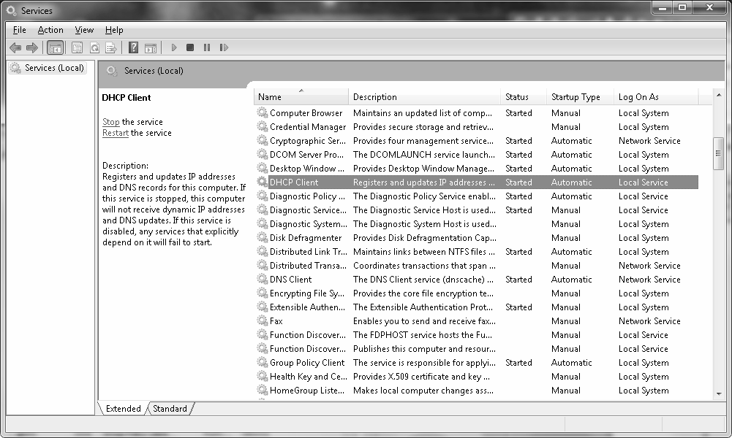
Windows Services GUI

Slide 21
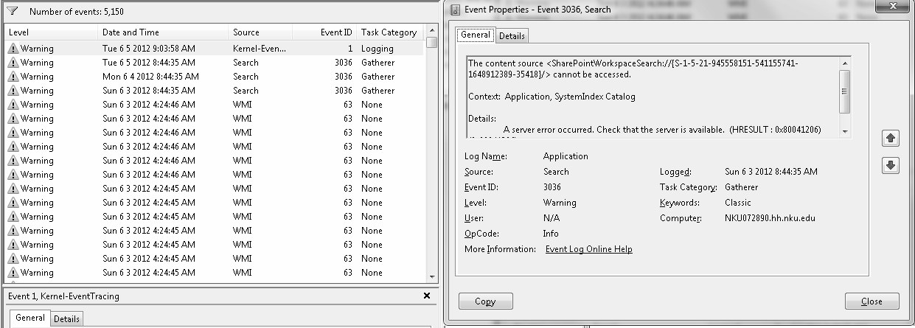
Windows Logging Service
Windows event viewer displays the results of different events
Events are logged at one of the five levels: critical, error, warning, information, audit success
Below are examples of warnings and one specific event warning

Slide 22
Automating Services
In Windows, specify
when services will run
at system boot time
at system boot but delayed until the rest of the system is running
disabled (not running)
what to do when a service stops running (how long to wait before restarting, how many attempts at restarting)
In Linux, based on the runlevel, services are either scheduled to start or stop at initialization time
Runlevels discussed in the next two slides
The system administrator can start or stop any service at any time

Slide 23
Linux Runlevels
7 Runlevel as shown below
Each runlevel starts/stops different services
The directory /etc/rc.d/rc#.d has symbolic links to indicate which services start (S) and which stop (K) (see the next slide)

Slide 24
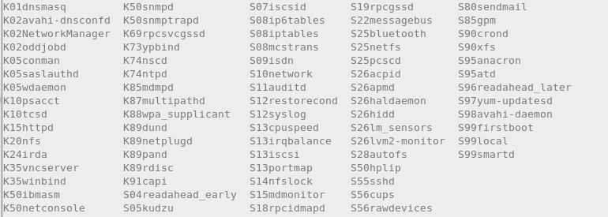
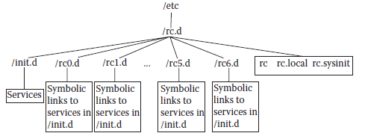
rc5.d (Runlevel 5) Directory
Structure of rc#.d directories

Slide 25
Configuring Services in Linux
Alter configuration file and restart service
/sbin/service servicename command
command is one of start, stop, restart, status
Configuration files stored in /etc
/etc/syslog.conf – to configure syslogd logging daemon
/etc/sysconfig/iptables – to configure Linux firewall (ip6tables to configure for IPv6)
/etc/resolv.conf – configure IP resolver (map IP aliases to IP addresses by calling upon DNS servers listed in this file)
/etc/ldap.conf – LDAP authentication service

Slide 26
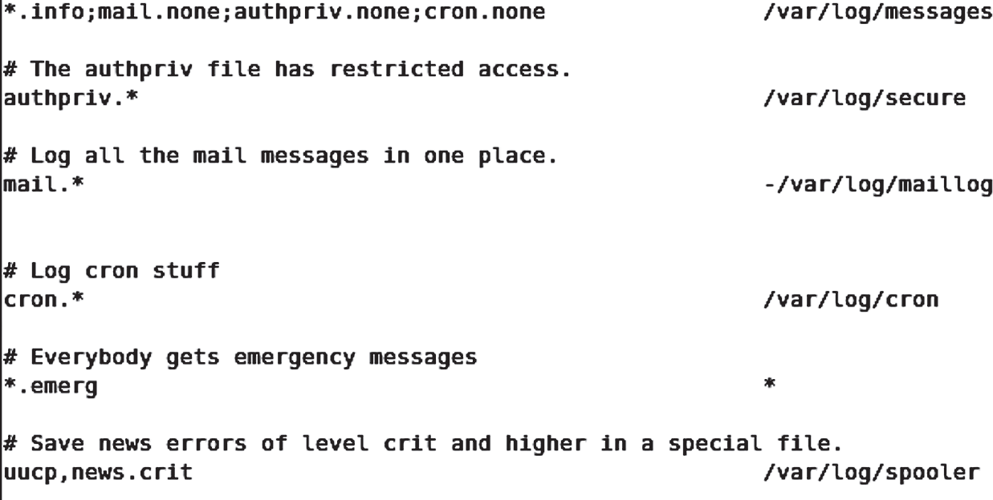
syslog.conf Entries
This file stores entries that describe for each type of system software, what types of events should be logged
Entries are of the form source:priority action
where source is the software type, priority is the type of message, and action is usually a log file

Slide 27
Firewall Configuration Rules
We specify firewall rules that indicate
The direction of the message (input, output, forward)
The result of the message (accept, reject, drop)
reject causes the computer to respond to the sender that the message was received but dropped, drop just drops the message with no response
any parameters such as port, protocol, IP source address, etc
-A RH-Firewall-1-INPUT –p udp --dport 5353 –d 224.0.0.251 –j ACCEPT
accept UDP packets coming in over port 5353 from IP address 224.0.0.251
-A RH-Firewall-1-INPUT –j REJECT
reject all remaining messages (a backstop rule)

