Slide 1
Files, Directories, Partitions
Files – executables (programs), data
Directories - store files and subdirectories
Creates a hierarchical file space used to organize the file space (/ in Linux, \ in Windows to denote directory)
Directories are used to create logical divisions in the file system
Partitions create physical divisions in the file system
Different directories reside in different partitions
Unmounting one partition does not impact others
Partitions are independent of each other
mount and unmount one without affecting others
back up one without impacting others
place disk quotas on one but not others

Slide 2
Files and File Operations
Linux/DOS
ls/dir – list directory contents
cp/copy – copy file
mv/move – move or rename file
rm/del – delete file
cat, more, less/type – display textfile contents
mkdir/mkdir – create directory
rmdir/rmdir – delete directory (empty dir only)
Windows (use Windows Explorer)
select directory from left hand pane to view its contents in the right hand pane
drag icons to copy or move
select icon and press <delete> (or drag to trash can) to delete
right click on icon and select rename
right click and select New → Folder to create directory
Names / extensions
Types
Pointer(s) to physical storage of file
number of pointers (hard links)
Creation, modification, access dates
Owner, group
Permissions

Slide 3
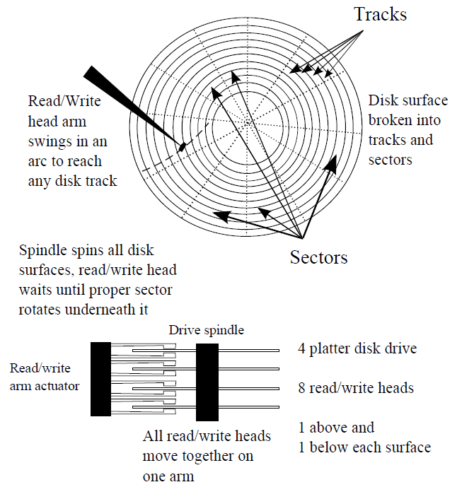
File System Storage
File’s blocks distributed across
available blocks on disk surfaces dedicated to the given partition
Mounting / unmounting
Adding/removing partitions from the file system
partitions may share same physical storage space (e.g., same drive)
partitions may be spread across multiple drives
Disk blocks
Files broken into fixed size chunks, blocks

Slide 4
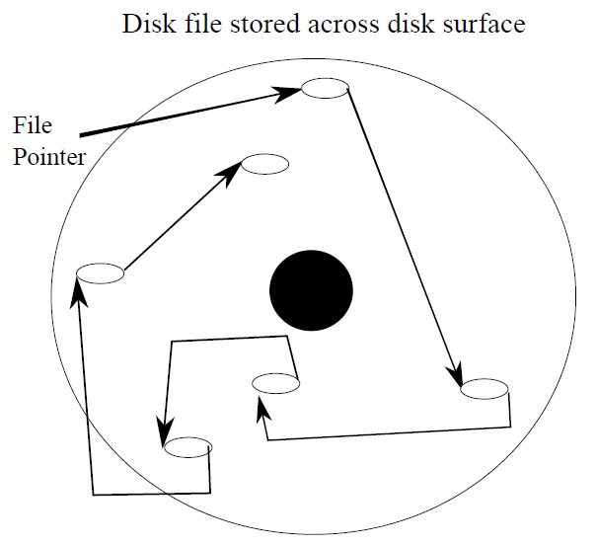
File Access
Disk blocks store same amount
of content; last block may
contain a fragment
File blocks not stored consecutively on a disk
makes access more efficient
reduces chance of fragmentation
creates a linked list structure
File Allocation Table (FAT)
loaded into memory to
allow quicker search for
file block

Slide 5
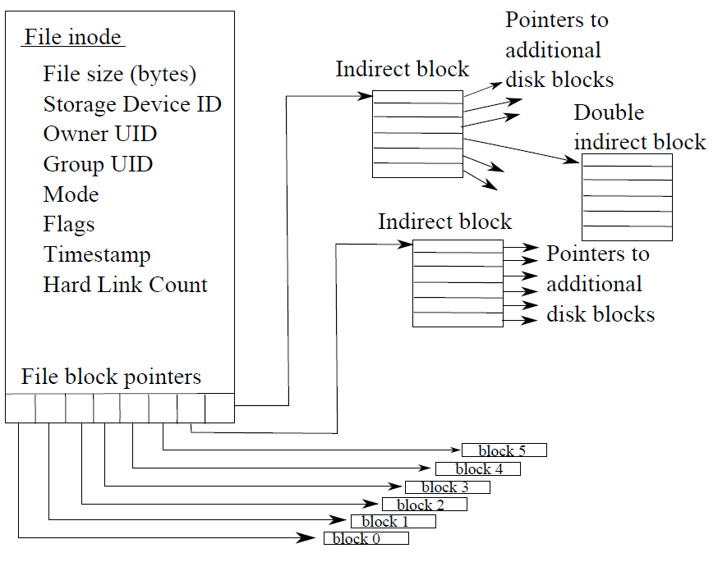
Linux inodes
Each Linux file and directory is represented by an inode (a data structure stored on disk)
inode stores information about the file/directory
pointers point to disk blocks

Slide 6
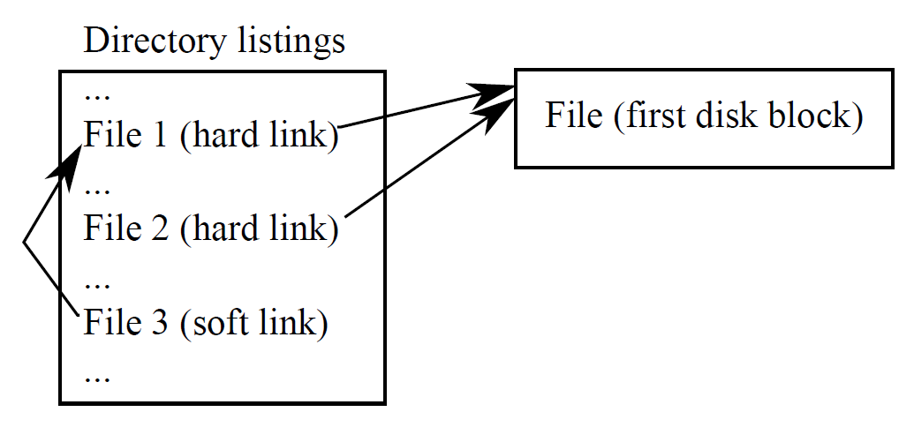
Links
Links create aliases (alternate names
to the item)
Aliases can be dangerous
– if you delete the original file,
the alias points at nothing
The pointer to the initial disk block is known as a hard link
You may create additional links
hard links also point at the file
soft links point at the initial file name with its hard link
In Linux, soft links are called symbolic links
In Windows, soft links are called shortcut icons

Slide 7
Linux File System
Top level directories
/bin – common user applications and file system operations like cd, ls, rm, cp, mv (see also /usr)
/sbin – common system administrator programs
/etc – configuration files, initialization scripts, service rule files
/root – home directory for root
/lib – shared program files
/dev – device files – supports program and user interfaces with hardware devices as if they were files
/tmp – temporary storage for running applications
/boot – boot loader files and Linux kernel stored here
/usr – system and applications software (/usr/bin, /usr/sbin)
/var – running program data files (log files, printer spool files, error files, email, web space files, locked files)
/home – user directories
/proc – although this acts like a directory with subdirectories and files like any other directory, it is really stored in memory and consists of information data regarding running processes

Slide 8
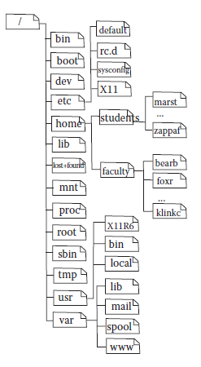
The Linux Directory Structure
As shown here, the top level directories are already created when you install Linux
Typical partitions divide this space up as follows:
/ - root partition contains /bin, /root, /sbin, /etc
/boot (if not on a separate partition, then this is placed under /)
/var – for the /var directory
/home – for all user directories
swap – the swap space
possibly also /usr and /tmp

Slide 9
Windows File System
Partitions are provided automatically
Each partition is lettered
A:/B: - floppy disks
C: - the hard disk
D: - the optical disk
E: - mounted flash drive or remote hard disk
You can partition your internal hard disk into multiple partitions if desired
Top level directories already established
Windows – the operating system
Users – user space
Temp – temporary storage space for running applications
Program Files – application software

Slide 10
Users
We require that computer systems have user accounts to ensure
Security – only qualified people can use the system
Protection – users who create files can establish if and what forms of access other users might have on them
Performance – user accounts allow us to gage the impact that the users are having on the system in order to recommend upgrades
Accounting – to illustrate the size and scope of the system and keep track of such things as how many users are using the system at any given time
Users are authorized through some sort of log in process
User name + password is the most common form
Some newer or highly secure systems might use keycards or biometric forms of authentication
Once a user has been authorized, the operating system is able to match the user against access rights (permissions)

Slide 11
Types of Users
Generally, we differentiate between two classes of users: administrator and normal user
There might be different levels of administrators
e.g., some users may be able to mount cdrom, others might have access to a printer, etc
The system administrator, or root in Linux/Unix has access to all files, all resources, all programs
Aside from end-user accounts, software is also given user accounts
This is necessary as a program, when run, is given your access rights, but a program might need access to its own files, so the program has its own account
In such accounts, there may be no home directory, and usually the software accounts have no log in shell

Slide 12
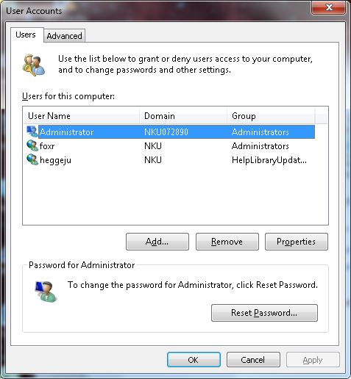
Creating User Accounts
In both Windows and Linux there is a simple GUI approach to creating user accounts
See the figures below
You have to be administrator/root to do this
There is also a command line way to set up accounts, in Linux, it is useradd
useradd [-u uid [-o]] [-g group] [-G group group group …] [-d home] [-s shell] [-m] username

Slide 13
Account Data
In Linux, you are able to specify a number of different pieces of user data
Through both the GUI and command line although more data can be specified using the command line
ID number defaults to be 1 greater than the last account
username
comment field (used for the user’s full name)
whether a private group should be created for this user or not, and if so, what name to give it (the default is the same name as the username)
other groups to add the user to initially
what to set as the initial user password
log in shell and home directory and whether to create a home directory or not

Slide 14
Groups
Groups are created so that files can be shared among users in the same group
Without groups, the only access rights would be for the owner of the file and everyone else
With groups, files can be shared
Groups are available in both Linux and Windows
In Linux, a group is created for every user, known as that user’s private group
Groups can be created via GUI or command line (Linux) and users can be added to groups at any time
The groupadd command creates groups and allows you to insert users into groups, or you can use the GUI from the previous slide to modify groups, or you can edit the groups file itself

Slide 15
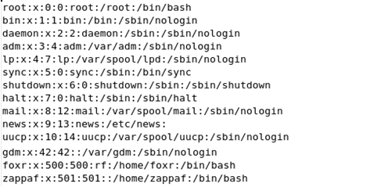
/etc/passwd
Stores user account information in Linux
Named passwd but it no longer stores passwords because it was viewed as a security hole
in place of the password, there is an x
passwords now stored in the file /etc/shadow
Entry for every user
Although you can edit this file as root, it is better to modify user account information using the usermod instruction
The first entry is root, this is
followed by various software
accounts and finally user
accounts (user numbers
500 and 501 here)
Related files are /etc/group
and /etc/shadow

Slide 16
Linux User Management Instructions
passwd – change password
root can change any user’s password by doing passwd username
root can establish when users must change passwords
-f forces the user to change their password at the next login
-x allows you to set the maximum number of days until a password expires (needs to be changed)
-w gives them a warning some number of days before their password expires
passwd –w 7 -30 foxr – foxr’s password must be changed within 30 days with a warning given 7 days prior to the deadline
chown – change ownership of a file
format: chown newuser filename
chgrp – change the group that owns the file
format: chgrp newgroup filename
chown newuser:newgroup filename – changes owner and group
usermod – change a user’s data

Slide 17
Strong Passwords
Because of the need to secure our computer systems (due to the confidential nature of data stored there) and the fact that there are a lot of people trying to break into accounts (known as hackers or more properly crackers)
We need to ensure that passwords are strong enough to not be easily broken
Strong passwords are typically at least 8 characters in length with a combination of letters and non-letters (and possibly both upper and lower case letters), the words do not appear in a dictionary, and need to be changed fairly often (1-3 months)
We may also demand that the password not be similar to any previously used password, for instance changing abcdef12 to abcdef13

Slide 18
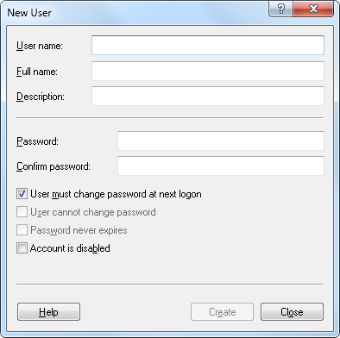
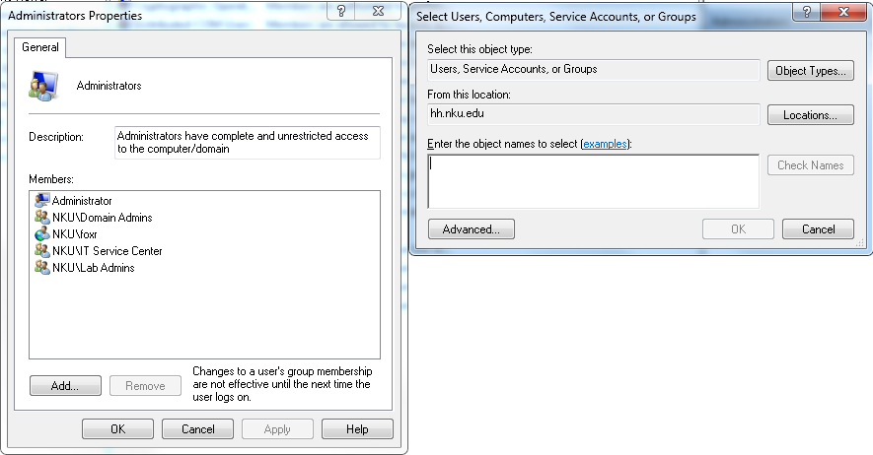
Windows
Account creation, group creation, account management, group management and changing passwords is all done through GUI windows

Slide 19
Access Control Lists
In order to control who can access a resource, resources will need some mechanism for protection
Some operating systems use ACLs
Every file and directory will have its own access control list
This list describes what users can access the item and what type of access
the advantage of such a list is that every resource can have different access rights for each user
the disadvantages are that the length of such lists could take up quite a bit of storage, and they may not be easily altered when, for instance, a new user is added to the system
Windows uses a variation of ACLs while Linux uses a simplified set of permissions

Slide 20
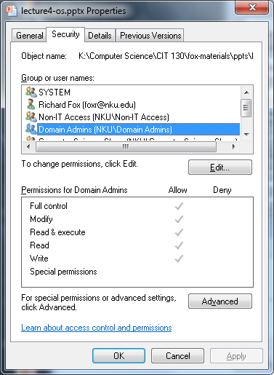
Windows Permissions
Permissions are placed on both files and directories
Permissions dictate who can do what to that file or directory
Read access – view the contents
Write access – save the file, save something into a directory
Modify access – save over a previous version
Execute access – run the file (only valid if the file is an executable or a script), cd into the directory
Windows also has read & execute combined as well as “full control”
In Windows, use
properties window

Slide 21
Permissions in Linux
There are three sets of permissions for any resource: owner (user or u), group (g), world (other or o) each has read, write, execute access (r,w, x)
Change permission use chmod
u/g/o+/-r/w/x or ugo=rwx or use 3-digit number
Examples:
chmod u+x,g-w file1.txt
chmod u=rwx,g=rx,o=x file2.txt
To view a file’s permissions, use ls –l

Slide 22
3-Digit Approach
Add up the 3 values below based on whether you want r, w or x
4 if readable
2 if writable
1 if executable
file foo3.txt (previous slide) has permissions of rw-rw-r--
read + write = 4 + 2 = 6
read = 4
3-digit value = 664
Example command
chmod 755 file1.txt
owner gets rwx, group and world get r-x (read and execute, not write)
Other common numbers are:
400 – read-only for owner
444 – readable by all
644 – readable by all, read/write by owner
755 – all access for owner, read/execute for group and world
660 – read/write by owner and group, none to world
000 – no access to anyone (except root)

Slide 23
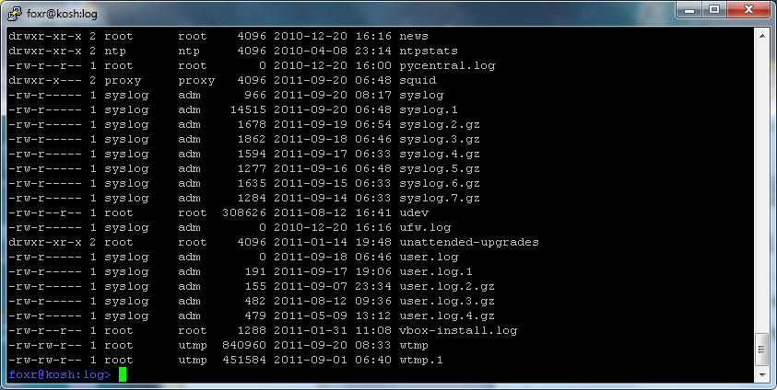
Viewing a Linux Directory
Let’s examine the excerpt from a Linux directory to see if we can understand the information
Can you make sense of the permissions, owner and group entries?

Slide 24
Switching Users
In Windows, if you want to switch to another user account, you use the “switch user” facility through the log out/shutdown mechanism
This prevents you from having to log out, have the new user log in, do their work, log out and then you having to log in again
In Linux, from a terminal window, use the su command (switch user)
su username
You will have to log in as the new user but once you are logged in, you have that user’s full access rights
Note that su will log in you to that user, but not that user’s home directory, so you might follow this with cd ~
Type exit to exit that user’s session and resume yours
su <enter> allows you to switch to root
If you are root, su username does not require that you specify the user’s password

Slide 25
Sudo Access
In Linux, the system administrator can provide additional access rights to users through the sudo command
A file, /etc/sudoers, lists users and the commands that they can execute
entries are listed as: user(s) location=command
location is either ALL (all computers in this domain), localhost (this computer only) or a list of specific computers
command is the command to be made available, listed with its full path as in /usr/sbin/useradd
The user can then run the command using sudo as in
sudo /usr/sbin/useradd –m newuser
With sudo, you can have more access levels between the user and root
using sudo, we might permit some (or all) users to perform the shutdown command – why?

