Slide 1
What is an Operating System?
The OS is a program
Permit easy access, control hardware, communicate between user and software, user and hardware, software and hardware, maintain the computer system (hardware and software)
Users can access the OS via GUI and command line
Kernel
Always resident in memory
Responsible for primary OS tasks (process management, memory management, resource management, protection, security)
Device drivers
Program interfaces between OS and peripheral devices
Shell
User interface, tailorable
Utility programs
Add on programs to further manage and fine-tune your system (anti-viral programs, disk utilities, screen savers, etc)

Slide 2
Interrupts
The CPU’s fetch-execute cycle runs continuously unless interrupted
Interruptions can come from hardware or the running program
control+alt+delete
mouse moved
printer out of paper
program has run-time error
An interrupt interrupts the CPU at the end of fetch-execute cycle
Upon interrupt, CPU determines what device (or user or software) raised interrupt
select the proper interrupt handler (piece of OS code)
execute interrupt handler to handle the interrupt
resume the interrupted process

Slide 3
User Interface
GUI
Point and click, drag, double click
Touch screen devices use gesture-based motions (swiping, tapping, pinching, reverse pinching)
Command line
Enter commands from a command line prompt
Commands executed by an interpreter
breaks instructions into component parts
converts instructions to machine code and executes them
maintains a “session”
we examine the Bash interpreter in chapter 9
Commands may look cryptic and be hard to learn but offer more power and flexibility
Linux command: find ~ -name ‘core*’ –exec rm {} \;

Slide 4
Process Management and Scheduling
Process – a running program
Processes have a status (running, ready, waiting, stopped)
And data (stored in memory, cache, registers)
Process management is how the OS handles the tasks of starting processes, managing running processes, performing interprocess communication, terminating processes
Another aspect is process scheduling – selecting the next process to run
Scheduling algorithms include round robin, priority, first come first serve, shortest job first, longest job first
Processes wait in queues
Waiting queue – waiting to be loaded into memory
Ready queue – in memory, but not currently executing by the CPU
I/O queue – waiting for I/O to complete

Slide 5
Memory Management
We may not be able to fit all of our running program(s) in memory
We use swap space as “backing storage”
Swap space is placed on the hard disk
We break our programs into fixed sized units called pages
The OS moves pages for us between swap space and memory as needed (on demand)
This is known as virtual memory
Program broken into fixed sized pages
Memory broken into fixed sized frames
when process begins running, first pages are moved to available frames
OS maintains page table
CPU generates a memory address:
page #, position on page
Use page table to translate this to physical address
frame #, position on frame
If page not in memory, page fault occurs

Slide 6
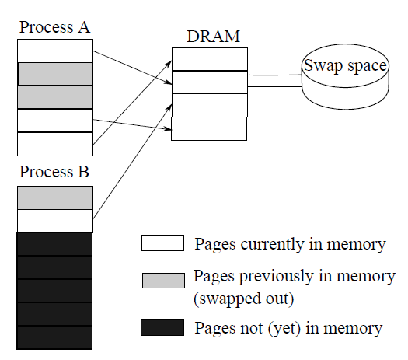
Virtual Memory: Paging and Page Tables
Process A page table
Process B page table
Valid means page in memory
Page | Frame | Valid
0 | 1 | T
1 | - | F
2 | - | F
3 | 3 | T
4 | 0 | T
Page | Frame | Valid
0 | - | F
1 | 2 | T
2 | - | F
3 | - | F
4 | - | F
5 | - | F
6 | - | F

Slide 7
Page Faults and Swapping
A page fault causes an interrupt
OS uses a replacement strategy to find frame to free
if frame is of a page that has been modified, the page has to be saved back to swap space
once a frame is free, new page is loaded from swap space into memory
page table updated
Movement of pages from swap space to memory (and memory to swap space) is swapping
swapping slows down the process because disk access time is much slower than memory access time

Slide 8
Resource Management
The OS is also responsible for maintaining all other system resources
disk files, tape drives, flash drives
network access
printer access
Most resources require mutually exclusive access
no more than 1 process can access a device at a time, others must wait until device is free
Multitasking processes P0 & P1
P0 opens access to file F0
P0 reads datum X
P0 adds 10 to X
CPU switches to P1
P1 opens access to file F0
P1 reads datum X
P1 subtracts 300 from X
P1 writes new value to F0
CPU switches to P0
P0’s value of X is now incorrect
This is data corruption

Slide 9
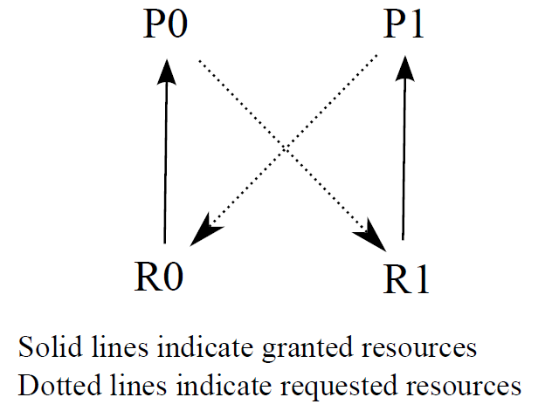
Deadlock
In the above scenario, P0 is using R0, P1 is using R1, P0 wants to access R1 and P1 wants to access R0
Deadlock
The result is that neither P0 nor P1 can continue
We would have to kill one of the processes to let the other continue (restart the killed process later)
OSs will often ignore deadlock and require that the user discover it and kill one of the processes off

Slide 10
Other OS Tasks
File management
Users dictate file system operations through windows explorer or command line instructions (DOS, Linux)
creating directories, moving files, copying files, deleting files, etc
Every file operation is a request
the OS must ensure that the user has access to the given resource to perform the operation
Protection
Resources need protection from misuse
Each resource has permissions associated with it (access, read, write, execute)
User accounts/authentication are used to establish protection
Security extends permissions across a network
A user can then remotely control the computer

Slide 11
Forms of Process Management
Can the OS run more than one program at any time?
not simultaneously but concurrently
One process at a time
single tasking
batch processing
Concurrent processing
multiprogramming
multitasking
multithreading
multiprocessing

Slide 12
Single Tasking and Batch Processing
Single Tasking
User starts the process
Process runs to completion
If I/O is needed, CPU waits
User is not allowed to run more than 1 program at a time
Most early operating systems were single tasking
Most PC operating systems were single tasking until mid 90s
Batch Processing
For multiple user systems
users submit processes at any time
off-line system receives requests
OS schedules processes
Otherwise, very similar to single tasking (one program at a time)
No interactivity because the process may not be executed until the user is gone
input supplied with the program (e.g., punch cards, magnetic tape)
output sent to off-line source (tape, printer)

Slide 13
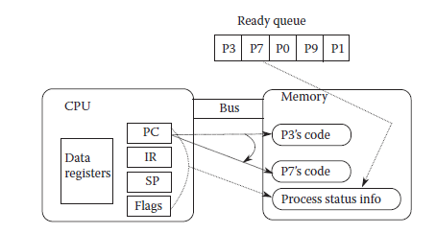
A Context Switch
Concurrent processing needs a mechanism for the CPU to switch from one process to another
New process needs to be loaded into memory
Old process’ status (PC, IR, stack pointer, status flags, etc) saved to memory
New process status (register values) restored (from memory)
During the switch, the processor is idle
Ready queue – stores those processes available for switching
These are processes loaded into memory which have either started execution and been paused or can start execution
Below, we see a switch between process P3 and P7

Slide 14
Multiprogramming & Multitasking
Multiprogramming (or cooperative multitasking) is like batch processing in that one process is executed at a time except
When a process requires I/O, it is moved to an I/O queue
Context switch to next waiting process
When process finishes with I/O, switch back to it
More efficient than batch processing or single tasking because the CPU does not remain idea during time consuming I/O, only delay is during the context switches
For multitasking, add a timer and before a process starts, set the timer to some value (e.g., 10,000)
After each machine cycle, decrement the timer
When timer reaches 0, force a context switch to the next process in the ready queue
User will not notice the time it takes to cycle through the processes

Slide 15
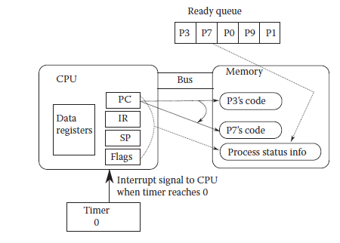
Multitasking
More appropriately called competitive (or pre-emptive) multitasking
Computer appears to be executing two or more processes simultaneously
it is switching quickly between processes
Most OSs do both cooperative and competitive multitasking today
Competitive multitasking was originally
called time sharing in the 1960s

Slide 16
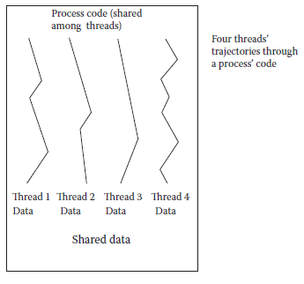
Threads & Multithreading
Threads – multiple instances of the same process sharing the same code
But with separate data
For instance, you might have 3 Firefox windows open, these are threads of the same process
Threads make their way through the same code along different paths
See figure to the right
Multithreading is multitasking across both processes and threads
Switching between threads is simpler (less time consuming)

Slide 17
Multiprocessing
Many computers today have multiple processors
Or multiple cores on one chip (a core is basically a processor which shares pins and a cache with other cores on the same chip)
Multiprocessing is multitasking spread across multiple processors
Most OSs are capable of multiprocessing but do not necessarily share the cores effectively
For instance, if you have 4 cores, you would not achieve a 4 times speedup over a computer with a single core processor

Slide 18
Booting
Main memory (DRAM, SRAM) is volatile
Turn off the power, lose the contents
Turn on the power, memory is empty
We need the OS loaded and running in memory to load and run programs
If you turn your computer on, how do we get the OS loaded into memory and running when the OS is needed to load programs into memory to run them?
We need a 1-time process – booting
The boot process (or portions of it) are stored in ROM (non-volatile memory)

Slide 19
The Boot & Initialization Process
CPU initializes itself (registers, control signals)
BIOS performs power on self test
Disk controllers tested
BIOS determines where the OS is stored
Boot loader runs to load OS (if multiple OSs available, user might be able to select)
OS kernel loaded and initialized
OS runs initialization scripts
Establish runlevel (Linux is a number from 0 to 6, windows is safe mode, safe mode with network, user mode, etc)
OS running, computer ready for user
BIOS is stored in ROM
Kernel often stored on hard disk (possibly also available on optical disk, flash drive or over network)

Slide 20
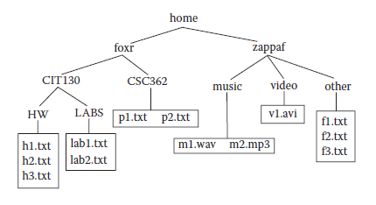
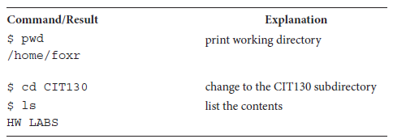
Moving Around the Linux File System

Slide 21
Continued

Slide 22
Continued

Slide 23
Continued

Slide 24
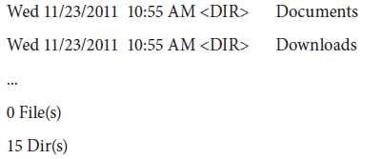
DOS

Slide 25
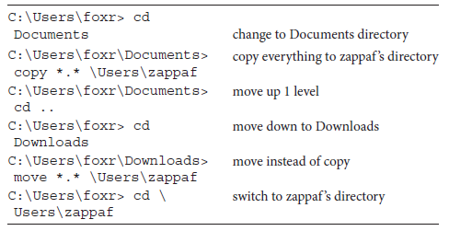
Continued

