Slide 1
The Binary Numbering Systems
A numbering system (base) is a way to represent numbers, base k dictates
We denote the base by adding k as a subscript at the end of the number as in 1234₅ for base 5 (we can omit 10 if in base 10)
Decimal is base 10, binary is base 2
We use 10 because of 10 fingers, but are interested in 2 (also 8 and 16) because computers store and process information in a digital (on/off) way
1 binary digit is a bit
In 1 bit, we store a 0 or a 1
This doesn’t give us much meaning, just 1/0, yes/no, true/false
We group 8 bits together to store 1 byte
00000000 to 11111111
In 1 byte, we can store a number from 0 to 255 or a character (e.g., ‘a’, ‘$’, ‘8’, ‘ ’)

Slide 2
Interpreting Numbers
The base tells us how to interpret each digit
The column that the digit is in represents the value base^{column}
the rightmost column is always column 0
Example:
5372 in base 10 has
5 in the 10³ column (1,000)
3 in the 10² column (100)
7 in the 10¹ column (10)
2 in the 10⁰ column (1)
To convert from some base k to base 10, apply this formula
abcde_{k} = a * k⁴ + b * k³ + c * k² + d * k¹ + e * k⁰
a, b, c, d, e are the digits, k⁰ is always 1
To convert binary to decimal, the values of k⁰, k¹, k², etc are powers of 2 (1, 2, 4, 8, 16, 32, …)

Slide 3
Binary to Decimal Conversion
Multiply each binary bit by its column value
In binary, our columns are (from right to left)
2⁰ = 1
2¹ = 2
2² = 4
2³ = 8
2⁴ = 16
2⁵ = 32
Etc
10110 = 1 * 2⁴ + 0 * 2³ + 1 * 2² + 1 * 2¹ + 0 * 2⁰ = 16 + 0 + 4 + 2 + 0 = 22
1100001 = 1 * 2⁶ + 1 * 2⁵ + 0 * 2⁴ + 0 * 2³ + 0 * 2² + 0 * 2¹ + 1 * 2⁰ = 64 + 32 + 0 + 0 + 0 + 0 + 1 = 97

Slide 4
Simplifying Conversion in Binary
Our digits will either be 0 or 1
0 * anything is 0
1 * anything is that thing
Just add together the powers of 2 whose corresponding digits are 1 and ignore any digits of 0
10110 = 2⁴ + 2² + 2¹ = 16 + 4 + 2 = 22
1100001 = 2⁶ + 2⁵ + 2⁰ = 64 + 32 + 1 = 97

Slide 5
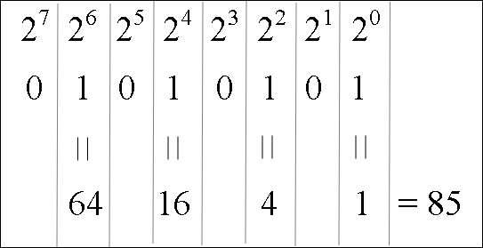
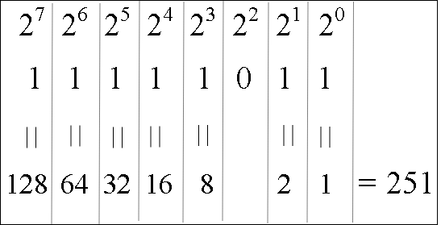
Examples
11010110 =
128 + 64 + 16 + 4 + 2
= 214
10001011 = 128 + 8 + 2 + 1
= 139
11111111 = 128 + 64 + 32 +
16 + 8 + 4 + 2 + 1
= 255
00110011 = 32 + 16 +
2 + 1
= 51

Slide 6
Converting from Decimal to Binary
The typical approach is to continually divide the decimal value by 2, recording the quotient and the remainder until the quotient is 0
The binary number is the group of remainder bits written in opposite order
Convert 19 to binary
19 / 2 = 9 remainder 1
9 / 2 = 4 remainder 1
4 / 2 = 2 remainder 0
2 / 2 = 1 remainder 0
1 / 2 = 0 remainder 1
19 = 10011₂
Record the remainders
and then write them
in opposite order

Slide 7
Examples
Convert 200 to binary
200 / 2 = 100 r 0
100 / 2 = 50 r 0
50 / 2 = 25 r 0
25 / 2 = 12 r 1
12 / 2 = 6 r 0
6 / 2 = 3 r 0
3 / 2 = 1 r 1
1 / 2 = 0 r 1
200 = 11001000
Convert 16 to binary
16 / 2 = 8 r 0
8 / 2 = 4 r 0
4 / 2 = 2 r 0
2 / 2 = 1 r 0
1 /2 = 0 r 1
16 = 10000
Convert 21 to binary
21 / 2 = 10 r 1
10 / 2 = 5 r 0
5 / 2 = 2 r 1
2 / 2 = 1 r 0
1 / 2 = 0 r 1
21 = 10101
Convert 122 to binary
122 / 2 = 61 r 0
61 / 2 = 30 r 1
30 / 2 = 15 r 0
15 / 2 = 7 r 1
7 / 2 = 3 r 1
3 / 2 = 1 r 1
1 / 2 = 0 r 1
122 = 1111010

Slide 8
Another Technique
Recall to convert from binary to decimal, we add the powers of 2 for each digit that is a 1
To convert from decimal to binary, we can subtract all of the powers of 2 that make up the number and record 1s in corresponding columns
Example
19 = 16 + 2 + 1
So there is a 16 (2⁴), a 2 (2¹) and 0 (2⁰)
Put 1s in the 4th, 1st, and 0th columns:
19 = 10011₂

Slide 9
Examples
Convert 122 to binary
Largest power of 2 <= 122 = 64 leaving 122 – 64 = 58
Largest power of 2 <= 58 = 32 leaving 58 – 32 = 26
Largest power of 2 <= 26 = 16 leaving 26 – 16 = 10
Largest power of 2 <= 10 = 8 leaving 10 – 8 = 2
Largest power of 2 <= 2 = 2 leaving 0
Done
122 = 64 + 32 + 16 + 8 + 2 = 1111010
More examples:
555 = 512 + 32 + 8 + 2 + 1 = 1000101011
200 = 128 + 64 + 8 = 11001000
199 = 128 + 64 + 4 + 2 + 1 = 11000111
31 = 16 + 8 + 4 + 2 + 1 = 11111
60 = 32 + 16 + 8 + 4 = 111100
1000 = 512 + 256 + 128 + 64 + 32 + 8 = 1111101000
20 = 16 + 4 = 10100

Slide 10
Number of Bits
Notice in our previous examples that for 555 we needed 10 bits and for 25 we only needed 5 bits
The number of bits available tells us the range of values we can store
In 8 bits (1 byte), we can store between 0 and 255
00000000 = 0
11111111 = 255 (128 + 64 + 32 + 16 + 8 + 4 + 2 + 1)
In n bits, you can store a number from 0 to 2^{n}-1
For 8 bits, 2⁸ = 256, the largest value that can be stored in 8 bits is 255
What about 5 bits?
What about 3 bits?

Slide 11
Negative Numbers
To store negative numbers, we need a bit to indicate the sign
0 = positive, 1 = negative
Several representations for negative numbers, we use two’s complement
Positive numbers are the same as in our previous approach
Negative numbers need to be converted, two ways to do this:
NOT (flip) all of the bits (1 becomes 0, 0 becomes 1)
Add 1
Example: -57 in 8 bits
+57 = 32 + 16 + 8 + 1 = 00111001
-57 = NOT(00111001) + 1 = 11000110 + 1 = 11000111
Starting from the right of the number
record each bit THROUGH the first 1
flip all of the remaining bits
1s become 0s, 0s become 1s

Slide 12
Examples (all are 8 bits)
-57
+57 = 00111001
from the right, copy all digits through the first one:
-------1
Flip remaining bits (0011100)
1100011 1 = 11000111
-108
+108 = 01101100
from the right, copy all digits through the first one:
-----100
flip the rest of the bits (01101)
10010 100 = 10010100
-96
+96 = 01100000
from right, copy all bits through the first one:
--100000
flip rest of the bits (01)
10 100000 = 10100000
-5
+5 = 00000101
from right, copy all bits through the first one:
-------1
flip rest of the bits (0000010)
1111101 1 = 11111101

Slide 13
Real (Fractional) Numbers
Extend our powers of two to the right of the decimal point using negative powers of 2
101.1 = 2² + 2⁰ + 2⁻¹
What is 2⁻¹? 1/2¹
2⁻² = 1/2² = 1/4, 2⁻³ = 1/2³ = 1/8
10110.101 = 16 + 4 + 2 + 1/2 + 1/8 = 22 5/8 = 22.625
How do we represent the decimal point?
We use a floating point representation, like scientific notation, but in binary where we store 3 integer numbers, a sign bit (1 = negative, 0 = positive), the mantissa (the number without a decimal point) and the location of the decimal point as an exponent
1011011.1 = .10110111 * 2^7
Mantissa = 10110111
Exponent = 00111 (7, the exponent)
Sign = 0
further details are covered in the text, but omitted here

Slide 14
Character Representations
We need to invent a represent to store letters of the alphabet (there is no natural way)
Need to differentiate between upper and lower case letters – so we need at least 52 representations
We will want to also represent punctuation marks
Also digits (phone numbers use numbers but are not stored numerically)
3 character codes have been developed
EBCDIC – used only IBM mainframes
ASCII – the most common code, 7 bits – 128 different characters (add a 0 to the front to make it 8 bits or 1 byte per character)
Unicode – expands ASCII to 16 bits to represent over 65,000 characters

Slide 15
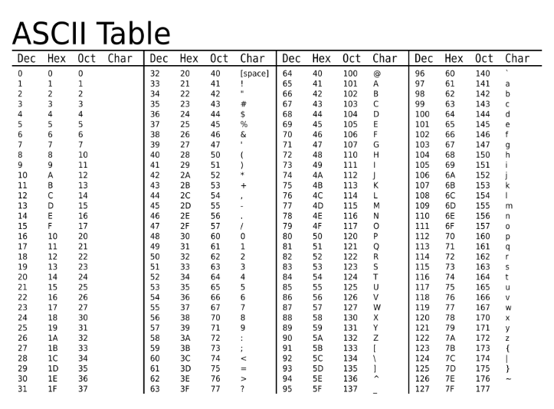
First 32 characters are control characters (not printable)

Slide 16
Example
To store the word “Hello”
H = 72 = 01001000
e = 101 = 01100101
l = 108 = 01101100
l = 108 = 01101100
o = 111 = 01101111
Hello = 01001000 01100101 01101100 01101100 01101111
How much storage space is required for the string
R U 4 Luv?
10 bytes (5 letters, 3 spaces, 1 digit, 1 punctuation mark)
The ‘U’ and ‘u’ are represented using different values
‘U’ = 01010101
‘u’ = 01110101
The only difference between an upper and lower case letter is the 3rd bit from the left
upper case = 0, lower case = 1

Slide 17
Binary Operations
We learn the binary operations using truth tables
Given two bits, apply the operator
1 AND 0 = 0
1 OR 0 = 1
1 XOR 0 = 1
Apply the binary (Boolean) operators bitwise (in columns) to binary numbers as in
10010011 AND 00001111 = 00000011

Slide 18
Examples
AND – if both bits are 1 the result is 1, otherwise 0
11111101 AND 00001111 = 00001101
01010101 AND 10101010 = 00000000
00001111 AND 00110011 = 00000011
OR – if either bit is 1 the result is 1, otherwise 0
10101010 OR 11100011 = 11101011
01010101 OR 10101010 = 11111111
00001111 OR 00110011 = 00111111
NOT – flip (negate) each bit
NOT 10101011 = 01010100
NOT 00001111 = 11110000
XOR – if the bits differ the result is 1, otherwise 0
10111100 XOR 11110101 = 01001001
11110000 XOR 00010001 = 11100001
01010101 XOR 01011110 = 00001011

Slide 19
Binary Addition
To add 2 bits, there are four possibilities
0 + 0 = 0
1 + 0 = 1
0 + 1 = 1
1 + 1 = 2 – we can’t write 2 in binary, but 2 is 10 in binary, so write a 0 and carry a 1
To compute anything useful (more than 2 single bits), we need to add binary numbers
This requires that we chain together carrys
The carry out of one column becomes a carry in in the column to its left

Slide 20
Continued
With 3 bits (the two bits plus the carry), we have 4 possibilities:
0 + 0 + 0 = 0
2 zeroes and 1 one = 1
2 ones and 1 zero = 2 (carry of 1, sum of 0
3 ones = 3 (carry of 1 and sum of 1)
Example:
Check your work, convert to decimal!

Slide 21
Addition Using AND, OR, XOR
To implement addition in the computer, convert addition to AND, OR, NOT and XOR
Input for any single addition is two binary numbers and the carry in from the previous (to the right) column
For column i, we will call these X_{i}, Y_{i} and C_{i}
Compute sum and carry out for column i (S_{i}, C_{i+1})
S_{i} = (X_{i} XOR Y_{i}) XOR C_{i}
Example: if 1 + 0 and carry in of 1
sum = (1 XOR 0) XOR 1 = 1 XOR 1 = 0
C_{i+1} = (X_{i} AND Y_{i}) OR (X_{i} AND C_{i}) OR (Y_{i} AND C_{i})
Example: if 1 + 0 and carry in of 1
carry out = (1 AND 0) OR (1 AND 1) OR (0 AND 1) = 0 OR 1 OR 0 = 1
Try it out on the previous problem

Slide 22
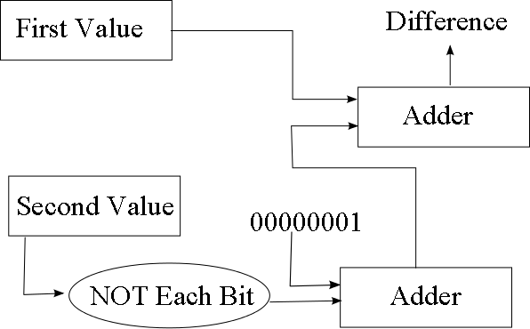
Subtraction
From math, A – B = A + (-B)
Store A and B in two’s complement
We can convert B into –B by
Flip all bits in B and adding 1
to flip all bits, apply NOT to each bit
to add 1, add the result to 00000001
We build a subtracter unit to perform this

Slide 23
Network Addresses
Internet Protocol (IP) version 4 uses 32-bit addresses comprised of 4 octets
1 octet = 8 bits (0..255)
Each octet is separated by a period
The address 10.251.136.253
Stored as 00001010.11111011.10001000.11111101 in binary
Omit the periods when storing the address in the computer
The network address comprises two parts
The network number
The machine number on the network
The number of bits used for the network number differs depending upon the class of network
We might have a network address as the first 3 octets and the machine number as the last octet
The netmask is used to return either the network number or the machine number

Slide 24
Netmask Example
If our network address is the first 3 octets, our network netmask is 255.255.255.0
11111111.11111111.11111111.00000000
AND this to your IP address 10.251.136.253
11111111.11111111.11111111.00000000
AND 00001010.11111011.10001000.11111101
Gives 00001010.11111011.10001000.00000000
or 10.251.136.0 which is the network number
The machine number netmask is 0.0.0.255
What value would you get when ANDing 10.251.136.253 and 0.0.0.255?

Slide 25
Another Example
In this case, the network address is the first 23 bits (not 24)
The netmask for the network is 255.255.240.0
Different networks use different netmasks we
will look at this in detail in chapter 12

Slide 26
Image Files
Images stored as sequences of pixels (picture elements)
row by row, each pixel is denoted by a value
A 1024x1024 pixel image will comprise 1024 individual dots in one row for 1024 rows (1M pixels)
This file is known as a bitmap
In a black and white bitmap, we can store whether a pixel is white or black with 1 bit
The 1024x1024 image takes 1Mbit (1 megabit)
A color image is stored using red, green and blue values
Each can be between 0 and 255 (8 bits)
So each pixel takes 3 bytes
The 1024x1024 image takes 3MBytes
JPG format discards some detail to reduce the image’s size to about 1MB using lossy compression, GIF format uses a standard palette of colors to reduce size from 3 bytes/pixel to 1 (lossless compression)

Slide 27
Parity
Errors arise when data is moved from one place to another (e.g., network communication, disk to memory)
We add a bit to a byte to encode error detection information
If we use even parity, then the number of 1 bits in the byte + extra bit should always be even
Byte = 001101001 (even number of 1s)
Parity bit = 0 (number of 1s remain even)
Byte = 11111011 (odd number of 1s)
Parity bit = 1 (number of 1s becomes 8, even)
If Byte + parity bit has odd number of 1s, then error
The single parity bit can detect an error but not correct it
If an error is detected, resend the byte + bit
Two errors are unlikely in 1 byte but if 2 arise, the parity bit will not detect it, so we might use more parity bits to detect multiple errors or correct an error

