Slide 1
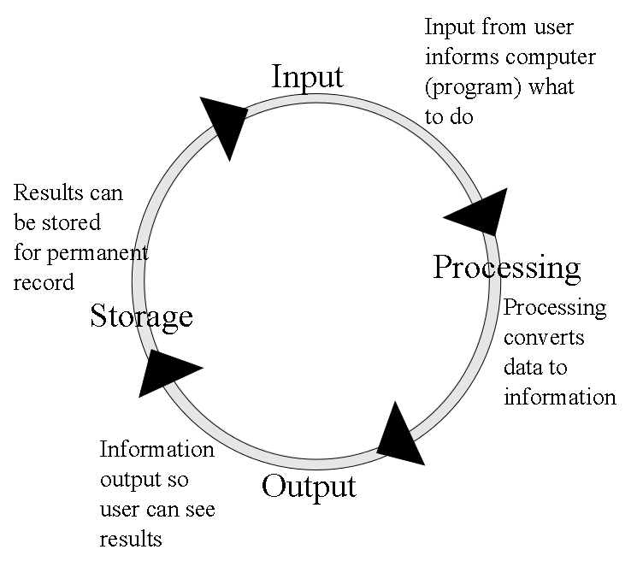
Computer Organization
All computers perform IPOS
Here, we concentrate on how IPOS is carried out through the fetch-execute cycle
This requires that we study
the structure of the components in the computer
the function of those components
how the CPU works
the role of memory
the role of I/O devices

Slide 2
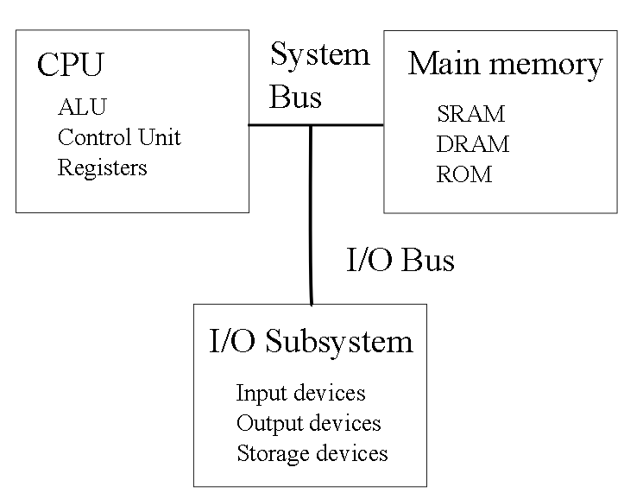
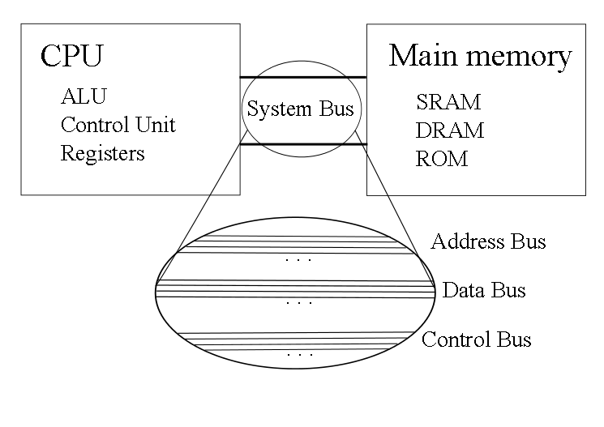
The Structure of the Computer
To execute a program, the CPU
performs the fetch-execute cycle
Fetch next instruction from memory
Decode the instruction
Execute the instruction
Store the result

Slide 3
The Bus
Address bus:
CPU sends address to memory or I/O subsystem
Address is the location of the item being moved
Control bus:
CPU sends out commands to other devices
read, write for memory
input, output, are you available for I/O devices
Devices send signals back to the CPU such as interrupt
Data bus:
Used to send data and program instructions
from memory to the CPU
from the CPU to memory
between I/O device and the CPU
between I/O device and memory
Size of data bus is often size of computer’s word

Slide 4
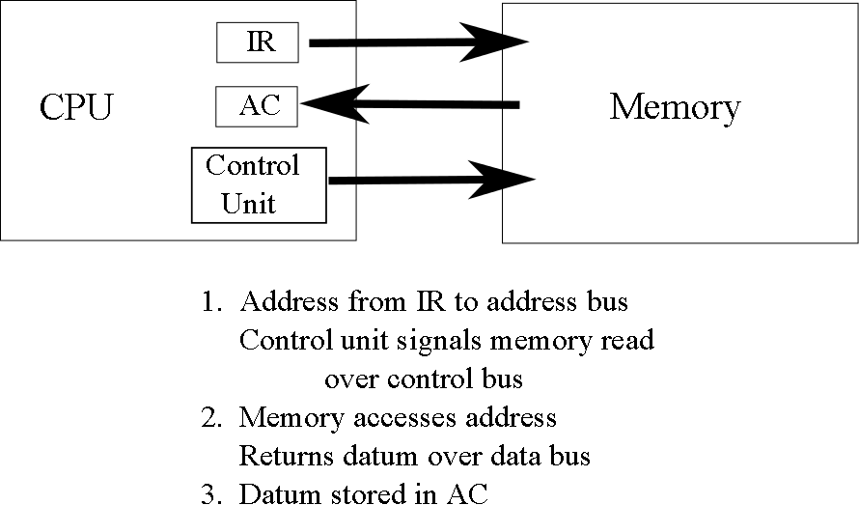
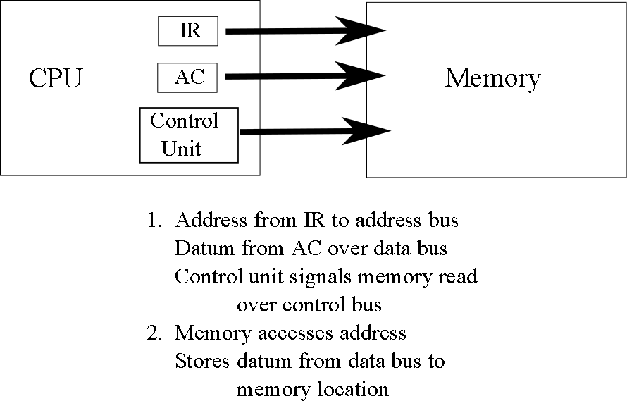
Memory Read & Write

Slide 5
Example: A Program
We use the following C program to better understand the fetch-execute cycle
#include <stdio.h> // input/output library
void main( ) // start of the program
{
int a, b, c; // use 3 integer variables
scanf(“%d”, &a); // input a
scanf(“%d”, &b); // input b
if(a < b) // compare a to b, if a is less then b
c=a + b; // then set c to be their sum
else c=a - b; // otherwise set c to be their difference
printf(“%d”, c); // output the result, c
}

Slide 6
Program in Assembly Language
Input 33 // assume 33 is the keyboard, input a value from keyboard
Store a // and store the value in the variable a
Input 33 // repeat the input for b
Store b
Load a // move a from memory to CPU, a location called the accumulator
Subt b // subtract b from the accumulator (accumulator = a – b)
Jge else // if the result is greater than or equal to 0, go to location “else”
Load a // otherwise, here we do the then clause, load a into accumulator
Add b // add b (accumulator is now a + b)
Store c // store the result (a + b) in c
Jump next // go to the location called next
else: Load a // here is the else clause, load a into the accumulator
Subt b // subtract b (accumulator is now a – b)
Store c // store the result (a – b) into c
next: Load c // load c into the accumulator
Output 2049 // send the accumulator value to the output device 2049, assume
// this is the monitor
Halt // end the program

Slide 7
Program in Machine Language
Assembly language version of our C program is stored in the computer in machine language
The first four instructions might look like this:
1000100 0000000000000000000100001 – input (from keyboard)
1000111 0010011000100101101010001 – store the datum in a
1000100 0000000000000000000100001 – input (from keyboard)
1000111 0010011000100101101010010 – store the datum in b
op code operand (datum)

Slide 8
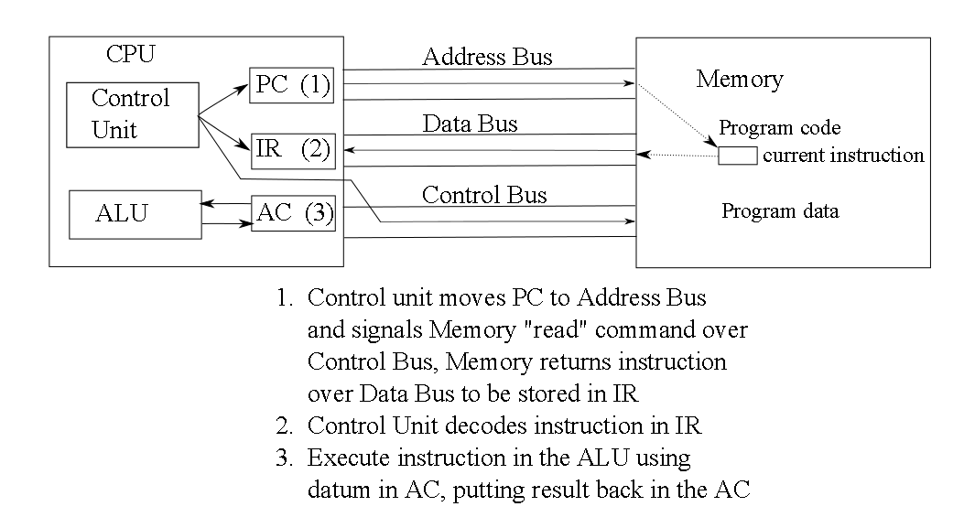
Fetch-Execute Cycle

Slide 9
Registers
Temporary storage in the CPU
Store values used during the fetch execute cycle
PC – program counter
Memory location of next instruction, used during instruction fetch
Data registers
To store temporary results during execution
Some computers have one, the accumulator (AC), others have several, maybe dozens (eax, ebx, ecx, edx or R0, R1, R2, …, R31)
IR – instruction register
Current instruction, used during decoding
Status flags
To store information about the result of the previous ALU operation
positive, negative, zero, even or odd parity, carry, overflow, interrupt

Slide 10
Fetch-Execute Cycle: Details
Fetch:
PC stores address of next instruction
Fetch instruction at PC location
Increment PC
Instruction sent over data bus
Store instruction in IR
Decode:
Decode opcode portion in IR
Determine operand(s) from instruction in IR
Execute:
Issue command(s) to proper circuits
Use data register(s)
Store result
In AC (or data register), or memory
Input 33
Store a
Input 33
Store b
Load a
Subt b
Jge else
Load a
Add b
Store c
Jump next
else: Load a
Subt b
Store c
next: Load c
Output 2049
Halt

Slide 11
Fetch-Execute Cycle: Example
Assume our program starts at location 5,000,000
PC: 5,000,000
IR: -------
Fetch instruction
PC: 5,000,000
IR: 1000100 0000000000000000000100001
Increment PC to 5,000,001
Decode instruction
Input operation (obtain input from keyboard)
Execute:
Take input value from keyboard
Move to AC

Slide 12
Continued
Fetch instruction
PC: 5,000,001
IR: 1000111 0010011000100101101010001
Increment PC to 5,000,002
Decode instruction
Store datum to memory location 0010011000100101101010001 (memory location storing variable a)
Execute:
Move datum from AC over data bus to memory location a
NOTE: the next two instructions are almost identical except that the second input’s datum (from the third instruction) is sent to memory location b instead of a)

Slide 13
Continued
Load a
Fetch instruction at 5,000,004
Increment PC to 5,000,005
Decode – load instruction, operand is a from memory
Execute – loads datum at location a into AC
Subt b
Fetch instruction at 5,000,005
Increment PC to 5,000,006
Decode – subtract instruction, operands are AC register and b from memory
Execute – fetch b from memory, send AC and b to subtracter circuit
Store result in AC
Set status flags as appropriate (negative, positive, zero, carry, overflow)
Input 33
Store a
Input 33
Store b
Load a
Subt b
Jge else
Load a
Add b
Store c
Jump next
else: Load a
Subt b
Store c
next: Load c
Output 2049
Halt

Slide 14
Continued
Jge else –a branch instruction
Fetch instruction at 5,000,006
Increment PC to 5,000,007
Decode instruction
Execute instruction – if positive or zero flag are set (1) reset PC to 5,000,011 (branches to “else”) otherwise, end instruction
Next instruction fetch is 5,000,007 or 5,000,011
Next few instructions executed depend on the previous conditional branch
Either “Load a”, “Add b”, “Store c”, “Jump next”
Or “Load a”, “Subt b”, “Store c”
Jump next – PC altered to 5,000,014 (location of “next”)
Output 2049 – outputs value in AC to device 2049 (the monitor)
Halt – ends the program
Input 33
Store a
Input 33
Store b
Load a
Subt b
Jge else
Load a
Add b
Store c
Jump next
else: Load a
Subt b
Store c
next: Load c
Output 2049
Halt

Slide 15
The Components of the CPU
Control Unit
Operates the fetch-execute cycle
Decodes instructions
Sends out control signals
Registers
Data register(s)
Control unit registers
Arithmetic-Logic Unit
Contains circuits to perform arithmetic and logic operations
adder/subtracter
negater (convert + to -, - to +)
multiplier
divider
shifter
rotate
comparator
Sets status flags

Slide 16
Microcode and System Clock
Each clock cycle, the control unit issues instructions to the devices in the computer (1 part of the fetch-execute cycle, not a full instruction)
These instructions are in the form of microcode
1 bit per line on the control bus
Example: instruction fetch
Move PC to address bus, Signal memory read, might look like
10000000000000100000000000000000000000000000000000
1 clock cycle = 1 microinstruction executed
Fetch-execute cycle might have between 5 and 30 steps depending on architecture
Clock speeds are given in GHz
1 GHz = 1 billion clock cycles per second, or 1 clock cycle executes in 1 billionth of a second (1 nanosecond)

Slide 17
Measuring CPU Performance
A faster clock does not necessarily mean a faster CPU
CPU1 2.5 GHz, 12 stage fetch-execute cycle requiring 20 cycles to complete 1 instruction
CPU2 1 GHz, 5 stage fetch-execute cycle requiring 8 cycles to complete 1 instruction
CPU1 = 20 / 2.5 GHz = 8 nanoseconds / instruction
CPU2 = 8 / 1 GHz = 8 nanoseconds / instruction
Other impacts of CPU performance include
Word size – size of datum being moved/processed
Cache performance (amount and usage of cache)
The program being run (some programs are slower than others)
How loaded the OS is
Virtual memory performance
Any parallel processing hardware?
Best measure of CPU performance is to examine benchmark results

Slide 18
Role of Memory
Memory is referenced every instruction
1 instruction fetch
Possibly 1 or more data accesses
data read as in Subt b
data write as in Store a
In Intel x86 architecture, Add x, 5 involves 3 memory references
instruction fetch
load x for addition
store result in x
Random Access Memory
There are several types of RAM
DRAM – “main memory”
made of capacitors
requires timely refreshing
slow but very cheap
SRAM – cache and registers
much faster
but more expensive
ROM – read only memory
used to store boot program, BIOS
information permanent (cannot be altered)
even more expensive

Slide 19
Memory Hierarchy

Slide 20
Using The Memory Hierarchy
The goal is to access only the highest levels of the hierarchy
On a miss, move down to the next level
cache hit rates are as high as 98-99%
misses happen in 1 to 2 of every 100 accesses
Bring item up to higher level
Bring its neighbors up as well in hopes of using them
Lower levels act as “backstops”
On-chip caches are 32KB to 64KB today
Off-chip cache might be as large as 8MB
Main memory (DRAM) up to 8GB
Use hard disk space for memory’s backstop, known as swap space or virtual memory
When something is not in memory
Need to swap it from disk
May require discarding something from memory

Slide 21
The Role of I/O
I/O – input and output
All I/O takes place in the I/O subsystem
Devices connect to computer by expansion cards and ports
Earliest form of I/O was punch cards (input) and printer (output) with magnetic tape used as intermediate storage
No direct interaction with computer
Today, we expect to interact directly with the computer
Pointing devices, keyboard, microphone, monitor, speakers
To improve interactivity, human computer interaction (HCI) combines
Computer science
Psychology
Design
Health
And ergonomics
Reduce stress on the body (repetitive stress injuries very prevalent, particularly Carpal Tunnel Syndrome)
Improve accessibility for people with handicaps through larger monitors, speech recognition, Braille output devices
See for instance Rehabilitation Act section 508

Slide 22
The Portable Computer
We no longer view the computer as a stationary device
Laptops, notebooks
Handheld devices
Recent and near-future I/O devices
Wearables
Touch screens
Virtual reality interfaces
Sensor networks
Plug and play
With wireless access we have
Interaction anywhere

