Slide 1
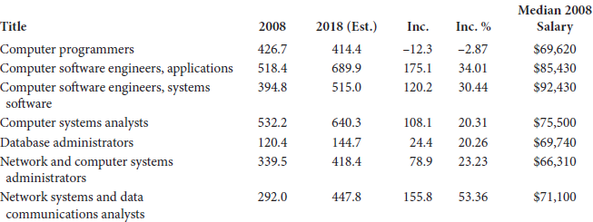
IT Predicted Job Growth

Slide 2
Hiring of IT Personnel Today
More and more, organizations are looking to hire IT personnel with a 4-year degree
IT degree or a related field
Computer science
Management information systems
Business administration with IT background
Rather than a 2-year technical degree
Here, we look at many of the types of IT roles
Note: salaries cited as of 2008

Slide 3
Network Administrator
Installation, maintenance of network hardware and software
Hardware: switches, routers, hubs, firewalls, adaptive security appliances, wireless access points, VoIP
Software: operating systems, protocols for communication (IPv4 and IPv6, routing protocols, trunking protocols, spanning tree protocols), network applications (virtual LANs, VPNs, firewalls intrusion detection systems)
Securing the network, maybe designing the network
Will probably work in conjunction with system administrators
Will need basic knowledge of TCP/IP, OSI, possibly security, wireless, VoIP, Internet services
Maybe certification opportunities available
CCNA, CCNP, Novel CNE, CWNA, CompTia
Salaries range from 41K to 104K, median of 66K

Slide 4
System Administrator
Responsible for computer systems
Computer hardware and software (servers, mainframes, personal computers, others)
Operating systems
Maybe networks (if not specific network administrator)
Specific roles include
Hardware and software installation and maintenance
Account creation
System troubleshooting
Securing systems including backups and recovery
Training and documentation
Should know multiple operating systems
Many certifications available
MCSA, MCSE, MCITP, RHCE, RHCSS, Novel CAN
Salaries are similar to those of a network administrator

Slide 5
Web Administrator
Install, configure, secure, and maintain a web server
Primarily from the software side but some hardware as well
Work with the system administrator of the organization
Configuration might involve dealing with
Directives
Security
Authentication
Encryption
Monitor performance
The web administrator will probably not be a web developer but will have to understand web development to assist the developers
Salaries range from 40K to 90K with an average of 55K

Slide 6
Database Administrator
Install, configure, maintain the database management system and its servers
Design, develop, support database construction
Monitor performance and fine tune parameters
Troubleshoot and secure
Account creation
Assist database managers as needed
Database administrator involves more specialized knowledge than system or web administrator so the salaries are a good deal higher
Median of 70K, highest salaries over 110K
Certifications include MSCDA, Oracle Certified, MySQL certification

Slide 7
Computer Support Specialist
Umbrella term that ranges from system administration to help desk
Includes training personnel on IT systems, producing technical manuals and other forms of documentation
Entry level typically involves help desk
People might move up from help desk to more general troubleshooters, called in when help desk cannot solve the problem

Slide 8
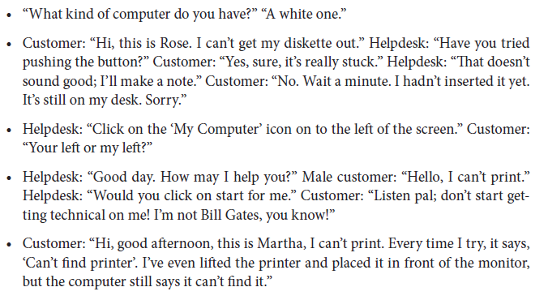
Some (reportedly) True Help Desk Conversations

Slide 9
Continued
Still want to be an IT person?

Slide 10
IT Management
Managers of the IT staff
Combines the technical expertise of IT personnel with management
Requires additional skill sets
Communication
Collaboration
Team leadership
Often requires a business degree, usually a masters degree (e.g., MBA)
Responsibilities include
Project management
Budget
Hiring
Substantially higher salaries are possible with management

Slide 11
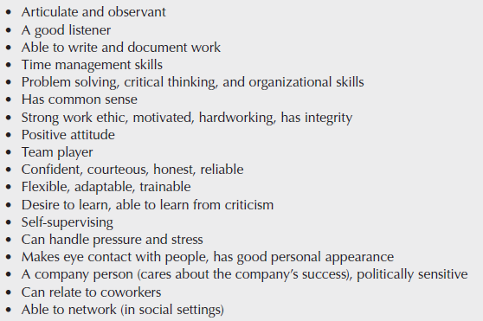
IT Soft Skills

Slide 12
Related Careers
Software engineer
Ability to write systems and application software
Knowledge of programming, programming languages, data structures and algorithms, computability theory, computer organization, operating systems
Salaries are typically higher than IT related areas
Information systems
Emphasis on business software (spreadsheets, DBMS, statistic software), networks and storage
Study business disciplines and technology
Programming limited perhaps to VB or COBOL, use of CASE tools
Computer Forensics
Applying computer security and criminal justice
Document evidence for court
Knowledge of OS, computer security, computer storage, software applications, cryptology, programming, analytical skills
Salaries: 75-115K, average around 85K
Web development
Build web pages/web sites
Knowledge of HTML, CSS, scripting languages and programming (scripting), also graphic design
Salaries between 30K and 70K

Slide 13
IT Ethics
As an administrator, you will have access to all system resources including
user files, user emails, user web browsing behavior
How should you use that access? Wisely!
Computer ethics was first coined in 1950
Most of the computer ethics codes of conduct are designed for computer scientists (i.e., programmers) but there are many that should also pertain to IT/administrators
You can find codes of conduct by IEEE, ACM and the British Computer Society

Slide 14
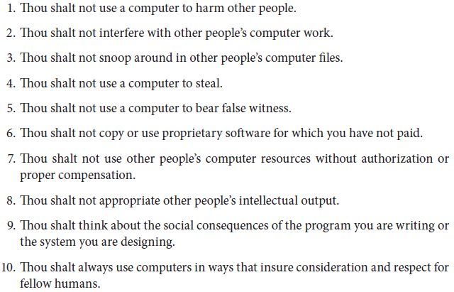
10 Commandments of Computer Ethics

Slide 15
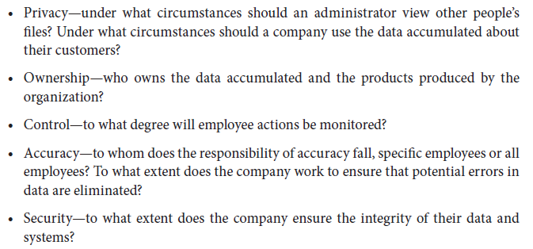
Computer Ethics Issues

Slide 16
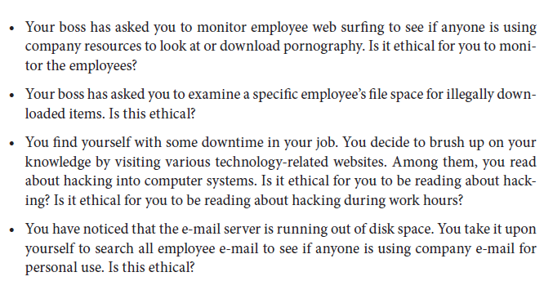
Ethical Situations

Slide 17
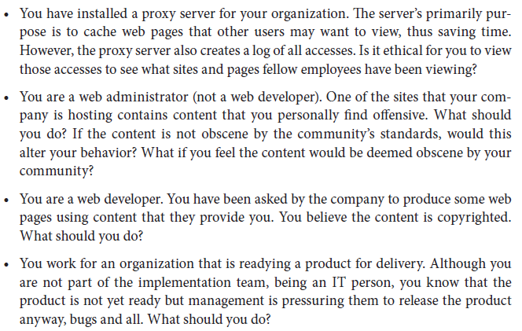
Continued

Slide 18
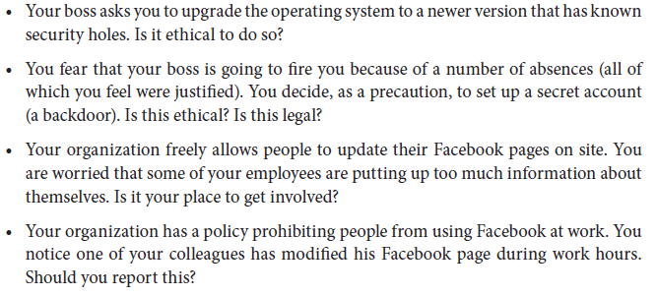
Continued

Slide 19
In Addition
Aside from having to act in an ethical manner, you might be expected
To be available 24/7
To understand legal ramifications of IT usage by your organization
To understand social ramifications of IT usage by your organization
To understand privacy issues
To provide help in drafting policies for the organization

Slide 20
Other Considerations
As an IT expert, you might be asked to write or help draft IT policies
the role that IT plays in the organization
proper employee usage of IT
the employee’s rights to privacy (if any)
proper usage of collected data
security and privacy of data
ownership of ideas developed through IT in the company (intellectual property)
how the company handles copyright protection issues
Digital divide
Computer-related health issues
Maintaining privacy
Digital litter
Internet addiction
Obscenity and censorship

Slide 21
Continuing Education
You should consider yourself a lifelong learner
Keep up with IT or you will be left behind!
Conferences and trade shows
Journals, technical magazines and books
IT related web sites
Classes, certifications
Your organization will probably be willing to pay for many of these and may even reward you with raises or promotions

Slide 22
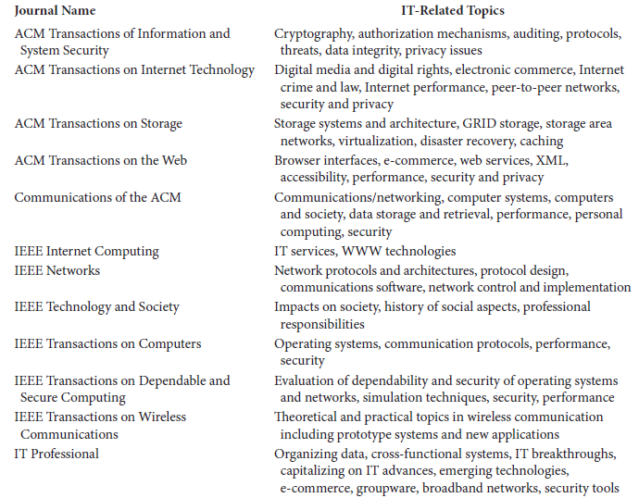
IT Related ACM/IEEE Journals

