Slide 1
Information
TInformation is not the end result of information processing, instead we view the spectrum as
data → information → knowledge → wisdom (DIKW)
data are the inputs
information are the results of processing data
knowledge is the application of information or the synthesis multiple sources of information
wisdom places knowledge within a social context
We process data through organizing, manipulating, sorting, filtering, and/or performing computations on it
We might consider data as raw data (accumulated but unorganized findings, inputs or perceptions)
While information, knowledge and wisdom collectively consist of intellectual property (human created artifacts, plans/designs, formulas/recipes, books, computer programs, strategies)

Slide 2
Databases
The primary form of data storage today
An organized collection of data
Use a database management system (DBMS) to
Create a database
Access the data in the database
Manipulate the data in the database
View the data through various filters
search for specific records that match some criteria
sort data on some field
update data based on some criteria
The common form of a database is a relational database
Database is made up of relations – tables

Slide 3
Relational Database
Relations are
A collection of records
Each pertaining to an individual entity
a student record
a customer record
an incident report record
All records in a relation share the same structure (the same attributes or fields)
A relation looks like a table
The rows of a relation are the records
The columns of a relation are the fields
Fields are typed (string, number, date, boolean (or yes/no), etc)
Given one or more database relations, what might we do with it(them)?
Query – ask questions of the relation(s) through projections, restrictions and joins
Insert – add a record to a relation
Update/Modify – update a value of one or more records in a relation
Delete – remove records from a relation
Set operations – intersection, union, difference

Slide 4
Two Relations
We might perform a projection: print all first and last names
We might perform a restriction: print the records of all students from OH
We might perform a join: join records from both relations
We might combine operations: print last names of MUS majors from OH

Slide 5
Unique Identifiers
In order to combine data from multiple relations, we need some piece of information that is the same in the relations
In this example, the piece of information available from both relations is the Student ID
We would prefer this information to be unique
if not, we might wind up withdrawing the wrong contact information when we apply a join
Known as the unique identifier or the primary key
why couldn’t se use the last name as a primary key?
why shouldn’t we use social security #s as primary keys?

Slide 6
Data Warehouse
Organizations collect data (dozens to thousands of databases), known as data warehouses
sum total of data collected by or about the organization
processed data (information), business processes and practices, etc
To build a warehouse, organizations often use an ETL process
Extract data – data from a variety of sources
Transform data – different sources may not “sync up” (e.g., different fields, different ranges of values)
Load data – into a storage facility (DB)
How do we learn from a warehouse?
Processes vary by organization but include
database management system operations
analysis tools
statistical algorithms
Collectively, the suite of tools available are called data marts

Slide 7
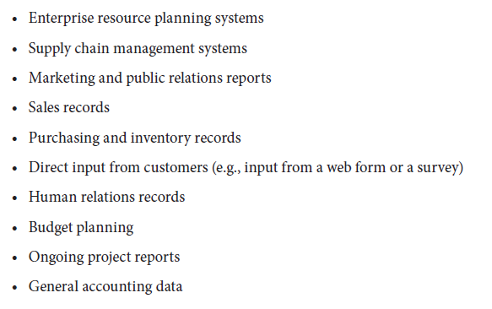
Data Warehouse Sources

Slide 8
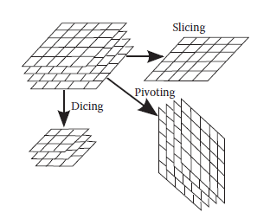
OLAP
Online Analytical Processing – creating meaningful subsets of data
Slicing – collapsing multidimensional data to one dimension
Dicing – through restrictions and projections
Drilling up/down – shifting the view up (less detail) or down (more detail)
Rolling up – collapsing collections to individual meaningful units
Pivoting – changing the perspective of the data

Slide 9
Data Mining
Offshoot of artificial intelligence
statistical algorithms applied to groupings of data
try to discover something interesting/useful
Revolves around nearest neighbors
Given some datum whose values are (X1, X2, X3, X4, …, Xn) find its nearest neighbor(s)
distance computed using Euclidean distance formula
$\sqrt{\left(X1−Y1\right)2+\left(X2−Y2\right)2+\left(X3−Y3\right)2}$
Can we compute (X1-Y1) if the data are not numeric?
How do you compute this if the datum represents sex, nationality, ethnicity, etc?
Variation is K-nearest neighbors
Select K fields (possibly randomly) instead of n fields
10 fields would lead to 1024 different combinations!

Slide 10
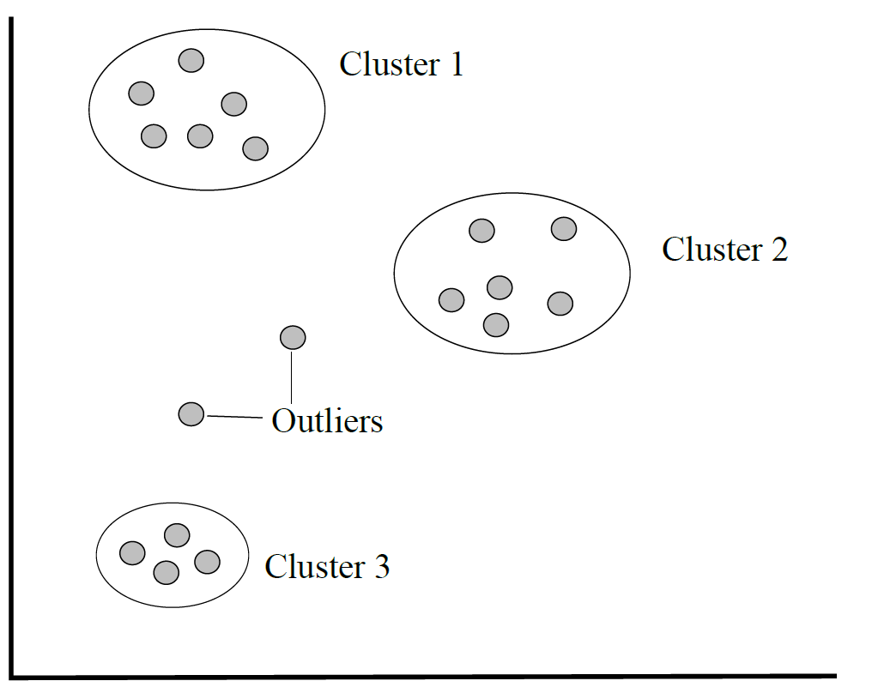
Clustering
Group data together that are neighbors
Start with select data as “centers” of clusters
For a given record, Rx, find which center it comes closest to
Identify clusters (groups of data in close proximity) and label them by their category
Clusters might tell us something about the data
In medical data, perhaps one cluster can be associated with patients who have type 2 diabetes so that we can identify features (fields and their values) that tell us contributing factors for developing diabetes

Slide 11
Association Rule Learning
Given records, find trends that can be expressed in rule form (if-then statements) based on frequency of co-occurrences
rules may be useful, useless or even misleading
Given 10,000 grocery store receipts:
4,000 include peanut butter, 3,600 of those include bread
if customer buys peanut butter then they will buy bread
rule has a frequency of 90% (3600/4000)
result: move bread to peanut butter aisle or offer a deal “buy peanut butter, get bread for ½ off”
10,000 receipts, 12 people bought sushi, all 12 also bought white wine
if customer buys sushi, then they will buy white wine
rule has a frequency of 100% but its utility is low

Slide 12
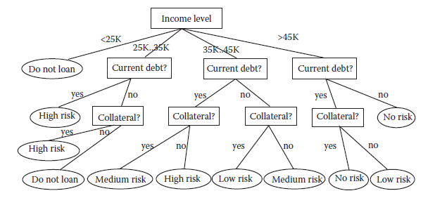
Decision Trees
Use previous “episodes” of an expert making decisions to build a decision structure
Select database relation and enumerate possible values (e.g., sex is male or female, age might be “youth”, “young adult”, “middle age”, “retirement age”), etc
For each possible value, add a branch in the tree
Leaf nodes will be past decisions
Banking
decisions
based on prior
loan decisions

Slide 13
Advantages/Disadvantages of Data Mining
Computationally challenging
With n data, we might have to try 2^{n} combinations to obtain a result
If n = 10, 2^{n} = 1024
If n = 20, 2^{n} is more than 1 million
If n = 30, 2^{n} is more than 1 billion
As n increases, 2^{n} increases much more rapidly
There’s no telling if we will obtain anything meaningful in data mining
The mined data may or may not be true, for instance a rule about peanut butter and bread may work well but it may not
Data readily available
Mining potentially gives us new information
Often applied in business to assist decision making
Has also been used in medical/bioinformatics research
Also applied in the intelligence community

Slide 14
Information Assurance and Security
Ensuring information is both correct and secure
IAS proscribes three goals:
Confidentiality - ensuring data is secure (cannot be accessed by individuals who do not have adequate rights)
Use access control rights (permissions) and encryption
Integrity – ensuring data is correct
data gathering, data entry, data modification must all have checks and balances (auditing) for accuracy
Availability – ensuring data is accessible when needed
C + I seem incompatible with A
As applied to three components of IT: communication, hardware, software

Slide 15
Y2K
Big instance where data integrity was threatened
In the 60s/70s to reduce memory usage years were stored as 2 digits
The problem was not realized until around 1997
Consider the following piece of logic
if (currentyear – birthyear >= 18) …
if you were born in 1973, compare the year 1999 and 2013
2013 – 1973 >= 18
now compare 73 and 99: 13 – 73 < 0!
No one knew how many programs might be affected or the results of the affected programs
would missile silos launch their missiles?
would planes fall out of the skies?
The US alone spent over $100 billion to fix this problem by working line by line through this old code to update it as necessary

Slide 16
Risk Management
IAS is primarily concerned with the protection of IT (both the physical hardware and the information/data)
In order to perform this protection, organizations will undergo a strategic risk analysis using risk management
identify goals of the organization
identify information assets of the organization
enumerate vulnerabilities of those assets
identify threats that exploit those vulnerabilities
find solutions
prioritize the solutions based on the original goals

Slide 17
Information Assets and Vulnerabilities
Physical assets
computers, computer networks, people
Intellectual property
ideas, products, business strategies
Information
data gathered and processed
Assets are then prioritizes by their usefulness or utility within the organization
The organization may apply security classifications to the assets
Vulnerabilities will vary asset to asset although some vulnerabilities exist across categories
All computer hardware is vulnerable to fire, water damage
Most computers are vulnerable to network based attacks
People are vulnerable to bribes or social engineering but not all people in an organization may have this vulnerability

Slide 18
Threats and Goals
How might each asset’s vulnerabilities be exploited?
A person might be exploitable by
social engineering
being hired away
A server might be threatened by a denial of service attack
Any computer might be threatened with an unauthorized access (break-in) by exploiting some operating system weakness
With assets, vulnerabilities and threats define, we return to our goals
We prioritize the goals so that we can prioritize the assets and the threats
If we value our people more than our information, we will make sure that the threats to the employees are handled before we tackle hardware threats
If the information is more critical, we must handle threats to confidentiality and integrity

Slide 19
Policies and Actions
Derive mechanisms to handle the threats
Generate policies and actionable items
Policies: user access limitations, strong passwords, training against social engineering, etc
Actions: intrusion detection software, fireproof buildings with sprinkler or foam systems, keep data secure off-site, etc
One threat is of disaster (natural, man-made accidents, man-made purposeful) so we must define policies that specify preventative measures and means of recovering from disaster
physical mechanisms (fire prevention, fire alarms)
procedures (evacuation, shut down)
policies (no smoking, keeping off-site backups)
detection of a disaster in progress
recovery from disaster (disaster recovery plan)

Slide 20
IT Disaster Recovery Planning
Preparation
Regular and timely backups held off-site
Redundancy of data storage
Having spare equipment
Surge protectors, uninterruptible power supplies, use foam retardant for fires instead of sprinklers
Monitoring of equipment and logging personnel who access sensitive data
Strong passwords
Recovery
Restoring data, bringing equipment back up, replacing damaged equipment
Having other sites that can handle processing during emergencies

Slide 21
IT Threats and Solutions
Humans:
Social engineering, phishing scams, insider attacks – education, good morale, auditing access, providing restrictive access rights
Computer systems:
Protocol attacks, software exploits, malware – properly configured and secured systems, educating users, strong passwords and/or biometric forms of authentication
Denial of service attacks, intrusions – firewalls, other configurations to test for suspicious messages and activities, examining log files
Damage to storage, interception of messages – encryption, digital signatures, redundancy

Slide 22
Digital Signatures and Certificates
In order to provide authenticity across the Internet
Used by certain communication protocols like https
Business transactions, secure logins to websites
A digital certificate is used to match a web site with its owner
The DC is signed by a certificate authority to ensure authenticity and to provide an expiration date
The DC also includes the public key used for secure encryption (we cover this later)
The https protocol requires that a certificate be sent to the user’s browser
If the certificate is self signed, this indicates that the owner did not obtain certificate authentication
Or, a signed certificate could be expired
When such a certificate is received by your browser, it alerts you of the risk

Slide 23
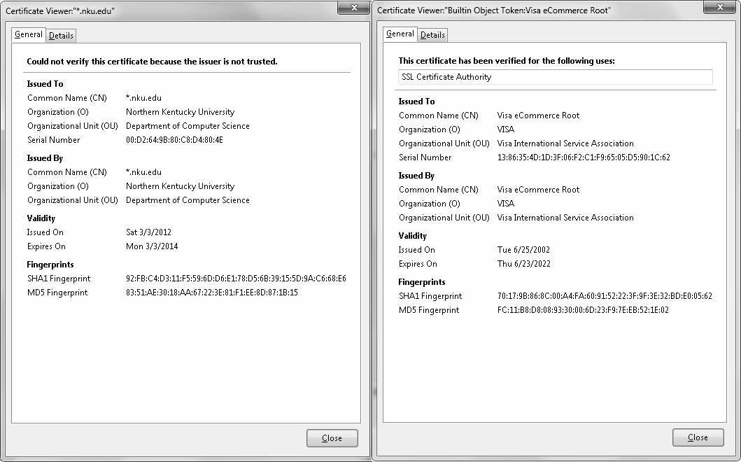
Two Sample Certificates
Self signed certificate Certificate authenticated by authority

Slide 24
Data Redundancy
To help ensure availability, we need to protect against damage to our stored files
We do this through data redundancy
Two forms
Backups – a backup of the file system or at least the important files and maybe done incrementally
might be stored on external hard disk, network file server, magnetic tape
often best to store off site
might be stored for weeks or years at a time
RAID is redundant array of inexpensive (or independent) disks
Equip your disk drive with multiple spindles of disks
Distribute data and redundancy information across the disks
There are several different RAID levels

Slide 25
RAID Levels
RAID 0 – no redundancy, just distribution of files
RAID 1 – mirror, half the drives are a backup
RAID 2 – redundancy through Hamming codes
RAID 3 – redundancy through parity bits
Hamming codes are time consuming to compute, unlike parity bits, so RAID 2 is not used
RAIDs 2 & 3 split a file into the smallest units per disk surface so that a single access is done in the shortest amount of time
RAIDs 4-6 – opposite of 2 & 3, files are kept to few surfaces to promote parallel accesses
RAID 4 – redundancy (parity) stored on a single drive
Becomes a bottleneck so is not used
RAID 5 – redundancy split across surfaces
RAID 6 – same as 5 but duplicate parity data for more redundancy

Slide 26
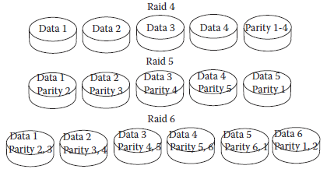
RAID 4-6

Slide 27
Cryptography
Placing a message into a coded form using a key to encrypt and decrypt the message
Today, cryptography is based on mathematical manipulation of the message
Store message in ASCII, for each 1 bit in the message, add a number, store or transmit the sum
Message is “Hello”
01001000 01100101 01101100 01101100 01101111
Use a “key” of 13 bits, group our message into 13-bit sequences
0100100001100 1010110110001 1011000110111 1
Use 13 integer numbers
1, 2, 5, 9, 19, 41, 88, 181, 370, 743, 1501, 3003, 6081
If the 13 bits has a 1, add the corresponding integer number
0100100001100 → 2 + 19 + 743 + 1501 = 2265
Store or transmit 2265

Slide 28
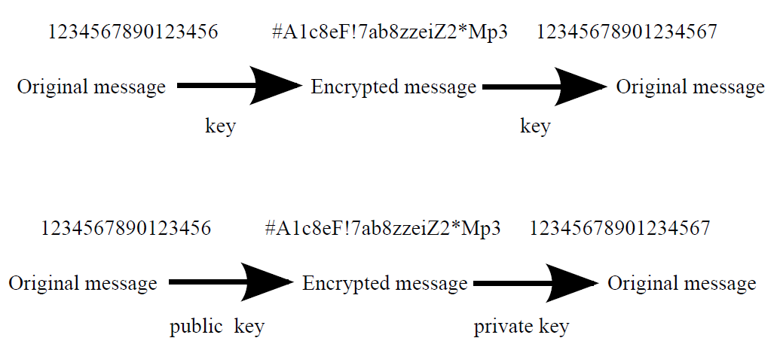
Public vs Private Key Encryption
Symmetric (public) key encryption – one key used for both encrypting and decrypting
Asymmetric (private) key encryption – one key used for encrypting (public key) and another for decrypting (private key)
public key can be given to anyone, private key is kept secret

Slide 29
Using a For Decrypting Key
The numeric sequence of 13 integer numbers is increasingly additive
For any single number in the sequence, it is greater than the sum of its previous numbers
This makes it easy to convert from 2265 back to the numbers that sum up to 2265
Largest number <= 2265? 1501. 2265 – 1501 = 764
Largest number <= 764? 743. 764 – 743 = 21
Largest number <= 21? 19. 21 – 19 = 2
Largest number <=2? 2. 2 – 2 = 0.
So 2265 = 2 + 21 + 764 + 1501 = 0100100001100

Slide 30
Public Key Encryption
In private key encryption, only one person has the key so this is useful if you want to store a file in an encrypted form
But if you want to transmit encrypted information to someone else, you don’t want to share the key with them
Use the private key to generate a public key
The public key is not in increasingly additive form
642, 1284, 899, 1156, 643, 901, 1032, 652, 1818, 940, 2266, 552, 723
The recipient uses the public key to encrypt their message
Instead of 2265, the first 13 bits are now encrypted to 5133
Along with the private key, we have two important numbers which lets us convert the received number, 5133, into 2265
Now we use the private key to quickly decrypt 2265
Without the “increasingly additive” nature of the numbers
it will take 2¹³ = 8192 different combinations to try to decrypt a message with a public key (imagine a key of 256 bits!)

