Slide 1
Software and Algorithms
Programs are termed software because they do not exist in a physical, tangible form
Stored in memory as electrical current
Stored on disk as magnetic charges
As opposed to hardware, the physical components of the computer
Memory, CPU, I/O devices
Software (programs) are the implementation of ideas
A program is essentially a plan or strategy for solving a problem, also known as an algorithm
The program is written in a programming language
To run on the computer, the program must be translated into machine language
We run the machine language version of the programs

Slide 2
The Equivalence of Hardware and Software
Tells us any problem solvable
by software can be implemented in hardware
by hardware can be written as a program
Recall that a computer at its lowest level consist of AND, OR, NOT, XOR circuits and storage locations
Thus, all programs, at their lowest level, are sequences of these logic operations and data movement
We prefer software because
It is cheaper and is flexible (programs can be changed and recompiled)
However, directly implementing a solution in hardware will provide a faster execution of the program
The program is stored in memory and requires the fetch-execute process to execute

Slide 3
Types of Software
Application Software
programs users run to accomplish some task(s)
many different types
productivity software, account software, art software, educational software, communication software, entertainment software (including games), etc
horizontal software – software used across organizational units
productivity software falls in this category
Object Linking Embedding permits linking or copying of objects from one piece of application software to another
vertical software – software used within an organizational unit
Systems software
the operating system, programs run to maintain the computer system itself

Slide 4
System Software
Kernel
Core components of the OS, always resident in memory
Device drivers
Add on software so the OS can communicate with a piece of hardware
Services
Pieces of the OS that may or may not be running, used to control some portion of the OS as requested by other agents
Utilities
Software “helper” programs to help maintain the environment, usually run at the request of the user
Shells
Tailorable environments such as desktops with shortcut icons, or aliases as defined in Linux
BIOS
Mechanisms to boot and communicate with basic hardware, stored in firmware (ROM)

Slide 5
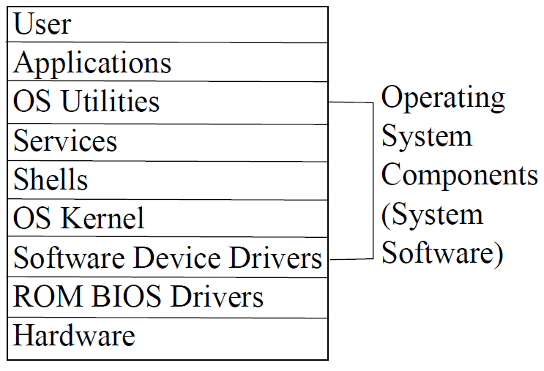
Levels of a Computer System

Slide 6
Software Releases
Major release
Usually means the software has undergone substantial changes such as a new interface, new features
Minor release
Usually fixes to discovered errors and security holes
Beta release (beta test)
Early release of software given to select users to help them discover problems before a major release
Upgrades/patches
Often released quickly as the result of a discovered problem, may not warrant a minor release
Software version
An official designation for a software release, often given as two numbers, the major release number and the minor release number such as 5.2

Slide 7
Compatibility
Ability for software to run on multiple platforms
Software needs to be compiled for a specific platform (hardware type, OS type)
This allows you to share software between computers that are compatible
In the early days of mainframes, very little software was compatible
This was also true of early PC software
Backward compatibility is when a new release of software comes out, it can still access data files from older releases
This allows users to upgrade software without risk of losing older data files
Without this, we would probably still be using much older software
This term is also used when a newer processor can still run older software

Slide 8
Classification of Software Ownership
Proprietary/commercial software
Most software falls into this category
Purchase provides you a license to use the software, highly restricted in usage
“in-house”, custom written, or purchased from a company
We see a lot of piracy of proprietary software
To prevent this, software is “unusable” with a unique key, provided by the manufacturer upon purchase
Free software
Shareware – available for free but usually as a trial copy (limited usage or time or features), used to entice you to purchase a copy
Freeware – free to use but restricted by a license
Public domain software – free with no license, no restrictions
Open source software – free and available in source code so you can modify it, may be licensed (recall the GPL from chapter 8)

Slide 9
Software Management
Software management is a responsibility of the system administrator
Installing software
Updating software
Maintaining software
Troubleshooting software
Removing unneeded/unwanted software
May require creating
User accounts for users to access/use the software
Software accounts (that is, user accounts for the software itself)
Software directories and specialized files
Manuals/help/tutorials

Slide 10
Installation
To install software you need the software
The executable program and any supporting software
Or the source code (along with library files) to compile yourself
You need the appropriate hardware
If you are installing an executable, the program must have been compiled for your processor type and operating system
Sufficient amount of RAM, hard disk space
Other resources as needed (e.g., microphone for speech recognition program)

Slide 11
Software Installation Packages
Most software today requires installing numerous files
executable files, library files, data files, help files
To facilitate installation, these are bundled into a package
Users commonly install software packages through a package manager or a wizard
Easy to follow, little need for user interaction other than accepting the licensing agreement (and possibly specifying the location for the program)
See the next slide for four views of various installation wizards (from four different software titles)

Slide 12
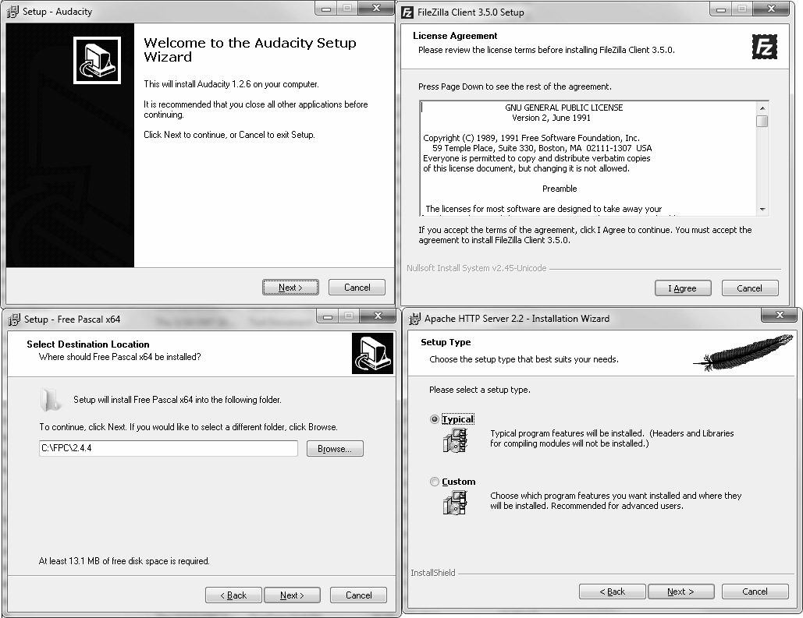

Slide 13
In Linux: RPM
Linux command line installation program (Red Hat Package Manager)
To install using RPM
Download the rpm file from a RPM repository (see for instance centos.karan.org/el4/extras/stable/i386/RPMS)
Issue rpm command: rpm –i file.rpm (-e for erase, -u for upgrade)
RPM can be a challenge because an installation package may depend on other files which are not yet installed yielding errors
Dependencies will lead to installation failures, but finding the right package(s) to fulfill dependencies can be challenging
Additionally, if the RPM file has errors (checksum) or does not have a digital signature, installation will yield warnings
Debian Linux uses apt (Advanced Package Tool)

Slide 14
In Linux: Yum
From Duke University, Yellowdog Updater, Modifier
Yum knows the location of RPM repositories
It fetches those rpm files automatically, downloads them and installs them
If dependencies are discovered, it attempts to fulfill the dependencies by downloading other rpm files
To use yum:
yum command packagename
Where command is one of install, remove, list (to obtain a listing of packages that match the given name), update
Yum will also update your Linux OS

Slide 15
Installing Open Source Software
There are several reasons to install software from source code
Executable may not be available
You want to change the software yourself (modify the source code)
You want to change some of the installation settings such as loaded modules, locations for files
Installing software from source code requires
That you compile the program(s) yourself
Most software today involves dozens or more files
C/C++ program files
Object files
Library files
Order of compilation and which files are involved is challenging

Slide 16
The Makefile
To simplify the compilation process, Linux provides the make command
Executes a makefile script
The makefile script contains all of the necessary compilation, installation and cleanup steps
Some open source software comes with a makefile, others contain a partial makefile
The configure script creates or modifies the makefile
Modifications include modules to enable or disable and installation directories for binary files, data files, configuration files, etc

Slide 17
The Process
./configure options
options will include for instance locations and modules
the configure script is set up to either build a makefile or modify the makefile
this step is optional if a makefile already exists
make
this command executes the makefile script (it may be called Makefile) to compile the software
make install
run the installation portion of the makefile to move files as needed to their destinations
make clean
run the cleanup portion of the makefile (if it exists) to delete temporary files and directories
make tar
wrap up the files in a tar file when done

Slide 18
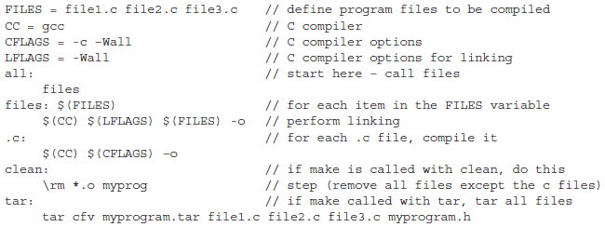
Example Makefile

Slide 19
Servers
The term server applies to
Software that performs a service to other computers
The computer running the server software
The collection of software, hardware and files (e.g., a web server can be thought of as the entire collection)
Servers are not the same as services
Servers do not (usually) run as background processes
Servers typically respond to remote requests only, not internal requests
Servers often run on designated machines so that other processes do not share the same machine
Servers have multiple parts, some of which may be running all the time, others run on demand and each part fulfills a different type of task

Slide 20
Types of Servers
File server
Supports shared files across a network
Can be used strictly for storing data files or for also storing application software which is then loaded over the network to a client on demand
Web server
A type of file server that responds to HTTP requests across the Internet
FTP server
A type of file server that permits anonymous logins for uploading/downloading files
Mail server
Stores incoming email for users of that server, sends outgoing email
Proxy server
Caches web pages coming in to an organization and shields users behind it for anonymity, also can be used to block content
Database server
Serves as a network connection to a database backend so that local and remote users can access a shared database
Domain name system server
Responds to IP alias requests to map to IP addresses

Slide 21
Installing Apache
By default, Apache is already installed in Red Hat Linux, it is called httpd
If you want to install a newer version or tailor the installation, you would do the following
Download the source code from httpd.apache.org
The file will probably appear as httpd-x.y.z.tar.gz
Untar and unzip it using tar –xzf httpd-x.y.z.tar.gz
After untarring the file, it creates a directory of the same name
Change to this directory and type each of the following commands:
./configure
tailor your configure step using options like --prefix=/usr/local/apache2, --enable-ssl, --enable-authn-file
make
make install
Each step takes several minutes

Slide 22
Contents of the Directory
buildconf and configure are scripts
Makefile.in and Makefile.win are initial versions of the makefile
Build, docs, include, modules, os, server, srclib, support and test are all
subdirectories containing C++ files, header files, library files, data files, etc
ABOUT_APACHE, INSTALL, LAYOUT, LICENSE, NOTICE, README,
ROADMAP and VERSIONING are all information files (readme text files)

Slide 23
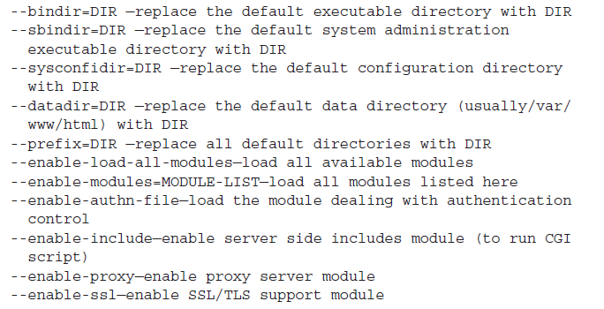
Some ./configure Options

Slide 24
Running and Configuring Apache
Once installed, Apache is ready to run
The Apache service is apachectl, located in the /bin directory of your installation
if you installed it all under /user/local/apache2, it is /usr/local/apache2/bin/apachectl
do ./apachectl start (or restart)
However, this runs Apache as the programmers set it up, not as you will want it to run
So you should configure your Apache server
Modify the httpd.conf file
this file contains directives and containers, modify it, save it, restart apachectl

Slide 25
Apache Directives
Two types of directives
Those that impact the server
Those that impact specific files and directories
the latter type of directives are placed inside containers (see the next slide)
Some examples of server directives
ServerName www.myserver.com
User apache
Group apache
TimeOut 120
MaxKeepAliveRequests 100
Listen 80
DocumentRoot “/usr/local/apache2/web”

Slide 26
Apache Containers
Containers can be used to specify how files or files within a directory are treated
Symbolic links allowed?
If the URL does not contain a filename, will you display an error or a directory listing of the contents of the directory?
What file names and extensions are used automatically when no file name is listed (e.g., index.html, index.php)
Can CGI scripts execute here?
Is authentication required to access files in this directory? If so, where is the password file?
Can anyone access files in this directory? Restrictions can be placed based on IP address
Can subdirectories override options specified here?

Slide 27
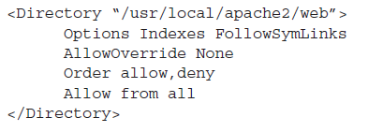
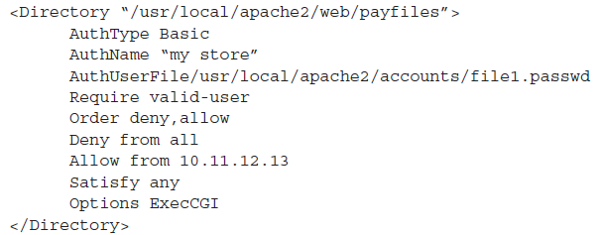
Two Example Directory Containers

