Slide 1
Programming
The idea behind programming is specifying an algorithm (a solution) to a problem
Written in a computer programming language
Made available in an executable form
this requires compiling the program which itself requires that the program has no syntax errors
or it requires writing the program instructions in a session with an interpreter – again, the code cannot have syntax errors
Programming can be challenging
You must think logically, write conditions in logic form
You must have a solution, written in specific steps and in the proper order
You must deal with the programming language’s syntax

Slide 2
Language Types
Machine language
The only language a computer can directly execute
a program in any other language requires translation to machine language using a language translator program
Cryptic (0s and 1s), simple (primitive) instructions
Assembly language
Slightly easier than machine language, but still simple instructions
need an assembler to translate code from assembly to machine language
High level language
Instructions are more abstract, deal with concepts like conditions, selections, repetition
Read more like English with mathematical notation
Two types of translator programs: compilers and interpreters

Slide 3
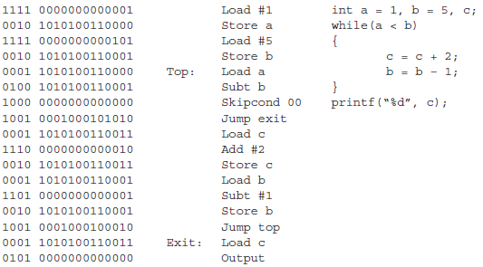
Comparing the Types
Example code in machine language, assembly language and a high level language (C)

Slide 4
Compiled vs Interpreted
Interpreted languages allow for experimentation
Working in the interpreted environment allows you to define parts of a program and test them out and then redefine them
Compiled program executes more quickly and efficiently than an interpreter program
You must have the proper translator program for the given language and platform
You need a C++ compiler for Windows to compile a C++ program to run on a Windows machine and a different C++ compiler for Linux
Interpreter runs within an environment so that you can add instructions and definitions as you work, but once the session ends, all of that is lost
most of today’s interpreted languages have compilers so that you can later compile your program to run more efficiently later

Slide 5
Errors
Programs will often have errors
Syntax errors – errors in misusing the syntax of the language (e.g., forgetting a semicolon in C, misspelling a word, forgetting to declare a variable, trying to store the wrong type of value in a variable of a different type)
syntax errors are caught by the compiler at compile time
programs with syntax errors will now compile
in an interpreted environment, syntax errors are caught at run time rather than compile time
Run-time errors – errors that arise while the program is running causing the program to terminate abnormally
dividing by 0, overflowing a memory location, trying to place the wrong type of data in a variable such as inputting a string into an integer
Logical errors – errors with the logic of the program so that it runs but not correctly or as planned

Slide 6
Error Examples
Type mismatch error
int x = 5;
float y;
x = 1/y; // cannot put float into an int
Runtime error
int x = 5;
float y = 0
x = 1/y; // cannot divide by 0
Logical error
int x = 5;
float y;
y = 1/x; // 1/x is 0, puts 0.0 into y, not 0.2
Infinite loop: a while loop
which never exits, so
unless we stop the program
externally, it will run forever
The following contains an
infinite loop:
int x = 0, y = 0;
while(x < 10)
y = y + x;

Slide 7
FORTRAN and COBOL
FORmula TRANslator – the earliest high level language, developed around 1957-1958
programmers would specify programs as mathematical formulas (along with I/O statements, GO TO statements, and a basic counting loop)
The compiler would translate the code into machine language (doubted as possible by many programmers)
Lacked features like character types/strings, if-then/if-then-else statements
COmmon Business-Oriented Language
Developed shortly after FORTRAN by the defense department to support business applications
Written in English sentences and paragraphs
COBOL programs divided into two sections: data definition, code definition
COBOL had many failings: little mathematical capability, all variables are global, no arrays

Slide 8
Other Early Languages
LISP – LISt Processing developed for AI use
Emphasized dynamically allocated memory, lists, recursion
Interpreted language
ALGOL – Algorithmic Language
Introduced nested if-then-else statements and blocks
Allowed recursion (unlike FORTRAN and COBOL)
PL/I – IBM language to “replace” FORTRAN
Contained features of nearly every earlier language
Added exception handling capabilities
SIMULA – for simulations
Class definition was the precursor to object-oriented programming
SNOBOL – StrinNg Oriented and SymBOlic Language
String matching language

Slide 9
Structured Programming
Early languages were all developed with specific uses in mind so that features of the language were specific to the application
Programmers were often restricted in the language that they had to use because of the available hardware, relying for instance on GOTO statements
GOTO statements create spaghetti code
ALGOL 68, a successor to ALGOL, introduced structured programming
Instead of low level GO TO statements, use more structured control statements like nested if-then-else statements and while loops
Two descendants of ALGOL 68 are C and Pascal

Slide 10
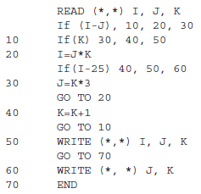
FORTRAN IF Statement
The early FORTRAN IF:
IF (expr) X, Y, Z
Meaning:
If expr is negative, GO TO X
If expr is 0, GO TO Y
If expr is positive, GO TO Z
If I = 5, J = 15, K = -1, can
you figure out what this
program does?

Slide 11
Object-Oriented Programming Languages
First developed in Smalltalk, 1980
It developed the idea of classes from Simula further
An class defines a type of object
Physical like a bike
Abstract like a window in an operating system
The class definition contains
Data structures that describes the object
Code manipulates the data structures within the object
Programming changed from writing subroutines of code to defining classes and creating objects
Objects communicate by message passing
Classes are organized hierarchically so that a child class can inherit from a parent class
This allows us to build on top of other people’s code
someone defines a Window class and I can then build on top of it

Slide 12
Byte Code
In most compiled languages, you must compile the program for each target platform
The executable code is not portable to other platforms
This places a burden on the programmer to compile a program for many platforms
The Java programming language uses byte code as an intermediate language
Byte code cannot be directly executed
An interpreter can then run the byte code program
While interpreting is usually slower than running compiled code, in this case it isn’t because the byte code is nearly compiled already
Java byte code interpreters built into Java Virtual Machines
The byte code concept was incorporated into Microsoft’s .Net (“dot net”) platform so that objects of any of the .net languages can be called upon by objects of any other .net language
Visual Basic, C++, J++ (a variation of Java), C#, ASP

Slide 13
Input/Output Instructions
Input – obtain information from the user (or a file)
store the input in a variable
Output – produce values stored in variables for the user to view (or placed into a file)
Some languages have different input/output instructions for file than keyboard/monitor, others use single input and single output instructions
In Ada, there are different instructions for each data type to be input or output (e.g., a different input for strings than for integers than for reals)
Input instructions are often preceded by an output statement that provides a user prompt

Slide 14
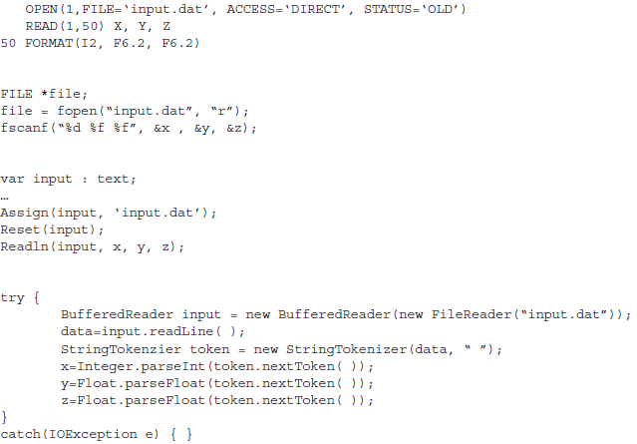
Examples
FORTRAN
C
Pascal
Java

Slide 15
Assignment Statements
Instructions that store values into variables (assign values to variables)
Format: Variable = Value
The right hand side can comprise an expression (arithmetic, relational, boolean, string operation) such as X + Y or 5 * (Z – 1) / (Q + A * 2)
Left hand side variable must be able to store the value computed on the right hand side

Slide 16
Control Statements
Code executes in a “straight line” or sequentially
In order to alter this behavior, we have to use decision-making instructions
Selection statements – based on a condition, select which statement(s) to execute
Iteration statements – repeat a set of code
a set number of times (counting loop)
based on a condition (conditional loop)
once for every item in a list (iterator loop)
Without control statements, a program will do the same thing every time it runs

Slide 17
Conditions and Selection Statements
Condition: compares variable’s value to another value
variable
expression
literal value
Used to make decisions
Uses relational operators
<, >, =, !=, <=, >=
Complex conditions combine two or more conditions with Boolean operators
AND, OR, NOT
Examples:
X = Y OR X = 0
X > 1 AND Y != 0
Select an action based on the value of a condition
Common forms are
If-then: 1-way selection
If-then-else: 2-way selection
Nested if-then-else: n-way selection
Case/switch: n-way selection

Slide 18
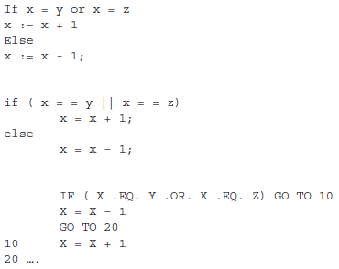
Example If-Then-Else Statements
Three versions
of the same
if-then-else
statement, in
C, Pascal and
early FORTRAN
Nested if-then-else
in Pascal

Slide 19
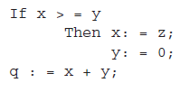
Blocks
In languages like Pascal and C, the then and else clauses expect only 1 instruction
If you have multiple instructions, you must enclose them in a block
in C, blocks are code placed between { }
in Pascal, blocks are placed between the words begin and end
In this example in Pascal, the only
instruction in the then clause is x : = z
Indentation is completely ignored by
the compiler, so if x < y, y:=0 is executed

Slide 20
Types of Loops
Conditional
Typical syntax is while (condition) body
execute body while condition is true
if the condition is never false, we have an infinite loop!
Counting
Assign initial, terminal and step (step size is optional and defaults to 1)
Use a loop variable to equal the iteration count
for I = 1 to 10 do body
can use the loop variable in the loop body
Iterator
For i in list do body
List must be a list of values, variable i takes on each value in list one at a time

Slide 21
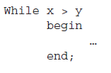
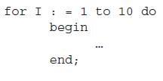
Example Loops
Pascal examples
(left) and C
examples (right)
If the loop body
contains more
than one statement,
the body is
placed in a block

Slide 22
Infinite Loops
If x is greater than y to start,
it remains greater than 1
so is an infinite loop
Eventually this loop would
Terminate with an overflow
error
Without block notation, this
loop contains only the printf
statement, the x = x – 1; occurs
after the loop, so is an infinite loop
Here we solve the problem by placing
the loop body in a block

Slide 23
Subroutines
Long programs are hard to understand, hard to write, hard to debug
Break them into smaller units - subroutines
Use modular design
Two pieces of code for a subroutine
the subroutine call – it invokes the subroutine
the subroutine itself
In most cases, a subroutine needs data from the calling function
The data are passed as parameters
Often parameters are indicated by placing them in parentheses

Slide 24
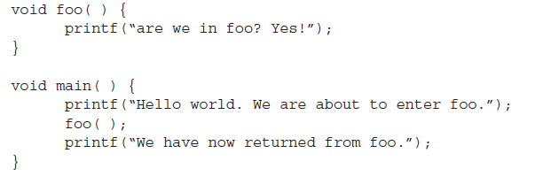
Simple C Program with a Function

Slide 25
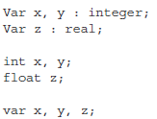
Other Instructions
Languages may require other types of instructions
Graphics operations
String operations
Operating system operations
Random number generator operations
Error handling operations
Variable declarations
Most compiled languages require variable
declarations, scripting languages usually don’t
Pascal (top) and C (middle) require
variables be typed, JavaScript (bottom)
does not

Slide 26
Bash: Variables
Variables are not declared
Variables obtain values through input or assignment statements
Variables store strings or integers (not floats)
Example assignments:
X=0
NAME=Frank
NAME=“Frank Zappa”
The variable is the name given to some storage location which stores a value
We treat the variable differently depending on whether we are placing a value into it or retrieving the value from it
To get the value from a variable, use $VAR as in $NAME
FULLNAME=“$FIRSTNAME $LASTNAME”

Slide 27
Bash: Output & Input
echo Statement
Format: echo list-of-values
The list of values can be any combination of
Literal values: 5, Hello
Values in variables: $NAME, $X
Values from Linux operations using `operation` or $(operation)
Examples
echo “Today is `date`” (quote marks optional)
echo Hello $FIRSTNAME $LASTNAME
read statement
Format: read variable1 variable2 variable3
do not put $ in front of the variable names here
When executed, Bash expects you to input the values with spaces between them
Precede your read statement with a prompting message using echo
echo Enter your name
read name

Slide 28
Assignment Statements
Format: VAR=expr
where expr is some expression which can include
Variable names do not have to be upper cased, this is just common convention
Expressions comprise
$variables
literal values
arithmetic operations placed inside $((…)) marks
results of a Linux operation
X=0
NAME=“$FIRST $LAST”
AGE=$((AGE+1)) // add 1 to AGE
Average=$(((num1+num2+num3+num4)/4))
Notice the extra set of ( ) around the numerator
Num=`grep –c ‘some pattern’ some-file.txt`

Slide 29
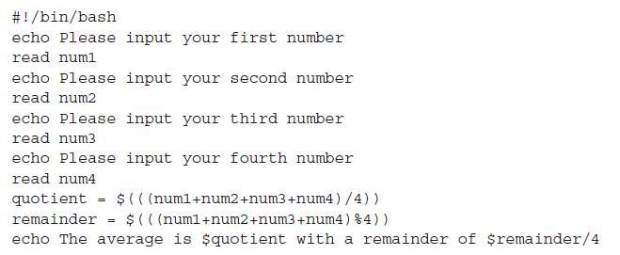
Example Script
Bash can only perform integer arithmetic,
the % operator performs mod (remainder)

Slide 30
Bash: Conditions
Conditions evaluate to true or false
Conditions in [ … ] notation
The expression in [ ] must include a blank space before and after each part
Three types of conditions
Test integer variable to value – comparisons use –eq, -ne, -gt, -lt, -ge, -le
Test string variable to value – equal to uses two equal signs (==) not equal uses !=
Test file type (see the next slide)
File conditions
-e filename – exist?
-f filename – exist and is regular file?
-l filename – link?
-d filename – directory?
-r filename – readable?
-w filename – writable?
-x filename – executable

Slide 31
Example Conditions
[ $x –gt 0 ] – is $x > 0?
[ $z –eq $((x+1)) ] – does z = x+1?
[ $name == Frank ] – does $name store Frank?
[ $str1 != $str2 ] – does $str1 and $str2 store different strings?
[ ! –r $filename ] – is the file whose name is stored in the variable
filename readable?
Complex conditions are placed in [[ ]] marks and the conditions
are separated by && (and) and || (or)
[[ -r $filename && -w $filename ]] –
is $filename readable and writable?
[[ -d $filename || ! –e $filename ]] –
is $filename a directory or not executable?

Slide 32
Bash: Selection Statements
Three forms:
If-then – does action or not
If-then-else – chooses action by condition
If-then-elif-else – nested if-then-else statement
Entire statement must end with the word fi
If [ name == Frank ]; then echo Hi Frank!; fi
if [ $x –gt $y ]; then
z=$((x+1))
else
z=$((y+1))
fi
if [ $avg –ge 90 ]; then grade=A;
elif [ $avg –ge 80 ]; then grade=B;
elif [ $avg –ge 70 ]; then grade=C;
elif [ $avg –ge 60 ]; then grade=D;
else then grade=F;
fi

Slide 33
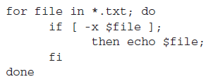
Bash: Loops
SUM=0
echo Input a number, 0 to exit
read num
while [ $num –gt 0 ]; do
SUM=$((SUM+num))
echo Input a number, 0 to exit
read num
done
echo $SUM
Why is this code
repeated?

Slide 34
Bash: Parameters
Aside from inputting values using read, we can get values into our Bash script by passing the script parameters
This is done at the command line when we call the script
./myscript 5 10 15
myscript receives 3 parameters, 5, 10, 15
You can access the parameters using $1, $2, $3
If there are more parameters, use $4, $5, etc
$@ is the entire list of parameters
useful for for loops
for file in $@; do if … fi done
$# is the number of parameters (useful for testing to see if the user supplied the right number of parameters)
if [ $# -eq 0 ]; then echo You did not specify any parameters; fi

Slide 35
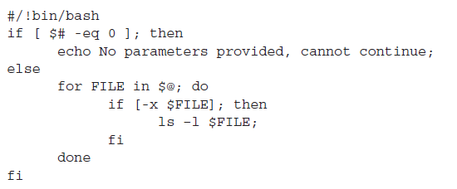
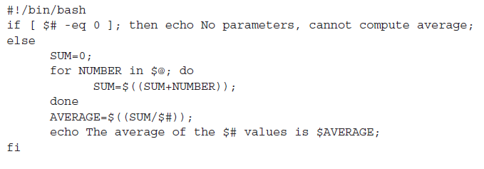
Examples

Slide 36
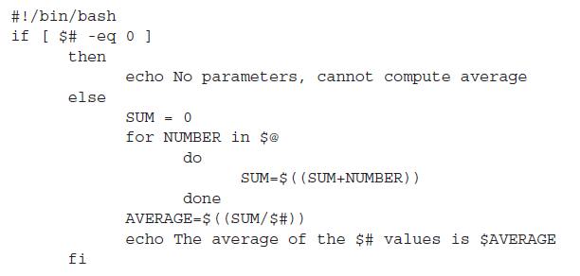
Example Script 3

