Slide 1
Computer Networks
A computer network is a collection of computers and computer resources connected together to permit communication between resources
Resources include
PCs, laptops, servers, mainframes
Printers
File servers
Network broadcast devices
Computer networks permit resource sharing, data sharing, easy communication, e-commerce, telecommuting (also sources of entertainment, etc)
Computer costs: administration and security, cost in lost labor (due to distractions), attacks on the network (denial of service, sabotage/viruses, etc)

Slide 2
Some Terminology
Host – a compute that can be logged into over network
Local – the computer that the user is on (physically)
Remote – the computer being accessed over the network
Server – a type of computer that offers a service to remote computers on request
Client – the remote computer making requests
Bandwidth – the amount of data that can be transmitted over a unit of time, such as bits per second – indicates to some extent network communication efficiency
Modulation – translating a digital signal to an analog signal (used to send information over analog media like a telephone line)
Demodulation – translating analog back to digital

Slide 3
Network Hardware
The network itself
Typically some form of cable
twisted wire – low bandwidth, old, but cheap
coaxial
fiber optic – highest bandwidth, data transmitted as light pulses
May also utilize wireless, radio, microwave or signals bounced off of satellites in orbit
Broadcast devices
Used to connect resources together to handle message routing
MODEM
Modulation/demodulation – devices that permit computers to communicate over an analog medium

Slide 4
Communicating by Network
Typically, a network consists of multiple nodes
nodes are different forms of broadcast devices
Switching is used for a message (packet) to be moved from one location to another
Circuit switched network - pathway between two devices established at the start of communication and remains that way throughout entire communication (telephone network is circuit switched)
Packet switched network - pathway established as messages is sent from one location to another (most computer networks are packet switched)

Slide 5
Broadcast Devices
Hub – passes incoming message to all devices connected to it
Switch – uses network address to pass incoming message onto one destination computer
Router – connects multiple networks together, uses destination address to pass message onto the next pathway in the network
Gateway – connects multiple networks of different types together – can translate a message from one protocol to another
A hub (switches,
routers and
gateways will all
have similar
appearances)

Slide 6
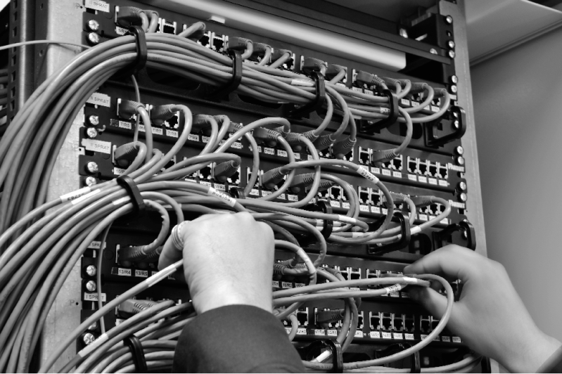
Broadcast Devices
Rack mounted network switches connecting
computers in a local area network
In a hub (upper left), message sent to all devices
In a switch (lower left),
message sent to one destination
In a router, (right) message routed to the proper network switch/hub

Slide 7
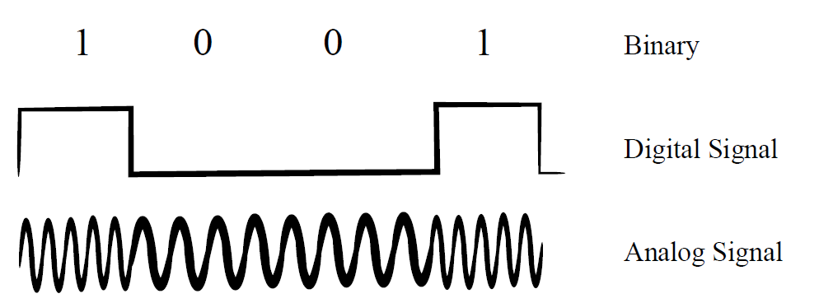
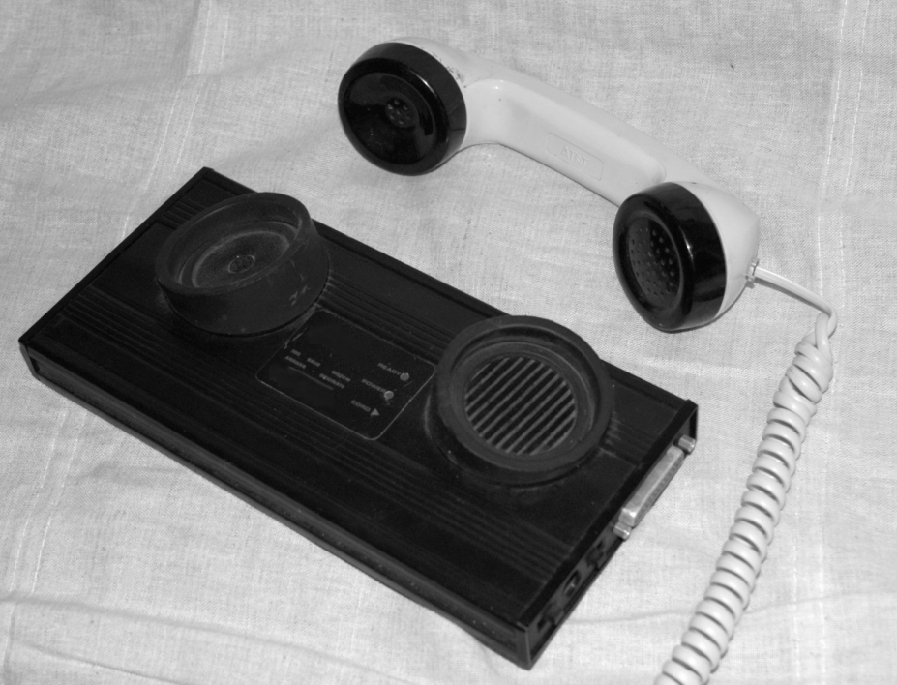
MODEMs and Phone Lines
Before broadband Internet, most home computer users accessed computer networks via a MODEM and their phone lines
MODEM translates digital signals into tones (analog signal) to be broadcast over the phone lines
Insert telephone handset into
MODEM cradle – computer
connects to MODEM

Slide 8
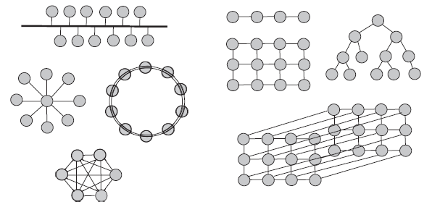
Network Topologies
Computer networks can be organized using a variety of layouts
These topologies describe how computers are connected together
on the left below, top-down, bus, star, ring, mesh
on the right, forms of nearest neighbor – 1 D, 2 D, tree, 3D

Slide 9
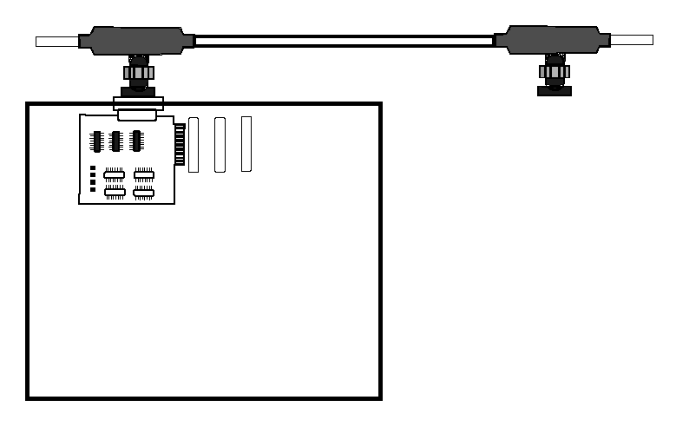
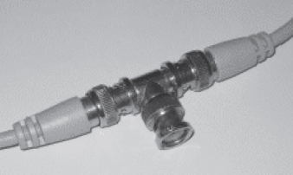
Bus Topology
Bus – computers connect via “t” connector to a line that connects all computers
In essence, the network is one long cable
Cheap network but not efficient
if multiple computers attempt to use the bus at the same time, there is a collision and the computers must wait to try again

Slide 10
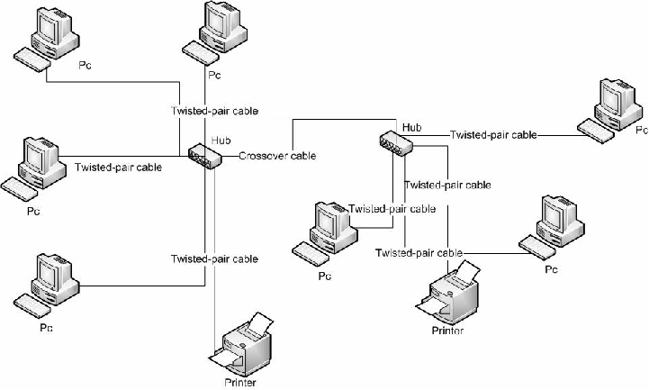
Star Topology
All computers connect to a centralized point
A hub, switch, router or even a dedicated computer used as a “switching point”
More expensive although does not have to deal with the message contention of the bus (unless the central point becomes a bottleneck)
Two star networks
connected together
with a “crossover”
cable

Slide 11
Ring Topology
In the ring network, each computer directly connects to two other computers
A form of nearest neighbor
The network is cheap but the time it takes to communicate with other computers depends on
The size of the network
The distance between the two computers in terms of the number of intervening computers
The ring was a direct competitor with the bus network when computer networks were more expensive
For large networks, the ring is cheap but not very practical

Slide 12
Mesh Topology
A mesh is also known as a full connected network
Requires point-to-point connections between each device
Not practical for any large network because of the number of connections
Assume n devices, this requires (n-1)² connections
In addition, each device must have n-1 physical ports available to connect to each device
Mesh networks, if used, are typically used to connect processors together in a parallel processing computer
Expensive but performance is not impacted by message contention

Slide 13
Classifying Networks by Size
PAN – personal area network
found in many households, connects no more than a few devices together
LAN – local area network
connects computers together in a room or floor of a building, LANs can be combined to create larger LANs
CAN – campus area network
collection of LANs that make up some organization’s site
MAN – metropolitan area network
collection of LANs and other forms of connectivity to provide a network within one metropolitan area
WAN – wide area network
anything larger, the Internet is the largest WAN

Slide 14
Other Network Classifications
VPN – virtual private network
Permitting secure off-site access to LAN
Allows users of network to access network resources remotely
Intranet – local area network that uses IP (Internet Protocol) so LAN supports Internet
Extranet – extending an intranet to permit remote access
The VPN is a form of extranet that uses encryption technology
Peer-to-peer vs client-server is a model of communication
Peer-to-peer – no central server, all devices equal
Client-server – some devices are services, some are clients

Slide 15
Ethernet
A physical level implementation of a LAN
Can use either twisted wire or fiber optic cable
Ethernet repeaters
48-bit MAC (media access control) addressing
Error handling mechanisms
CSMA/CD (see next slide)
Produced by 3Com in 1980
Originally implemented using the bus topology but also supports the star topology
Theoretical bandwidth of 10 Mbps made it very popular, today its upper bandwidth is 100 Gbps

Slide 16
CSMA/CD
Carrier Sense Multiple Access with Collision Detection
Device senses media for message traffic
If none found, device places message onto media
Device continues to sense for message traffic
if another device uses network, the message over the network would not match the device’s transmitted information, thus a collision is detected
Upon collision detection, sending device(s) sends out a jam signal to prevent other devices from using network
Device(s) wait a random amount of time before trying again

Slide 17
Network Protocols
A protocol is a set of rules to govern how people behave and interact
This might be diplomacy, etiquette, means of communication
A network protocol is a set of rules that govern how messages can be converted from their application software form to a form that can be transmitted over network
And mapped back from the messages received over network to a message for an application
A protocol can include
Forms of addressing
Size of messages (packets)
Error handling mechanisms and encryption

Slide 18
OSI Model
The Open Systems Interconnection model was generated to provide network developers with a target
OSI is not any particular protocol, but it describes what all network protocols should include
An implementer of a network is free to add mechanisms to the OSI model but should try to fit the model
The OSI model consists of 7 layers
Existing networks have numerous implementations for the 7 layers
TCP/IP (which we examine later) is an older model that has some overlap with OSI, but OSI being newer has ideas that are not found in TCP/IP

Slide 19
7 Layers at a Glance
Layers 7-5 operate at the message level
That is, treating the message as a whole
Layer 4 breaks messages into “segments” such as packets
Layers 3-1 operate at the network layer
Layer 1 involves the physical network

Slide 20
Layers 7-5
Layer 7: Application layer
From the application software, a message is created
telnet, ftp, email, http all operate at this level
Layer 6: Presentation layer
Translate message into a common syntax such as stripping out the hierarchical notation of XML or removing special characters such as \0 in C programs
Encryption, if used, is applied here
SSL, TLS, MIME among others implement layer 6
Layer 5: Session layer
Maintains session between two devices
NetBIOS, SAP, PPTP, SOCKS

Slide 21
Layer 4: Transport Layer
Divide message into segments
Implement reliability by error correction
for instance, through a checksum
stamp each segment, for instance, 4 of 7
Implement control flow
if two devices communicate at different rates (speeds), handle it here
Many implementations including
tcp, udp, sctp

Slide 22
Layer 3: Network Layer
Addressing takes place here
Messages at this level are variable length
add or utilize host and destination addresses here such as IP addresses
messages are further broken into packets
a message might consist of a single packet or hundreds depending upon the length of the message
If segments from layer 4 are not already packets, packets are formed here
IP, AppletTalk, IPX, ICMP, ARP
Routers operate at layer 3

Slide 23
Layer 2: Data Link Layer
Messages on the same network are transmitted at this layer
they do not need to involve layer 3
Packets are broken into frames for synchronization (start bits)
Two sublayers
logical link control sublayer for multiplexing
media access control sublayer to use MAC addresses
Many implementations including
IEEE 802.2, IEEE 802.3, PPP, X-25, ATM
switches operate at this layer

Slide 24
Layer 1: Physical Layer
How devices communicate over the media
Includes details of voltage, modulation/demodulation
How to establish and terminate connections, how to detect message traffic and resolve it
IEE 802.3, IEEE 802.11, Bluetooth, USB, hubs
Packets are placed on the media for transmission at this layer (or received from the media)
Ethernet is implemented at both layers 1 and 2

Slide 25
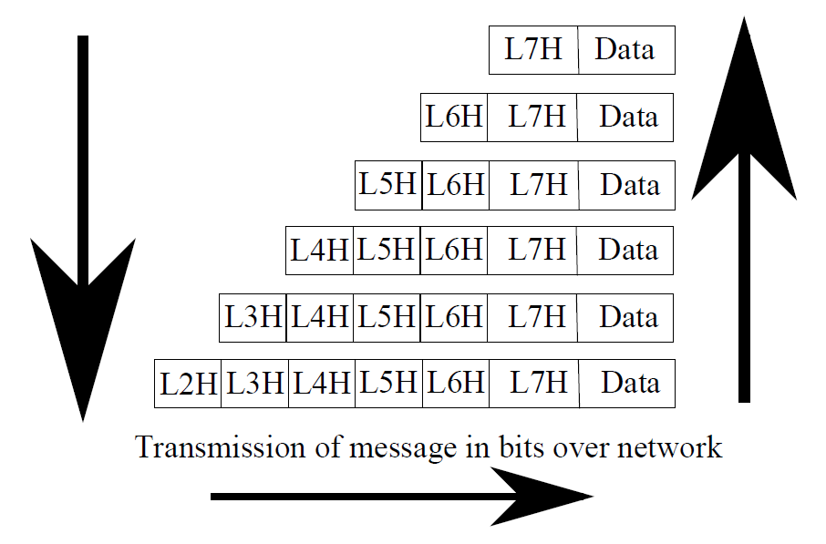
OSI Mapping
Notice how
headers are
affixed at each
layer except
for layer 1

Slide 26
TCP/IP
TCP/IP is known as a protocol stack
Although TCP and IP are protocols themselves, there are other protocols that can operate in conjunction with them
TCP and IP were developed separately but united to help develop the Internet
TCP handles the higher layers and IP handles the lower layers
TCP/IP has 4 layers
These 4 map roughly onto the 7 layers of OSI with some missing components

Slide 27
TCP
Application layer: similar to OSI’s layers 7-6
Messages are taken from applications
Handles different communication protocols such as ftp, smtp, http
libraries are available to handle the different types of protocols
Transport layer: similar to OSI’s layer 4
Two forms of data streams, TCP and UDP (see next slide)
This layer has mechanisms to maintain a session with the remote computer, similar to OSI’s layer 5

Slide 28
TCP vs UDP
Two forms of data packets
Transmission control protocol
uses sequence numbering (e.g., 4 of 7)
contains acknowledgement information for network handshaking and control flags
User datagram protocol
foregoes reliability information making the packets more concise
UDP is used primarily when guaranteed delivery is less important than speed
For instance, TCP will be used for email and web pages while UDP will be used for streaming audio and video and for DNS and DHCP

Slide 29
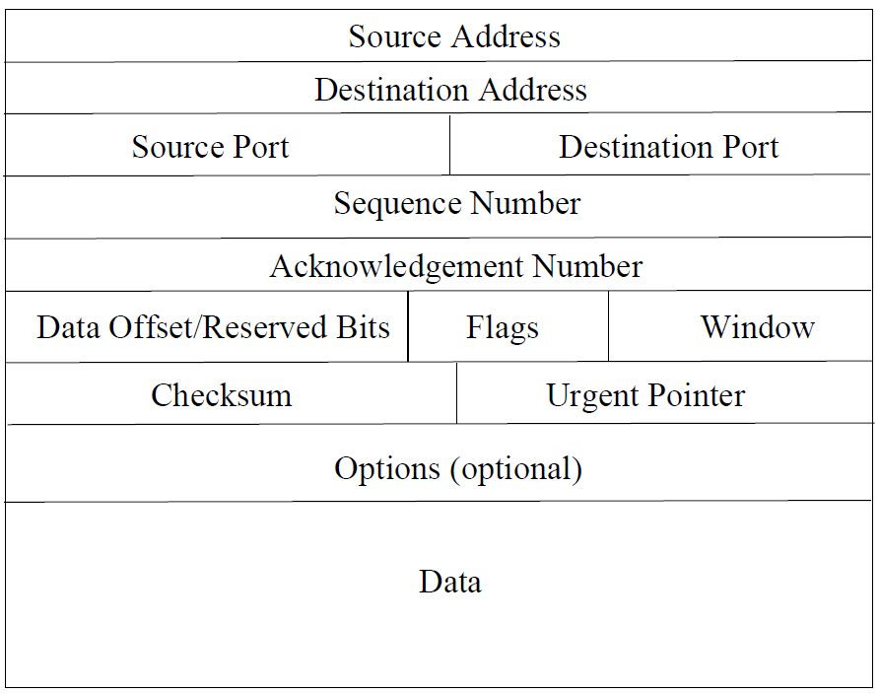
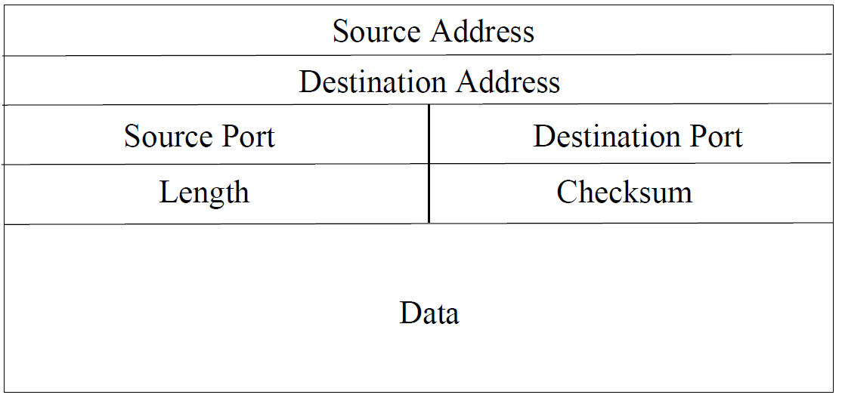
Comparing the Packets
TCP
UDP

Slide 30
IP
Internet layer: similar to OSI’s layer 3
Responsible for sending packets from one network to another
routers operate at this level
Addressing takes place here using IP addresses
IPv4 – 32 bits (4 octets of 8 bits each, or 4 numbers from 0-255) such as 127.31.49.6, provides 2³² different addresses (over 4 billion) but not all addresses are used leading to a situation where we have run out of addresses!
IPv6 – 128 bits (64 bit network address for routing, 64 bit interface number), provides 2¹²⁸ different addresses
Link layer: similar to OSI’s layers 1 & 2
Performs all services related to the physical network
hubs, switches and the physical network operate at this level

Slide 31
IPv4 Network Classes
This is a way to assign IP addresses based on class
Class A network has millions of individual addresses
Class C networks have 256 individual addresses but there are millions of class C networks
Although obsolete today, network classes still exist

Slide 32
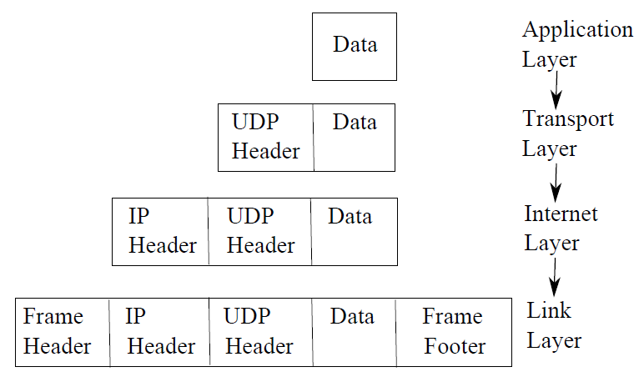
TCP/IP Mapping

Slide 33
TCP/IP Handshaking
A network handshake involves
Source computer requesting communication with destination computer
Destination computer acknowledging
In TCP/IP, there is a three-way handshake
Machine 1 sends synchronization packet (SYN)
Machine 2 replies with synchronization and acknowledgement packet (SYN/ACK)
Machine 1 confirms with acknowledgement (ACK)
examine the TCP packet (slide 36), there is an entry for acknowledgement number to support the TCP/IP handshake

Slide 34
TCP/IP Ports
Aside from IP addresses, messages are sent using a port address
The address is used to specify the type of message
This in turn specifies how the message is expected to be handled
in terms of application software or server
Most software have officially designated port addresses
This helps with security
ftp (20), ssh (22), telnet (23), smpt (25), http (80, 8080), https (431)

Slide 35
Network Address Translation
Converting external IP address to internal IP address
Basic NAT – one-to-one mapping, hides internal IP addresses, also used when two networks have incompatible addresses
Many-to-one – used so that a single external IP address can be converted into many internal addresses
when organizations have fewer IP addresses available than devices
provides anonymity in that internal addresses are “hidden”
also called IP Masquerading or NAT overload
NAT requires converting message header (which then requires computing a new checksum)

Slide 36
Network Software
Telnet/ssh – log in to remote computer
Need an account
telnet not secure, ssh is by using encryption
R-utilities like rlogin – for a network of Unix computers that share authentication so that you don’t have to log in
Ping – send packets to remote machine – used to determine if remote machine is accessible and to gage efficiency of network
Traceroute – like ping, but respond with addresses of all intervening network nodes reached (usually routers)
HTTP – the hypertext transfer protocol, basis for web browser communication
FTP – file transfer protocol, older form of transferring files prior to HTTP
anonymous logins available to permit access to public ftp areas

Slide 37
IP Aliases vs IP Addresses
Because IP addresses are hard to remember
We tend to use IP aliases for http, ftp, ssh, etc
Routers use IP addresses
We need a way to map from aliases to addresses
We use the domain name system for this
DNS servers are available on the Internet to perform the mapping
a local DNS server will know enough to contact other DNS servers to obtain proper mapping
Programs that perform mapping include
nslookup, host, dig

Slide 38
Linux Network Handling
Start the network service
/sbin/service network start (or restart)
Obtain IP address and routing table information
Done when the service starts
You can view this information using the ip program (newer), or ifconfig and route programs (older)
Important Linux network files
/etc/hosts – IP alias to address mapping for commonly accessed machines (allows you to skip DNS step)
/etc/resolv.conf – location of your local DNS servers
/etc/sysconfig/network-scripts – location of network information and scripts
/etc/hosts.allow and /etc/hosts.deny – IP addresses of computers allowed or disallowed access

Slide 39
Network Security
Firewall
A program that contains a set of rules
Incoming (and outgoing) messages are examined against the rules to be permitted in (out) or rejected
Rules might test type of message (protocol), destination port, source IP address
Antiviral software
Attempts to identify if a file has a virus (often done by comparing file’s size to checksum data)
Also can look for other forms of malware (spyware)
Network intrusion detection software
Look for evidence of illegal access into computer or reconnaissance attacks

Slide 40
Types of Network Attacks
Denial of service
Flood a server with requests so that it cannot handle all of the requests
IP spoofing
Use someone else’s IP address to intercept messages
ARP poisoning
Modify a switch’s address table so that message intended for one machine go elsewhere
Buffer overflow
Overflow an area of memory to insert your own instructions to be executed
SQL injection
Send your own database instructions to a backend database to obtain, alter or destroy data stored there
we will examine attacks again in chapter 15

Slide 41
Morris’ Internet Worm
Cornell Graduate student Robert Morris
Wrote a program to exploit weaknesses in Unix
Launched on November 2, 1988, it infiltrated about 6000 Unix machines during a 3 day period
Enter Unix systems by guessing weak passwords, exploiting weaknesses in sendmail and finger (using buffer overflow among other techniques)
Once logged in, it uploads the rest of itself to spawn copies to other networked computers using r-utilities
Morris claims the attack was not malicious but to prove the security holes in Unix

Slide 42
The Internet
Based on three technologies
Packet switching – messages are routed while making their way across the Internet
Routers – devices that perform the packet switching, moving messages from one network to another
IP addresses – the method by which we address our messages, along with DNS servers to map aliases to addresses
Users use application to send out machine (e.g., http request)
Computer packages up the message into packets
Request to DNS server to translate destination IP alias into IP address until address properly mapped
Given IP address from DNS server, IP address added to message
Local router sends packets out onto your local area network to Internet point of presence (a gateway)

Slide 43
Continued
Each packet is sent out on Internet
Packets are transmitted from one site to another
At each site, the router routes the packet to another let of the network
Multiple packets of the same message will find their own paths (quite possibly different paths)
At the destination site, received packet sent to proper internal LAN via internal routers
NAT may be required
At proper LAN, network switch broadcasts message to destination computer
If multiple packets expected (e.g., packet 3 of 5). destination computer waits for all packets to arrive
Puts message together for appropriate application software
When full message arrives (if correct), destination sends acknowledgement (or request for missing or erroneous packets)

Slide 44
Subnet Masks
Router needs network address portion of an IP address
AND netmask to destination IP address
Assume IP address of 10.11.241.105 and class C network (first 24 bits are network address, last 8 bits are machine address)
Netmask for network address is 255.255.255.0
Netmask for machine address is 0.0.0.255
recall 255 = 11111111 in binary, 0 = 00000000
Example

Slide 45
Example
To obtain network address:
10.11.241.105
AND 255.255.255.0
= 10.11.241.0
00001010.00001011.11110001.01101001
11111111.11111111.11111111.00000000
= 00001010.00001011.11110001.00000000
To obtain machine’s address
00001010.00001011.11110001.01101001
AND 00000000.00000000.00000000.11111111
= 00000000 . 00000000 . 00000000 .01101001
= 0.0.0.105

Slide 46
The Internet vs the World Wide Web
People often confuse the two
The Internet is the physical infrastructure (media, routers) along with the computers
The web are the collection of documents, linked together by hyperlinks, that are stored on some specific computers on the Internet
the web sits on top of the Internet
without the Internet, we would not have the WWW
You may have heard people say things like
“I’ve lost the Internet” or “The Internet is down”
They have lost their connection only
This might be a hardware failure, a software failure, a problem with their firewall, lost connection with their DNS server
In fact, the Internet was built to survive a nuclear war!

Slide 47
History of the Internet
1968 – four research organizations (funded by the department of defense) form a computer network for long-distance communication
The ARPAnet, at University of Utah, UCLA, UC Santa Barbara, Stanford Research Institute
Uses packet switching, allows remote access to computers on other sites and transfer of files, first message sent October 29, 1969
June 1970 – 9 computers connected
September 1971 – 18 computers
1972 – 29 computers
1973 – 40 computers
1971 – first email
1973 – FTP implemented
1973 – two satellites in use, connects computers in Hawaii and Norway

Slide 48
Continued
1974 – UK adds X.25 protocol
1975 – 57 computers
1979 – Duke students create UUCP (electronic bulletin boards) – eventually becomes Usenet
1983 – military portion of ARPAnet separated to form MILNet, TCP/IP used, network renamed Internet
In the 1980s, push to connect US universities (edu) and libraries to Internet, home computer users gain access through pay sites
Computer hosts grow to tens of thousands

Slide 49
Continued
1990s
First web browser, MOSAIC, created (1994), creating the WWW
US Legislature allows companies to become Internet service providers
Operating systems (like Windows 95) supports Internet access
Users of the Internet grows from thousands to millions and beyond
2000s
Smart phone and tablet access
Billions of Internet users
Trillions of web documents (exact number is not known)

Slide 50
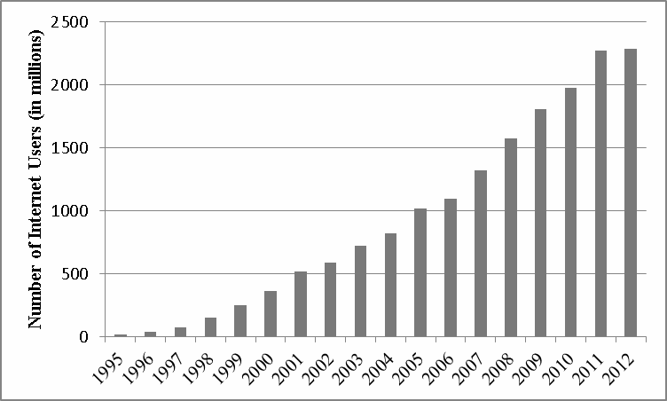
Internet Users

Slide 51
Internet Issues
Who controls the Internet?
In the 90s, US government handed control to commercial companies and organizations like
ICANN – Internet Corporation for Assigned Names and Numbers
WWWC (W3C) – World Wide Web Consortium for standards on web site construction (html, css, xml, etc)
Governments enact legislature on Internet usage
copyright infringement, anti-piracy, obscenity laws, censorship
We have reached many limitations of the Internet
Running out of IPv4 addresses, Internet backbone not developed to support billions of users and streaming audio/video
Last mile technology still in use
Many users still use the telephone lines which limit their bandwidth, broadband access not available in rural areas, third world countries, etc
Cell phone technology used in some cases but 3G has many problems, 4G not yet available everywhere

Slide 52
Semantic Web
The WWW has limitations – poorly indexed info, flat files
Add artificial intelligence capabilities to improve web access
Searching and inferencing to permit websites to solve problems for you
Creating of representative-bots to act on your behalf
Construction of the semantic web is ongoing, started around 2001
Requires converting information into ontologies, better query languages
Creation of intelligent agents – bots (software) that can make inferences, each agent has a specific, small role to play, groups of bots work together to solve the problem
Semantic web is in its infancy but currently being used to support
Intelligence gathering in support of antiterrorism
Medical research

Slide 53
Cloud Computing
Already here but we look to improve it
A network of resources made available remotely
Remote storage
Remote processing
Somewhat like 3rd generation computers, you access the mainframe from your office using a dumb terminal
Here, you access the cloud remotely through your (possibly mobile) I/O device(s)
Most or all computing and storage are located elsewhere

