Slide 1
CIT: What is it?
New to NKU? New to the CIT program?
CIT – computer information technology
a 4-year degree program
practical experience in Windows, Unix/Linux, open-source administrative computer software
student-focused exploration of the design, maintenance, and use of a variety of computing technologies
many hands-on courses/coursework
Courses in
database, networks, web development, Windows system administration, Linux system administration, scripting
tracks in web development or network/system administration and security

Slide 2
CIT 130: What is it?
Information Technology Fundamentals
Sort of like computer literacy for the IT person
Computer hardware, assembling a computer
Computer organization – the role of the CPU, memory, I/O, storage
The binary number system, Boolean logic
Operating systems (specifically, Linux/Unix and Windows/DOS) including OS installation, process management, file systems, services, shell scripting, software installation, booting and initialization, virtual memory, accounts and permissions
Computer and operating system history
Computer networks
Information
IT careers

Slide 3
How to FAIL This Course
About ¼ of the students do not pass this class (C- or better)
They do not take quizzes – 7 quizzes worth 35% of your grade (about 20-25% of the students miss at least 1 quiz, many miss multiple quizzes!)
They do not complete lab assignments – 14 labs worth 50% of your grade
They do not study for quizzes or the final (50% of your grade), average quiz grade is around 63, average final grade in the 50s)
They do not take the course seriously
Don’t fall into the bad habits of past students
Take the quizzes during their window
Study for quizzes, keep up with readings
Hand in all lab assignments
Prepare for the final exam

Slide 4
IT Roles
Role | Job/Tasks
System Administrator | Administer the computers in an organization; install software; modify/update operating system; create accounts; train users; secure system; troubleshoot system; add hardware
Network Administrator | Purchase, configure and connect computer network; maintain computer network; troubleshoot network; secure network from intrusion
Database Administrator | Install, configure and maintain database and database management system; back up database; create accounts; train users
Web Administrator | Install, configure and maintain web site through web server; secure web site; work with developers
Web Developer | Design and create web pages and scripts for web pages; maintain web sites
Security Administrator | Install, configure and administer firewall; create security policies; troubleshoot computer system (including network); work proactively against intrusions

Slide 5
System Administration
Account management
Password management
File protection management
Installing and configuring new hardware
Troubleshooting hardware
Installing and configuring software
Updating software
Providing documentation and support
System-level programming (scripting)
System-level security
IT Support
Documentation, manuals, website support (wikis, FAQs), A/V demos
Training
Help desk support

Slide 6
Skills for the Successful IT Person
Skill | Description | Example(s)
Troubleshooting, problem solving | Detect a problem Diagnose its cause Find a solution (means of fixing it) | Poor processor performance Disk space full Virus or Trojan horse infection
Knowledge of operating systems | Operating system installation Application software installation User account creation System monitoring | Versions of Linux Versions of Unix Windows Mac OS
System level programming | Shell scripts to automate processes Manipulating configuration files for system services | Bash, Csh scripts DOS scripts Ruby scripts C/C++ programs

Slide 7
Continued
Skill | Description | Example(s)
System security | Ensuring proper system security is in place Following or drafting policies for users Monitoring for threats | Configuring a system firewall Installing antiviral/anti-malware software Examining log files for evidence of intrusion and system security holes Keeping up with the latest security patches
Hardware | Installing and configuring new hardware Troubleshooting, replacing or repairing defective hardware | Replacing CPUs and disk drives Connecting network cables to network hubs, switches, routers

Slide 8
Be Prepared
Keep up with new trends in technology
Be a self-starter
Be curious
Be willing to learn on your own
You might be on call 24/7
Behave ethically at all times
Know the difference between ethical and unethical behavior

Slide 9
What is a Computer?
Examples:
Supercomputers
Mainframes/minicomputers
Personal computers/laptops
Notebook computers
Handheld devices
What about these
Smart phones
Mp3 players
Electronic book readers
GPS
Electronic device
General purpose (executes any type of program)
Stores data
Performs the IPOS Cycle

Slide 10
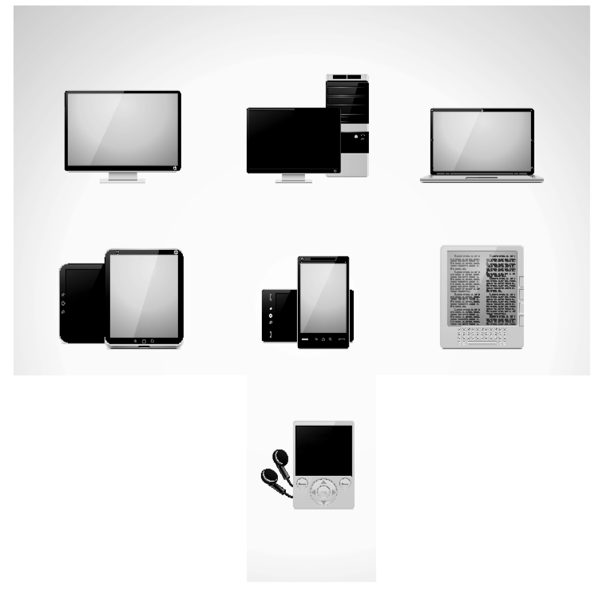

Slide 11
Components of a Computer
Processor
Storage
Short term (memory)
SRAM
DRAM
ROM
Long term
Hard disk
Optical disk
Floppy disk
Flash drive
Magnetic tape
I/O devices
The system unit
The motherboard, which contains
The CPU
CPU cooling unit
Extra processors (optional)
Memory chips for RAM, ROM
Connectors (ports) for peripherals
Expansion slots for peripheral device cards
ROM BIOS (booting, basic input & output instructions)
Power supply connector
Disk drives
Fan units
Power supply

Slide 12
Storage Sizes
Size | Meaning | Example
1 bit | A single 0 or 1 | Smallest unit of storage, might store 1 black & white pixel or 1 true/false value, usually we have to combine many bits to create anything meaningful
1 byte (1B) | 8 bits | We might store a number from 0 to 255 or -128 to 127, or a single character (letter of the alphabet, digit, punctuation mark)
1 word | 32 or 64 bits | One piece of data such as a number or a program instruction
1KB | 1024 bytes | We might store a block of memory in this size
1MB | ~1 million bytes | A small image or a large text file, an mp3 file of a song might take between 3 and 10 MB, a 50 minute tv show highly compressed might take 350MB
1GB | ~1 billion bytes | A library of songs or images, dozens of books, DVD requires several GB of storage (4-8GB)
1TB | ~1 trillion bytes | A library of movies

Slide 13
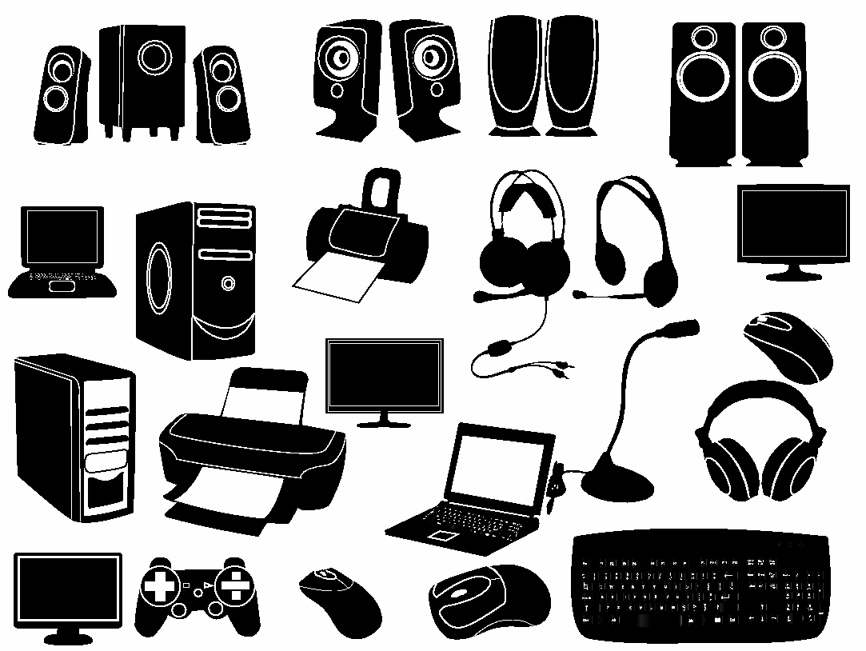
I/O Devices (Peripherals)

Slide 14
Software
Programs
Step-by-step instructions to the computer
To run the program, the program must be written in the computer’s machine language
We write programs in high level languages
C/C++, Java, Python, Ruby, C#, Visual Basic, etc
We translate programs from high level to machine language using language translator programs
compilers, interpreters, assemblers

Slide 15
Example Program
Compare 2 numbers and output the larger
In English:
In C code:
scanf(“%d”, &number1);
scanf(“%d”, &number2);
if(number1 > number2)
printf(“%d is greater”, number1);
else printf(“%d is greater”, number2);
Input number1
Input number2
Compare the two numbers
If the first is greater
than the second
Then output number1
Otherwise output number2

Slide 16
Users
Initiates the processes that computers run
Uses interactivity
Makes computer usage more enjoyable
Early users were engineers and programmers of the computers
That changed in the 60s
Today, nearly everyone is a user

Slide 17
Computers Today
Computers were easily identifiable
Expensive
Required clean room environments
People connected to them via network and terminals
Not so today
Computers of any size
Wireless provides Internet access
Go anywhere and still have access
Billions of processors in our world

Slide 18
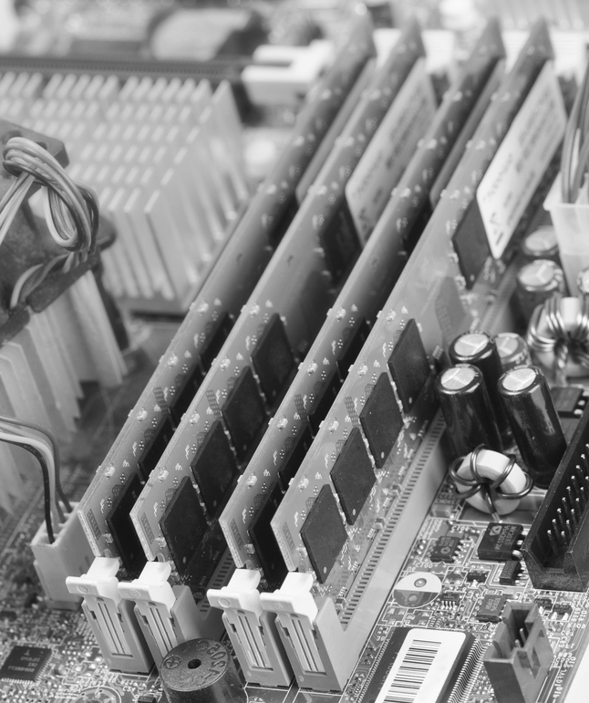
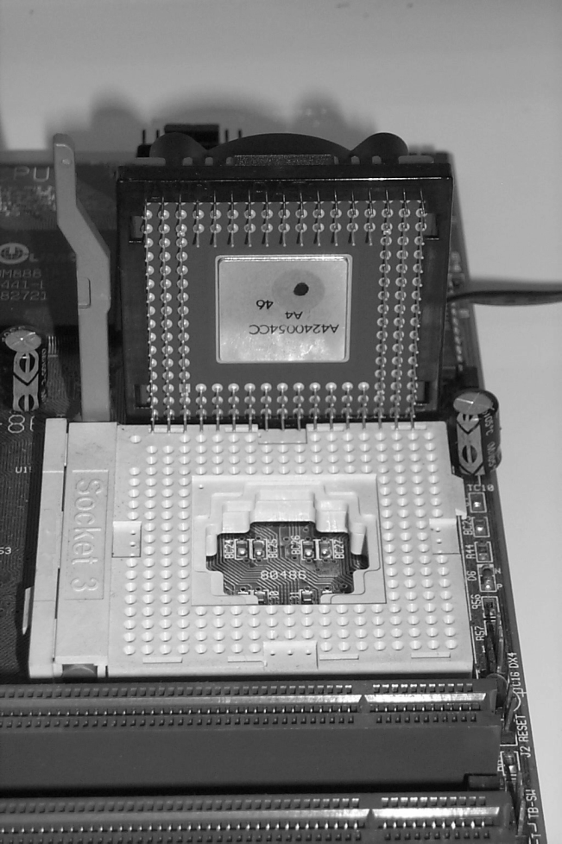
Computer Hardware
Microprocessor – the CPU on 1 chip
Pins on one side to plug into motherboard CPU slot
Cooling unit sits on top
Memory – individual chips placed on circuit board
Slip circuit board into memory slot(s)
System bus – part of the motherboard

Slide 19
System Unit
Case into which
You place the motherboard
Fan(s)
Disk drive units
Power supply
Internal MODEM connected to motherboard directly
Peripheral devices connect to motherboard through ports in system unit

Slide 20
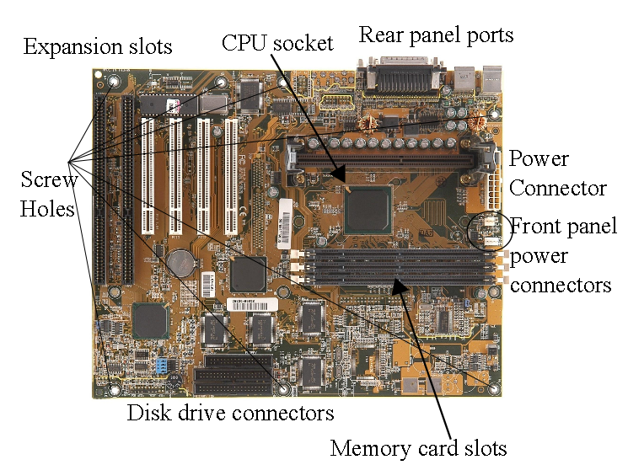
Motherboard Explained

Slide 21
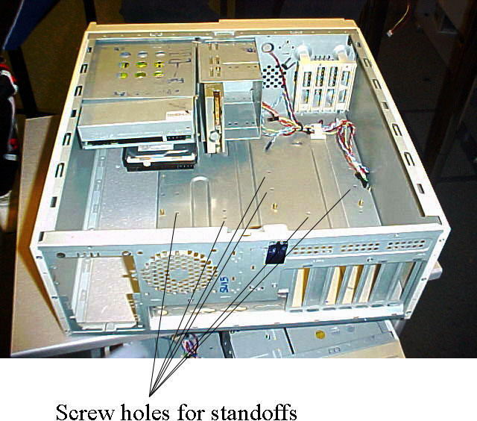
System Unit
Insert motherboard to
rest on top of
standoffs

Slide 22
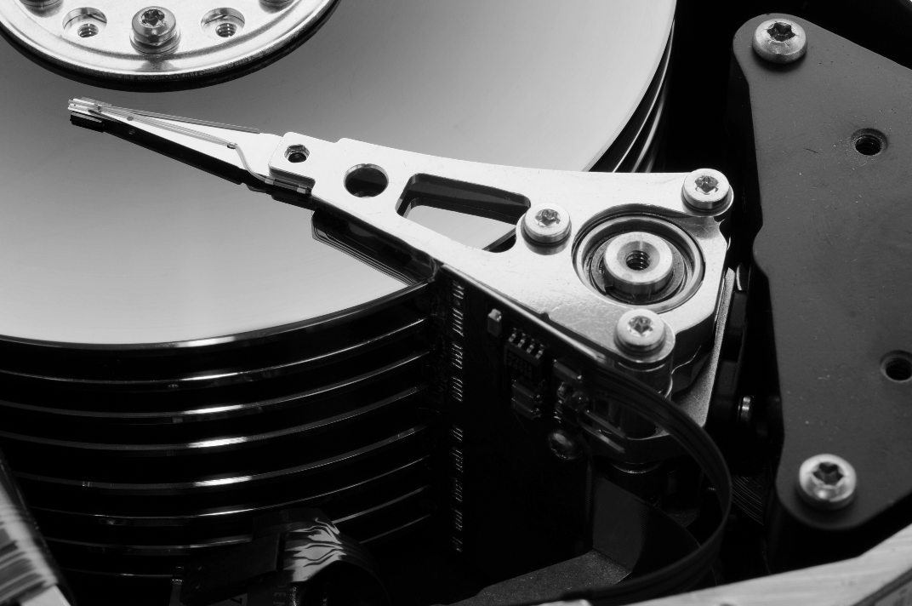
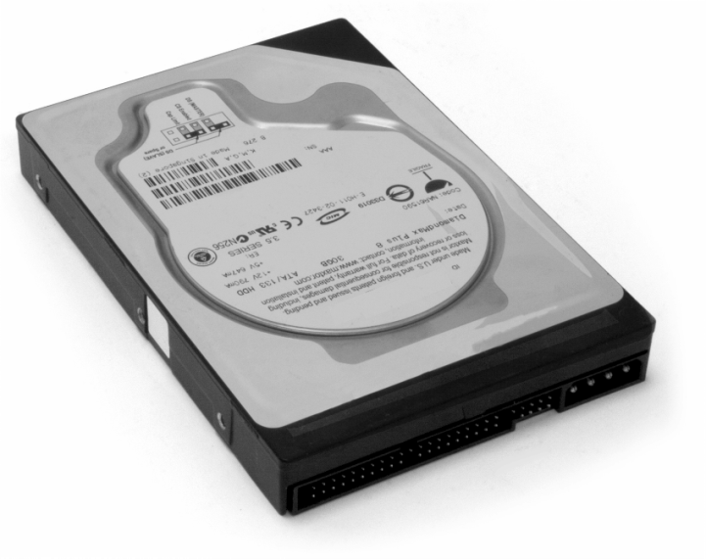
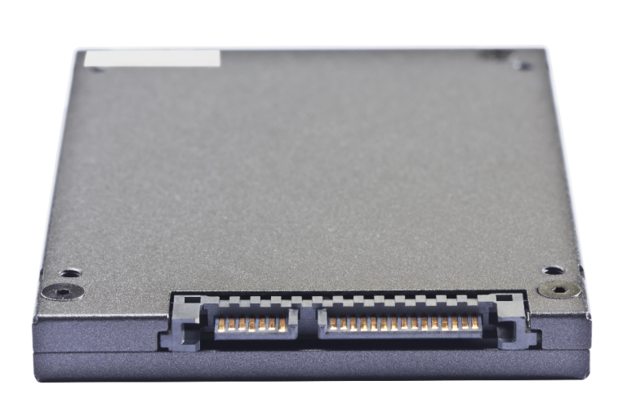
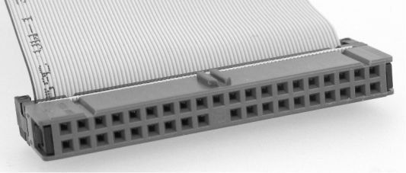
Hard Drive
Multiple platters
1 read/write head
per surface
All disks spin in unison
by central spindle
IDE (below) and SATA (below
to the right) use different
connectors

Slide 23
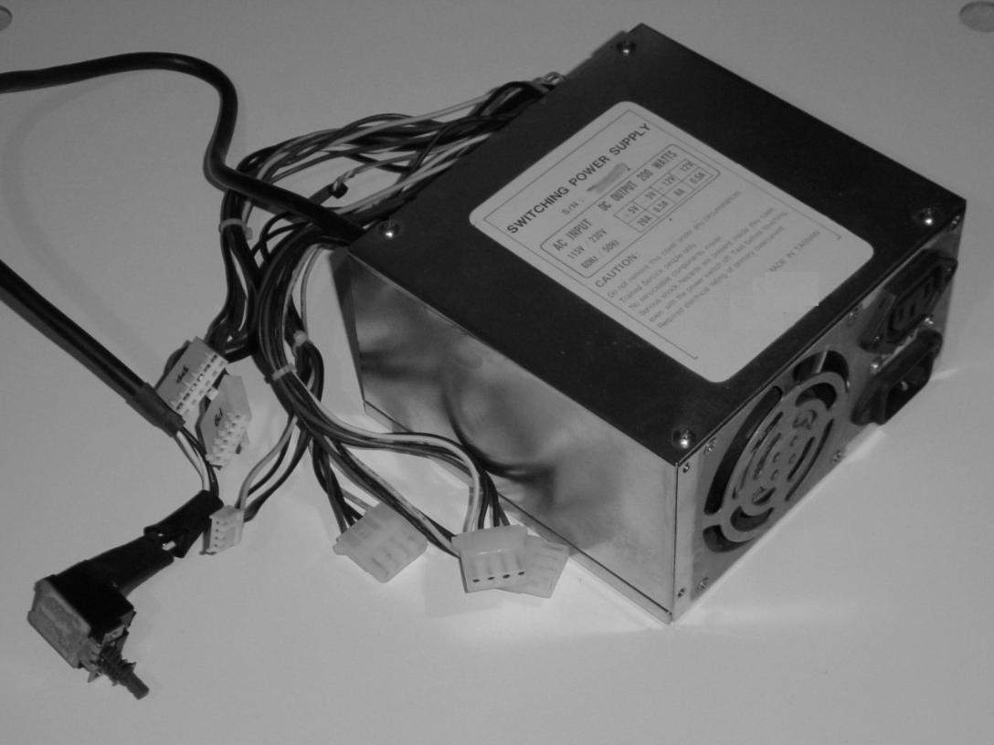
Power Supply
Cables connect
to drives, fan and
motherboard

Slide 24
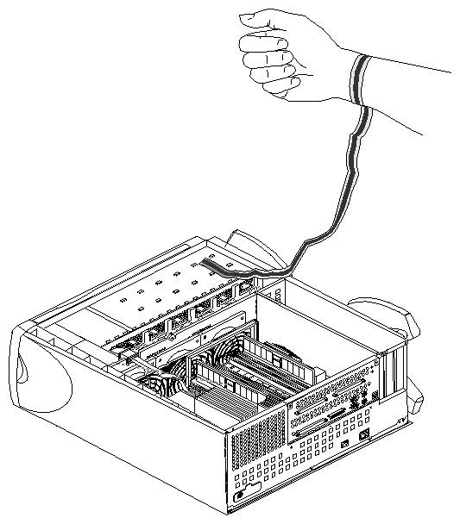
Computer Assembly
Prepare system unit
Identify the components to assemble
Remove system unit side panel
Screw in standoffs
Prepare motherboard
Wear grounding strap
Insert CPU
Use a dab of thermal energy paste
Attach cooling unit to CPU and plug in to motherboard
Attach memory circuit board(s)

Slide 25
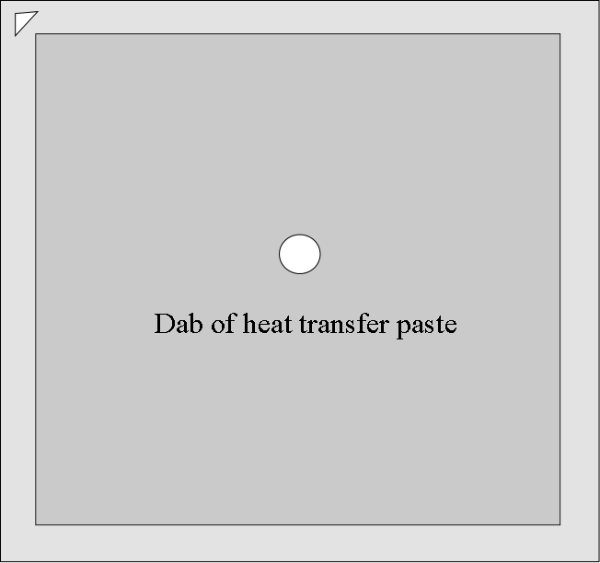
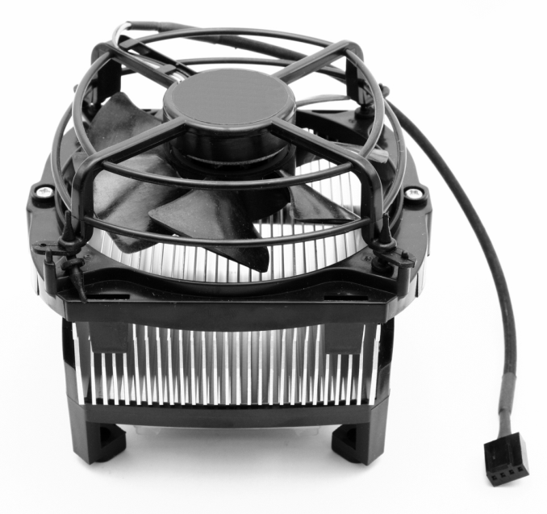
CPU Cooling Unit
Place a “pea-sized”
dab of heat paste
on the surface
of the CPU
Cooling unit “bolts”
Inserted into holes around
CPU
Plug cooling unit’s power
Connector into motherboard
socket

Slide 26
Finish System Unit
Insert disk drive unit(s)
Remove from bezel panel for optical drive but not for hard disk drive(s)
Insert power supply unit into system unit
Connect power supply cables to
Hard disk drive(s)
Optical disk drive
Motherboard LED panel
Fan
Plug in external power cord to power supply unit, power on computer, does it boot?
When done, reinsert system unit panel

Slide 27
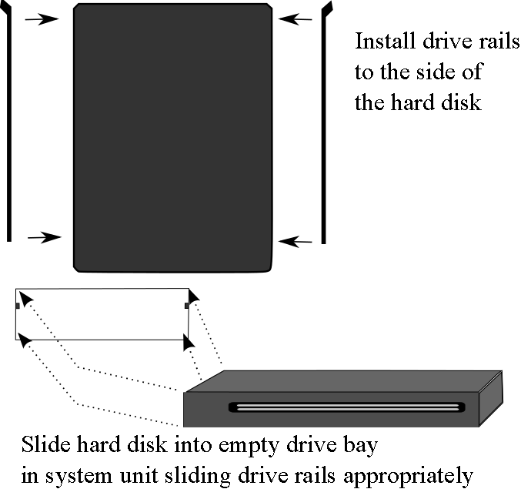
Insert Disk Drive(s) Into Slot(s)
Disk drive bays may
have rails otherwise
slip rails to sides of
drive(s)
Slide disk drive
into empty bay
in system unit
Best to place drives
as far toward the
top of the system unit
as available

