Slide 1
The Evolution of JN-25 and Attacks on It
Chris Christensen
Department of Mathematics and Statistics
Northern Kentucky University

Slide 2
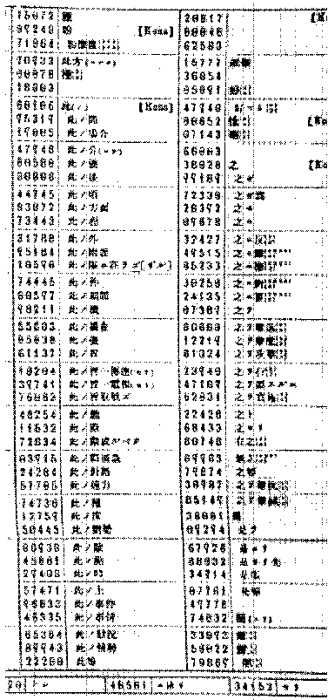
1 June 1939
Codebook

Slide 3
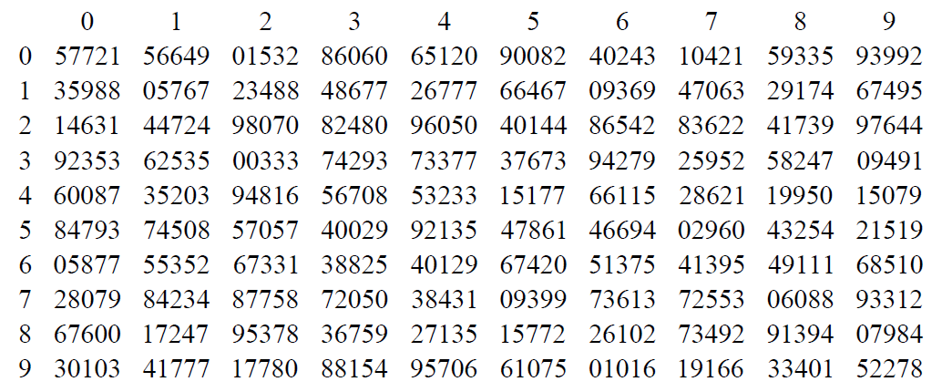
1 June 1939
Codebook
Additive book

Slide 4
JN-25
JN-25B-8
code
cipher

Slide 5
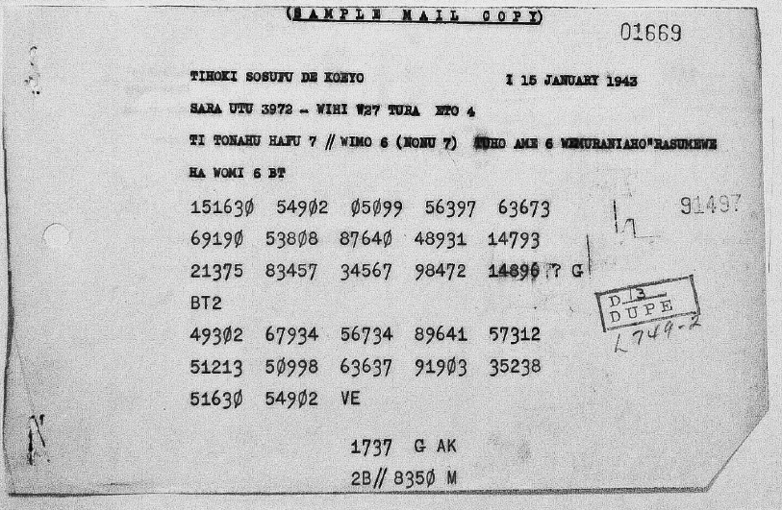
JN-25 message

Slide 6
Encode
United States Navy Battleship(s) Ten
24396 31143 74412

Slide 7
Additives
United States Navy Battleship(s) Ten
24396 31143 74412
58204 99706 53532

Slide 8
Encipher
United States Navy Battleship(s) Ten
24396 31143 74412
58204 99706 53532
72590 20849 27944

Slide 9
Indicator
Page 137, line 1
3 x 137 = 411
-1 from 3rd digit -1
410
Append line 4101
Add key additive 4567
8668
5th digit? 86683

Slide 10
Scanning
… 67854 59199 76833 57699 10047 70863 06138 27924 …

Slide 11
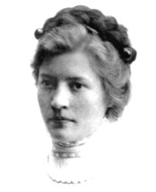
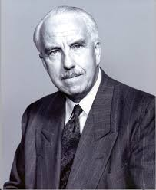
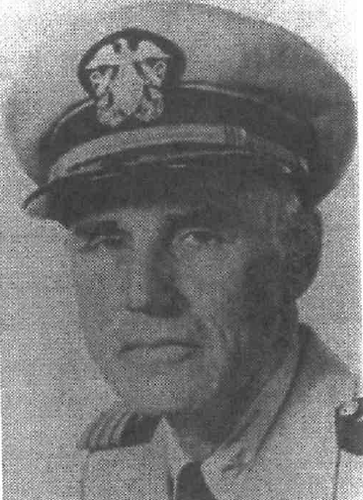
Five-numeral system (Orange Navy)
John Tiltman
Agnes Driscoll and Prescott Currier

Slide 12
Depth

Slide 13
Double repeats
Two messages
… 05661 06511 07465 07495 12143 14240 14963 18673 …
… 78009 57047 79519 06511 90318 72216 12143 94860 70240…
Possible depth
…05661 06511 07465 07495 12143 14240 14963 18673 40876 …
… 06511 90318 72216 12134 94860 70240 54911 32814 …

Slide 14
Differencing
(Clear code group 1 + Additive)
(Clear codegroup 2 + Additive)
Clear codegroup 1 – Clear codegroup 2

Slide 15
Differencing
Groups in depth
Differences
43713
74751
89854
78330
98366
56066
79062
00000
15103
04689
24615
82304

Slide 16
Differencing
Differences
From difference table
79062
00000
15103
04689
24615
82304

Slide 17
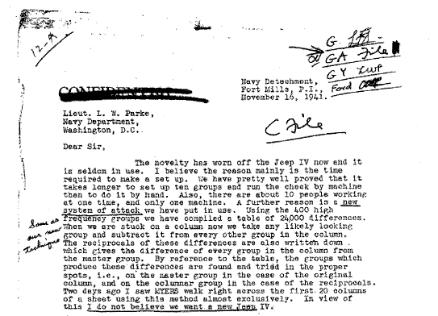
Differencing

Slide 18
15 August 1942
Channel 1 JN-25D10 General purpose system for all naval forces on land and sea. Introduced 15 September 1942.
Channel 2 JN-25E11 General purpose for system for larger shore bases and all fleet units except submarines. Introduced 1 October 1942.
Channel 3 JN-25D16-A and JN-25D16-B General purpose system for high command. Introduced 15 September 1942.
Channel 4 JN-25F10 For auxiliary vessels, minor shore stations, and Resident Naval Officers. Introduced 1 November 1942.

Slide 19
Use #1
Use #1
15 August 1942 – 14 April 1943
10 x 10 table of additives
Group 3 enciphered S/P
30443
Group 4 enciphered S/P
30443
3rd from last enciphered E/P
30462

Slide 20
Depth
30443 and 30465
30452 and 30471

Slide 21
Depth

Slide 22
Use #3
Use #3
1 December 1943 -
15 x 12 table of additives
Group 4
13702
Group 5
48137
2nd from last group
13789
Last group
55137

Slide 23
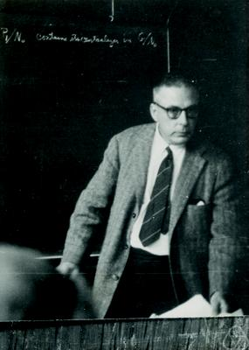
Hall’s weights

Slide 24
Hall’s weights

Slide 25
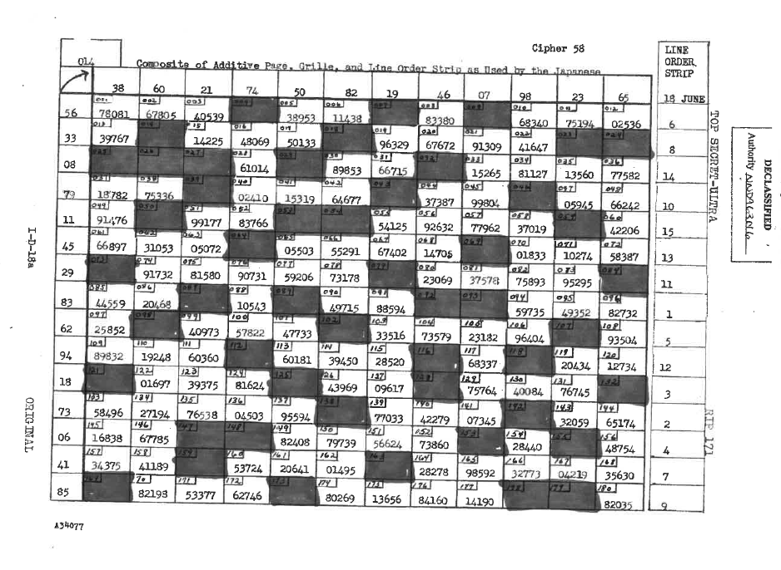
15 June 1944

Slide 26
25 July 1944
N Code
Indicators
46172 97918 97935…
Group 4
02417
Group 5
02417
3rd from last group
02475
2nd from last group
02475

Slide 27
Nan code additives

Slide 28
5 November 1944 Ransuuban
75306

Slide 29
20 February 1945
False addition
24396
58204
72590
Conversion square
24396
58204
97436

Slide 30
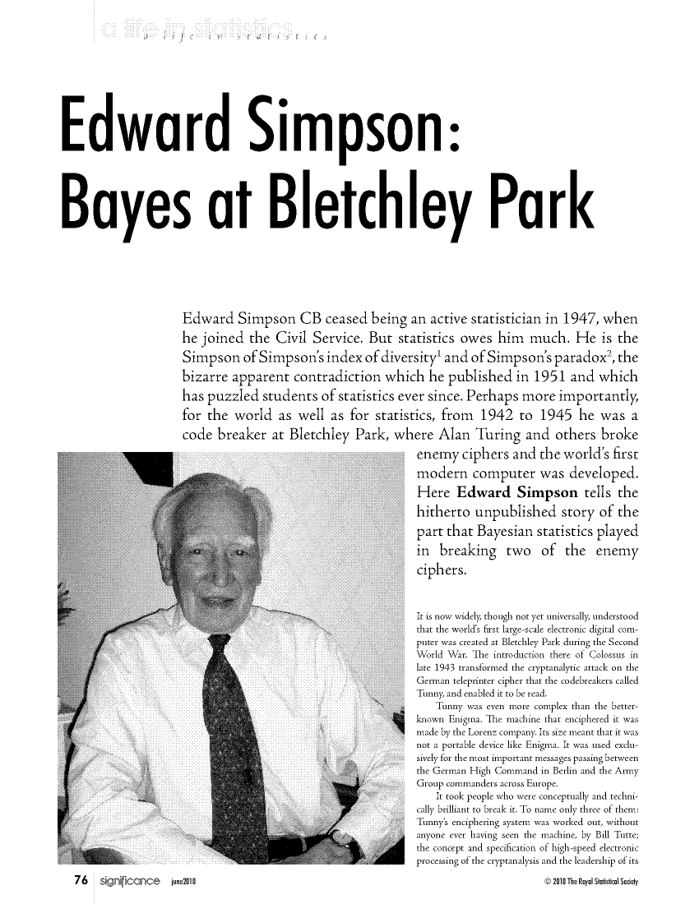
Thanks
Jared Antrobus
Jacob Englert

