Slide 1
T. R. Hollcroft’s Problem
Chris Christensen
Department of Mathematics and Statistics
Northern Kentucky University

Slide 2
25 November 1944
51st Annual meeting of AMS, Chicag0
T. R. Hollcroft: The probability of repetitions.
The probability of repetitions is concerned with repetitions only and not with the particular numbers that are repeated. For example, let one number be drawn at a time from ten and replaced after each draw. Eight may be drawn as follows:
4 3 7 6 4 7 6 7.
his set contains one triple and two double repetitions. … This set is represented by
(3221).
The repetitions and number of trials in the set characterize the set.
Received 10 October 1944

Slide 3
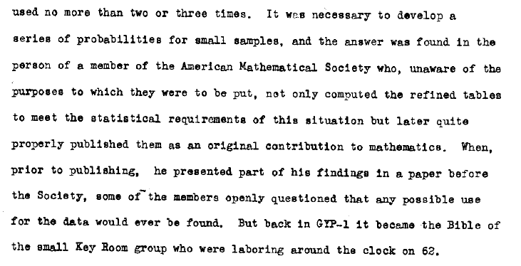
The real story

Slide 4
Back Up a Bit
25 July 1944

Slide 5
“24” or “a 2 and a 4?”
03824

Slide 6
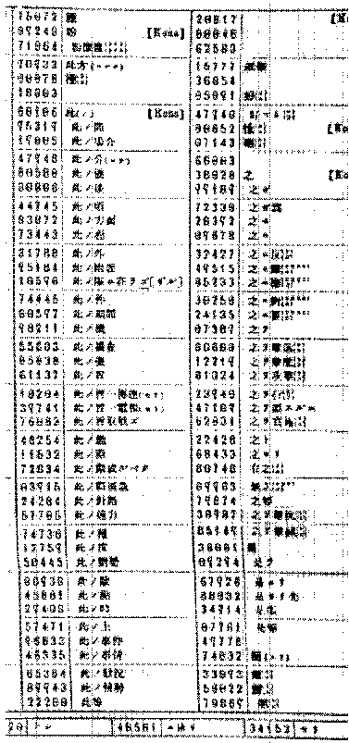
JN-25, 1 June 1939
Codebook

Slide 7
JN-25
Codebook
Additive book

Slide 8
Encoded
United States Navy Battleship(s) Ten
24396 31143 74412

Slide 9
Additives
United States Navy Battleship(s) Ten
24396 31143 74412
86525 59794 32265

Slide 10
False sum
United States Navy Battleship(s) Ten
24396 31143 74412
86525 59794 32265
00811 80837 06677

Slide 11
Indicators
Use #3
1 December 1943 -
15 x 12 table of additives
Group 4
16856
Group 5
35168
2nd from last group
16856
Last group
97168

Slide 12
Indicator
Page 137, line 1
3 x 137 = 411
-1 from 3rd digit -1
410
Append line 4101
Add key additive 4567
8668
5th digit? 86683

Slide 13
Indicators
Use #1
15 August 1942 – 14 April 1943
10 x 10 table of additives
Group 3
13743
Group 4
13743
3rd from last group
13762

Slide 14
Indicators
Use #2
15 April 1943 – 30 November 1943
10 x 10 table of additives
Group 4
13745
Last group
13765

Slide 15
Indicators
25 July 1944
? x ? table of additives
Group 4
03824
Group 5
03824
3rd from last group
03871
2nd from last group
03871
?

Slide 16
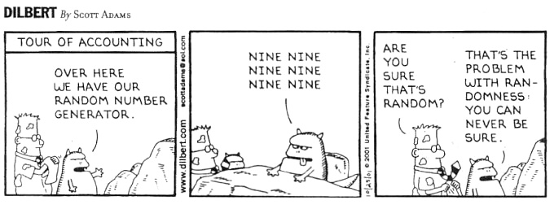
Random?

Slide 17
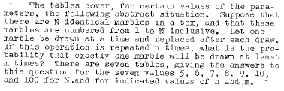
Hollcroft’s problem
N marbles numbered 1, 2, …, N
n draws with replacement
Probability of one marble being drawn at least m times
Tables for N = 5, 6, 7, 8, 9, 10, and 100

Slide 18
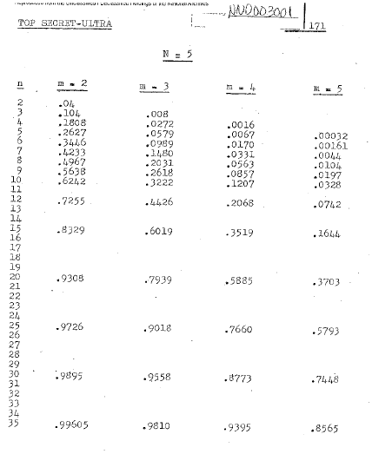
Hollcroft’s tables

Slide 19
The answer
2 and 4

Slide 20
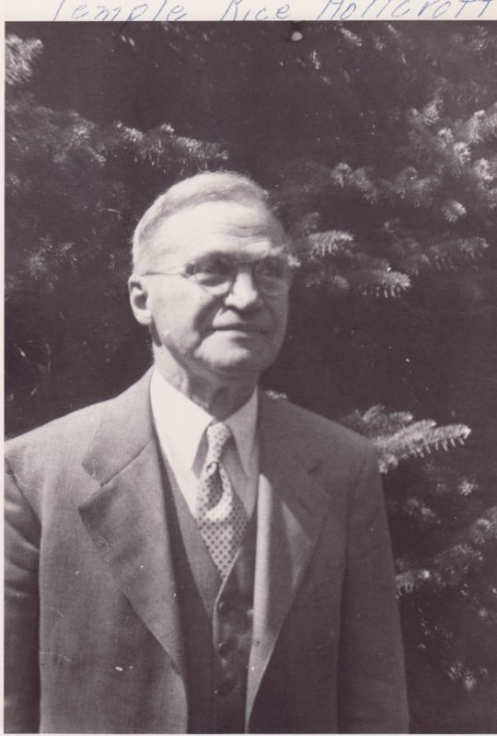
T. R. (Temple Rice) Hollcroft
Born 1889 Alton, IN
Greencastle HS 1908
Hanover College 1912 and 1914
Univ of Kentucky 1915
Cornell 1917 (Virgil Snyder/Felix Klein)
Joined Wells College, Aurora, NY 1918

Slide 21
T. R. (Temple Rice) Hollcroft
Wells College, 1918 – 1954
Chair, 1920 - 1954
38 papers
Associate Secretary of AMS, 1937 – 1950
Wells College historian
Cayuga County Historian

Slide 22
But, why T. R. Hollcroft?

Slide 23
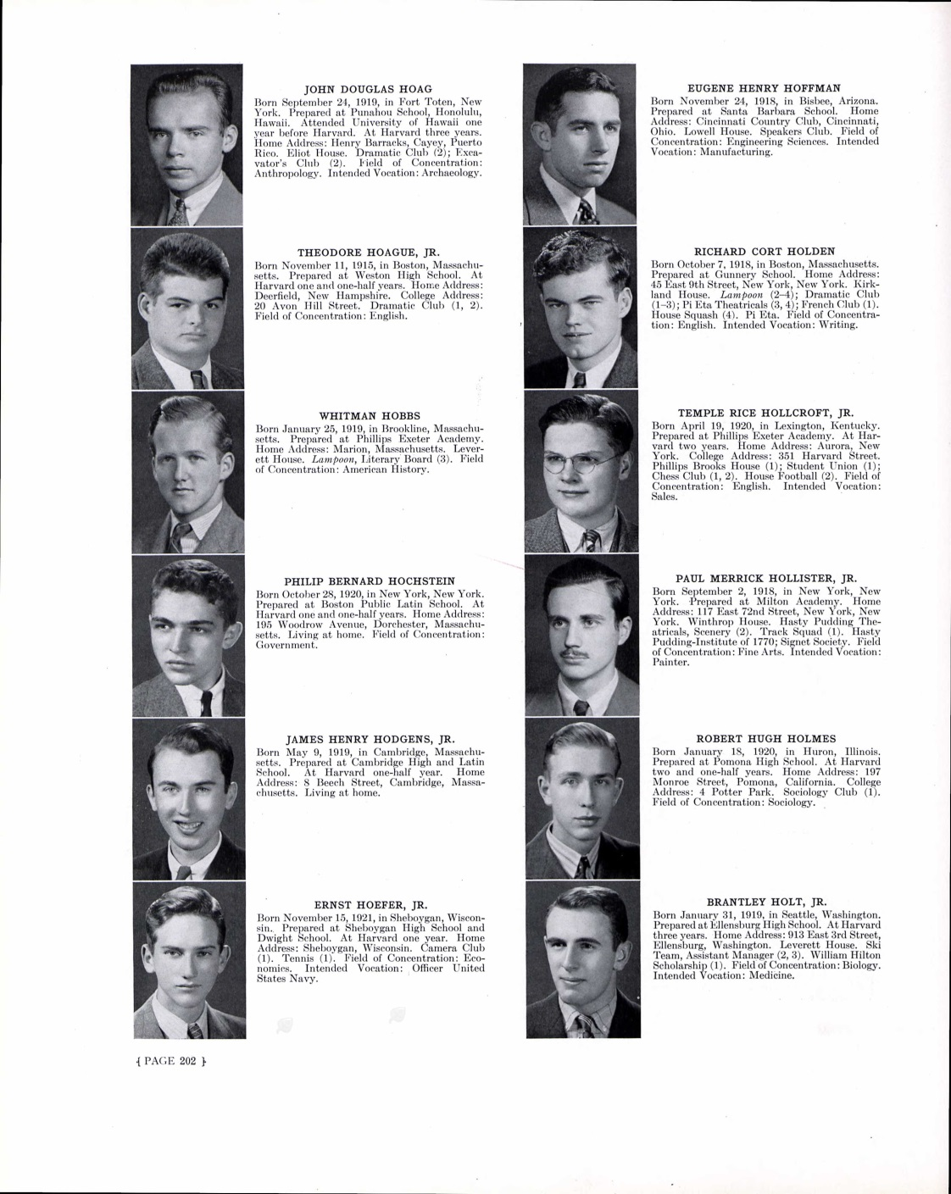
T. R. Hollcroft, Jr.
Born 1920, Lexington, KY
“Prepared at Phillips
Exeter Academy”
“Attended Harvard”

Slide 24
Washington Post, 1990
Temple Rice Hollcroft, 70, a retired cryptanalyst with the National Security Agency who had lived in the Washington area since 1938 died … at his home in Silver Spring.
Mr. Hollcroft, who was born in Lexington, KY., attended Harvard University and served in the Navy in World War II. After the war, he joined a predecessor agency of the NSA. He retired from the agency in 1984.

Slide 25
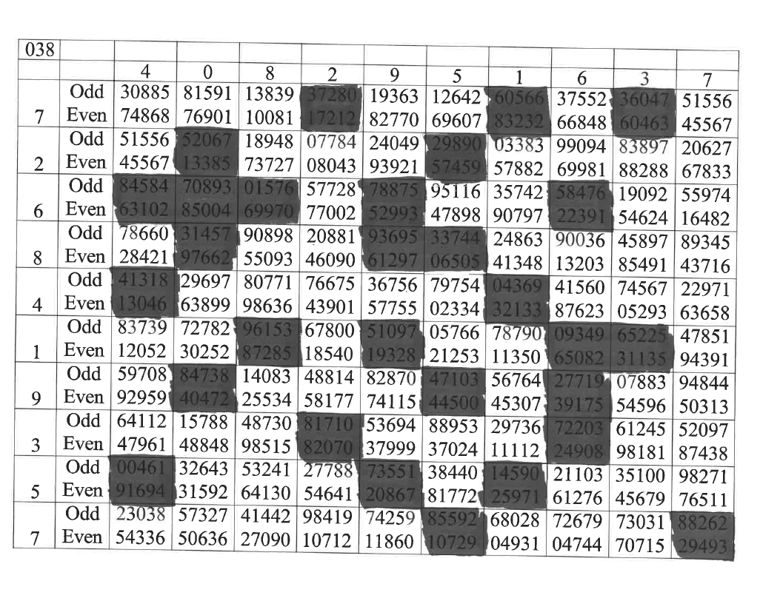
Grilles and Pairs of Lines

